Slide 1
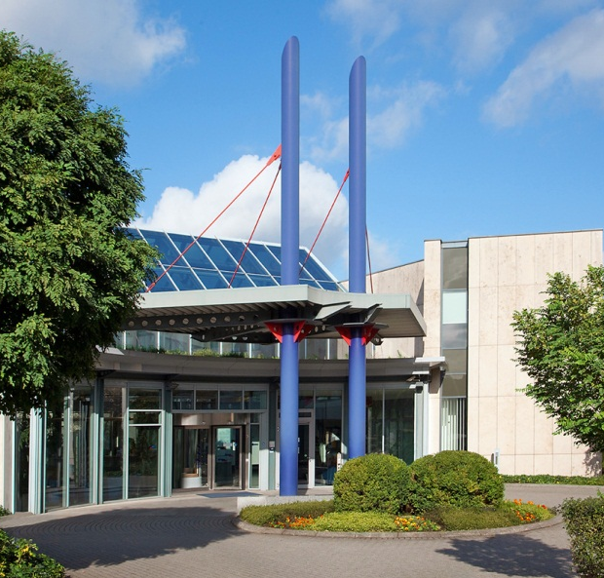
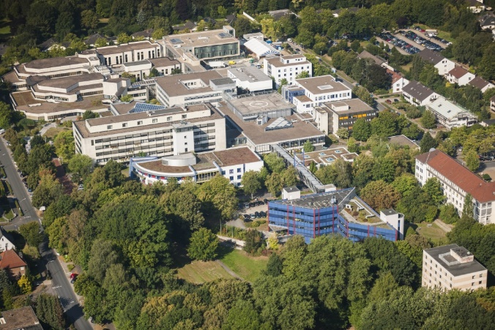
18th Conference on Targets and Target Chemistry
Preliminary results of Zinc recycling for ⁶⁸Gallium liquid target routine production
Antje Uhlending
Cyclotron Engineer
Department of Radiology, Nuclear medicine and Molecular Imaging

Slide 2

18th Conference on Targets and Target Chemistry
1
Content
⁶⁸Ga radiotracer production from ⁶⁸Ga liquid target
⁶⁸Ga liquid target upgrade
Original post prosessing and the optimization of the purification process
Labeling and the fine tuning labeling
Requirements for recycling zinc solution
Recycling process
Results
Conclusion

Slide 3
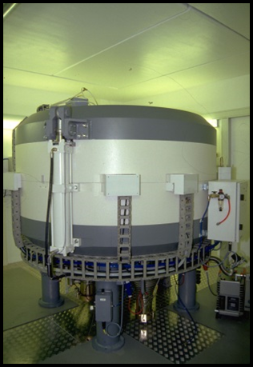
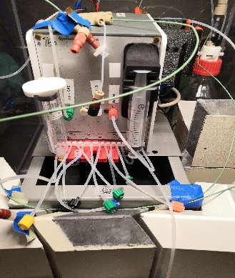
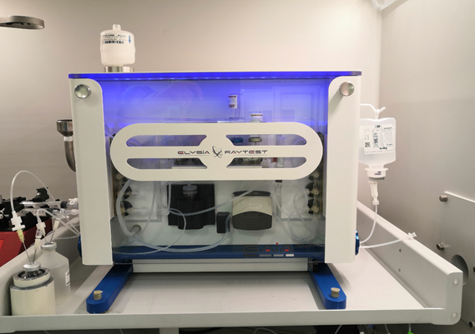
18th Conference on Targets and Target Chemistry
2
⁶⁸Ga radiotracer production from ⁶⁸Ga liquid target
The first challenge for using recycled Zinc is the implementing of a
Stable
Flexible ⁶⁸Ga-Radiotracer-routine production
Routine suitable
Cyclotron
⁶⁸Zn (p.n) ⁶⁸Ga
Purification
⁶⁸Zn/⁶⁸Ga
->
⁶⁸Ga Cl₃
Peptide Synthesis
  ⁶⁸Ga-PSMA
  ⁶⁸Ga-DOTATOC

Slide 4
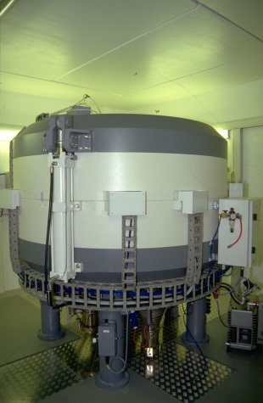
3
18th Conference on Targets and Target Chemistry
⁶⁸Ga liquid target upgrade
IBA Nirta Conical® C8 with 2.8 ml
Helium cooling upgrade 300 W (Alfa Laval)
Protection of the Helium cooling with stainless steel trap
Metal-free loading valve (Vici)
IBA 18/9 H03
Installation 1994
⁶⁸Ga-irradiation parameter
Bam current 45 µA
Target pressure 8 – 20 bar
Irradiation time 30 – 50 min
Target foil 250 μm niobium
Target solution ⁶⁸Zn(NO₃)₂ (99.5%)
Target concentration 33 – 66 mg/ml (0.5- 1.0 molar)

Slide 5
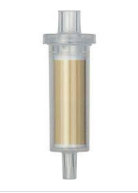
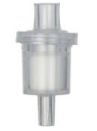

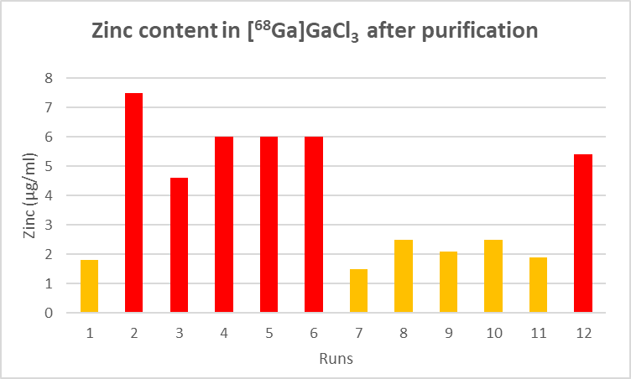
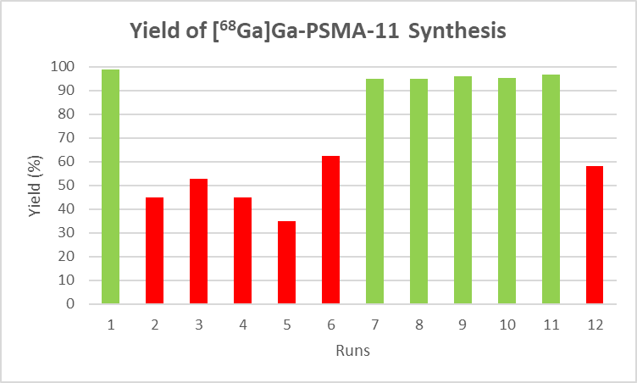
4
18th Conference on Targets and Target Chemistry
Original Post Processing
Post processing module: IBA Synthera® Extension
Chemicals: Fludomica®
⁶⁸Ga/⁶⁸Zn in HNO₃
[⁶⁸Ga]Ga₂Cl₇⁻
Target
solution
SCX
SAX
^{0.1 mol/l HCL 68}[Ga]GaCl₃
Aceton/HBr
Zn²⁺

Slide 6
5
18th Conference on Targets and Target Chemistry
Optimization of the purification process
[⁶⁸Ga]Ga₂Cl₇⁻
Target
solution
SCX
SAX
^{0.3 mol/l HCL 68}[Ga]GaCl₃
Aceton/HBr
Zn²⁺
Wasching with 8M HCl
1. Optimizing Step:
SCX Chromafix® PS-H+
SAX Chromafix® HR-XA
2. Optimizing Step:
Additional washing SAX with 8M HCl
 | Zinc Content [⁶⁸Ga]GaCl₃ [µg/ml]
Original Setting | 4.0
Cartridge Change | 2.1
Washing step of SAX | < 0.1
Zinc content after purification < 0.1 µg/ml Zinc

Slide 7

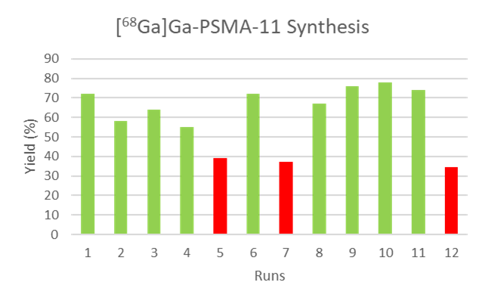
6
18th Conference on Targets and Target Chemistry
⁶⁸Ga-Peptide Labeling
Labeling module: Elysia Raytest®
Chemicals: ABX
NH₄OAc -Buffer
SCX
C18
^{10 ml 0.3 mol/l HCl}
[⁶⁸Ga]GaCl₃
80-95⁰C
⁶⁸Ga-Tracer
5-10 Min.

Slide 8
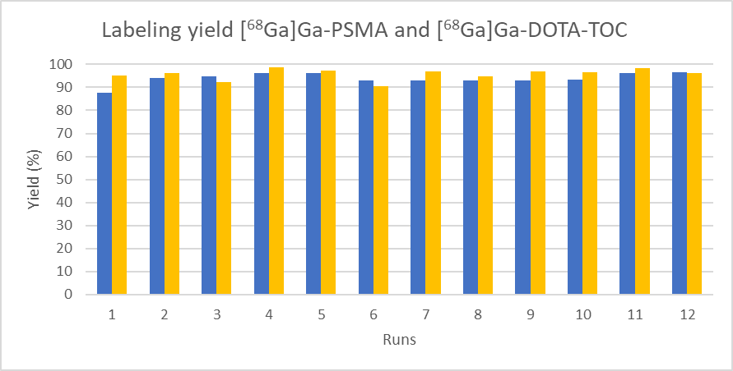
7
18th Conference on Targets and Target Chemistry
Fine tuning ⁶⁸Ga-Peptide labeling process
HEPES or NaOAC Buffer + Ascorbic acid
^{10 ml 0.3 mol/l HCl}
[⁶⁸Ga]GaCl₃
SCX
C18
80-95⁰C
⁶⁸Ga-Tracer
H₂O
5-10 Min.
H₂O
Variation | [⁶⁸Ga]Ga-PSMA-11 | [⁶⁸Ga]Ga-DOTA-TOC
Washing step: SCX with H₂O | 50 ml | 50 ml
Buffer | 3.1 mL Acetate buffer | 3.0 ml HEPES buffer
Masking of Fe traces | 900 ng Ascorbic acid | 450 ng Ascorbic acid
Washing step: C18 with H₂O | Not needed | 20 ml
[⁶⁸Ga]Ga-PSMA-11
[⁶⁸Ga]DOTA-TOC

Slide 9
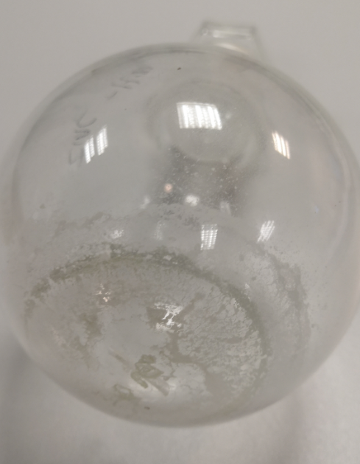
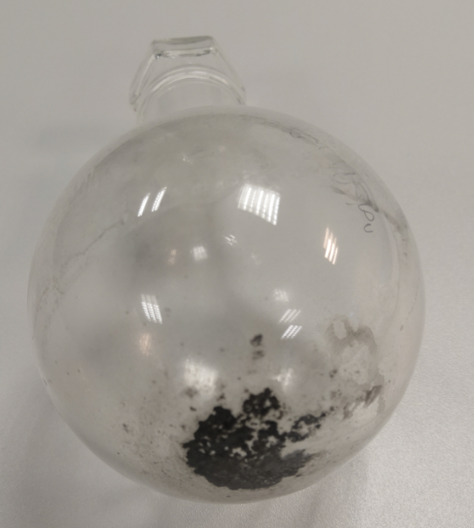
8
18th Conference on Targets and Target Chemistry
Requirements for recycling zinc solution
The basic requirement is stable ⁶⁸Ga-Radiotracer-routine production:
Using only ultra pure chemical quality and metal free items
Collecting only the ⁶⁸Zn-target-solution
Target solution
1. Collected waste (Zn²⁺ in HNO₃)
10 ml
Residue only
⁶⁸Zn-target-solution
⁶⁸Ga/⁶⁸Zn in HNO₃
SCX
Washing solution Aceton/HBr
2. Collected waste (Aceton/HBr)
50 ml
Residue
Aceton/HBr solution

Slide 10
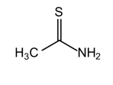
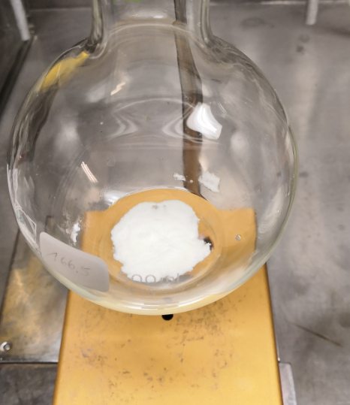
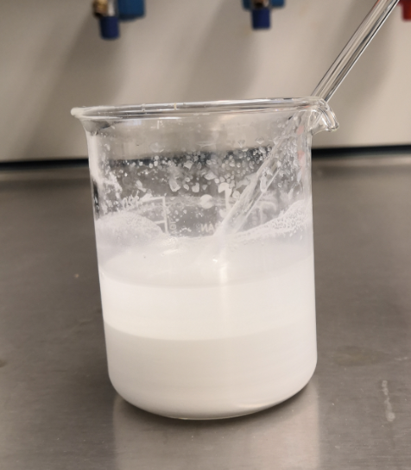
9
18th Conference on Targets and Target Chemistry
Recycling process
1.
Collect SAX waste
2.
Dissolve the residue Zinksalt in
3.
Precipitating
4.
Dissolve ZnS in cons. HCl and
5.
Dissolve ZnCl in
evaporate
(Zn²⁺ in HNO₃) and evaporate till dry
2 mol/l HCl
0.2 mol/l HNO3
and sterile filtration
Zn²⁺ +
^{pH 8 -9} ZnS

Slide 11
10
18th Conference on Targets and Target Chemistry
Results Recycling
Recycling yield of ⁶⁸Zn:
Callculated ⁶⁸Zn used for 60 runs with 45 mg/ml 2700 mg ⁶⁸Zn
Amount of ⁶⁸Zn in waste solution ( EDTA titrated) 2600 mg ⁶⁸Zn
Amount of ⁶⁸Zn in ⁶⁸ZnS 2590 mg ⁶⁸Zn
Amount of ⁶⁸Zn in recycled target soultion 2585 mg ⁶⁸Zn Recovery yield 95.7 %
Quality of [⁶⁸Ga]GaCl₃ after post processing:
Quality [⁶⁸Ga]GaCl₃ | Original [⁶⁸Zn]Zn(NO₃)₂ | Recycled [⁶⁸Zn]Zn(NO₃)₂
pH | 0.7 | 0.7
Zn | < 0.1 µg/ml | < 0.1 µg/ml
Fe | < 0.1 µg/ml | < 0.1 µg/ml
Endotoxin | < 0.25 EU/ml | < 0.25 EU/ml
⁶⁷Ga (EOP) | 0.59 % | 0.48 %
⁶⁷Ga (1h EOS) | 1.12 % | 0.87 %
⁶⁷Ga (2h EOS) (< 2% Pharm. Eu) | 1.80 % | 1.35 %

Slide 12
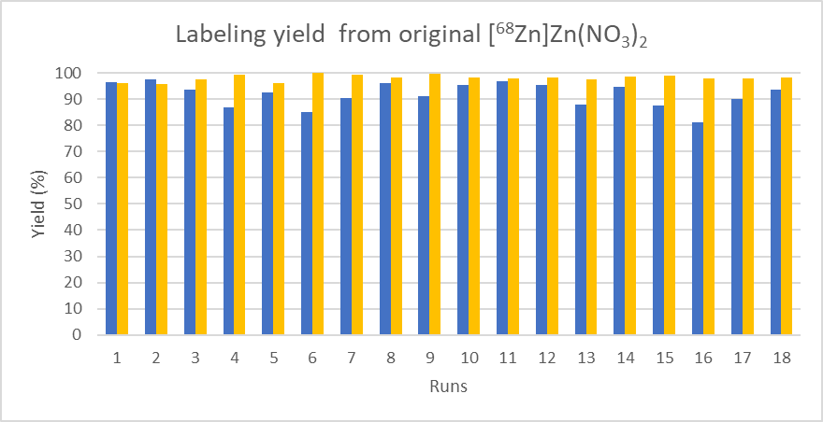
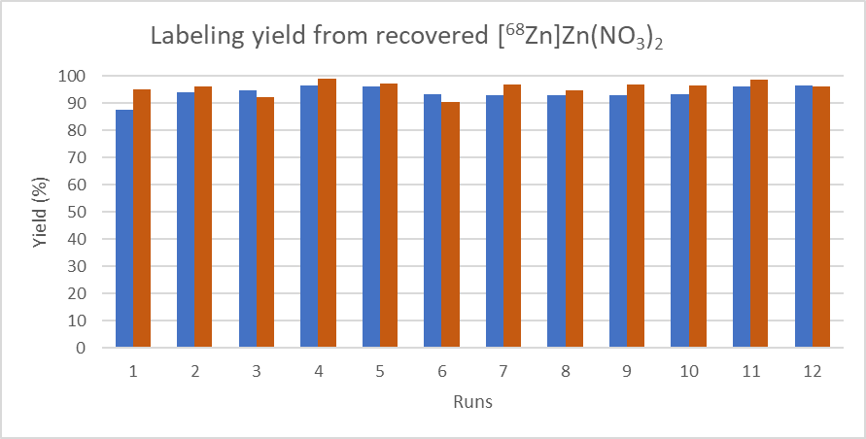
11
18th Conference on Targets and Target Chemistry
⁶⁸Ga-Peptide labeling results
[⁶⁸Ga]Ga-PSMA-11
[⁶⁸Ga]DOTA-TOC
[⁶⁸Ga]Ga-PSMA-11
[⁶⁸Ga]DOTA-TOC

Slide 13
12
18th Conference on Targets and Target Chemistry
Results
Since January 2021:
300 successful ⁶⁸Ga-Radiotracer-production
100 successful ⁶⁸Ga-Radiotracer-production with recycled Zinc solution
1.2 - 3.0 GBq (EOS) produced Activity of
[⁶⁸Ga]Ga-PSMA-11
[⁶⁸Ga]DOTA-TOC
Radiochemical purity
> 95% [⁶⁸Ga]Ga-PSMA-11
> 90% [⁶⁸Ga]DOTA-TOC
< 2 % free ⁶⁸Ga
< 2 % ⁶⁷Ga 2h EOS

Slide 14


13
18th Conference on Targets and Target Chemistry
Conclusion
Checklist: Zinc recycling in ⁶⁸Ga radiotracer production from ⁶⁸Ga liquid target
Implementing of a stable, routine suitable ⁶⁸Ga-radiotracer routine production
Collecting only Zinc waste
Metal free process by using ultra pure chemical quality
Sufficient recovery yield
Equal quality of [⁶⁸Ga]GaCl₃ after purification
Good ⁶⁸Ga-Peptide labeling results and quality

Slide 15
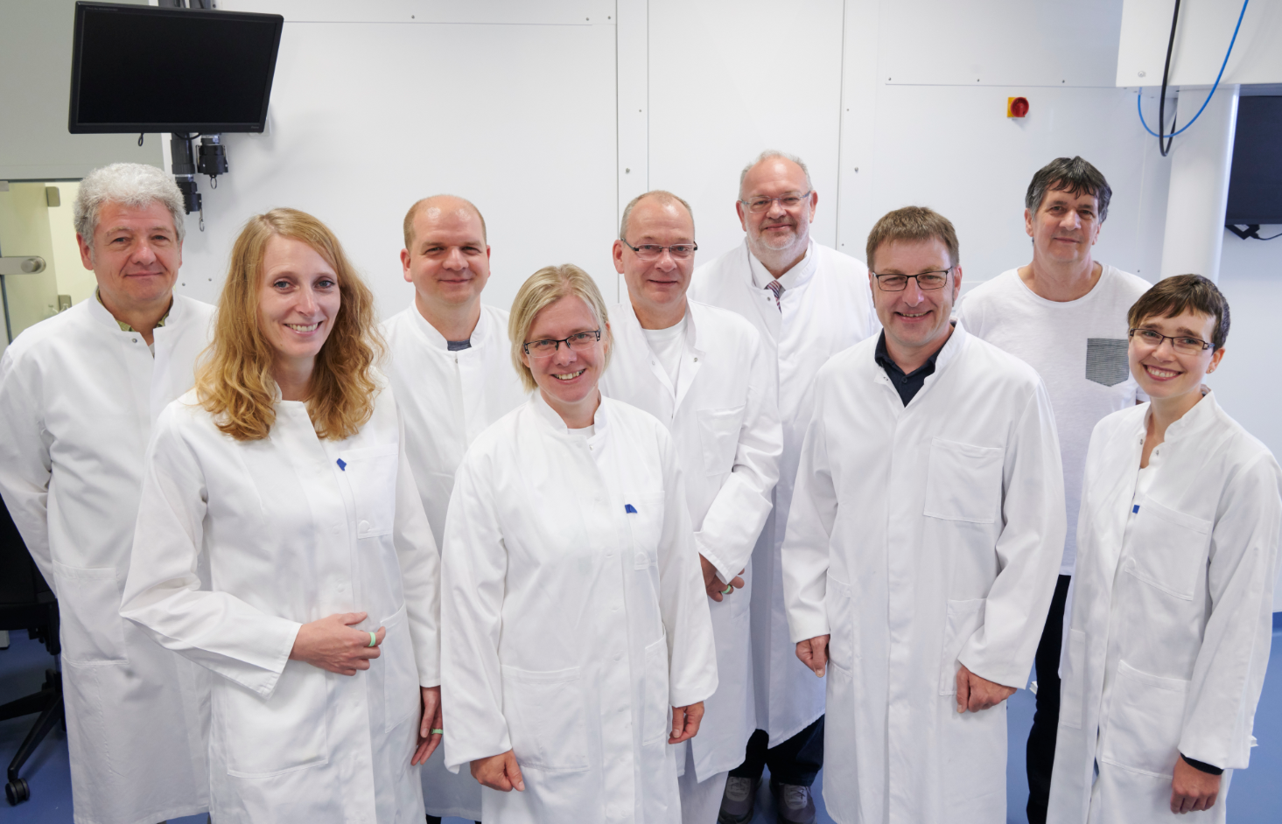
14
18th Conference on Targets and Target Chemistry
Acknowledgements
IBA Ion Beam Applications
Fluidomica, target solutions
Heart and Diabetes Center
North Rhine-Westphalia
Bad Oeynhausen
Germany

Slide 16


18th Conference on Targets and Target Chemistry
?
any questions

