Slide 1
A Reverse ²³⁰U/²²⁶Th Radionuclide Generator for Targeted Alpha Therapy Applications
T.E. Mastren and M.E. Fassbender
Los Alamos National Laboratory, P.O. Box 1663, Los Alamos, NM 87545, USA
18th Workshop on Targetry and Target Chemistry (WTTC 18)
August 23rd, 2022
LA-UR-18-28992

Slide 2
²³⁰U/²²⁶Th: a novel α-treatment
nuclide pair
Similar to ²²⁵Ac/²¹³Bi
Production energies available at university/commercial facilities
Indirect application as ²²⁶Th:
Th labeling in development;
28.2 MeV combined α-dose
Direct application as ²³⁰U: Leverages rich U coordination chemistry; 34.2 MeV combined dose
Compare to 19.5 (²²⁵Ac) and 5.9 MeV doses for ²¹³Bi
Makvandi, M., et al., Alpha-Emitters and Targeted Alpha Therapy in Oncology: from Basic Science to Clinical Investigations. Targeted Oncology, 13(2), pp. 189–203 (2018).
Fassbender, M.E., Guest Edited Collection: Radioisotopes and radiochemistry in health science. Sci Rep, 10(1), 340 (2020).

Slide 3
Production modes for ²³⁰U
Direct:
  ²³¹Pa (p,2n) ²³⁰U
  ²³²Th (α, 6n) ²³⁰U
  ²³²Th (³He,5n) ²³⁰U
Indirect:
²³²Th(p,3n) ²³⁰Pa
²³²Th(d,4n) ²³⁰Pa
Cumulative cross sections for
²³²Th(p,3n)²³⁰Pa (17.4 d)*
Ideal indirect production energy range: 50 → 12 MeV
V. Radchenko, et al., Formation cross-sections and chromatographic separation of protactinium isotopes formed in proton- irradiated thorium metal. Radiochim Acta 104(5), 291-304 (2016).

Slide 4
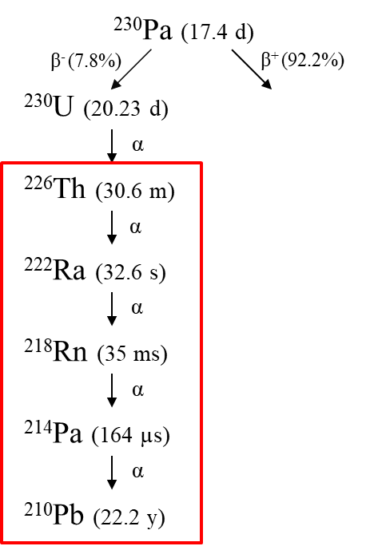
Formation and Decay of Precursor ²³⁰Pa
²³⁰Th (7.5E4 a)
²³²Th(p,3n)²³⁰Pa

Slide 5
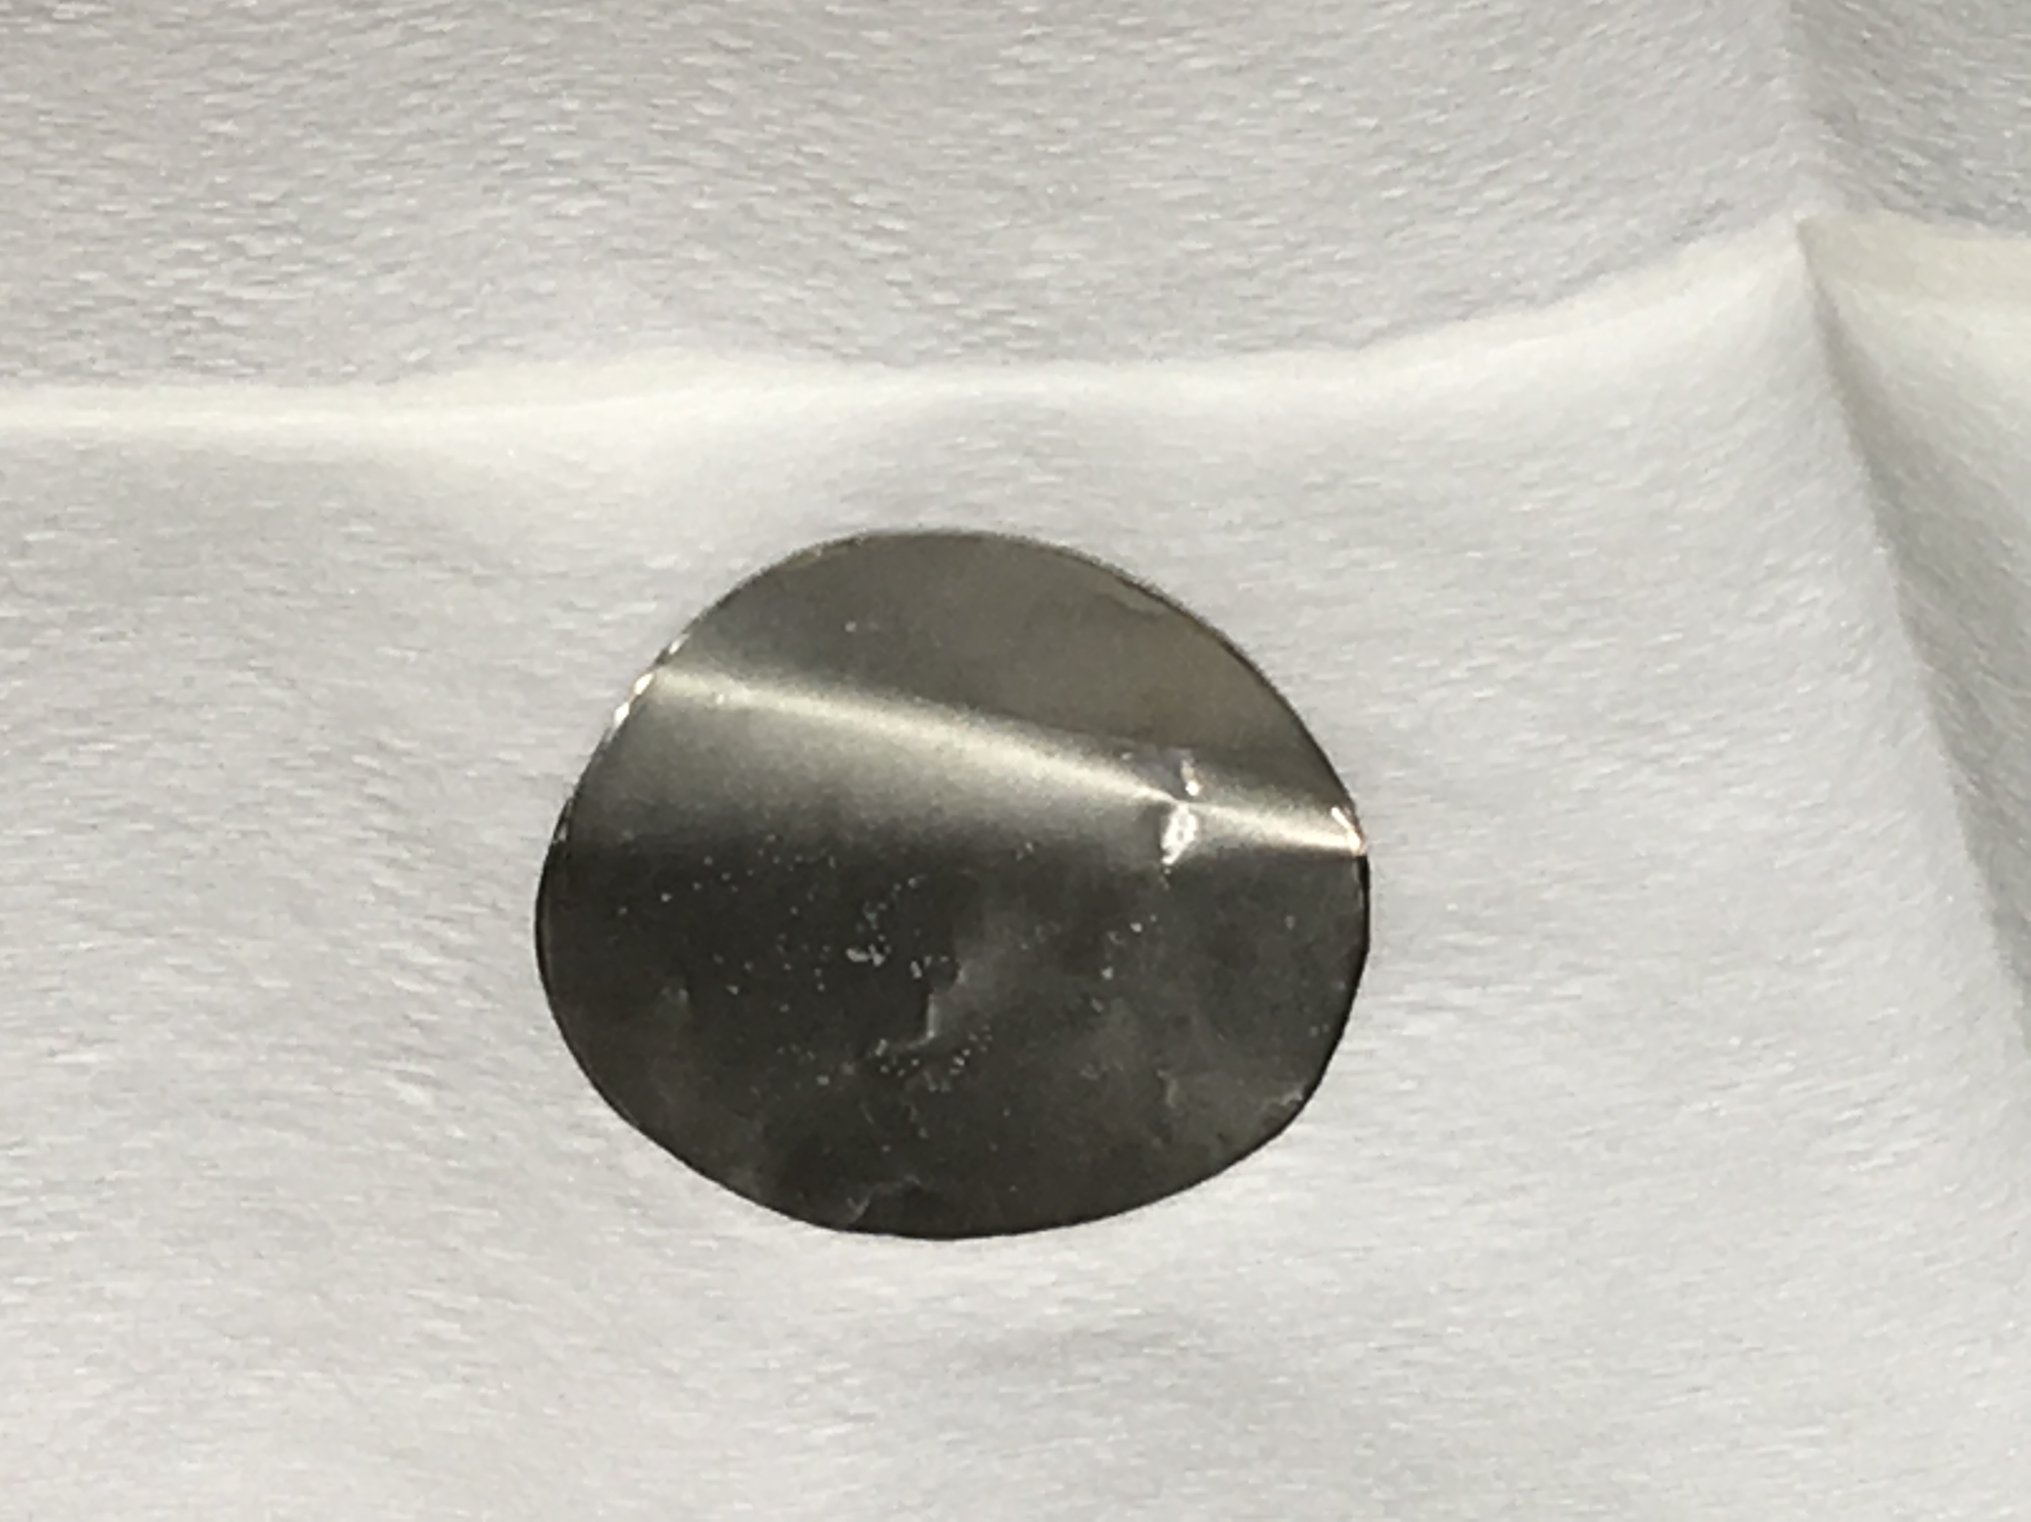
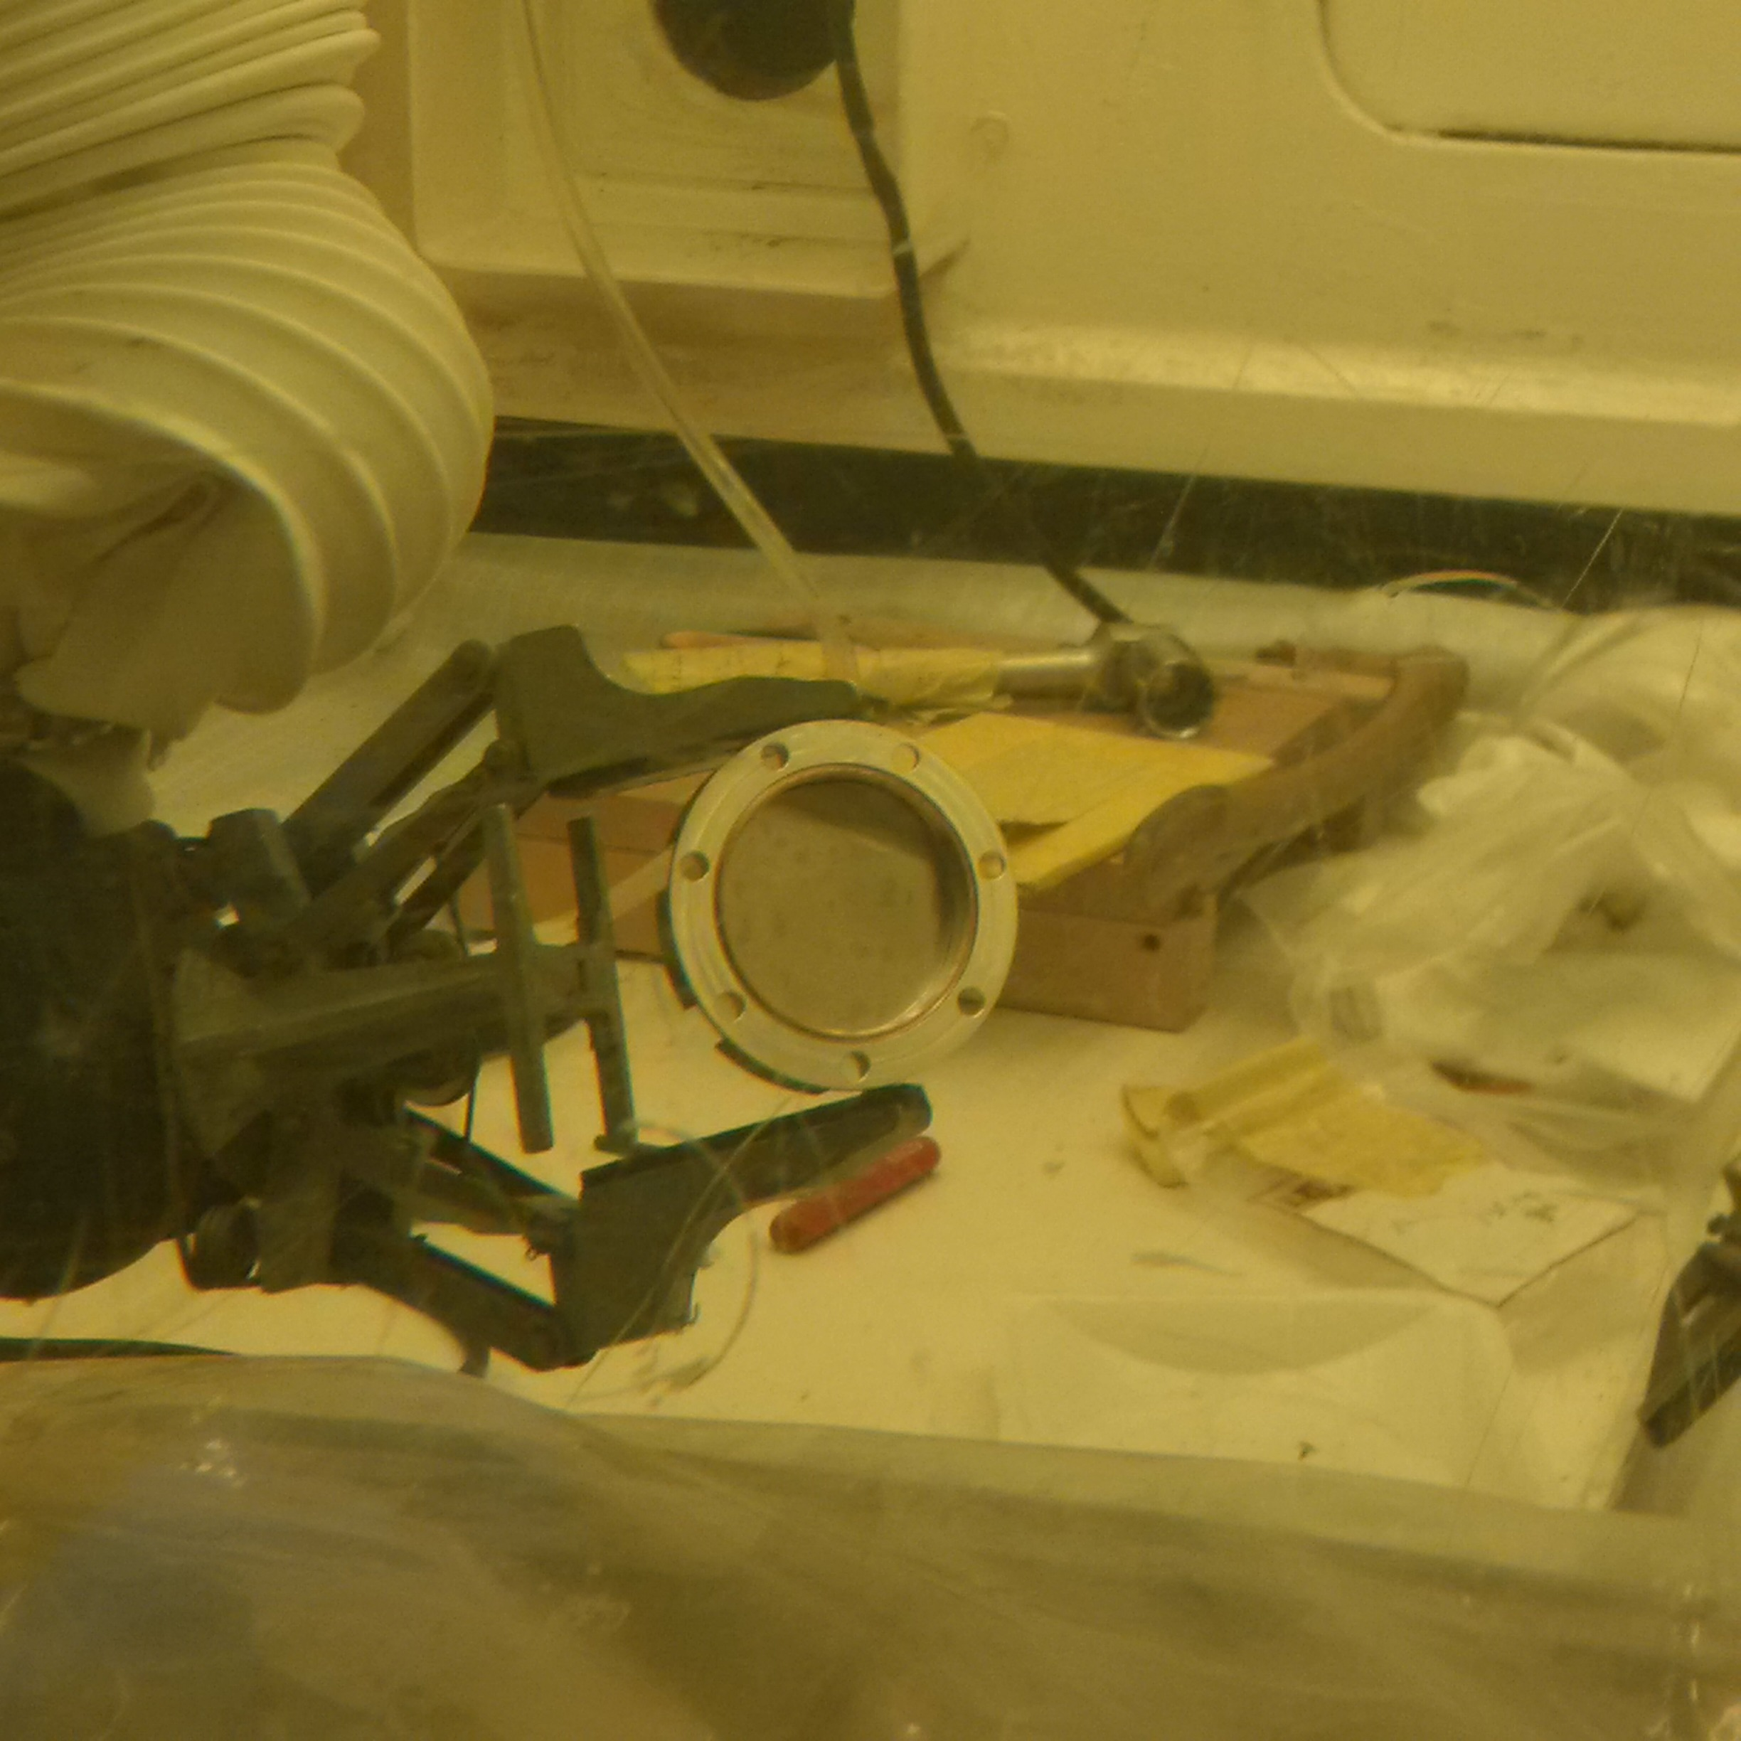
Los Alamos Isotope Production Facility
Irradiations of Th Metal Foils
Target stacks Al/Ni/Th; integrated beams ~4.5 µAh
Ni monitor foil (25 µm) for ⁵⁷Ni/⁵⁷Co ratio
LANL In-house made Th foil, thickness 0.1 mm, p energy loss ~1.5 MeV
Friend, M.T., et. al., Production of ²³⁰Pa by proton irradiation of ²³²Th at the LANL isotope production facility: Precursor of ²³⁰U for targeted alpha therapy, Appl Radiat Isot 156, 108973 (2020).

Slide 6
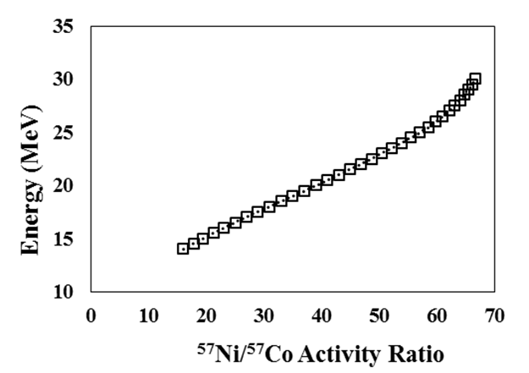
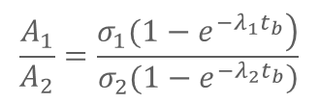
Energy Determination for ²³⁰Pa production via ⁵⁷Ni/⁵⁷Co Activity Ratios
$$\frac{A_{1}}{A_{2}}=\frac{\left.σ_{1}(1−e^{{−λ}_{1}t_{b}}\right)}{\left.σ_{2}(1−e^{{−λ}_{2}t_{b}}\right)}$$
A_{x} = Activity
σ_{x} = Effective Cross Section
λ_{x} = Decay Constant
t_{b} = Bombardment Time
Date | Energy (MeV) | ²³⁰Pa Yield | % of Theoretical | ²³⁰Pa Activity/µAh
Jan 2017 | 19 ± 1 | 32.4 µCi (1.2 MBq) | 88 | 7.3 µCi (270 kBq)
Sept 2017 | 24 ± 1 | 45.9 µCi (1.7 MBq) | 118 | 10.1 µCi (374 kBq)
Jan 2018 | 27 ± 1 | 29.7 µCi (1.1 MBq) | 110 | 6.4 µCi (237 kBq)
T. Mastren, et al., Natural Nickel Foil as a Monitor for Proton Energies Ranging from 15-30 MeV, Nucl Instr Meth Phys Res B 443, 1-4.

Slide 7
Sulfur-based Ligands for the Separation of Protactinium
DGTA (diglycolthioamide,
LANL In-House):
Extraction resin made in house containing a sulfur variant of TODGA
CL Resin (Triskem):
Extraction resin made by Triskem that contains alkyl phosphine sulfides (R₃P=S)

Slide 8
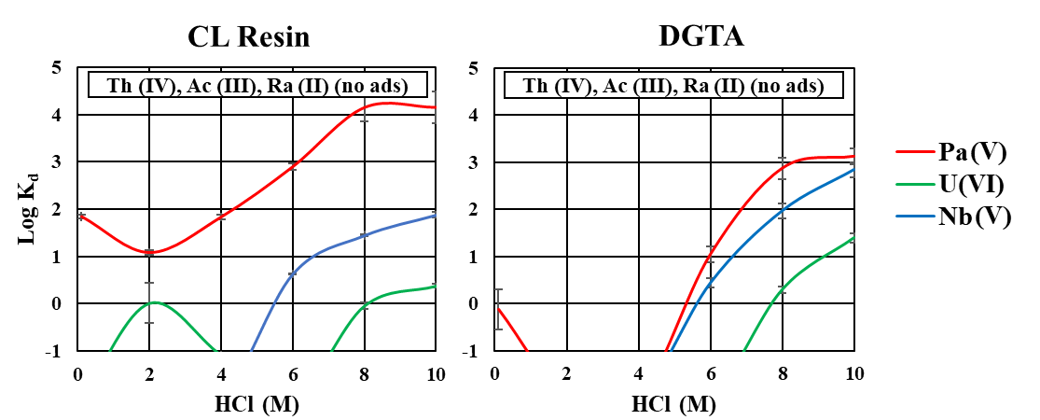
Equilibrium Distribution Coefficients
T. Mastren, et al., “Separation of protactinium employing sulfur-based extraction chromatographic resins”, Anal Chem, 90(11), 7012-7017.

Slide 9
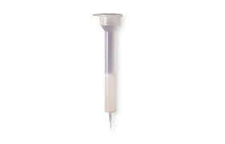
Chemical Separation of Pa
Irradiated a 0.1 mm ²³²Th target with 22.0 MeV protons for 5 µAh
Dissolved target containing ²³⁰Pa and fission products in 10 M HCl spiked with HF
4 M HCl/0.1 M HF
1 mL CL Resin
50-100 µm mesh
Bulk thorium and fission products
^{230/233}Pa and ⁹⁵Nb
Convert to 10 M HNO₃
1 M HNO₃
4 M HCl/0.1 M HF
1 mL DGA Resin
50-100 µm mesh
93 ± 4 % Recovery of Pa
99.8% ^{230/233}Pa
0.2% ⁹⁵Nb
²³³Pa is ~7% of total Pa activity
⁹⁵Nb
Hopkins, P.D., et al., Synthesis and radiometric evaluation of diglycolamide functionalized mesoporous silica for the chromatographic separation of actinides Th, Pa and U. Dalton Transactions, 47(15), 5189–5195 (2018).

Slide 10
Direct-Phase Concept: ²³⁰Pa/²³⁰U Separation
²³⁰Pa in 10 M HCl
5mL 10M HCl
Binds ²³⁰Pa
CL
Column
Elute >95% of the ²³⁰U with >99.99 % purity
for direct use or use in ²²⁶Th generator
T. Mastren, et al., A Reverse ²³⁰U/²²⁶Th Radionuclide Generator for Targeted Alpha Therapy Applications, Nucl Med Biol 2020, 90-91, 69–73.

Slide 11
Reverse-Phase Generator: ²³⁰U/²²⁶Th Separation
5mL 0.1M HNO₃
²³⁰U/²²⁶Th in equilibrium
1mL 0.1M Citrate, pH 5
Binds ²³⁰U/²²⁶Th
Column
100 μg DGA Resin
<0.001% ²³⁰U/²²⁶Th
Elute ~96% ²²⁶Th (<0.18% ²³⁰U)
Add 6mL Concentrated HCl to ²³⁰U Fraction
Elute ²³⁰U
(>99.8 %)
Wash Column w/ 10mL water
Equilibrate Resin with 2mL conc HCl
Successful chelation studies with 70 µCi of ²³⁰U/²²⁶Th
Two more generator concepts in development (²³⁰U sorption/ ²²⁶Th elution)
Ferrier, M.G., et al., Thorium chelators for targeted alpha therapy: Rapid chelation of thorium-226. J Labelled Comp. Radiopharm. 63(12), 502–516, (2020).

Slide 12
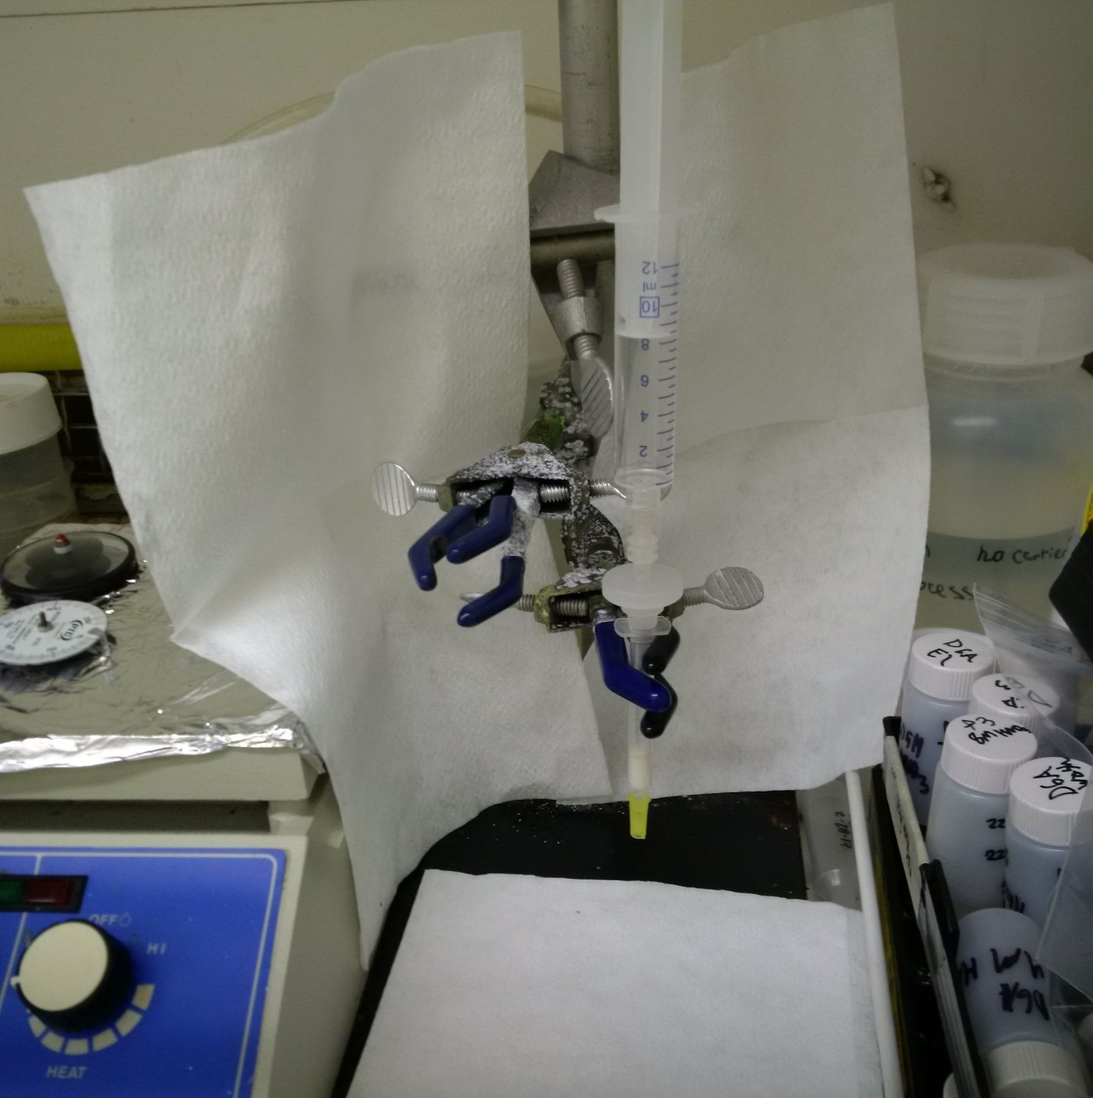
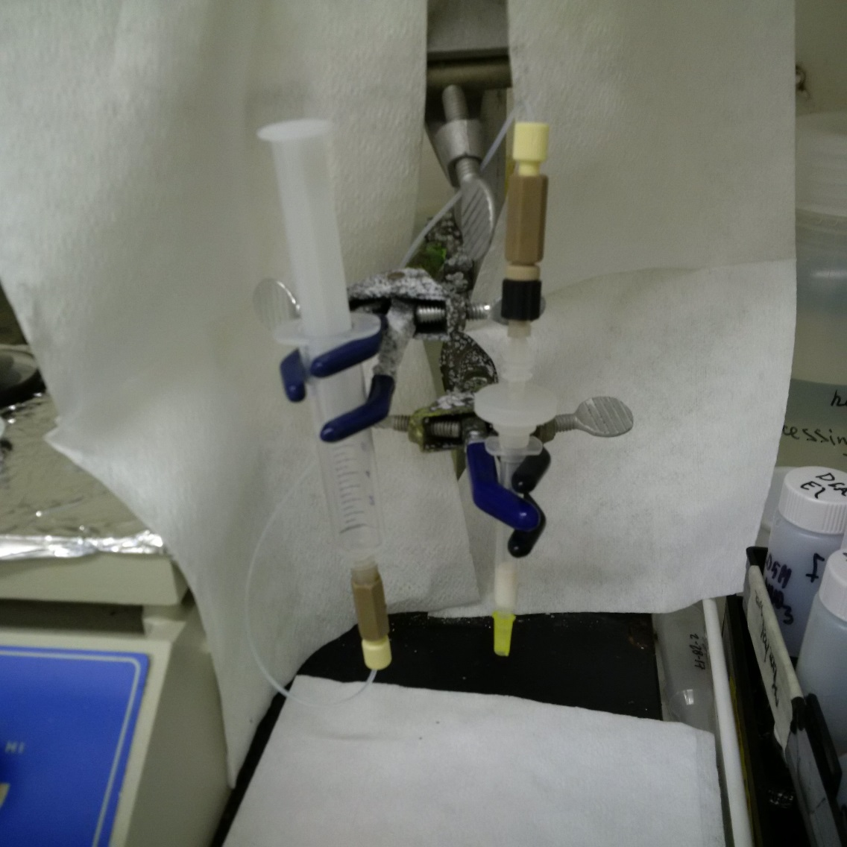
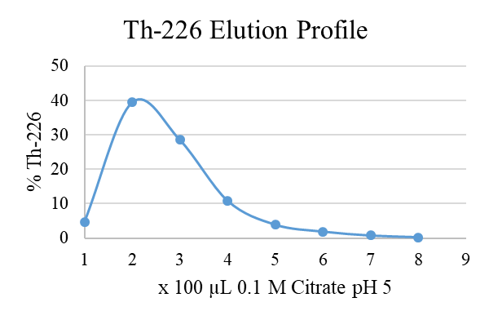
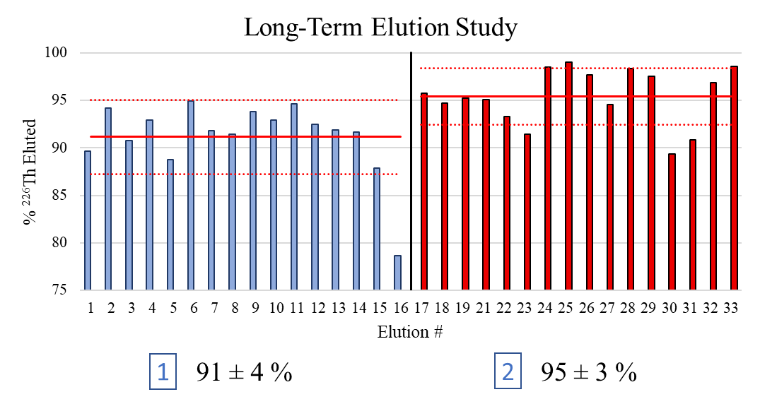
²³⁰U/²²⁶Th Generator Elution Evaluation (6 weeks)
1
2

Slide 13
Conclusions
Separation of ²³⁰Pa from bulk thorium targets and co-produced fission products
Designed a dual generator system first to yield ²³⁰U from ²³⁰Pa and second to yield ²²⁶Th from ²³⁰U
Generator provides ²²⁶Th in a chelated form, which is amenable to direct labeling due to short 30.6 minute half-life
Precedence for optimized Th chelates with fast complexation kinetics
Follow-on work granted for FY20(larger scale production of ²³⁰U, Th chelator development, call FOA-LAB-18-1896)

Slide 14
Acknowledgment
This research was supported by the U.S. Department of Energy Isotope Program, managed by the Office of Science for Isotope R&D and Production
(Grants FOA LAB 14-1099 and LAB 18-1896)

