Slide 1



Development of Enriched Gadolinium Target for Cross Section Measurement and Future Production of Terbium
Yizheng Wang, Thomas Sounalet, Arnaud Guertin, Férid Haddad, Nathalie Michel, Etienne Nigron
18th Workshop on Targetry and Target Chemistry
AUGUST 22, 2022

Slide 2
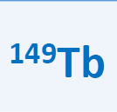
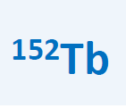
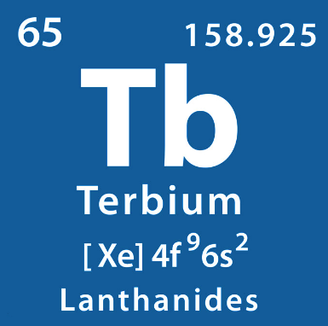
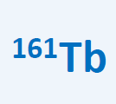

Introduction
Cross section
Thick target
Conclusion Perspectives
Thin target
Mass production
T_{1/2} = 4 h
Eα = 4 MeV, E_{β+} = 638 keV
T_{1/2} = 18 h
Mean E_{β+} = 1,14 MeV
Applied in “Alpha-PET”
(Muller, 2017; Umbricht 2019)
Applied in PET/CT
(Muller, 2016; Baum 2017)
T_{1/2} = 7 d
Mean E_{β-} = 154 keV
T_{1/2} = 5 j
E_{γ}= 87 MeV (32%)
E_{Auger}= 87 keV (37%)
An alternative to ¹⁷⁷Lu
Applied in β therapy
(Lehenberger, 2011; Gracheva, 2019)
Applied in SPECT + Auger therapy
(Muller, 2014; Baum 2017)
Terbium: a competitive candidate for theranostics

Slide 3
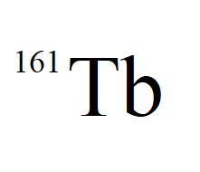
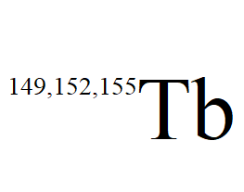
Introduction
Cross section
Thick target
Conclusion Perspectives
Thin target
Mass production
Production routes of Tb radionuclides
Produced by nuclear reactors: large quantity and good quality
  ¹⁶⁰Gd(n,γ)¹⁶¹Gd →¹⁶¹Tb
☺
Produced by spallation reactions: limited quantity and complex procedure
  High energy (1,4 GeV) and many impurities
  Low efficiency to separate impurities
☹
This work: produce ^{149,152,155} Tb with enriched Gd targets by cyclotrons
Lower energy (10-20 MeV), lower cost, less impurities
¹⁵²Gd (p, 4n)¹⁴⁹Tb (enrichment of ¹⁵²Gd: 30%)
¹⁵²Gd (p, n) ¹⁵²Tb
¹⁵⁵Gd (p, n) ¹⁵⁵Tb, ¹⁵⁵Gd (d, 2n) ¹⁵⁵Tb (enrichment of ¹⁵⁵Gd: 90%)
☺

Slide 4
Introduction
Cross section
Thick target
Conclusion Perspectives
Thin target
Mass production
Introduction
Irradiation
Comptage
Résultat
Conclusion et Perspectives
Cible préparation
Objectives : produce ¹⁵⁵Tb using ¹⁵⁵Gd
Cross section measurement of the reaction ¹⁵⁵Gd(d,n)¹⁵⁵Tb to estimate production yield
Make very thin targets (10-20 µm)
Manufacture a complete and uniform Gd-containing target for the routine production of Tb
Make thicker targets (≥ 100 µm)
1
2

Slide 5
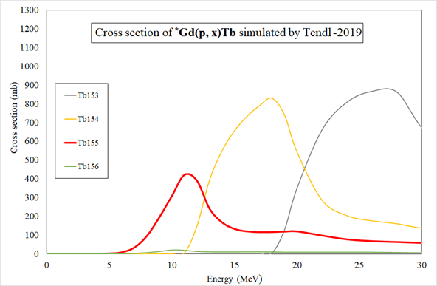
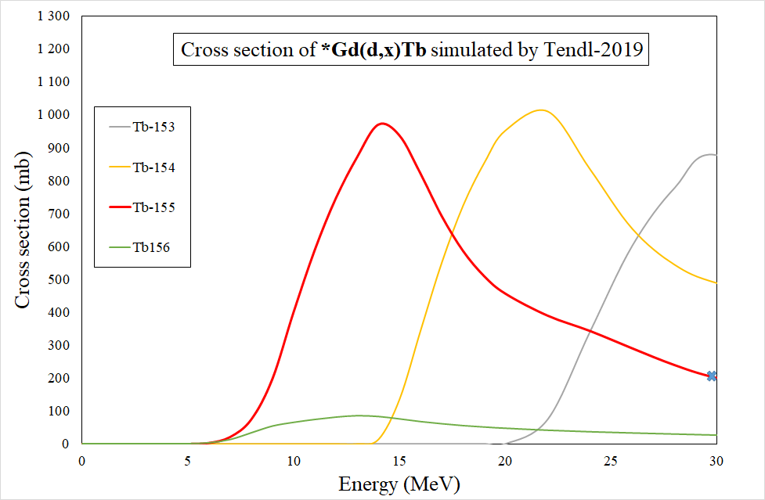
Introduction
Cross section
Thick target
Conclusion Perspectives
Thin target
Mass production
Introduction
Irradiation
Comptage
Résultat
Conclusion et Perspectives
Cible préparation
Objectives : produce ¹⁵⁵Tb using enriched Gd
Prepared enriched Gd₂O₃ (Trace Science):
Isotopes | Gd-155 | Gd-156 | Gd-157 | Gd-158 | Gd-160
Proportion (%) | 92.8 | 5.7 | 0.8 | 0.5 | 0.2
σ maximum produced by proton: 400 mb
σ maximum produced by deuteron: 1000 mb

Slide 6
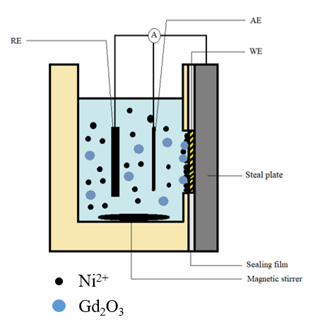
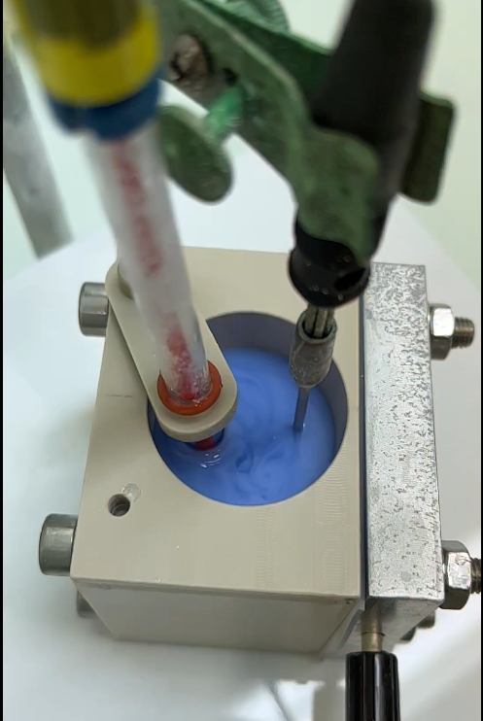
Thin targets fabrication: Co-electrodeposition method
Introduction
Cross section
Thick target
Conclusion Perspectives
Thin target
Mass production
The reduction potential of Gd³⁺/Gd is too negative (-2,3 V/ENH) to obtain an adhered deposit in aqueous solutions because of the HER.
WHY?
Insoluble Gd₂O₃ particles are mixed in the alkaline Ni plating bath, by applying a potential, the Gd₂O₃ particles will move with Ni²⁺ and trapped in the Ni metal matrix (mechanical process).
HOW?
A Ni-Gd₂O₃ composite target with a thickness of 10-20 µm can be obtained.
WHAT?

Slide 7

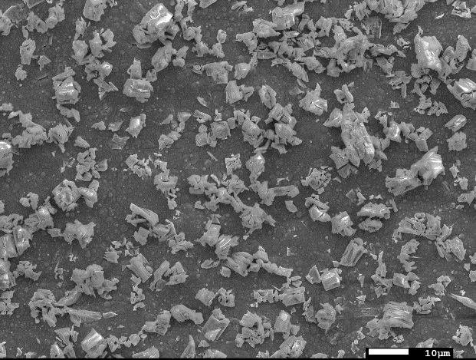
Introduction
Cross section
Thick target
Conclusion Perspectives
Thin target
Mass production
Obtained targets: thin and homogenous
Morphological analysis: SEM
E= 15kV, zoom x1000
E = 15kV, magnitude x100
Mesure time = 60 s
One hour of co-electrodeposition
Au substrate
Thickness = 13 µm
Gd trapped in the deposit: 3 mg
Composition analysis: EDX et ICP-OES
According to the ICP-OES results, the target contains about 3 mg of Gd atoms.
For 1 g of Gd₂O₃ powder, 10 targets was made, 0.6 g of powder left.

Slide 8
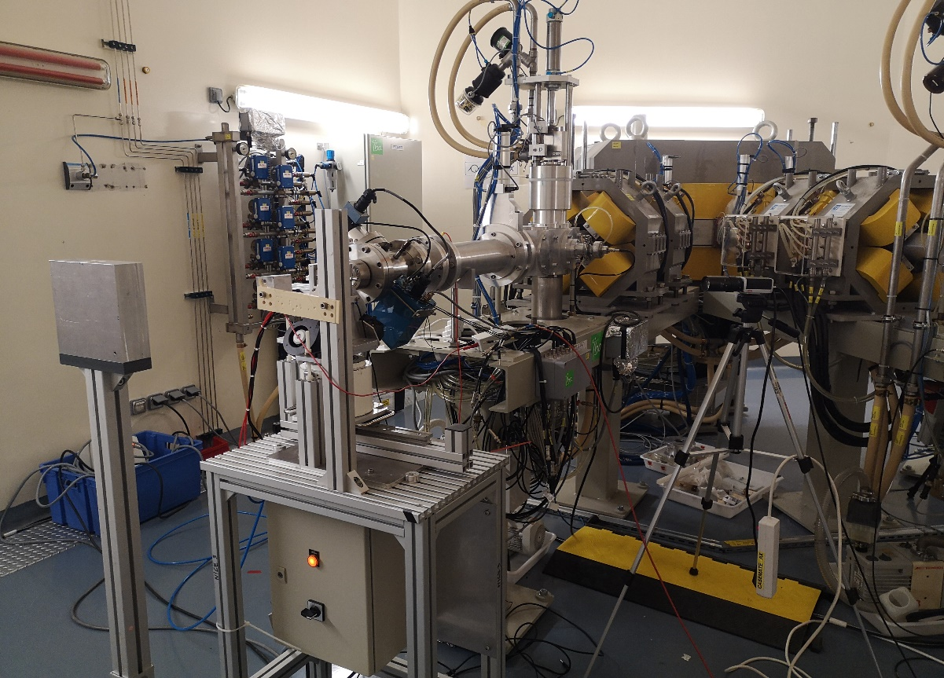
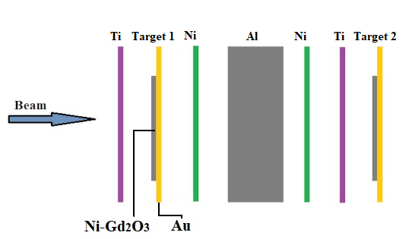
Cross section measurement: stacked-foils technique
Introduction
Cross section
Thick target
Conclusion Perspectives
Thin target
Mass production
Target: Ni/Gd₂O₃ composite target deposited on the Au substrate
Monitor: Ti and Ni foils (measure ⁴⁸V and ⁵⁸Co)
Degrador: Al foils
Schematic diagram of the stack composition
Beam line used at ARRONAX cyclotron facility

Slide 9
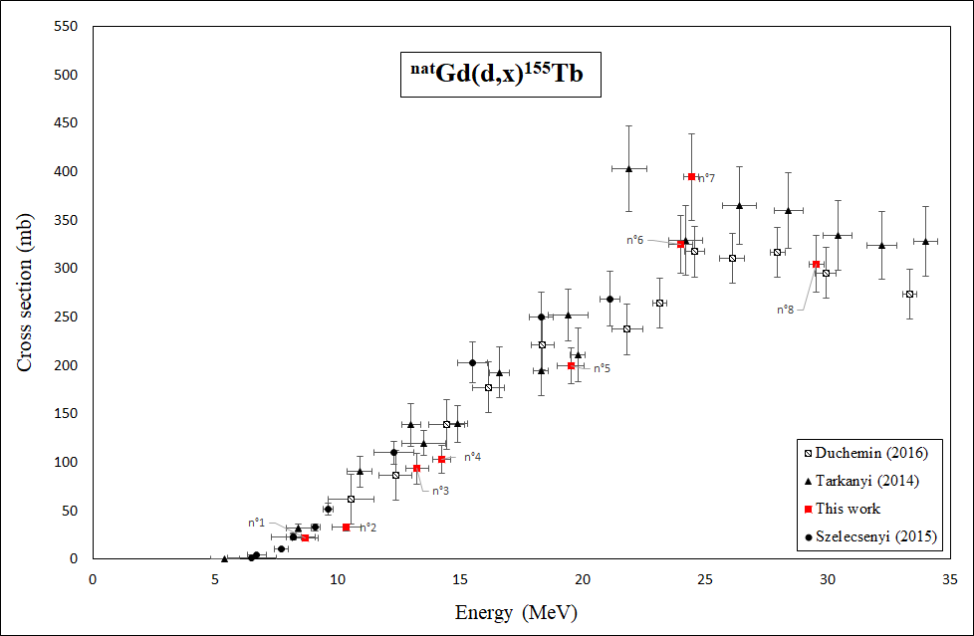
Reliability of obtained targets?
Introduction
Cross section
Thick target
Conclusion Perspectives
Thin target
Mass production
Eight targets made with natural Gd₂O₃ powder were used to measure the σ of ^{nat}Gd(d,x)¹⁵⁵Tb:
The measured results are consistent with existing data.

Slide 10
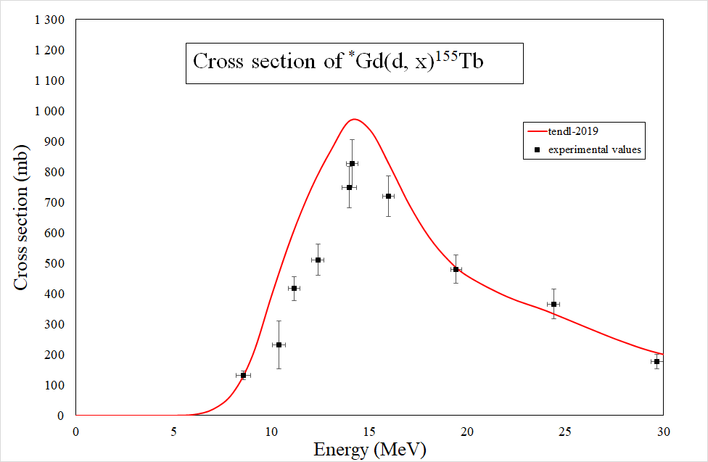
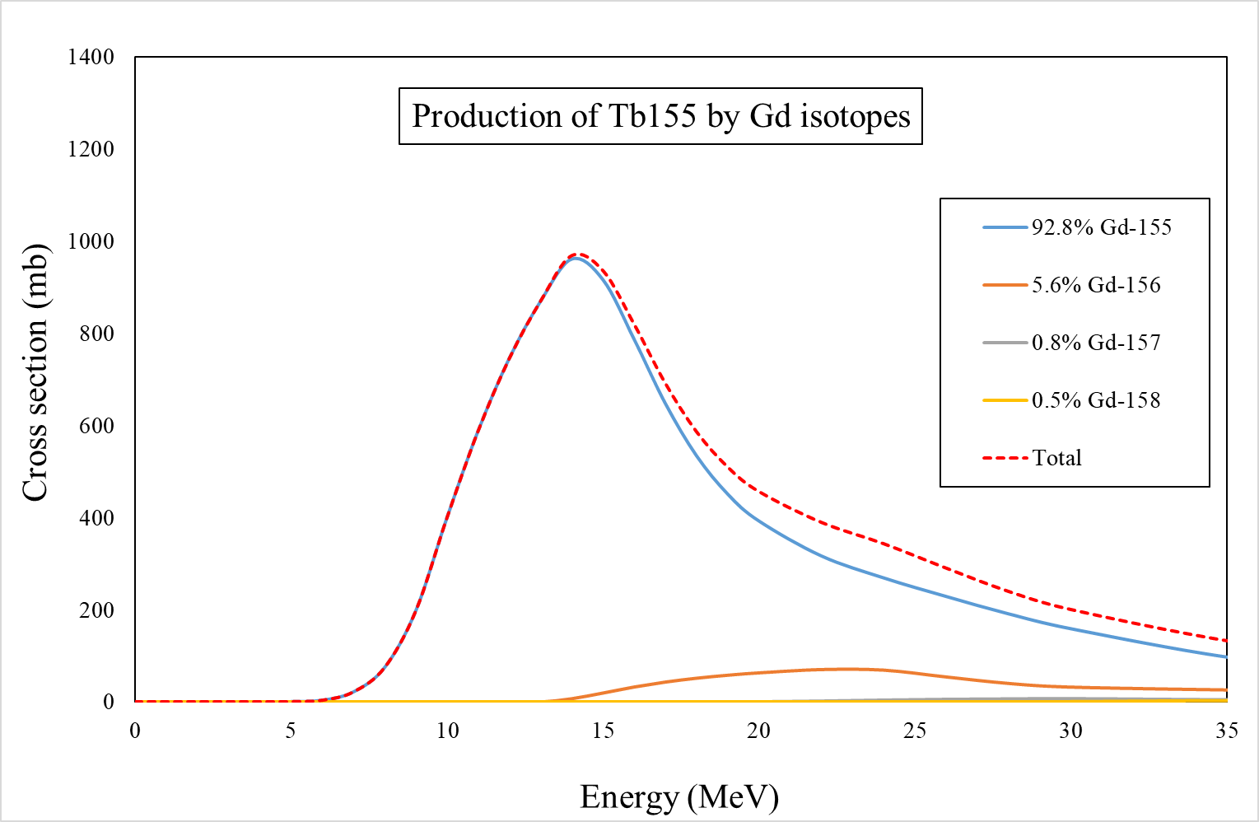
Cross sections measured for ¹⁵⁵Tb
Introduction
Cross section
Thick target
Conclusion Perspectives
Thin target
Mass production
The contribution of ¹⁵⁶Gd starts when energy is bigger than 13 MeV.
We got 4 measured cross section values of the reaction ¹⁵⁵Gd(d,2n)¹⁵⁵Tb.

Slide 11
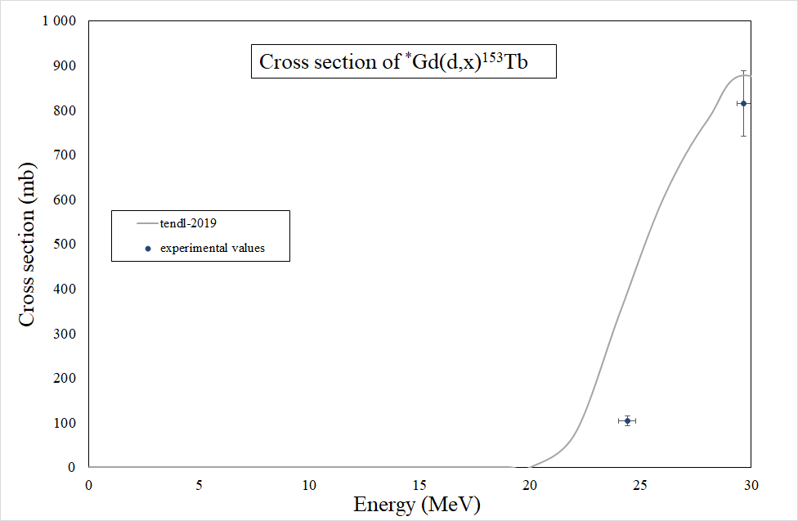
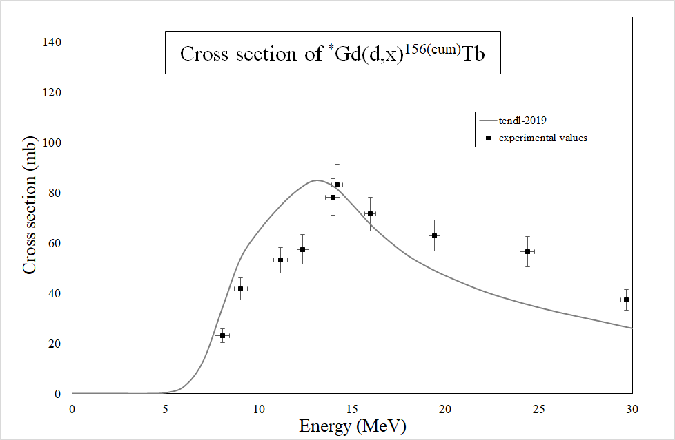
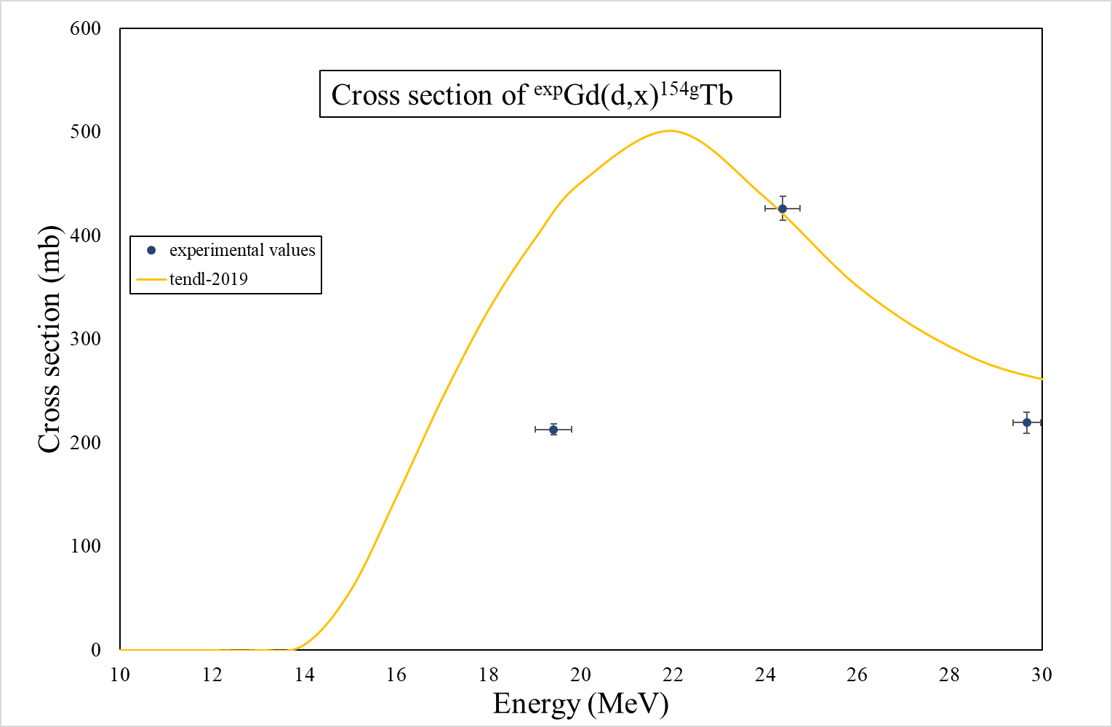
Cross sections measured for ^{153,154,156}Tb
Introduction
Cross section
Thick target
Conclusion Perspectives
Thin target
Mass production
¹⁵⁶Tb always exits while ¹⁵³Tb and ¹⁵⁴Tb can be limited by limiting energy.

Slide 12
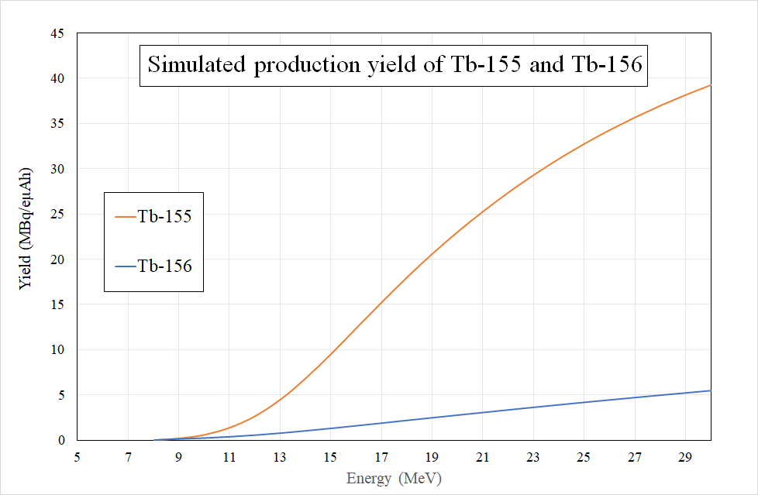
Estimation of production yield
Introduction
Cross section
Thick target
Conclusion Perspectives
Thin target
Mass production
The purity of ¹⁵⁵Tb varies from 60% to 89% when energy varies from 9 to 15 MeV.

Slide 13
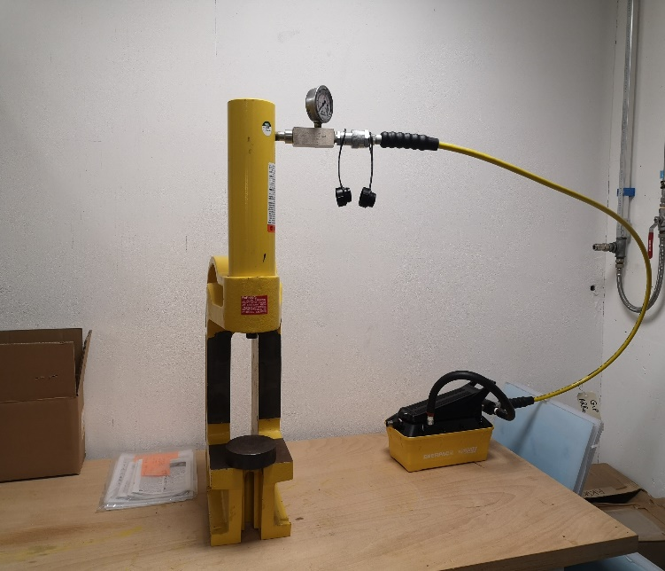
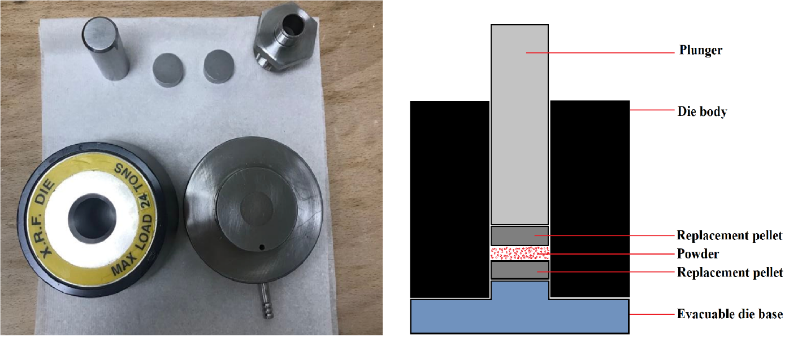
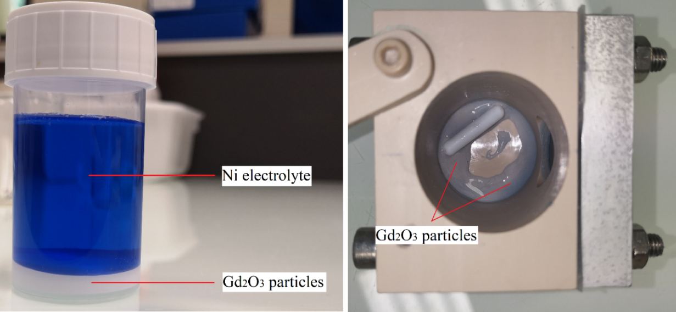
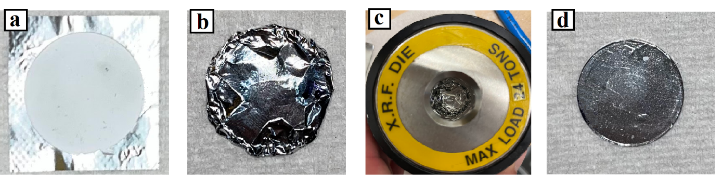
Thick targets fabrication: pelletizing method
Introduction
Cross section
Thick target
Conclusion Perspectives
Thin target
Mass production
Mass = 0.6 g, thickness = 0.4 mm

Slide 14
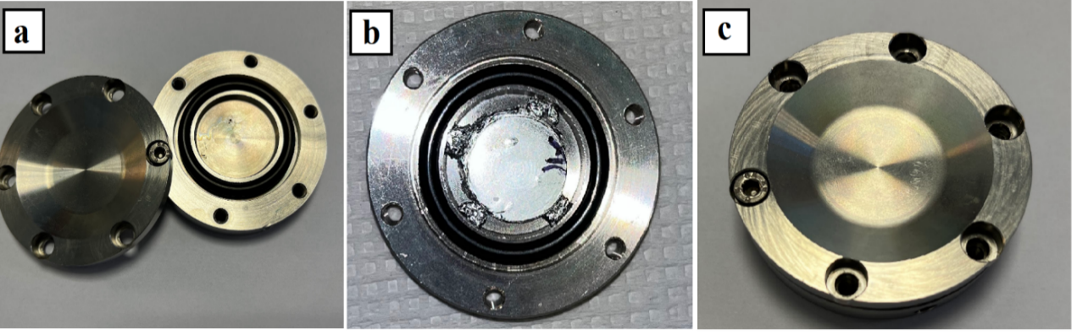
First test of mass production
Introduction
Cross section
Thick target
Conclusion Perspectives
Thin target
Mass production
Experiment:
Estimation according to the measured excitation function:
E_{incident} = 15.1 MeV, E_{outgoing} = 8.6 MeV
500 nA for 1 h
Production yield:
Tb-155: 10.2 ± 0.7 MBq/µAh
Tb-156: 1.3 ± 0.1 MBq/µAh
Purity of Tb-155: 89% (10 d after EOB)

Slide 15
Conclusion and perspectives
Introduction
Cross section
Thick target
Conclusion Perspectives
Thin target
Mass production
Work completed:
Cross section measurement:
The cross sections of *Gd(d,x)¹⁵⁵Tb and other impurities have been measured using Ni-Gd₂O₃ composite targets.
First test for mass production:
Production yield Tb-155 is about 10 MBq/µAh, purity is about 89%.
Follow-up:
Modification of encapsulation system.
Purification

Slide 16
Thank you for your attention!
If you have any questions, please contact: yizheng.wang@subatech.in2p3.fr

