Slide 1
Production of ⁵⁵Co Using Pressed Nickel and Magnesium Foils
Jonathan Siikanen^{1.3}, Stefan Milton^{2,3}, Mélodie Ferrat^{2,3}, Erik Samén^{2,3}, Emma Jussing^{2,3}, Thuy. A. Tran^{2,3}
¹Karolinska University Hospital, Department of Medical Radiation Physics and Nuclear
Medicine, Stockholm, SWEDEN, ²Karolinska University Hospital, Department of
Radiopharmacy, Stockholm, SWEDEN, ³Karolinska Institutet, Department of Oncology and Pathology, Stockholm, Sweden

Slide 2
Overview
Introduction of ⁵⁵Co
Motivation for pressed Ni/Mg powder
Making targets
Target performance
Conclusions
Acknowledgements

Slide 3
⁵⁵Co
Production on PET-cyclotrons
⁵⁴Fe(d,n) ⁵⁵Co (Naturally: 6 % ⁵⁴Fe)
⁵⁸Ni(p,α)⁵⁵Co (Naturally: 70 % ⁵⁸Ni)
Known chemistry
AG1-X8, DGA, etc.
DOTA, NOTA, etc.
β⁺ =76 %, E_{K}=0.4-0.6 MeV

Slide 4
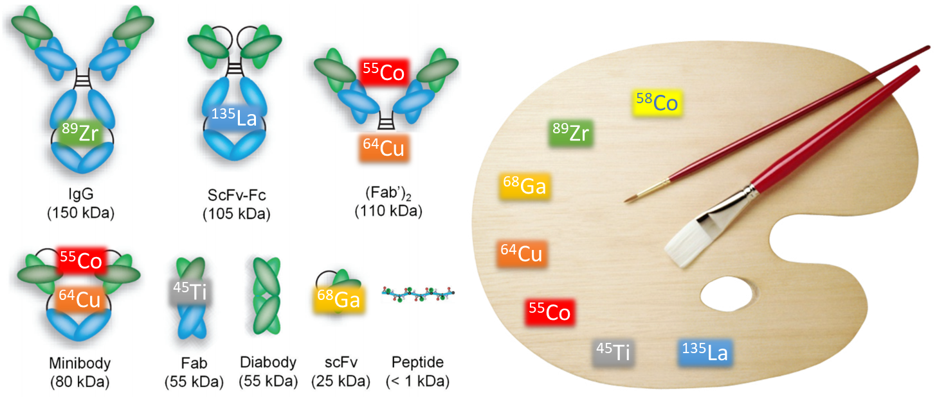
⁵⁵Co for PET: Different molecules require different radionuclides
T_{1/2} (h)
⁸⁹Zr 74
⁵⁵Co 18
⁶⁴Cu 13
^{58m}Co 9
⁶⁶Ga 9
⁴⁵Ti 3
⁶¹Cu 3
⁶⁸Ga 1
Theranostic pair with ^{58m}Co

Slide 5
Motivation for pressed Ni/Mg powder
Speeds up dissolution
(with heating: plated =0.5-1h, intact foils= hours)
Mg dissolves fast in HCl
Creates spongy Ni-matrix with increased surface area
Also:
Making mechanically stable foils from metal powder
Fast and easy to produce
“sponge effect”

Slide 6
Motivation for pressed Ni/Mg powder
Distribution coefficient of Mg is very low for AG1-X8 in strong (6-10 M) HCl (Kraus and Nelson 1958)
Thermal conductivity (W·m⁻¹·K⁻¹)
Mg= 156, Ni=98
Irradiation of Mg
13 MeV P, 4 h→ 10² Bq ²²Na (T_{1/2}=2.6 y) and short lived (sec) Al isotopes
https://www-nds.iaea.org/relnsd/isotopia/isotopia.html

Slide 7
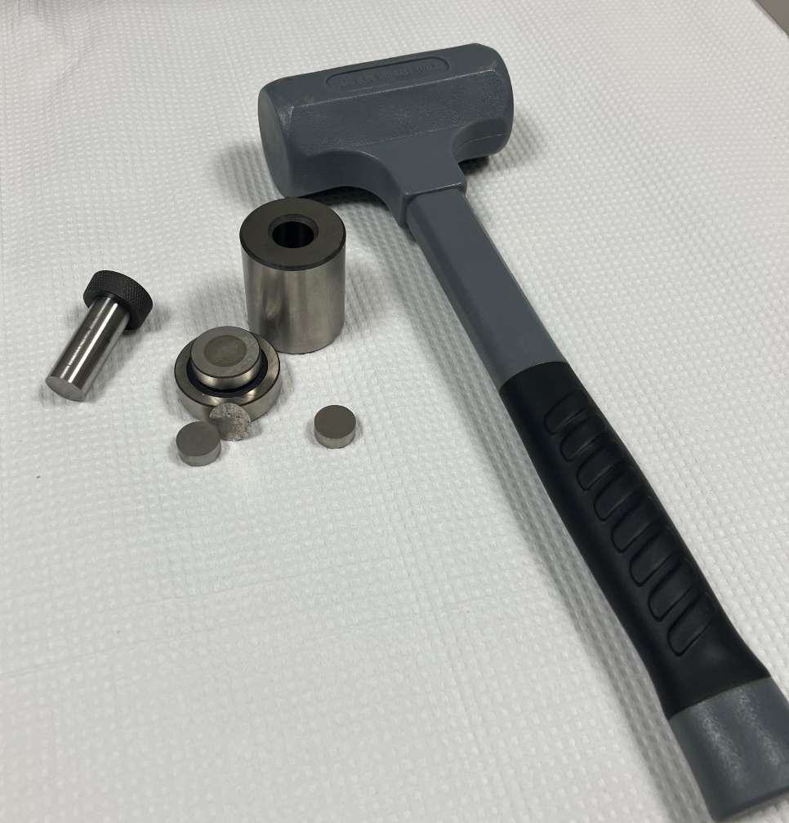
Pressing ^{nat}Ni/Mg-foils in 5 min
Ni
Mg
15 mm d
350 USD
400 USD
20 ton, 1.1 GPa

Slide 8
^{nat}Ni/Mg-foils
Thickness (mm): 0.2 0.4 0.8
Diameter = 15 mm
Thickness = 0.3 mm

Slide 9
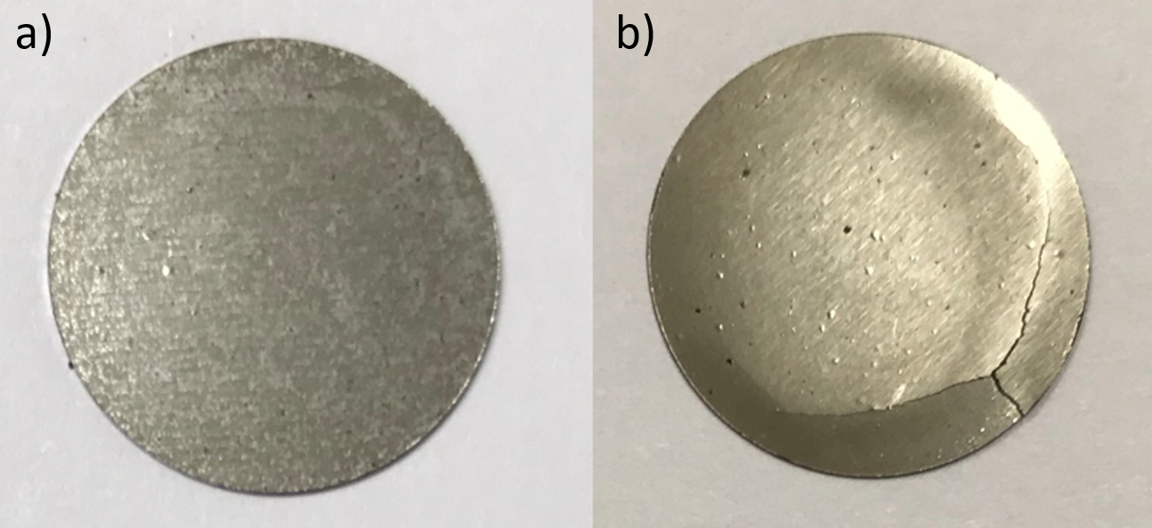
^{nat}Ni and Mg
pressed ^{nat}Ni (150 mg)-Mg (50 mg) foil
b) a ^{nat}Ni (200 mg) foil.
The 100% ^{nat}Ni foils were fragile containing cracks and were not suited for bombardment because the risk of foil fragmentation inside the solid target system.

Slide 10
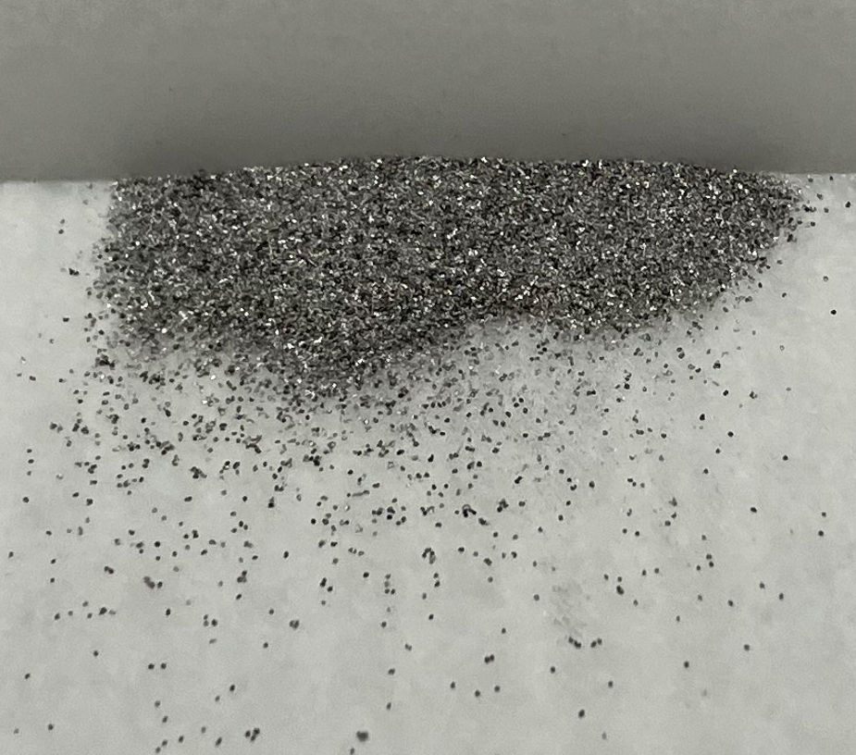
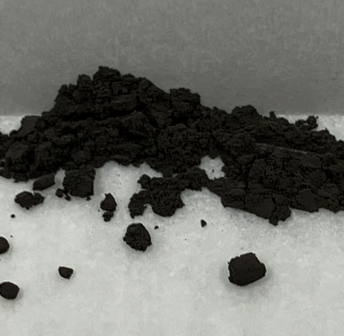
Making ⁵⁸Ni/Mg-foils (⁵⁸Ni 2000 EUR/g or 300 EUR/foil)
Mg
^{nat}Ni
⁵⁸Ni
+
or
^{<50 µm}
^{Up to 3 mm}
Mg: 50 mg
Ni: 150 mg

Slide 11
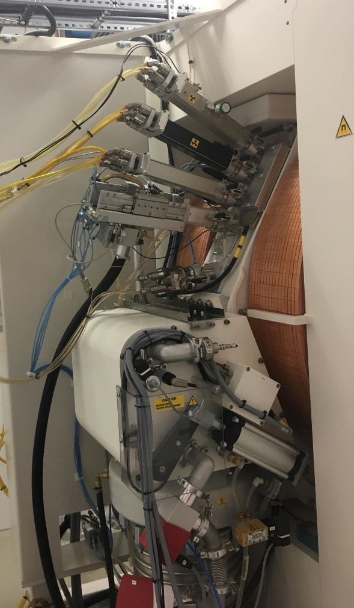
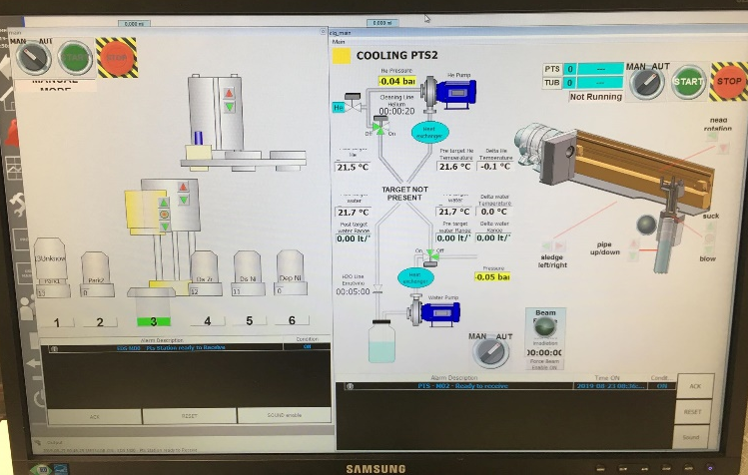
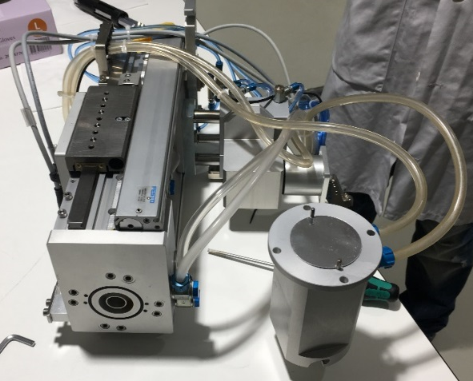
Cyclotron & Solid Target System
PETtrace, GE Healthcare
E_{p} ~16 MeV
I_{p}=130 µA
Comecer ALCEO EDS/PTS
E_{p} degraded to ~12.6 MeV
500 µm Al-foil
I_{p}= 25 µA

Slide 12
Enriched ⁵⁸Ni (Metal Powder)
Isotope | ⁵⁸Ni | ⁶⁰Ni | ⁶¹Ni | ⁶²Ni | ⁶⁴Ni
Enrichment (%) | 99.905 | 0.083 | 0.004 | 0.004 | 0.004
Chemical admixture
Element | Al | Co | Cr | Cu | Fe
Content (ppm) | < 10 | < 10 | < 10 | <10 | <10
Element | Mg | Mn | Pb | Si | Ti
Content (ppm) | <10 | 10 | <10 | <10 | <10
Element | Zn | C | S | P
Content (ppm) | <10 | 104 | <10 | 2
Threshold
⁵⁸Ni(p,2p)⁵⁷Co 8.3 MeV
⁶⁰Ni(p,α)⁵⁷Co 0.3 MeV
Notes:
58Ni only as powder

Slide 13
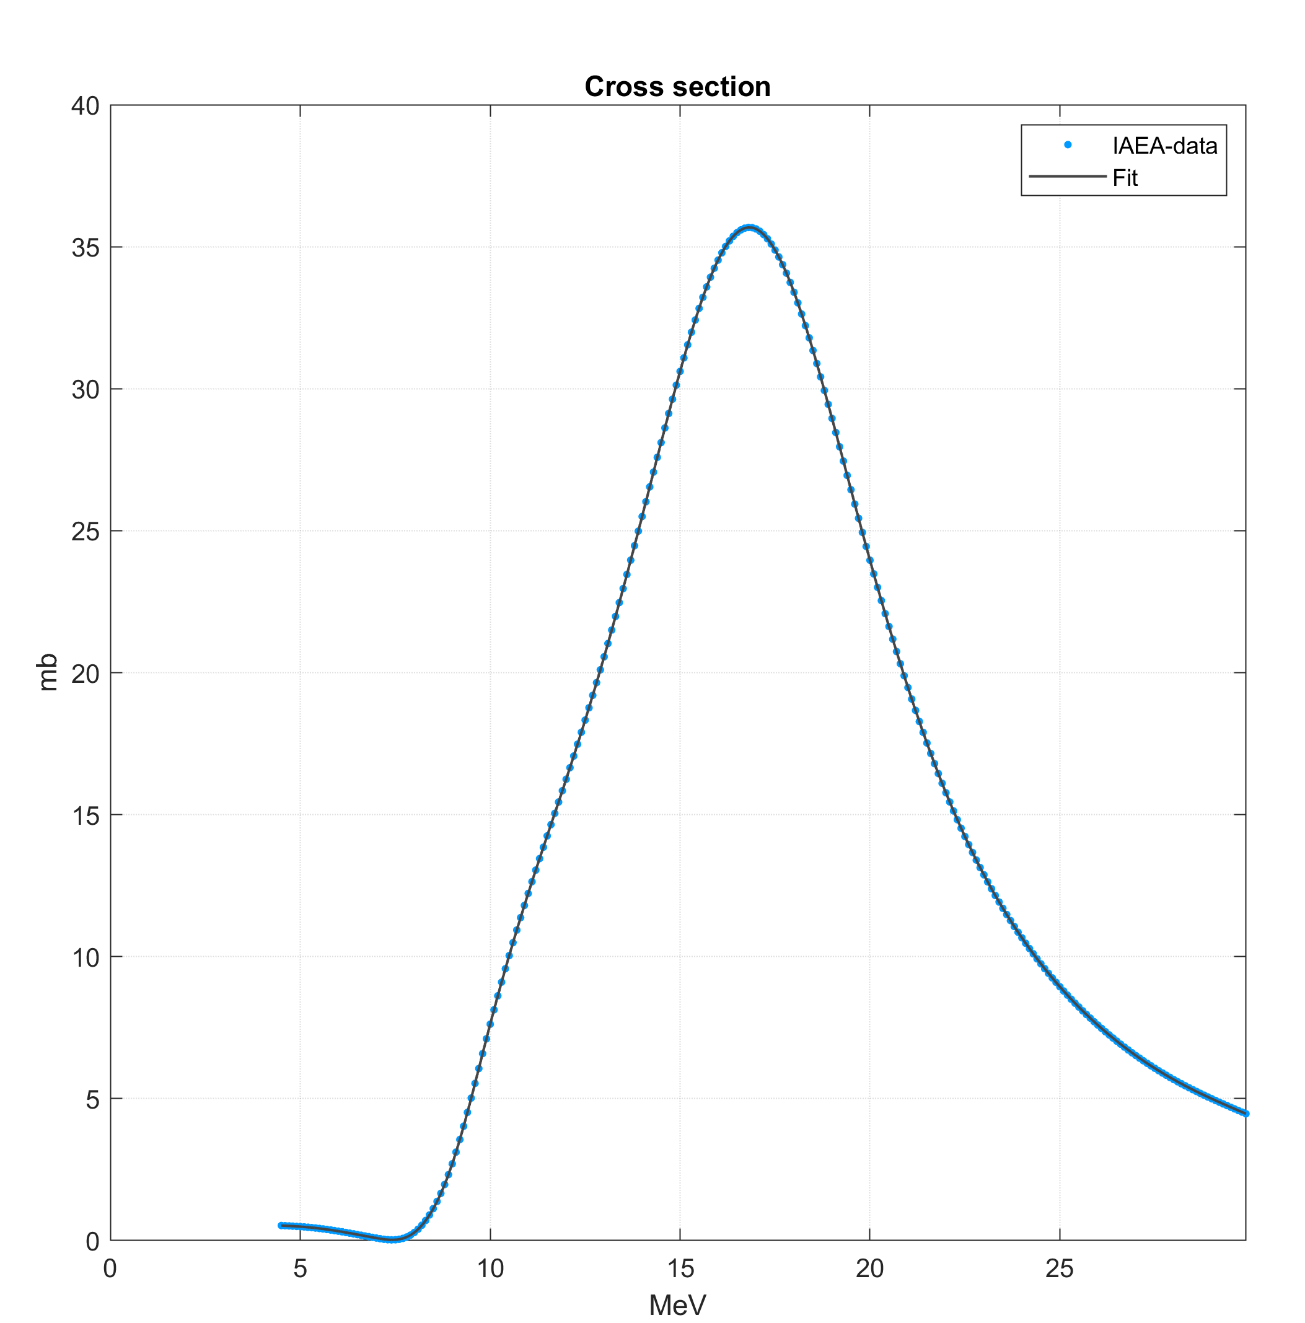
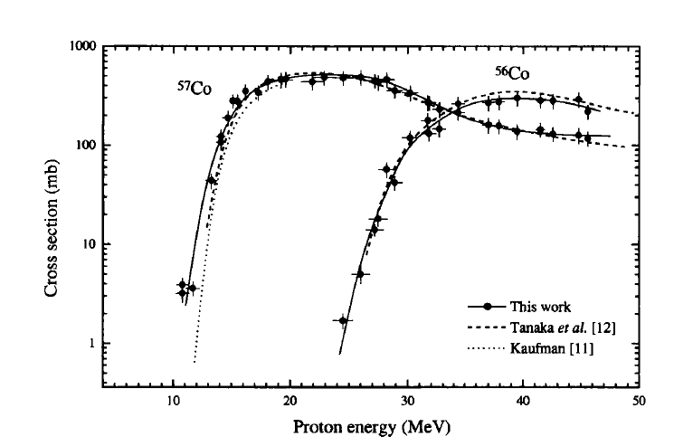
⁵⁸Ni(p,x)⁵⁷Co
⁵⁸Ni(p,α)⁵⁵Co
0.3 mm
150 mg Ni
50 mg Mg
E_{in}=12.6 MeV
E_{exit}= 6 MeV
Reimer & Qaim 1997
IAEA NDS

Slide 14
Irradiations
10, 18, 25 µA
1-180 min
Completely intact without burn marks
25 µA, 3 h

Slide 15
Dissolution in 50 ml falcon tube
4 ml 9.5 M HCl + 0.4 ml HNO₃ (70%)
4 min waiting
1 ml H₂O + 0.4 ml H₂O₂ (70%)
5 ml 9.5 M HCl
Purification
Wash: 30 ml 9.5 M HCL
Frit filter
Elution: 4 ml, 0.25 M, HEPES
AG1-X8 resin (2g)
Pre cond: 10 ml 9.5 M HCl
Elution: cobalt in HEPES
Waste:⁵⁸Ni/Mg target material
Wash waste: Remaining ⁵⁸Ni/Mg + trace metals
Notes:
We are using a higly oxidative and strong acid solution to dissolve our foils

Slide 16
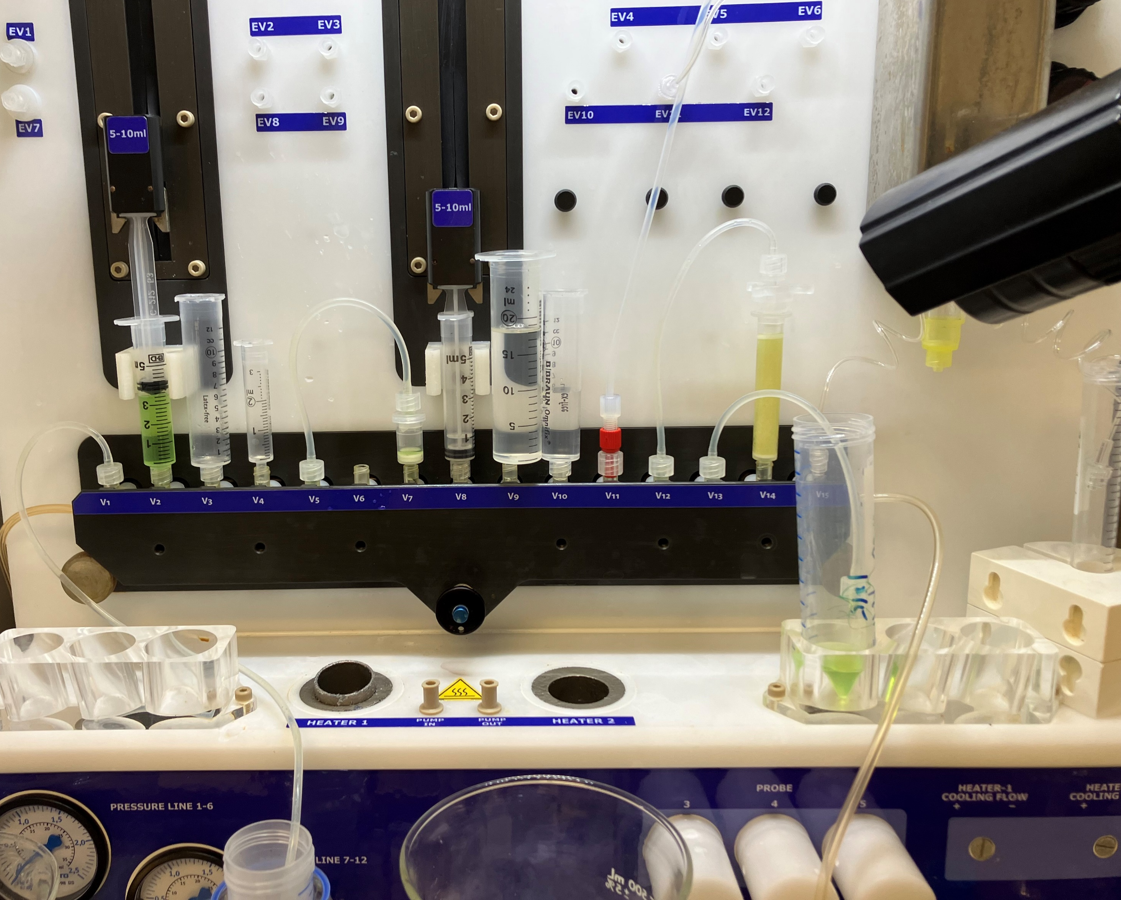
Dissolution & Purification
Automated with Comecer Taddeo PRF
Ultra pure water, chemicals and no metal needles etc.
Dissolution (without heating)=10 min
Pressed Ni > 1h
Ni-foil > many hours
Purification=20 min
Total= 35 min
Including shuttle drying=5 min

Slide 17
Production and QC
Produced activity & Half-life: Capintec Dose Calibrators
RNP: Energy & Efficiency calibrated HPGE-detector (Canberra)
2 and 17 h post EOB
Ni breakthrough assessed with semi-quantitative test strips (Quantofix)
Apparent Molar Activity (AMA): DOTA-titration in 0.25 M HEPES adjusted to pH 7.0
Notes:
using NaOH. TLC (0.5 M triethylammonium acetate in acetonitrile:H₂O 1:1, SG 60 RP-18 (F₂₅₄S) TLC-strip)

Slide 18
Results |  | comment
Produced A in foil | 340±10 MBq (EOB) | A_sat=120±5 MBq/µA
⁵⁵Co at EOP (35 min post EOB) | 240±20 MBq 60 MBq/ml HEPES | 5 min shuttle drying 10 min dissolution 20 min purification
Isolated ⁵⁵Co/Foil ⁵⁵Co (EOP) | >70 % | Un-dissolved larger grains
RCY (EOP) | 82±2 % | Y=prod/(waste+resins+prod)
Ni in eluate | 0 mg/L | Semi-quantitative Strips
AMA at EOB | 1.8±0.2 GBq/µmol DOTA | (3.6 GBq/µmol x 50 %)
RNP (EOB) | 99.98±0.014 % | 2h & 17 h post EOB Contaminant is ⁵⁷Co
T_{1/2} | 17.48 h | 17.53 h (Nudat3)
pH | ≤1

Slide 19
Conclusions
Easy to make mechanically stable foils from commercially available ⁵⁸Ni-powder
Mixed Ni/Mg foils dissolves rapidly due to “Sponge effect” at room temperature
Foils looked completely intact after long irradiations with 25 µA
Should tolerate more beam, 50, 100, 150 µA?
Mg does not seem to disturb purification and chelation chemistry for a “standard” Ag1-X8 resin

Slide 20
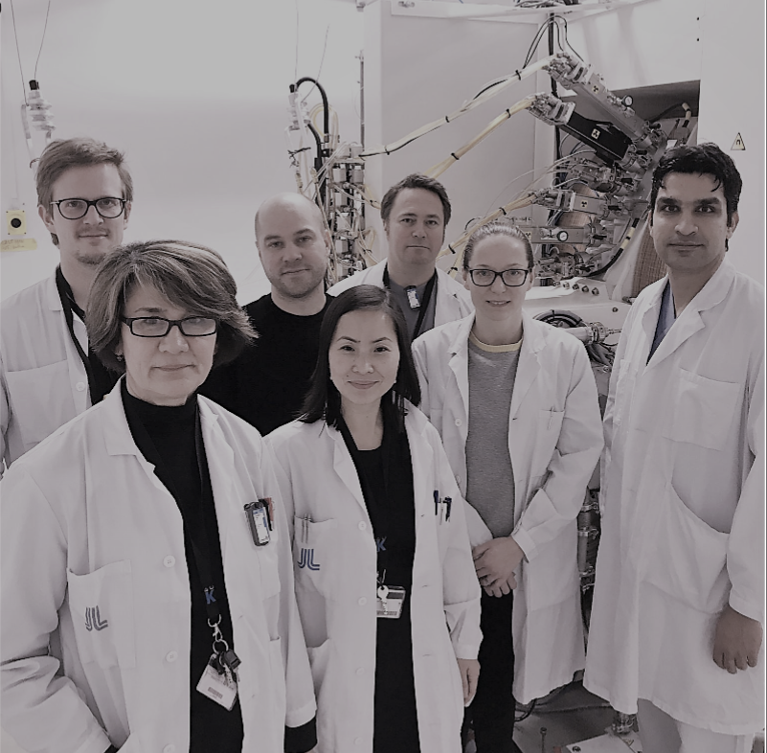
Acknowledgements to research team Thuy Tran
Thuy Tran, Associate professor, Team leader
Emma Jussing, PhD, Researcher
Stefan Milton, PhD, Researcher
Mohammad Moein, PhD, Researcher
Erik Samén, PhD, Researcher
Melodie Ferrat, PhD, Post doc
Ida Friberger, PhD student
+ more students starting..

