Slide 1
Characterizing the Thermal Performance of Isotope Production Targets
Jonathan Morrell, Jason Cooley, Ellen M. O’Brien, Christiaan (Etienne) Vermeulen
18th Workshop on Targetry and Target Chemistry
Whistler, BC
Aug 24, 2022
LA-UR-22-28730

Slide 2
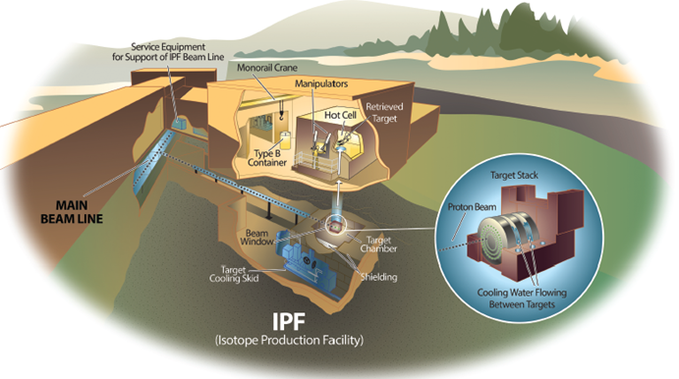
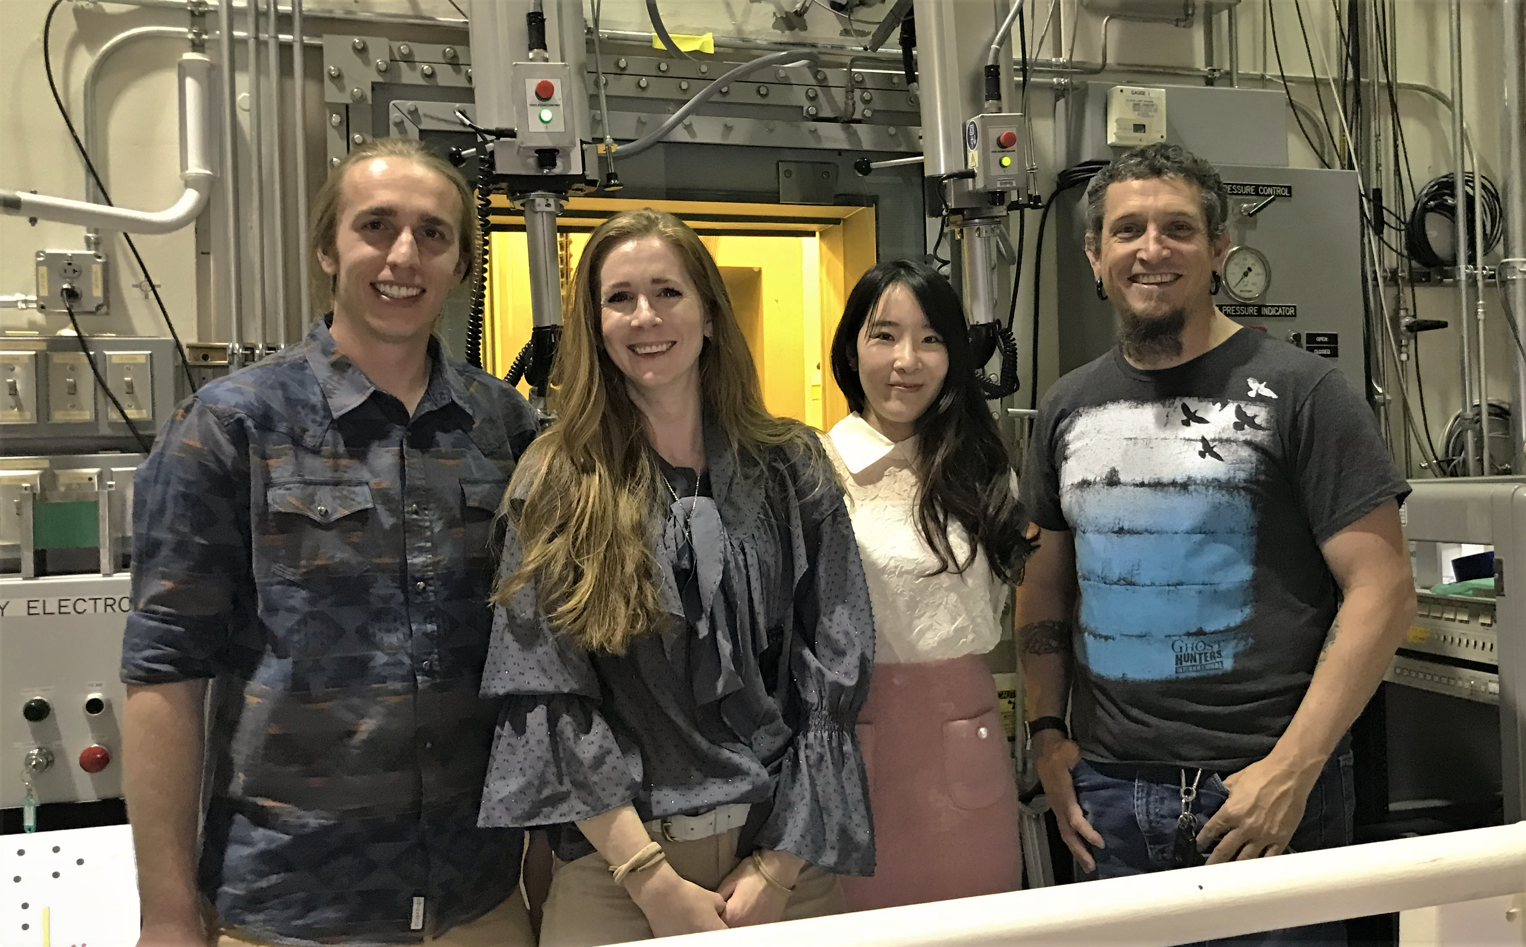
Overview
Los Alamos Isotope Production Facility (IPF)
100 MeV H⁺, ~250 μA
Part of the DOE Isotope Program
Tri-lab collaboration between LANL, BNL and ORNL produces ²²⁵Ac from Th targets
Emphasis on thermal characterization:
Enable higher current irradiation
Improve confidence in safety margins
Thermal characterization of targets prior to irradiation could mitigate target failures
Science Staff - Isotope Team at LANL IPF
Me, E. O’Brien, J.H. Seong, E. Vermeulen

Slide 3
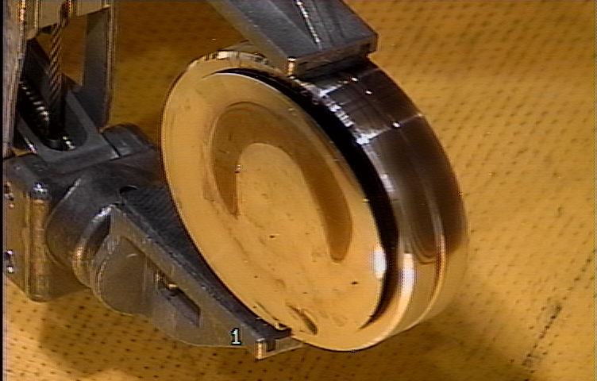
Thermal Considerations in Isotope Production Targetry
Target failure mechanisms are complex
Need to understand:
How much heat is deposited in target?
Measure the proton energy distribution through the stack
Impacted by thermal related changes to dimensions/densities
How well is heat conducted out of the target?
Major uncertainty: contact conductance between “target” and encapsulation
Measurement prior to irradiation could prevent failure (QA tool)
Boiling heat transfer – see Jee Hyun Seong’s talk later today
Credit: Eric Olivas

Slide 4
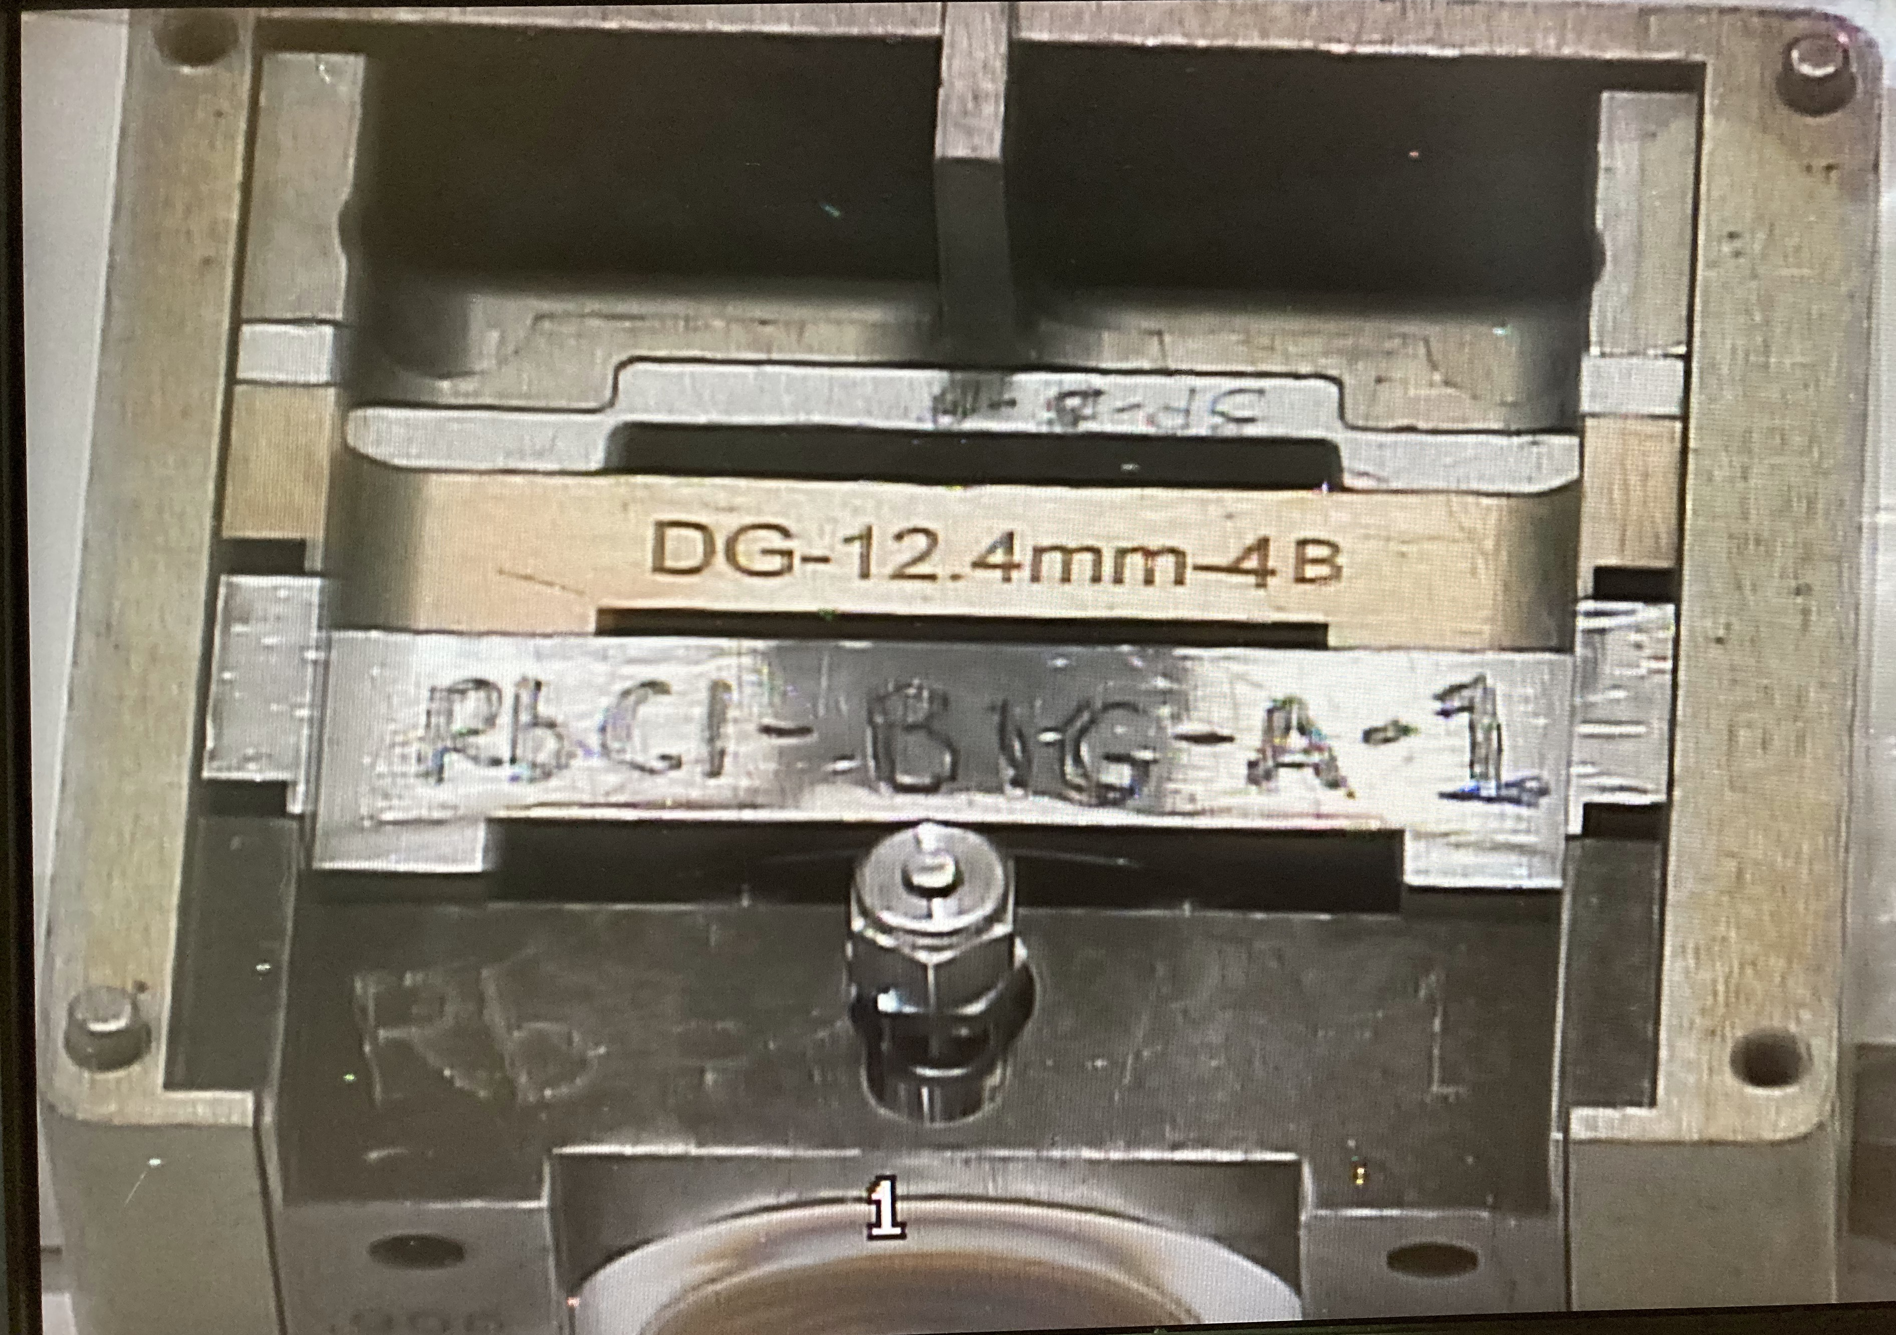
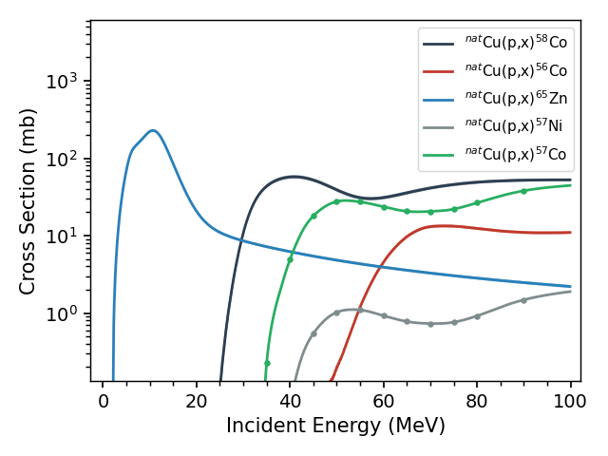
Proton Beam Energy Measurement
Co-irradiation of thin monitor foils within a production stack
Measure at production-level (250 μA) current, for a short time
Measurement at high, medium, low energy (“ABC”) slots - 95, 65 and 30 MeV
Monitor foils are sensitive to proton energy as well as beam current
Sensitivity is greatest where production cross section is highly-varying
E.g. observing ⁵⁸Co without ⁵⁷Co indicates 25 < E_{p} < 35 MeV
Combining many reaction channels gives up to 0.1 MeV precision

Slide 5
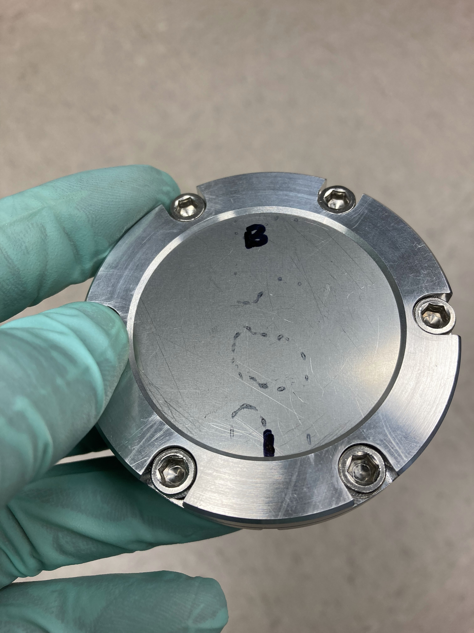
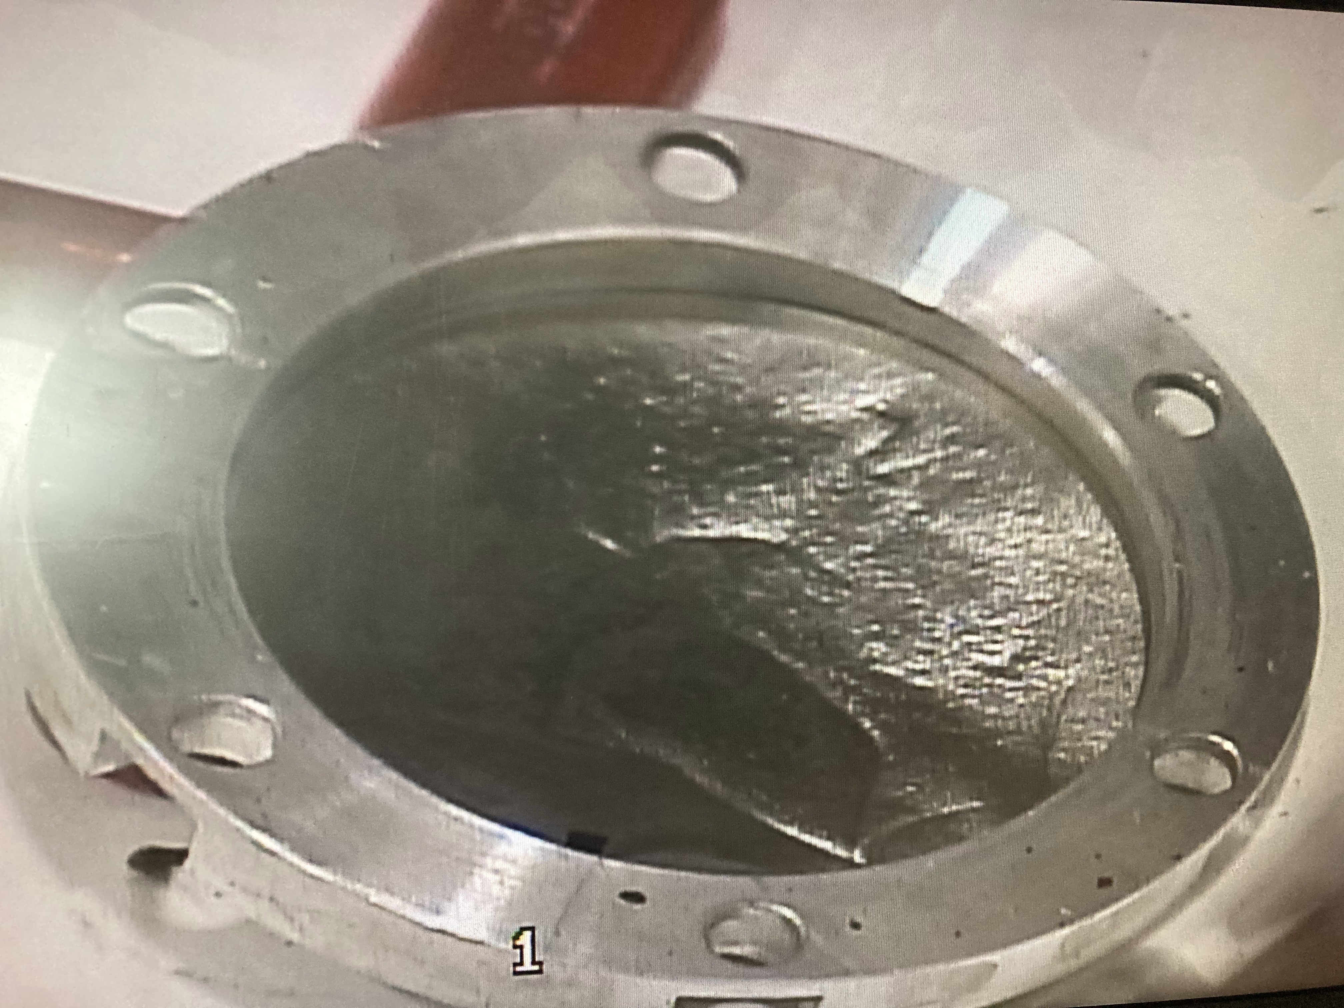
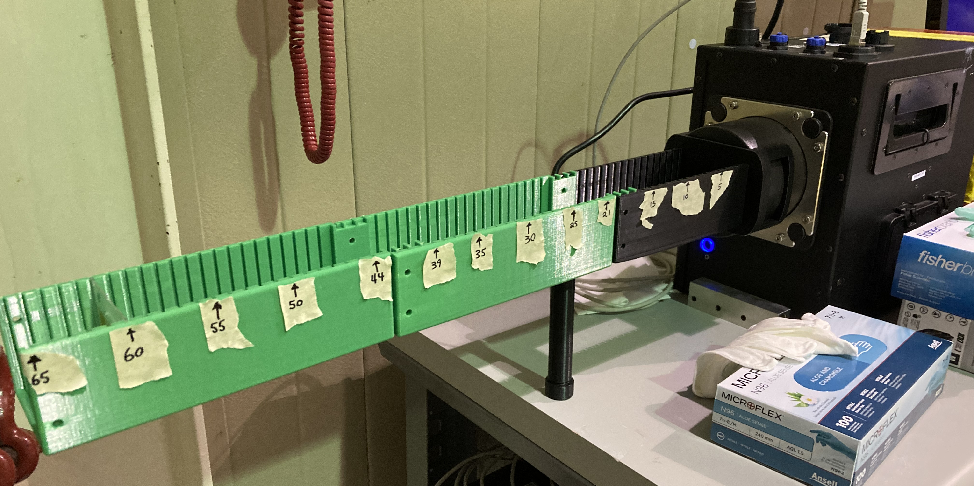
Experimental Methods
Irradiate 3 “bolt-together” targets at 250 μA:
Cu/Ni/Al
Rb + Cu/Ni/Al
Rb + Rb + Cu/Ni/Al
HPGe γ-ray assay 1 mo. post-EoB
4.7 cm rastered beam necessitates counting far from detector
Future: collimated counting of individual raster-pattern rings
Quantify production rates of all activation products
Use IAEA evaluated monitor reactions to extract beam current, energies

Slide 6
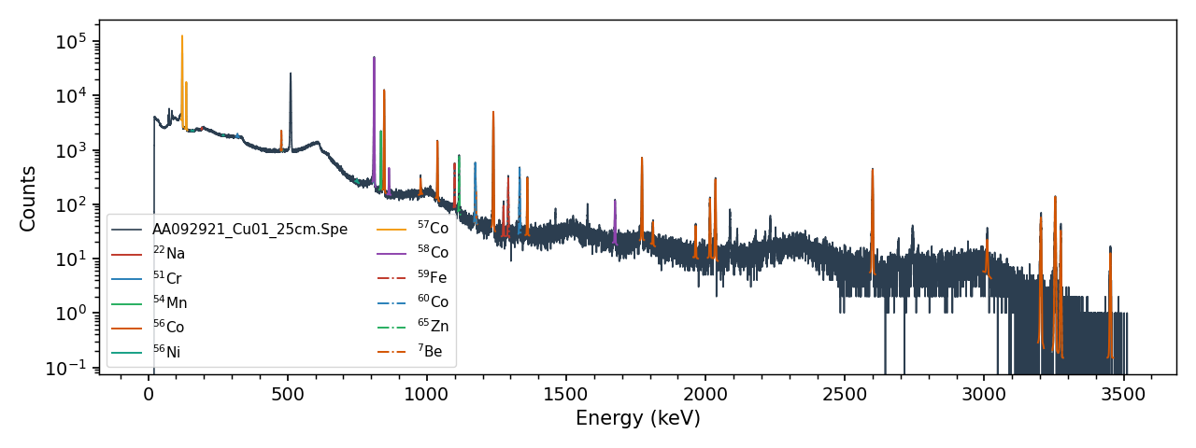
Activation Analysis
https://jtmorrell.github.io/curie/
Activation analysis performed using curie python library
Peak fitting, production/decay correction, stack energy-loss calculation and cross section libraries
Extract measured activities, production rates from each foil
Convert to beam current (on per-reaction channel basis)
Adjust stack composition to match data (minimize variance)

Slide 7
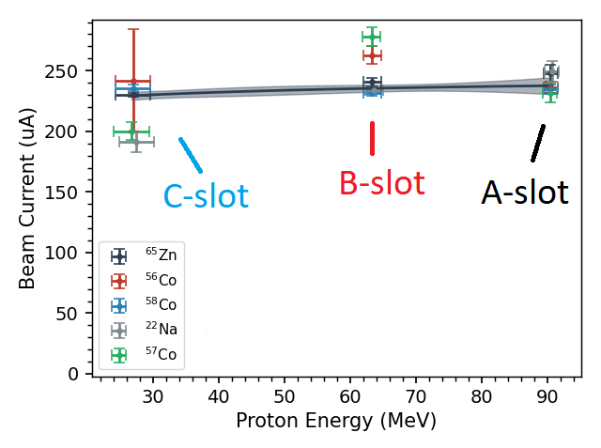
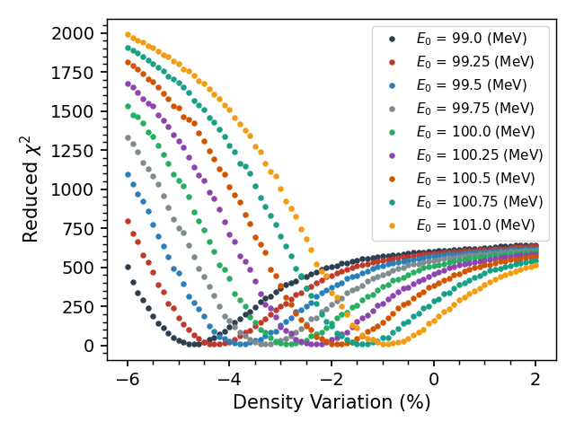
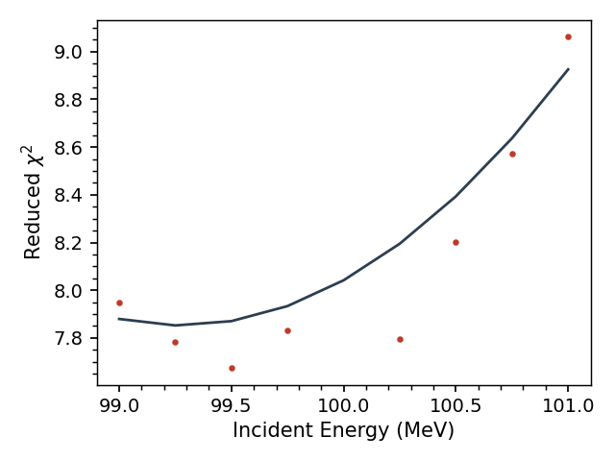
Measured 1-D Energy Profile
Minimize variance of beam currents extracted from activation measurement
Tuning parameters:
Beam window deflection
Expect some deformation due to loading from water pressure, and beam heat
Rb metal target density
Expect to decrease as temperature increases
Optimize together:
If window deflection (incident energy) incorrect, B-slot Rb density also incorrect

Slide 8
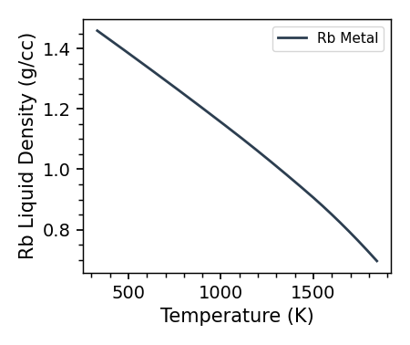
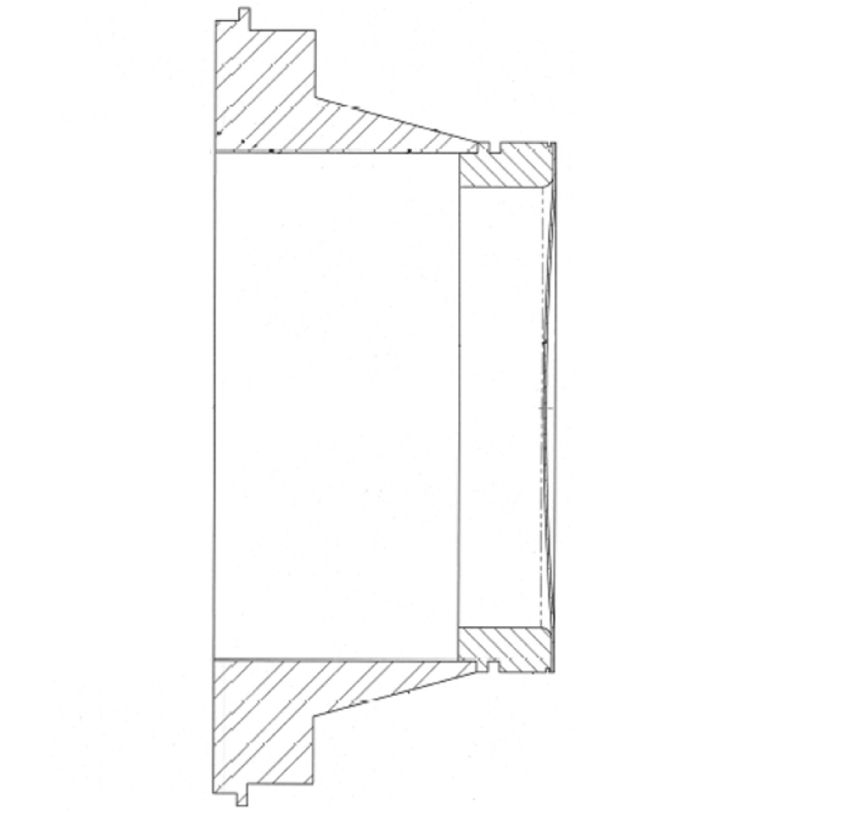
Implications for Thermal Characterization
Rb density measurement can be used to extract average temperature in beam-strike area
Beam window deflection greatly impacts downstream energy loss (heat deposition)
First water-channel thickness also impacts flow-rate
Can be used to validate simulations
Other key components:
Boiling heat transfer (see Jee’s talk!)
Thermal contact conductance between target and encapsulation
Credit: Eric Olivas

Slide 9
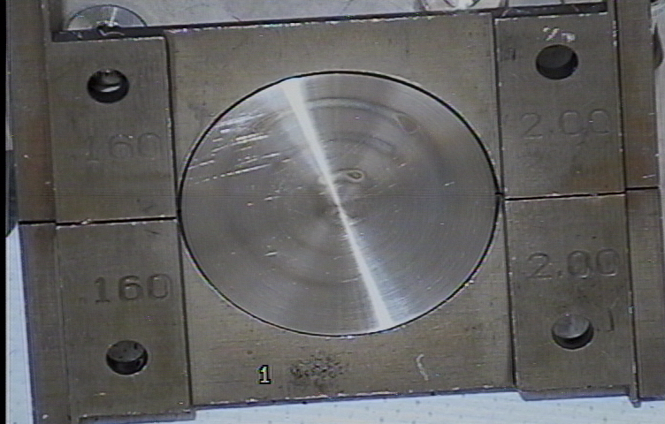
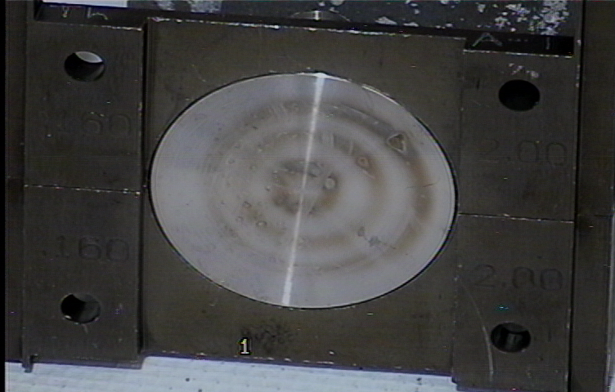
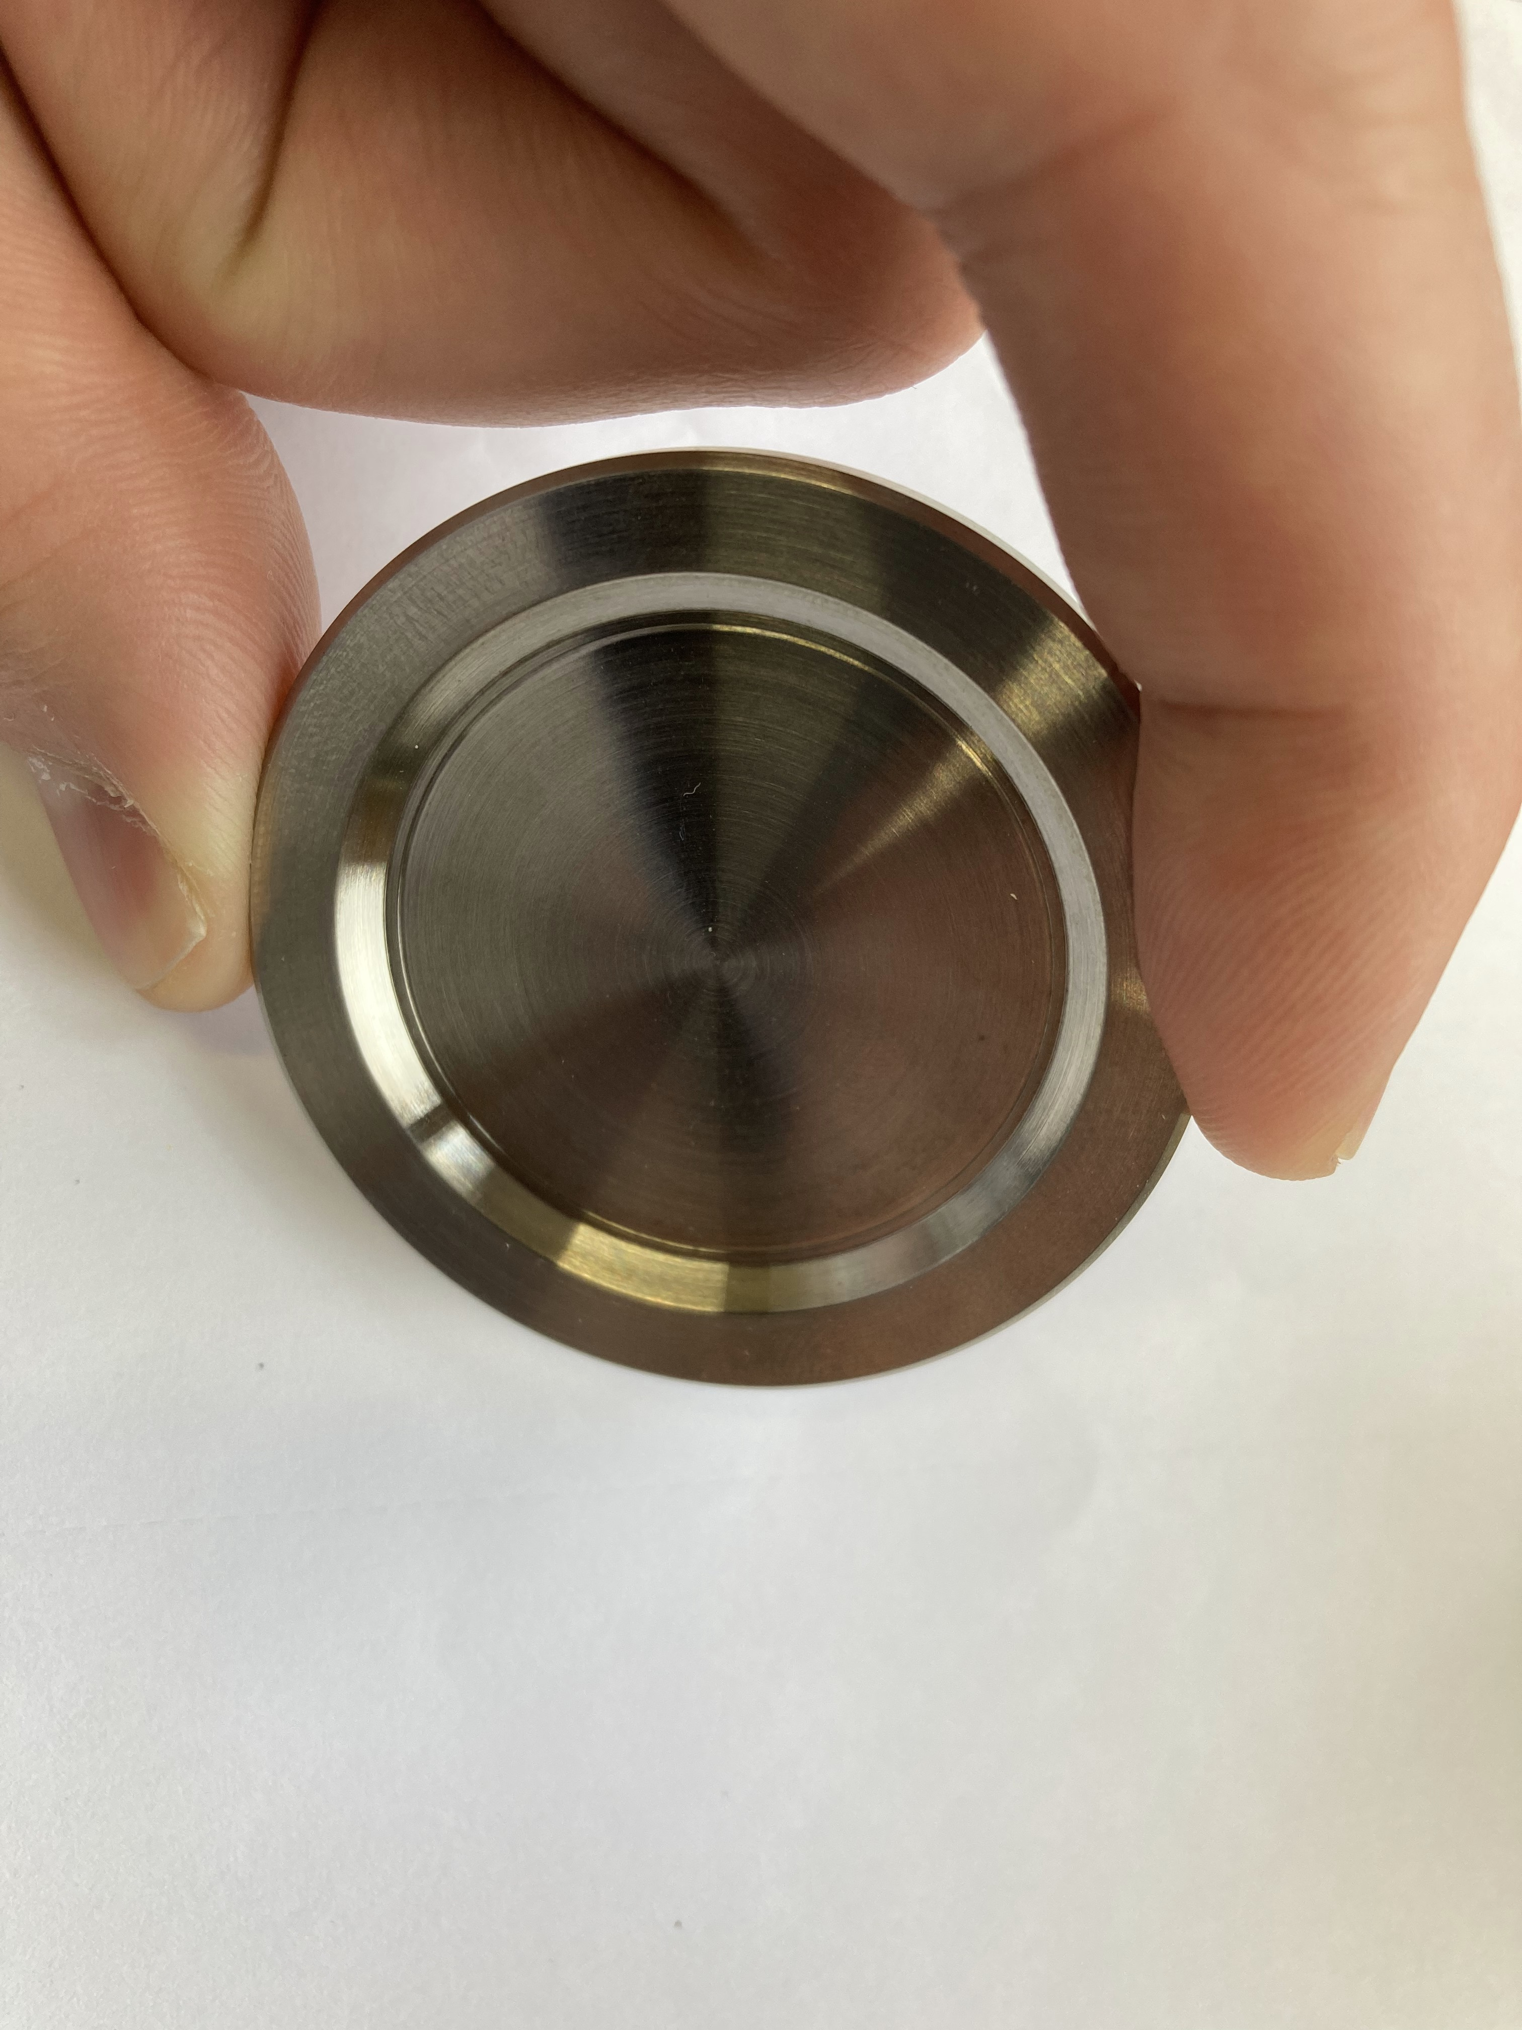
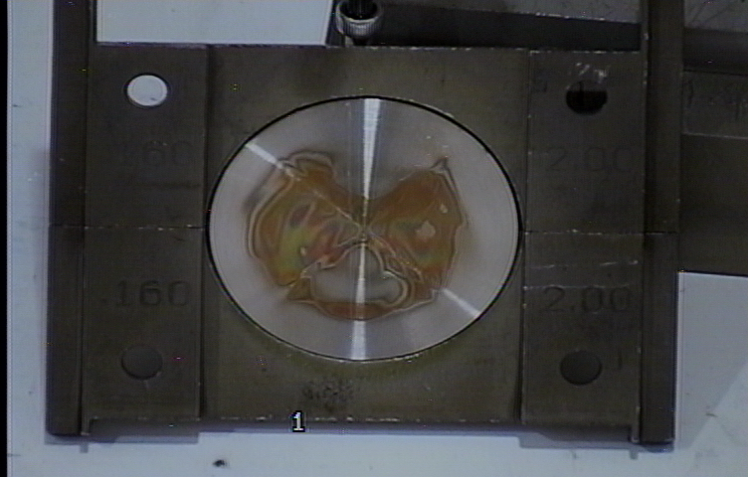
Need for Contact Conductance Measurements
Targets manufactured in the same way do not always show repeatable behavior under irradiation
Contact conductance is affected by:
Surface roughness and hardness
Contact area
Fill-gas
Surface treatment (coatings, etc.)
Measurements of contact conductance can inform target manufacturing methods

Slide 10
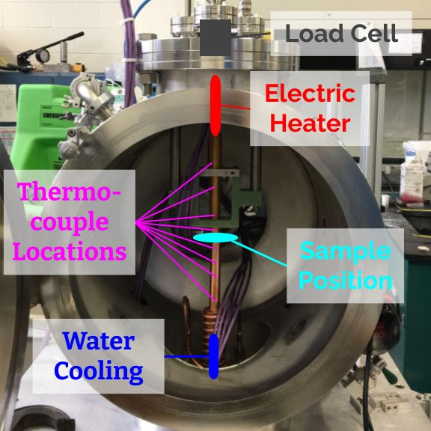
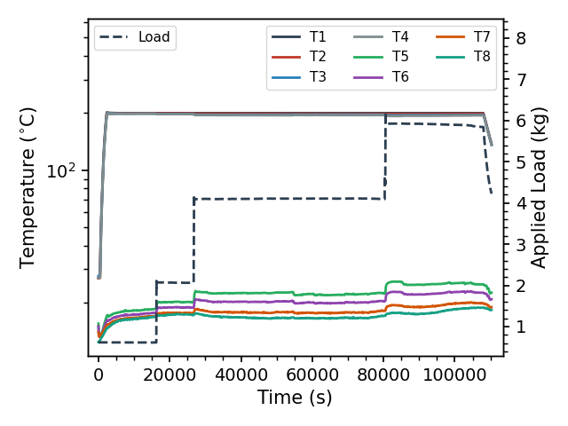
How to Measure Contact Conductance
Sample placed in custom “gadget”, with PID controlled heater (top) and water cooling (bottom). A load is applied, and varied over time
Thermocouples measure $∆T$ over target, and input heat $Q$, to calculate total thermal resistance $R_{θ}$
Process repeated for multiple loads (pressures) and temperatures

Slide 11
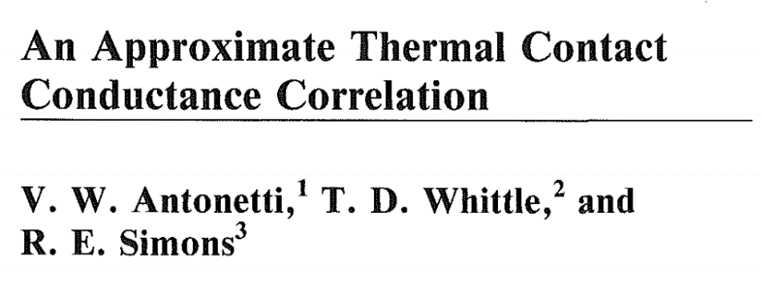
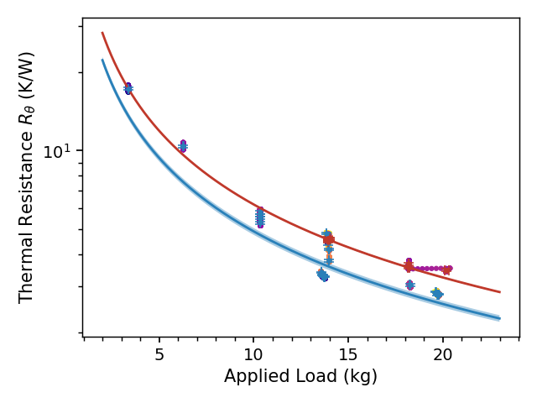
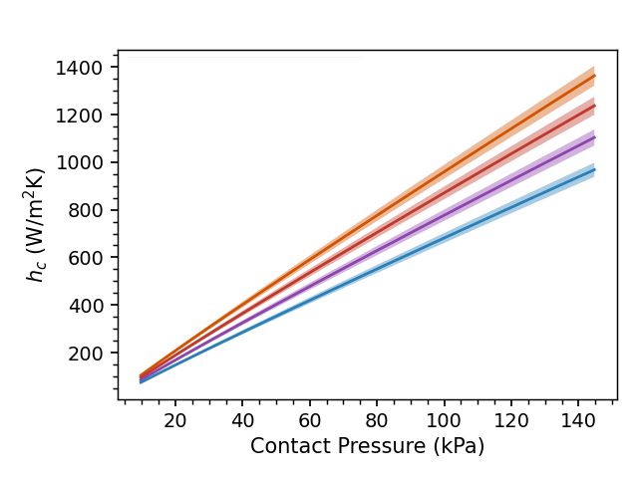
Data Processing
Measure 𝑅_{𝜃} for various temperatures and pressures
Use hardness H and roughness R_{a} as fit parameters to determine gap conductance ℎ_{𝑐}
Use correlation (with fit parameters) to extrapolate to IPF operating conditions
Histogram $h_{c}$ at operating pressure

Slide 12
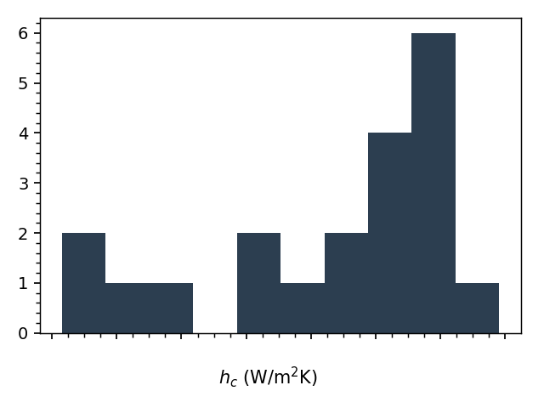
Results: Using TCC as a QA Tool
Histogram of $h_{c}$ at operating conditions shows clear “good vs bad” target distinction
Set threshold below which targets should not be irradiated
Can also be used to compare target manufacturing methods

Slide 13
Conclusions
Improving characterization of target thermal performance:
Enables higher current irradiation
Improves confidence in safety margins
Can potentially mitigate target failures by rejecting “bad” targets
Ultimately leads to higher yields, better repeatability, and enhanced safety
Credit: Andrew Burgoyne (ORNL)

Slide 14
Acknowledgements
Joseph Archuleta
Kirti Bhardwaj
Marshall Bullock
Ross Capon
Tomas Cavero
Jason Cooley
Lisa Cummins
Ida DiMucci (PD)
Guy Dutech
Michael Fassbender
Chris Henning
Kevin John
Anthony Kedge
Jan Klouda (PD)
Anthony Koppi
Nate Kollarik
Stosh Kozimor
Carl Iverson
Christopher Martinez
Artem Matyskin (PD)
Veronika Mocko
Jonathan Morrell (PD)
Ellen O’Brien
Beverly Ortiz
Jeffrey Pietryga
Kirk Rector
Nicole Romero
Jee Hyun Seong (PD)
Etienne Vermeulen
Heath Watkins
Many Isotope Alumni
SIGMA targetry, AOT teams… and many others!
This research is supported by the U.S. Department of Energy Isotope Program, managed by the Office of Science for Isotope R&D and Production.

