Slide 1
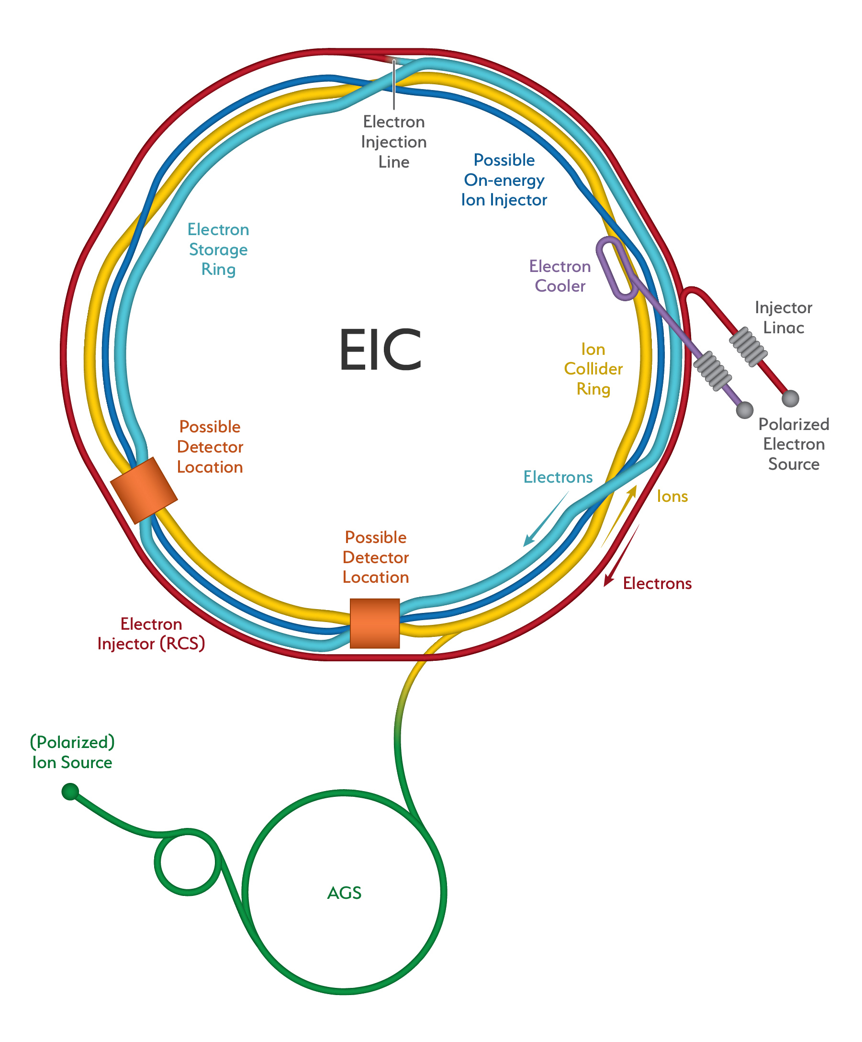
Welcome from the EIC Workshop Co-Chair
Oliver Kester
Associate Laboratory Director – Accelerators
TRIUMF, Canada

Slide 2
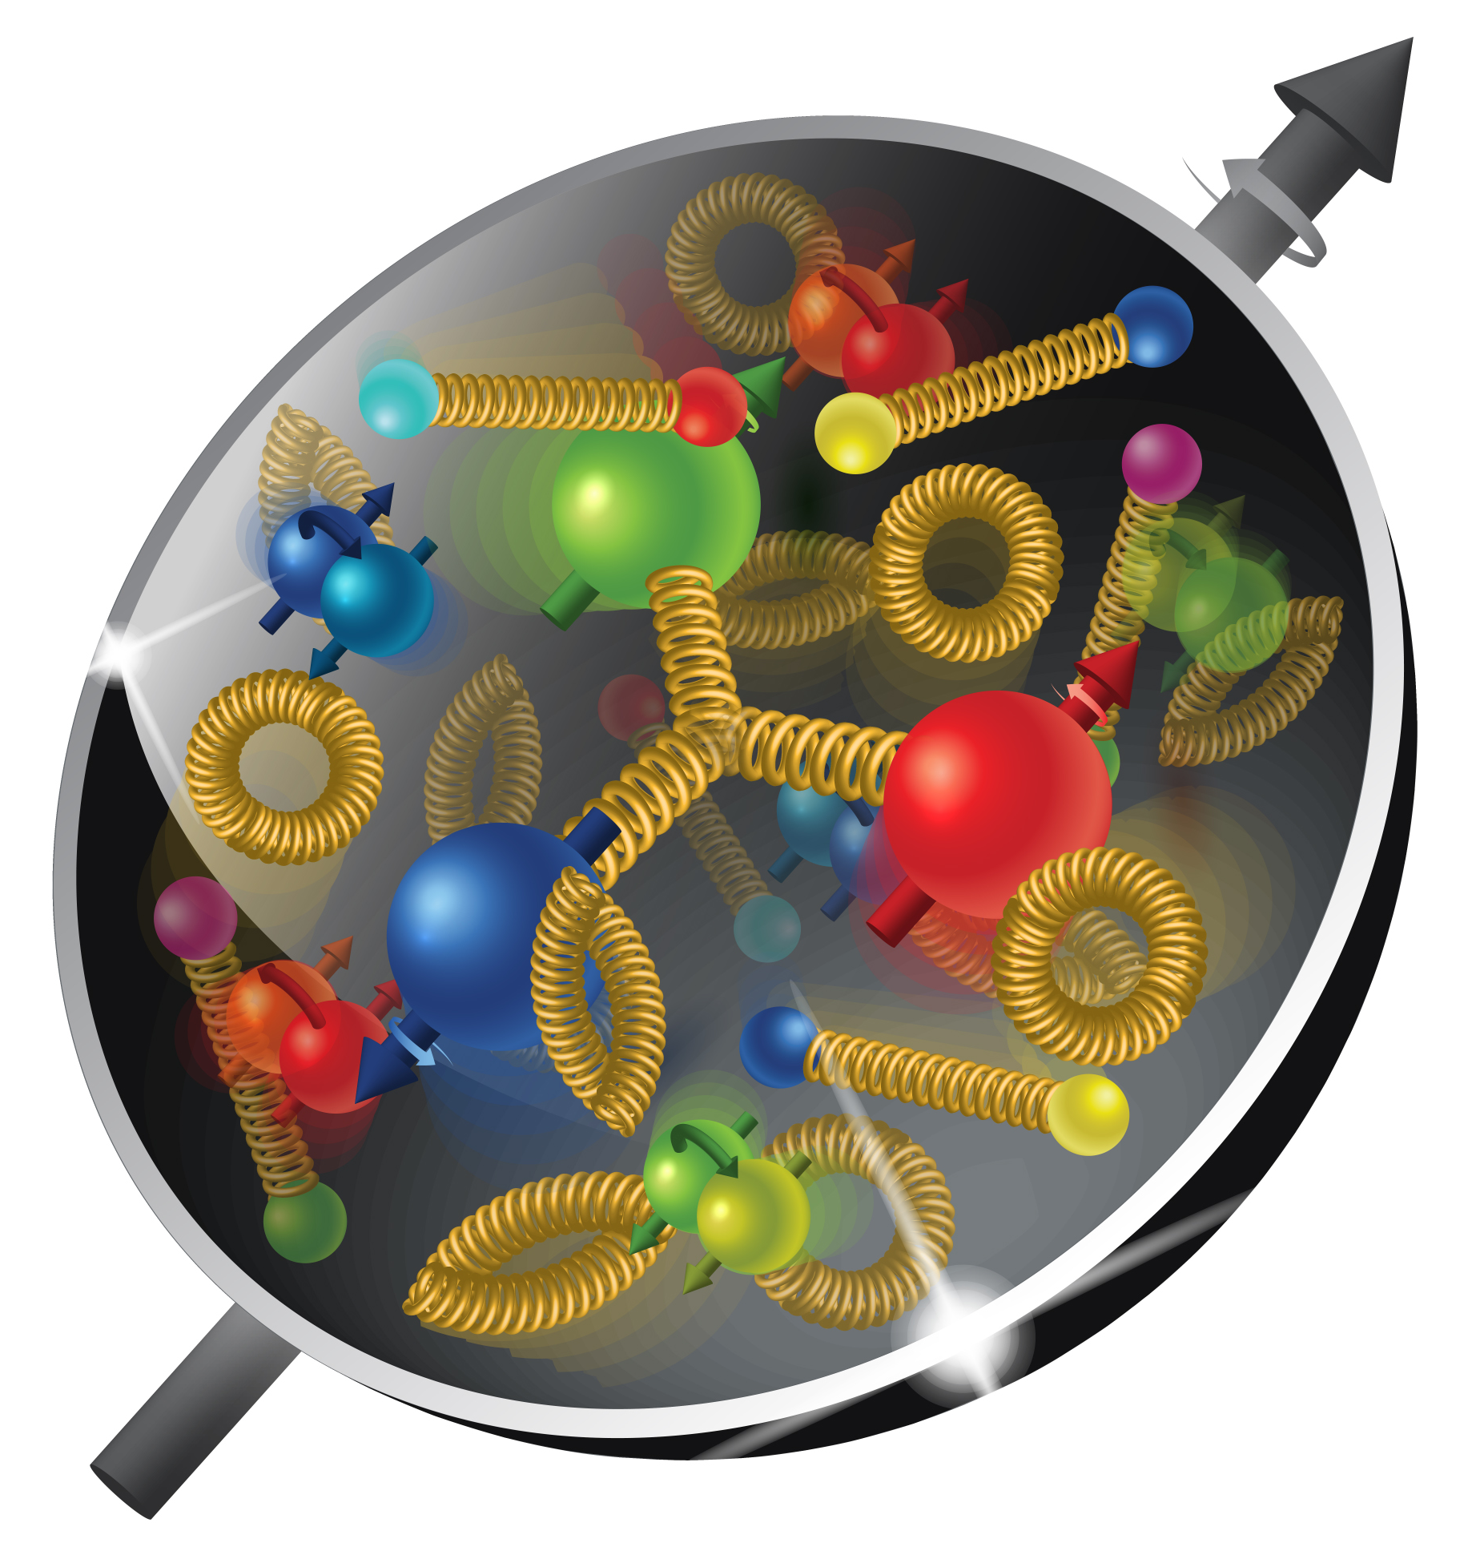
TRIUMF 2021 EIC Accelerator Partnership Workshop
The EIC Accelerator Partnership Workshop 2021 – Promoting Collaboration on the Electron-Ion Collider – is the second workshop of this kind, this year hosted by TRIUMF, Canada.
With the EIC project having received the CD1 approval in June 2021, and with the project moving towards CD2, the EIC project team is aiming to advance the progress on defining the areas of collaboration and possible contribution from potential partners well before CD2.
Unlike the 2020 workshop which included broad overview of EIC and related accelerator technology topics, this Accelerator Partnership Workshop will focus primarily on the areas where there are advanced technical discussions between the EIC Project and potential partners regarding collaboration and technical scope of work.

Slide 3
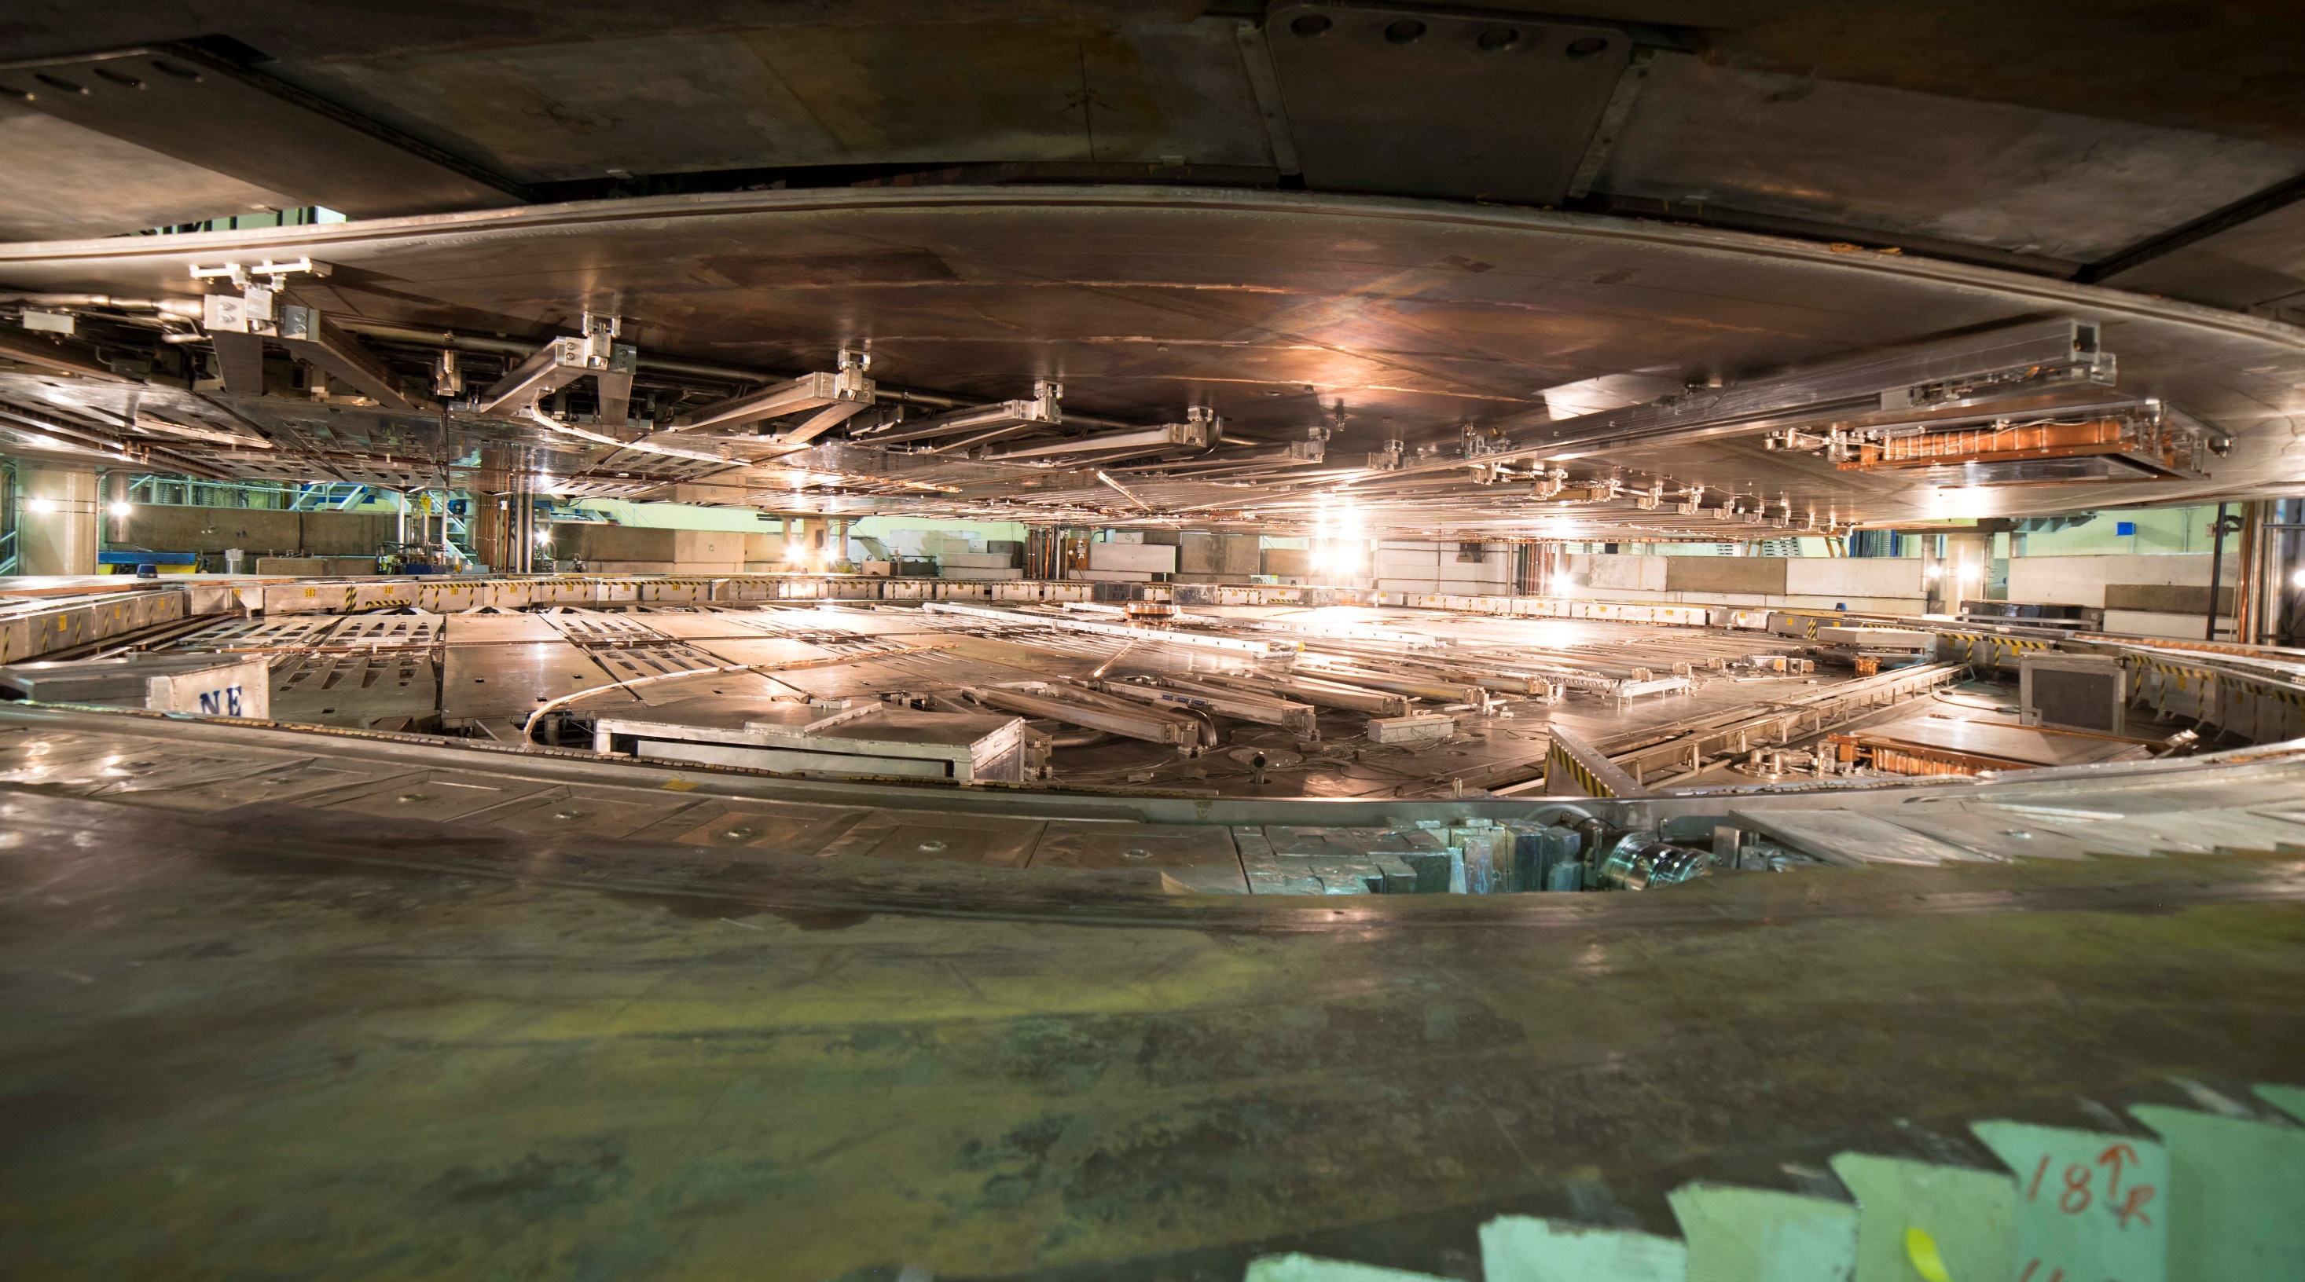
TRIUMF has five decades of experience in building a rich particle accelerator infrastructure that enables cutting-edge research while growing accelerator expertise.
TRIUMF is Canada’s particle accelerator centre.

Slide 4
2021 EIC Accelerator Partnership Workshop organization
The workshop has over 227 registered participants who will discuss
Crab Cavities
IR SC magnets and spin rotators
Second IR based on Nb₃Sn option
HSR and ESR vacuum system
ESR high current elements
ESR SRF and CM
Lessons from SuperKEKB
Machine Detector Interface (MDI), First and Second IR
in the next 2.5 days
Organizing Committee
Oliver Kester (TRIUMF, Canada) Co-Chair – LOC
Andrei Seryi (JLab, USA) Co-Chair – LOC
Bob Laxdal (TRIUMF, Canada) – LOC
Silke Bergelt-Bruckner (TRIUMF, Canada) – LOC
Ferdinand Willeke (BNL, USA) – LOC
Graeme Burt (Cockcroft Institute, UK)
Peter Williams (Cockcroft Institute, UK)
Pierre Vedrine (CEA Saclay, France)
Walid Kaabi (IJCLab, France)
Roberto Cimino (INFN, Italy)
Roberto Losito (CERN, Switzerland)
Makoto Tobiyama (KEK, Japan)
In Soo Ko (PAL, S. Korea)
Bernd Surrow (EIC UG)

Slide 5
Workshop reminder
ZOOM engagement:
When you connect to the meeting and if you are not speaking, please be muted
If you have a question, you can either write it in the “Chat” window or use the “Raise Hand” function under “Reactions”
Speakers are asked to stay in their allotted time, which includes time for questions. Discussion and questions are an important part of a workshop.
Conveners need to keep time of the talks and sessions. All sessions are sequential and delayed sessions have impact on all sessions until we have a long break. We have NOT scheduled coffee breaks between sessions (nor can we provide coffee, sorry for that).

Slide 6
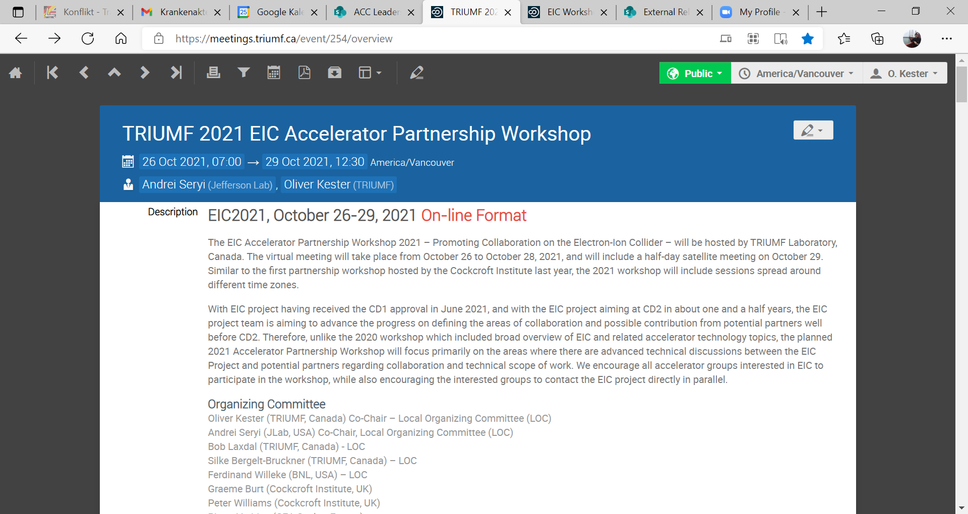
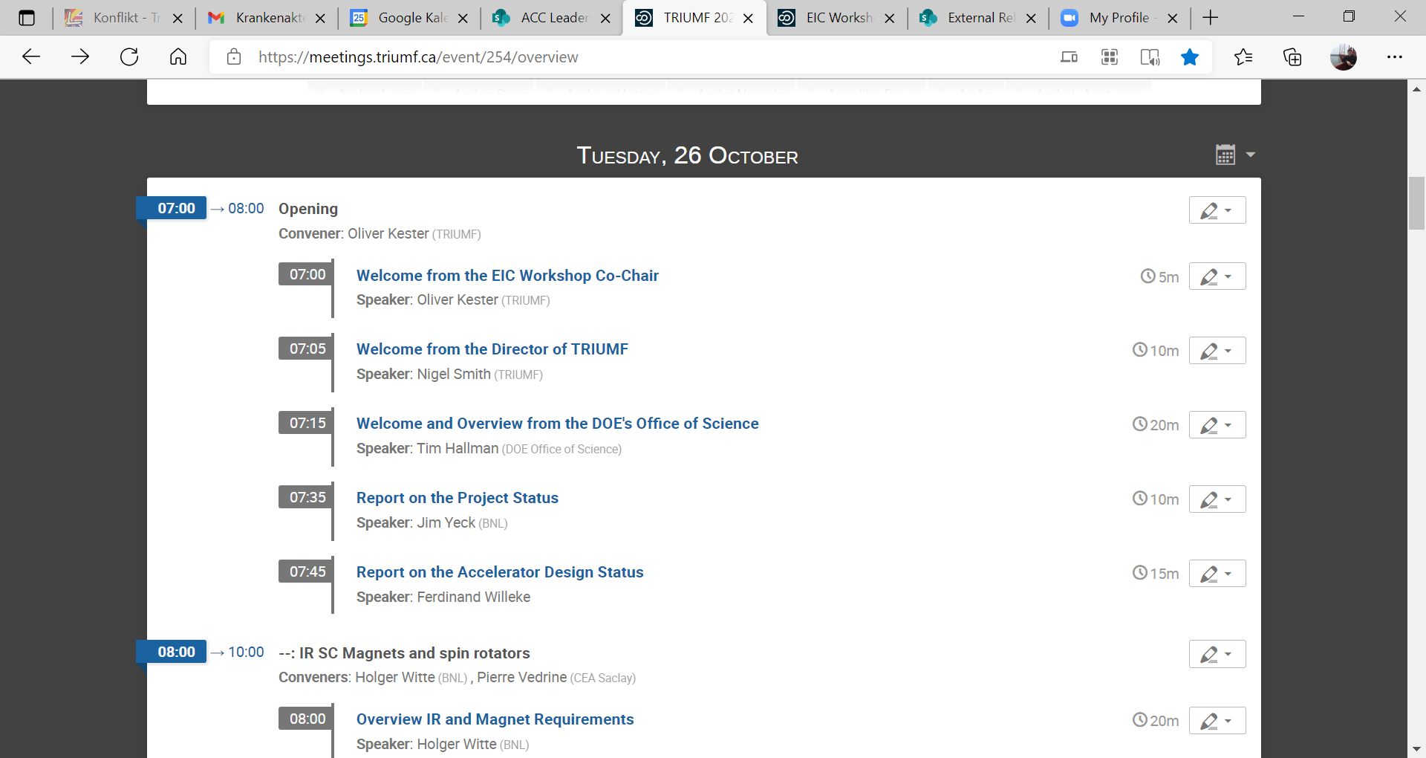
2021 EIC Accelerator Partnership Workshop program
https://meetings.triumf.ca/event/254/
Presenters, please post your talks on the Indico site in advance of your presentation

Slide 7
Thank you! Merci!
And welcome again to the
TRIUMF 2021 EIC Accelerator Partnership Workshop

