Slide 1
EIC Crab System Technical Overview
Binping Xiao
Oct 27 2021

Slide 2
Crab cavity system overview - Outline
Reasons to have crab cavity system
Locations, frequencies, voltages, geometric constraints, number of cavities/cryomodules.
ESR/HSR impedance budget
RF control
Other specifications
Summary

Slide 3
Reasons to have crab cavity system
Collisions with a 25 mrad crossing angle reduce the overlap region of the colliding bunches so that:
  Parasitic crossing without separator magnets can be avoided.
  Synchrotron radiation in the detector region can be avoided.
Without crab cavity system:
  The transverse beam-beam forces depend strongly on the longitudinal position of individual particles.
  These forces generate strong synchro-betatron coupling and strong resonances.
  Beam lifetime and stability will be affected.
  Luminosity will be reduced by an order of magnitude.

Slide 4
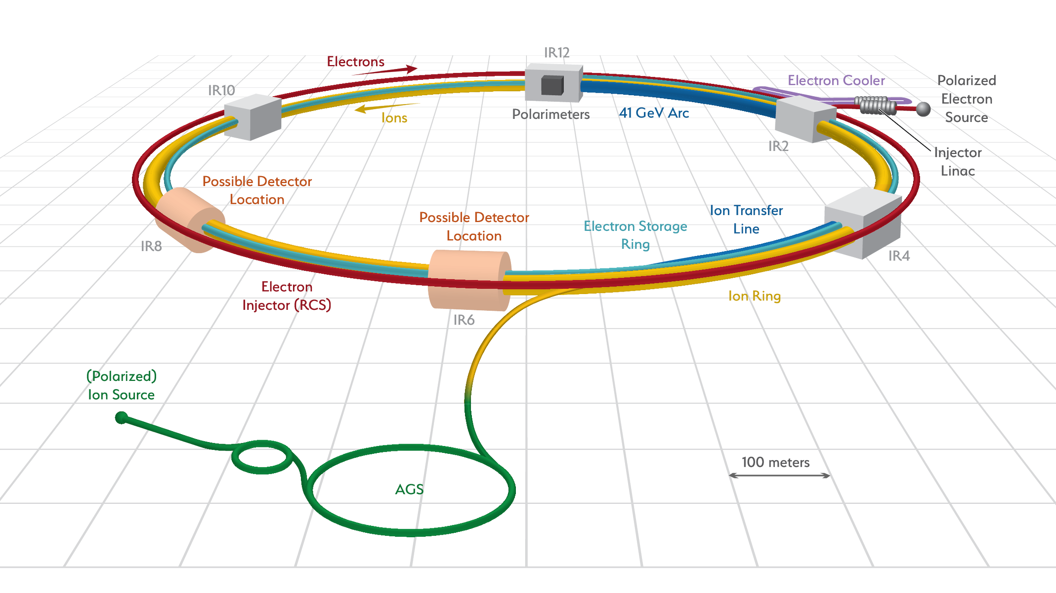
Locations
IR6, for both Electron Storage Ring (ESR) and Hadron Storage Ring (HSR).
Local crabbing scheme, 25mrad full crossing angle.
Possible second IP (IR8).
IR6 design in CDR

Slide 5
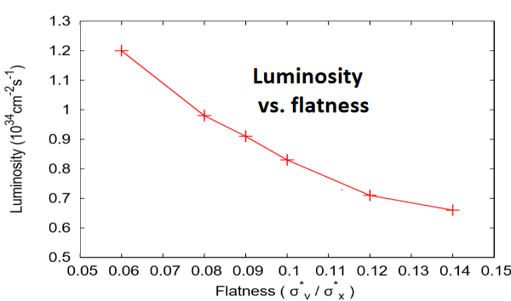
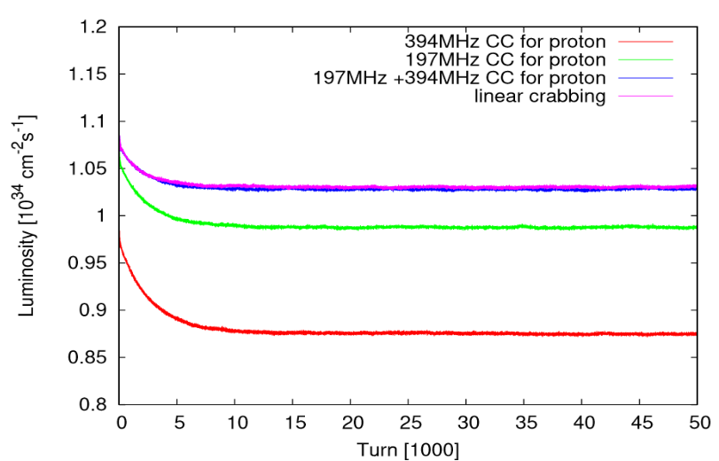
Frequencies
From beam beam group
Considerations:
  Linear crabbing on long proton bunch requires low frequency, or combination of high frequencies.
  Low frequency also helps reducing the synchro-betatron oscillation, and regaining the geometric loss in luminosity, thus beam lifetime can be increased.
  System with frequency lower than 197MHz (98.5MHz) will be difficult to fabricate/install, which also requires higher voltage.
  High frequency cavity with large aperture is also difficult to design.
Different scenarios have been studied.
Reasonable performance: 197MHz alone, 197+394MHz, 394+788+1182+1576MHz, degraded performance: 394+788+1182MHz, 394+788MHz. (weak-strong & strong-strong)
197+394MHz for HSR and 394MHz for ESR are chosen.
Strong-strong

Slide 6
Voltages
From beam beam group
Beam-beam simulation suggested three schemes (per IP per side):
  HSR: 24MV from 197MHz & ESR: 2.90MV from 394MHz.
  HSR: 33.83MV from 197MHz -4.75MV from 394MHz & ESR: 2.90MV from 394MHz.
  increase the HSR voltage by a factor of 20%.
Scheme 1 is the current baseline.
Cavity designs are based on scheme 2.

Slide 7
Geometric constraints
From beam beam group
15m for HSR and 4m for ESR are reserved per IP per side.
Further reducing the crab cavity cryomodule assembly for HSR to 12m is under consideration to provide more space between crab cavities and the next dipole so that chromaticity can be reduced.
For 197MHz crab cavity:
Cavity with HOM damper and stiffener, and without Helium vessel, should be able to be fitted into BNL large vertical test facility, with diameter constraint at 90cm. HOM damper for vertical test might be slightly different from the version for cryomodule.
Cavity length should be <1.5m.
Cavity aperture should be ≥10cm.
Beam offset 0.6mm for HSR and 0.25mm for ESR, contains a safety factor of 2, preliminary. (For fundamental power requirement and HOM power calculation)

Slide 8
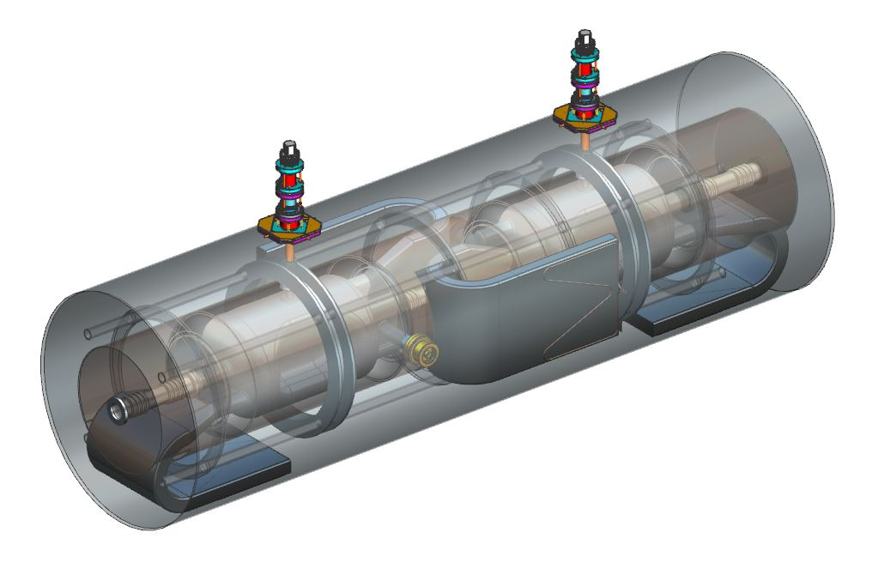
Number of cavities & cryomodules
197MHz for HSR, 394MHz for both ESR and HSR (identical).
Four 197MHz cavities + two 394MHz cavities per IP per side for HSR, and one 394MHz cavity per IP per side for ESR.
Current considering two 197MHz cavities in one 197 cryomodule, and one 394MHz cavity in one 394 cryomodule.
Specs on deflecting voltage per cavity:
  Design specs: 11.5MV for 197MHz, 3.5MV for 394MHz.
  Operation specs: 8.5MV for 197MHz, 2.9MV for 394MHz.

Slide 9
HSR impedance budget
From beam dynamics group
316kΩ longitudinal (at 300MHz) and 2.64MΩ/m transverse with 1300m beta function in CDR.
Between 300MHz and 2000MHz, longitudinal impedance budget increases with increasing frequency. (Qiong and Shaoheng)
16 cavities in HSR with 2 IPs.
Transversely consider 8 197MHz cavities only since 2 IPs will not have the same high beta function (at 1300m) simultaneously.
For 197MHz per cavity: 19.75kΩ longitudinal (considering 16 cavities) and 0.33MΩ/m transverse (considering 8 cavities).

Slide 10
ESR impedance budget
From beam dynamics group
26kΩ-GHz longitudinal and 12MΩ/m transverse at ESR H1 cavity with 12m beta function, corresponding to 0.96MΩ/m transverse at crab cavity with 150m beta function.
For 394MHz per cavity: longitudinal impedance <6.5 kΩ-GHz, transverse impedance <0.24 MΩ/m.
This budget is more critical than HSR thus 394MHz cavity budget is limited by ESR.
Budget showed here are for the whole ring, thus final check that summing up all impedances in the ring is needed for both ESR and HSR.

Slide 11
RF control
Mike Blaskiewicz’s study on the instabilities driven by the fundamental crabbing mode requires a high gain (Qeff at ~300, meaning for FPC Qext at 3e6, loop gain should be 10,000) and low delay (~380nS) feedback system. Transverse dampers are also needed for injection/ramping.
With the above requirement, large tuning ranges that cover the frequency shift during injection/ramping (0.8MHz for 197MHz cavity & 1.6MHz for 394MHz cavity) are not required. FMDs are not required as well.
Emittance growth due to crab cavity phase and amplitude noise is studied by Themis Mastoridis/River Huang, Phase noise should be 2 orders of magnitude lower than that of LHC. A low frequency feedback system with precise pickup measurement is needed.
Preliminary but challenging, needs more effort on this.

Slide 12
Other specifications to be defined
RF multipoles of crabbing mode (Qiong Wu & Yun Luo)
Static heat load & dynamic heat load. Total budget is 280W for one IP (Roberto Than), can be increased if needed.
Lorentz force detuning & mechanical stability.
Final locations, compensation of the solenoid effect/ESR tilting to avoid vertical crabbing. (beam beam group)
ESR is tilted along the IR6-IR8 line by 200urad to avoid components conflict in other IRs. (Doug Holmes)

Slide 13
Summary
Details on the crab cavity system like locations, frequency choice, voltage requirements are discussed.
Impedance budget on both ESR and HSR are showed.
RF control specifications are challenging.

Slide 14
Thank you!

