Slide 1
Crab Cavity Cryomodules for HiLumi
Thomas Jones on behalf of the UK-CERN Team
TRIUMF 2021 EIC Accelerator Partnership Workshop, 27th October 2021

Slide 2
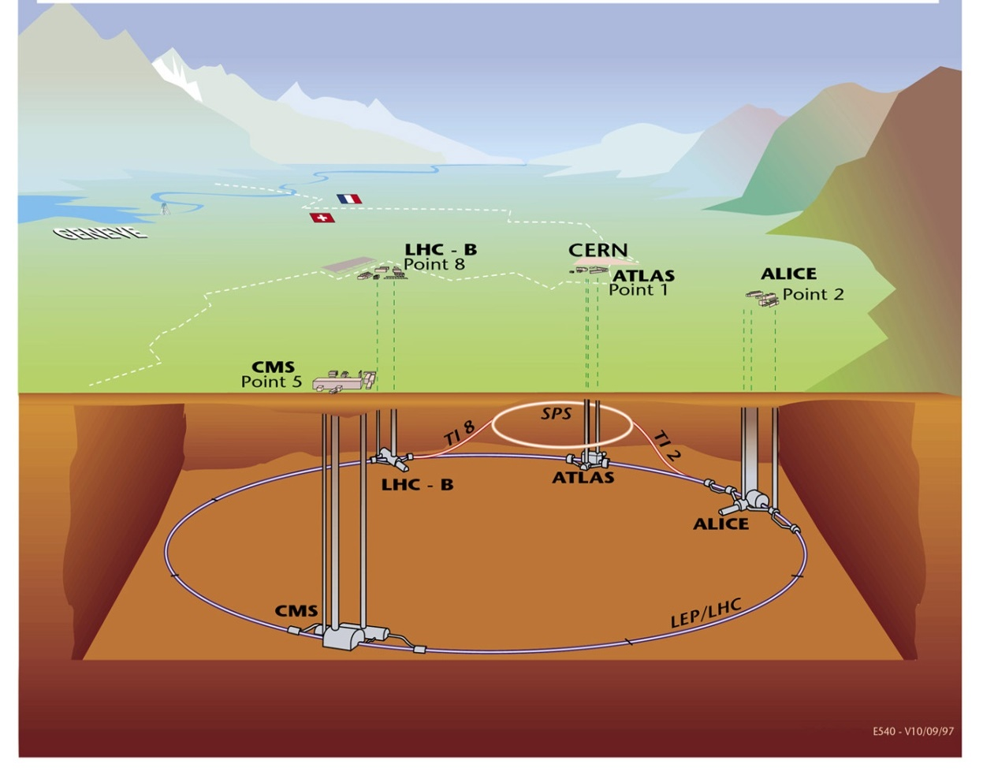
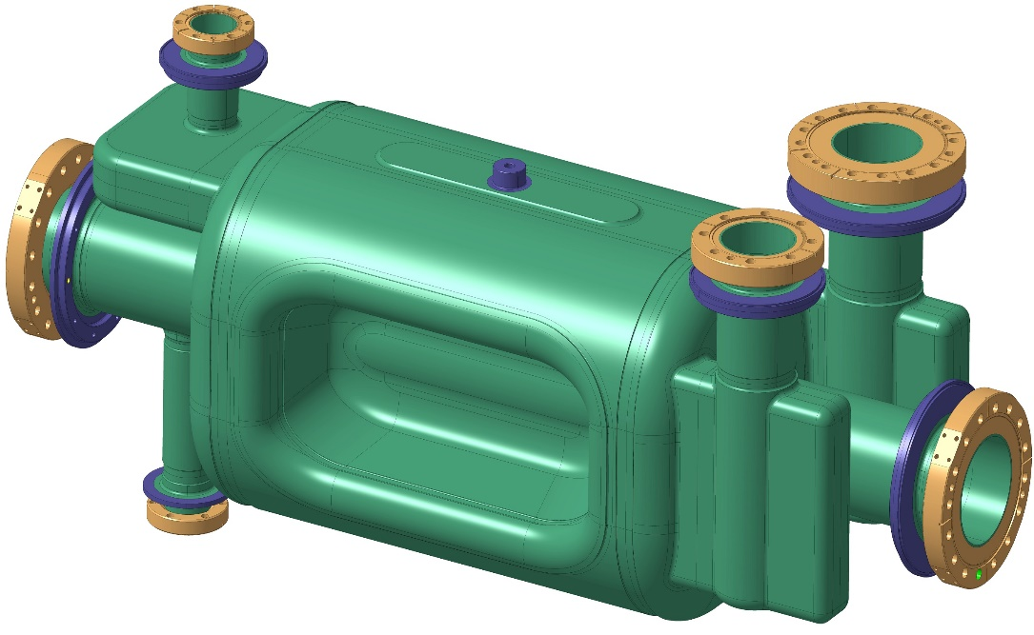
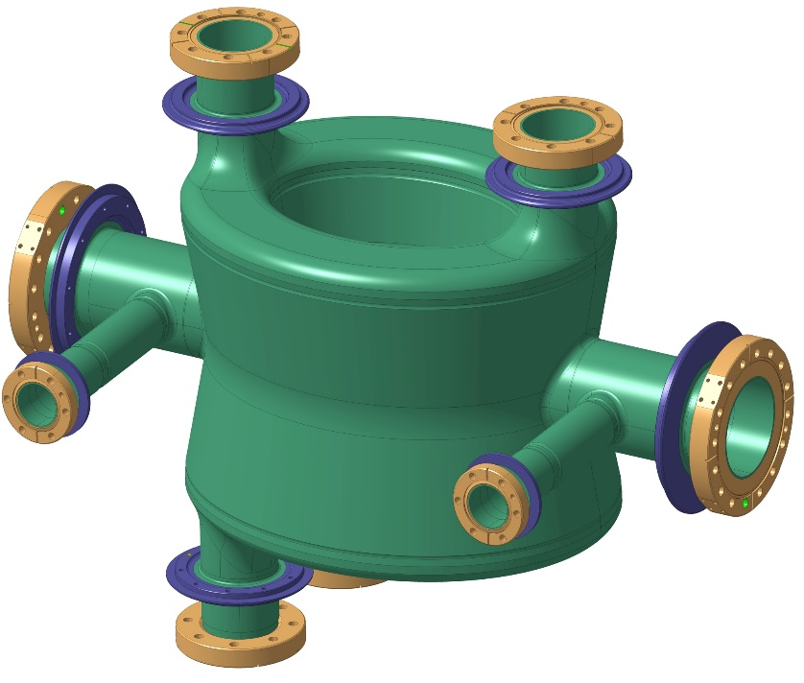
Crab Cavities at CERN
SM18 Area
Cavity cold testing, clean room facilities & cryomodule qualification
SPS BA6
Test Prototype Modules with proton beam
1 DQW proto CM + 1 RFD proto CM
RF Dipole (RFD) Cavity (ODU)
LHC Point 5 (vertical)
2 cavities / IP side/ beam to be installed during LS3
=
4 DQW CM to be installed + 1 CM spare
LHC Point 1 (horizontal)
2 cavities / IP side/ beam to be installed during LS3
=
4 RFD CM to be installed + 1 CM spare
Double Quarter Wave (DQW) Cavity (BNL)
TRIUMF 2021 EIC Accelerator Partnership Workshop, 27th October 2021

Slide 3
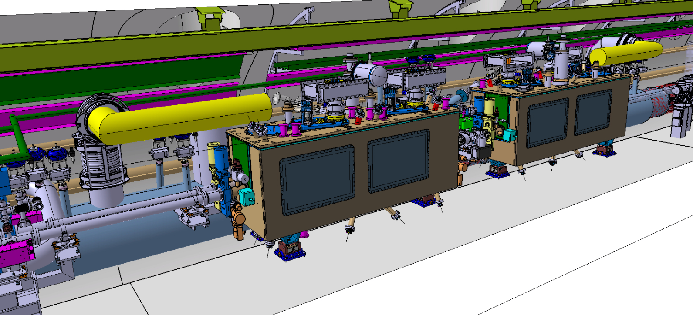
Crab Cavity Cryomodule in LHC Tunnel
3.4m
0.9m
LHC integration– courtesy of Maria Gonzalez de la Aleja – ATS/DO

Slide 4
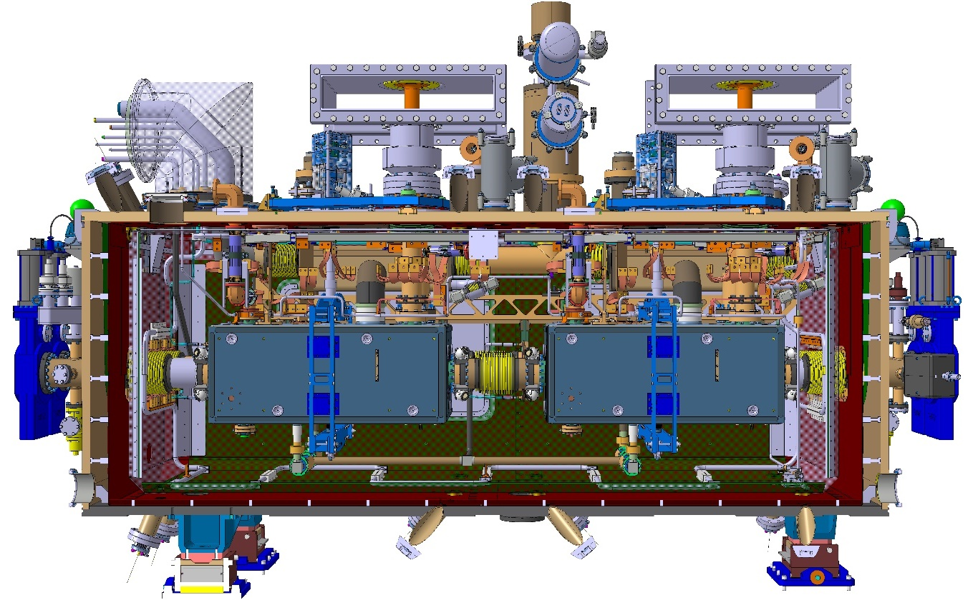
RFD Pre-Series Crab Cavity Cryomodule
Fundamental Power Coupler
Cryogenic Safety System
Cryoline Jumper
CAD Images courtesy of Teddy Capelli CERN/EN-MME
Cavity Tuner
Frequency Scanning Interferometry
Cavity Support System
Sector Valve
Vacuum Diagnostics
Thermal Shield
Crab Cavity (RFD)
Cold Magnetic Shield (internal)
Plug in module
Outer Magnetic Shield
Outer Vacuum Chamber

Slide 5
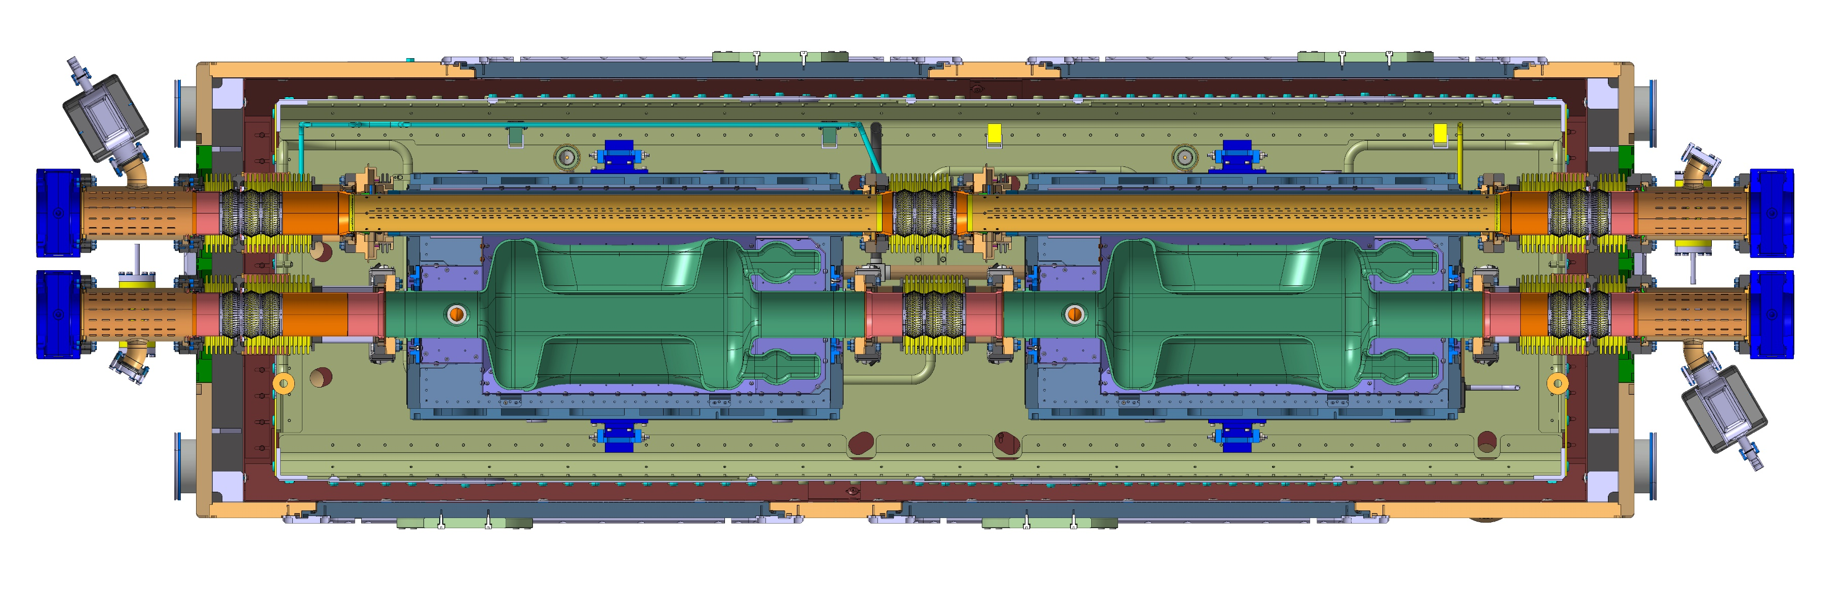
Beam section of RFD Cryomodule
Extremity vacuum chamber LHCVMACAA_T0001
Beam screen Cold/Warm transition Long
Inter beam screen plug-in module
Beam screen Cold/Warm transition Short
Extremity vacuum chamber
Beam screen
Beam screen
Extremity vacuum chamber
Cavity Cold/Warm transition Long
Inter cavities plug-in module
Cavity Cold/Warm transition Short
Extremity vacuum chamber
TRIUMF 2021 EIC Accelerator Partnership Workshop, 27th October 2021

Slide 6
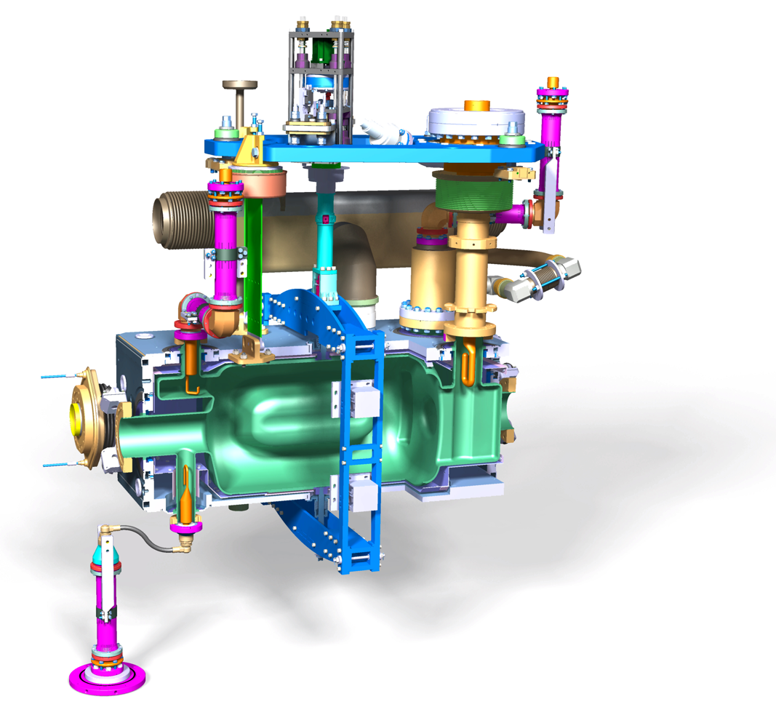
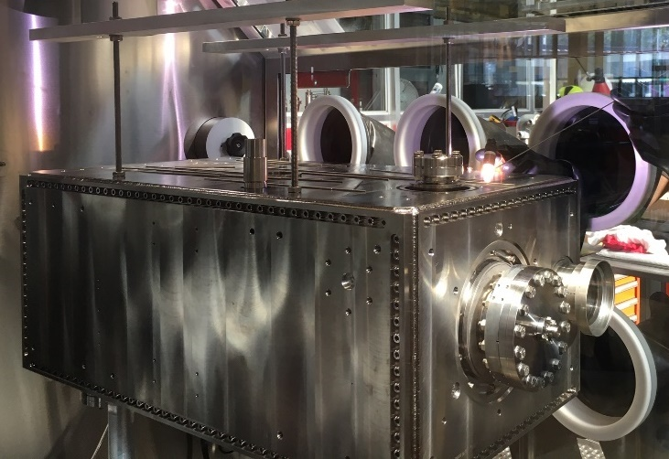
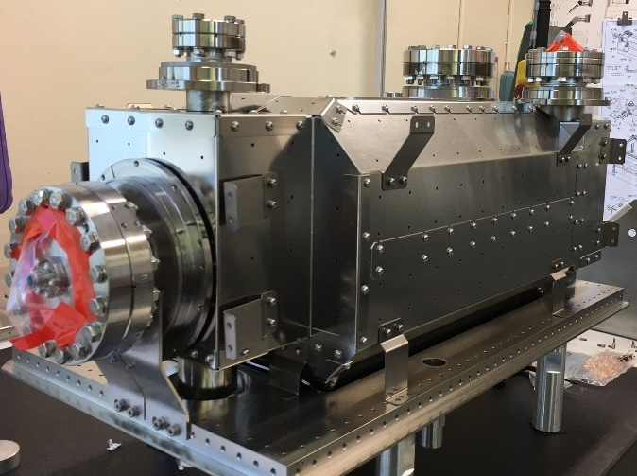
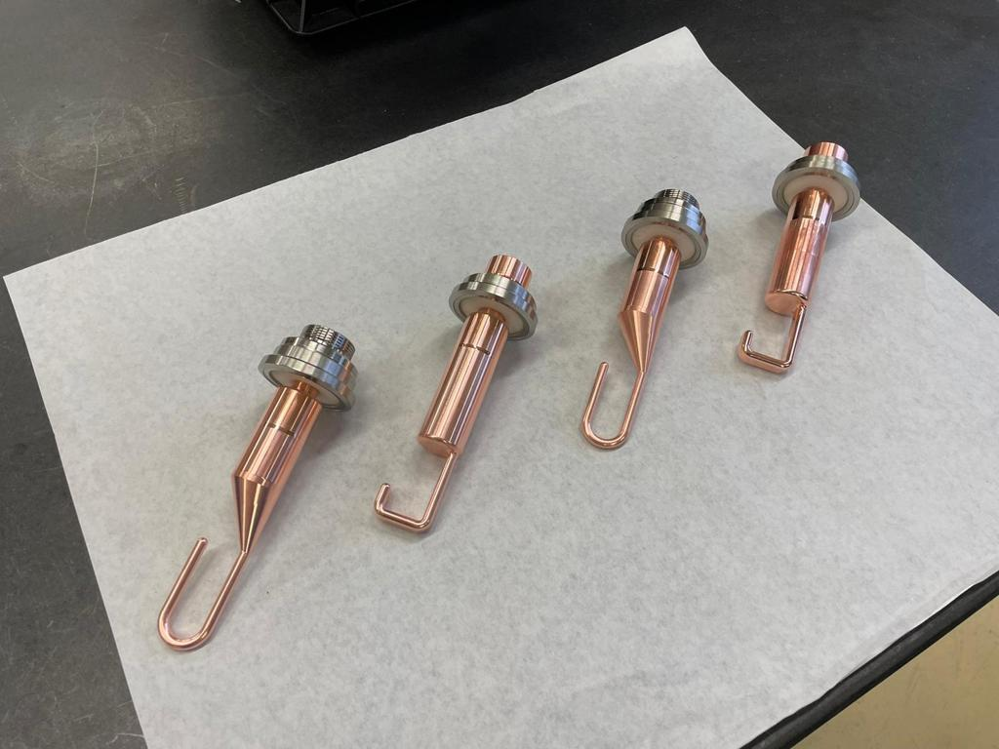
Dressed Crab Cavity
Helium Vessel Welding at CERN.
Cold shield design and production in UK
V-HOMs
Antenna
H-HOMs
Ancillary design and manufacture from CERN

Slide 7
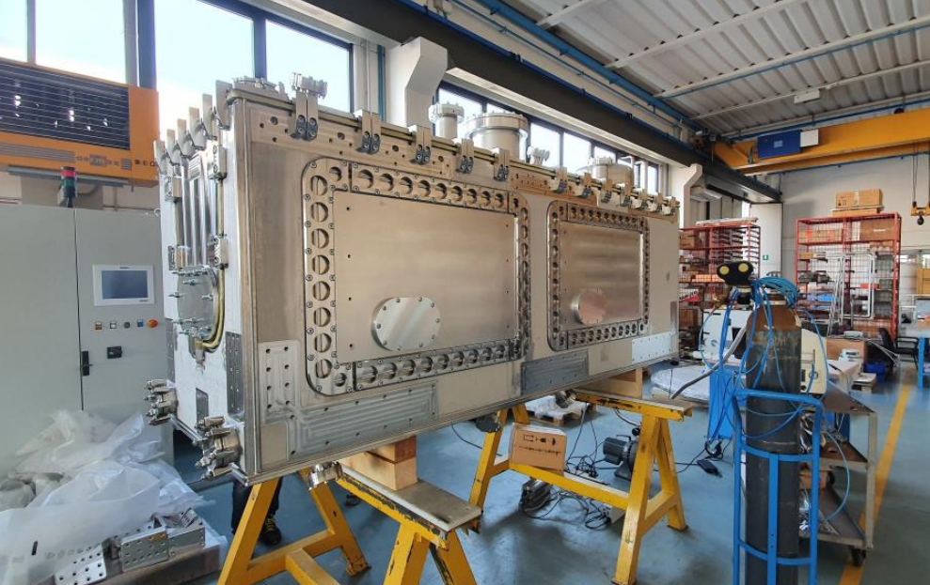
Outer Vacuum Vessel
RFD outer vessel :
Large gaskets removed for LHC compatibility
Overall dimensions : 2800x950x1300
Mass : 3100kg
St. Steel welded assembly
Brackets take the Top Plate mechanical loads
Image courtesy J.Sauza Bedolla - Lancaster

Slide 8
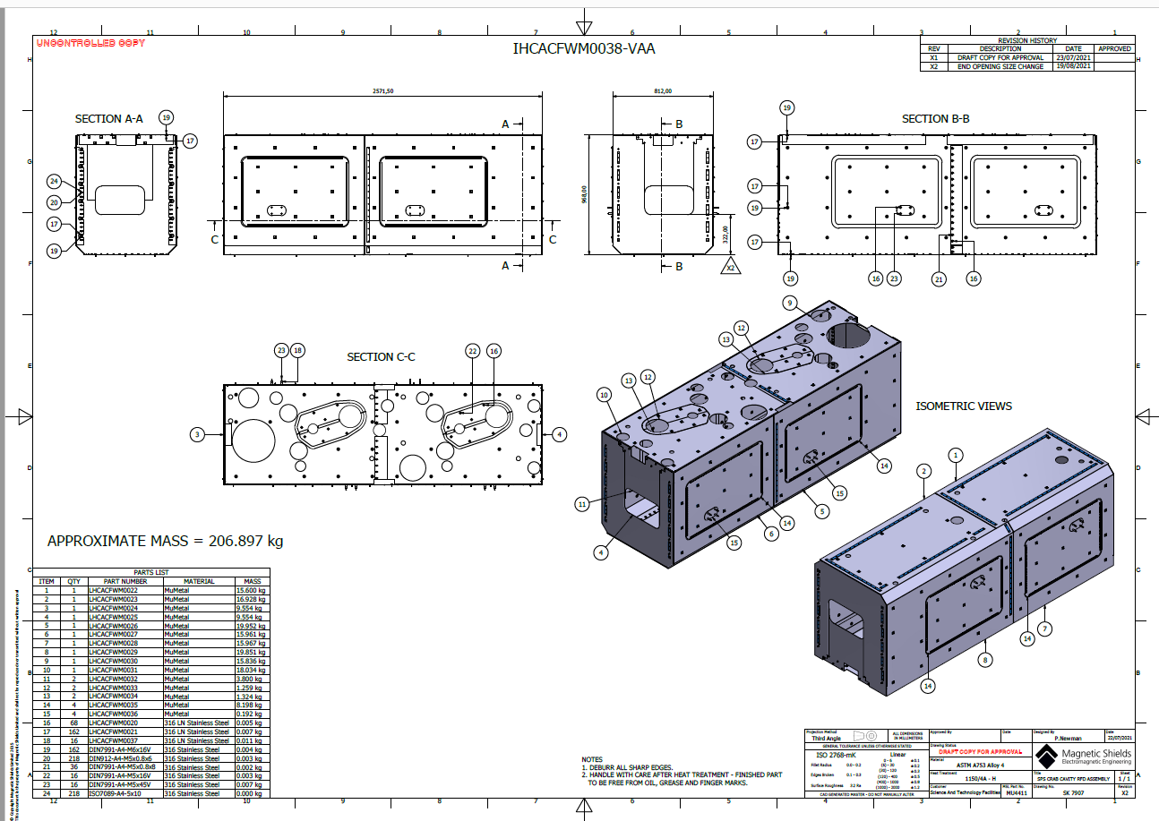
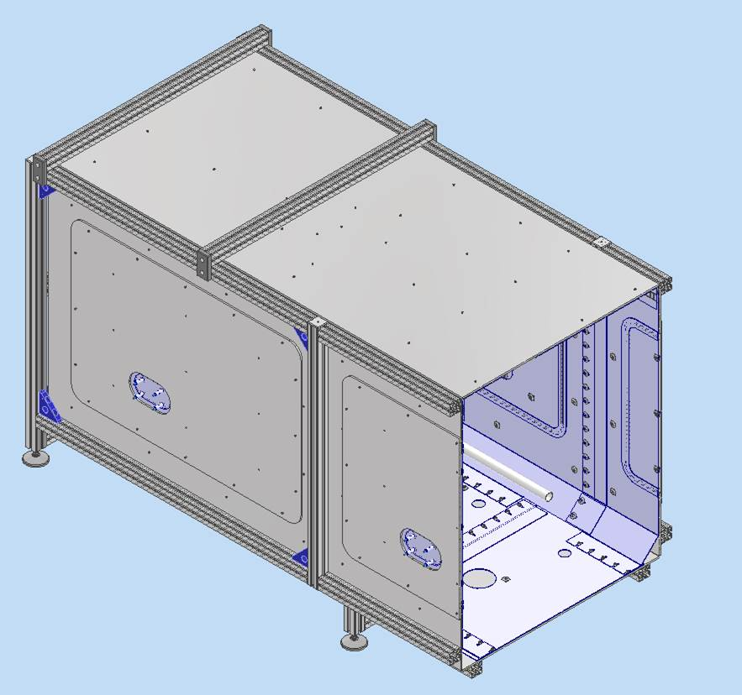
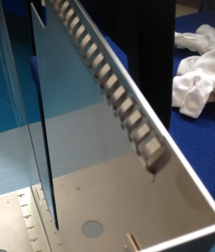
Warm Magnetic Shield
  DQW design adapted to RFD
  Forms a “Second Skin” to the Outer Vacuum Chamber
  Material : MuMetal Th.:2mm
  Currently in production in the UK
Shield test setup
Shield supplier production drawings approved
Mu Metal Spring finger contacts

Slide 9
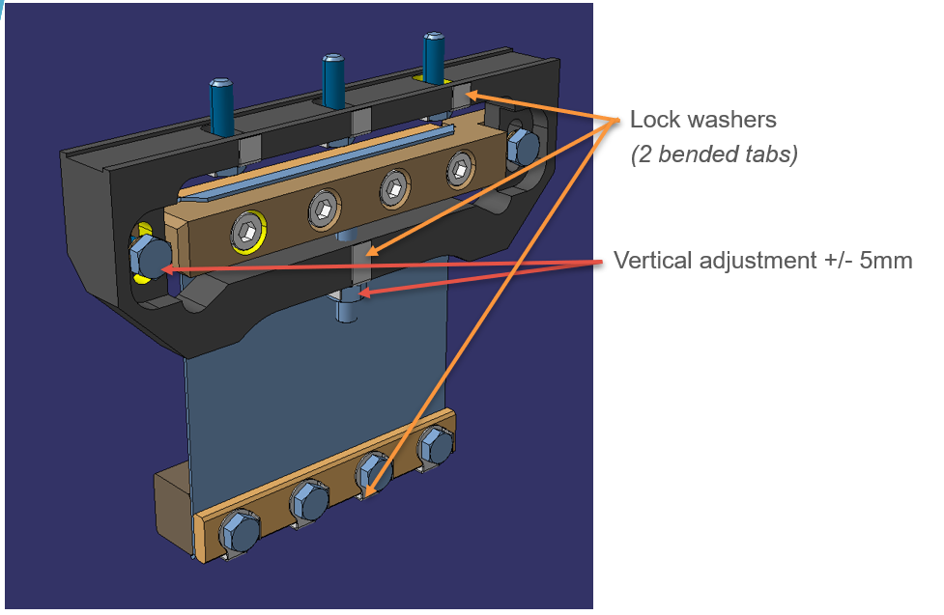
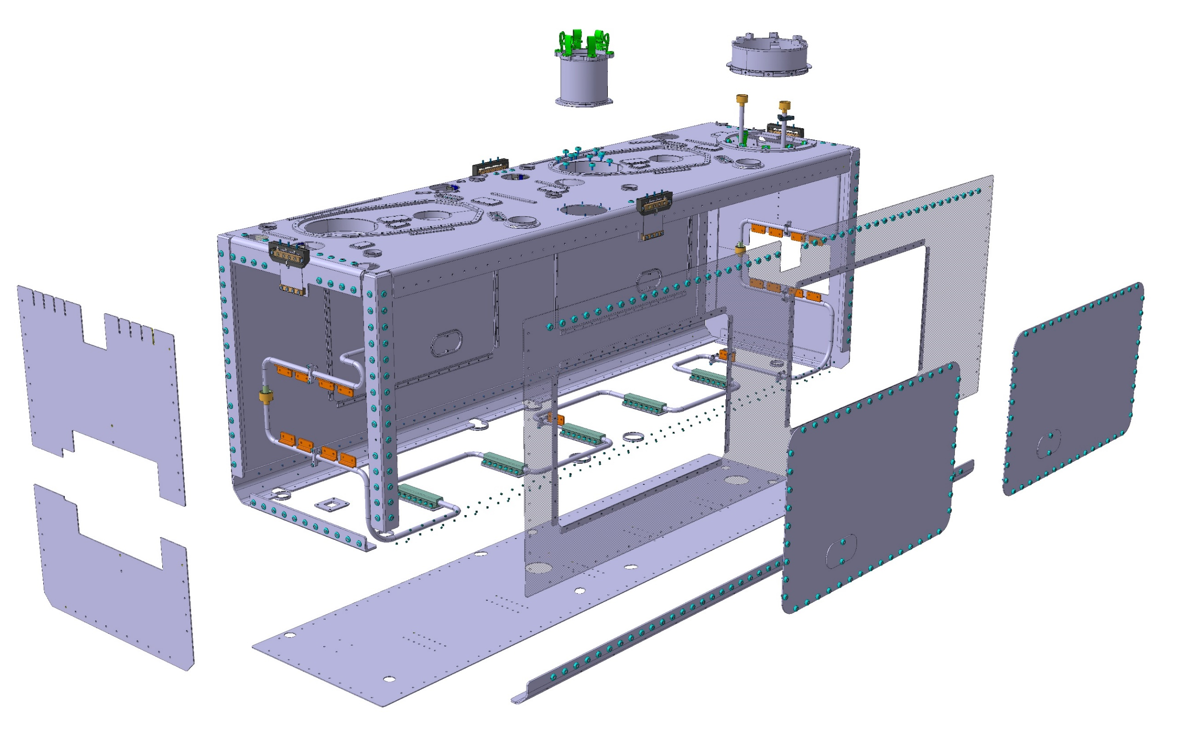
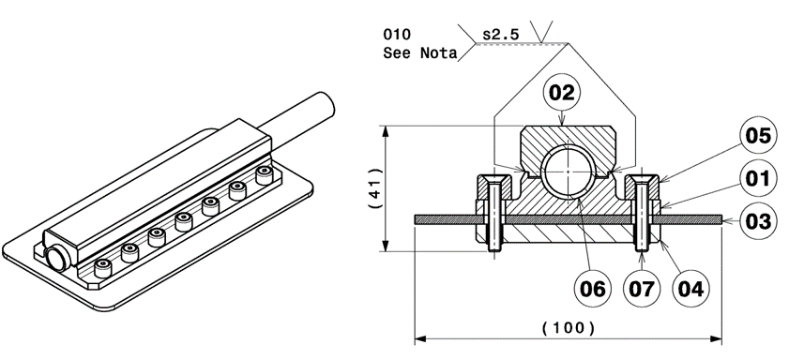
Thermal screen
Design changes from DQW:
  Copper changed to 3mm thick 6061 T6 Aluminium Alloy plates
  Significant cost and weight saving
  Stainless Steel 316L Cooling circuit
  Adjustable flexure support system
Support Flexure
Cooling circuit connection
~100 kg
11th HL-LHC Collaboration Meeting, Oct ‘21, CERN

Slide 10
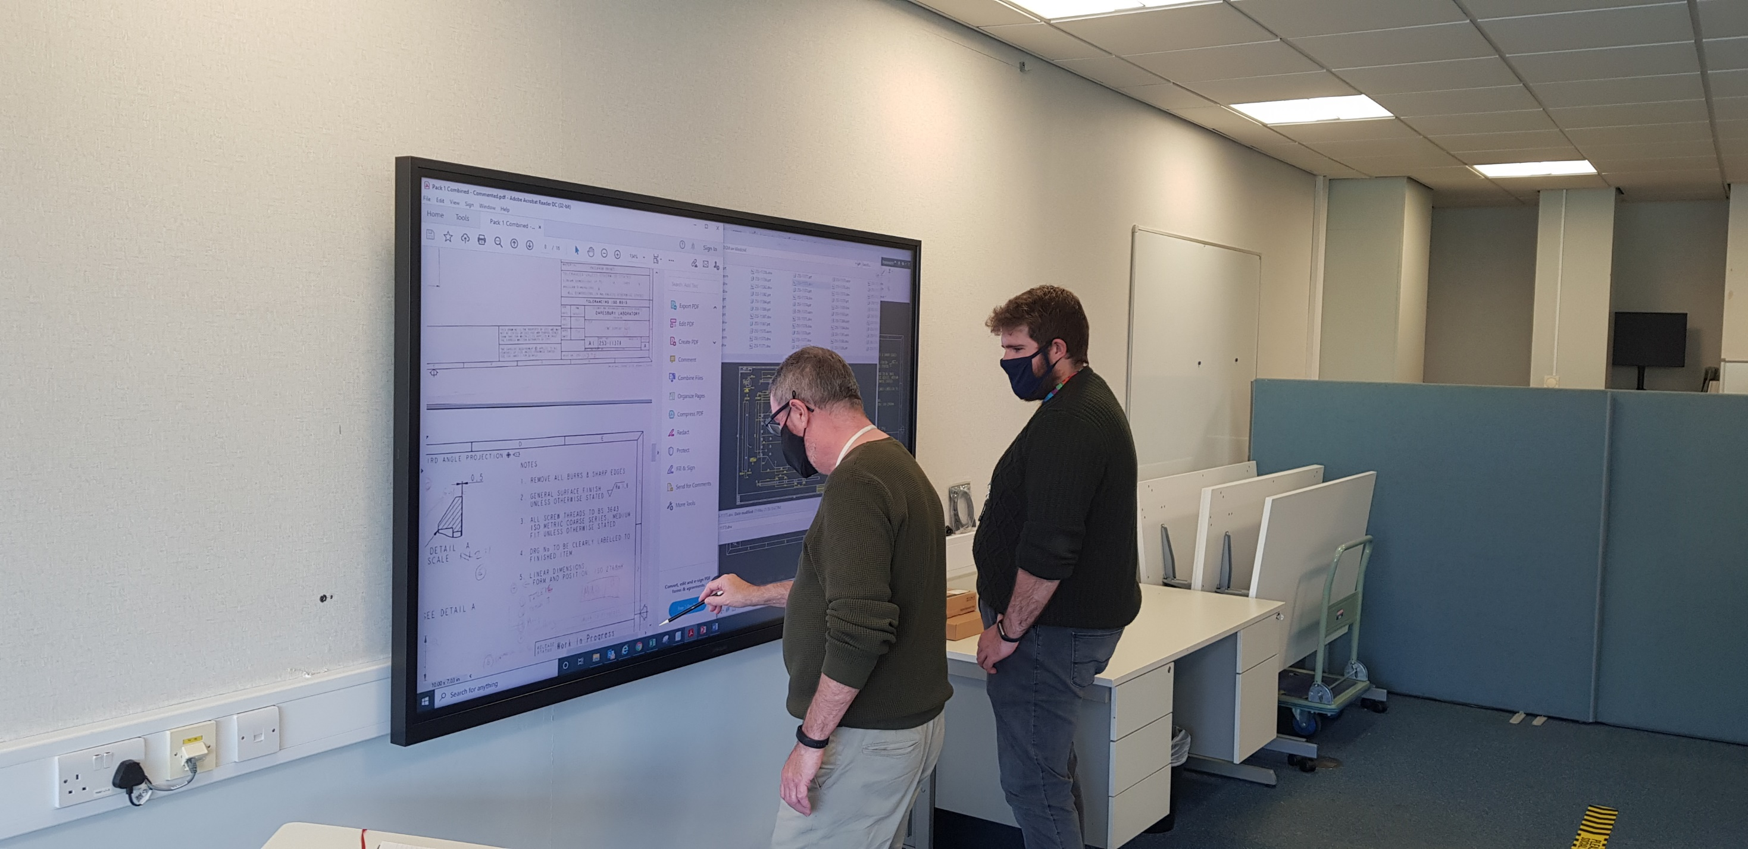

Touch Screen Installed in Design Office
Collaborative procedure development, design review and drawing checks whilst socially distant
TRIUMF 2021 EIC Accelerator Partnership Workshop, 27th October 2021

Slide 11
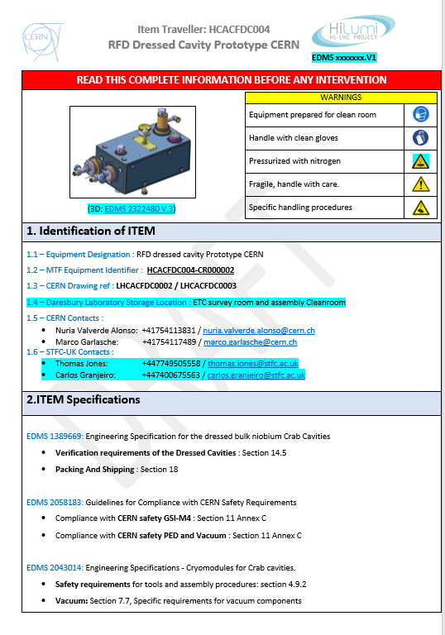
Logistics planning
Development of travellers including outgoing and incoming inspection procedures for all equipment
Using Assembly Building 3D model in planning assembly and storage.
Considerable amount of work to ensure a trouble free transport of goods from CERN to the UK post Brexit.
TRIUMF 2021 EIC Accelerator Partnership Workshop, 27th October 2021

Slide 12
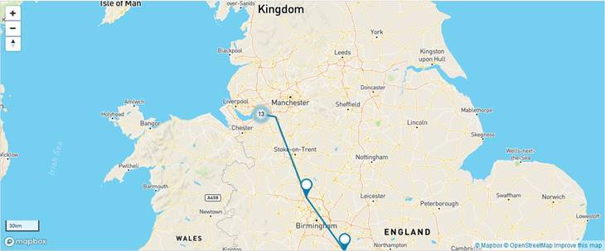
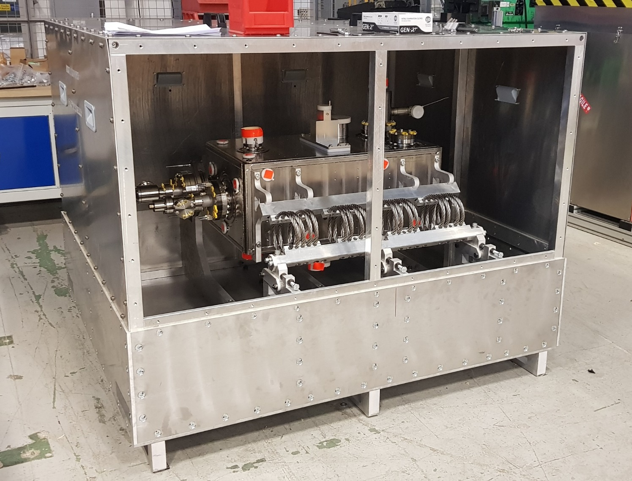
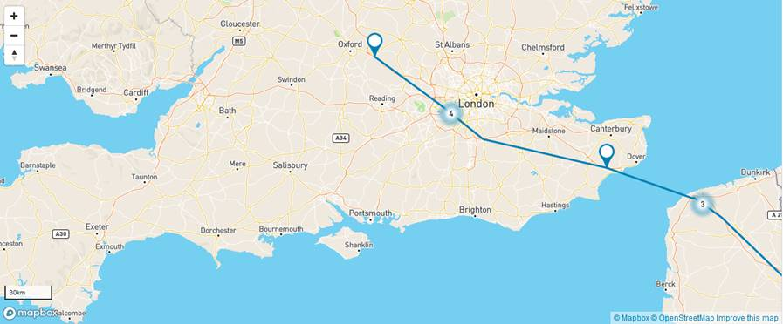
RFD2 Cavity and Ancillaries arrived at Daresbury
Arrived 29th September 2021. Careful prior planning led to a trouble free transport
RF Acceptance Testing of the Cavity taking place now
Next Cavity to be delivered early November 2021.

Slide 13
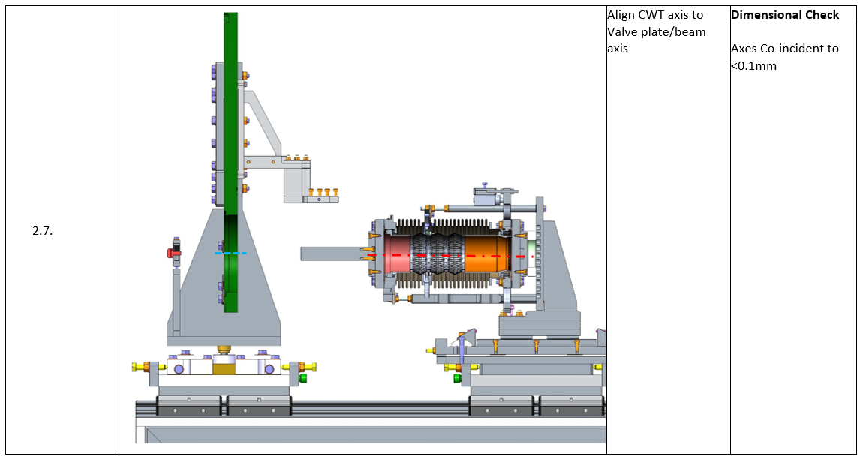
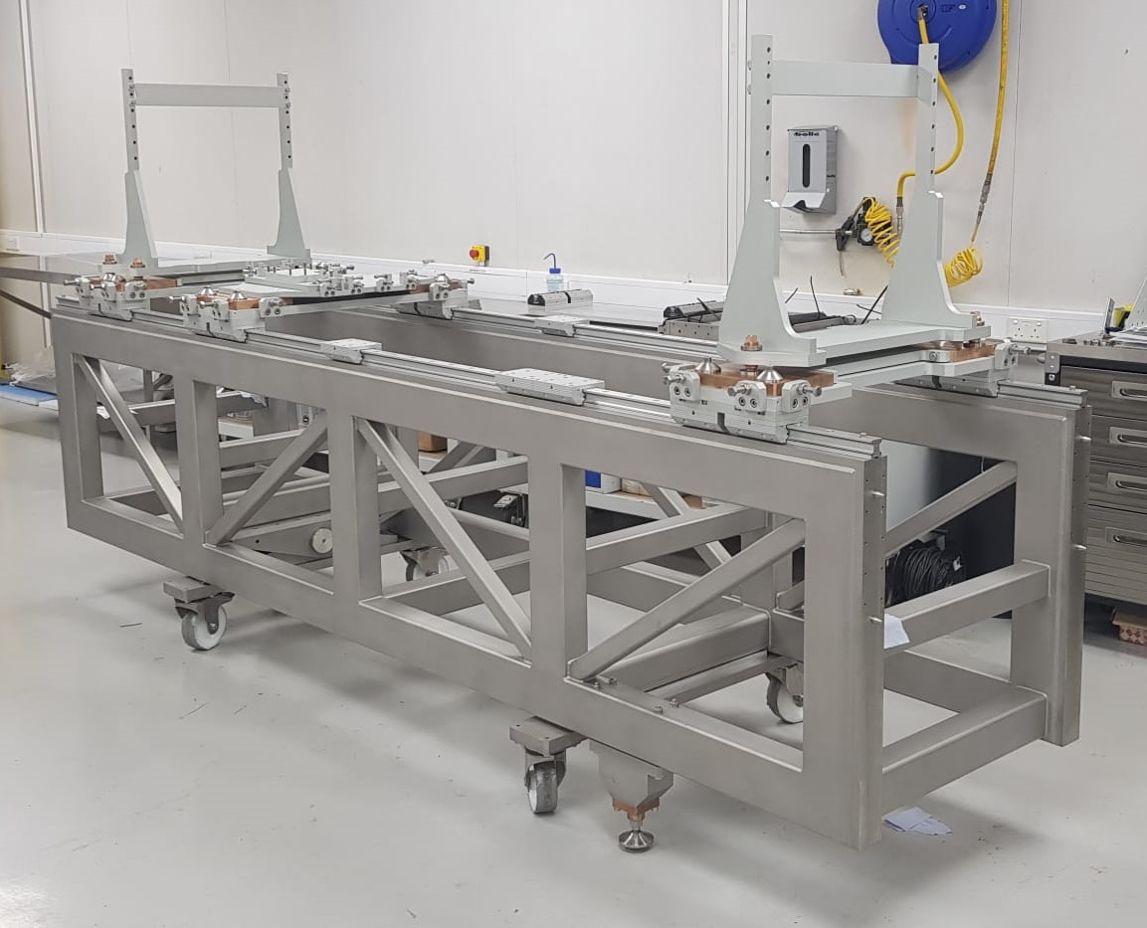
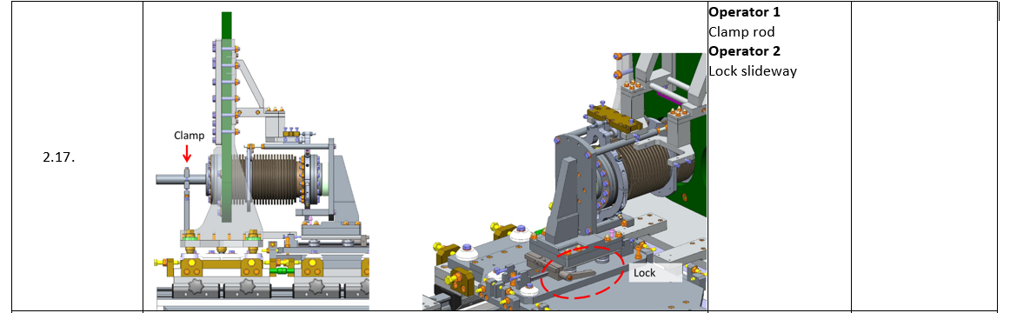
Pre-Cleanroom Assembly Procedure
Pre-Cleanroom Assembly Procedure Approved
Cleanroom Assembly Procedure - made good progress.
Tooling for first steps is on site.

Slide 14
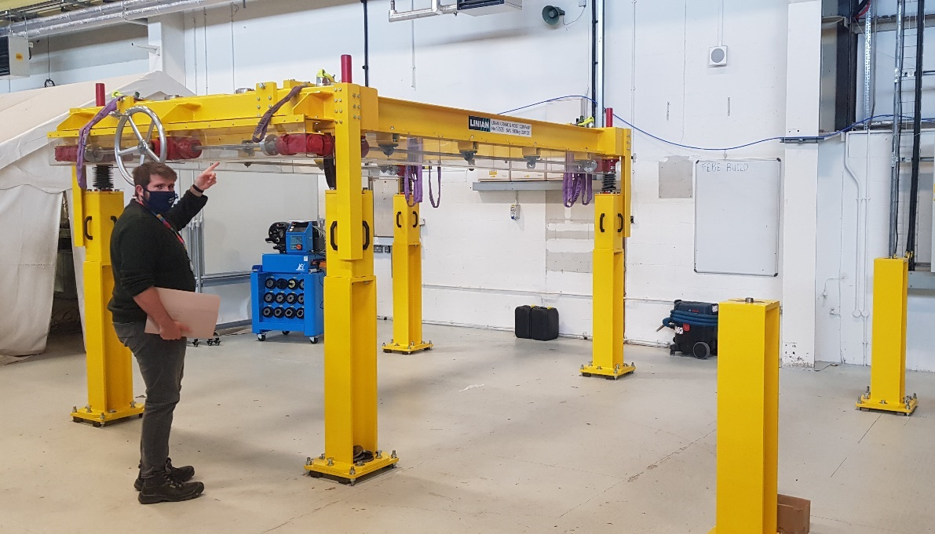
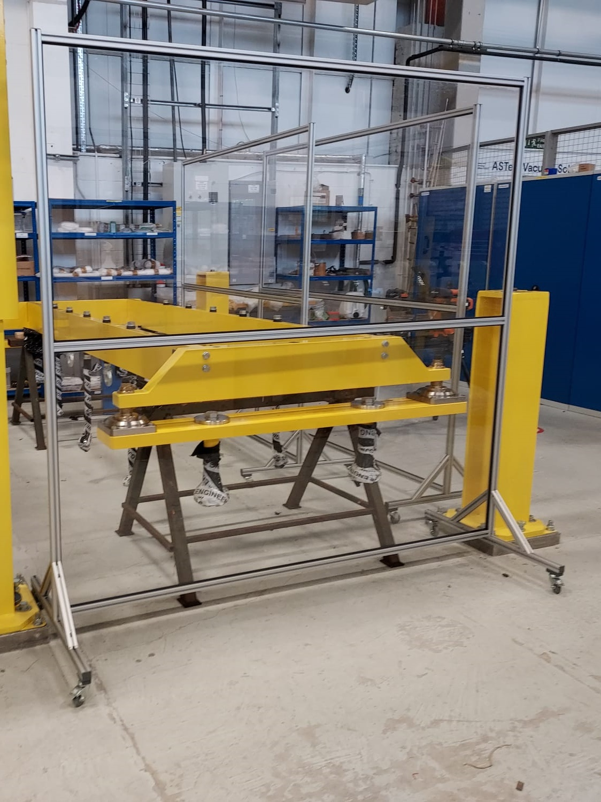
Cavity String assembly Lifter
Movement qualified with the laser tracker
<1mm lateral movement over the full stroke
TRIUMF 2021 EIC Accelerator Partnership Workshop, 27th October 2021

Slide 15
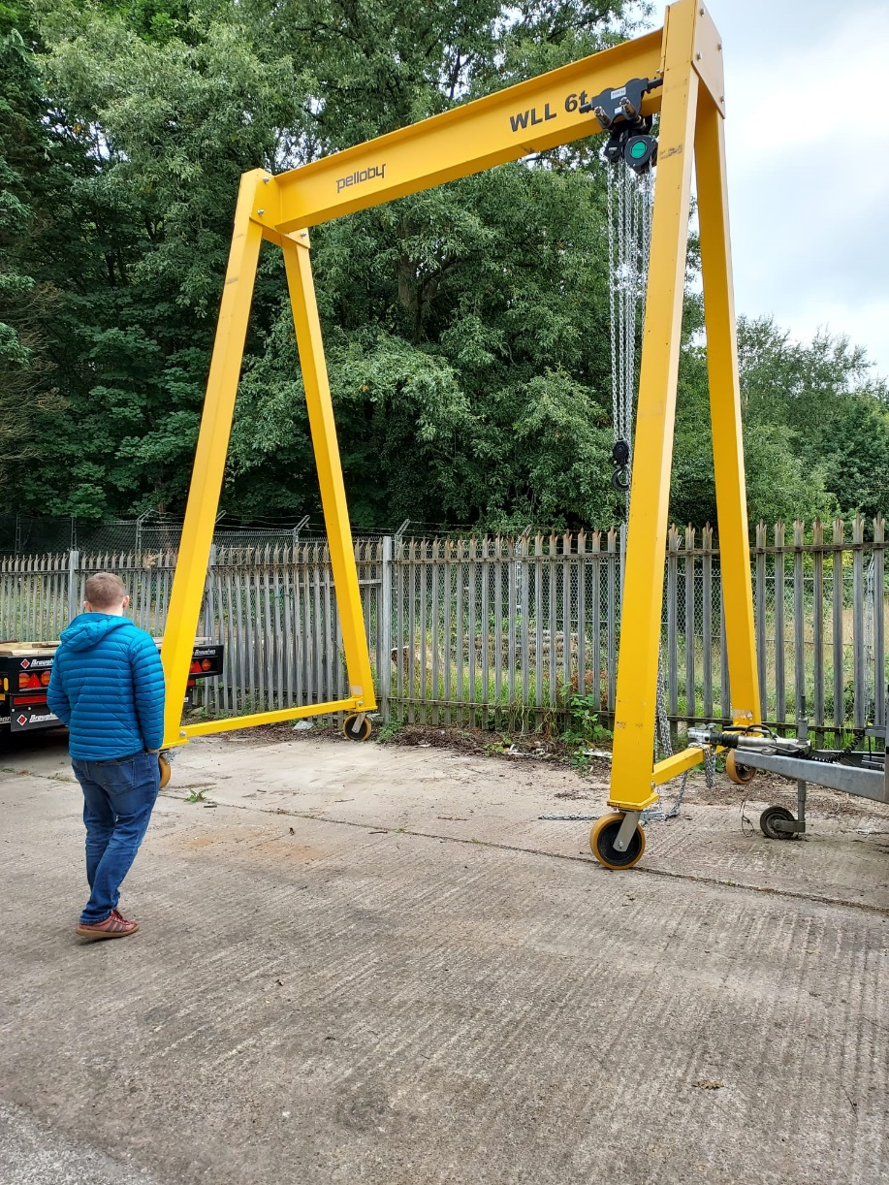
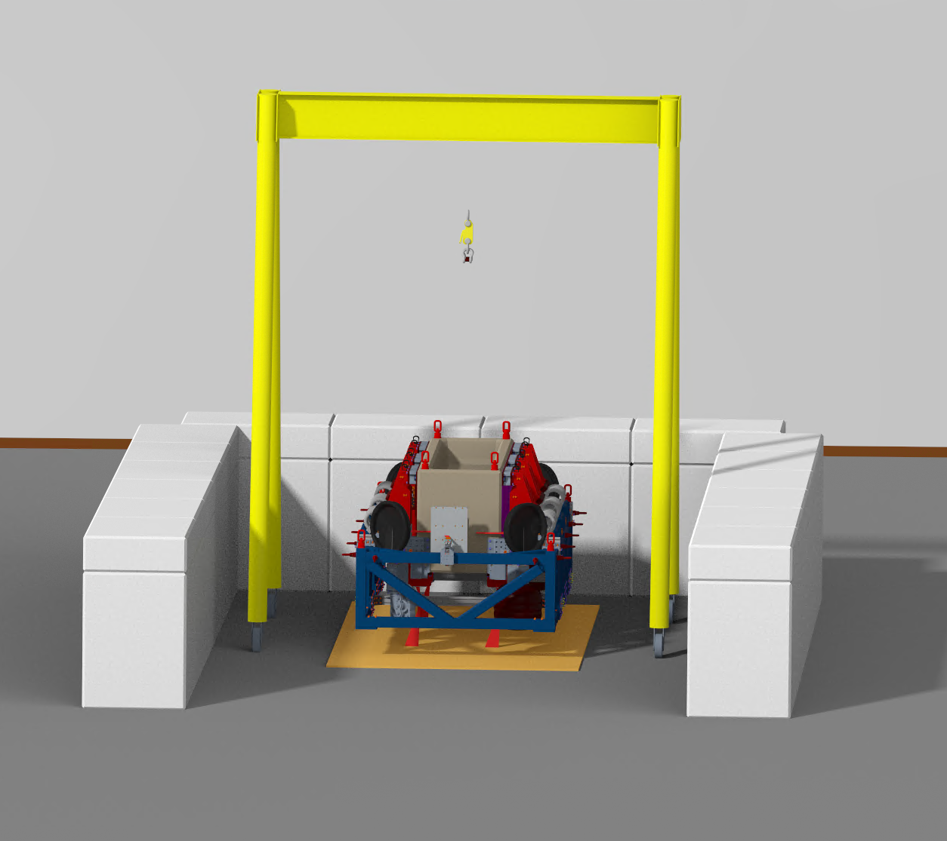
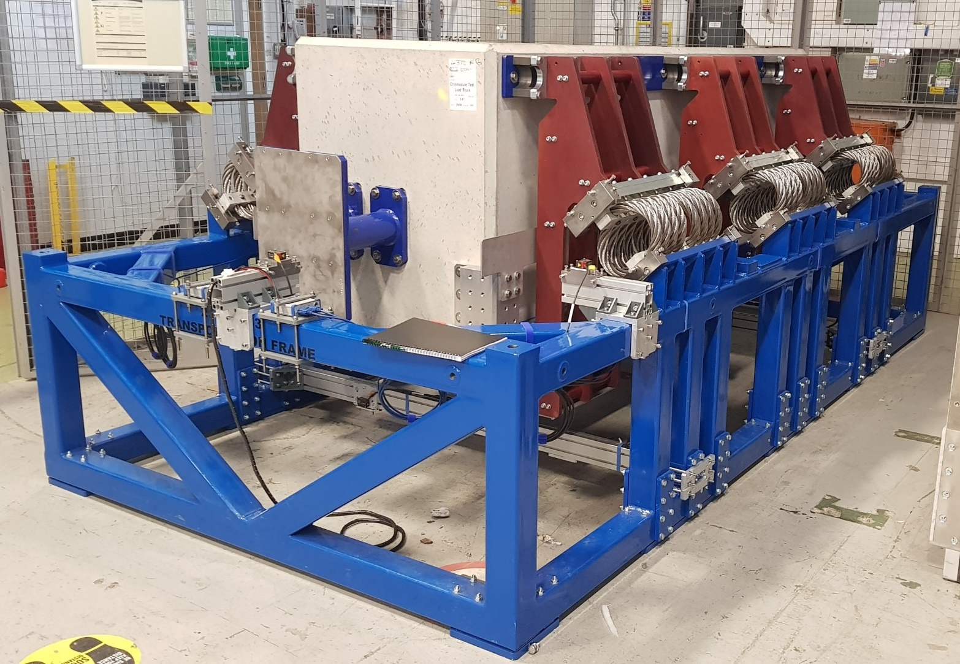
Transport Frame and Drop Test Kit all on site
Lifting gantry
Quick-release hook
Wire Rope Isolators
1KHz displacement sensors
Steel plate
Practise assembly of the transport frame
Testing taking place over the next couple of weeks

Slide 16
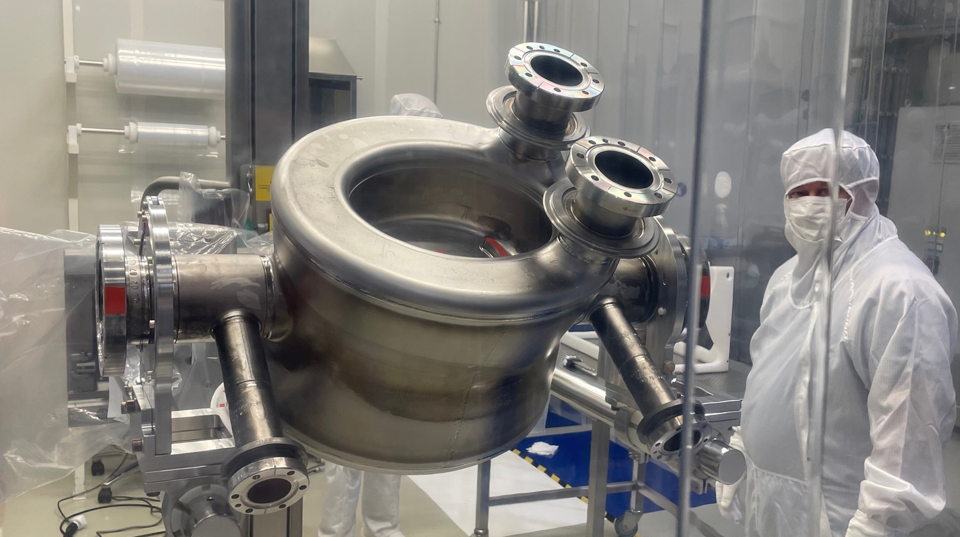
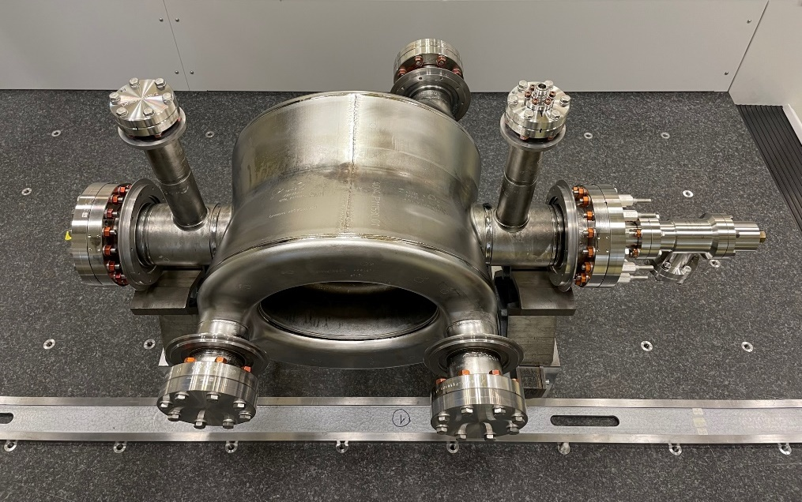
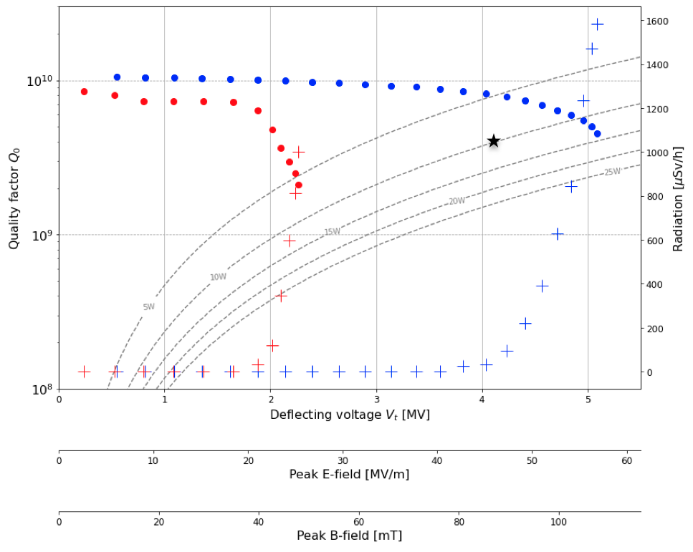
DQW Pre-Series in industry (@ RI)
DQW Pre-series 1 HPR Preparation
DQW Pre-series 2 Metrology
Pre-series bare cavity 1:
  Metrology done.
  HPR and Ready for re-CT, week 43/44.
Pre-series bare cavity 2:
  CT successful.
  Currently in metrology.
Cold Test @CERN
TRIUMF 2021 EIC Accelerator Partnership Workshop, 27th October 2021

Slide 17
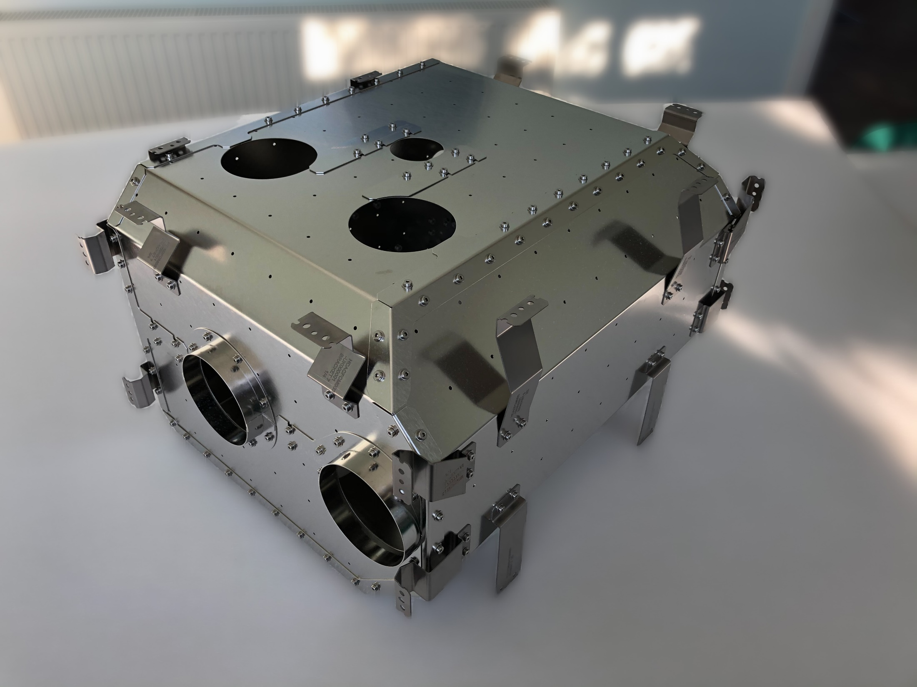
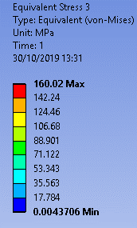
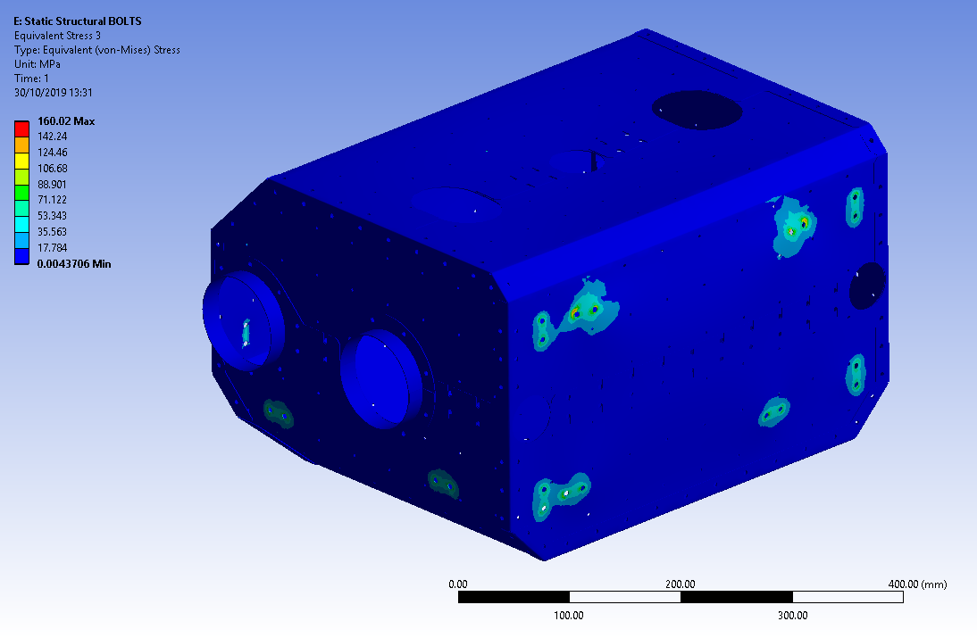
DQW Series Cold Magnetic Shield
DQW Production Cold Magnetic Shield
First hardware delivered for HL-LHC-UK Phase 2
Designed by STFC/Lancaster Uni.
Manufactured in UK Industry.
TRIUMF 2021 EIC Accelerator Partnership Workshop, 27th October 2021

Slide 18
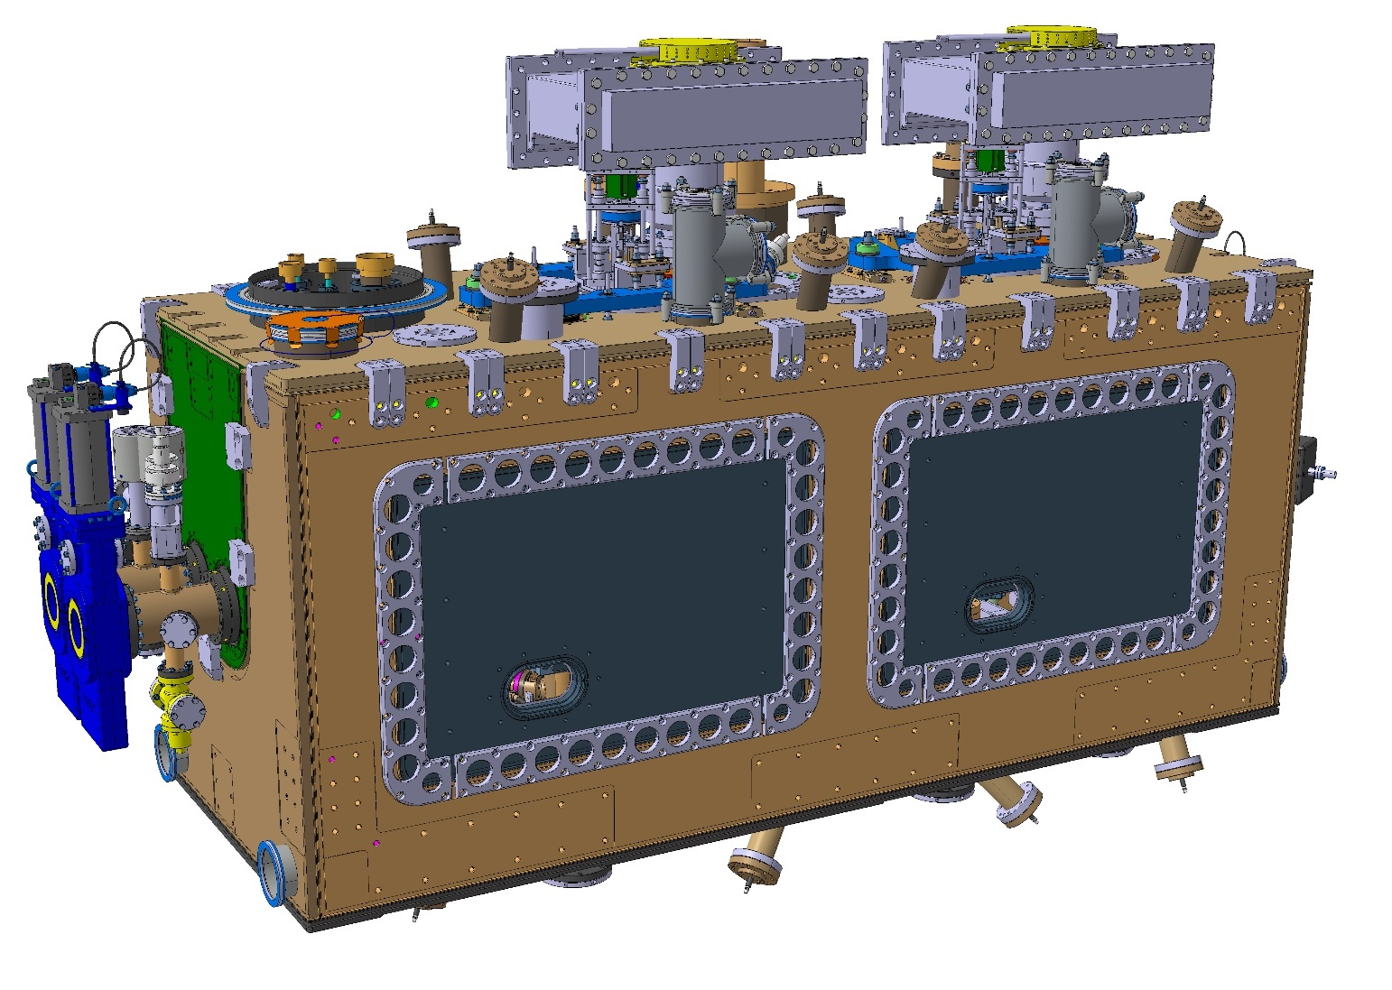
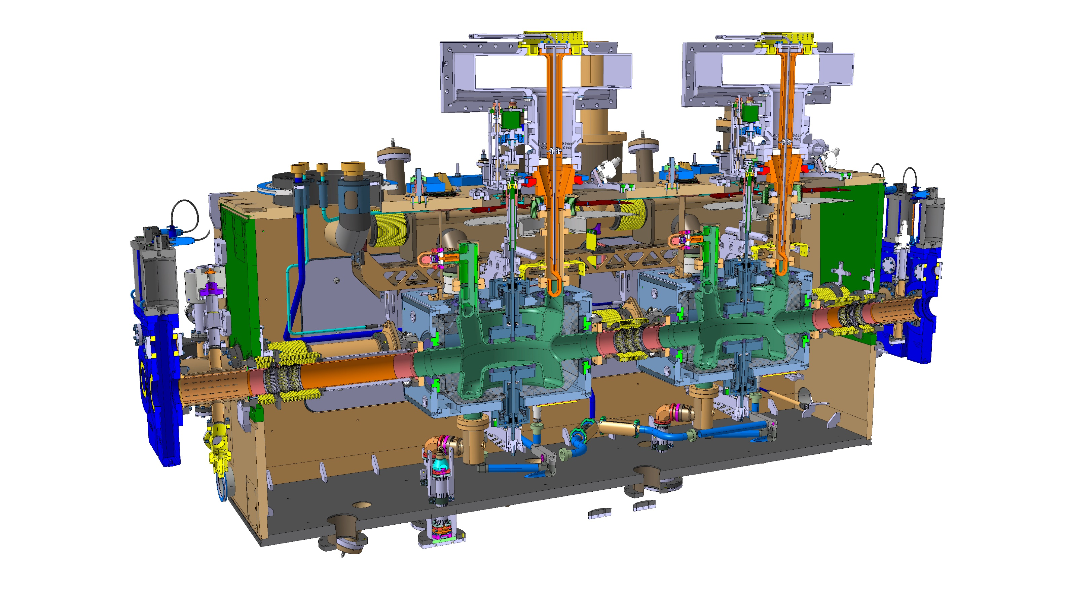
DQW Series Cryomodule
Design work in progress.
Aim to be as similar to the RFD Pre-series as possible.
Conceptual review in March 2022 at the latest.
Fundamental Power Coupler
Cryoline Jumper
Cavity Tuner
Sector Valves
Crab Cavity (DQW)
Cold Magnetic Shield (internal)
Outer Vacuum Chamber
Plug in module

Slide 19
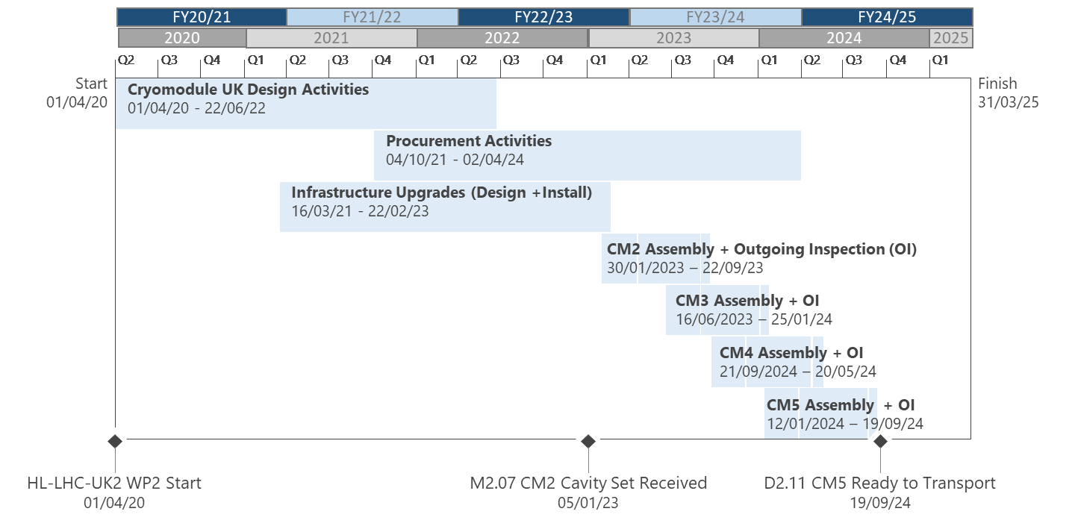
Timeline for Crab Cryomodule Production in UK
RFD CM Assembly
30/09/2021 to 08/09/2022
TRIUMF 2021 EIC Accelerator Partnership Workshop, 27th October 2021

Slide 20
Conclusions
RFD Pre-Series CM assembly will start in the coming weeks
On track with long lead time procurement/manufacture.
New infrastructure installed at DL for CM assembly.
Testing to take place for the CM Transport Frame
RFD Pre-Series CM assembly should be complete in September 2022
Work started to adapt Cryomodule design for DQW Series.
Series CM assembly to start at DL in January 2023, with 4 modules complete by September 2024.
TRIUMF 2021 EIC Accelerator Partnership Workshop, 27th October 2021

Slide 21
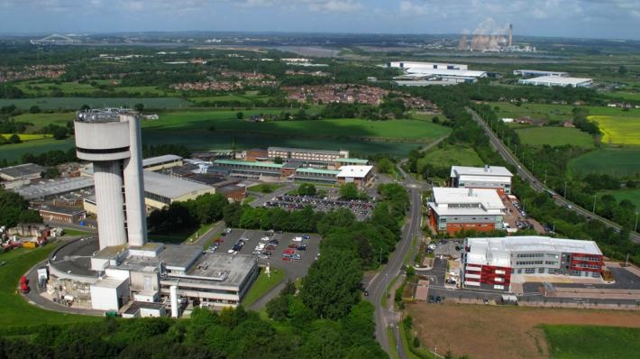

Any Questions?

