Slide 1
International Collaborations for HL-LHC (Crab Cavities)
HL-LHC WP4, CERN
27 October 2021

Slide 2
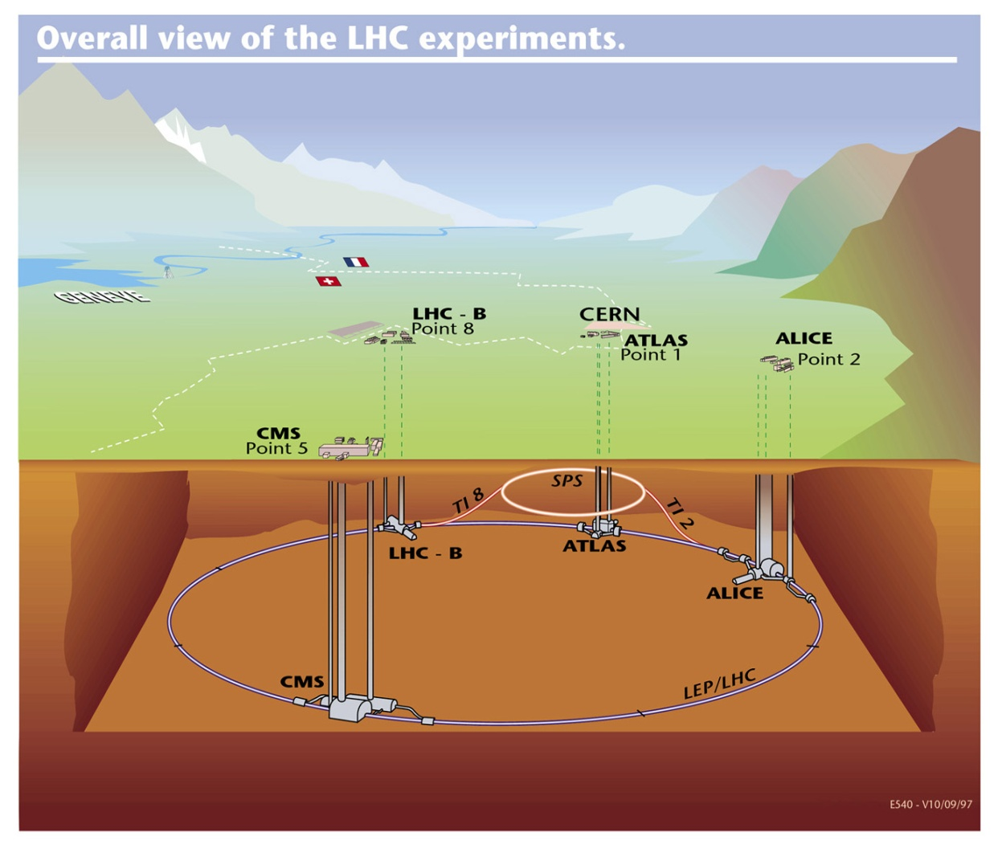
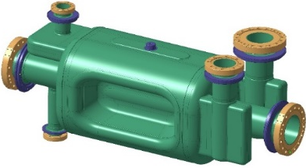
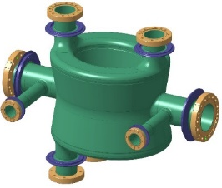
HL-LHC Crab Cavities (WP4)
4+1 RF Dipole cryomodules
US-AUP, Canada, CERN & Russia
SPS BA6 – CERN & UK
2 Test Prototype
(1-DQW, 1-RFD)
4+1 DQW Cryomodules
UK, CERN, Russia
*each cryomodule consists 2-cavities & independent powering system and control /cavity

Slide 3
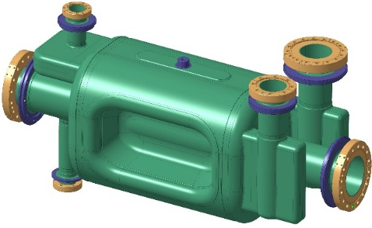
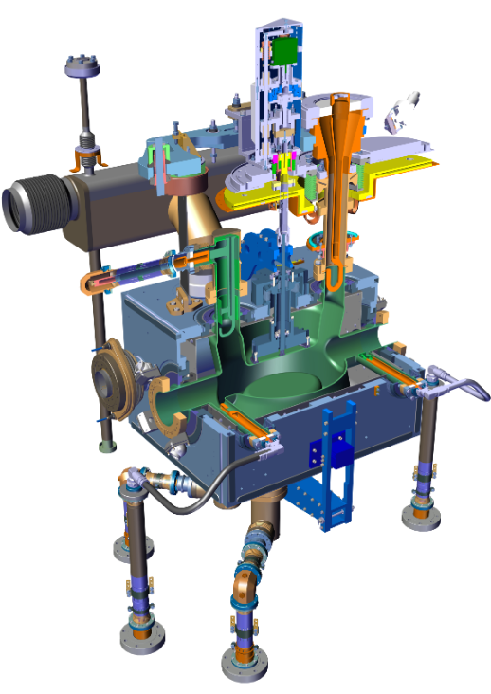
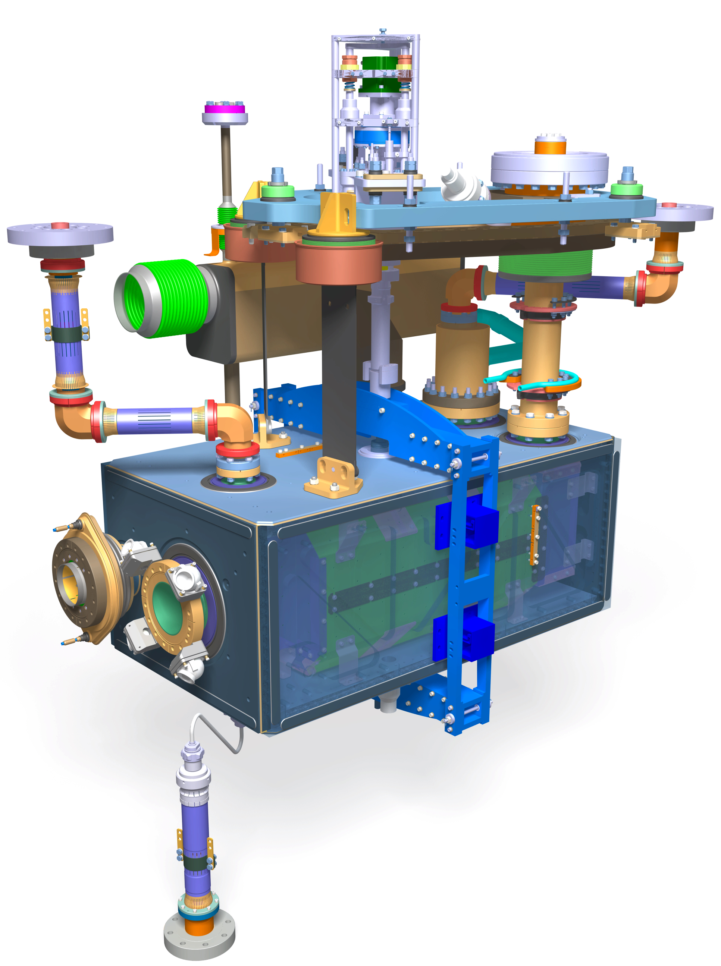
Reminder: Dressed Cavity Geometries
Double Quarter Wave
RF Dipole
$f_{0}=400 MHz$
$VT = 3.4 MV$/cavity*
($E_{p}, B_{p} <40 MV/m, 70 mT$)
$$Beam aperture = 84 mm$$
Common FPC = 40 kW-CW
Operating Temp = 2 K
*Engineering spec: 4.1 MV dressed for 20% margin

Slide 4
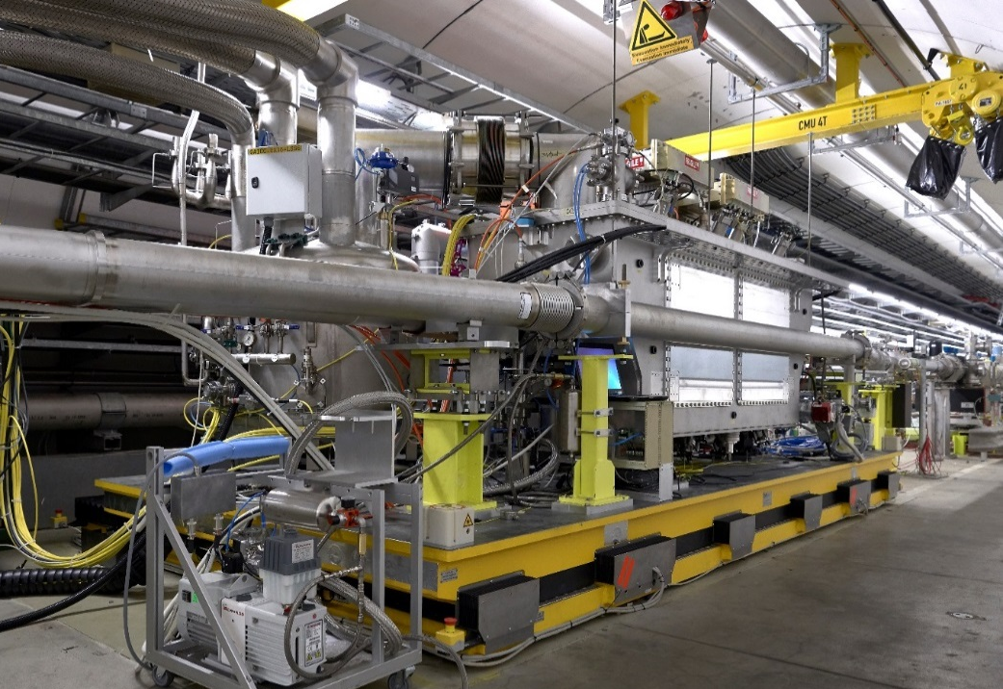
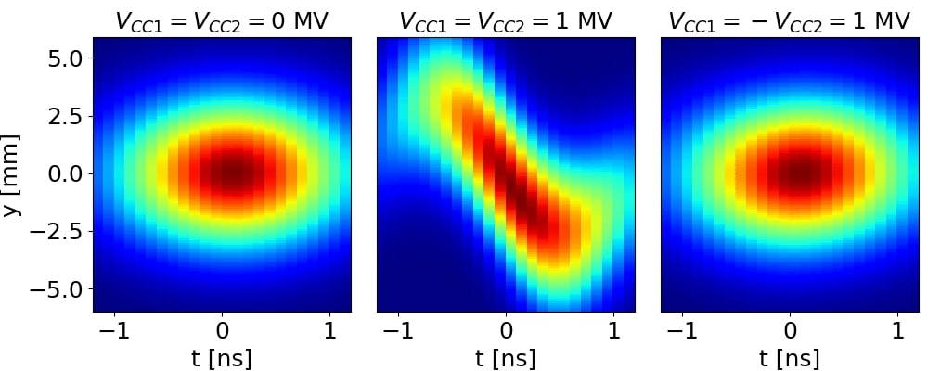
2018: DQW Prototype Module Validated!
Phys. Rev. Accel. Beams 24, 062001
*CERN built with contributions from UK, US & Japan

Slide 5
RF Dipole Prototype for SPS Tests (CERN + UK)
Dressed cavities CERN
Cryostating at the UK

Slide 6
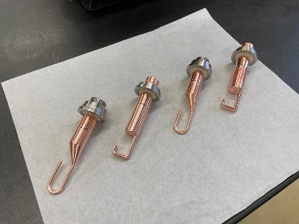
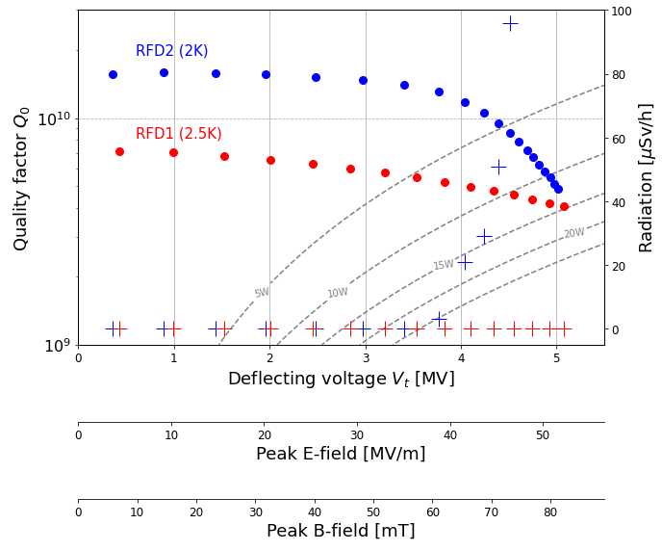
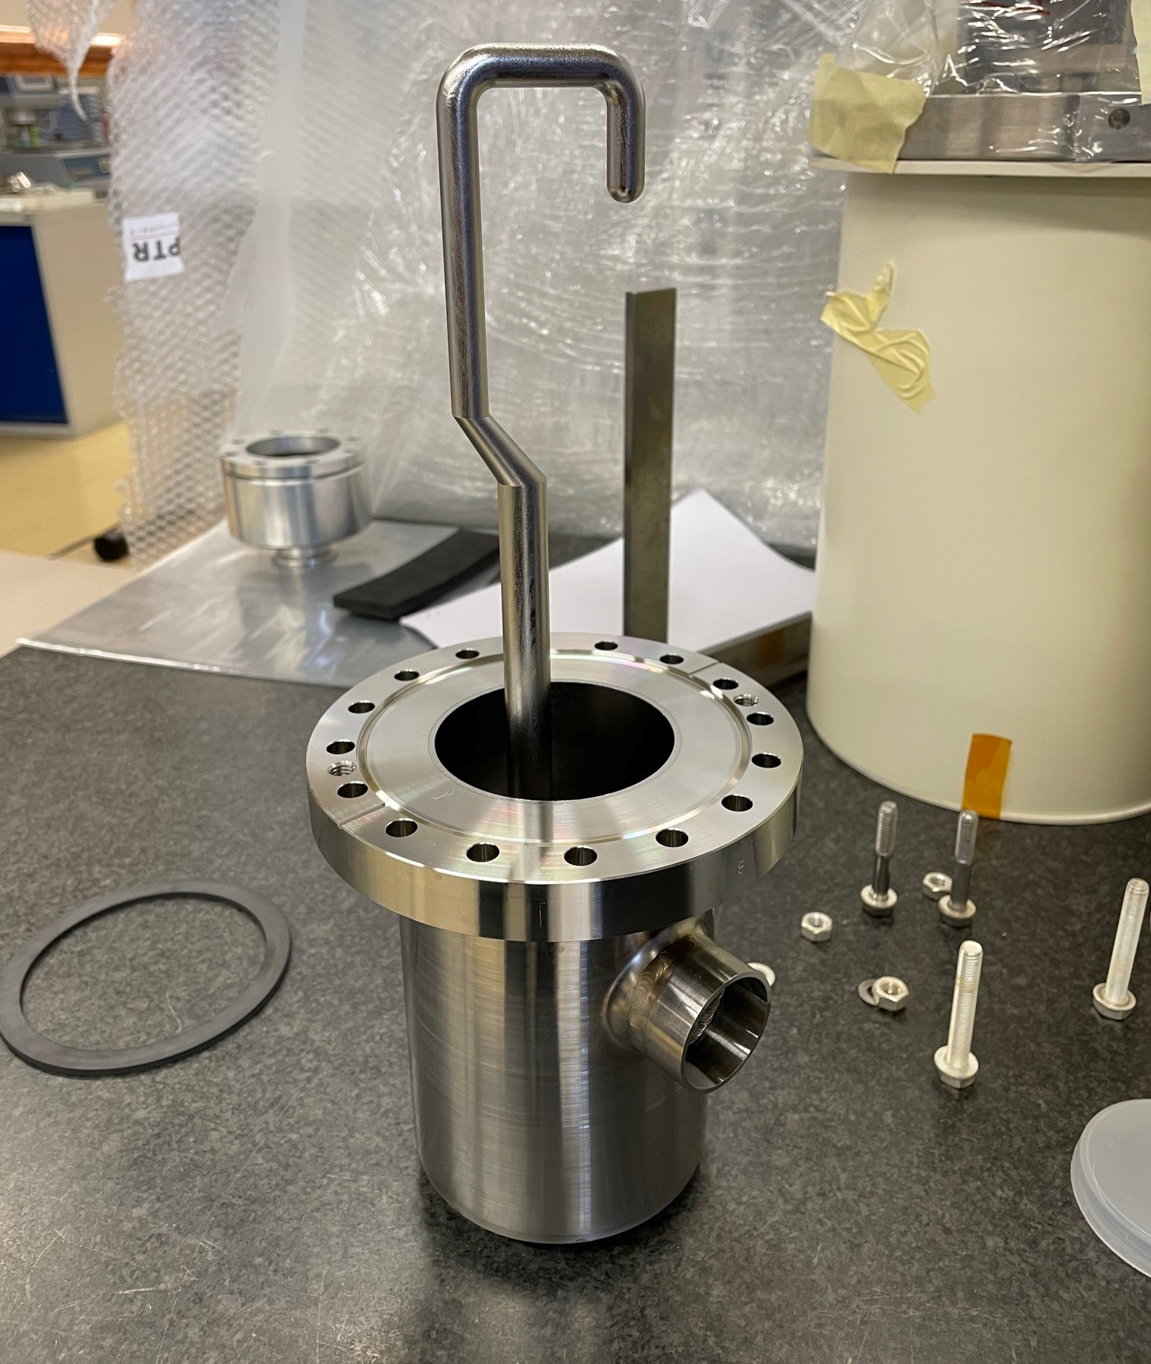
RF Dipole Dressed Cavity - CERN
Standardized $25Ω$ feedthrough for all HOM couplers validated
Note: RFD1 tested at 2.5K due to superfluid leak, the leaky flange was tightened at warm

Slide 7
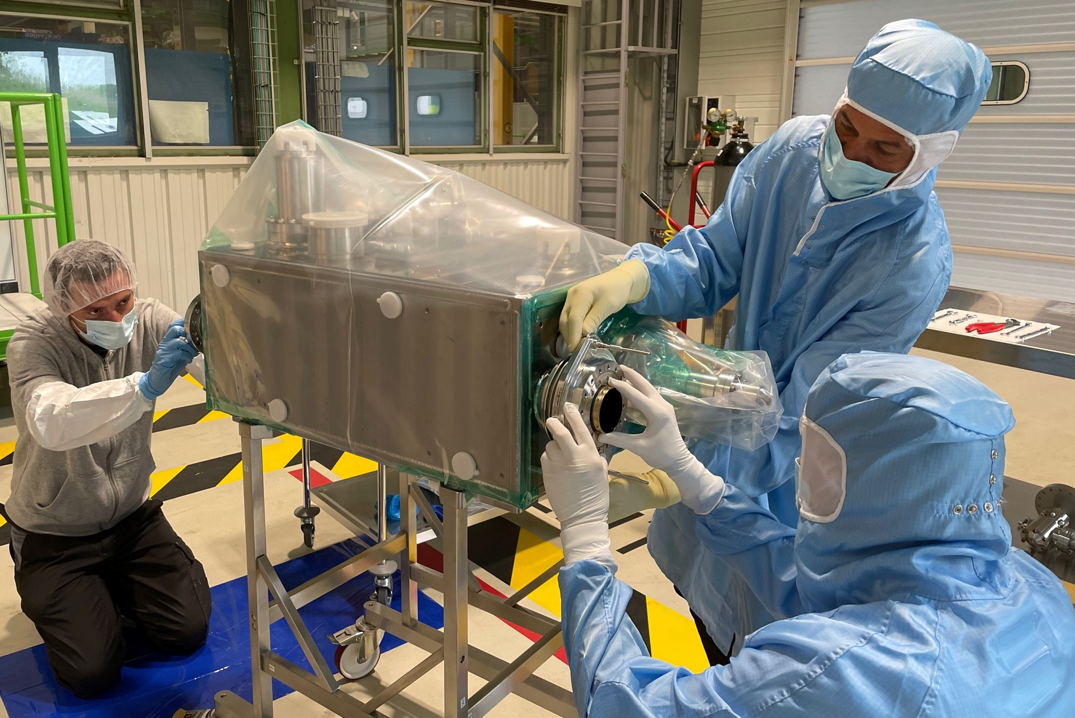
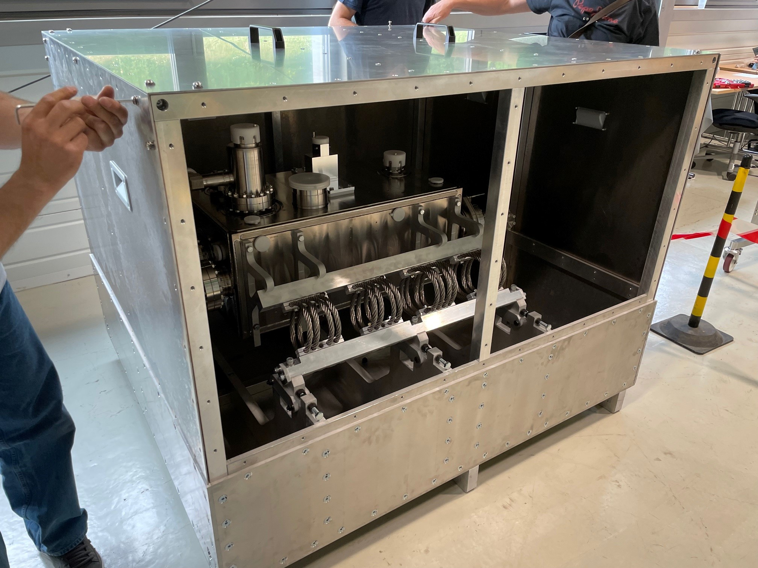
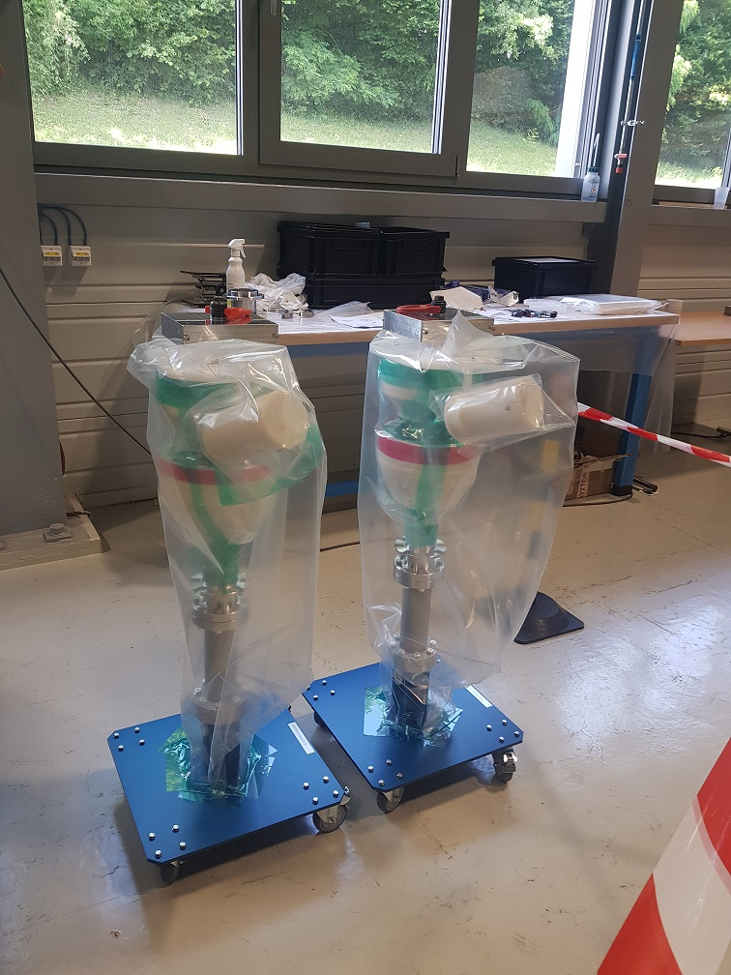
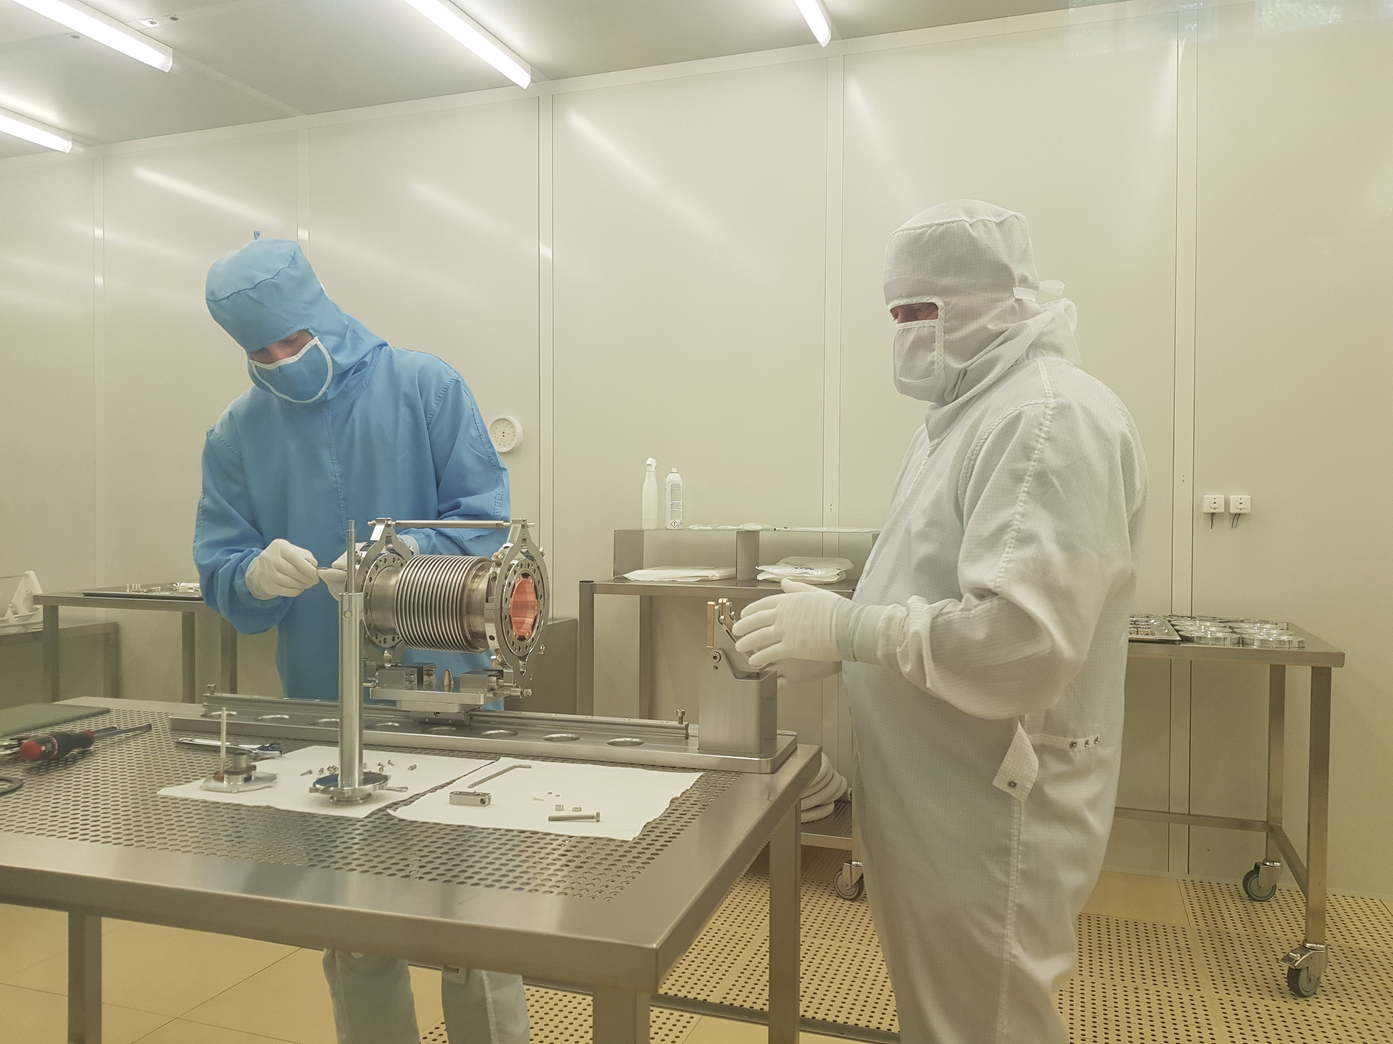
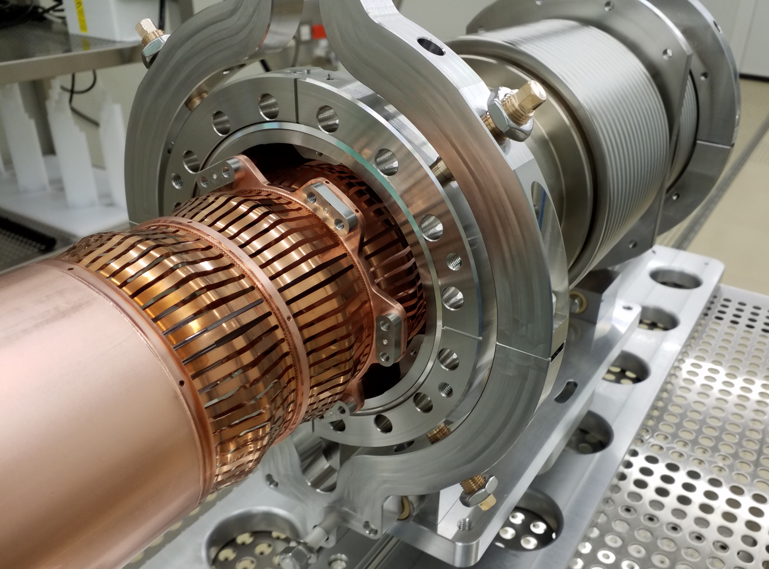
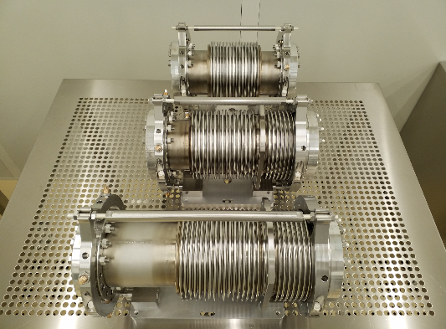
Final Assembly & Transport
Important learning experience both for CERN and collaborations for the series production
(see Wed WP4 parallel)
RFD2 beam screen assembly
Transport Frame/box
RFD Power couplers
Plug-in-module assembly
Cavity line

Slide 8
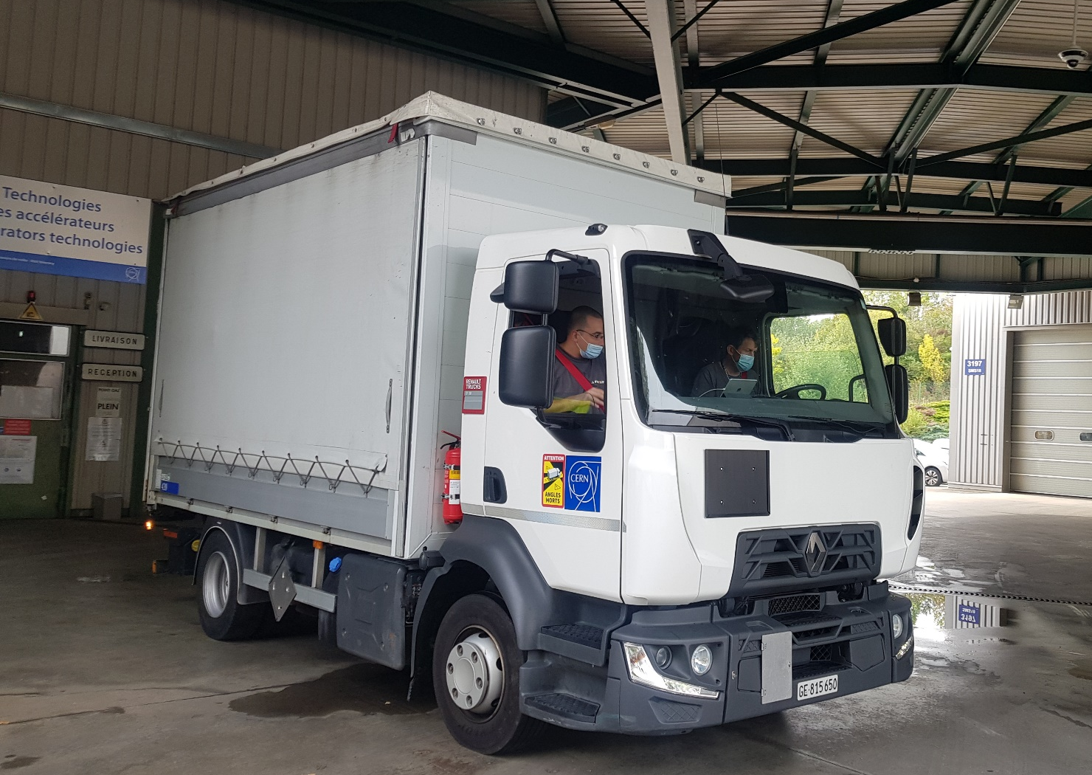
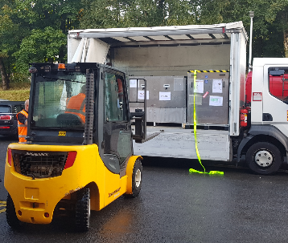
RF Dipole 2 Transport (27-Sept, 2021)
CERN-SM18
UK
Dedicated and fully instrumented transport, executed smoothly
See Thursday afternoon session

Slide 9
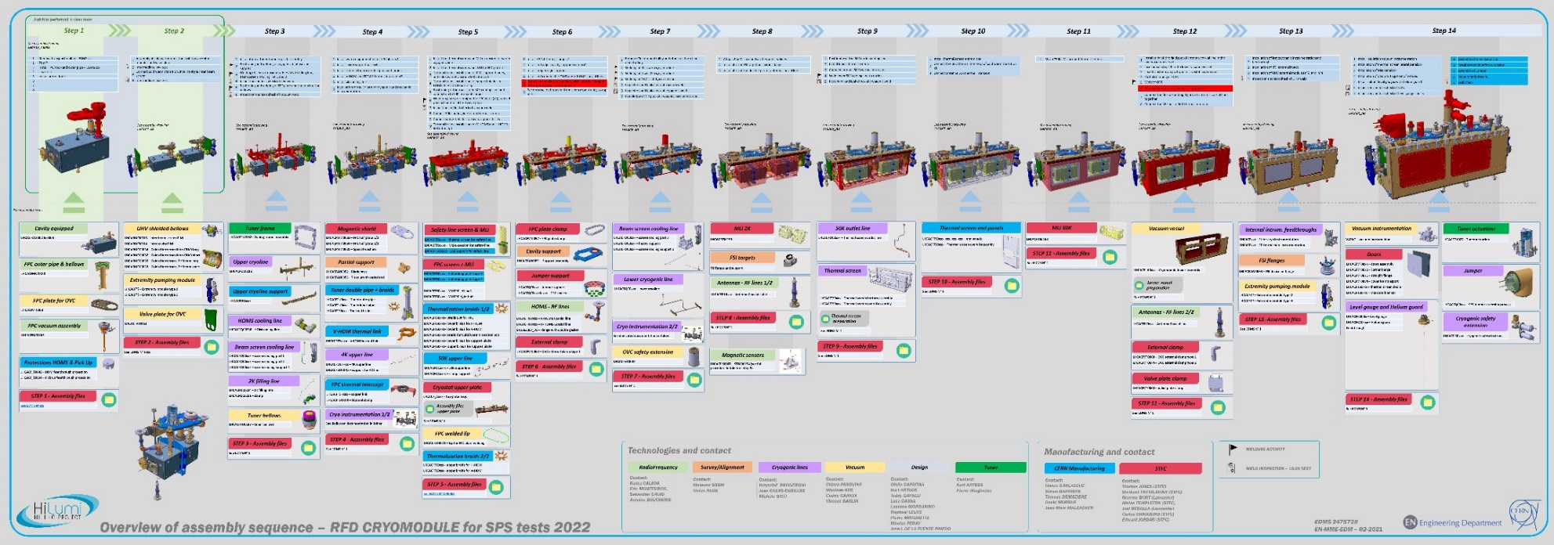
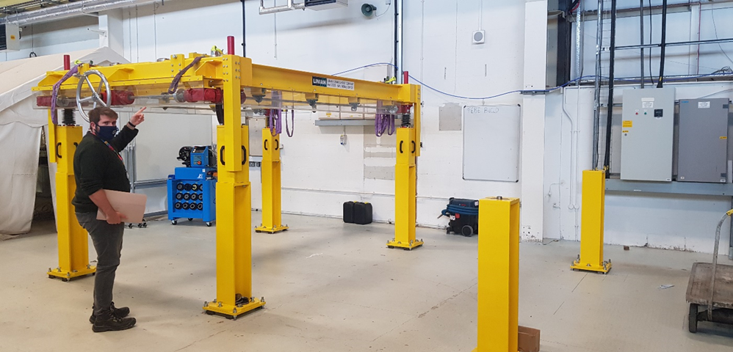
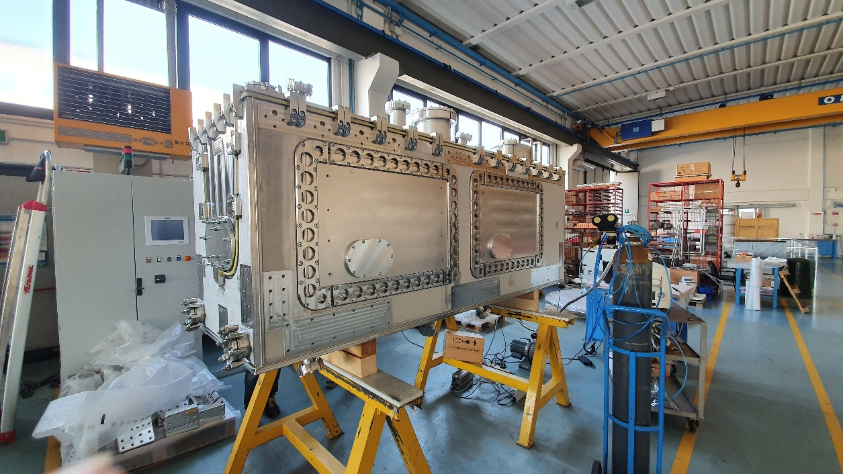
Next Steps: RF Dipole Cryostating
Dressed
Cavity
String Assembly
Cryostating
Q3 2022
See next talk: T. Jones
Vacuum vessel leak check
Cryomodule Lifter

Slide 10
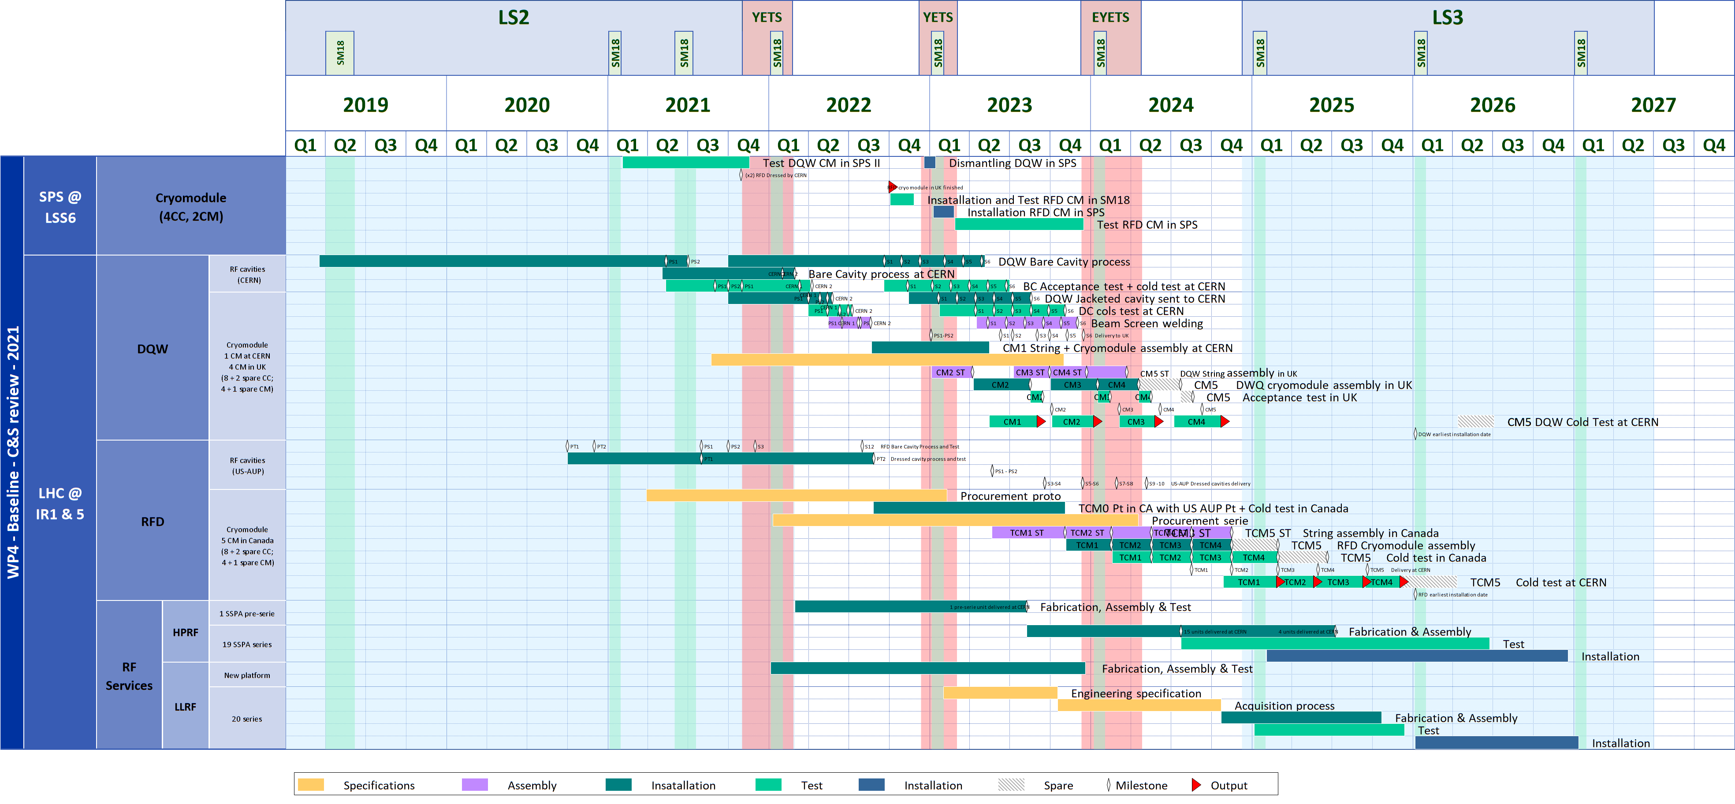
Masterplan of WP4
Courtesy: Planning Team
Prototype (SPS-tests)
HL-LHC Series

Slide 11
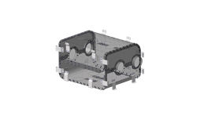
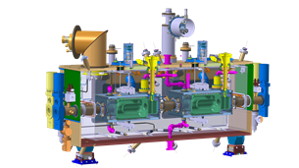
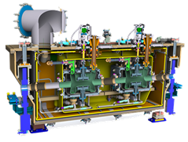
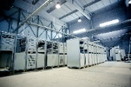
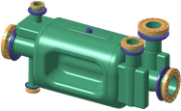
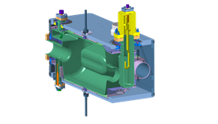
HL-LHC Series (CERN, Canada, Russia, UK, US-AUP)
HPRF Lines
Components (FPC, beam screen, RF lines, …)
Components
5 DQW cryomodules | 5 RFD cryomodules | 20 Solid State RF Systems
Cavities + processing + helium vessels by Research Instruments (DE) & CERN Cold magnetic shields by UK HOM couplers + antennas by CERN 4 CM by UK (STFC) & 1 CM at CERN with some components from CERN All cavities & CM cold validation tests at CERN (and a few at Uppsala-Sweden) | Bare cavities by Zanon (IT) under US-AUP Processing + cold magnetic shield + helium vessel + HOM couplers + antennas + cold tests by US-AUP 5 CM by TRIUMF-Canada with some components by CERN CM cold validation tests at CERN | High power solid state amplifiers by BINP-Russia High power RF lines, circulators, loads by MEPHI-Russia

Slide 12
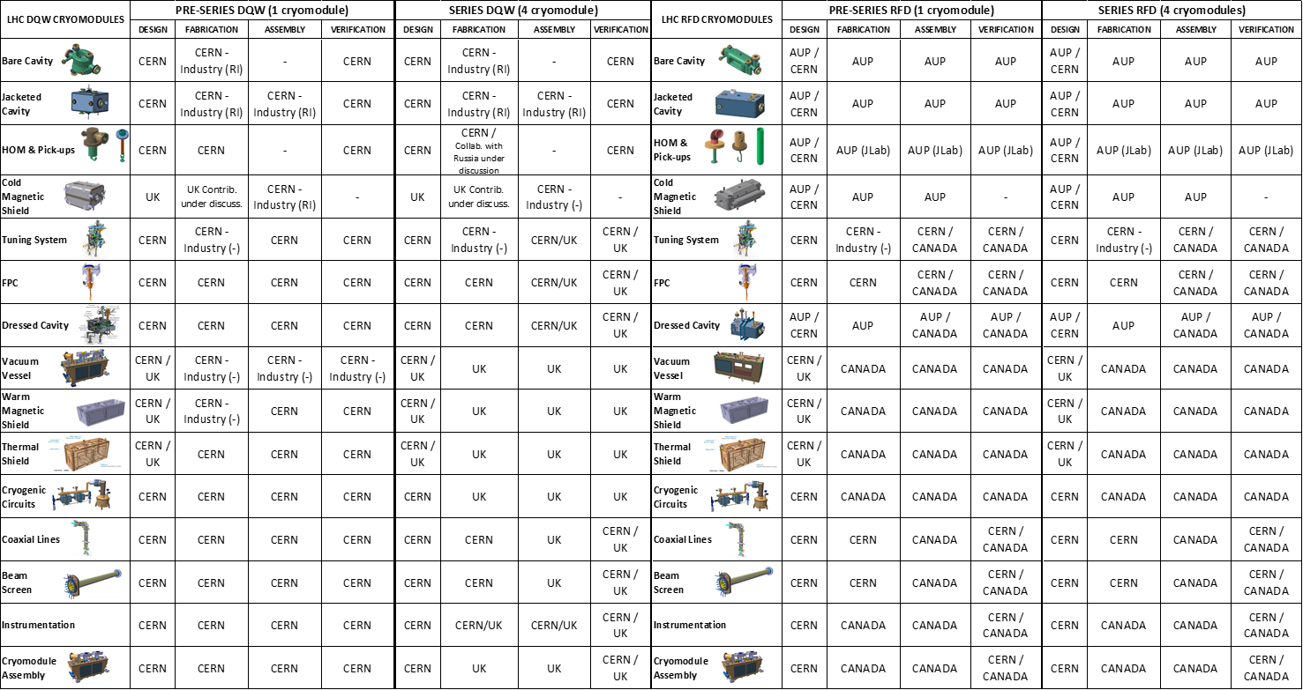
Supply Chain Crab Cavities
DQW
RFD

Slide 13
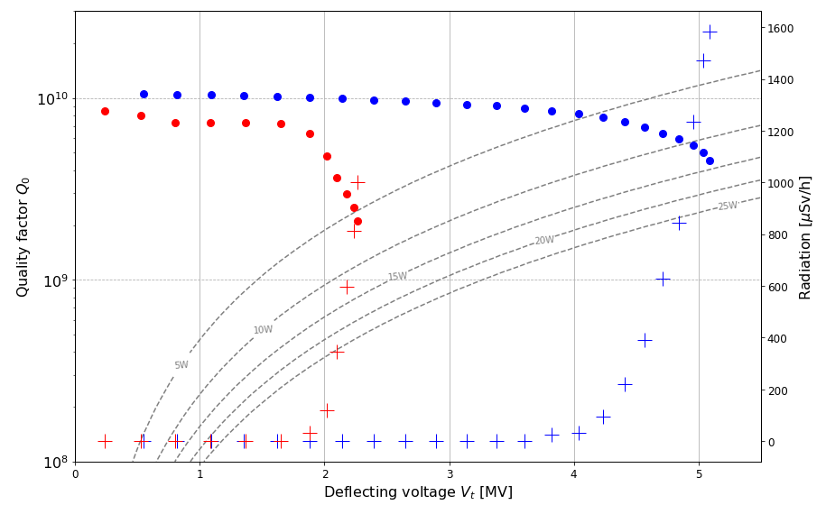
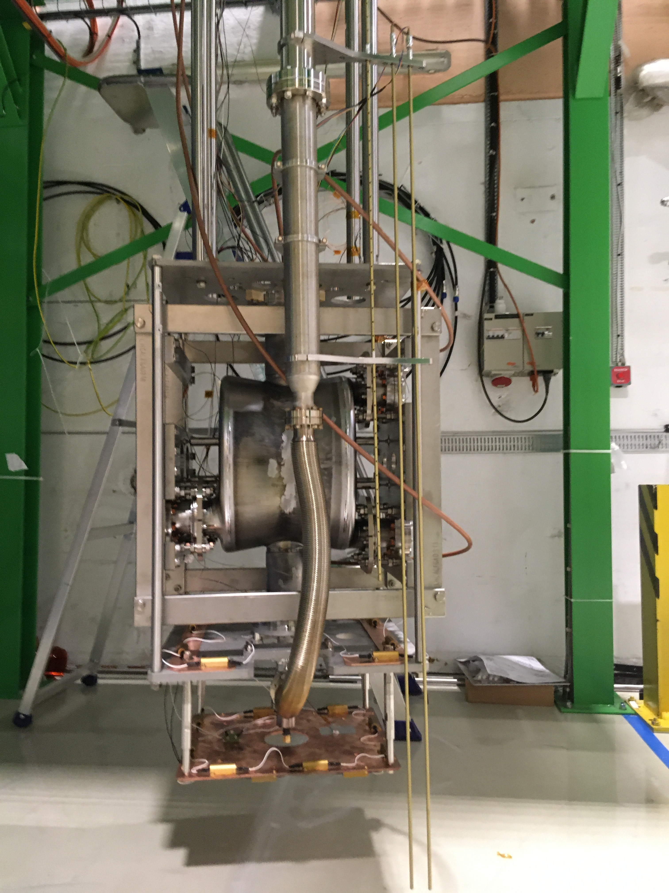
CERN DQW-Series with Industry
Successful manufacturing of 2 pre-series cavities with industry (RI) with 1-cavity reaching excellent results. Need to improve surface chemistry & cleanliness of the RF surface
Relatively long delays related primarily to conform with eng. specifications and aggravated due to COVID – but now on track for the series phase
DQW-RI

Slide 14
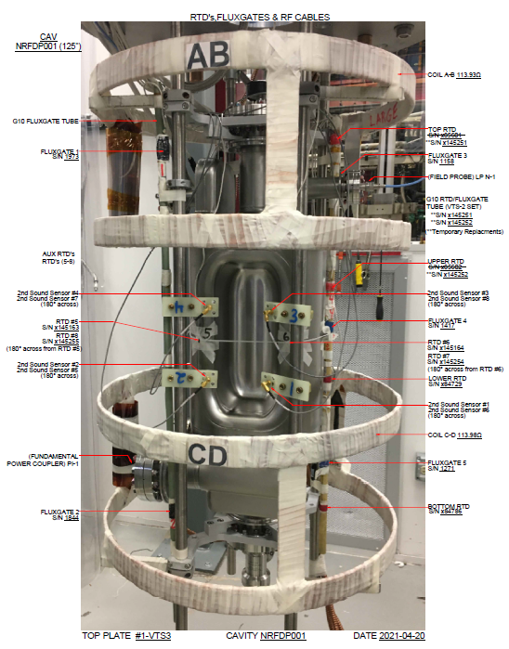
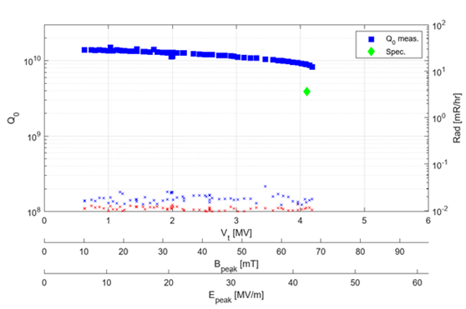
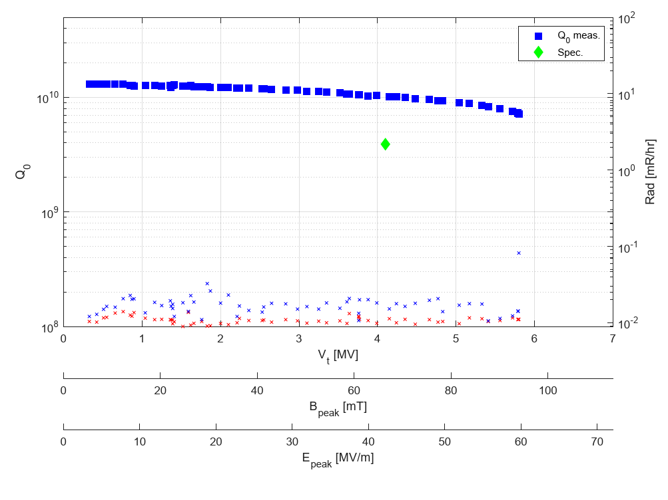
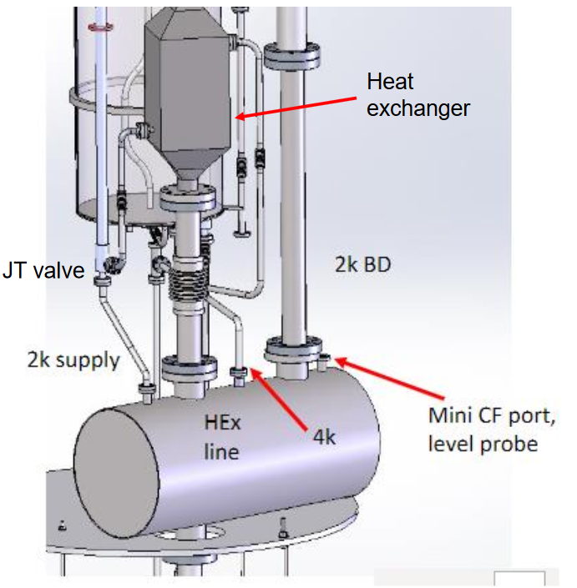
RFD Series (US-AUP & Canada)
Vertical test stand FNAL
Successful prototyping with industry (Zanon) to finish 2 cavities & test them beyond specification
Significant progress to launch pre-series & series
Preparations at TRIUMF for acceptance tests of dressed cavities
TRIUMF update to test dressed cavities at 2K
RFD2-AUP
RFD1-AUP

Slide 15
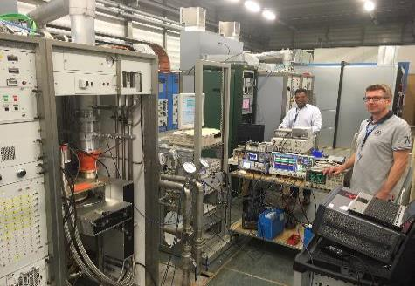
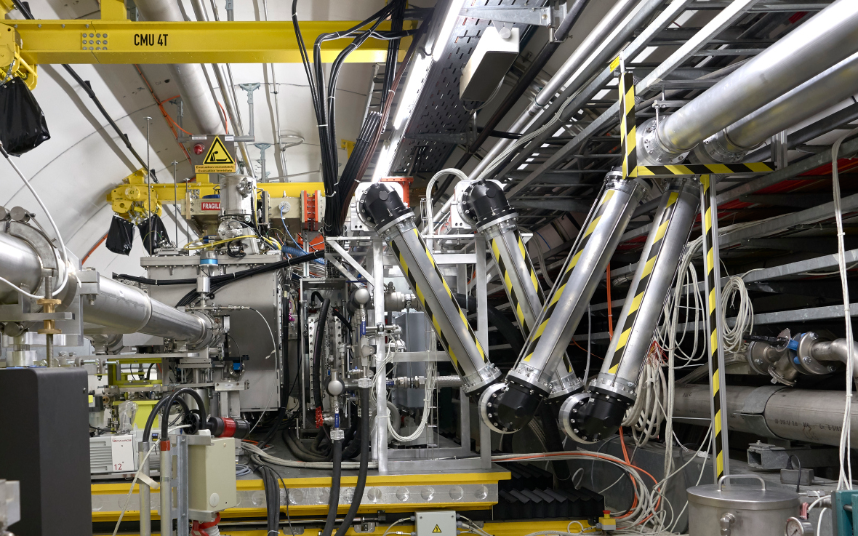
High Power RF for SPS Tests
Two 80 kW IOTs operational in SPS
Same system already in use for several years in the SPS for 800 MHz harmonic cavities. Adapted at CERN for 400 MHz for crabs
Rotatable high power waveguides to adapt the table movement
RF circulators and loads are of LHC type and a bit oversized
~150 m
Surface installation

Slide 16
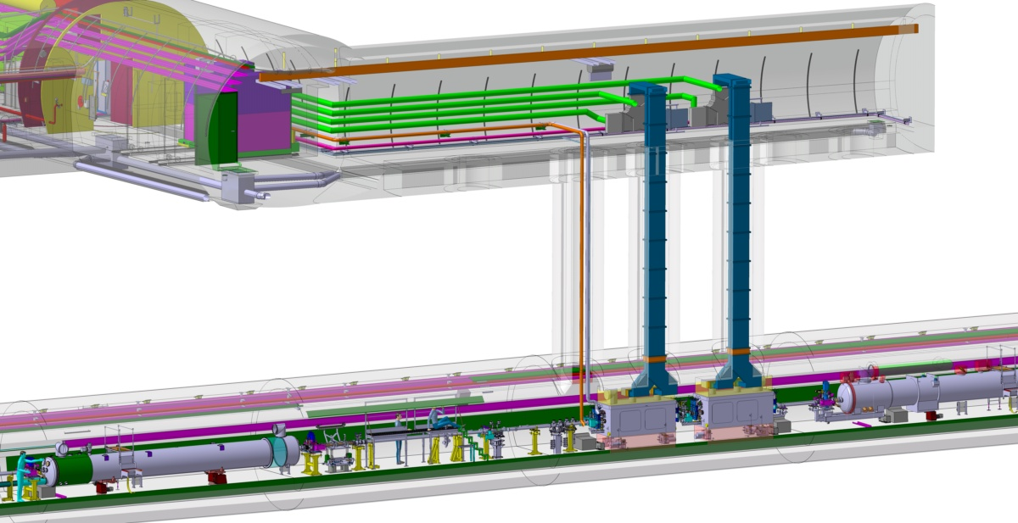
Series: High Power RF System & Chain
In-kind contribution BINP-Russia for high power amplifiers (solid state to replace IOT baseline)
In kind contribution for high power RF chain (transmission lines, circulators, RF loads)
UA Gallery to Tunnel Connection
UA Gallery on 1-IP side, Amplifiers
HL-LHC Tunnel
Graphics: Courtesy Integration

Slide 17
Final Comments
Two cryomodules (DQW & RFD) for SPS tests
DQW module successfully built at CERN and validated wit beam
RFD cavities fully validated, being transported to UK for cryostating
The RFD module is expected to be tested in SPS in 2023
Series production
Multi-lab collaboration & industry for series production
Only DQW cavities, HOM couplers, FPCs and some critical components are managed by CERN
Important contributions from Russia on solid-state power amplifiers and RF power chain for crab cavity powering

Slide 18
Thanks to HL-LHC management, CERN-Depts and our collaborations for their strong support
Special thanks to all WP4 colleagues for a fantastic job in 2021

Slide 19
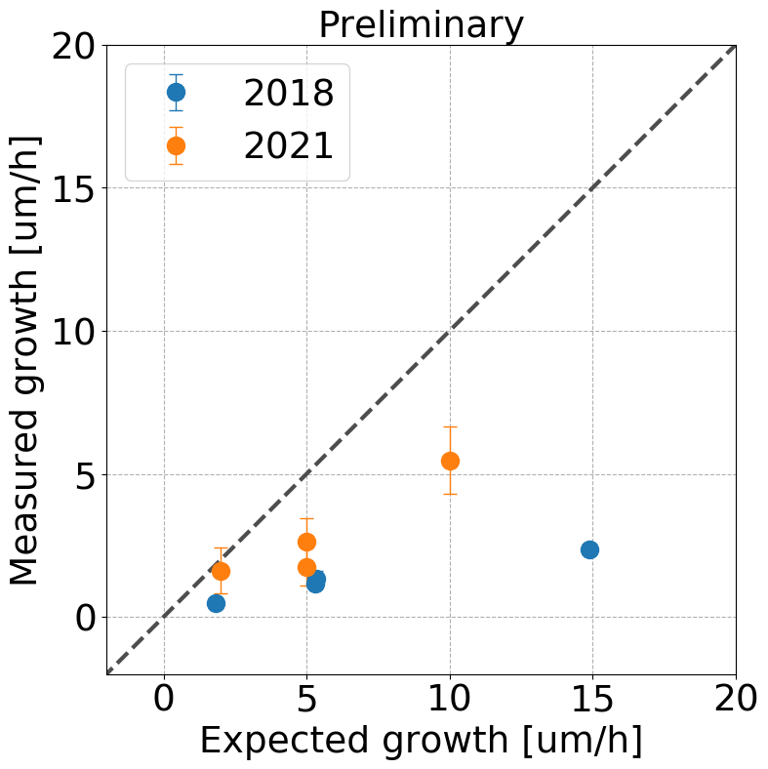
2021: DQW-SPS Re-commissioning
Important cryogenic consolidation and tuner consolidation completed during LS2. Cavity alignment reproducible ($\sim 50μm$)
(270 GeV)
MD on emittance growth successfully performed 13-Oct-2021 (200 GeV)
(200 GeV)
Analysis underway WP2/WP4
Cavities recommissioned; RF conditioning close to 2 MV. LLRF commissioned to ~1.5 MV
Re-learning of the cavity setup not trivial, also long
X-axis Not fully calibrated

Slide 20
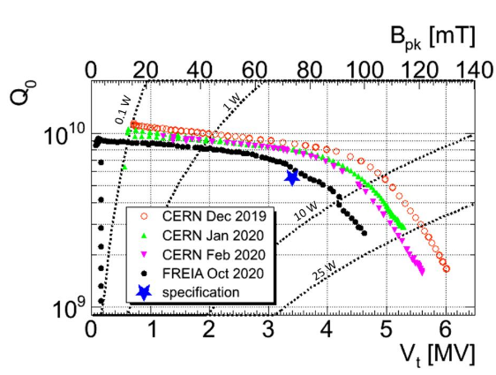
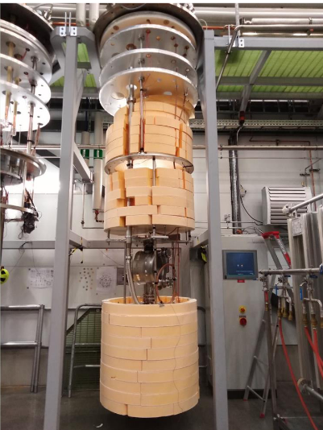
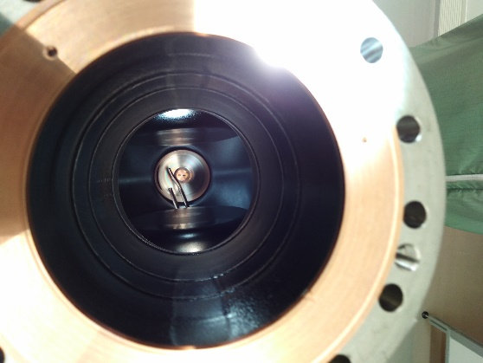
Cavity Testing at Uppsala/FREIA
USLARP prototype cavity test comparison between SM18 & FREIA – 2020 – successful with slightly lower performance
In 2021, cavity was re-rinsed at CERN for a 2nd validation test
During transport, the vertical test field antenna (fragile connection) fell off and had to sent back to CERN
2021 Antenna issue
2020 tests

