Slide 1
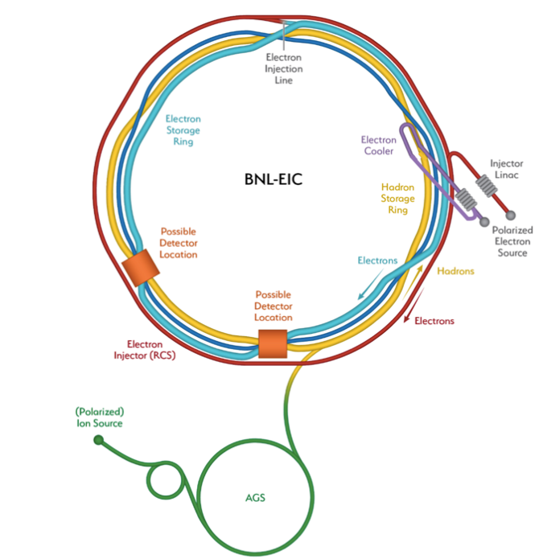

SEY properties of electron cloud mitigators at cryogenic temperatures
Marco Angelucci
LNF-INFN, Via E. Fermi 54, 00044 Frascati (Rome), Italy

Slide 2
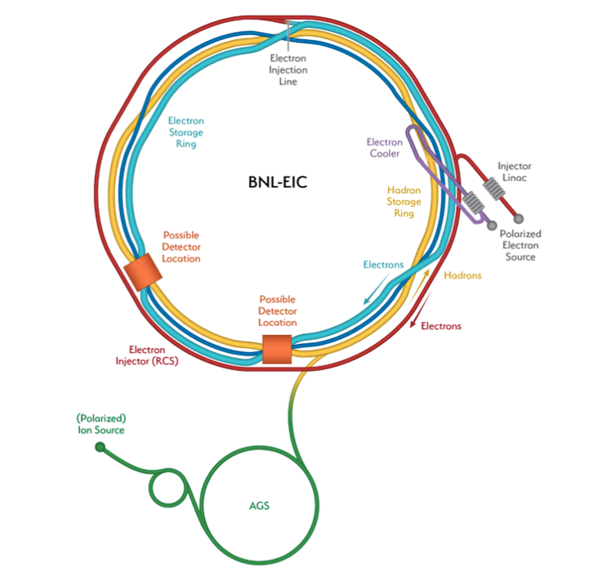

Slide 3
Introduction
The highest luminosity of L = 1 × 10³⁴ cm⁻² s⁻¹ is achieved due to the large circulating electron and proton beam currents distributed over as many as 1160 bunches.
The short spacing between the high-intensity bunches of the EIC favours the electron cloud build up which can lead to:
  vacuum degradation;
  beam instabilities;
  emittance growth;
  excessive heat load;
  etc.
e-cloud mitigation is crucial

Slide 4
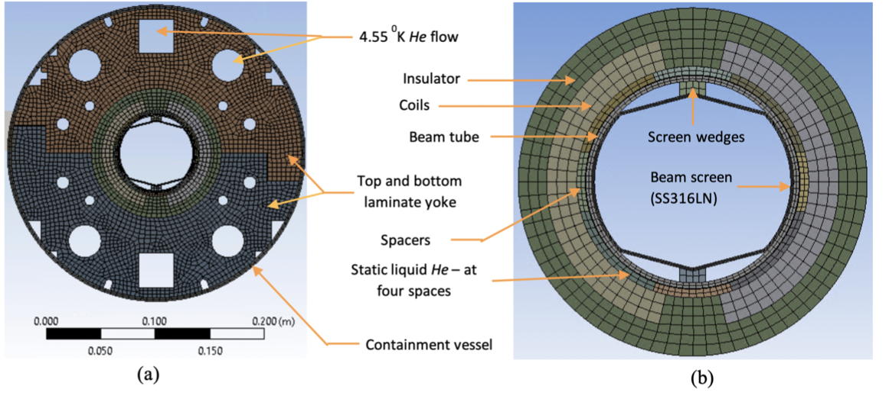
Introduction (Mitigation Strategy)
In the non-cryogenic (warm) sections, the electron cloud can be mitigated by using non-evaporable getter (NEG) coating.
To avoid high RW heating and electron cloud, a beam screen (BS) will be installed in the beampipe of the RHIC superconducting magnets.
K
EIC CDR 2021

Slide 5
EIC HSR beam screen must ensure:
Adequate vacuum level and stability.
Low impedance to limit dynamic heat load and to avoid impedance-driven instabilities.
The control of e-cloud build up.

Slide 6
EIC HSR beam screen will made of:
Non-magnetic 316LN stainless steel.
Oxygen-free high-conductivity (OFHC) copper.
K
EIC CDR 2021

Slide 7
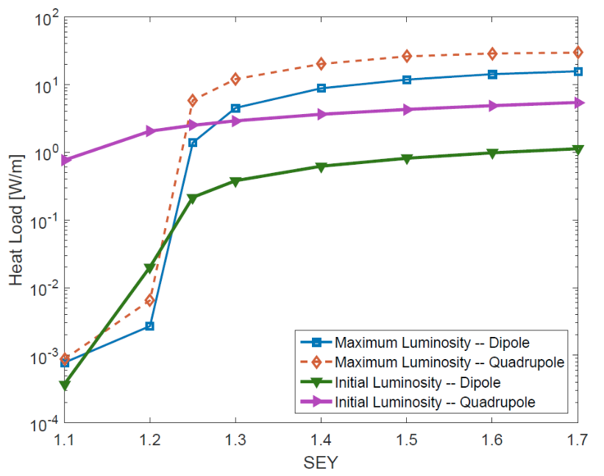
Heat Load on the BS (SS + OFHC copper)
The OFHC copper has a conductivity that is several orders of magnitude larger than 316LN stainless steel at 4 K, leading to smaller RW impedance and dynamic heat load expected from beam-induced currents.
The electron cloud starts for SEY values above 1.1.
EIC CDR 2021
e-cloud mitigator with SEY< 1.02
Heat load as a function of SEY for the EIC proton beams for initial and maximum luminosity scenarios

Slide 8
EIC HSR beam screen will made of:
Non-magnetic 316LN stainless steel.
Oxygen-free high-conductivity (OFHC) copper.
Low SEY coating. (a-C)
K
EIC CDR 2021

Slide 9
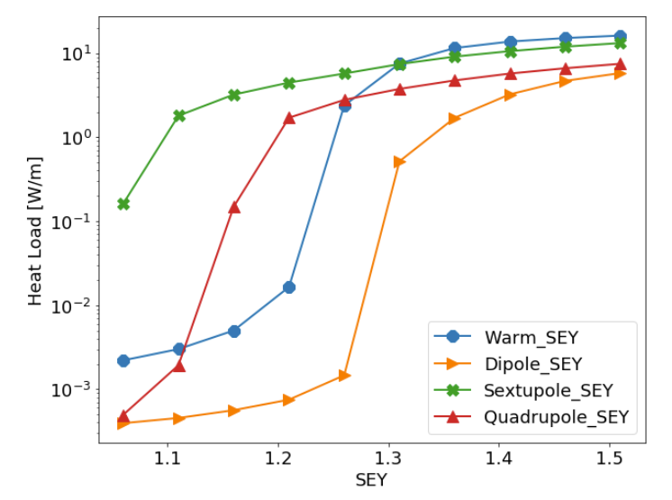
Heat Load on the BS (SS + OFHC Cu + a-C coating)
a-C film deposited on the copper surface. (SEY < 1.02)
The thickness of the a-C film can have significant impact on the RW impedance.
EIC CDR 2021
Minimum Thickness of a-C coating
Heat load as function of SEY for maximum luminosity scenario including a beam offset of 14 mm.

Slide 10
Studies of SEY of Cu with thin a-C coating
thermal evaporation from graphite rod
XPS analysis
(Coverage Estimation)
SEY measurements
Cu KLL
Minimum thickness evaluation

Slide 11


Minimum thickness of a-C coating on Cu
XPS estimation of Coverage
Conversion of deposition time to Carbon Coverage (nm)
Cu KLL
M. Angelucci et. al; Phys. Rev. Research Rapid comm. 2, 032030(R) (2020)

Slide 12
Minimum thickness of a-C coating on Cu
SEY Evolution
Low coverage ( < 6 nm):
Strong SEY modification
High coverage ( > 6 - 8 nm):
Stable δ_{max} <1
Low variation in the low ( <50 eV) and high (>500 eV) regions
M. Angelucci et. al; Phys. Rev. Research Rapid comm. 2, 032030(R) (2020)

Slide 13
SEY variation at Cryogenic Temperature
SEY is an intrinsic material property strongly sensitive to the surface composition and chemical state
SEY of cryogenic surfaces influenced by gas physisorption:
Coverage (even at sub-monolayer)
L. A. Gonzalez et al., AIP Adv. (2017)

Slide 14
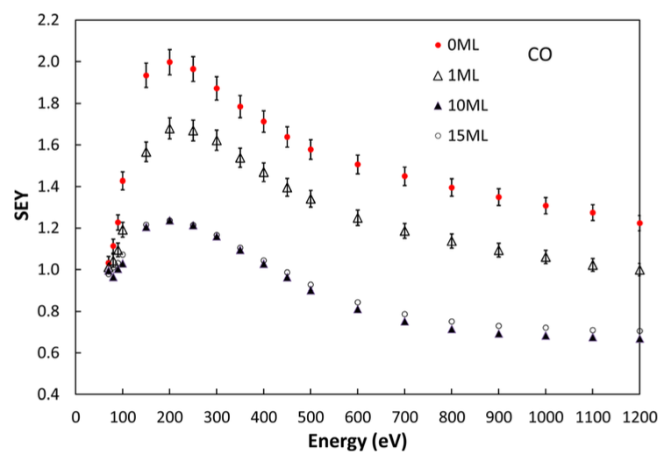
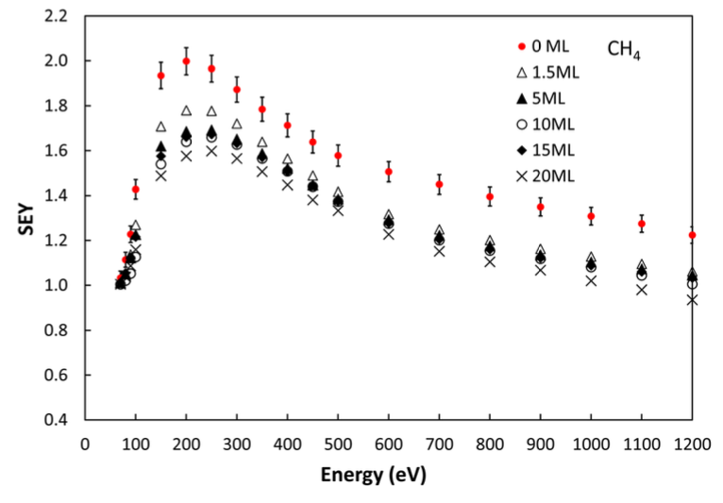
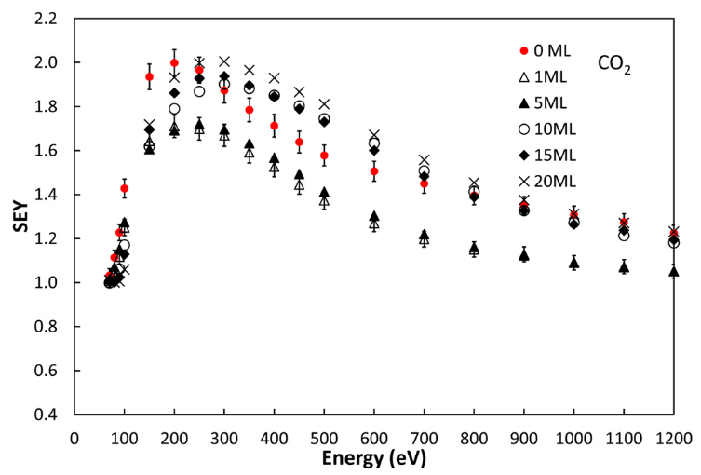
SEY variation at Cryogenic Temperature
SEY is an intrinsic material property strongly sensitive to the surface composition and chemical state
SEY of cryogenic surfaces influenced by gas physisorption:
Adsorbed gas
influences SEY
Coverage (even at sub-monolayer)
Gas Species
Kuzucan et al.,
J. Vac. Sci. Technol. A (2012)

Slide 15
SEY variation at Cryogenic Temperature
SEY is an intrinsic material property strongly sensitive to the surface composition and chemical state
SEY of cryogenic surfaces influenced by gas physisorption:
How is a-C thin film SEY modified by adsorbed gas?
Coverage (even at sub-monolayer)
Gas Species
Kuzucan et al.,
J. Vac. Sci. Technol. A (2012)

Slide 16
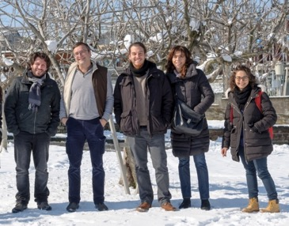

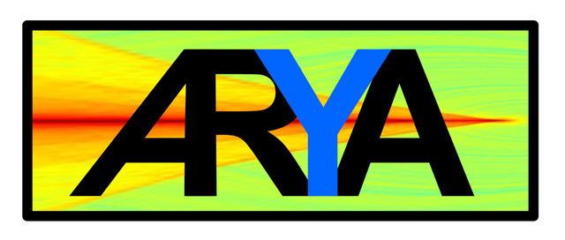

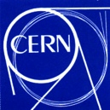
Thank You
Thanks to the low temperature team at LNF:
R. Cimino, A. Liedl, R. Larciprete, L. Spallino.
Tanks to the technical support of DAФNE-L Team:
A. Grilli, M. Pietropaoli, A. Raco, V. Tullio, V. Sciarra and G. Viviani
Thanks to ARYA supporting project funded by INFN-SNC5

