Slide 1
EIC IR Magnet Designs and BNL Magnet Capabilities
Kathleen Amm
Director
ammk@bnl.gov

Slide 2
Magnet Division
Vision-
To be a world class superconducting and electromagnetics team creating the future of superconducting magnet technology. This includes leadership in superconducting magnet technology, magnet development, manufacturing and testing with application to accelerator, science, fusion and industrial applications
Mission –
Utilize world class capabilities to:
Advance the science and technology of superconducting magnets
Apply these technologies to support accelerators, fundamental science discoveries, energy and other industrial applications requiring high magnetic fields
Ensure a strong national talent pool for superconducting magnet development in the US

Slide 3
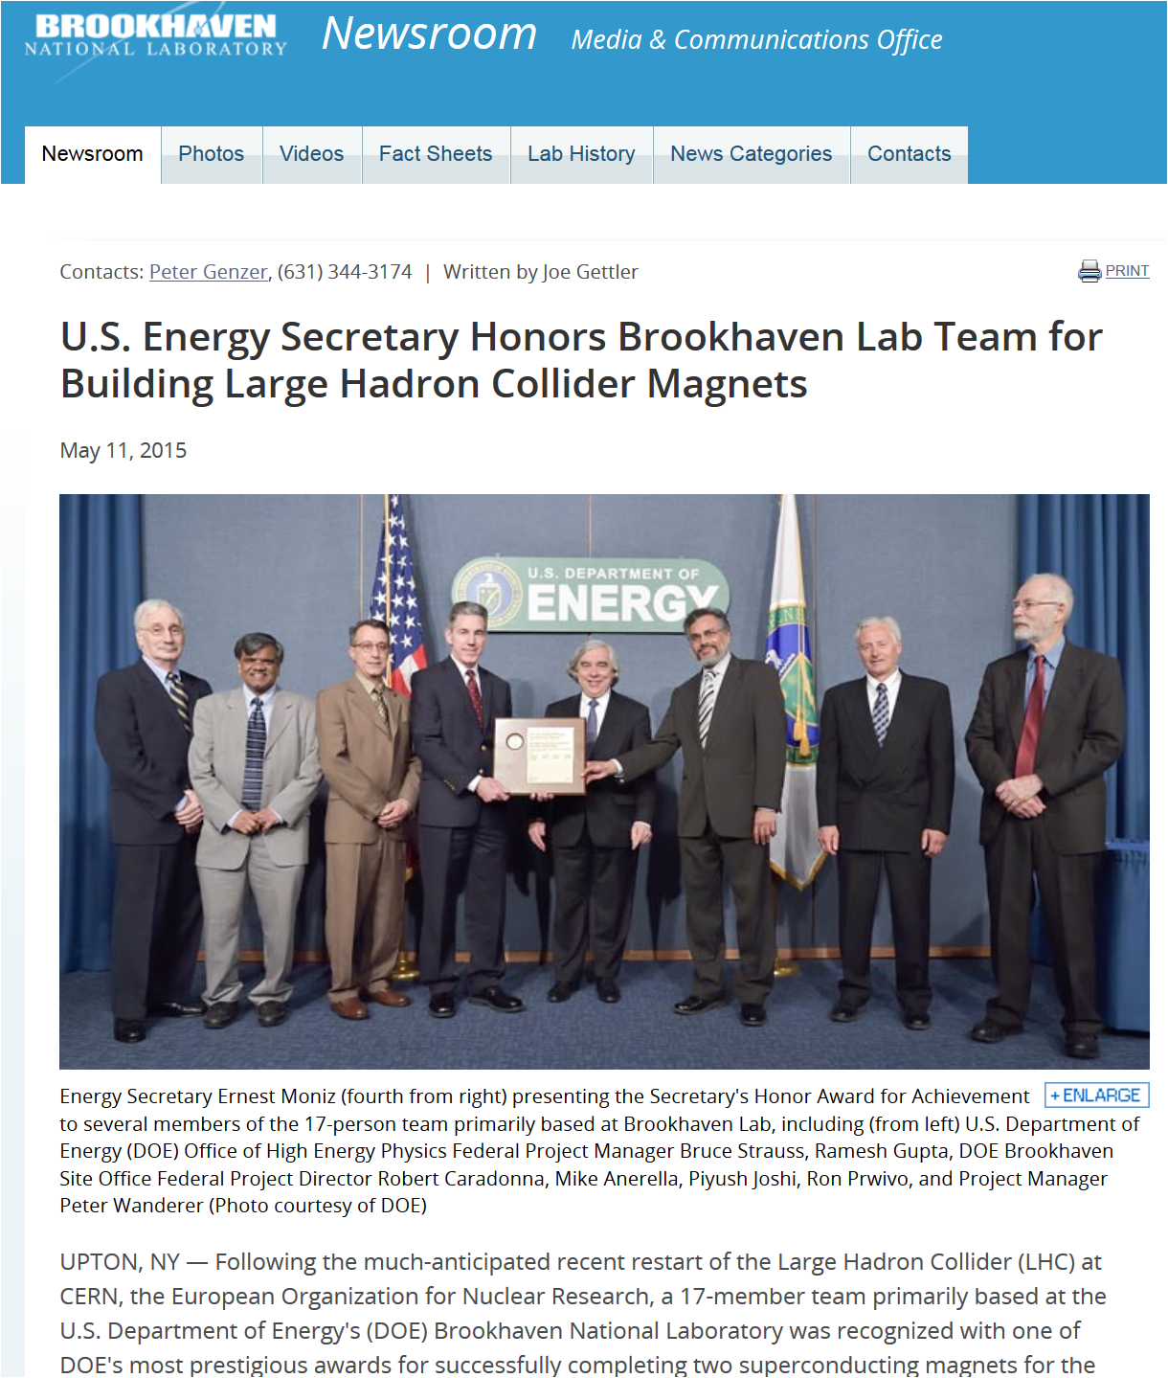
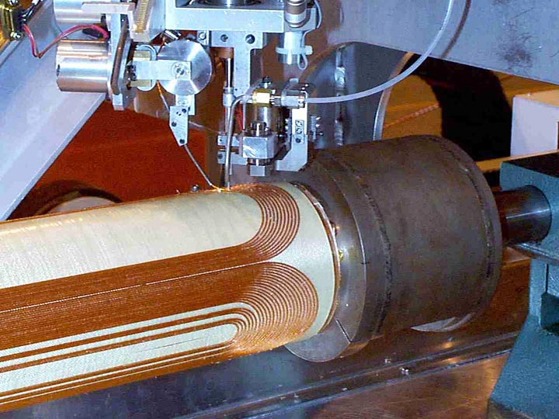
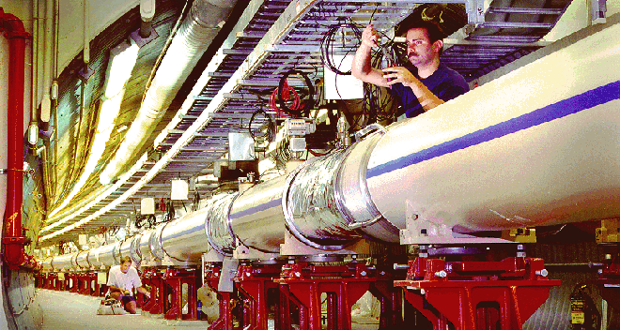
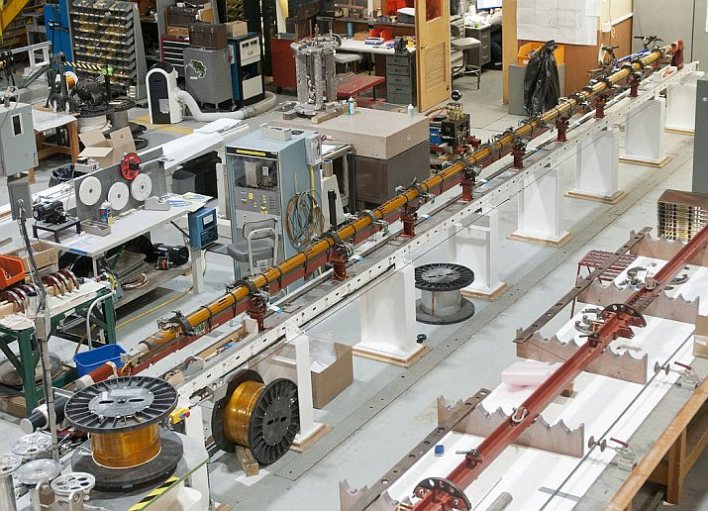
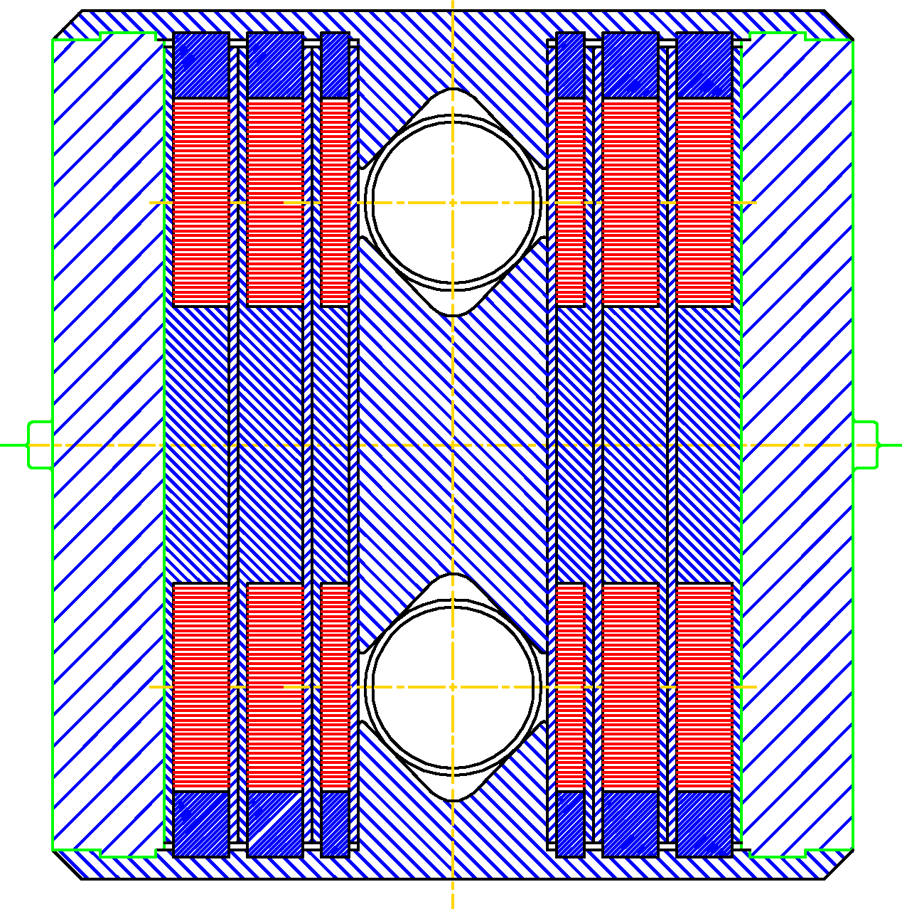
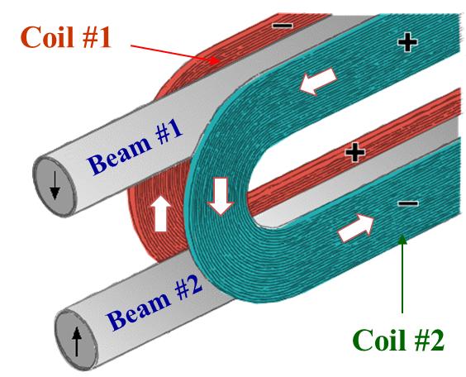
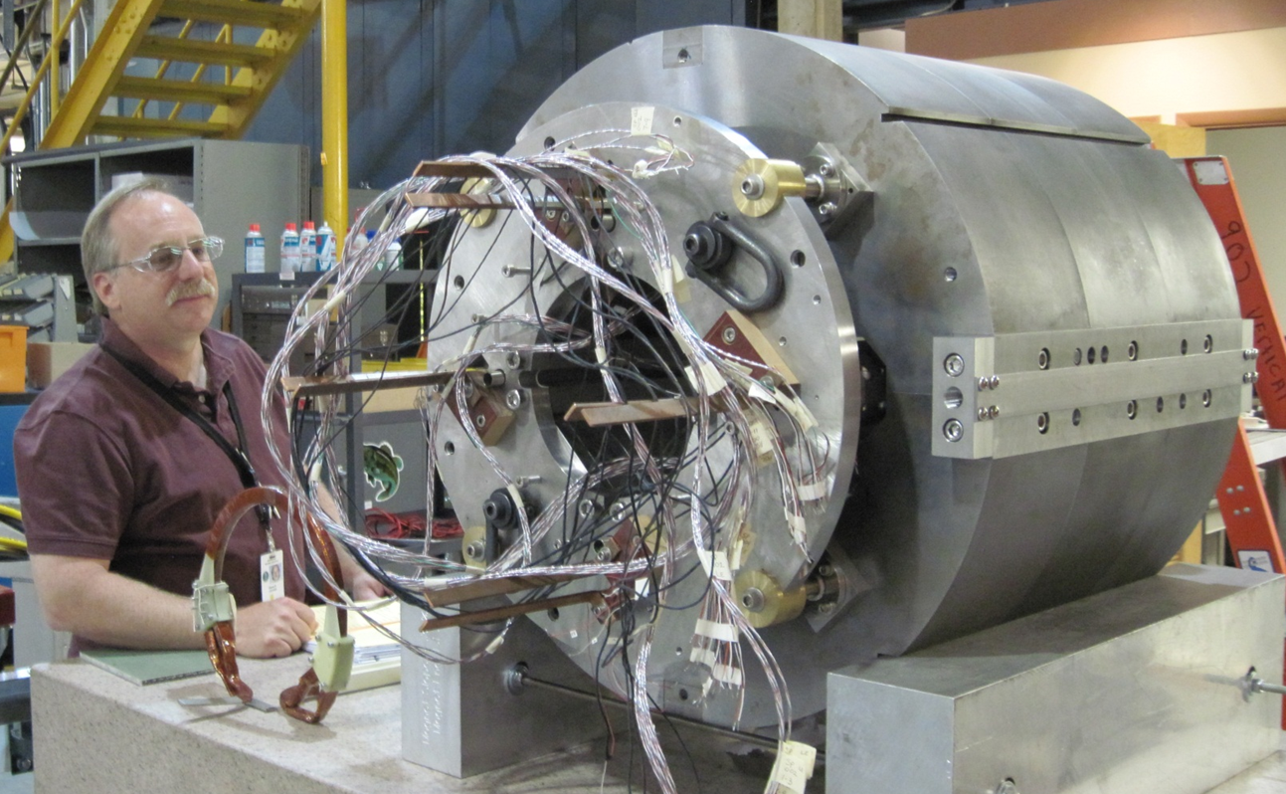
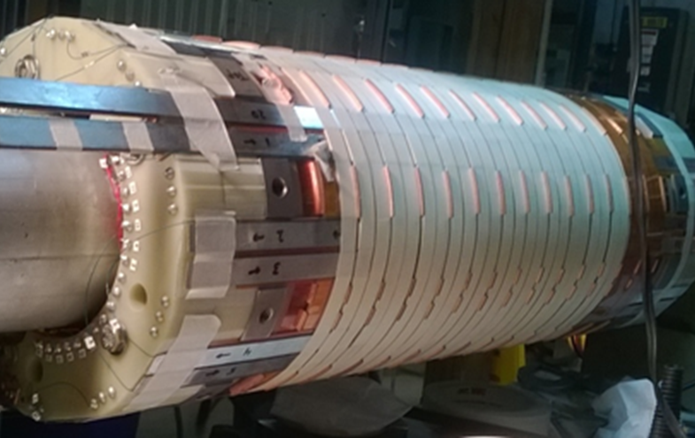
Superconducting Magnet Division – a Rich History
Relativistic Heavy Ion Collider – strong history of industrialization at Brookhaven
Magnets for Large Hadron Collider – Geneva, Switzerland
Hadron Electron Ring Accelerator magnet – Hamburg, Germany
High temperature superconducting magnet for Facility for Rare Isotope Beams, Michigan State
High temperature superconducting magnetic energy storage device
R&D on Common Coil dipole designs
https://www.bnl.gov/magnets/projects.php

Slide 4
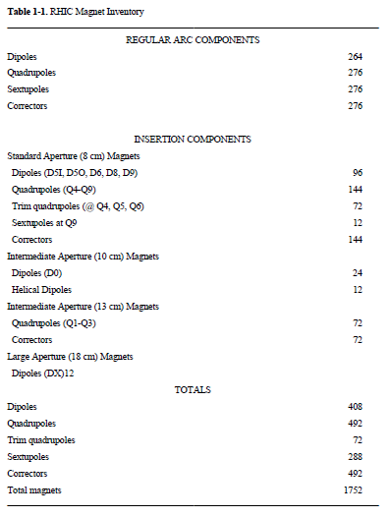
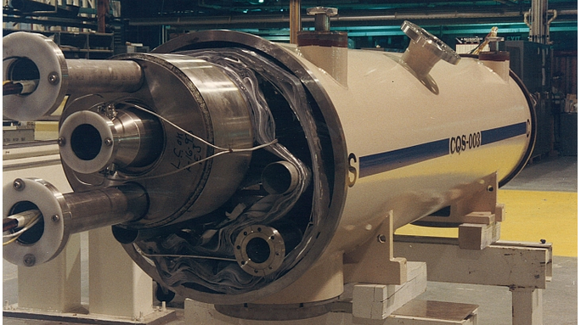
Superconducting Magnets for RHIC
(a large number, all developed @BNL, some built @industry)
BNL magnet division designed (all), built (all prototype) and tested (a fraction cold) sc magnets for RHIC
RHIC commissioning went very well, partly because of the superb quench and field quality performance of the magnets
Magnets operating well and will be used in EIC

Slide 5
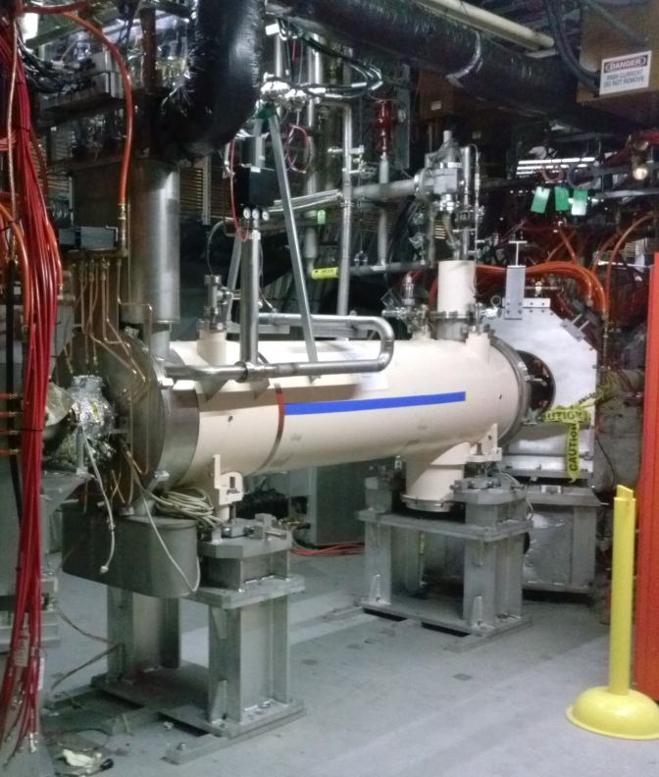
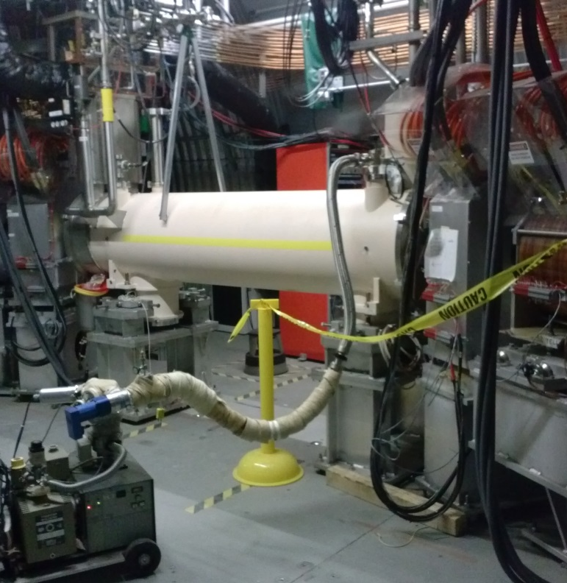
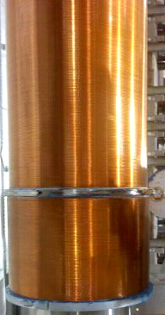
Superconducting Solenoid for RHIC
200 mm coil id, 6.6 T ~2.4 m long NbTi solenoids designed, built and tested at magnet division (complex and demanding requirements; industry didn’t build)
No prototype. Two fully cryostated solenoid, successfully built and installed and are being used for electron cooling in RHIC

Slide 6
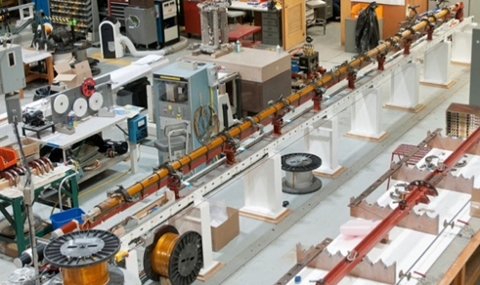
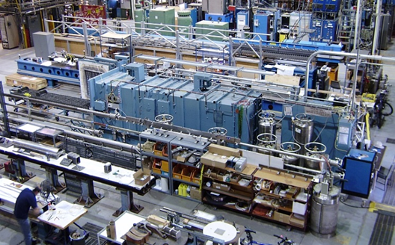
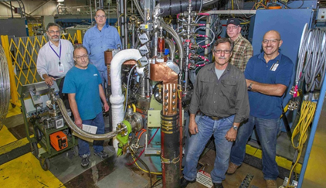
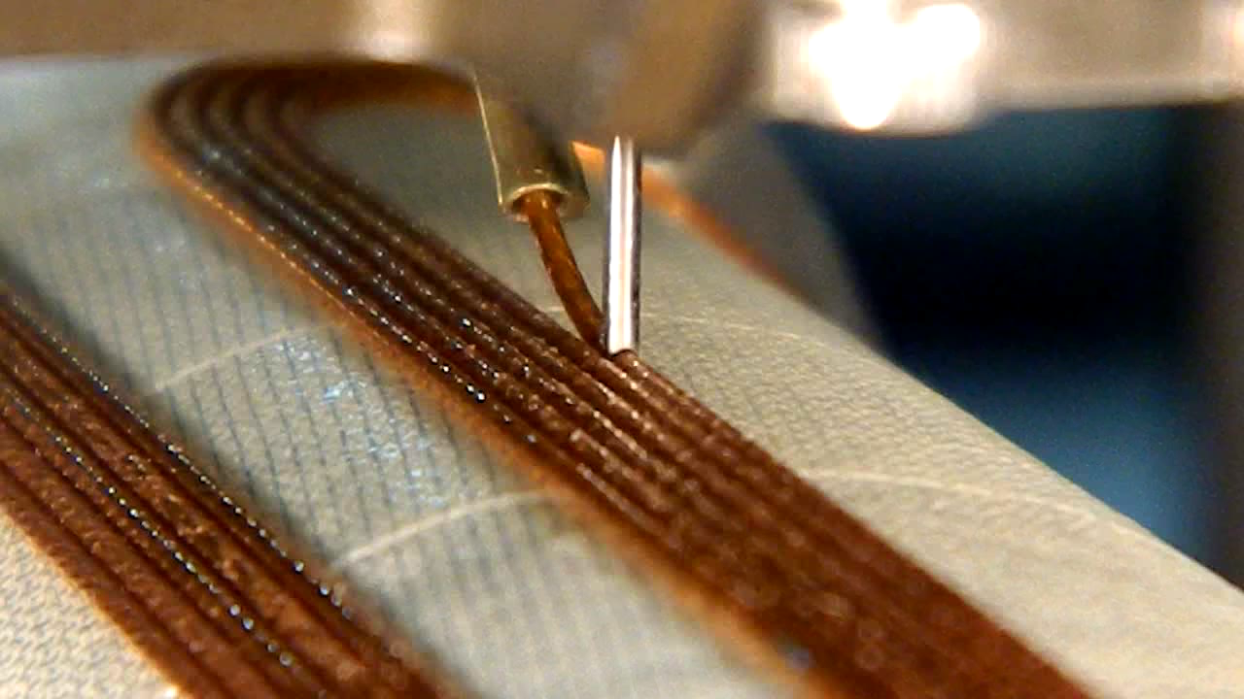
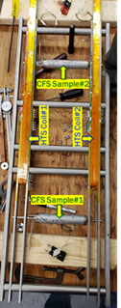
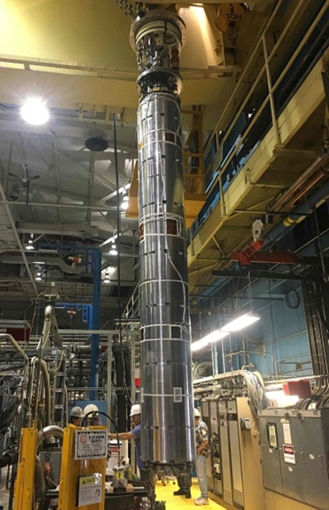
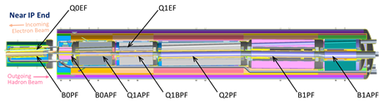
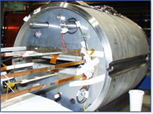
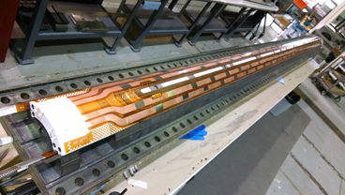
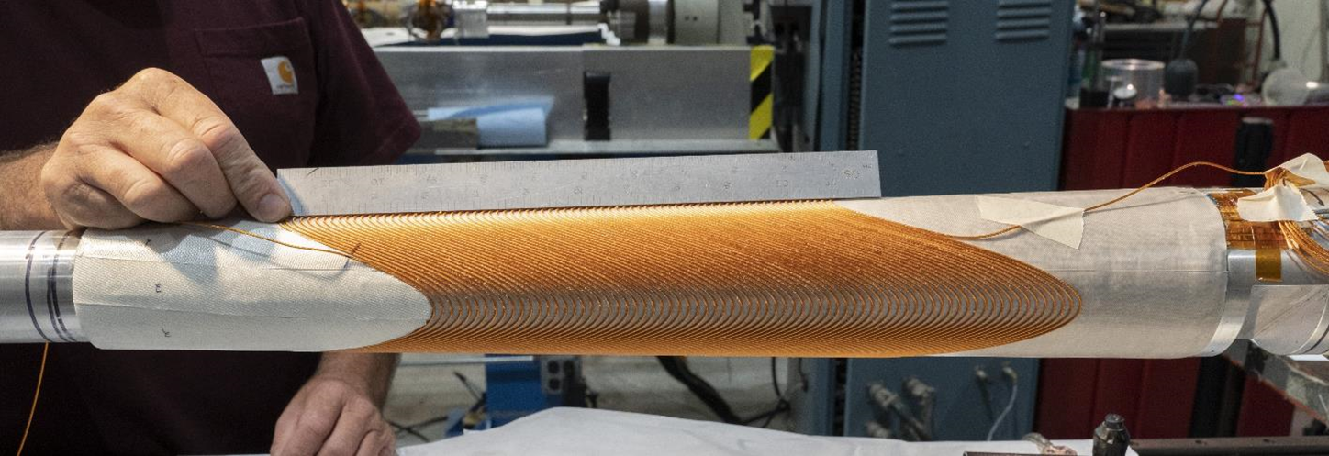
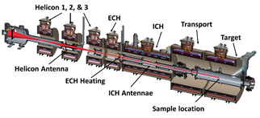
Magnet Division – Capabilities and Priorities
Winding facility
Vision: To be a world class superconducting and electromagnetics team creating the future of superconducting magnet technology.
Magnet Division staff deliver leadership in:
Superconducting magnet technology
Magnet development, manufacturing and testing with application to accelerator, science, fusion and industry
Capabilities:
LTS and HTS superconducting magnets - 10m Coil Winding Capability, Nb₃Sn furnace 4.2 m
Direct wind magnets and facility -IR and Specialty Magnets, Precision Field Quality, 2.5m Coil Winding Capability
Magnet Test facility - 1.9K, 22KA, 6.1m deep, 71cm dia.
Current priorities:
Accelerator Upgrade project – coil construction, vertical magnet test
EIC magnets – IR, magnet measurement, RHIC magnet re-use
Magnet Development Project – HTS/LTS hybrid, Diagnostics
Fusion – INFUSE, ARPA-E (CFS), MPEX
Nb₃Sn Furnace
Magnet Test facility
Direct wind facility
Deliver superconducting applications for DOE (SC, ARPA-E, ...) and SPP (Power, Fusion,...)
Fusion joint test
MDP HTS/LTS Hybrid
AUP vertical test
and coil manufacturing
EIC coil designs and direct wind double helix
MPEX conceptual design
Notes:
Utilizing BNL’s strengths –
Continuing to enhance test facility
Unique manufacturing capabilities – direct wind
Utilizing leadership in HTS development to accelerate implementation – e.g. fusion
Strong history of industrial partnership
Strong ability to execute and deliver on projects
Strengthening collaboration and broad strategy with other labs, superconducting industry
AUP Project – now ready for CD-3 after key successful
MDP re-introduced
Unique manufacturing capabilities – Direct wind and HTS → IR in EIC and also Fusion
Growing role in EIC Project
EIC also supports 7 FTEs in Magnet Division who are playing a critical role in the design and development of all of the IR region magnets. The EIC project is including the magnet division in the design, R&D and also the building of the IR region magnets either in house or with suppliers who have the capability to build some of the IR magnets. Magnet division has a unique capability to design and build high precision, multipole, IR magnets that have been used in accelerators around the globe. This technology will be implemented by Magnet Division to deliver high performance, low cost, IR magnets for the EIC.
In addition to the current project role of 7 FTEs on the development of IR magnets, Magnet Division has also been asked to help in replacing and moving the diodes in the current RHIC magnets so they can continue to perform in both the RHIC collider and the future EIC with the higher anticipated radiation loads. The Magnet Division, with its deep expertise in having designed and successfully partnered with industry to build the incredibly successful RHIC magnets, has also been asked to engage in a number of activities by the EIC HSR Vacuum Chamber team on risk reduction for existing RHIC magnets performance in the EIC. The deep expertise that is retained in the Magnet Division based upon its development of the RHIC magnets and IR magnets around the globe is an invaluable asset to the EIC project and should be leveraged further to obtain the greatest impact on the EIC project

Slide 7
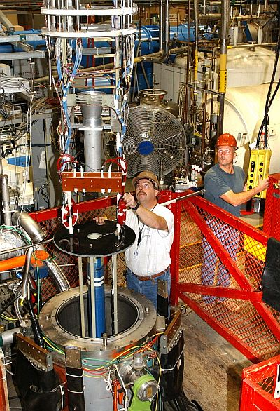
Superconducting Magnet Division
58,000 sq. ft. facility
Supports:
  Coil Winding – NbTi, Nb₃Sn, HTS
    Unique direct wind capability for high precision specialty and IR magnets
  Vacuum Impregnation
  Coil Reaction
  Flexible vertical test stand
    Operation down to 1.9K
Magnetic measurements
Estimate >$30M investment to
replicate these capabilities

Slide 8
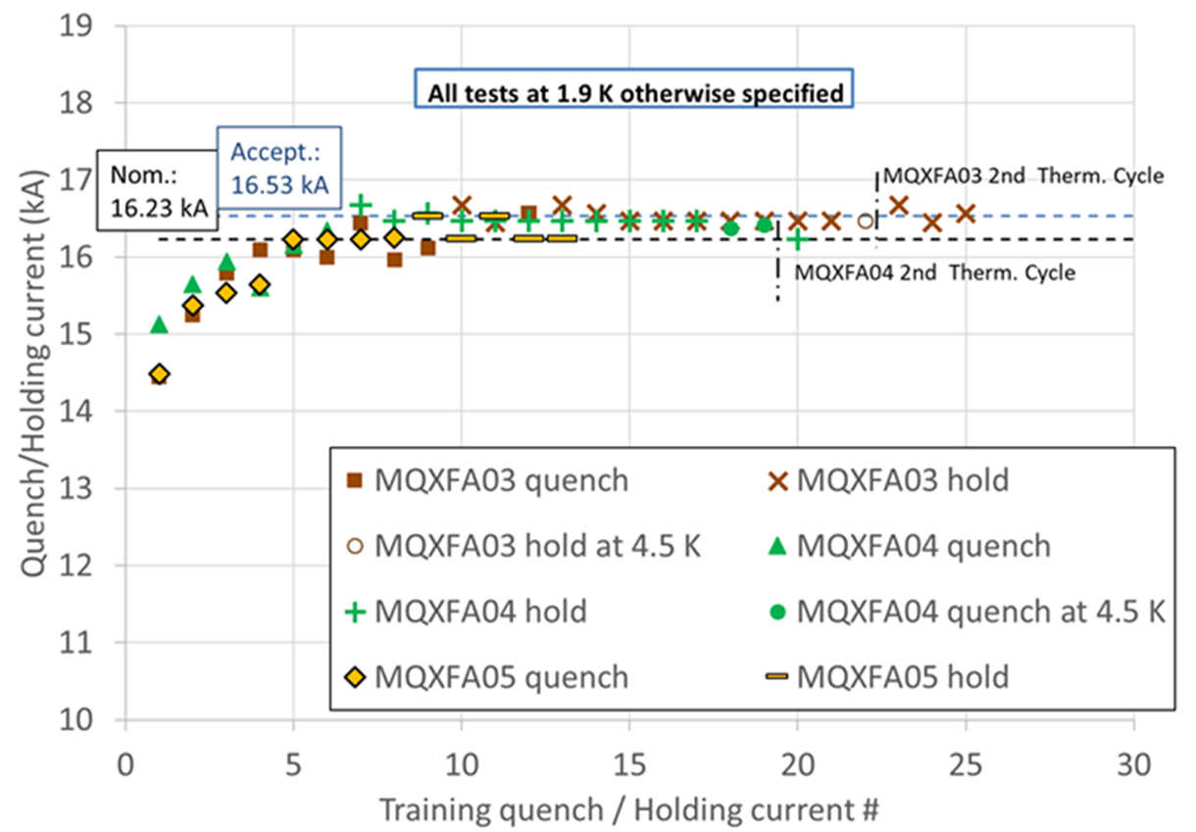
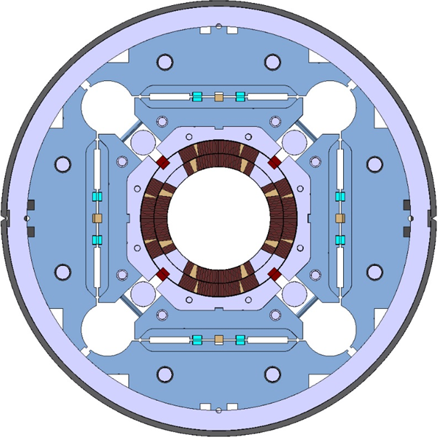
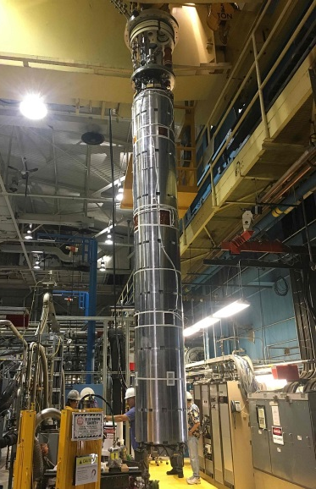
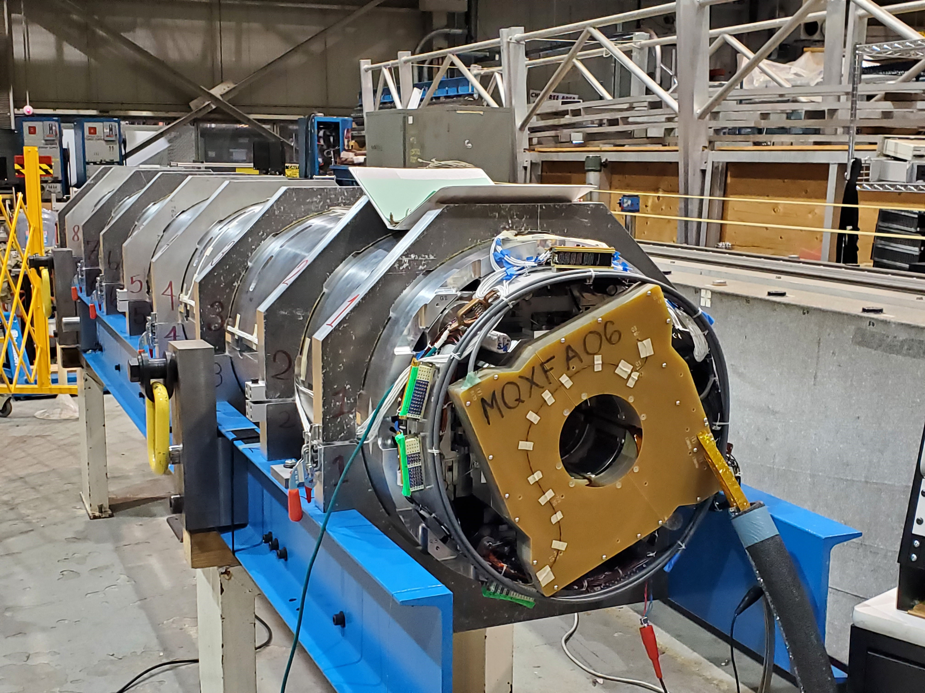
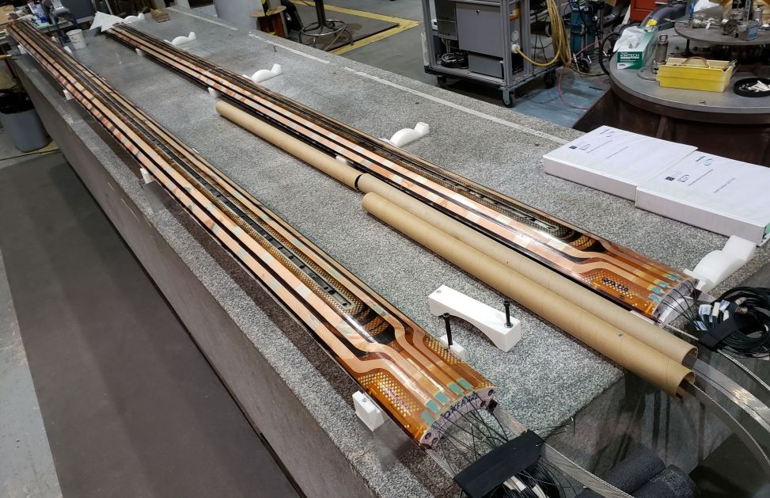
LARP a Accelerator Upgrade Project
BNL Scope
  Manufacture 47 4.2m quad coils
  Test 27 4.2 magnet cold masses

Slide 9
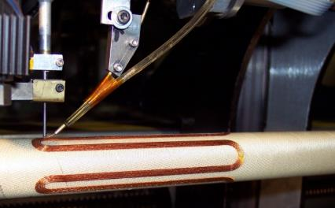
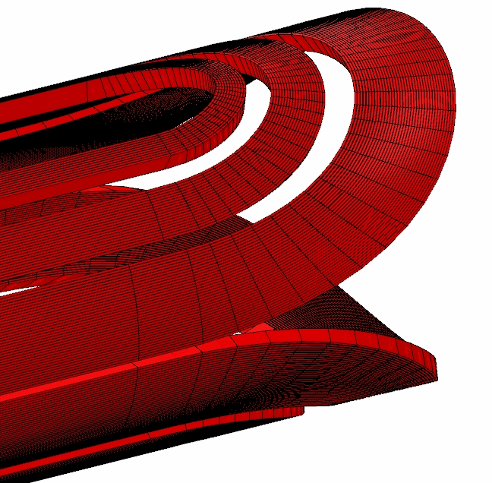
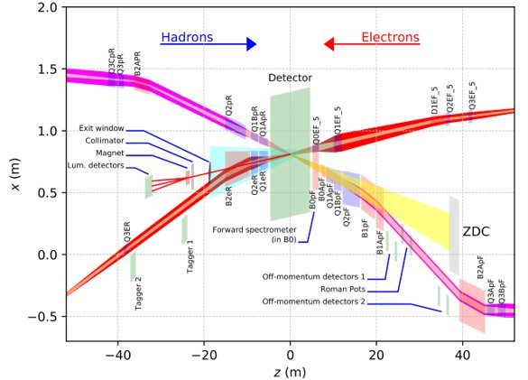
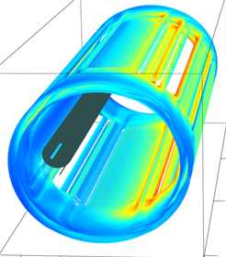
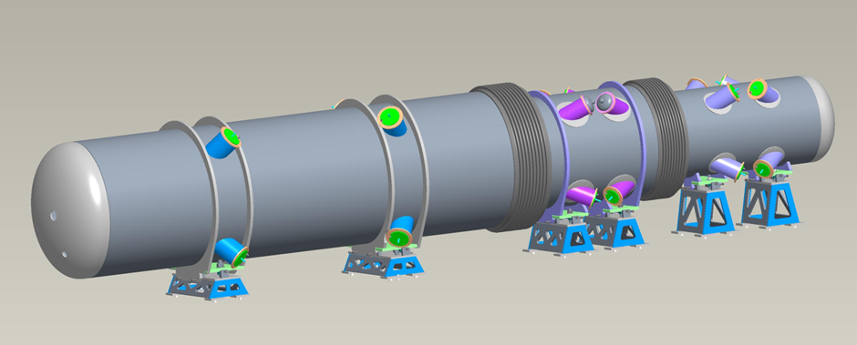
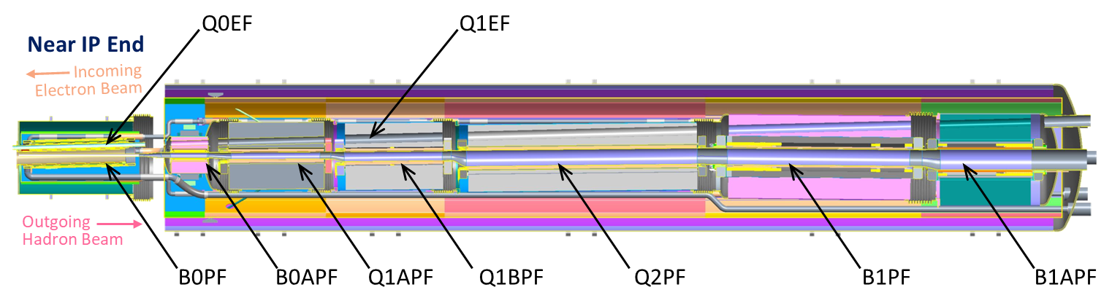

EIC Magnets Near IP Use Two Fabrication Techniques
Both Serpentine and Double Helix coil patterns are wound on either tapered or cylindrical support tubes using 6-around-1, round cable (corrector coils use single-strand superconducting wire).
The large aperture forward hadron quadrupoles and dipoles use Rutherford style cable; note electron beam passes through holes cut in their yokes.
11 Direct Wind Magnets
5 Collared Coil Magnets
Serpentine, Cylindrical Direct Wind
1 Rear Side Cryostat
Incoming Electron Beam
2 Forward Side Cryostats
Double Helix, Tapered Direct Wind Coils

Slide 10
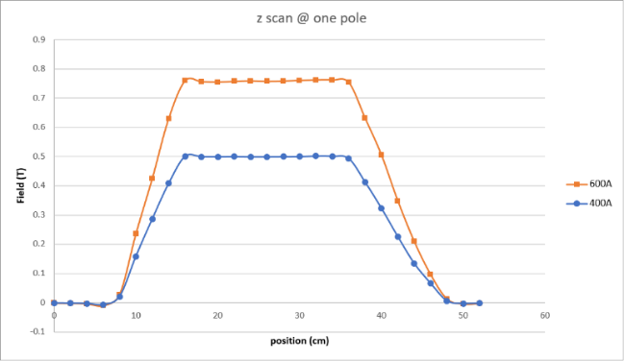
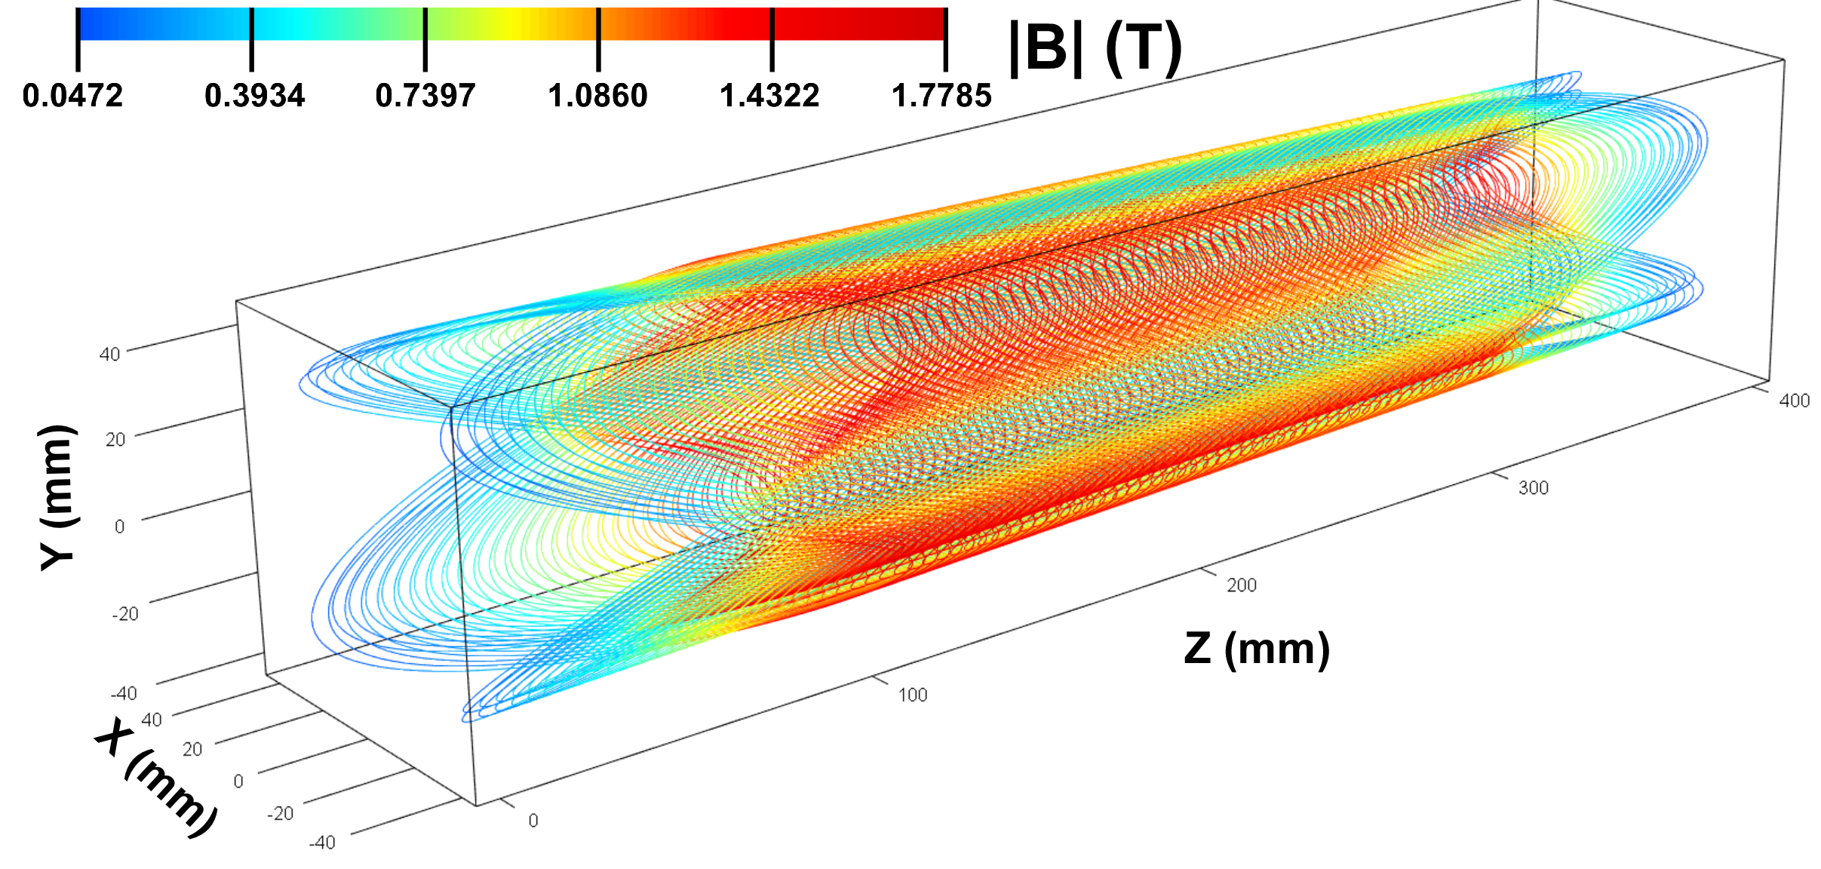
Tapered Double-Helix Magnet
Tapered coils used for some low-β quads closest to IP (Q1APR/Q1ER).
Use Double Helical coils produced via the BNL Direct Wind process (see below).
R&D Test Coil: 4 layers, aperture varies from 60 to 80mm over 0.4 m length, gradient 43 T/m, 30-40 mm inner radius
Although the aperture varies, the gradient is maintained constant.
Field Measurements
Tapered Quadrupole – no training, reached
short sample at 960 A
Calculated Coil Field
H. Witte et.al. http://dx.doi.org/10.1109/TASC.2019.2902982.

Slide 11
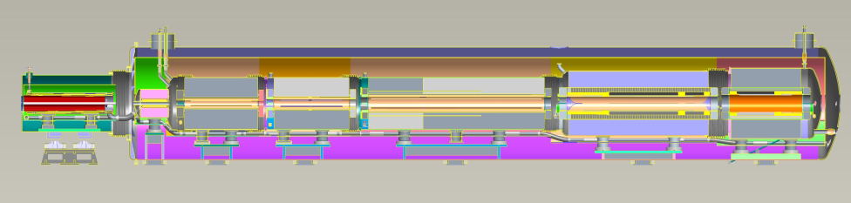
Forward Side – side sectional view
Q1BpF
Q1eF
B0pF
B0ApF
Q1ApF
Q2pF
B1pF
B1ApF
Standalone Ø54” cryostat
Common split Ø96” cryostat
Cold mass adjustments within cryostat
Each cold mass independently anchored
Common helium vessel, with bellows between all magnets

Slide 12
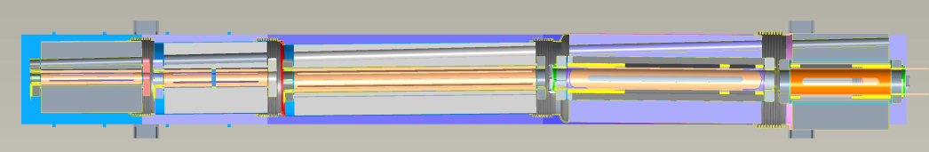
Forward Side – top sectional view
Q1BpF
Q1eF
B0pF
B0ApF
Q1ApF
Q2pF
B1pF
B1ApF
Bellows between all magnets
Space between end plates sufficient to weld inner helium vessels
Electron beam straight despite hadron magnet offsets, angular differences

Slide 13

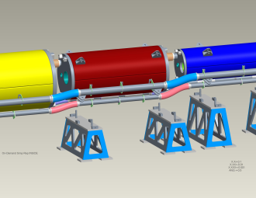
Rear Side Design / Installation
Separate cold masses - helium vessels
Separate circular cryostats with decreasing OD’s toward IP
Ø54”
Q1BpR – Q2eR
Ø42”
Q1ApR – Q1eR
Ø66”
Q2pR – B2eR
Helium piping completed
Cryostat stands completed
Work still needed on cold mass supports, cryostat reinforcements – awaiting FEA (Q2pR – B2eR cold mass ~ 30T)

Slide 14
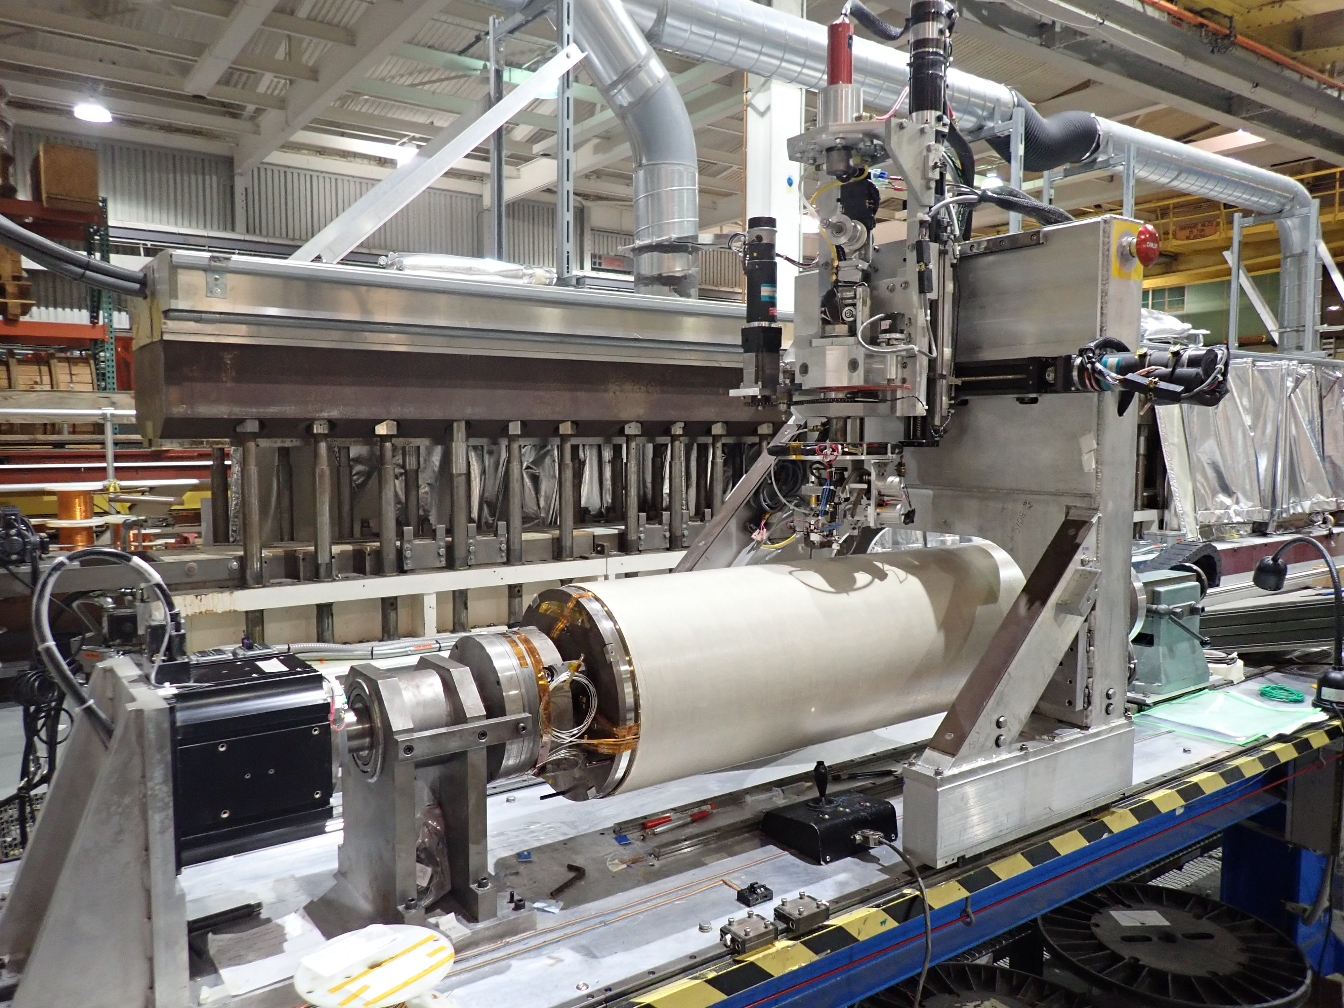
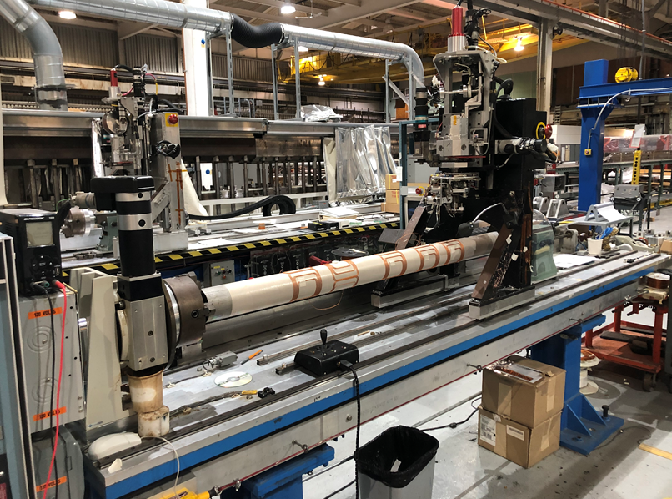
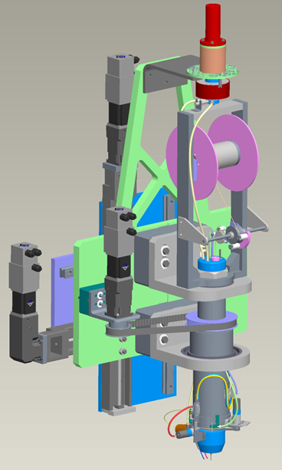
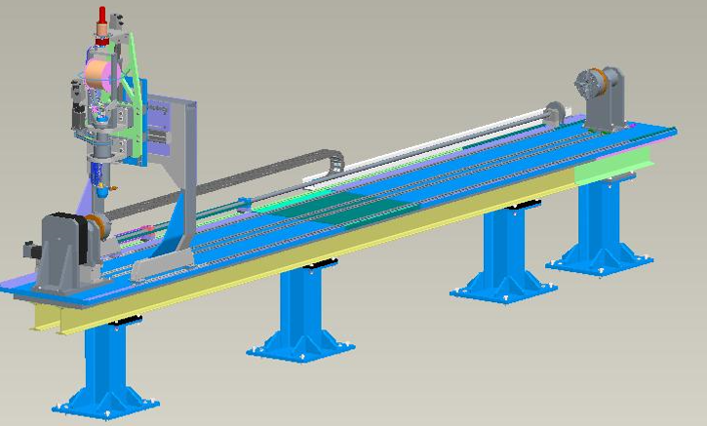
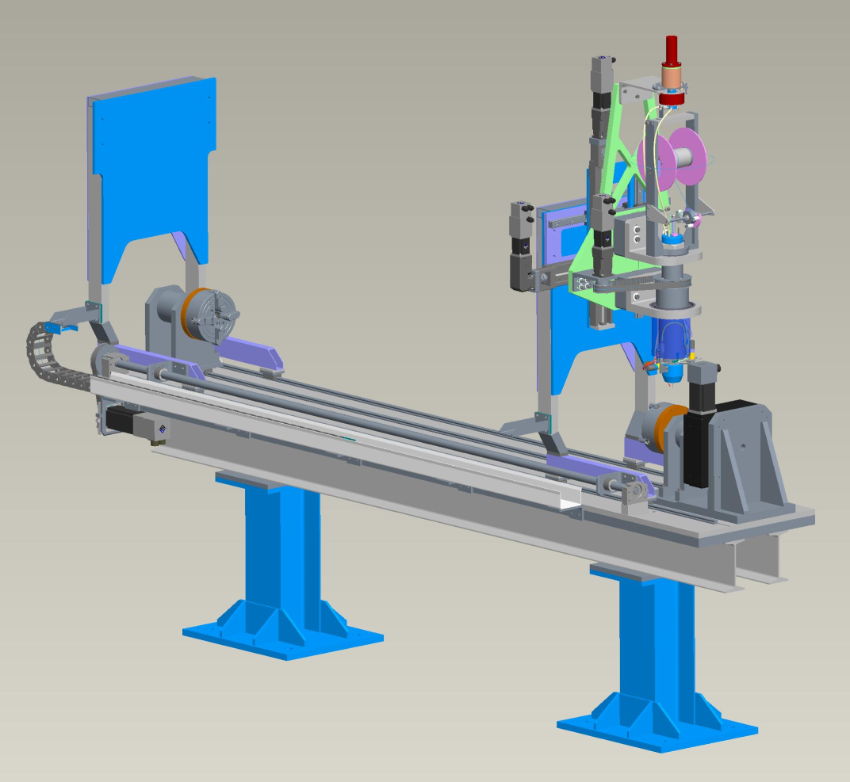
Direct Wind Coil Fabrication
(NbTi)
Long Winder
Short Winder
Presently upgrading computer hardware, software; increasing machine capacities & reliability
(“Off- Project”)
New winding heads commercial ultrasonic generator, increased capacity
Ø25mm min to Ø708mm max
Max travel 5.72 meters.
Ø25mm min to Ø446mm max
Max travel 2.51 meters

Slide 15
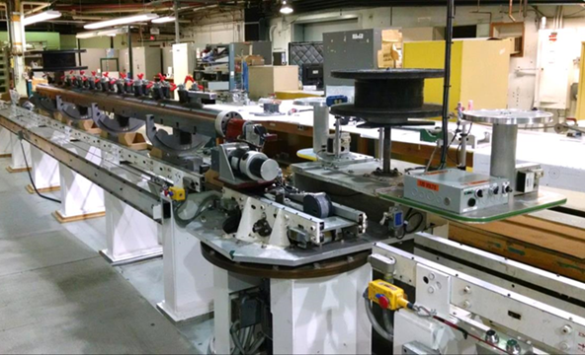
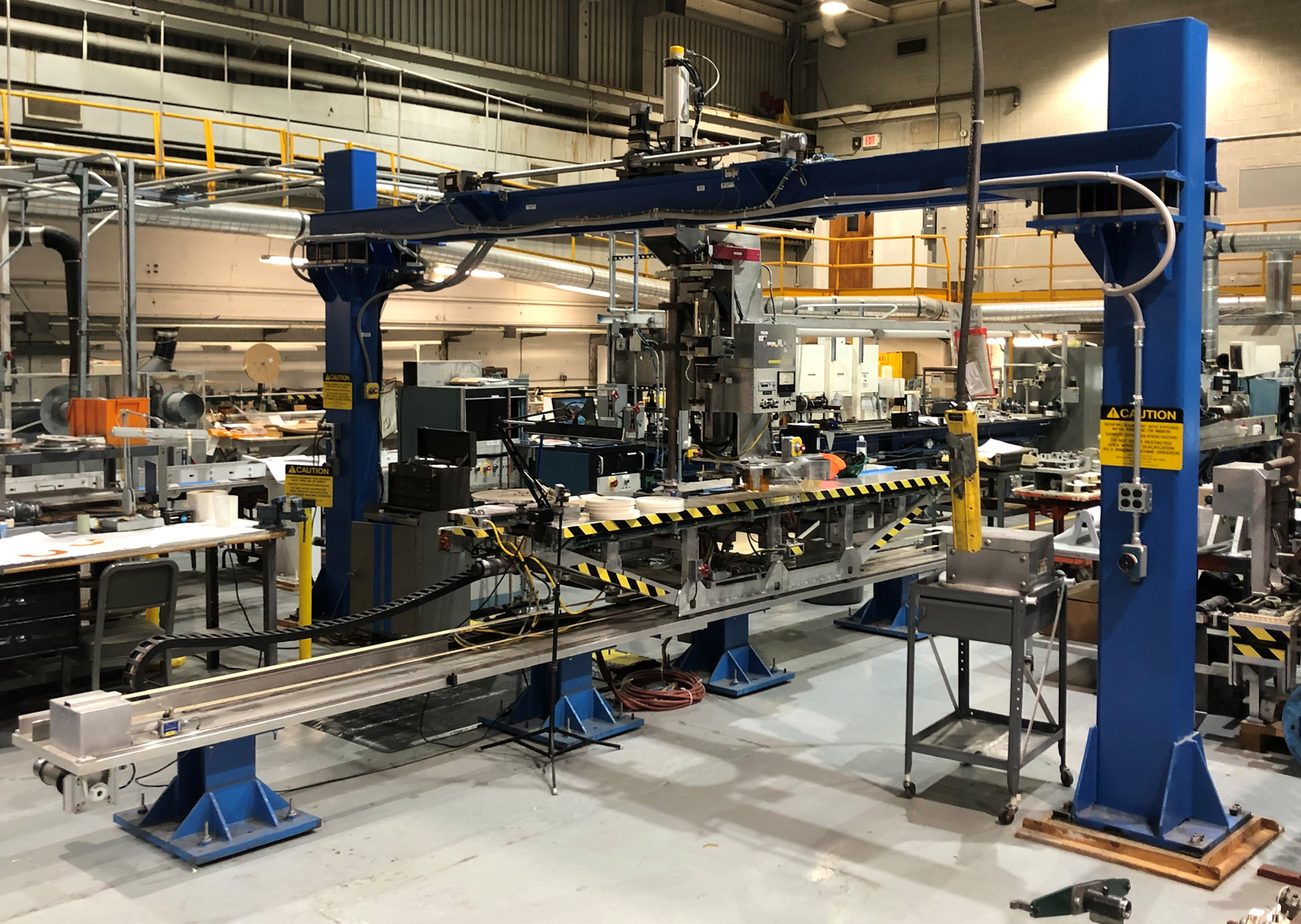
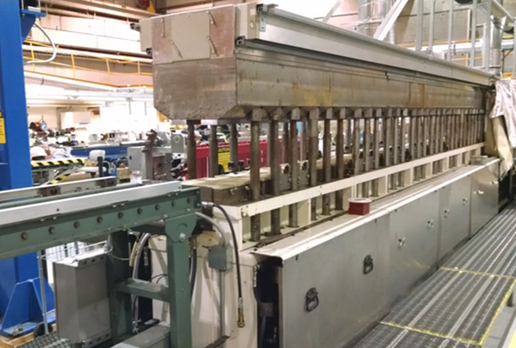
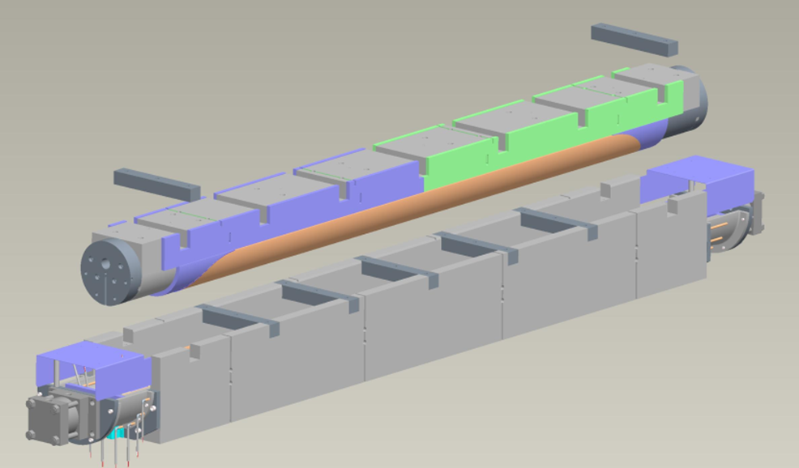


Rutherford Cable Coil Fabrication
(NbTi, Nb₃Sn)
10m Shuttle Coil Winding Machine
4m Universal Coil Winding Machine
10m Coil Curing Press
Curing sections easily separated
Coil size capacity increased for EIC (B1pF shown)
New mandrel & formblock needed B1pF shown
New roller supports needed
4m (EIC)
6m (AUP)

Slide 16


Cable Magnet Collaring Press
Operational Collaring Press (side hydraulics removed, in storage)
Size capacity increased for EIC (B1pF shown)

Slide 17






Cold Mass Shell Welding Press
Operational 10m Welding Fixture
New contact tools, clamps needed for EIC

Slide 18

Bldg 902 Facility, Magnet Testing Capacities
Nash “high capacity” helium vacuum Pump (1.9 K)
Dewar 6
Ø610mm, 2.7m deep
4.5K (1.9K) - 30kA
30 kA Power Supply
Dewar 3
Ø710mm, 6.1m deep
4.5K – 8.5kA
Dewar 2
Ø654mm, 6.1m deep, 4.5K; 5.1m, 1.9K - 24kA
MQXF
CTI 4000 He Refrigerator
CONTROL ROOM
2.7 m Deep Test Dewars
6.1 m Magnet Deep Test Dewars
Vertical Test Dewars 2-6
Horiz. Test Stand C 7.5kA, 4.5K
Horiz. Test Stand E 7.5kA, 4.5K
Upgrades possible to 2K, higher currents as needed
Horizontal testing cryostat(s) needed for forward side magnets

Slide 19





Nb₃Sn Common Coil Dipole for High Current HTS Cable Testing
A Nb₃Sn dipole with a large opening (335 mm) providing a field of 10.2 T
Unique Features: High current, long length, HTS cables with large bend radius can be tested in applied dipole field (important for Fusion cables)
Even larger radii, longer length cable/joints can be looped in the high field region
HTS cables can be tested at high temperatures (4K – 50⁺ K) with small upgrades
Advanced instrumentation (quench protection); capability to accommodate more
Innovative R&D facility offers unique opportunities to FES.
Available now while even a higher field facility becomes available in US in future
Empty space
https://www.bnl.gov/magnets/staff/gupta/commoncoil/cc-bnl-rapid-rnd-testing.pdf

Slide 20

A Unique US HEP/FES Facility – Status and Proposed Upgrades
The current facility provides a field of 0 -10 T at ~4 K and up to 10 kA in cable if connected in series with the magnet
BNL is investing significant funds (~1.5 M$) in various upgrades to turn this unique dipole with large opening to a unique facility
We will be implementing the following upgrades with internal funding over the next 1-3 years
  A reliable facility operating independently of other programs (some reconfiguration and maintenance required)
  1-50⁺ kA on cable/joints with superconducting transformer
  4-50⁺ K test temperature for users with a secondary cryostat
  ~40 m long cable in dipole field, 150-500 mm bend diameter
This 10 T dipole test facility is complimentary to SULTAN (solenoid-based), and a facility available to users in US now while the higher field (15 T) dipole FNAL/LBNL facility becomes operational in 5 (?) years.
Dipole
4K, 10 KA

Slide 21










Variety of Upcoming Cable Tests
Twisted Stacked/Viper from CFS (INFUSE) - two tests completed (one last week, 3 slides)
Magnum NXTM from SMS (INFUSE) – Performance under field - funded
Two tests of Viper cable from CFS (arpa-e) – funded
CORC from ACT (MDP) – Quench and technology studies – funded (also ACT/BNL STTR)
Cable-in-conduit for fusion magnets from BTG (SBIR) – Phase I funded
CICC from GA (INFUSE) – proposal submitted

Slide 22








Driving synergies across applications
Superconducting Magnet Division is developing, supporting and delivering on programs across DOE SC, broader DOE and industry
Current portfolio under development –
  NP – Electron Ion Collider
  HEP – Accelerator Upgrade Program (AUP), Magnet Development Program (MDP)
  FES – INFUSE, Commonwealth Fusion (CFS), MPEX (ORNL)
  Industry – CFS, GE, Raytheon, Best Medical, small businesses
  Other DOE – ARPA-E, EERE
Utilizing BNL’s strengths –
  Continuing to enhance test facility
  Unique manufacturing capabilities – direct wind
  Utilizing leadership in HTS development to accelerate implementation – e.g. fusion
  Strong history of industrial partnership
  Strong ability to execute and deliver on projects
  Strengthening collaboration and broad strategy with other labs, superconducting industry

Slide 23
What does SMD bring to the table?
SMD has a strong history of designing and industrializing SC magnets (RHIC) - Fundamental magnet developments at BNL were critical to enabling the magnet designs used at the LHC
SMD has a strong HTS program with a high field (10 T+) test facility
SMD has a world class facility that can take magnets from concept to build to test
SMD has incredible capabilities to test and characterize magnets
SMD has provided critical support to multiple teams with magnet issues across Brookhaven throughout its history
Current partnerships with industry under SBIR/STTR, ARPA-e, INFUSE, TSA and joint proposals
These capabilities are an asset for DOE across multiple areas : NP, HEP, FES, EERE, ARPA-e

