Slide 1
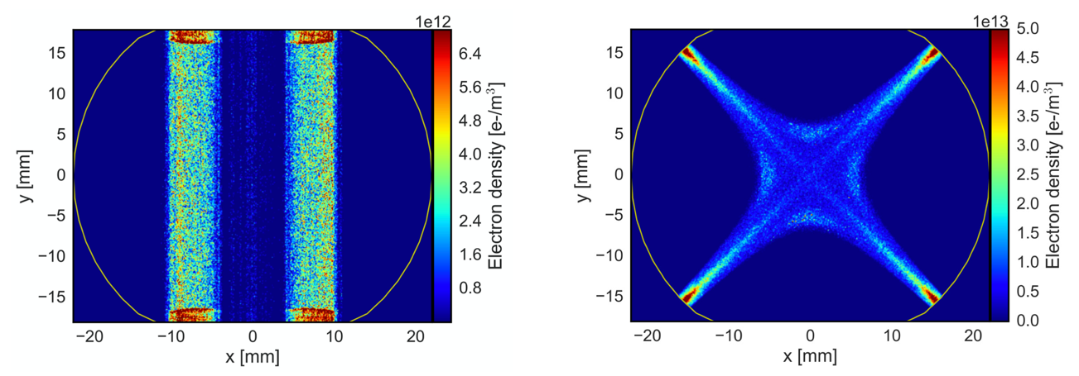

Electron cloud effects in the Large Hadron Collider (LHC)
Giovanni Rumolo
EIC Accelerator Partnership Workshop, 26-29 October 2021
https://meetings.triumf.ca/event/254/

Slide 2
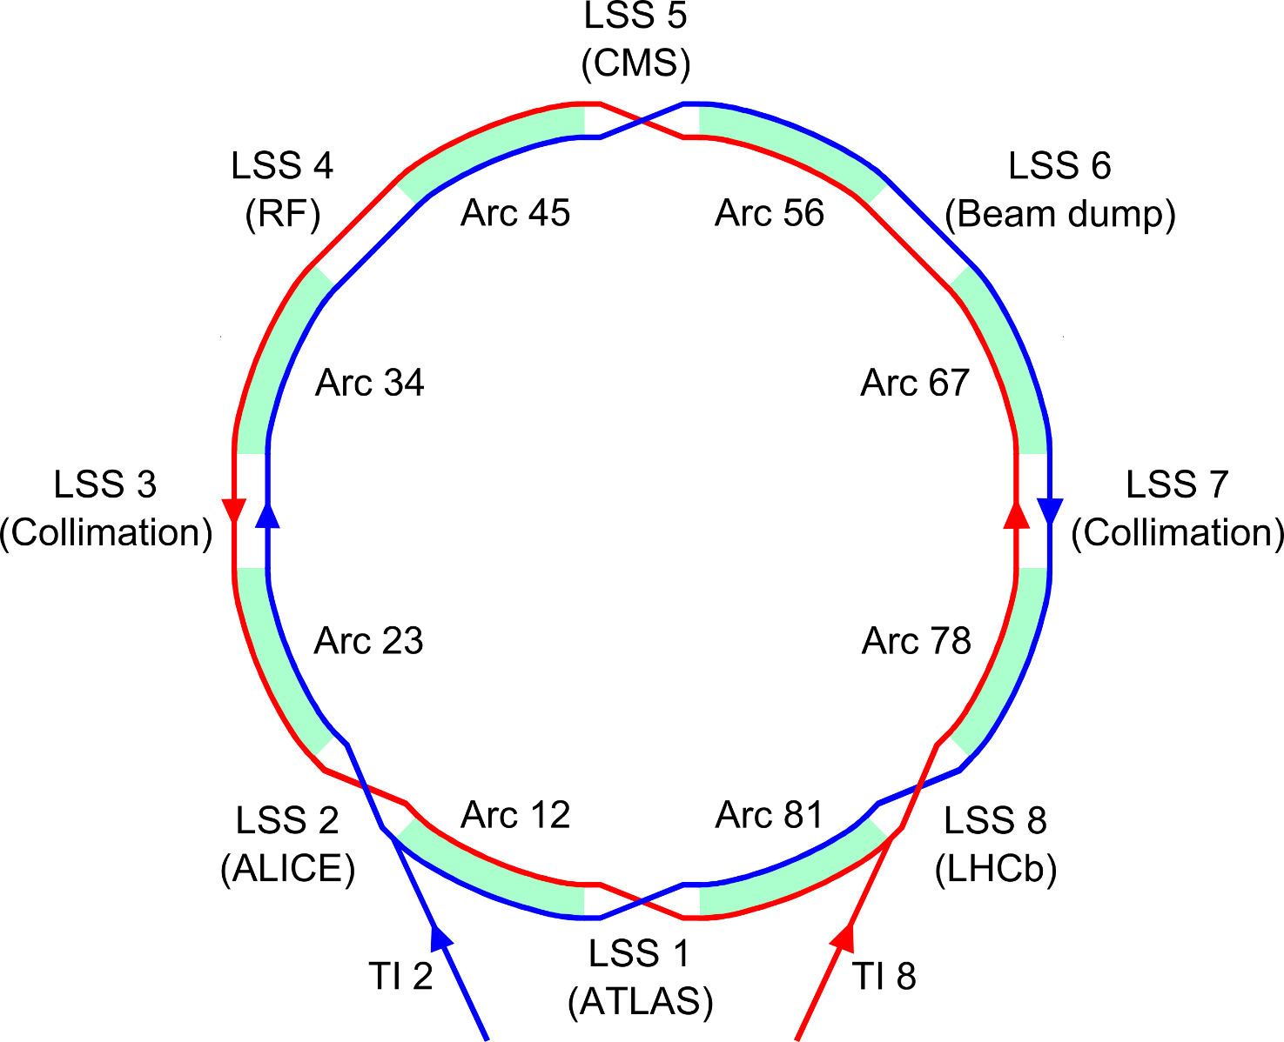
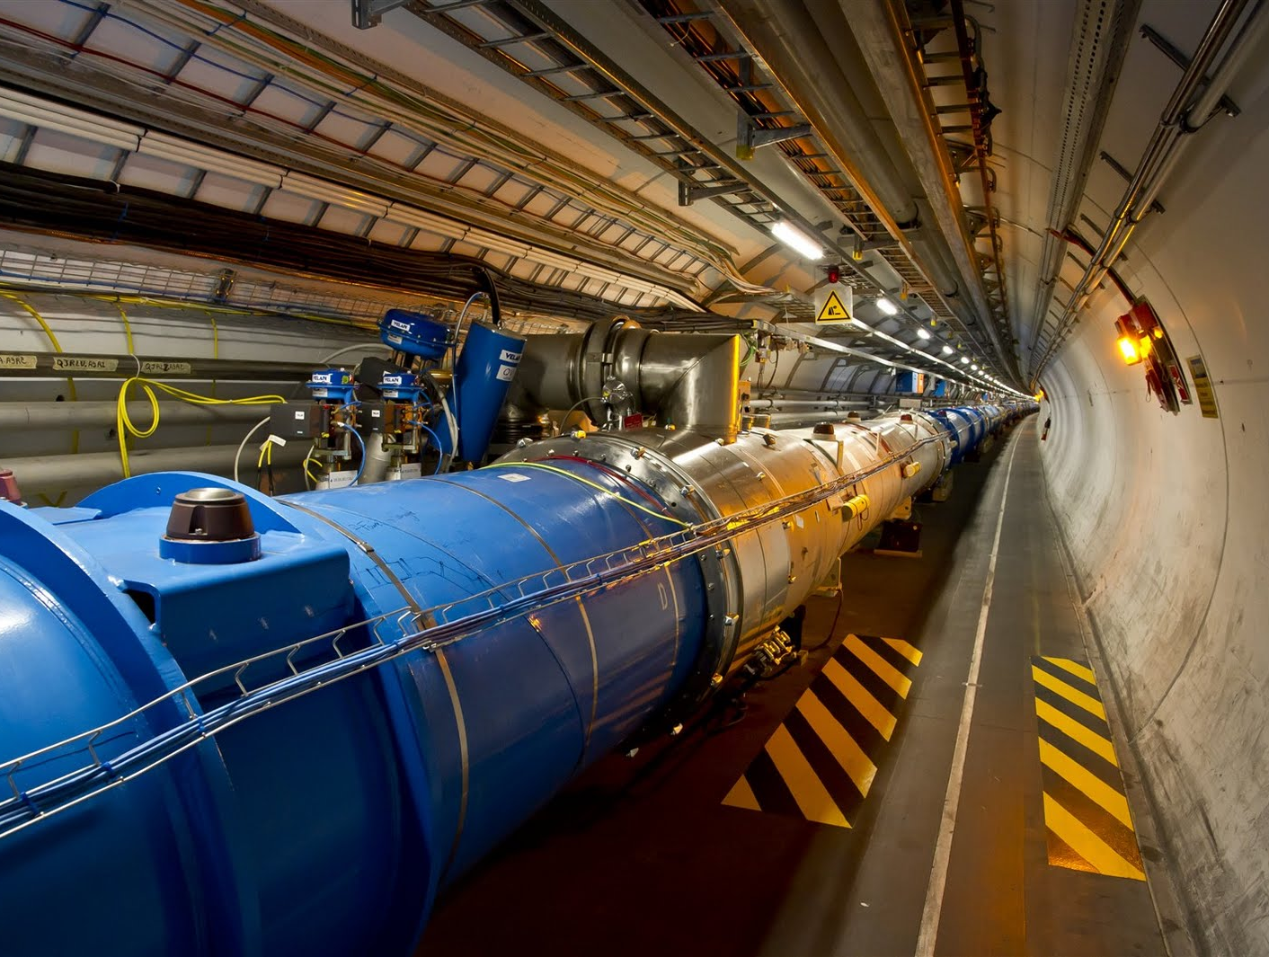
The Large Hadron Collider (LHC)
8-fold symmetric structure
  8 Long Straight Sections (LSS) to host experiments and other equipment
  8 Arcs (2.45 km each - Periodic magnet lattice, to bend and focus the beams)
  Main magnets
  (superconducting)
  8.33 T dipoles
  223 T/m quadrupoles

Slide 3
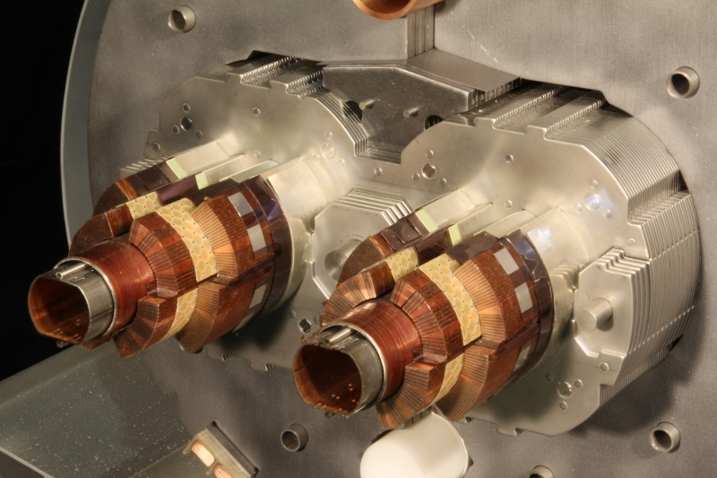
What the LHC beam mainly sees: The LHC beam screen
To avoid too high-power deposition on the superconducting coils a beam screen is inserted inside the 1.9 K cold bore
  The beam screen intercepts beam-induced
  heat sources (EM, synch. radiation, e-cloud)
  It is held by low conductivity supports and is
  actively cooled with a helium flow to operate in
  the range 5-20 K
  By measuring the thermodynamic properties of
  helium, the heat load on the screen is inferred
  Magnets in each “half-cell” share same cooling
  circuit → Heat load is measured per half-cell
  Section of a main dipole
    Beam screen cooling circuit
    (helium)
    Superconducting coils (1.9 K)
    Beam screen
    (5 – 20 K)
Half-cell (53.4 m)
Half-cell (53.4 m)
Half-cell (53.4 m)
Quad
(3.1 m)
Dipoles (3 x 14.3 m)
Quad
(3.1 m)
Dipoles (3 x 14.3 m)
Quad
(3.1 m)
Dipoles (3 x 14.3 m)
Quad
(3.1 m)

Slide 4
A glimpse on the history (and near future) of LHC
Today
2010
2013
2015
2019
2022
Run 1
LS1
Run 2
LS2
Run 3
Run 1 - data taking with:
Beam energy: 3.5 - 4 TeV
Bunch spacing: 150 – 50 ns
Max # of bunches: 1380
Bunch intensity: 1.7e11p
Run 2 - data taking with:
Beam energy: 6.5 TeV
Bunch spacing: 25 ns
Max # of bunches: 2556
Bunch intensity: 1.2e11p
Run 3 - forecast:
Beam energy: 6.8 TeV
Bunch spacing: 25 ns
Max # of bunches: 2556
Bunch intensity: 1.8e11p
Long Shutdown 1:
No beam
Consolidation and maintenance
All arcs were warmed up and vented
Long Shutdown 2:
No beam
Consolidation and maintenance for LHC
All arcs were again warmed up and vented
LHC injectors were upgraded to produce beams twice as intense and as bright

Slide 5
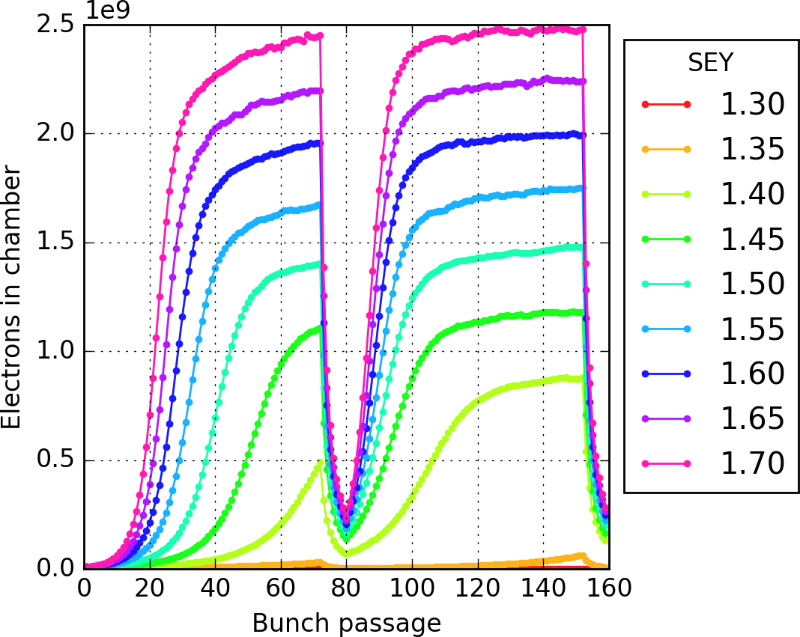
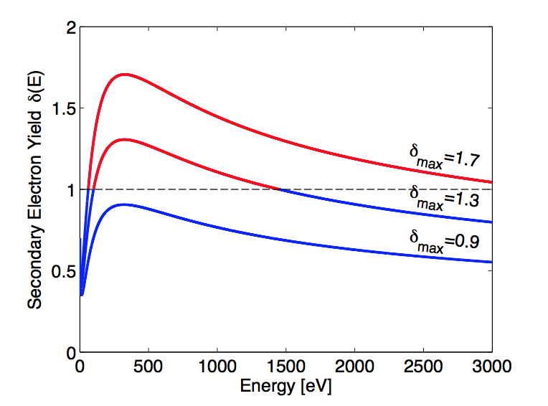
Closely spaced bunches ➔ Electron cloud
Seed electron
(e.g. photoemission)
~300 eV
~10 eV
Proton bunch
~50 eV
~10 eV
SEY_{max} > 1
SEY Curves for different surfaces
25 ns
time
This electron flux to the wall is responsible for:
Dynamic pressure rise
Heat deposition
Synchronous phase shift due to beam energy loss
Spurious signal for beam instrumentation
e⁻
e⁻
beam
e⁻
Notes:
T

Slide 6
Closely spaced bunches ➔ Electron cloud
Seed electron
(e.g. photoemission)
~300 eV
~10 eV
Proton bunch
~50 eV
~5 eV
SEY_{max} > 1
25 ns
time
A significant electron density inside the vacuum chamber causes:
Tune shift along the train
Coherent instabilities (both single and coupled bunch)
Poor beam lifetime and emittance growth
beam
Notes:
T

Slide 7
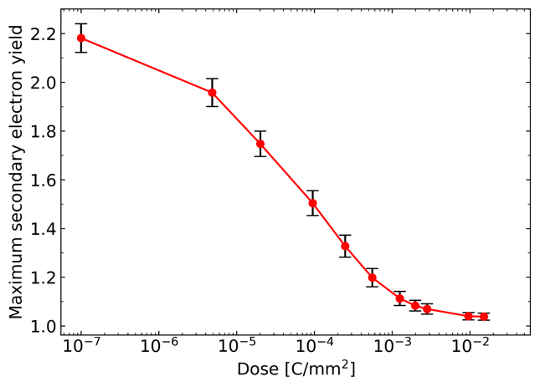
Closely spaced bunches ➔ Electron cloud
But there is a silver lining …
  The SEY of a surface is known to decrease under
  electron bombardment (conditioning or scrubbing)
  Running an accelerator with electron cloud will
  gradually reduce the electron cloud itself
  The electron cloud eventually ‘turns off’ if we can
  scrub to an SEY lower than the threshold value for
  electron cloud formation in the vacuum chamber
  Unfortunately, de-conditioning of the surfaces occurs when they are exposed to air
SEY reduction on copper surface by e⁻ bombardment (lab. experiment)
Beam induced scrubbing

Slide 8
LHC e-cloud observations
Today
2010
2013
2015
2019
2022
Run 1
LS1
Run 2
LS2
Run 3
Run 1 - data taking with:
Beam energy: 3.5 - 4 TeV
Bunch spacing: 150 – 50 ns
Max # of bunches: 1380
Bunch intensity: 1.7e11p
Run 2 - data taking with:
Beam energy: 6.5 TeV
Bunch spacing: 25 ns
Max # of bunches: 2556
Bunch intensity: 1.2e11p
Run 3 - forecast:
Beam energy: 6.8 TeV
Bunch spacing: 25 ns
Max # of bunches: 2556
Bunch intensity: 1.8e11p
Long Shutdown 1:
No beam
Consolidation and maintenance
All arcs were warmed up and vented
Long Shutdown 2:
No beam
Consolidation and maintenance for LHC
All arcs were again warmed up and vented
LHC injectors were upgraded to produce beams twice as intense and as bright

Slide 9
LHC e-cloud observations – Run 1
Today
2010
2013
2015
2019
2022
Run 1
LS1
Run 2
LS2
Run 3
Run 1 - data taking with:
Beam energy: 3.5 - 4 TeV
Bunch spacing: 150 – 50 ns
Max # of bunches: 1380
Bunch intensity: 1.7e11p
Run 2 - data taking with:
Beam energy: 6.5 TeV
Bunch spacing: 25 ns
Max # of bunches: 2556
Bunch intensity: 1.2e11p
Run 3 - forecast:
Beam energy: 6.8 TeV
Bunch spacing: 25 ns
Max # of bunches: 2556
Bunch intensity: 1.8e11p
Long Shutdown 1:
No beam
Consolidation and maintenance
All arcs were warmed up and vented
Long Shutdown 2:
No beam
Consolidation and maintenance for LHC
All arcs were again warmed up and vented
LHC injectors were upgraded to produce beams twice as intense and as bright

Slide 10
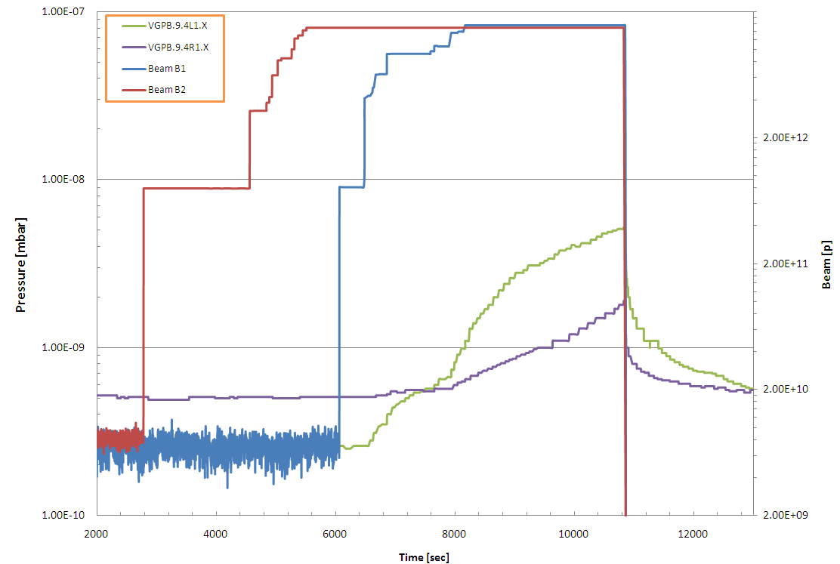
LHC e-cloud observations – Run 1
LHC showed first signs of e-cloud with 150 ns beams (2010), but only in the form of pressure rise in the interaction regions
150 ns - 450 GeV
Beam 1
Beam 2
ΔP₁
ΔP₂

Slide 11
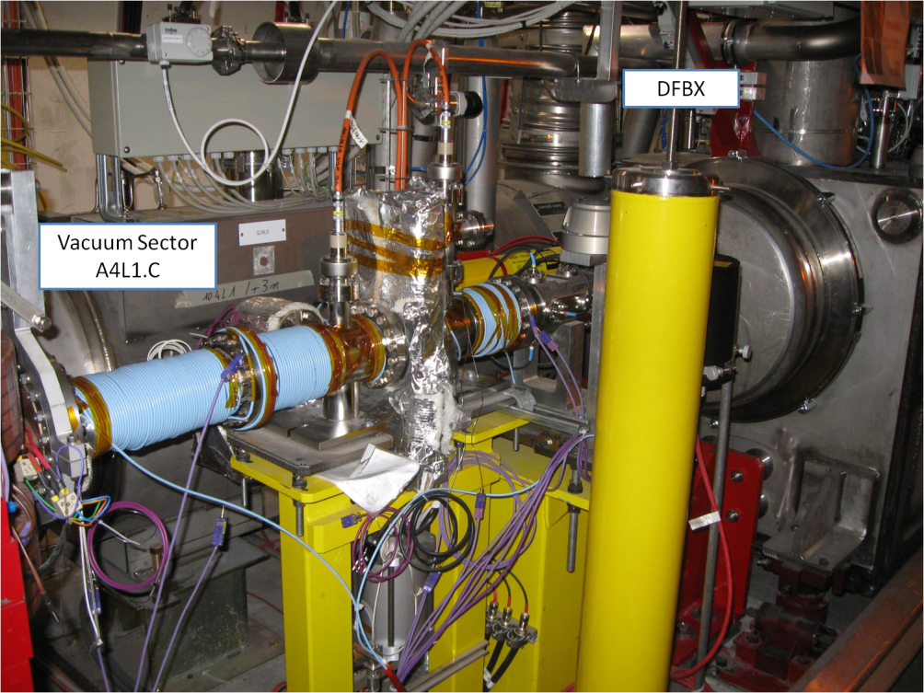
LHC e-cloud observations – Run 1
LHC showed first signs of e-cloud with 150 ns beams (2010), but only in the form of pressure rise in the interaction regions
  Solenoids were therefore applied at some
  locations of the common chamber

Slide 12
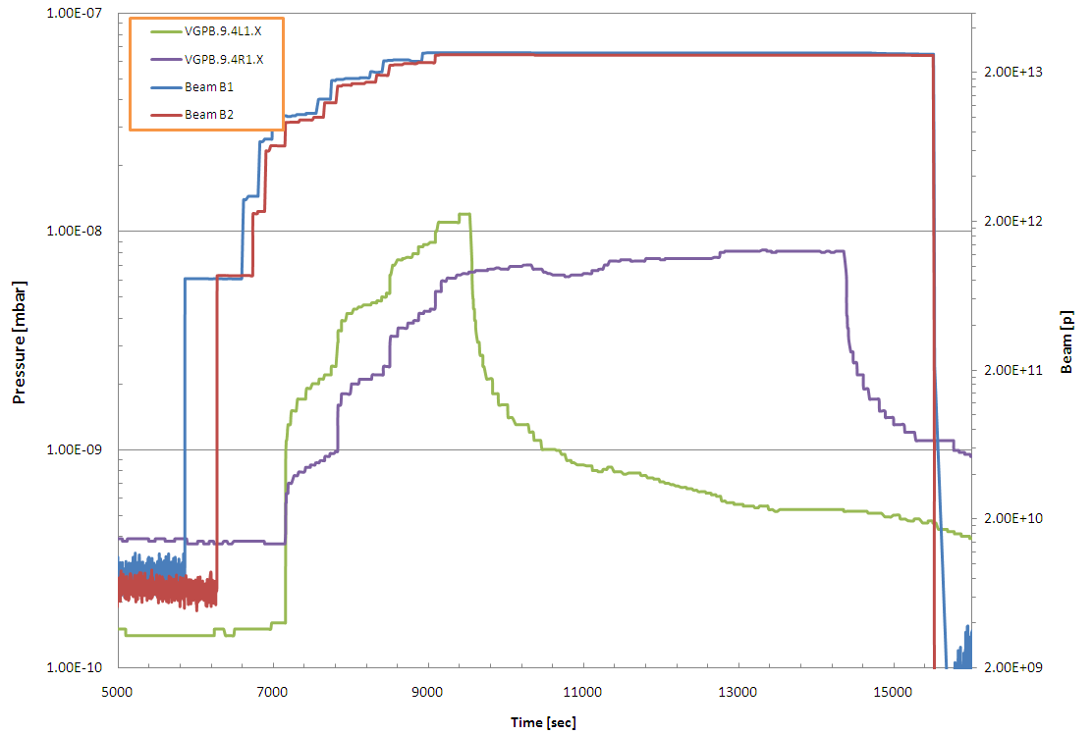
LHC e-cloud observations – Run 1
LHC showed first signs of e-cloud with 150 ns beams (2010), but only in the form of pressure rise in the interaction regions
  Solenoids were therefore applied at some
  locations of the common chamber
  They were seen to work effectively to
  suppress locally the e-cloud in
  operation
Solenoid ON
A4L1
Solenoid ON
A4R1
Beam Intensity
After 20 min
ΔP ≈10⁻⁸
After 20 min
ΔP ≈8·10⁻⁹
Remove multipacting
Still primary electrons

Slide 13
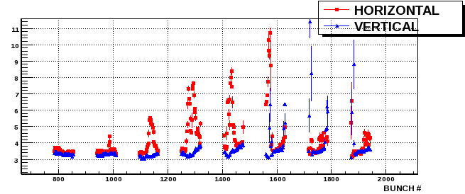
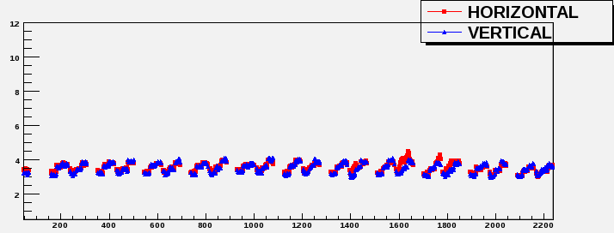
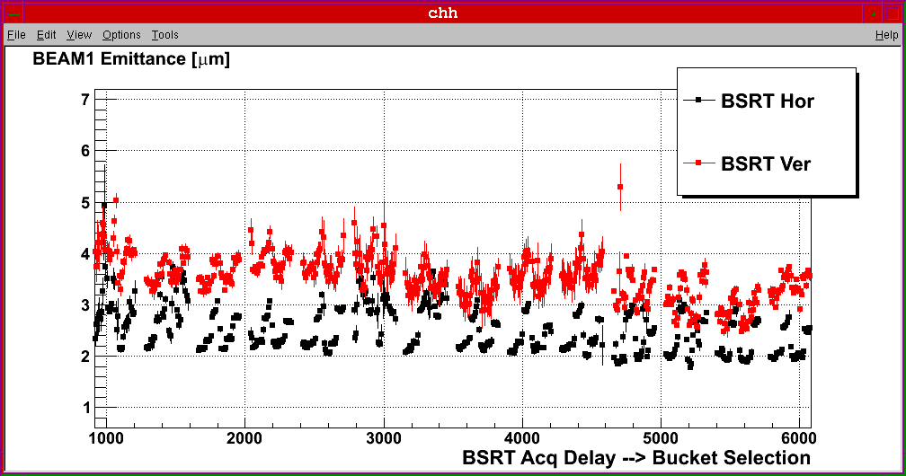
LHC e-cloud observations – Run 1
It was with 50 ns beams (2011) that clear signs of beam degradation from e-cloud appeared
  Visible effect in the emittance blow up along the trains
  Dedicated scrubbing run was necessary at the beginning of 2011 to go in physics production with 50 ns beams
Day 1 – 300 bunches
Day 3 – 800 bunches

Slide 14
LHC e-cloud observations – Run 1
It was with 50 ns beams (2011) that clear signs of beam degradation from e-cloud appeared
  Visible effect in the emittance blow up along the trains
  Dedicated scrubbing run was necessary at the beginning of 2011 to go in physics production with 50 ns beams
  Scrubbing clear in the evolution of the slope of the
  RF phase shift vs. beam intensity fill after fill

Slide 15
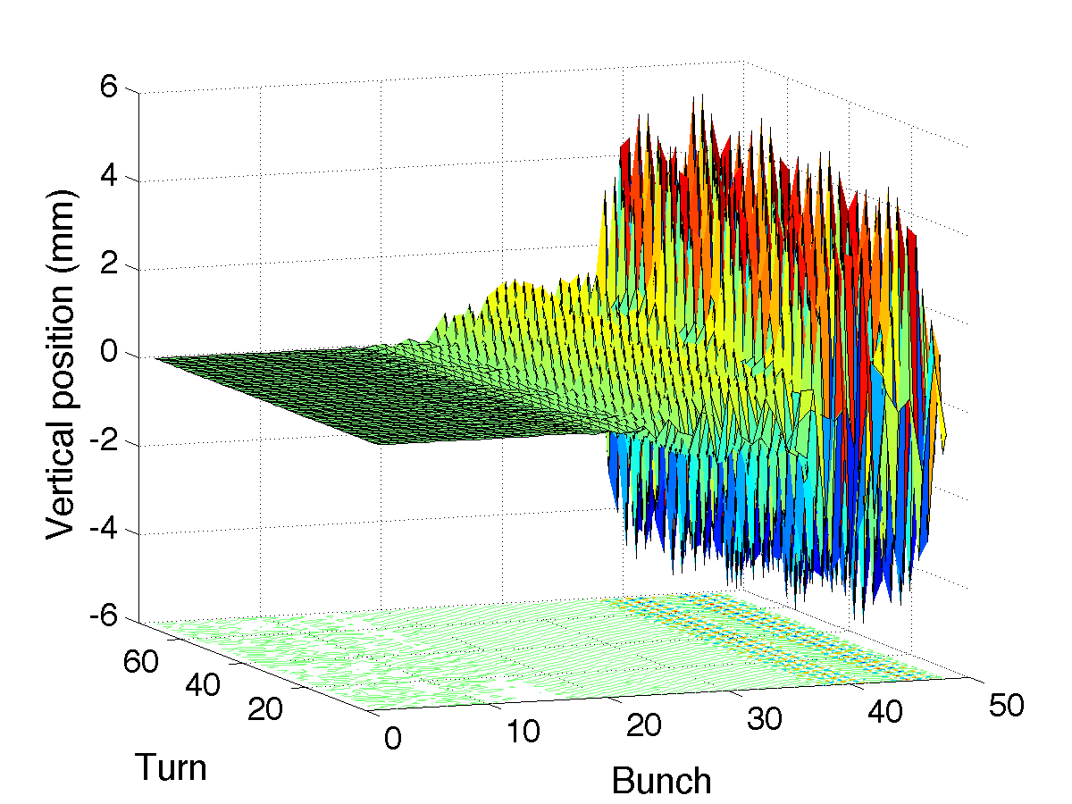
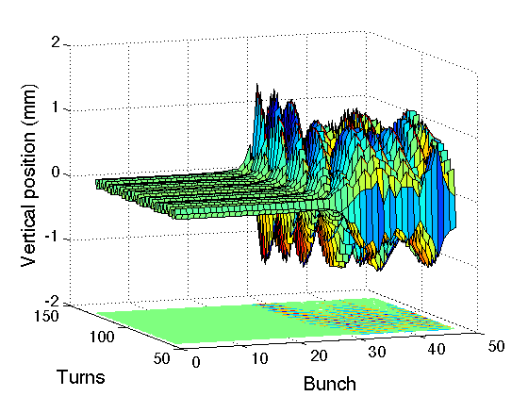
LHC e-cloud observations – Run 1
When first injecting 25 ns beams (2011) the beam showed immediately a strong instability even with relatively short trains (48 bunches)
  High chromaticity was needed to inject and keep 25 ns beams in the LHC, albeit with very poor lifetime especially at the beginning
First injection of 48 bunches with 25 ns spacing
Measurement
Simulation

Slide 16
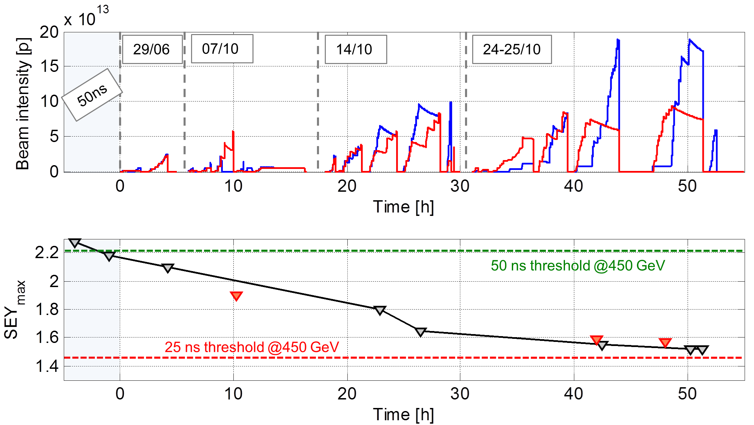
LHC e-cloud observations – Run 1
A few machine development sessions took place with 25 ns beams (2011) during which a measurable surface conditioning was observed
  The evolution of the average SEY in the arcs was reconstructed using heat load data and PyECLOUD simulations

Slide 17
LHC e-cloud observations – Run 1
A few machine development sessions took place with 25 ns beams (2011) during which a measurable surface conditioning was observed
  The evolution of the average SEY in the arcs was reconstructed using heat load data and PyECLOUD simulations
Tests with 25 ns beams in the course of 2011 already provided enough ‘conditioning margin’ in the arcs to run stably 50 ns beams for physics throughout 2011 and 2012, even increasing the bunch intensity to 1.7e11 p/b, without ever requiring additional dedicated scrubbing runs
At the end of 2012 there was also another dedicated scrubbing run with 25 ns beam to allow for a pilot run with 25 ns beams (3 fills with up to 800 bunches per beam) just before the long shutdown 1 (LS1 )

Slide 18
LHC e-cloud observations – Run 2
Today
2010
2013
2015
2019
2022
Run 1
LS1
Run 2
LS2
Run 3
Run 1 - data taking with:
Beam energy: 3.5 - 4 TeV
Bunch spacing: 150 – 50 ns
Max # of bunches: 1380
Bunch intensity: 1.7e11p
Run 2 - data taking with:
Beam energy: 6.5 TeV
Bunch spacing: 25 ns
Max # of bunches: 2556
Bunch intensity: 1.2e11p
Run 3 - forecast:
Beam energy: 6.8 TeV
Bunch spacing: 25 ns
Max # of bunches: 2556
Bunch intensity: 1.8e11p
Long Shutdown 1:
No beam
Consolidation and maintenance
All arcs were warmed up and vented
Long Shutdown 2:
No beam
Consolidation and maintenance for LHC
All arcs were again warmed up and vented
LHC injectors were upgraded to produce beams twice as intense and as bright

Slide 19
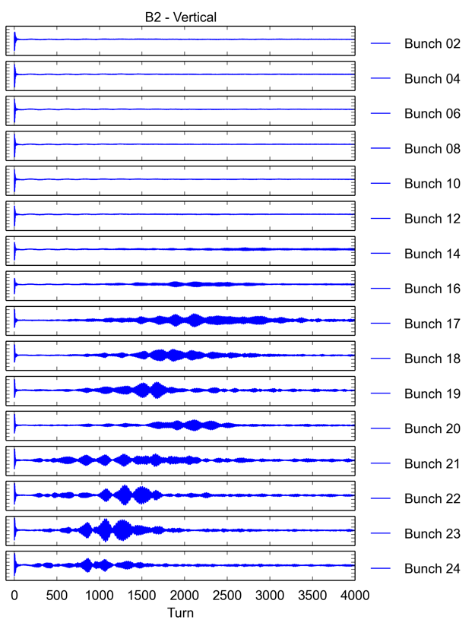
LHC e-cloud observations – Run 2
The conditioning state achieved until end 2012 was
undone when LHC was basically fully vented during
Long Shutdown 1 (LS1)
In 2015 the beams exhibited at the beginning strong
e-cloud instabilities causing severe losses even with
short bunch trains injected

Slide 20
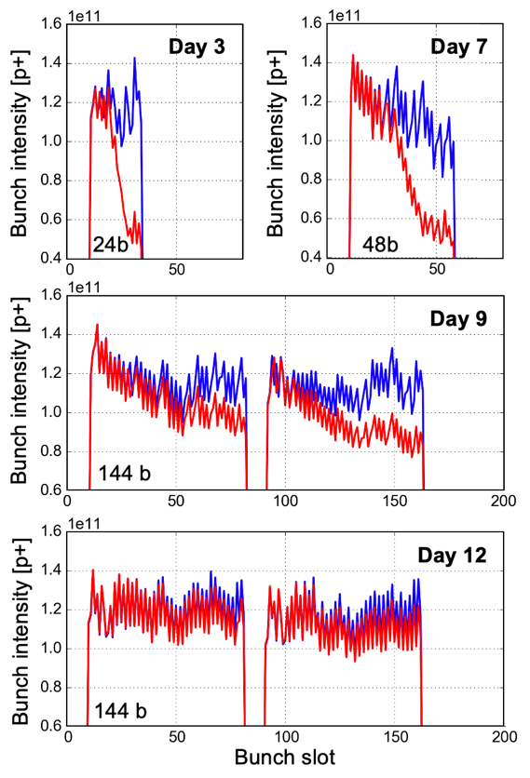
LHC e-cloud observations – Run 2
The conditioning state achieved until end 2012 was
undone when LHC was basically fully vented during
Long Shutdown 1 (LS1)
In 2015 the beams exhibited at the beginning strong
e-cloud instabilities causing severe losses even with
short bunch trains injected
Instabilities and slow losses due to e-ecloud could
be only gradually improved over several days of
dedicated scrubbing at 450 GeV
During this time, the length of the bunch trains and
the total number of bunches was gradually increased
in the machine and the lifetime kept improving
Right after injection 10 min after injection

Slide 21
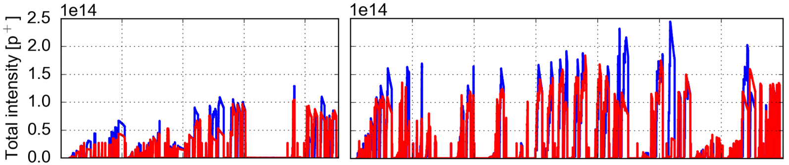
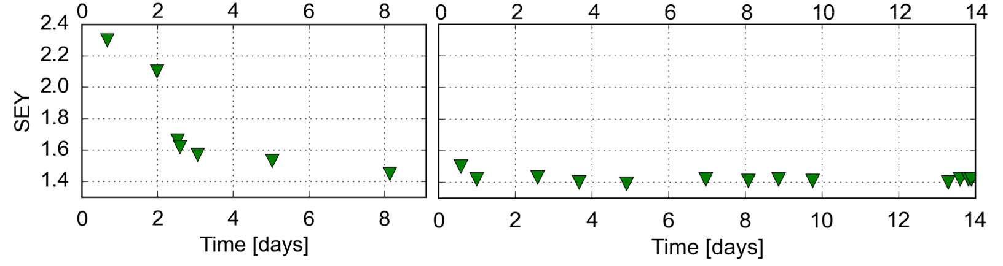
LHC e-cloud observations – Run 2
Scrubbing 2015: It took 24 days of patient and gradual scrubbing to feel confident that LHC start physics production with 25 ns beams
An average SEY in the arcs could be reconstructed from heat load data
Scrubbing Run 1
Scrubbing Run 2
Beam 1
Beam 2

Slide 22
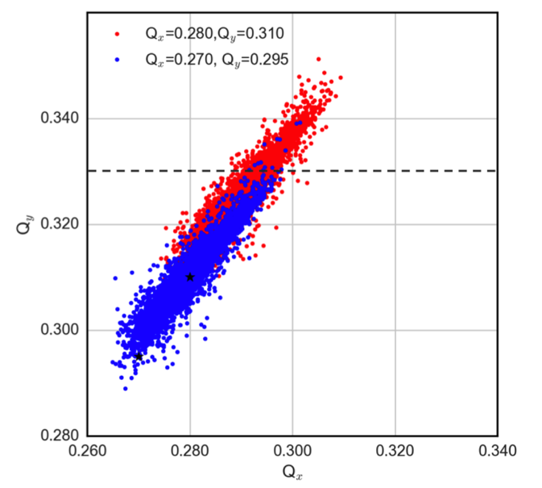
LHC e-cloud observations – Run 2
Even after scrubbing and going into operation, the e-cloud kept affecting the beam dynamics
  Machine settings: Need to run with high chromaticity
  (Q’ up to 20 units) & large octupole currents for stability,
  adjust tunes to accommodate the large tune footprint
  and preserve beam lifetime
PyECLOUD-PyHEADTAIL simulation

Slide 23
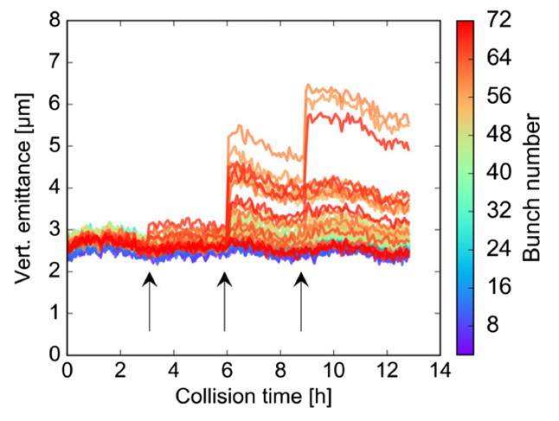
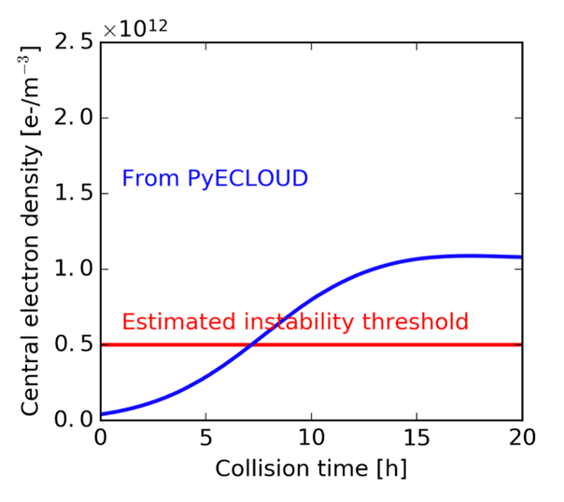
LHC e-cloud observations – Run 2
Even after scrubbing and going into operation, the e-cloud kept affecting the beam dynamics
  Instabilities during store due to build-up of central stripe for lower beam intensity
Observations
Simulations

Slide 24
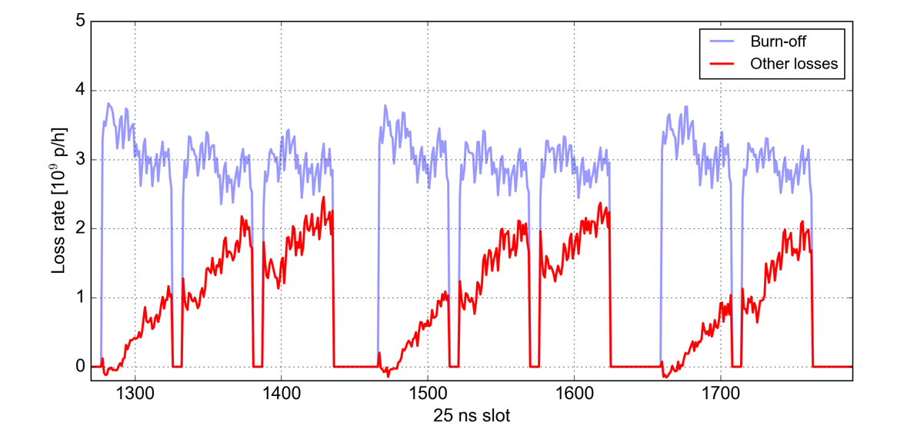
LHC e-cloud observations – Run 2
Even after scrubbing and going into operation, the e-cloud kept affecting the beam dynamics
  Slow beam losses during store mainly affecting bunches at the end of trains

Slide 25
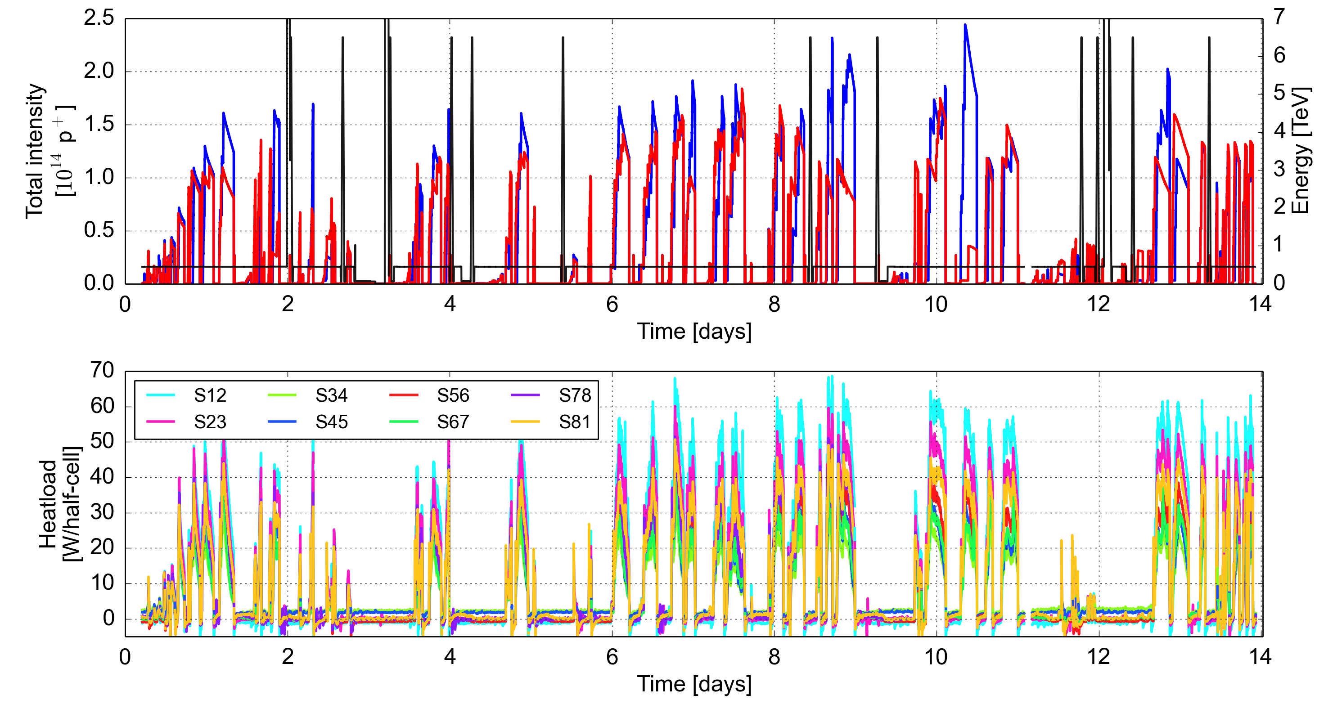
LHC e-cloud observations – Run 2
The heat load in the arcs showed persisting e-cloud and also – surprisingly – reached different levels in different arcs
Scrubbing Run 2

Slide 26
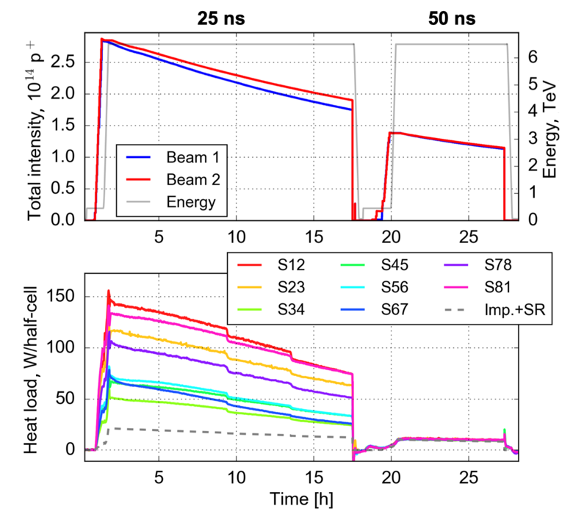
LHC e-cloud observations – Run 2
The heat load in the arcs showed persisting e-cloud and also – surprisingly – reached different levels in different arcs
  Additional heat load ranging by a factor 3 or more
  for typical 2015 physics fill
  Clearly due to e-cloud as only measured with
  25 ns bunch spacing

Slide 27
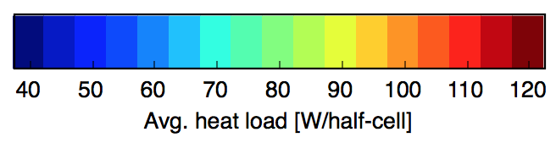
LHC e-cloud observations – Run 2
The heat load in the arcs showed persisting e-cloud and also – surprisingly – reached different levels in different arcs
  Additional heat load ranging by a factor 3 or more
  for typical 2015 physics fill
  Clearly due to e-cloud as only measured with
  25 ns bunch spacing
The LHC appeared divided into a ‘lower’ half with
high-load sectors and an ‘upper’ half with low-load
sectors
CMS
S45
S56
S34
S67
S23
S78
ALICE
LHCb
S12
S81
ATLAS

Slide 28
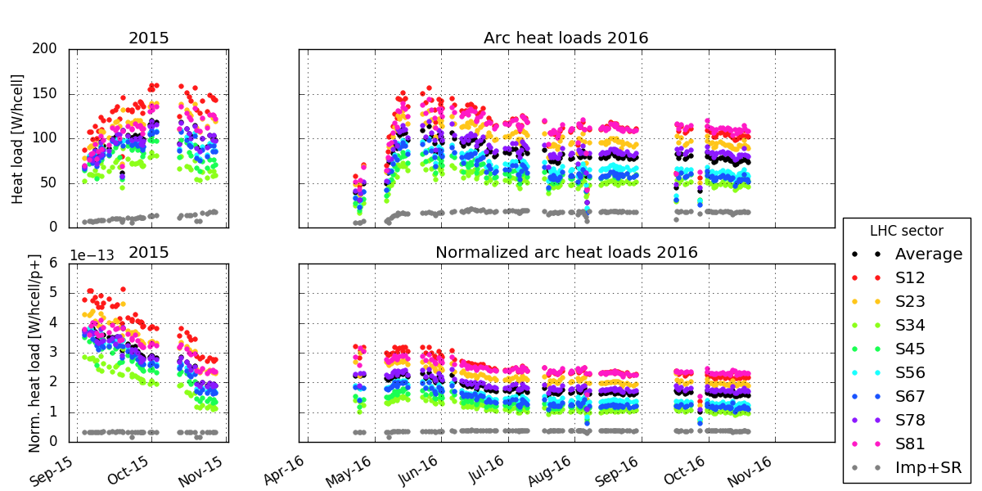
LHC e-cloud observations – Run 2
The heat load in the arcs showed persisting e-cloud and also – surprisingly – reached different levels in different arcs
  Limited operation in 2015 and beginning of 2016
Cooling capacity

Slide 29
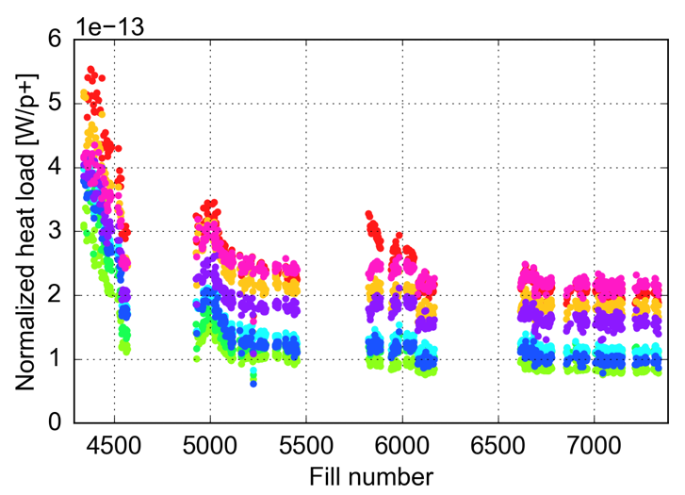
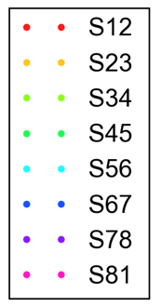
LHC e-cloud observations – Run 2
The heat load in the arcs showed persisting e-cloud and also – surprisingly – reached different levels in different arcs
  Limited operation in 2015 and beginning of 2016
  Fortunately, additional parasitic scrubbing during physics alleviated the problem in Run 2, but the difference between arcs remained till the end
25 ns physics fills with >600b
2015
2016
2017
2018
S12
vented
Highest load sectors
SEY ≃ 1.35
Low load sectors
SEY ≃ 1.25

Slide 30
LHC e-cloud observations – LS2
Today
2010
2013
2015
2019
2022
Run 1
LS1
Run 2
LS2
Run 3
Run 1 - data taking with:
Beam energy: 3.5 - 4 TeV
Bunch spacing: 150 – 50 ns
Max # of bunches: 1380
Bunch intensity: 1.7e11p
Run 2 - data taking with:
Beam energy: 6.5 TeV
Bunch spacing: 25 ns
Max # of bunches: 2556
Bunch intensity: 1.2e11p
Run 3 - forecast:
Beam energy: 6.8 TeV
Bunch spacing: 25 ns
Max # of bunches: 2556
Bunch intensity: 1.8e11p
Long Shutdown 1:
No beam
Consolidation and maintenance
All arcs were warmed up and vented
Long Shutdown 2:
No beam
Consolidation and maintenance for LHC
All arcs were again warmed up and vented
LHC injectors were upgraded to produce beams twice as intense and as bright

Slide 31
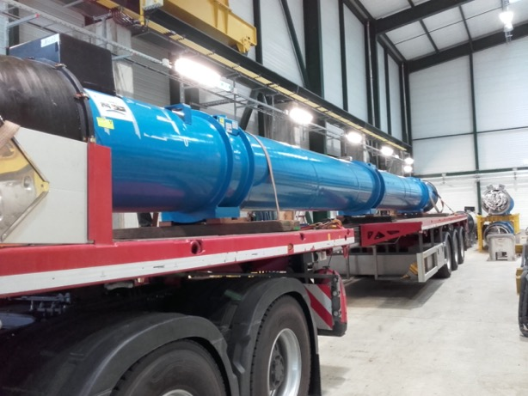
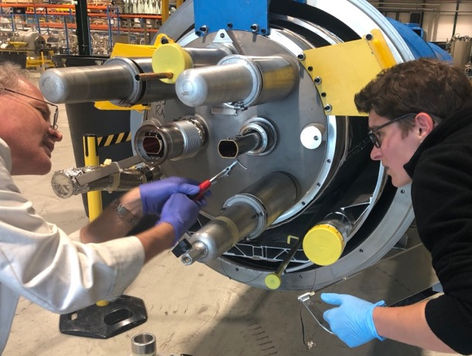
LHC e-cloud observations – LS2
During the last shutdown, direct inspection of the beam screens took place to try explaining the different behaviour of the LHC arcs
  Magnets showing very high and very low heat loads were extracted from the ring
  Their beam screens were removed from the magnet and underwent laboratory analysis

Slide 32
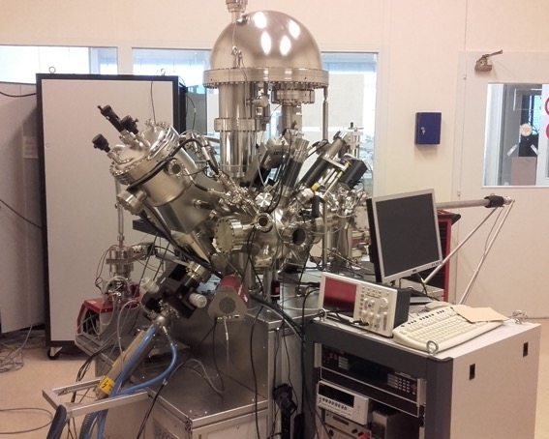
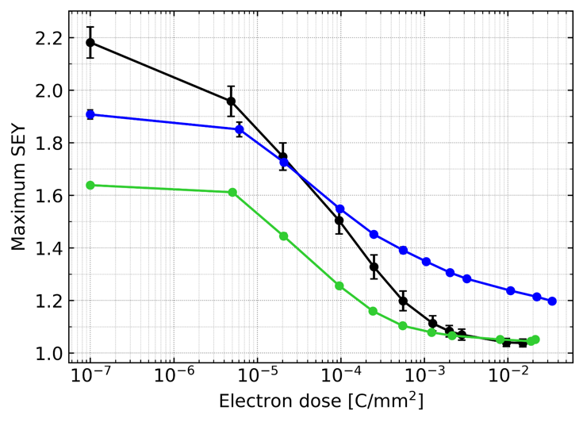
LHC e-cloud observations – LS2
From measurements of SEY and conditioning behavior at room temperature:
  High-load beam screen exhibited a higher SEY after venting compared to low-load magnets
  High-load beam screen shows worse conditioning behavior upon e- irradiation compared to the low-load magnet and to a spare beam screen (never installed)
SPECS measurement system (CERN TE-VSC)
Spare
High-load
Low-load

Slide 33
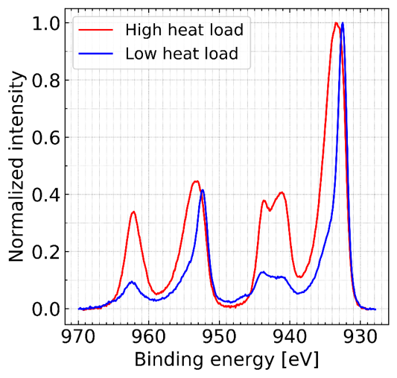
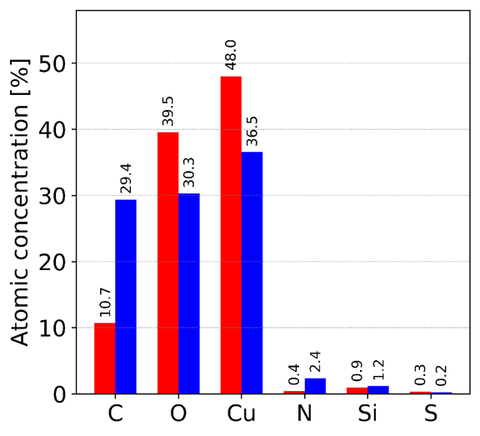
LHC e-cloud observations – LS2
The chemistry of the surface was analyzed using X-ray photoelectron spectroscopy (XPS)
  Low-load beam screen shows Copper(I) oxide (Cu2O) → native copper oxide
  High-load beam screen shows Copper(II) oxide (CuO) → unexpected!
  High-load beam screen shows a surprisingly low concentration of carbon
These chemical alterations are
likely the cause of the different
SEY and conditioning behaviour
XPS spectrum
Notes:
Though we now understand the origin of the different SEYs, we do not know what caused the growth of CuO in the first place and we can’t predict what the LHC beam screens will look like after LS2 …

Slide 34
LHC e-cloud projections – Run 3 (and beyond)
Today
2010
2013
2015
2019
2022
Run 1
LS1
Run 2
LS2
Run 3
Run 1 - data taking with:
Beam energy: 3.5 - 4 TeV
Bunch spacing: 150 – 50 ns
Max # of bunches: 1380
Bunch intensity: 1.7e11p
Run 2 - data taking with:
Beam energy: 6.5 TeV
Bunch spacing: 25 ns
Max # of bunches: 2556
Bunch intensity: 1.2e11p
Run 3 - forecast:
Beam energy: 6.8 TeV
Bunch spacing: 25 ns
Max # of bunches: 2556
Bunch intensity: 1.8e11p
Long Shutdown 1:
No beam
Consolidation and maintenance
All arcs were warmed up and vented
Long Shutdown 2:
No beam
Consolidation and maintenance for LHC
All arcs were again warmed up and vented
LHC injectors were upgraded to produce beams twice as intense and as bright

Slide 35
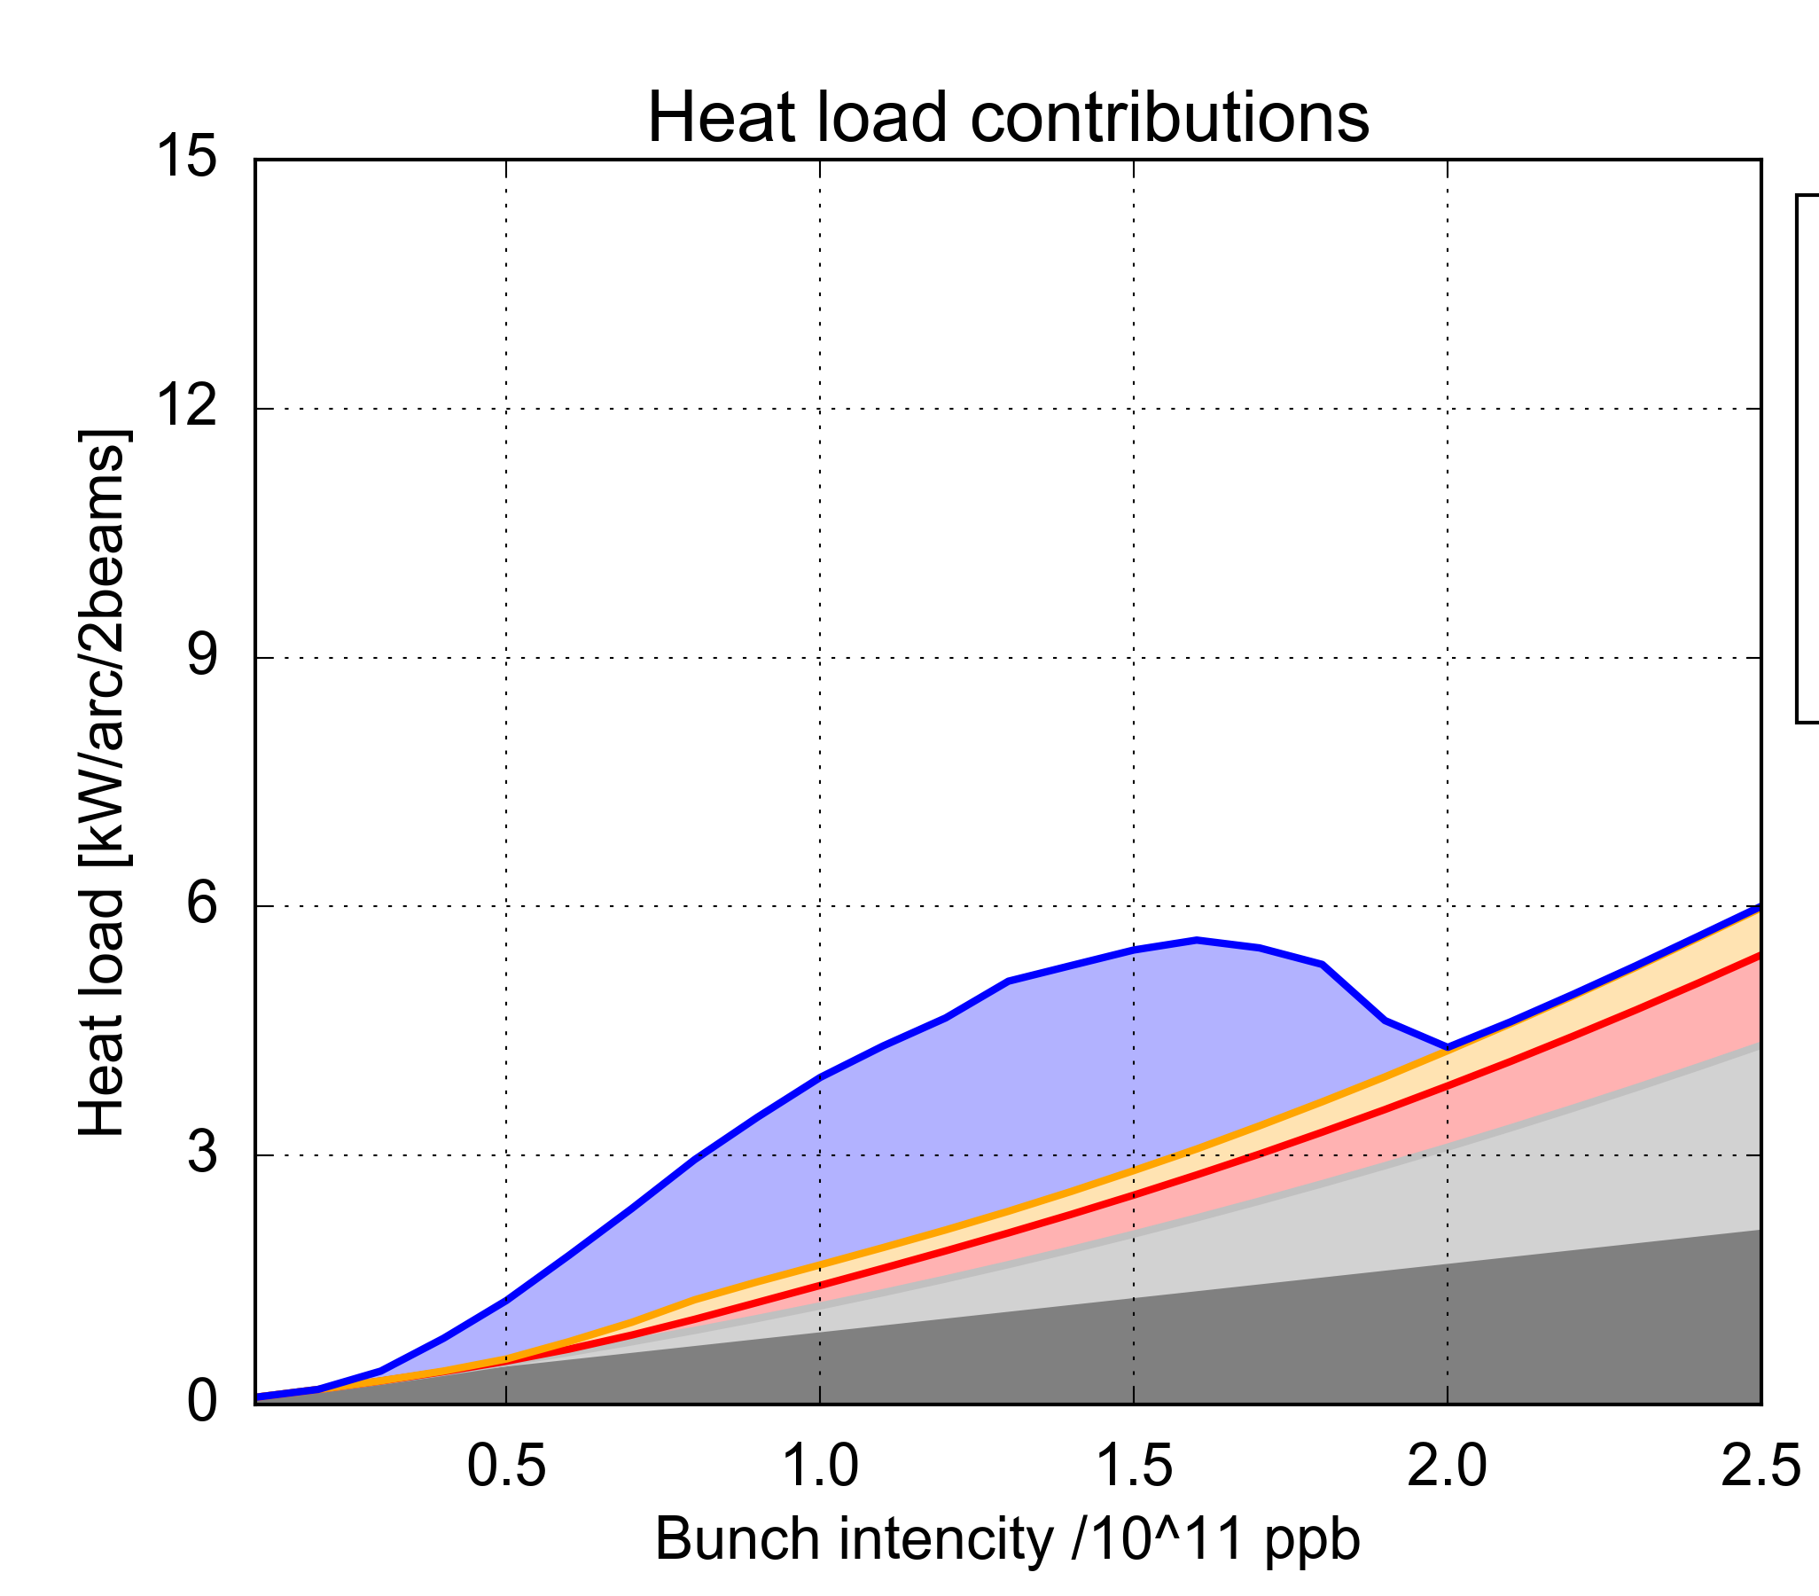
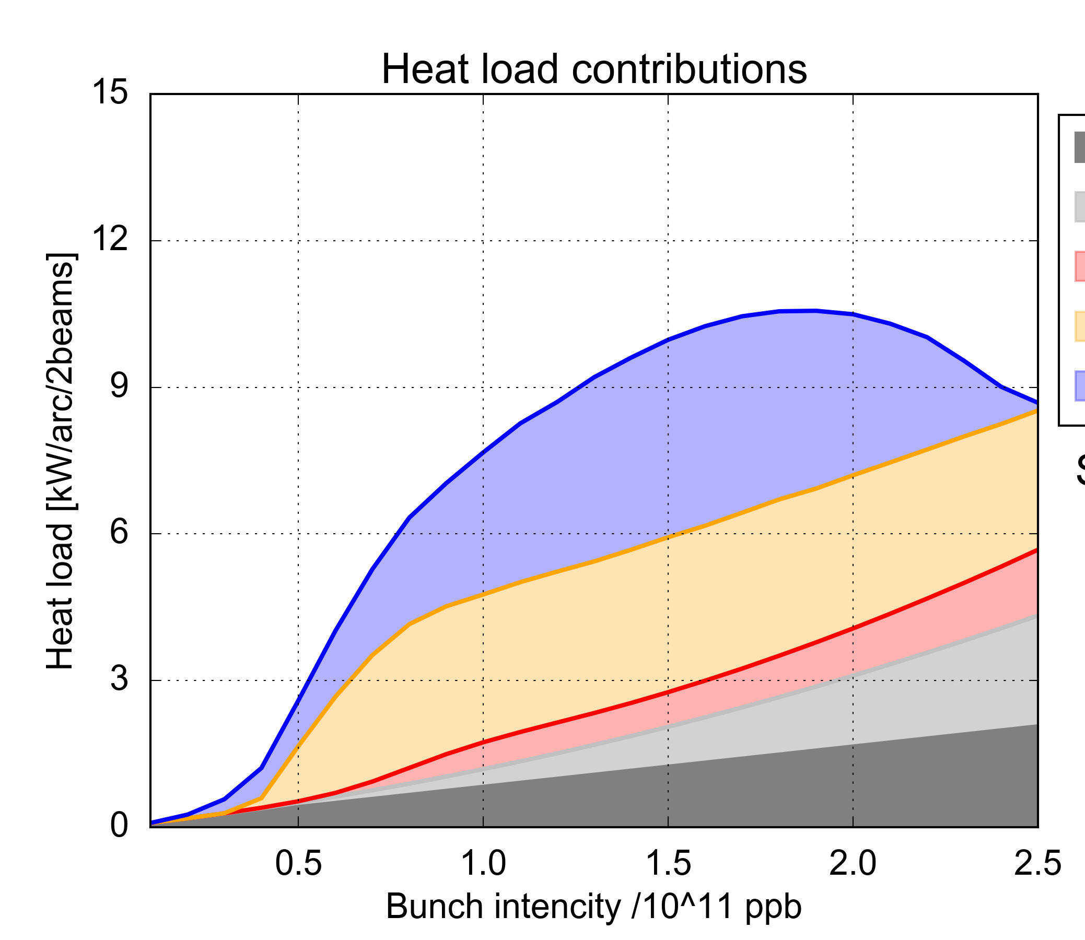
LHC e-cloud predictions – Run 3 (and beyond)
We can sum up contributions to e-cloud from all parts of the arc assuming SEY from latest 2018 heat load measurements (SEY=1.25 – 1.35)
  No margin during Run 3, any further deterioration of high load sectors not tolerable!
Low-load sectors
High-load sectors
e-cloud in dipoles
SEY=1.35
e-cloud in quadrupoles
e-cloud in drifts
  Run 2
  Run 3
  HiLumi
  HiLumi
Impedance
  Run 3
Synchrotron radiation
  10 kW/arc (~200W/hcell)
SEY=1.25
Heat load [kW/arc]
Heat load [kW/arc]
  Run 2
Bunch intensity [10¹¹ p/bunch]
Bunch intensity [10¹¹ p/bunch]

Slide 36
Closing remarks
The LHC has been suffering electron cloud issues when operating with closely spaced intense proton bunches
  Especially critical with 25 ns beams both in terms of beam dynamics (WP optimization, instability mitigation, lifetime in collision) and beam screen heating
Dedicated scrubbing runs have been necessary, and successful, after every partial or total machine opening, as conditioning is lost with venting
  Additional scrubbing takes place during physics operation but levels off
Different scrubbing efficiency for different sectors investigated and found to be caused by different chemical compositions of the screen inner surface
  Still investigating underlying reason and if anything can be done to ‘reverse’ the processes
If no further degradation, cooling capacity of cryogenic system expected to be just sufficient for Run 3 and High Luminosity (HiLumi) operation of LHC

Slide 37
References (and references therein) for more details
G. Rumolo et al. “Electron cloud effects at the LHC and LHC injectors”, MOZA1 in IPAC 2017
A. Romano et al. “Electron cloud buildup driving spontaneous vertical instabilities of stored beams in the Large Hadron Collider”, Phys. Rev. Accel. Beams 21, 061002, 2018
G. Ferlin et al. “Cryogenics experience during Run 2 and impact of LS2 on next run” in Proc. 9th LHC Operations Evian Workshop, CERN-ACC-2019-059, 2019
G. Iadarola et al. “Progressing in mastering electrons clouds at the Large Hadron Collider”, TUXA03 in IPAC 2021
V. Petit et al., Beam-Induced Surface Modification of the LHC Beam Screens: The Reason for the High Heat Load in Some LHC Arcs?”, WEPAB339 in IPAC 2021

