Slide 1
Nb₃Sn efforts in the US Magnet Development Program
Presentation to the 2021 EIC Accelerator Partnership Workshop
Soren Prestemon
Lawrence Berkeley National Laboratory
For the MDP Team
Composed of staff from LBNL, FNAL, BNL, and ASC/NHMFL

Slide 2
Outline
US Magnet Development Program – vision and goals
Research plan for Nb₃Sn magnets
Additional critical MDP Areas supporting Nb₃Sn magnet development
Summary comments
References:
“The 2020 Updated MDP Roadmaps”, https://arxiv.org/abs/2011.09539
“Global plans for high-field accelerator magnet R&D”, S. Prestemon, FCC Week 2021
“Nb₃5n cos-theta magnets with stress management”, A. Zlobin, this workshop
“Advantages and issues of the CCT structure and its possible use for the EIC IR2 quadrupoles”, D. Arbelaez, this workshop

Slide 3




Recap of our MDP vision & goals
Maintain and strengthen US Leadership in high-field accelerator magnet technology for future colliders
Focus on the four primary goals identified in the the original MDP Plan
  Explore the performance limits of Nb₃Sn accelerator magnets, with a focus on minimizing the required operating margin and significantly reducing or eliminating training
  Develop and demonstrate an HTS accelerator magnet with a self-field of 5T or greater, compatible with operation in a hybrid HTS/LTS magnet for fields beyond 16T
  Investigate fundamental aspects of magnet design and technology that can lead to substantial performance improvements and magnet cost reduction
  Pursue Nb₃Sn and HTS conductor R&D with clear targets to increase performance and reduce the cost of accelerator magnets
Further develop and integrate the teams across the partner laboratories and Universities for maximum value and effectiveness to the program
Identify and nurture cross-cutting / synergistic activities with other programs to more rapidly advance progress towards our goals

Slide 4
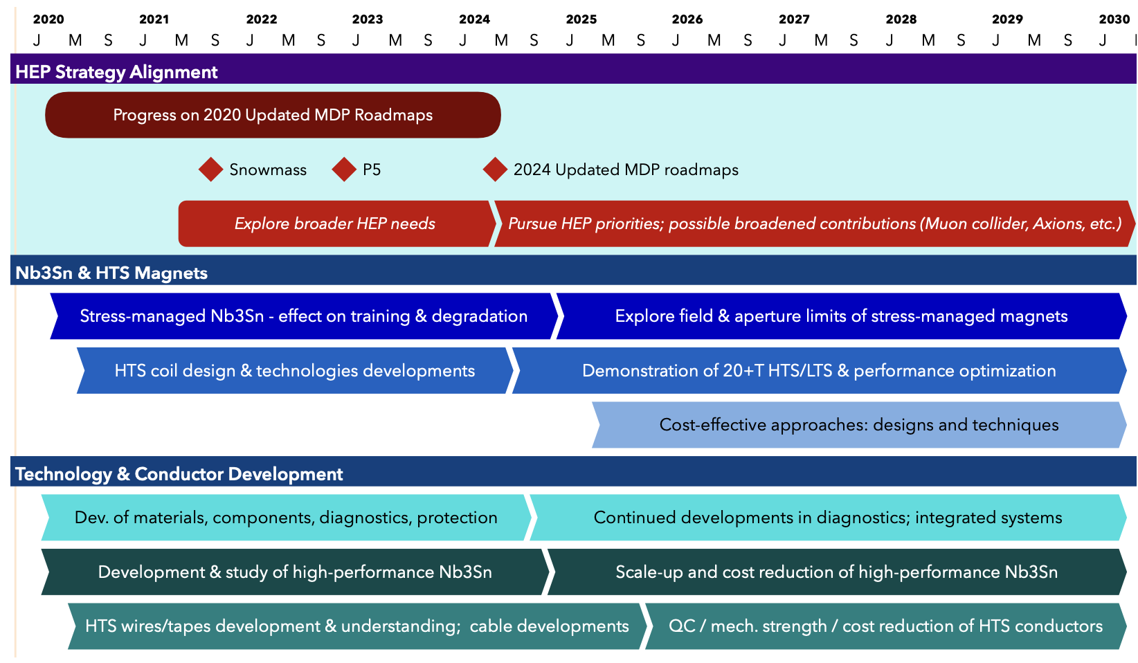
US MDP 2020 roadmaps – long range
Continue alignment with physics community needs
Focus on “stress-management” as well as hybrid HTS/LTS magnet technology
Continue to invest in the “science of magnets” and in improved conductors

Slide 5
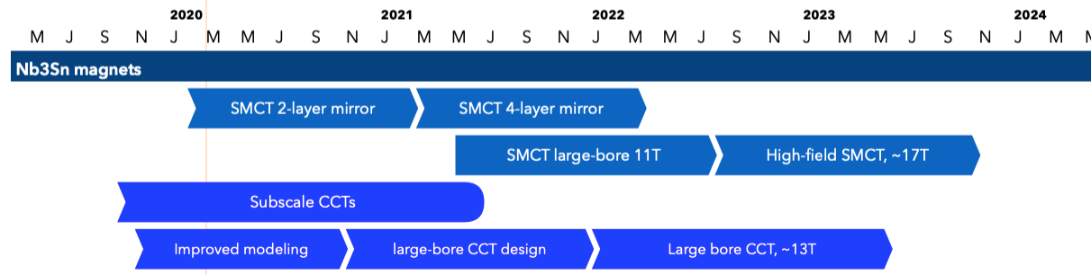
Program roadmap – 2020 Detailed Plan
Strategic priorities for the update plan:
  Probing stress management structures
  Hybrid HTS/LTS designs
  Understanding and impacting the disturbance-spectrum
  Advancing both LTS and HTS conductors, optimized for HEP applications
Nb₃Sn magnet elements of the program

Slide 6

R&D efforts for accelerator magnet technology are becoming more structured
DOE-OHEP created the US Magnet Development Program (MDP) in ~2016
Europe is in the process of forming the High Field Magnet program (HFM)
  Led by the Laboratory Director’s Group (LDG)
  Working to define roadmaps and coordinate activities by collaborating institutions
The programs strive to coordinate efforts to more rapidly advance technology development
General R&D - programmatic
(ex: US MDP)
Directed R&D
(Technology readiness)
(ex: LARP)
Directed R&D
(Technology readiness)
Project
Project
(ex: HL-LHC AUP)
The US DOE approach balances long-range R&D and project preparation

Slide 7
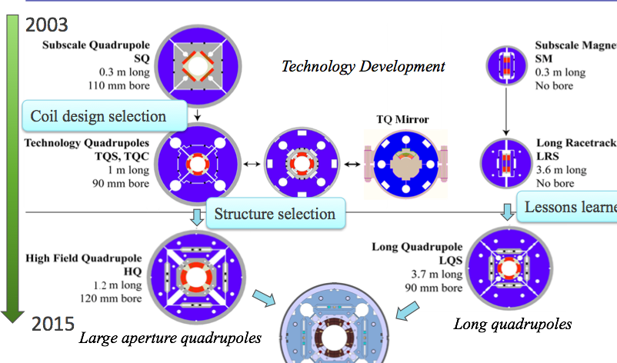
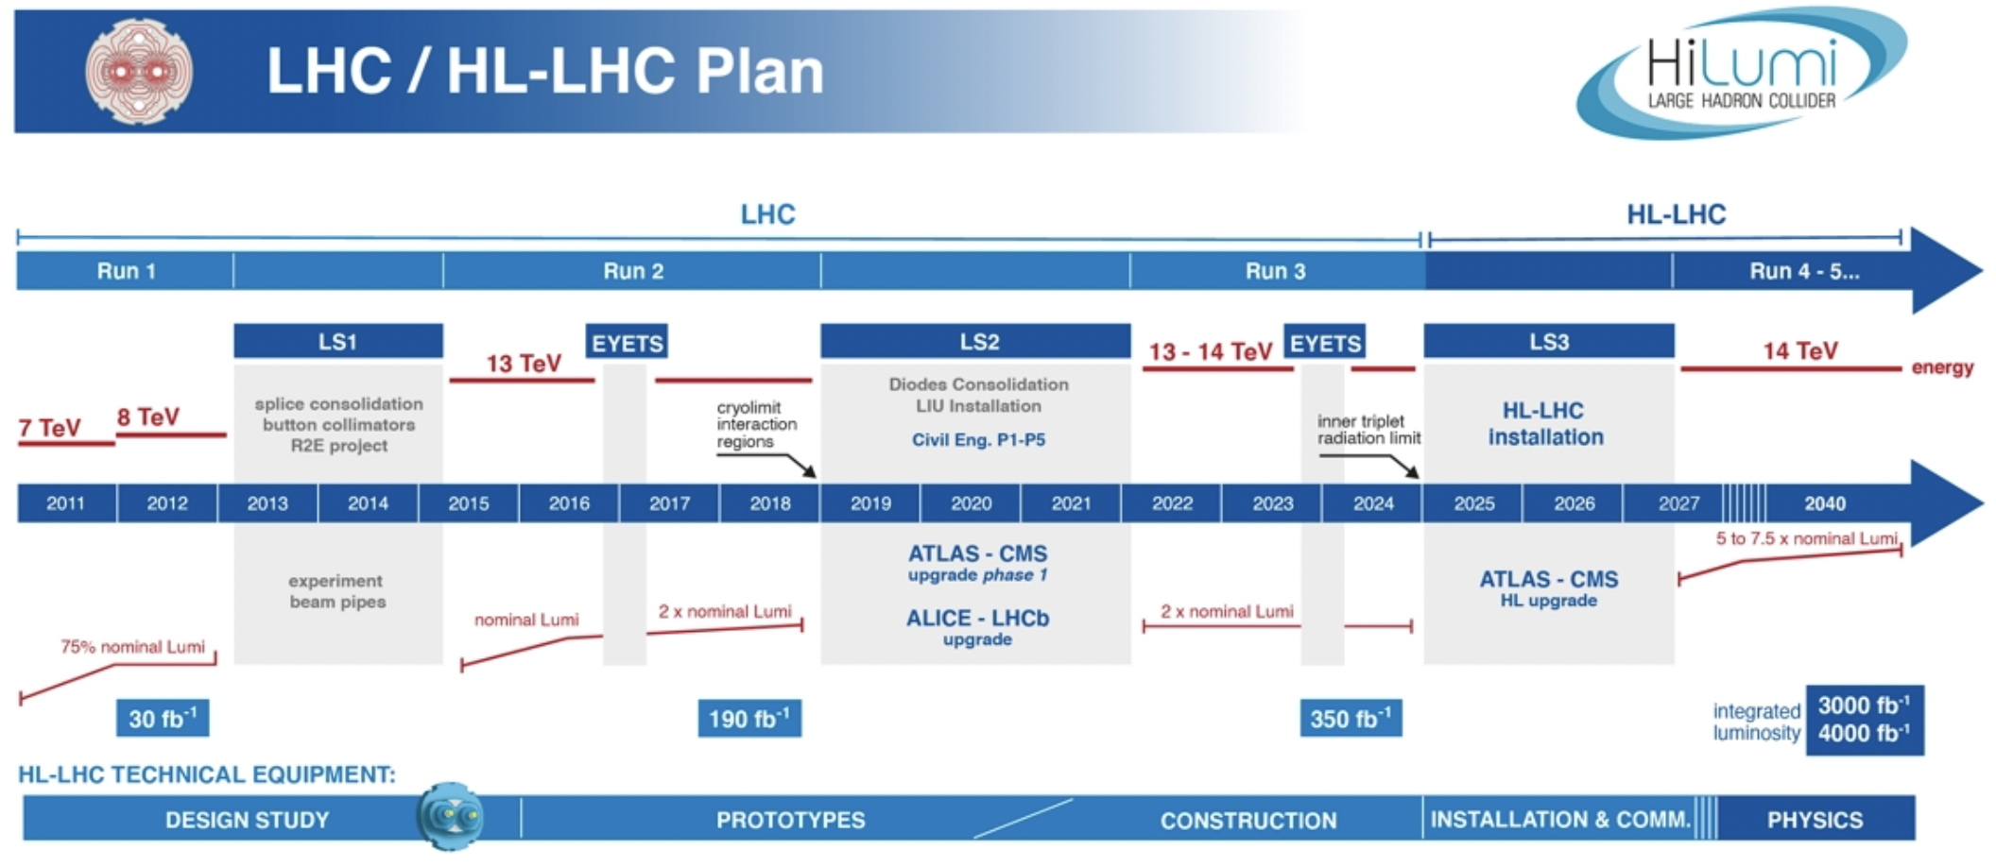
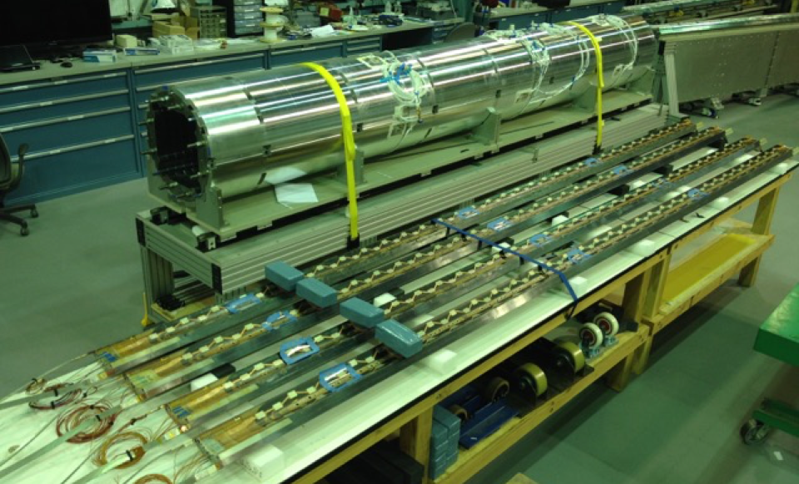
Nb3Sn accelerator magnet technology is - for the 1st time - being installed in a collider
S. Prestemon, Workshop on Advanced Superconducting Materials and Magnets, KEK January 22 2019
S. Prestemon, Workshop on Advanced Superconducting Materials and Magnets, KEK January 22 2019
HiLumi production is arguably “boutique production”
What are the risks and benefits of full-scale industrial production of Nb₃Sn magnets?
There is significant value-engineering that can be performed
What elements of the design are “robust”, and what elements generate risk/performance limitations?

Slide 8
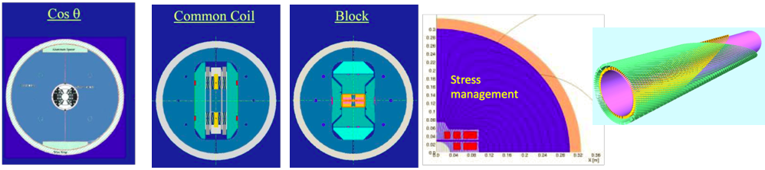


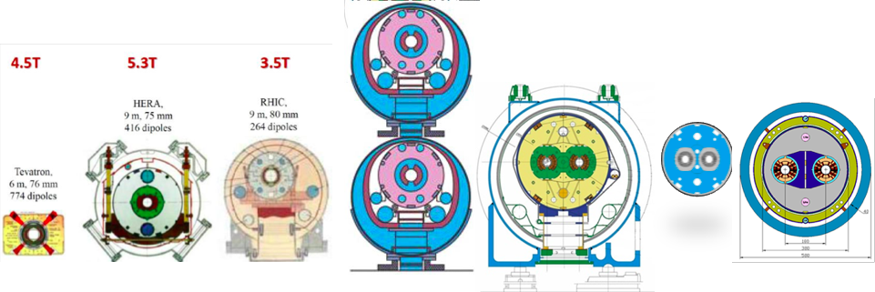


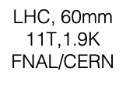


The “magnet zoo” in colliders are (to-date) all based on Cos(t) designs
R&D magnet designs explore layouts that attempt to address issues associated with conductor strain (to avoid degradation) and reduction of conductor/coil motion (to minimize training)
At high field “managing” stress through judicious force interception will be required
Development and use of Nb₃Sn and HTS requires strong physics motivation
  The technology is complex and costly, but in some cases enabling
[and/or for large bore…]
S. Prestemon, Workshop on Advanced Superconducting Materials and Magnets, KEK January 22 2019
S. Prestemon, Workshop on Advanced Superconducting Materials and Magnets, KEK January 22 2019

Slide 9
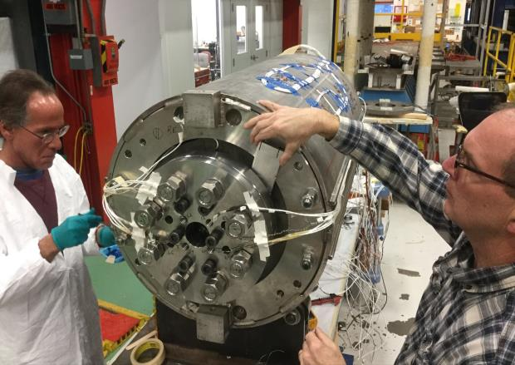
Program strategy and goals: driving questions related to performance
Ultimate Performance of Magnets
  What is the nature of accelerator magnet training? Can we reduce or eliminate it?
  How do we best define operating margin for Nb3Sn and HTS accelerator magnets, and to what degree can and should it be minimized?
  Can we control the disturbance spectrum and engineer a magnet response to reduce operating margin and enhance reliable performance?
  What are the mechanical limits and possible stress-management approaches for Nb3Sn, HTS, and 20 T hybrid LTS/HTS magnets, and do they have defined mechanical limits?
  Do hybrid designs benefit from the best features of LTS and HTS, or inherit the difficulties of both material technologies?
Example: MDP 4-layer, 60mm bore cosine-theta magnet led by FNAL
Record field!
[I]: Highest priority issue: degradation
  Mechanisms; design mitigation
[II]: Second priority: Initial quench current
and memory after thermal cycle
[III]: Third priority: Training rate

Slide 10
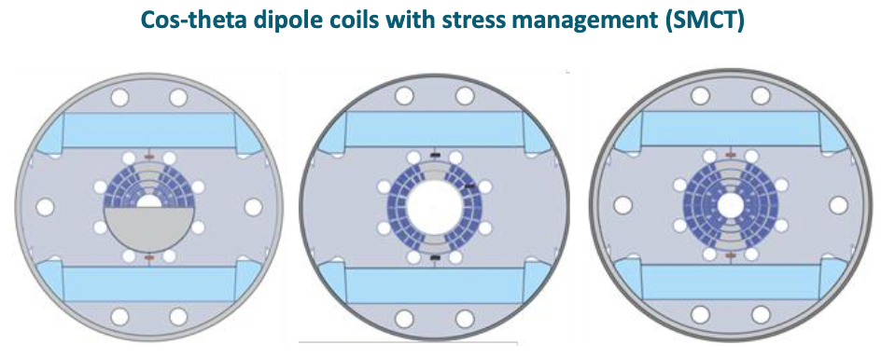
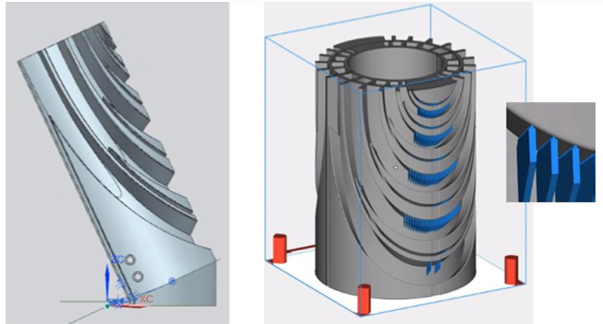
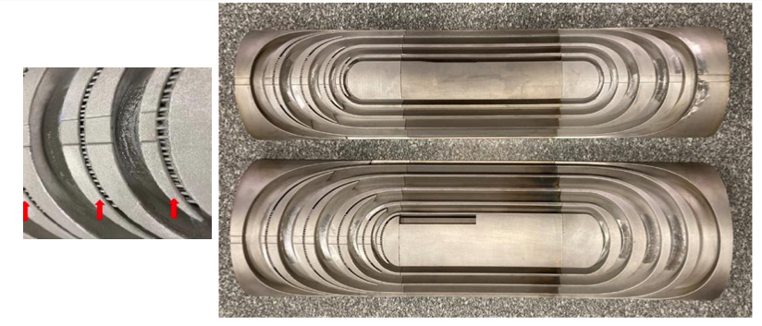
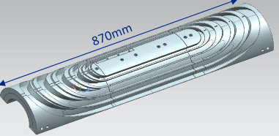
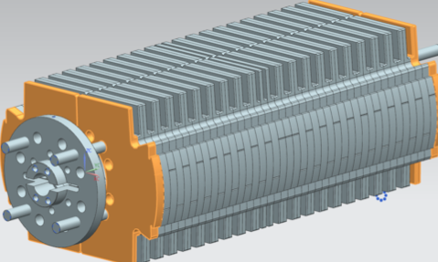
Nb₃Sn Stress-managed Cos-theta (SMCT)
Lead: A. Zlobin, FNAL
Direct Laser Melting (DLM) by GE Additive
Mirror block fab starts in Oct.
Improvement to coil end support
– lessons learned from 15T
Resulting 316L parts - <3 months to deliver

Slide 11
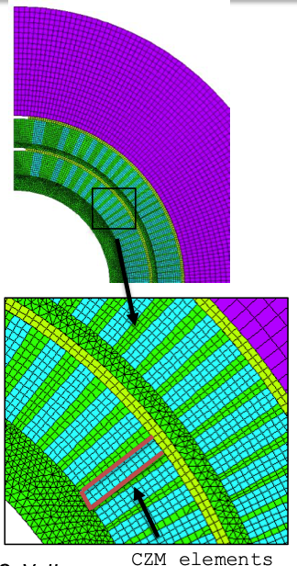
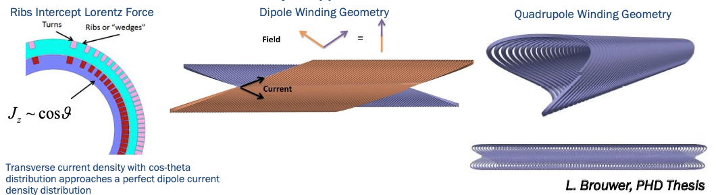
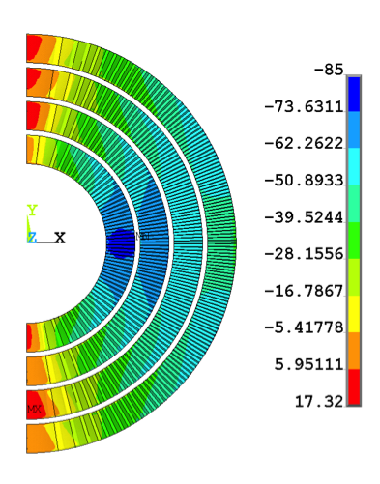
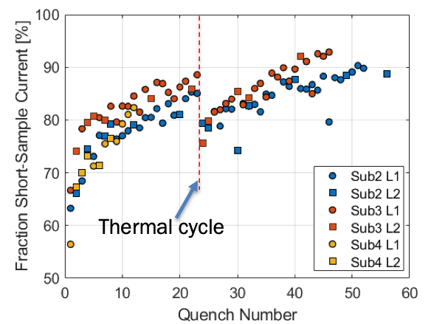
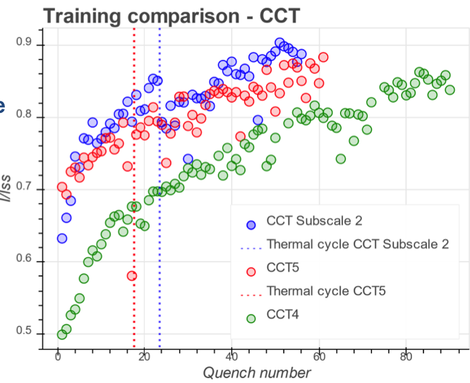
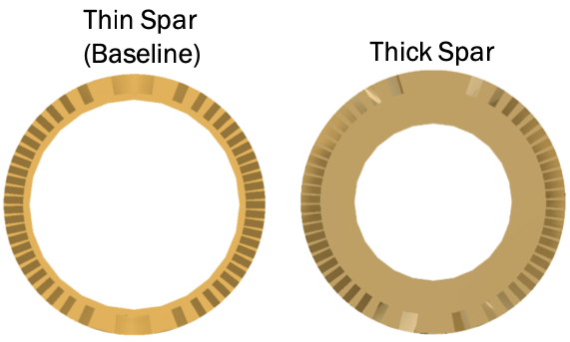
Nb₃Sn Canted Cos-theta (CCT) progress
Lead: D. Arbelaez, LBNL
“Cohesive Zone Modeling” underway
Lorentz forces at 12.2 T
stress
Feedback on thick/thin spars informs CCT6 design
Subscale reproduces training
Sub2 design
Sub3 design

Slide 12
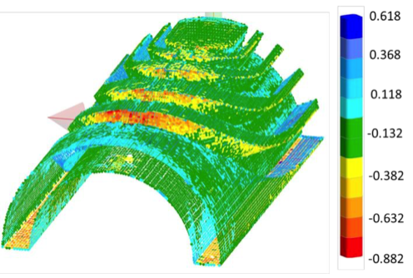
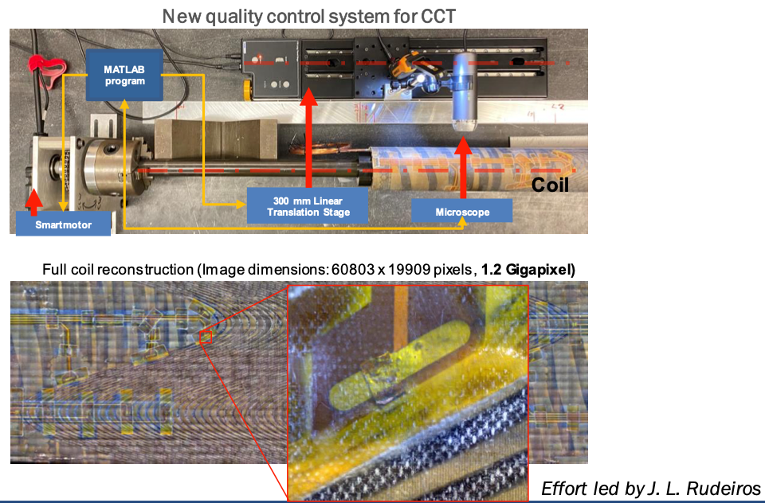
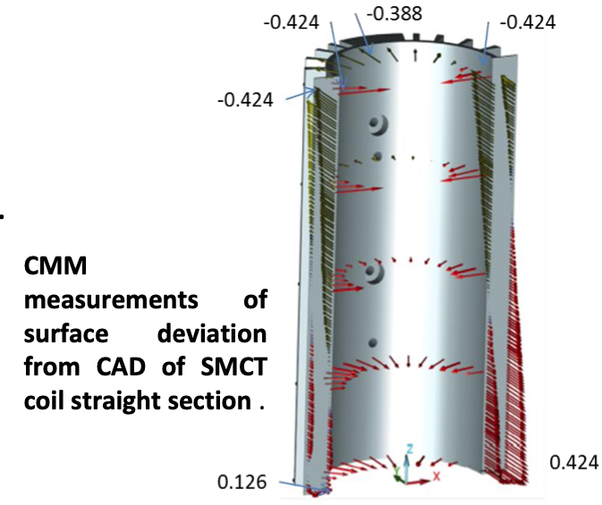
Advances in quality control are being applied
CMM surface deviation scans on SMCT parts provide feedback on Advanced Manufacturing process
In-house visual-microscope scanning of CCT surface provides QC of fabrication process
Automated laser-scanner
CT Scanning capability from industry also being explored
– should be available in coming months

Slide 13
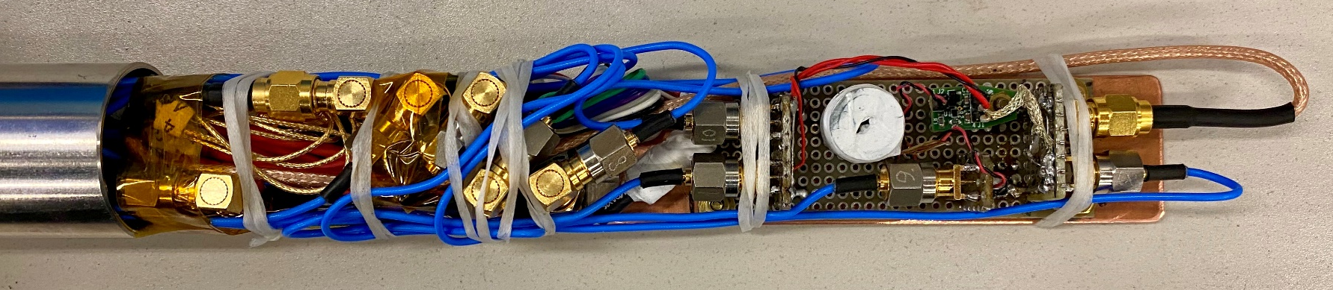
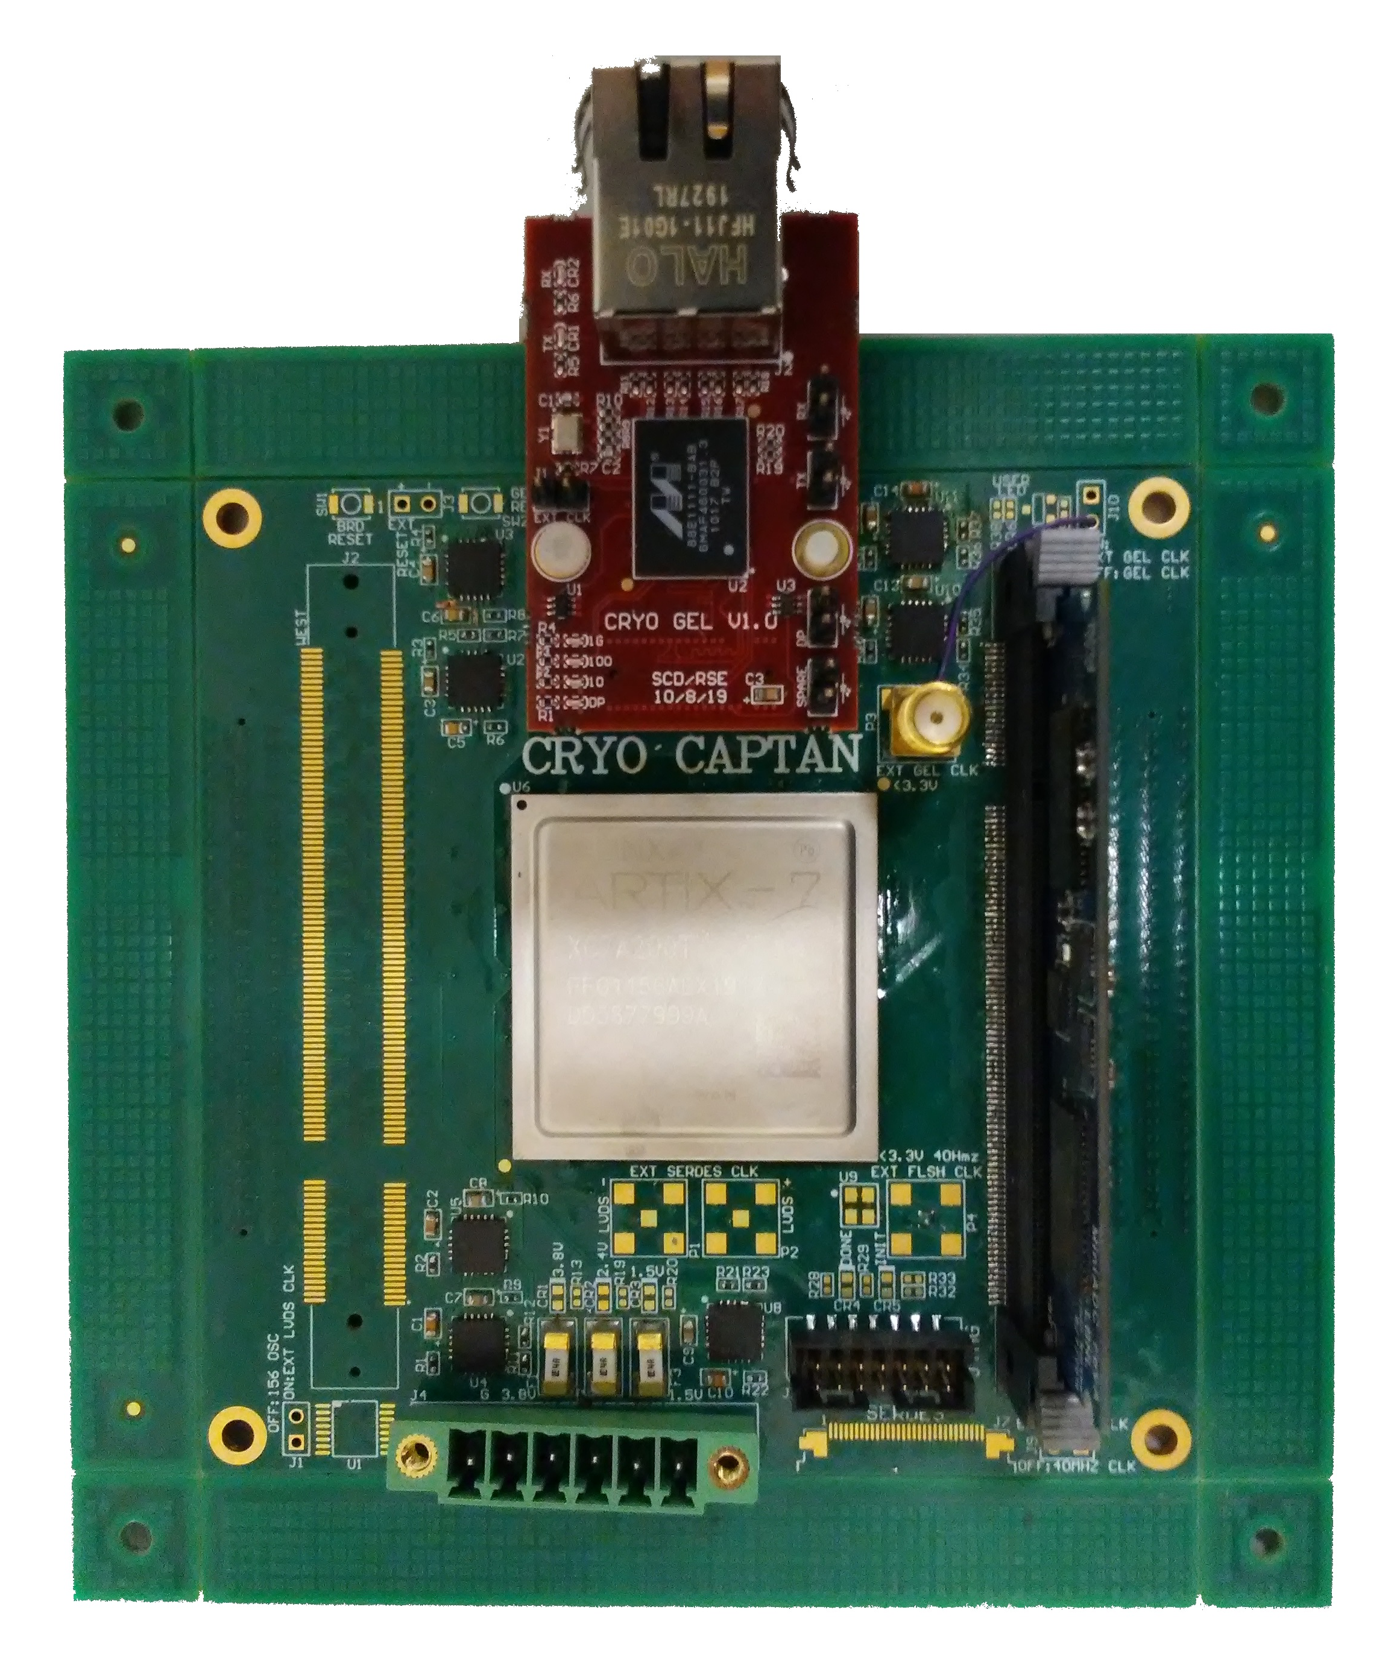
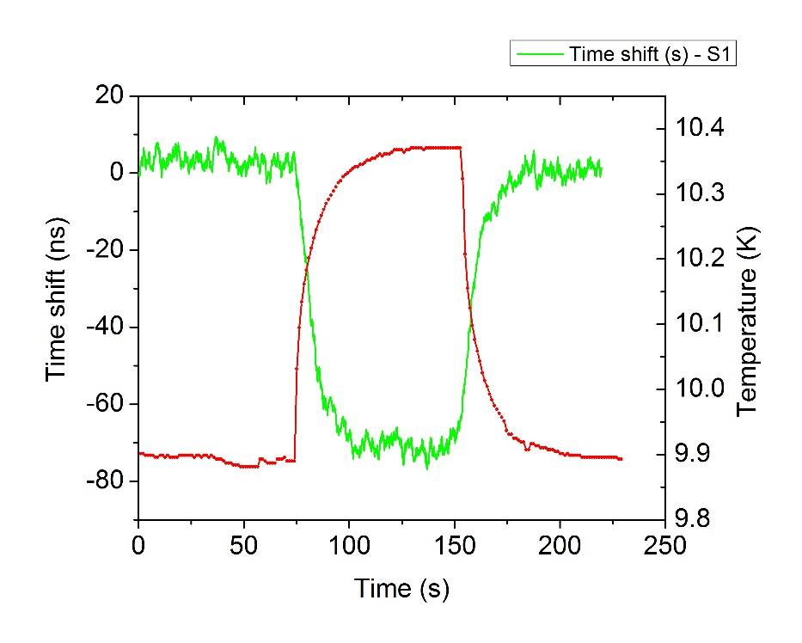
A sampling of diagnostics developments – driven by MDP needs, but with broad impact to DOE-SC and beyond
Machine Learning
Active acoustics
Goal: Use unsupervised learning to investigate physics (cracking vs. stick-slip) in magnet quench dataset
Stretch goal: Develop method to predict the quench in real-time
FPGA board
YBCO coil instrumented with
pulser and receiver piezos
Amplifier
First successful cryogenic (LHe) test of an FPGA digitizer with analog front end
CRYODAQ
Integration
Signal
Conditioning
Digitization
Communication
Processing
Experiment at 4.2 K. Current ramp stopped at 6100 A (stable) and then increased by 30 A (quenching)
Acoustic thermometry

Slide 14
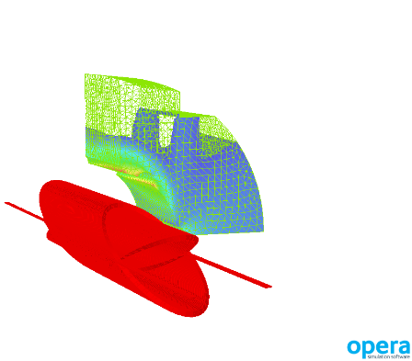
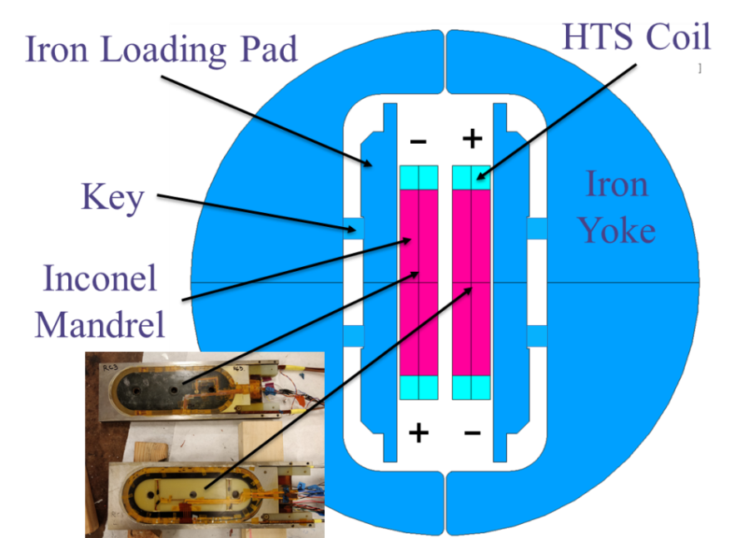
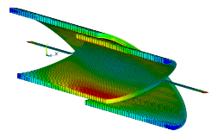
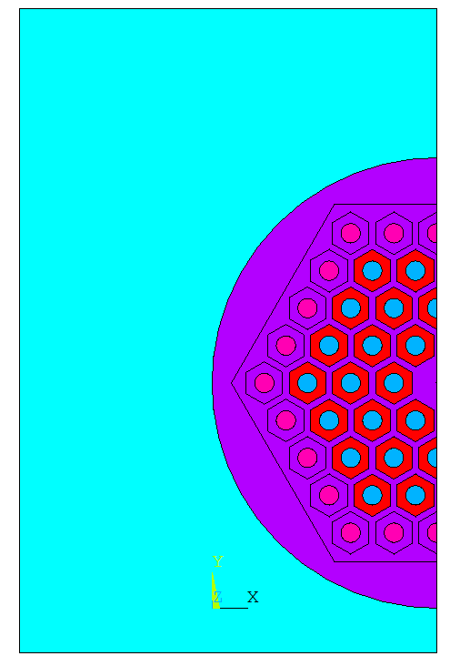
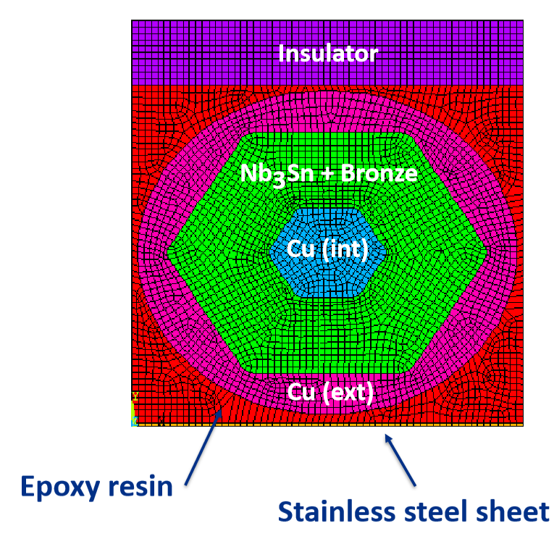
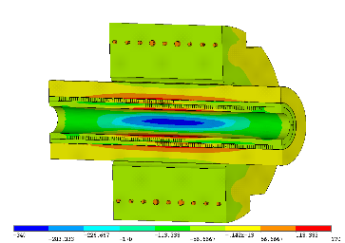
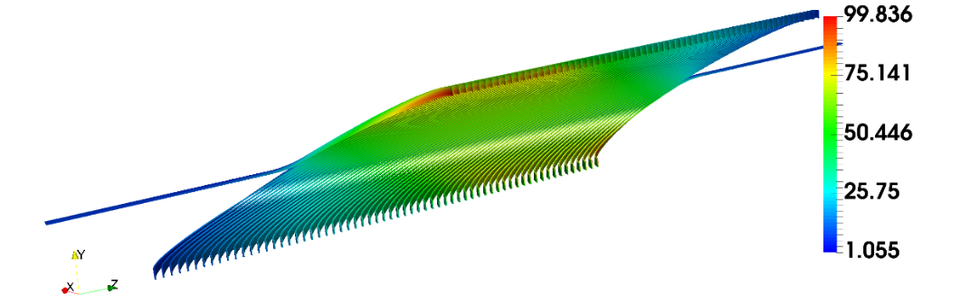
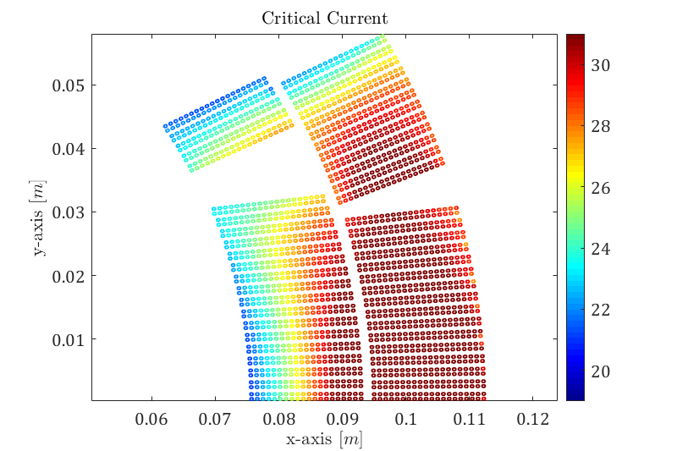
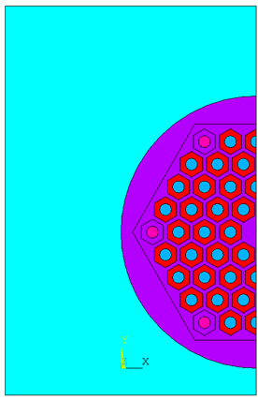
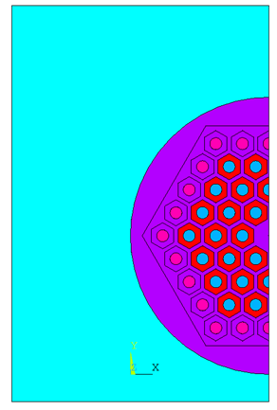
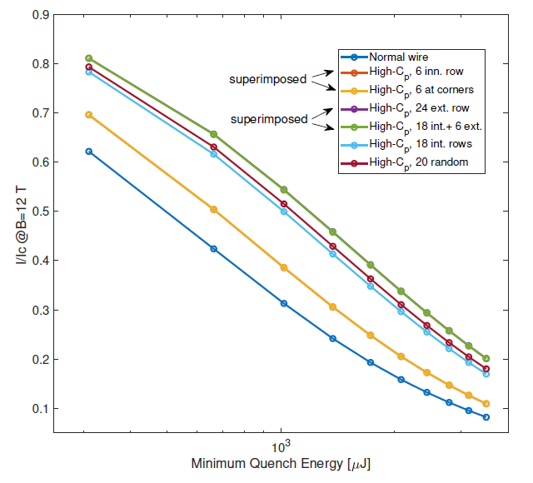
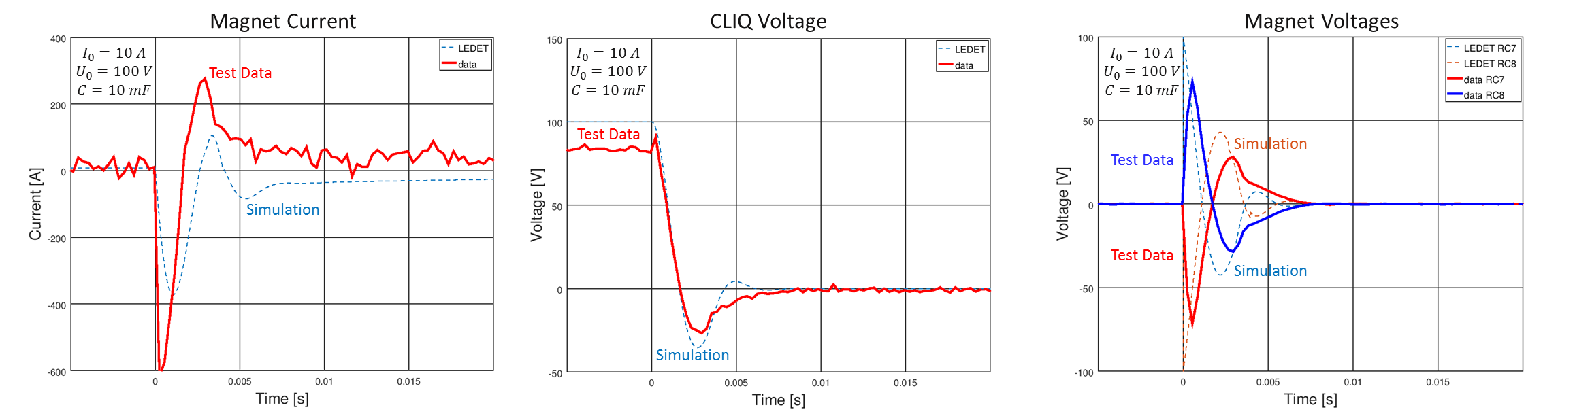
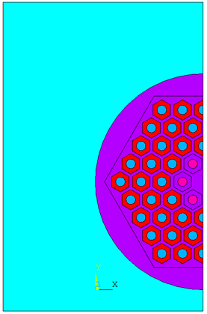
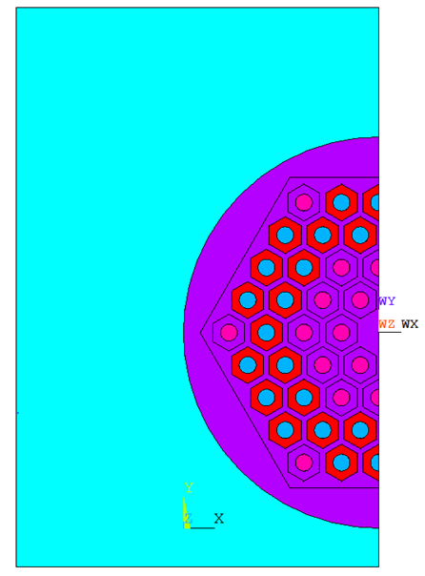
Wide array of modeling advances underway to support diagnostics feedback and to optimize magnet systems
Magnet Protection
Strain impact on operation
Mechanics and thermal processes in conductors
4.2 K, 12 T
Nb₃Sn
+
Stycast
Gd₂O₃+Cu
Heater
Cu
Bronze
6 at corners
24 external
First test of CLIQ on Bi-2212 common coil, 77 K: comparing simulation and measurement
6 central
Standard
60/61 RRP wire
24 (w/18 central)
“Heat diffusion in Nb₃Sn strands”, E. Barzi, to be published.

Slide 15
Summary comments
The US MDP is working on magnet technology that is highly relevant to possible EIC interaction region magnet needs
  Motivation for such technology needs to come from physics reach/potential!
If the science pull is sufficiently strong, and with timely decision and funding…
  more directed R&D could take LARP/AUP and MDP technology and develop a Nb₃Sn solution for the EIC 2nd detector on the timescale needed
Starting point…
Large aperture and/or strong focusing

