Slide 1
EIC Accelerator Collaboration
Andrei Seryi
Associate Director for Accelerator Systems and International Partnership
EIC Accelerator Partnership Workshop
28 October 2021

Slide 2



EIC - unique machine
EIC will be a unique and game-changing machine for worldwide nuclear physics community
EIC will also significantly advance accelerator science and technology
EIC is international from its conception
Collaboration on EIC design and construction – is natural and mutually beneficial
Possible contributions to the EIC accelerator could include the full range of accelerator design and hardware
  See examples on the next slide

Slide 3
Opportunities for Collaboration
The EIC teams welcomes any intellectual contribution to the EIC accelerator science: Beam-beam interactions, single particle stability, collective effects, physics of strong hadron cooling, physics of ERL and the intricate accelerator design
The EIC requires ~3500 normal conduction magnets ~3000 of storage ring quality
EIC develops a novel IR design based on superconducting magnets using the traditional collared NbTi magnet design, direct wind methods (NbTi) and for a 2nd IR, Nb₃Sn magnets are envisioned.
The EIC needs ~13 km of new vacuum system,~8 km of Cu systems and ~4km of Cu and aC coated liners. There are a large number of shielded bellows and other vacuum components, that are interesting and challenging especially for the ESR.
The EIC requires a large number of new superconducting cavities and cryo-modules: 591MHz single cell for the ESR, 5 Cell cavities for the RCS, the Hadron ring and the ERL and the 197 MHZ and 394 MHz crab - cavities for electrons and Hadrons in the interaction region. They are envisioned to be powered by state-of-the-art solid state RF amplifiers and controlled by the latest generation of digital controls.
In additions there are collimators, beam diagnostics, ultra-fast pulsed magnets and power supplies.
Any contribution to the EIC hardware leveraging existing expertise and experience will be very beneficial and welcome.
Any in-kind contribution will be helpful in building out this exciting machine in a timely fashion so it can perform at the highest performance level to the benefit of the Nuclear Physics community.
From Ferdinand’s opening talk at EIC2021

Slide 4
EIC Partnerships development
Mechanisms for defining collaboration areas
  Accelerator Partnership Workshops
    Oct 2020: hosted by Cockcroft Institute, UK
    Oct 2021: hosted by TRIUMF, Canada
  “Bi-lateral” meetings
    Started from L1* (management) meetings
    Expand to L2 & L3 (experts) meetings
    Both international and domestic meetings
    Also tri-lateral meetings
  In parallel:
    Activities on DOE – funding agencies level to prepare groundwork for agreements
* WBS speak – L1 = Level 1

Slide 5
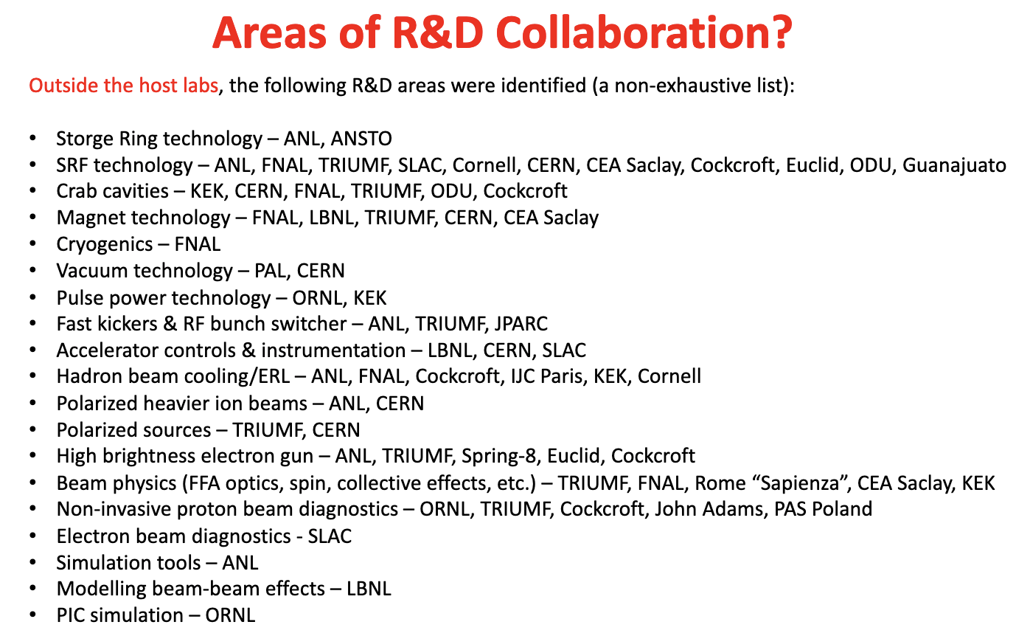
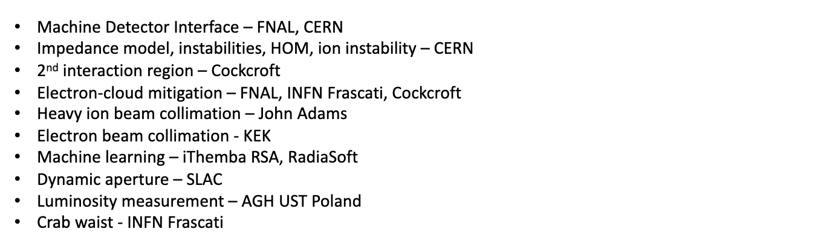
EIC 2020:
From closing talk of Peter Ratoff, Chair of EIC2020 workshop:
Wide list of areas of possible collaboration
Slide from closing talk of EIC2020 Acc Partnership Workshop
https://indico.cern.ch/event/949203/

Slide 6
Collaboration – path forward
The EIC Workshop – Promoting Collaboration on the Electron-Ion Collider – provided wealth of technical information to accelerator community about EIC, and to EIC team about institutional interests and expertise
  The EIC team immediately after this workshop will discuss where we saw a match of project needs and expertise of potential collaborators
  This will help to generate the list of project needs that can then be used in the follow-up bi-lateral meetings
Next partnership workshop similar to this one in about 9 months would also include presentations by groups that are making specific plans to contribute
Collaboration in EIC design, construction and scientific exploration is welcome!
Slide from closing talk of EIC2020 Acc Partnership Workshop
https://indico.cern.ch/event/949203/

Slide 7
Accelerator outreach – status snapshot
Approach: bi-lateral meetings & partnership workshops
Acc partnership workshops: Cockcroft, UK – Oct 2020; TRIUMF, Canada – Oct 2021
Sample WBS scope as seed for discussion of possible in-kinds for 5-10% identified
Bi-lateral meetings now expand from EIC L1 management to L2 & L3 EIC experts for detailed technical discussion of possible in-kind scope
  Examples: Crab Cavity system information exchange meeting with UK and Canada, meetings with INFN-Accelerator collaboration on HSR vac. system, with CERN on ESR vac. sys., etc.

Slide 8
Accelerator Partnership Workshop 2021 - focused
2021 Accelerator Partnership Workshop indeed focused on areas where there are advanced technical discussions between EIC and potential partners
Workshop sessions are targeted to areas of possible collaboration & on 2nd IR
Acc workshop sessions & conveners
Crab Cavities
  G. Burt (CI), R. Laxdal (TRIUMF), J. Preble (EIC/JLAB)
IR SC magnets and spin rotators
  P. Vedrine (CEA Saclay), H. Witte (EIC/BNL)
HSR vacuum system
  R. Cimino (INFN), S. Verdu Andres (EIC/BNL)
ESR vacuum system
  R. Losito (CERN), C. Hetzel (EIC/BNL)
ESR high current elements
  R. Losito (CERN), A. Blednykh (EIC/BNL)
ESR SRF and CM
  R. Losito (CERN), J. Guo (EIC/JLAB)
Lessons from SuperKEKB
  M. Tobiyama (KEK), M. Blaskiewicz (EIC/BNL)
MDI, First and Second IR
  In Soo Ko (PAL), A. Drees (EIC/BNL), W. Wittmer (EIC/JLAB)
Second IR based on Nb3Sn option
  P. Vedrine (CEA Saclay), A. Seryi (EIC/JLAB)
ERL Satellite meeting
  W. Kaabi (IJCLab), P.Williams (CI), S. Benson (EIC/JLAB)
  Satellite meeting by invitation only
Next steps, after 2021 Accelerator Partnership Workshop, should include detailed bi-lateral meeting for concretization of collaboration scope, in parallel with DOE-agencies level work to prepare for agreements
https://meetings.triumf.ca/event/254/

Slide 9
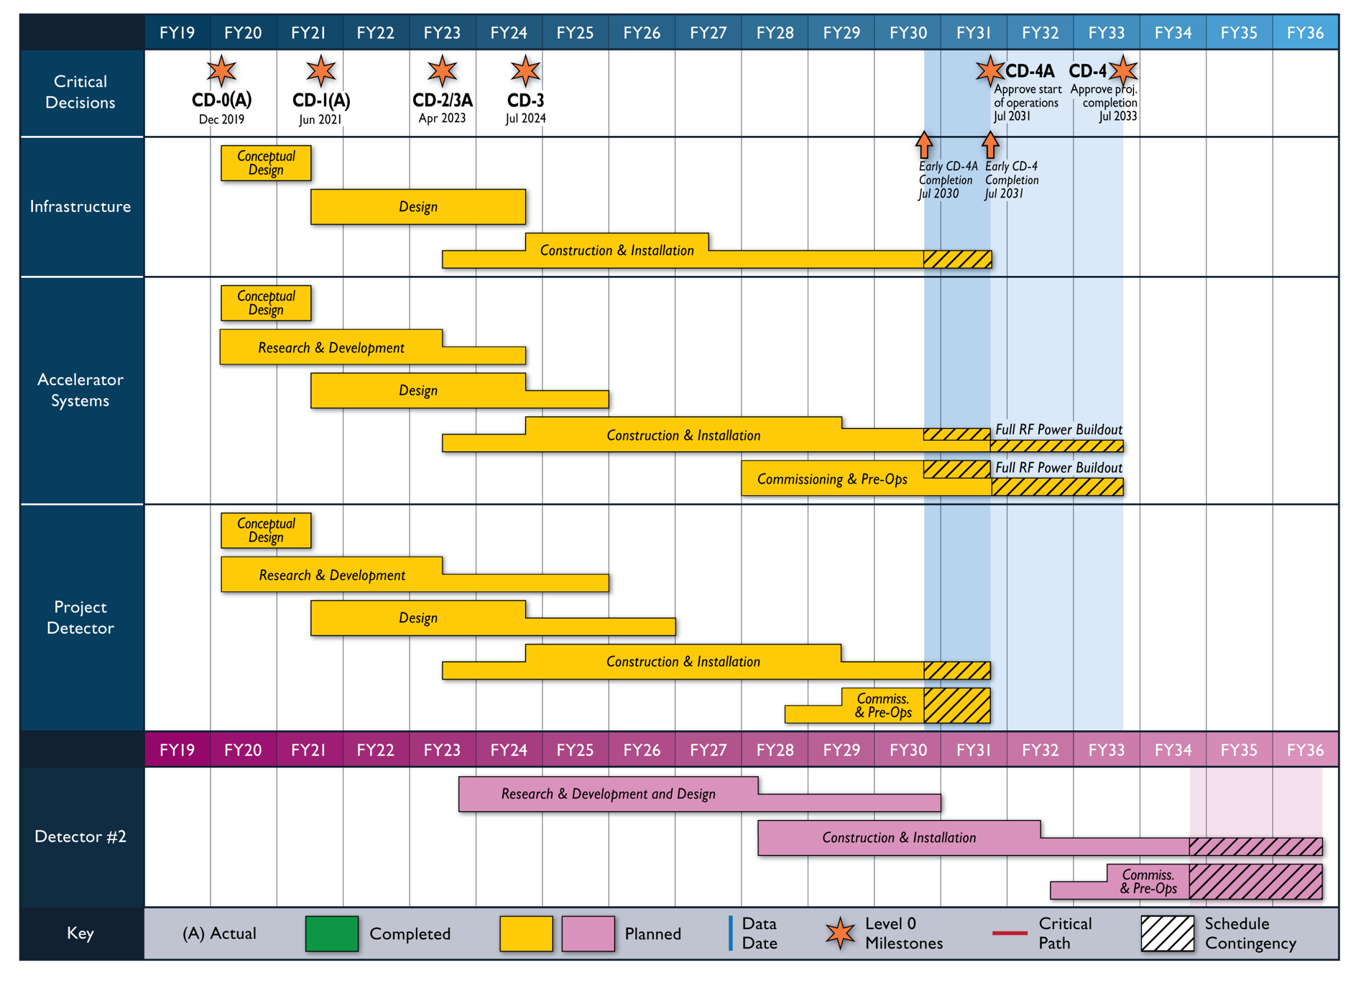
Reference Schedule
EIC2020
EIC2021
Notional Schedule
2nd IR and

Slide 10
Accelerator outreach – status snapshot
Approach: bi-lateral meetings & partnership workshops
Acc partnership workshops: Cockcroft, UK – Oct 2020; TRIUMF, Canada – Oct 2021
Sample WBS scope as seed for discussion of possible in-kinds for 5-10% identified
Bi-lateral meetings now expand from EIC L1 management to L2 & L3 EIC experts for detailed technical discussion of possible in-kind scope
  Examples: Crab Cavity system information exchange meeting with UK and Canada, meetings with INFN-Accelerator collaboration on HSR vac. system, with CERN on ESR vac. sys., etc.
Goals for the next steps

Slide 11
Collaboration – path forward
EIC 2020 Accelerator Partnership Workshop – broad program, broad scope of discussion
The 2020 workshop and bi-lateral meetings after EIC2020 revealed several areas of mutual interests
EIC 2021 Accelerator Partnership Workshop – focused on key technical areas of potential collaboration
Next steps: intensify focused bi-lateral technical meetings
  include other technical areas and all domestic and international partners who are interested to collaborate
Next accelerator partnership workshop in about a year
Collaboration in EIC design, construction and scientific exploration is welcome!

