Slide 1



Wire corrector system for the HL-LHC – P530
Marco Marchetto
Group leader Accelerator Engineering Physics
TRIUMF accelerator division
P530 project leader
TRIUMF & ATLAS Canada seminar - September 21st , 2021

Slide 2
Outline
Introduction
  terminology
Wire corrector
  concept
  first proof of concept
  numerical calculations
Wire corrector system (P530)
  components
  prototype
TRIUMF expertise
  beam dynamics
  engineering
Summary
TRIUMF & ATLAS Canada seminar - September 21st , 2021

Slide 3
Outline
Introduction
  terminology
Wire corrector
  concept
  first proof of concept
  numerical calculations
Wire corrector system (P530)
  components
  prototype
TRIUMF expertise
  beam dynamics
  engineering
Summary
TRIUMF & ATLAS Canada seminar - September 21st , 2021

Slide 4
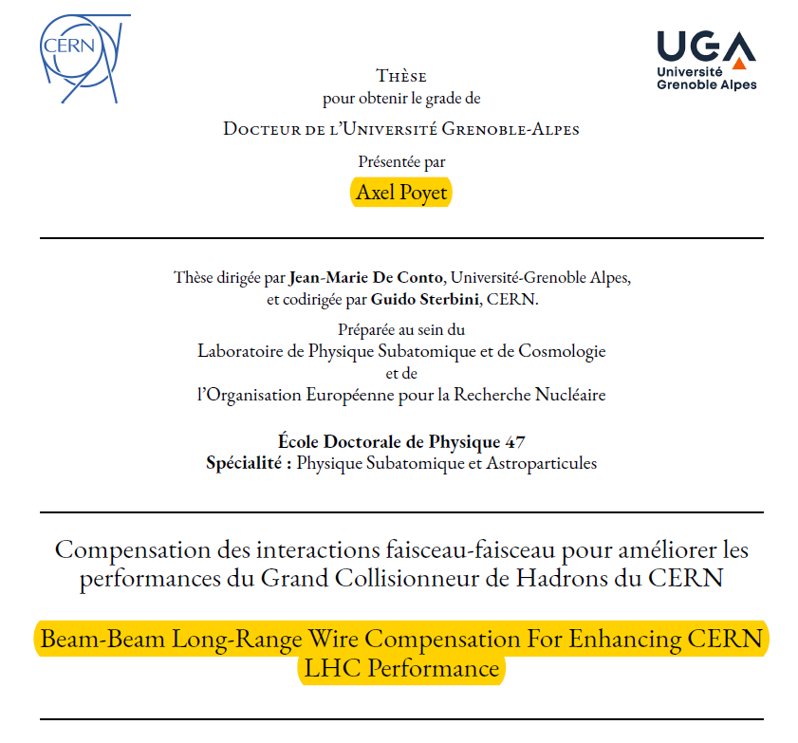
Preamble (acknowledgements)
Most of the material presented here is provided by the CERN collaborators:
Adriana Rossi
Alessandro Bertarelli
Guido Sterbini
Yannis Papaphilippou
Stephane Fartoukh
Nikos Karastathis
Kyriacos Skoufaris
Axel Poyet
TRIUMF & ATLAS Canada seminar - September 21st , 2021

Slide 5
a CERN initiative…
J.-P. Koutchouk et al.
Wires in the SPS
Since 2004
W. Fischer et al.
Wires in RHIC
2006
C. Milardi et al,
Wires in DAΦNE
Since 2006
F. Zimmermann et al.
Specification of the
LHC wires, 2013
1st Workshop on (HL-)LHC
Wire Compensation
December 2015
Experiment in the LHC
2017-2018
1997
V. Shilsev et al.
e⁻ Q-compression
2000
J.-P. Koutchouk
DC wires for LHC
2008
U. Dorda
PhD Thesis
2012
T. Rijoff
M.Sc.Thesis
2015
S. Fartoukh et al.
PRST-AB 18, 121001
March 2017
2nd Workshop on (HL-)LHC
Wire Compensation
1999
Y. Papaphilippou, F. Zimmermann
PRST-AB 2, 104001
2004
B. Erdeley, T. Sen
FERMILAB-TM-2268-AD
2007
H. J. Kim, T. Sen
PAC07-THPAN114
2016
A.S. Patapenka et al.
NAPAC2016-TUPOB17
DC wire proposed for LHC by J.P. Koutchouk in 2000
Experimental tests of DC wires in SPS, RHIC and DAFNE. Long range compensation never demonstrated in hadron collider with operational configurations hence the need for direct experiments in LHC
TRIUMF & ATLAS Canada seminar - September 21st , 2021

Slide 6
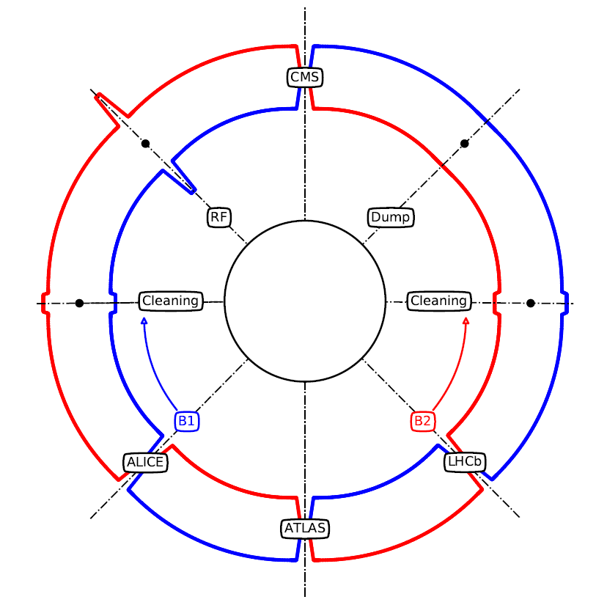
IR & IP
IR: Insertion Regions located in the straight sections between arcs
  LHC has 8 IR
IP: interaction points where the two counter-rotating proton beams collide
  IP are “special IR”
  LHC has 4 IP (experiments): ATLAS, ALICE, CMS and LHCb
  ATLAS and CMS are referred to as high luminosity experiments
from A. Poyet thesis
TRIUMF & ATLAS Canada seminar - September 21st , 2021

Slide 7
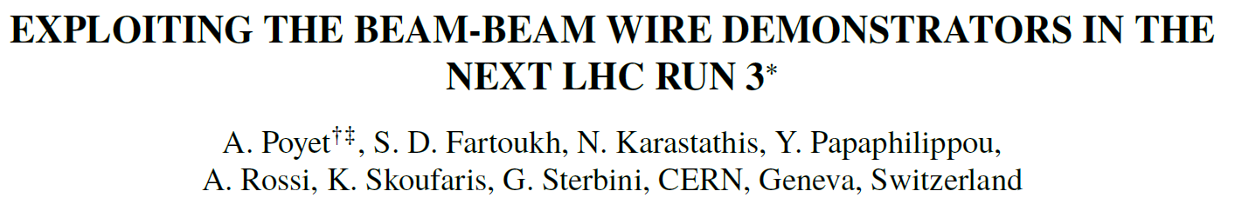
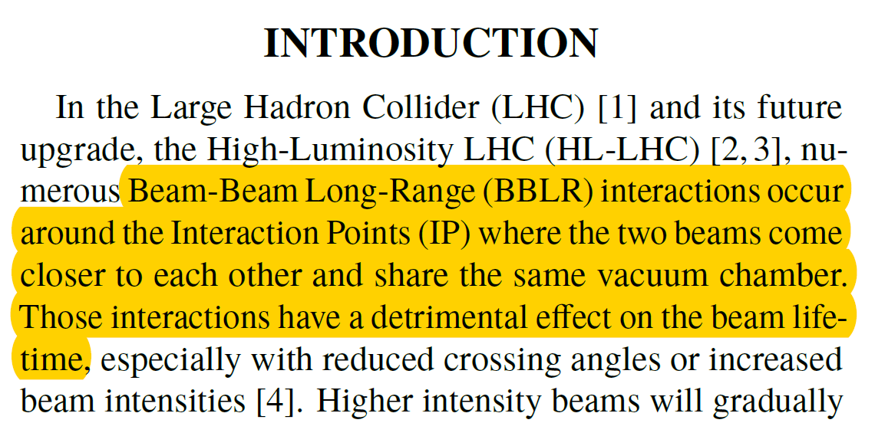
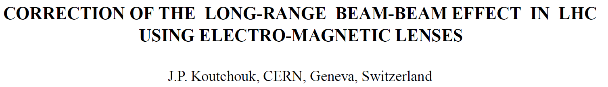
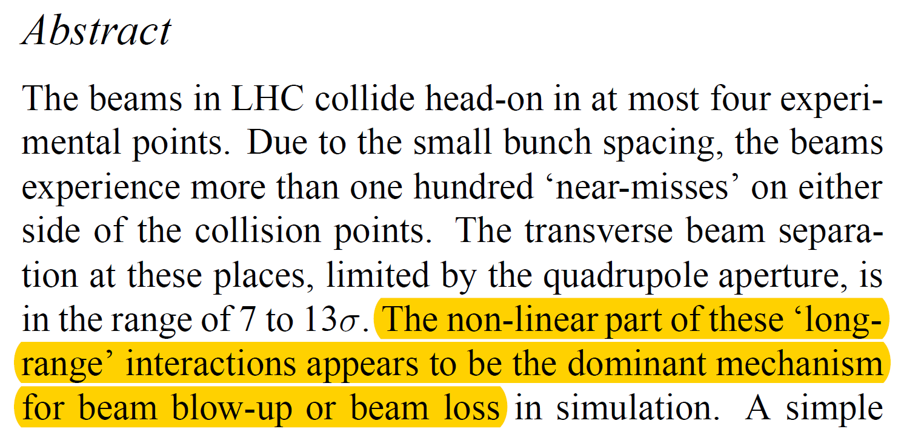
BBLR
BBLR (Beam-Beam Long Range) are electro-magnetic interactions between the two beams
“BBLR interactions occur around the IP where the two beams come closer to each other”
The closer the beams the stronger the BBLR
“The non-linear part of these long-range interactions appears to be the dominant mechanism for beam blow-up and beam losses”
BBLR needs to be compensated (can not be avoided) to increase beams lifetime
TRIUMF & ATLAS Canada seminar - September 21st , 2021

Slide 8
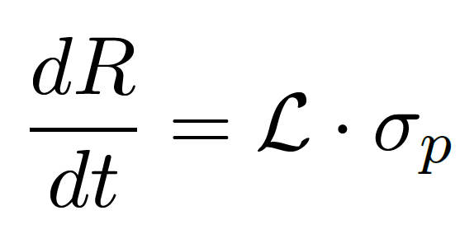
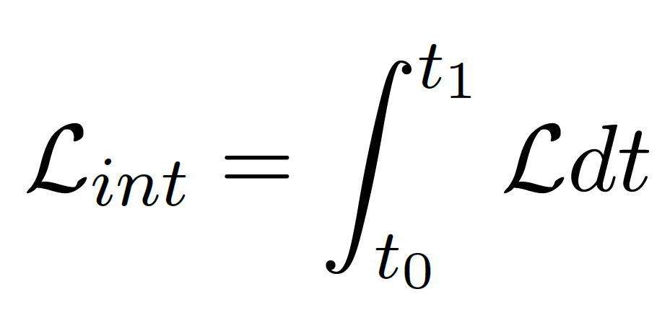
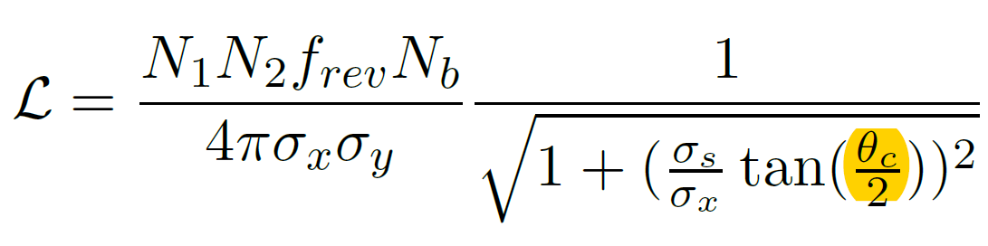
Luminosity
Luminosity: proportionality factor between the event rate and the cross-section of the event
measure in cm⁻²∙s⁻¹
Typically it is quoted the integrated luminosity (rather than previous “peak” luminosity)
measured in fb⁻¹
Luminosity of Gaussian bunches colliding with a crossing angle θ_{c}
formulas from A. Poyet thesis
TRIUMF & ATLAS Canada seminar - September 21st , 2021

Slide 9
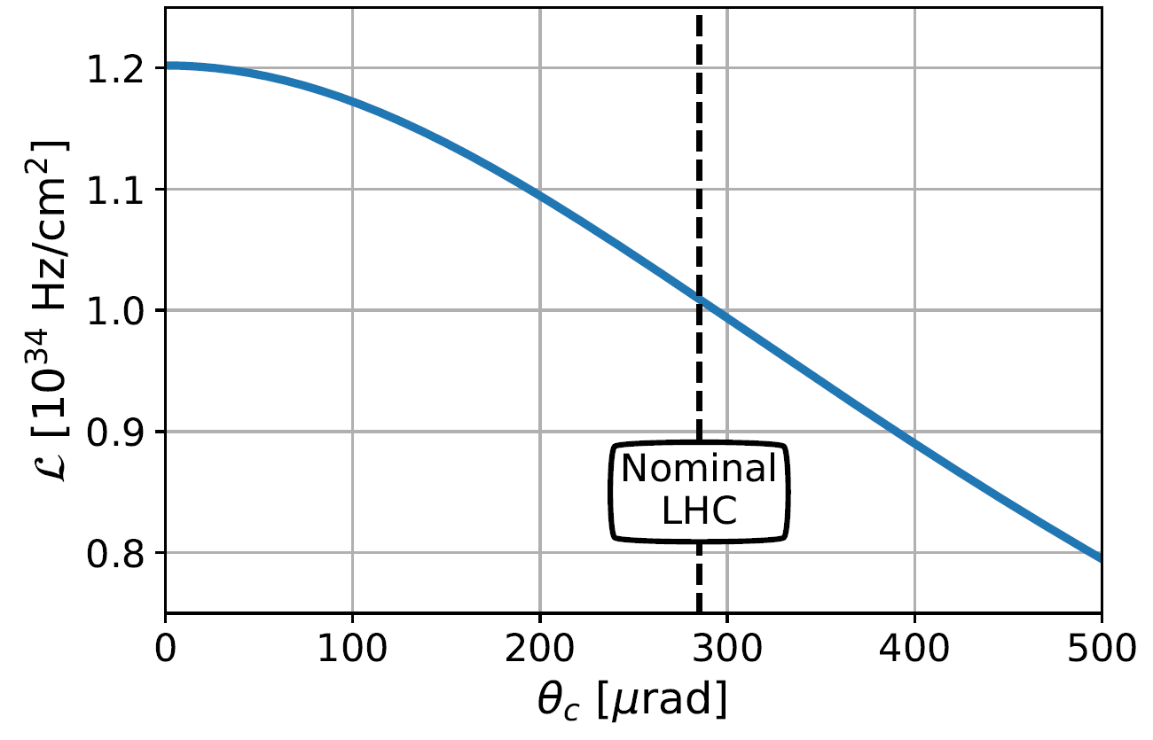
Crossing angle
B2
B1
Beam separation
(in unit of σ, beam size)
θ_{c} (μrad)
Reducing the separation, decrease the crossing (increasing the luminosity) but increase the BBLR
Increasing the separation (to reduce BBLR), increases the crossing angle but reduces the luminosity
from A. Poyet thesis
TRIUMF & ATLAS Canada seminar - September 21st , 2021

Slide 10
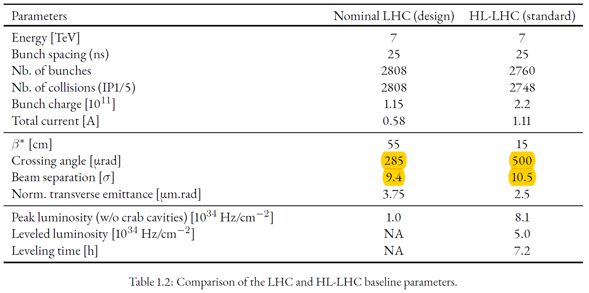
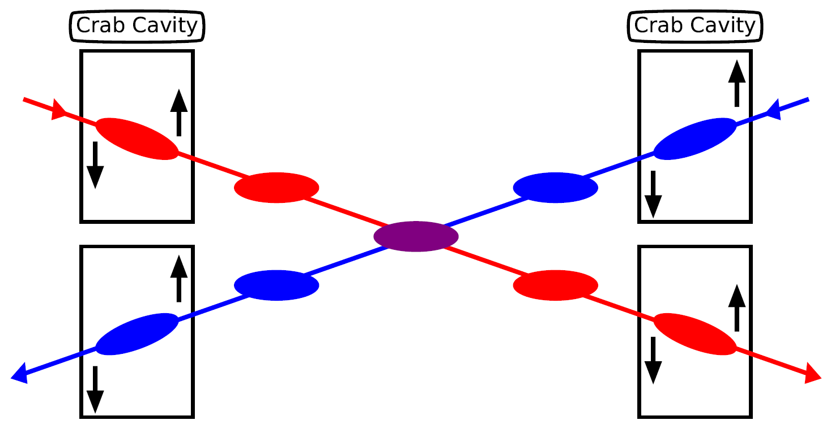
LHC vs HL-LHC parameters
Because of higher beam intensity (to reach higher peak luminosity) the beam separation had to be increase to reduce BBLR
Increase in crossing angle is compensated by means of the crab cavities (HL-LHC baseline configuration), but
  Only half of the cavities (16) necessary to fully compensate the crossing angle are going to be installed
  Hence beam separation had to be reduced (from 12.5 σ to 10.5 σ)
LHC integrated luminosity: 60 fb⁻¹
HL-LHC integrated luminosity goal: 250 fb⁻¹
Still integrated luminosity can be augmented even for the baseline by reducing the BBLR
from A. Poyet thesis
from A. Poyet thesis
TRIUMF & ATLAS Canada seminar - September 21st , 2021

Slide 11
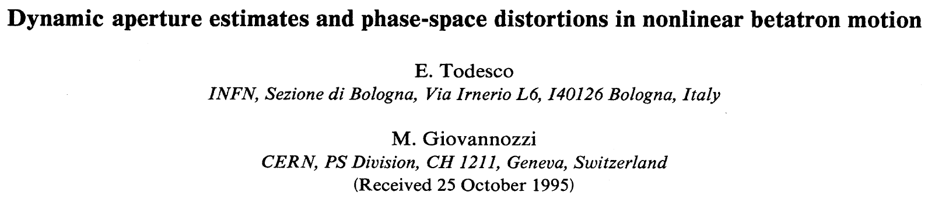
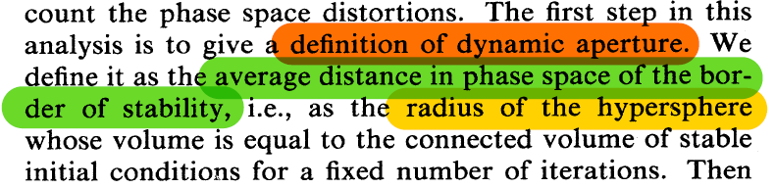
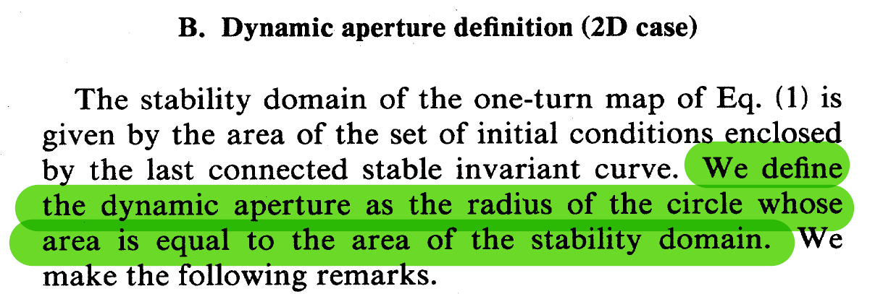
Dynamic aperture
Dynamic aperture (DA): “average distance in phase space of the border of stability”
“The numerical estimate of the dynamic aperture is related to the computation of the volume in phase space of the initial conditions that are stable after a give number of revolutions around the machine”
Stability domain: “the region of phase space where one can safely operate the machine”
Short-term stability: 1000 turns (CPU limited)
Dynamic aperture reported in unit of σ (beam size)
TRIUMF & ATLAS Canada seminar - September 21st , 2021

Slide 12
Outline
Introduction
  terminology
Wire corrector
  concept
  first proof of concept
  numerical calculations
Wire corrector system (P530)
  components
  prototype
TRIUMF expertise
  beam dynamics
  engineering
Summary
TRIUMF & ATLAS Canada seminar - September 21st , 2021

Slide 13
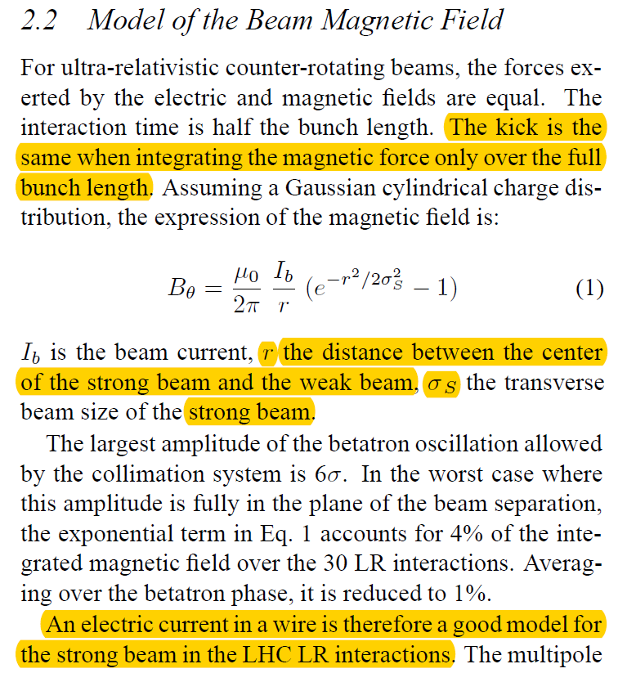
The wire compensation concept
The electromagnetic kick of the long-range beam-beam effect is similar to the one given by a DC wire
Analogy of the wire field with standard multipole magnets → Resonant Driving Terms compensation [S. Fartoukh et al., PRST-AB 18, 121001]
BBLR
IP
TRIUMF & ATLAS Canada seminar - September 21st , 2021

Slide 14
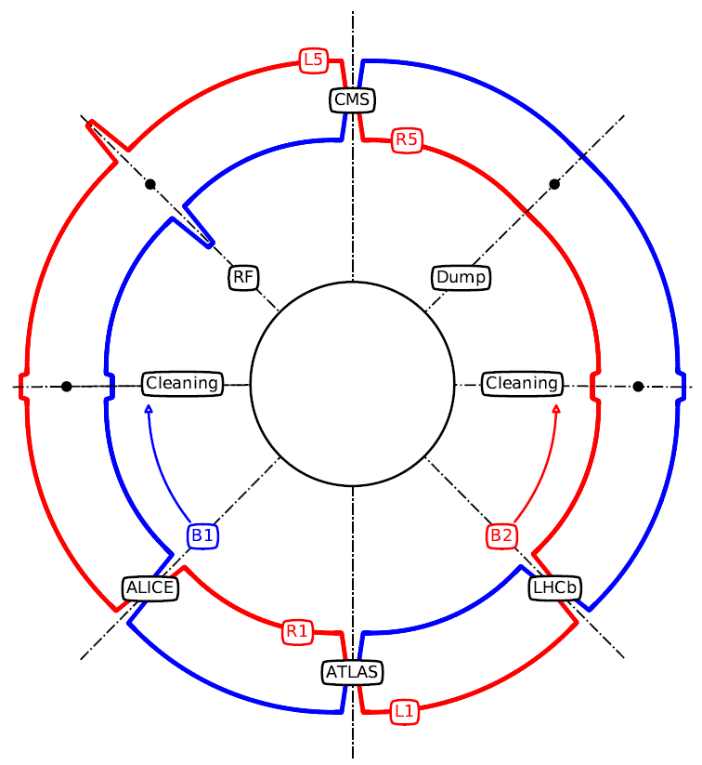
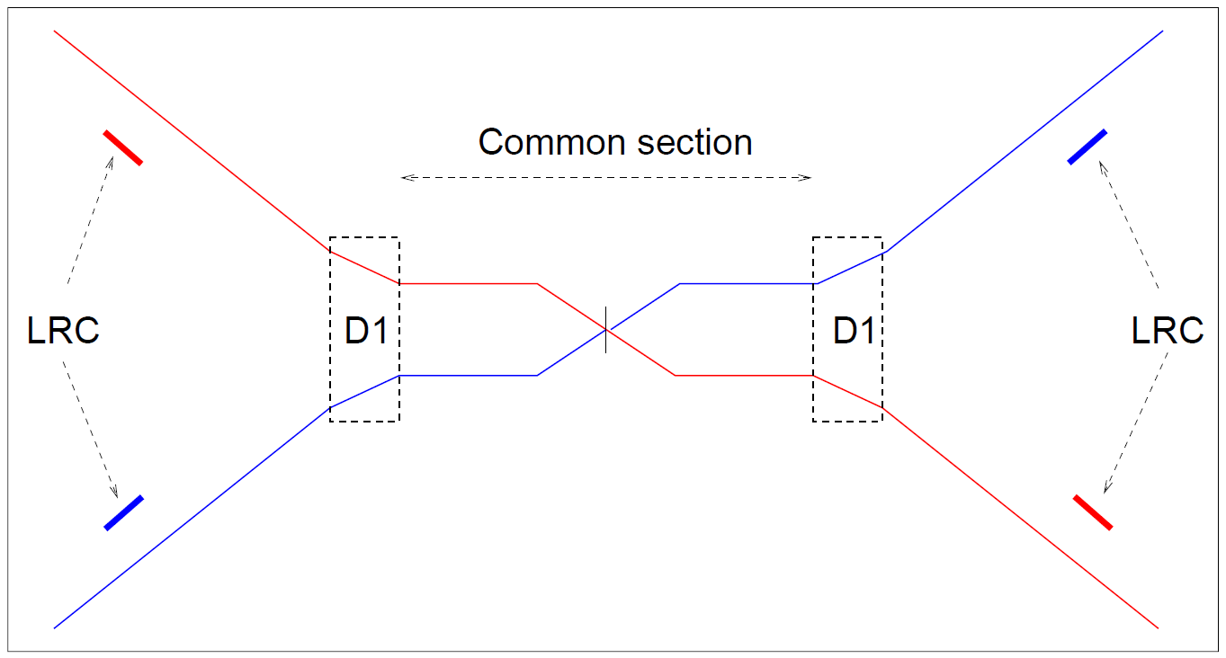
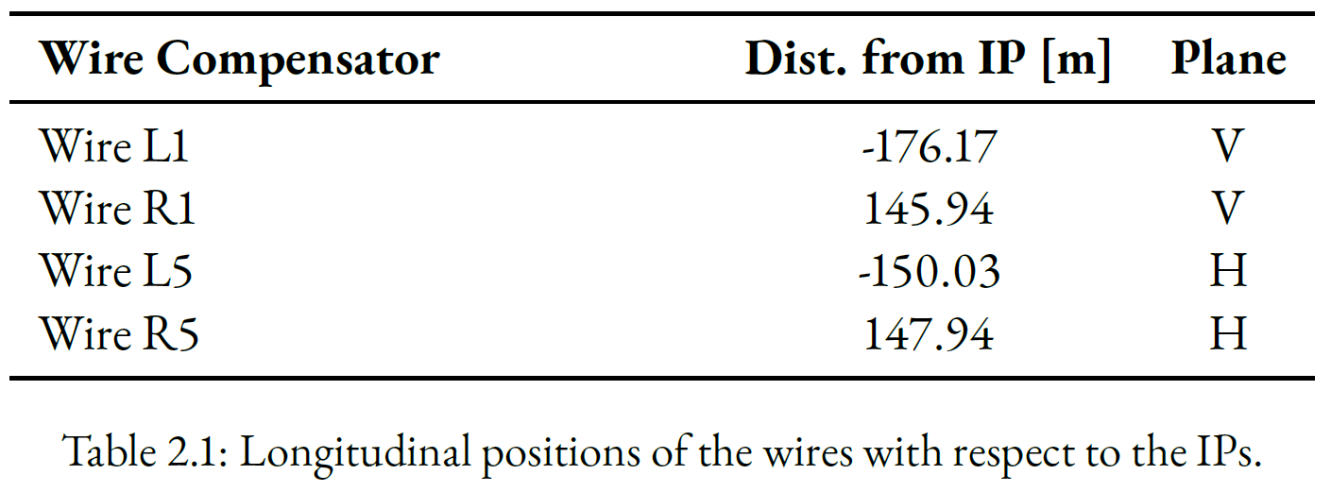
Wire locations
Wires to be located on both side of the interaction point to compensate before and after the IP
First proof of principle accomplished using wire embedded in collimator at IP1 (ATLAS) and IP5 (CMS) for a single beam correction
from A. Poyet thesis
Schematic from J. P. Koutchouk paper
TRIUMF & ATLAS Canada seminar - September 21st , 2021

Slide 15
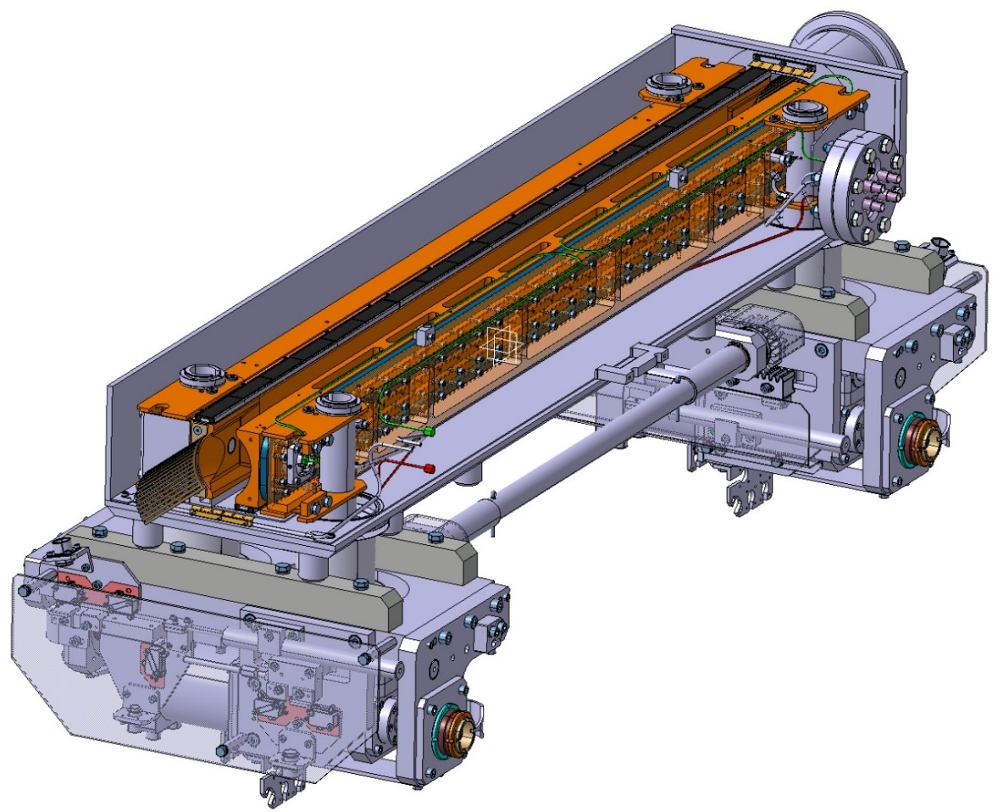
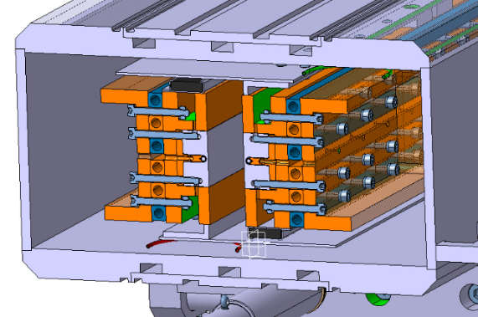
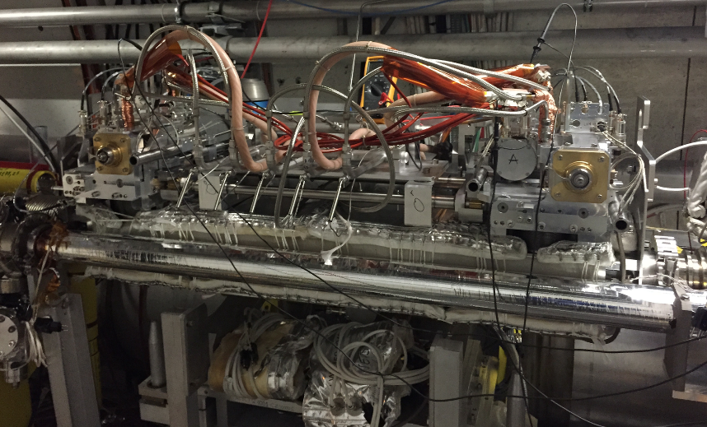
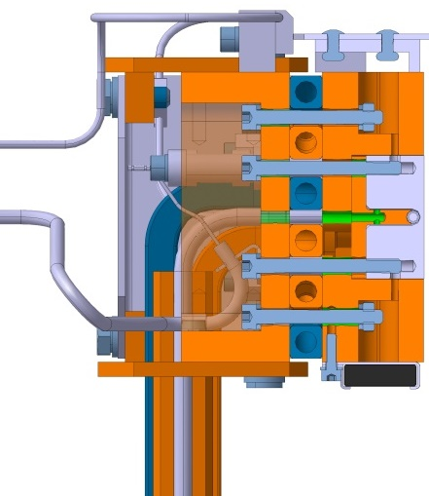
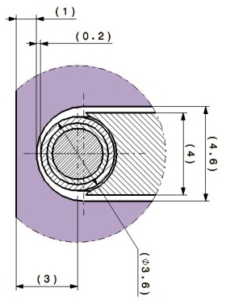
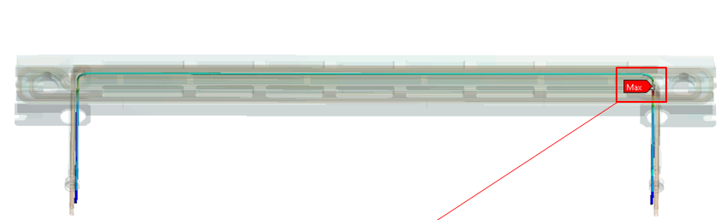
Wire-in-collimator demonstrator
LHC DC wire demonstrators embedded in the jaw of operational tertiary collimators
1-m long Cu wire of 2.48 mm diameter capable to carry up to 350 A
Vacuum tank
Jaws
Actuation system
≈1 m
2.48 mm
Maximum Current I_{W}=350 A → ~260 ºC
3 mm
TRIUMF & ATLAS Canada seminar - September 21st , 2021

Slide 16
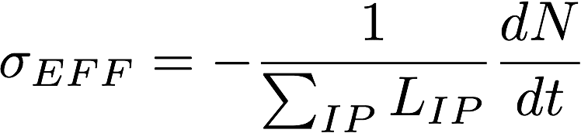
Objectives of the experiment
Prove a beneficial effect of the wire demonstrators in a regime dominated by long-range beam-beam effect. The compensation should not degrade the lifetime of the head-on bunches
Need to guarantee the beam-wire alignment, and that the linear effects of the wire (orbit and tunes) are compensated
The main observables are the beam losses, its lifetime and the bunch effective cross-section (σ_{eff})
Intensity loss-rate
Instantaneous luminosity
TRIUMF & ATLAS Canada seminar - September 21st , 2021

Slide 17
Experiment results
Transverse blow-up and BBLR signature
Current scan example
COMPENSATION ON
~80 mb
Wire alignment
COMPENSATION ON
Reduction of crossing angle
COMPENSATION OFF
Almost full compensation, even at reduced crossing angle, for regular bunch whereas PACMAN bunch (which experiences fewer long range interactions) are not degraded
TRIUMF & ATLAS Canada seminar - September 21st , 2021

Slide 18
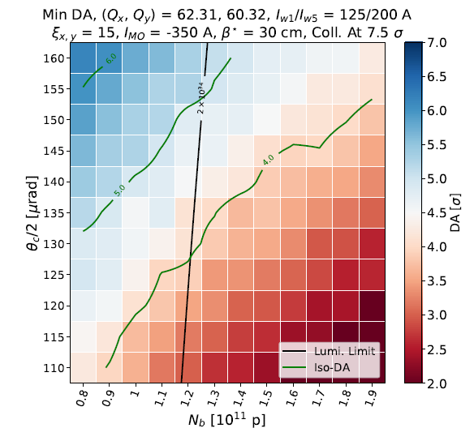
Dynamic aperture calculations
DA calculations shows that BBLR correction allows to:
  run with a smaller crossing angle for the same dynamic aperture (5 σ)
  reduce beam losses (because of the bigger dynamic aperture) and therefore reduce background noises
  reduce irradiation of adjacent quadrupoles
TRIUMF & ATLAS Canada seminar - September 21st , 2021

Slide 19
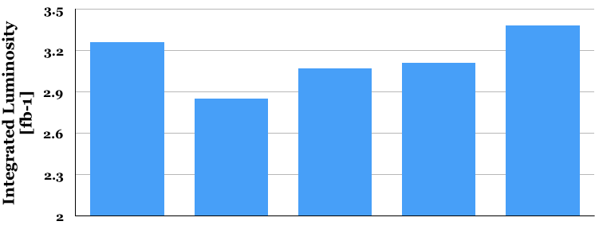
Estimated wire impact on luminosity
Without crab cavities (CC), integrated luminosity (per day) is reduced by 13 %
Wires partially restore lost performance
In the presence of CC and wire a slight increase of integrated luminosity is guaranteed
+3%
-6%
-5%
-13%
Round
or Flat
[fb⁻¹]
Round
Round
Flat
Round
Baseline
No CC
No CC with Wire
With CC
and Wire
TRIUMF & ATLAS Canada seminar - September 21st , 2021

Slide 20
Outline
Introduction
  terminology
Wire corrector
  concept
  first proof of concept
  numerical calculations
Wire corrector system (P530)
  components
  prototype
TRIUMF expertise
  beam dynamics
  engineering
Summary
TRIUMF & ATLAS Canada seminar - September 21st , 2021

Slide 21
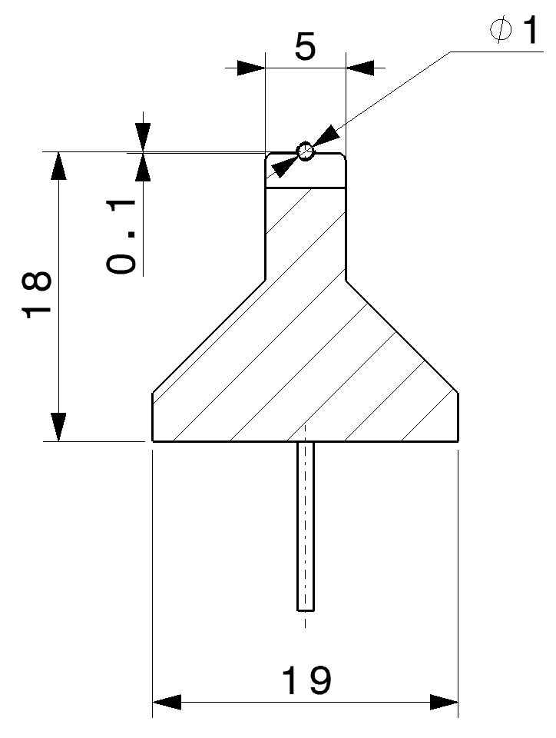
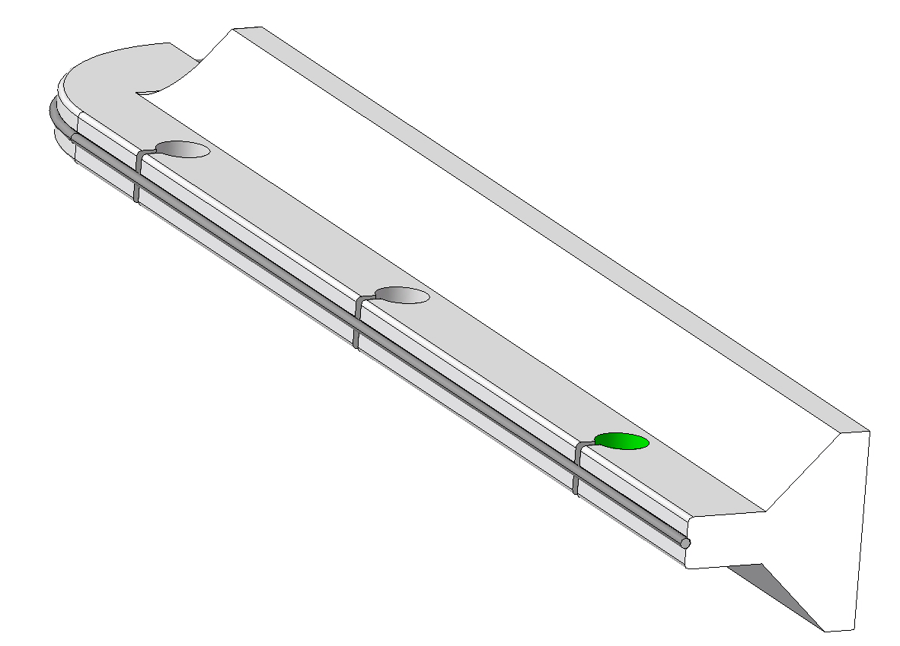
Main Design Features: Wire and Insulator
The present design for the prototype plans a ∅1 mm Mo wire with max. 150 A current
Mo wire has higher electrical resistivity compared to Cu (back-up), but is better matching ceramic temperature expansion (higher robustness)
The ceramics is AlN (Aluminum Nitride)
AlN segmented ceramic insulator
slots to reduce thermally induced stresses during brazing
Mo thin metal wire (Ø 1 mm)
TRIUMF & ATLAS Canada seminar - September 21st , 2021

Slide 22
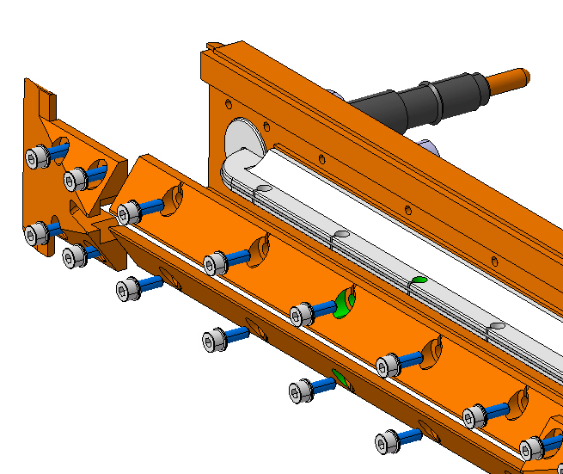
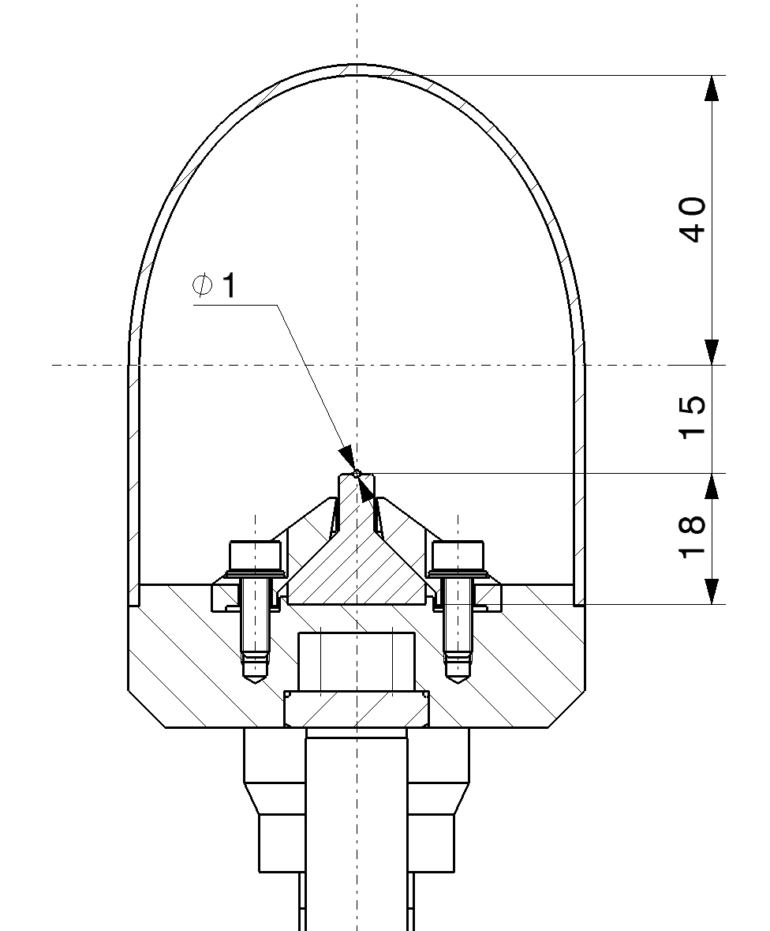
Low-cost modular design (proposal) from CERN
Insulator with wire is mechanically clamped to a Cu-based housing, via controlled-torque screws
Cu clamps to be designed to minimize RF impedance
Wire active length 1 m; several insulator modules to be assembled (250 ÷ 300 mm long)
TRIUMF & ATLAS Canada seminar - September 21st , 2021

Slide 23
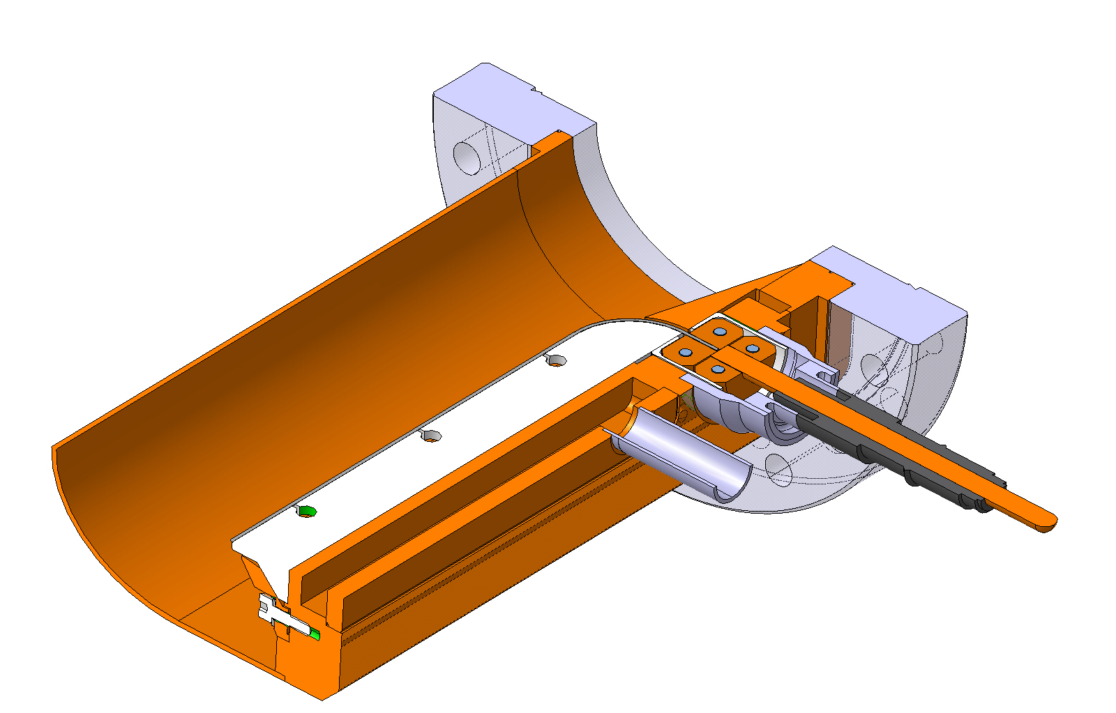
Vacuum chamber and feedthrough
Water cooling channel obtained by housing machining and cover welding. Cu half-shell welded to the housing.
Commercial feedthrough connection carrying up to 185 A. If more current is needed, liquid-cooled feedthroughs should be adopted
Stainless steel flange brazed to copper and then welded to vacuum chamber. TRIUMF proposes and accessible vacuum chamber!
weld
brazing
weld
feedthrough
weld
TRIUMF & ATLAS Canada seminar - September 21st , 2021

Slide 24
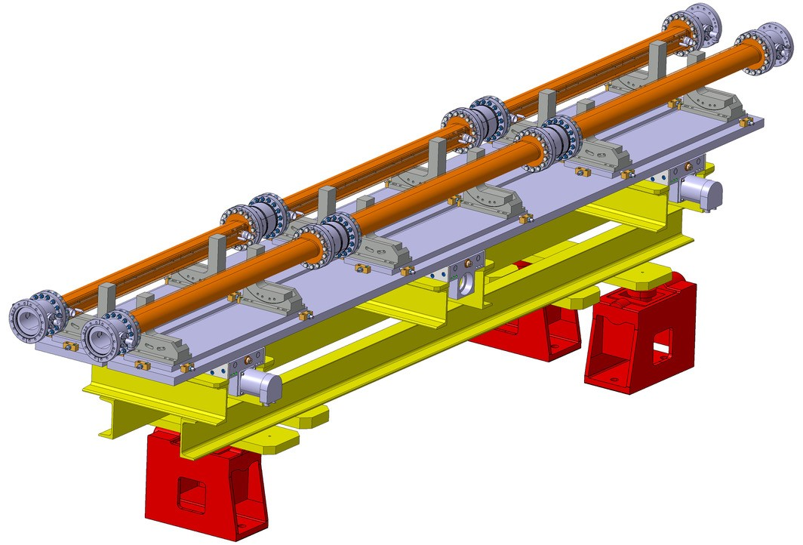
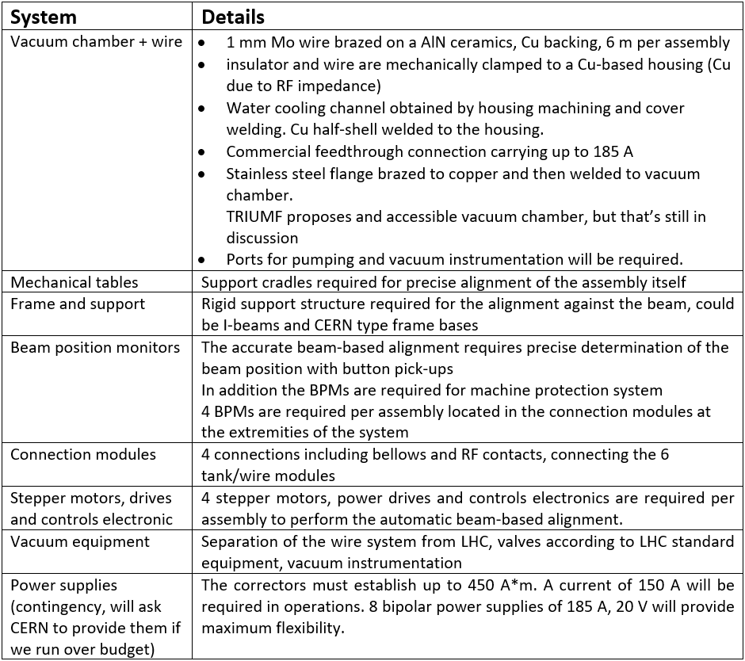
Main assembly
6 wire modules (wire in vacuum chamber) per assembly
4 assemblies: 2 (upstream and downstream) per IP (ATLAS and CMS)
B1
Bellow (RF module)
B2
Wire module
Table from O. Kester document
Beam position monitor
Frame and support
Automatic beam alignment
TRIUMF & ATLAS Canada seminar - September 21st , 2021

Slide 25
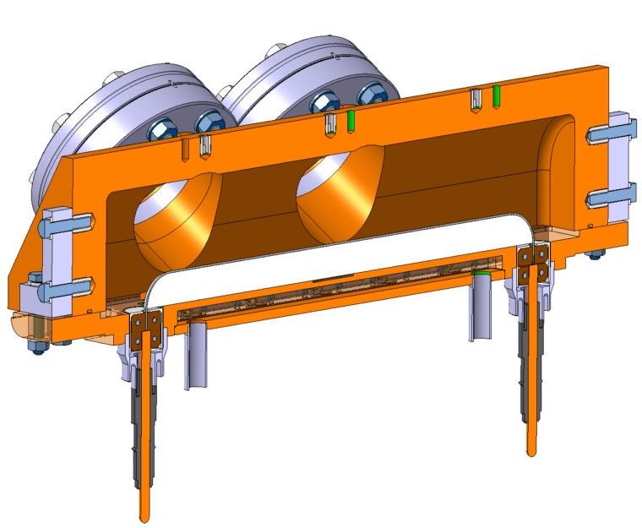
Proof of Concept - Demonstrator
Vacuum brazing is the most critical step in the process (few mm gap between wire and cooler may induce a thermal runaway of hundreds degrees …) → proof of concept proposed
On this basis a low-cost short demonstrator (290 mm long) has been built and tested to validate the concept and perform online measurements
A series of optical viewports allows measuring wire and insulator temperatures (IR camera and/or pyrometer) and wire deflection while varying current
TRIUMF & ATLAS Canada seminar - September 21st , 2021

Slide 26
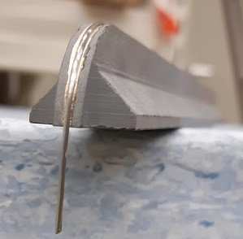
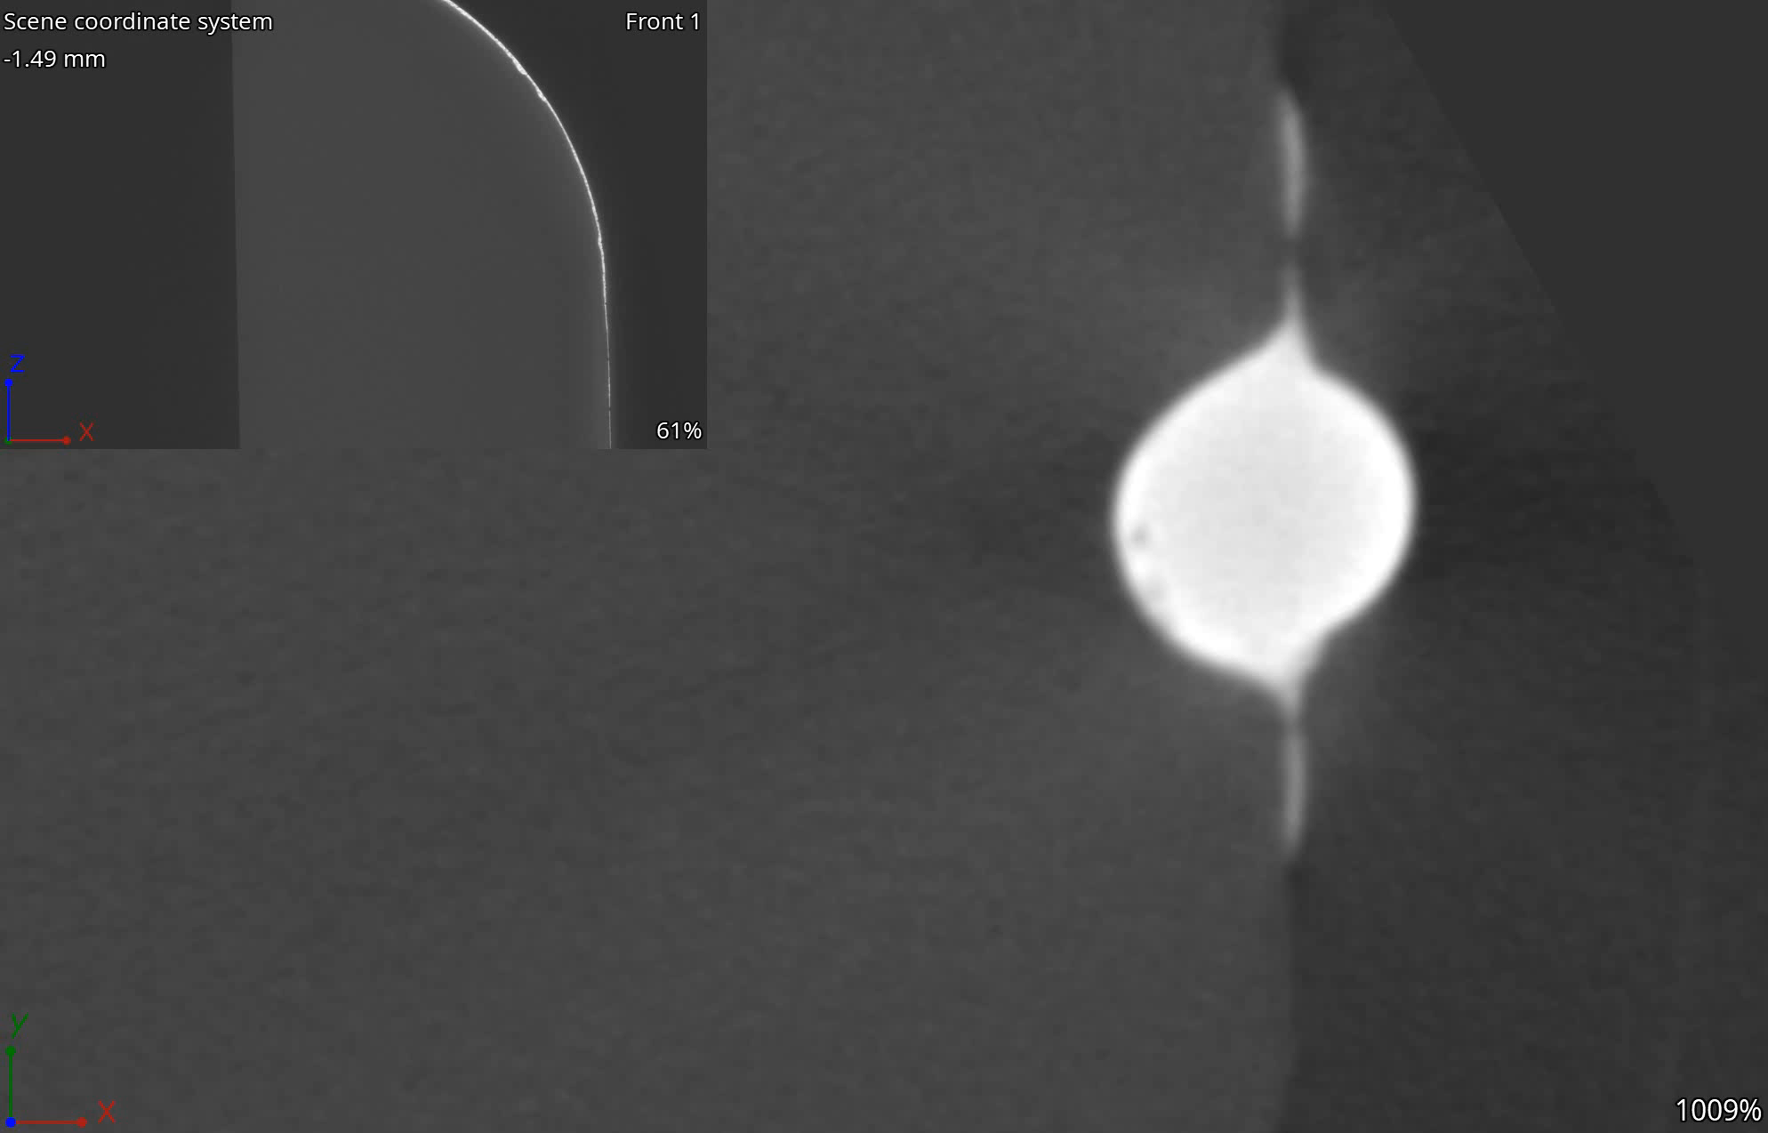
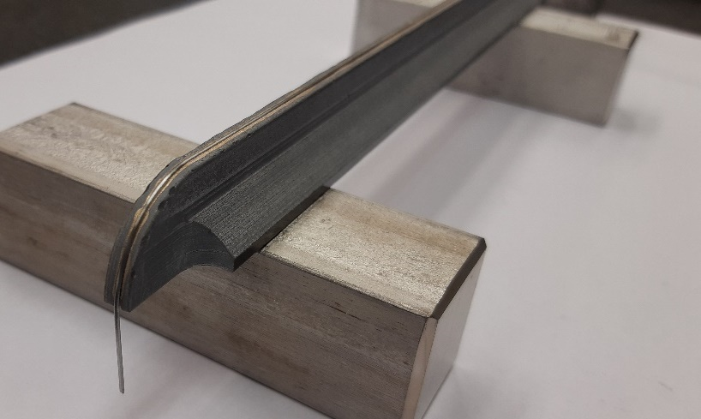
Demonstrator prototype
Components of the demonstrator procured
2 wire diameters (Ø0.8 and Ø1 mm) successfully brazed on AlN housings at CERN main workshop
Good adhesion throughout the length, only minor braze lacks at the ends
Thermo-physically characterization of AlN to ascertain its properties as a function of temperature
1 mm
TRIUMF & ATLAS Canada seminar - September 21st , 2021

Slide 27
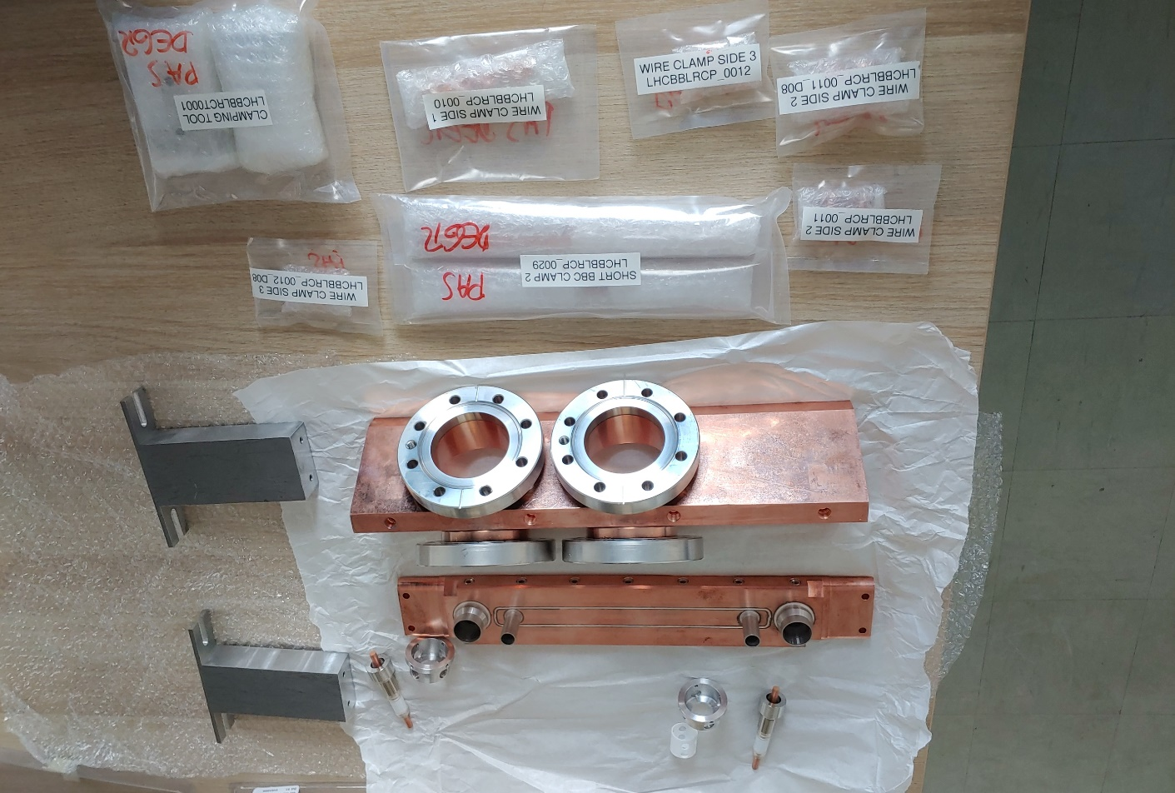
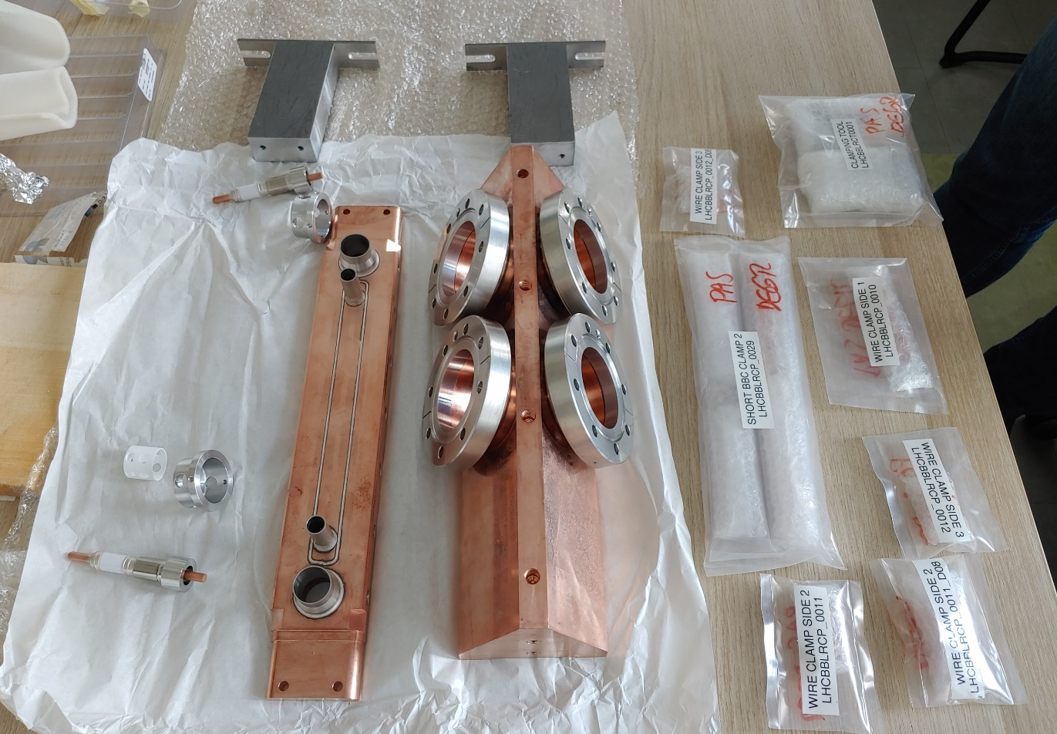
Demonstrator prototype – vacuum chamber
TRIUMF & ATLAS Canada seminar - September 21st , 2021

Slide 28
Prototype testing outcome
A simple, low-cost, modular design is being explored, allowing a certain scalability as to number of modules, current and dimensions
No showstoppers identified for thin Mo naked wire (Ø ≥ 0.8 mm) brazed onto a ceramic insulator
However, preliminary investigations ignored several key physical and technological aspects (e.g. beam and RF losses, mechanical feasibility, fabrication tolerances, UHV aspects etc.) which should be the object of a proper design study
The manufacturing of a demonstrator is a fundamental step to validate the concept. A simplified demo is foreseen by Autumn 2021. Tests expected to follow in Winter 21/22
A full-fledged design (number of modules, length, interfaces, motorization, integration…) should be launched after demonstrator proves this concept is viable.
TRIUMF & ATLAS Canada seminar - September 21st , 2021

Slide 29
Outline
Introduction
  terminology
Wire corrector
  concept
  first proof of concept
  numerical calculations
Wire corrector system (P530)
  components
  prototype
TRIUMF expertise
  beam dynamics
  engineering
Summary
TRIUMF & ATLAS Canada seminar - September 21st , 2021

Slide 30
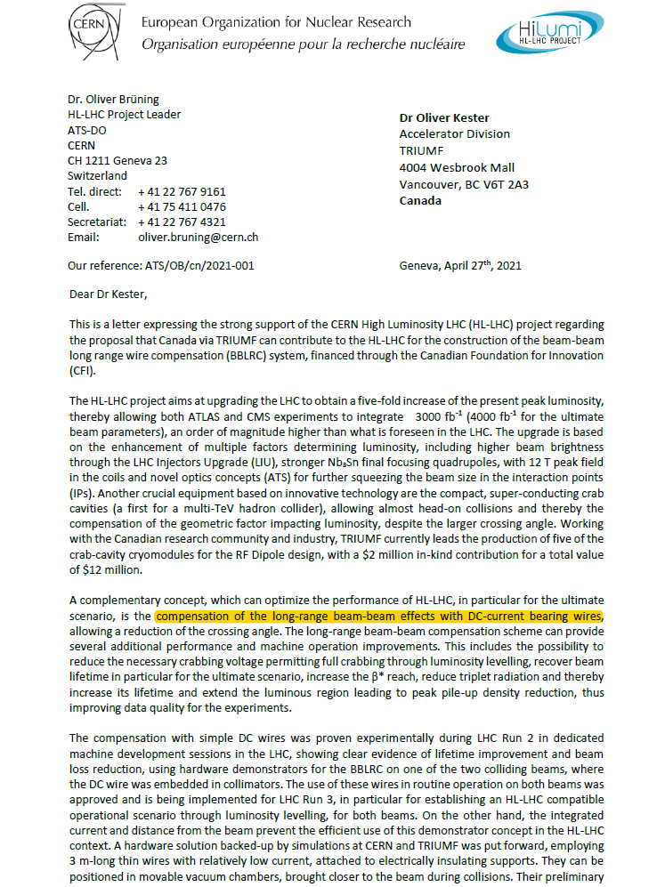
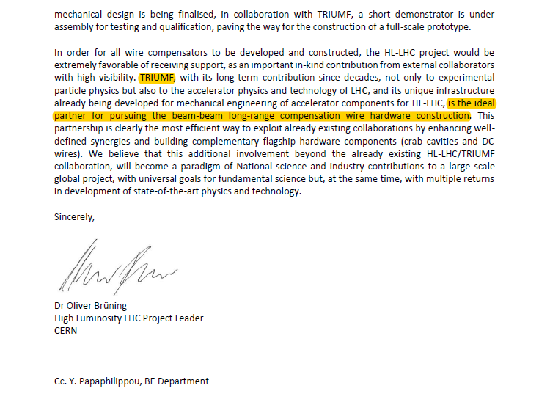
A call for TRIUMF and the Canadian scientific community
TRIUMF & ATLAS Canada seminar - September 21st , 2021

Slide 31
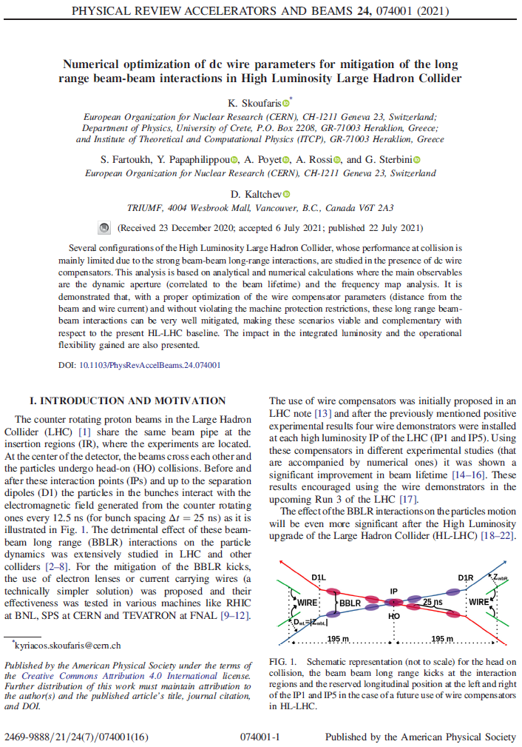
Beam dynamics group
Canada contributes via TRIUMF beam physics support including the wire compensation activities in the LHC;
Dobrin works on wire optimization with H driving terms – extension into 2D. Short-term tracking test with MadX and the BB Invariant
Testing wire on sixtrack (long term track and DA tune-scans)
Support for Yannis, Kyriacos and Nikos who are running DA calculations with wire
In the long term: moving to flat-beam optics scenario for both of the above points
TRIUMF & ATLAS Canada seminar - September 21st , 2021

Slide 32
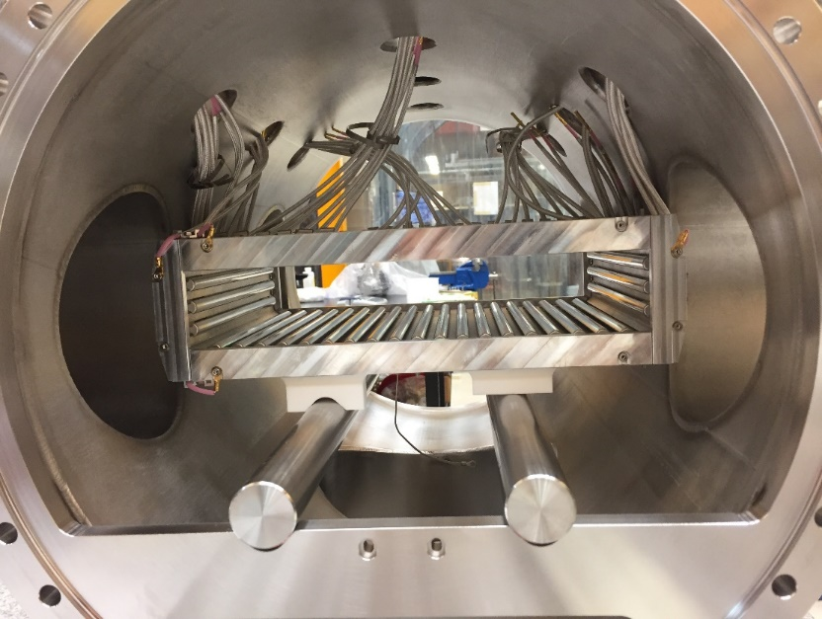
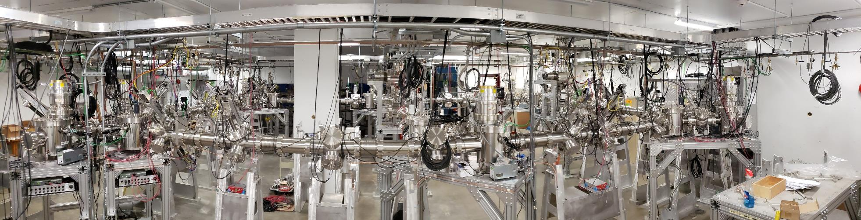
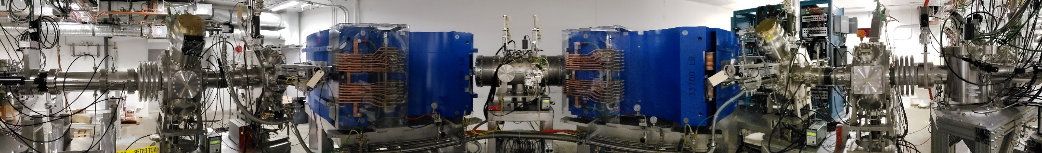
Engineering physics group
HRS multipole
Beam optics design (in collaboration with beam dynamics group)
Electrostatic (RIB transport) and magnetic (HRS) elements design
  OPERA® electro-magnetic field calculations
Hardware design, engineering and installation (including alignment) of electrostatic and magnetic beamlines
UHV cleaning and assembly procedure
ARIEL RIB transport system: 200+ m of electrostatic beamlines
High Resolution Separator
TRIUMF & ATLAS Canada seminar - September 21st , 2021

Slide 33
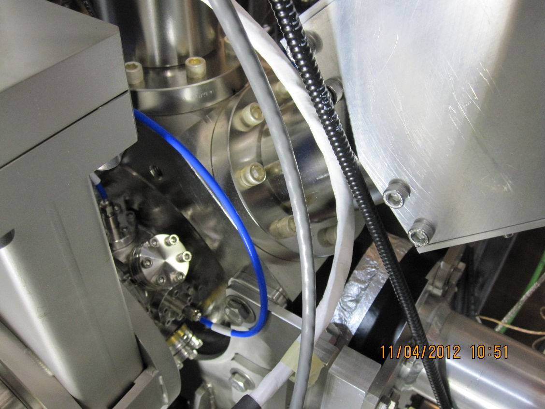
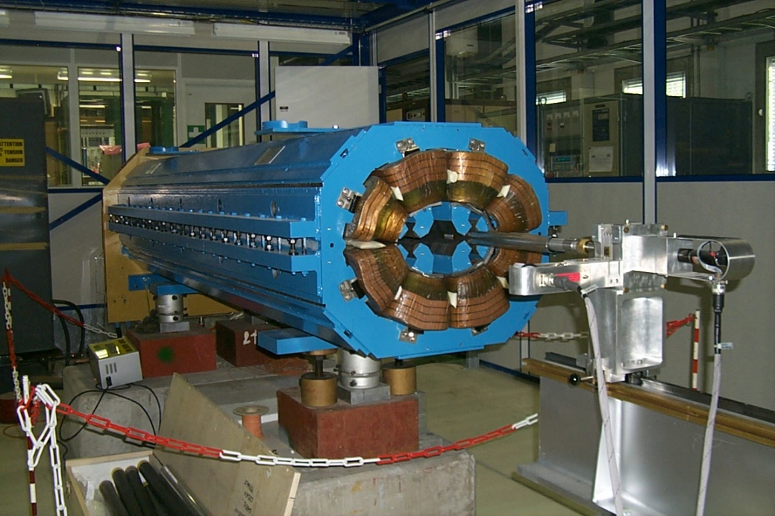
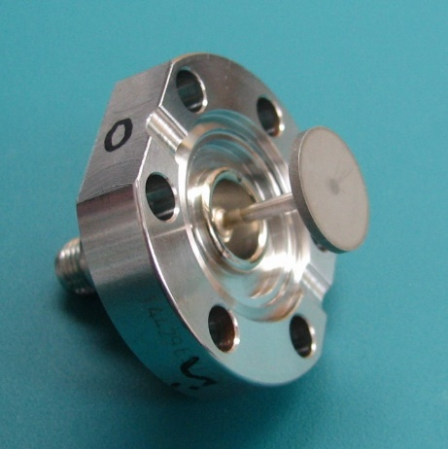
TRIUMF available expertise
Controls
Power converters (high current and high voltage)
Vacuum
Diagnostics (provided BPM for CERN awake)
Radio Frequency (providing crab cavity cryomodules)
Alignment (laser tracker)
Design and manufacturing
TRIUMF e-linac BPM
TRIUMF Twin Quadrupole Magnet for the LHC
TRIUMF & ATLAS Canada seminar - September 21st , 2021

Slide 34
Outline
Introduction
  terminology
Wire corrector
  concept
  first proof of concept
  numerical calculations
Wire corrector system (P530)
  components
  prototype
TRIUMF expertise
  beam dynamics
  engineering
Summary
TRIUMF & ATLAS Canada seminar - September 21st , 2021

Slide 35
Summary
The non-linear part of the BBLR interactions appears to be the dominant mechanism for beam blow-up and beam losses, hence reduce integrated luminosity
Wire correctors are a simple way to compensate for BBLR non-linearity and therefore reduce beam losses
Initial experiments carried out with a non-optimum apparatus (wire-in-collimator) already demonstrated the viability of this solution
Initial calculations also point in the same direction of increased integrated luminosity
Initial prototype of the improved hardware configuration has been tested at CERN
CERN called for TRIUMF and the Canadian scientific community support to build the wire corrector system
TRIUMF has the in-house capabilities for supporting CERN and contributing to the design and manufacturing of the final optimized wire compensation system
TRIUMF & ATLAS Canada seminar - September 21st , 2021

Slide 36





Thank you
Merci
www.triumf.ca
Follow us @TRIUMFLab
HL-LHC Wire Compensation Meeting, FERMILAB, 17th October 2019

