Slide 1
Probing physics beyond the standard model with TITAN: Measuring absolute nuclear charge radii with EUV spectroscopy at TITAN EBIT
Yilin Wang
TRIUMF / University of British Columbia
WNPPC 2022
15 Feb. 2022

Slide 2
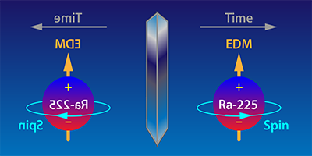
Searches for permanent electric dipole moments (EDM)
Time-reversal violation
Signature of EDM: scales with Z
First measurement candidates at TITAN: ²¹¹Fr, ²²⁵Ra
No absolute nuclear charge radius measurements for Fr (Z = 87) and Ra (Z = 88)
None known for Z > 83 (except U, Th)
Peter Mueller/Argonne National Laboratory
Notes:
To search for EDM, the overlap between (valence electrons) and (bound quarks in the nucleus) must be well known
This overlap can be deduced from the charge radius of the nucleus

Slide 3
Measuring absolute nuclear charge radius: EUV spectroscopy
 | High precision | Radioactive ion beam (RIB) compatible | Universality / compatible with all elements | Provide absolute, not relative, charge radius information
Elastic electron scattering
Muonic-atom spectroscopy
Collinear laser spectroscopy
Notes:
There are some typically used measurement methods out there for nuclear charge radius. However, some are only feasible for longer lived isotopes among other experimental constraints, and can only provide relative nuclear charge radius, not the absolute value.

Slide 4
Measuring absolute nuclear charge radius: EUV spectroscopy
 | High precision | Radioactive ion beam (RIB) compatible | Universality / compatible with all elements | Provide absolute, not relative, charge radius information
Elastic electron scattering | 🥳 | x | 🥳 | 🥳
Muonic-atom spectroscopy | 🥳 | x | 🥳 | 🥳
Collinear laser spectroscopy | 🥳 | 🥳 | x | x
Notes:
There are some typically used measurement methods out there for nuclear charge radius. However, some are only feasible for longer lived isotopes among other experimental constraints, and can only provide relative nuclear charge radius, not the absolute value.

Slide 5
Measuring absolute nuclear charge radius: EUV spectroscopy
 | High precision | Radioactive ion beam (RIB) compatible | Universality / compatible with all elements | Provide absolute, not relative, charge radius information
Elastic electron scattering | 🥳 | x | 🥳 | 🥳
Muonic-atom spectroscopy | 🥳 | x | 🥳 | 🥳
Collinear laser spectroscopy | 🥳 | 🥳 | x | x
Extreme ultraviolet (EUV) spectroscopy | 🥳 | 🥳 | 🥳 | 🥳
Notes:
There are some typically used measurement methods out there for nuclear charge radius. However, some are only feasible for longer lived isotopes among other experimental constraints, and can only provide relative nuclear charge radius, not the absolute value.

Slide 6
Electron Beam Ion Trap (EBIT)
Axially: electrostatic trapping potential created by drift-tube electrodes
Radially: space charge of the electron beam
Notes:
So how does the EBIT trap ions? The ”trap” component of EBIT comprises a series of drift tubes, on which electrostatic trapping potential is applied to trap ions axially, and superconducting magnets in Helmholtz configuration that produces an inhomogeneous magnetic field, which interplays with the space charge of the electron beam from the electron gun and traps ions radially.
=======
Ions are trapped axially by an electrostatic trapping potential created by electrodes in a drift-tube assembly. A magnetic field generated by Helmholtz coils surrounding the drift-tube assembly is centred on the EBIT’s cylindrical line of symmetry and compresses the electron beam, increasing its current density. The resulting electron-beam space-charge potential traps the ions radially

Slide 7
Charge breeding in EBIT
Electron impact ionization:
Electron beam successively strips the trapped ions’ outer shell electrons
Increase the charge state of trapped ions
Charge breed any element to a specific charge state
Electronic transition, light (EUV regime) released
Obtain nuclear charge radius
Notes:
With the ions trapped in where we want them to be, we are ready to charge them to increase their charge state, making the singly charged ions into highly charged ions. This is achieved through electron impact ionization. The electron beam produced from the cathode in the electron gun strips the trapped ions of their outer shell electrons, thereby increasing their charge state. This is achievable when the electron beam energy is highly than the ionization energy of the trapped ion for the specific charge state we have in time. In fact, empirically charge breeding is best done when the beam energy is at least twice the ionization energy, for the most optimal charge breeding.

Slide 8
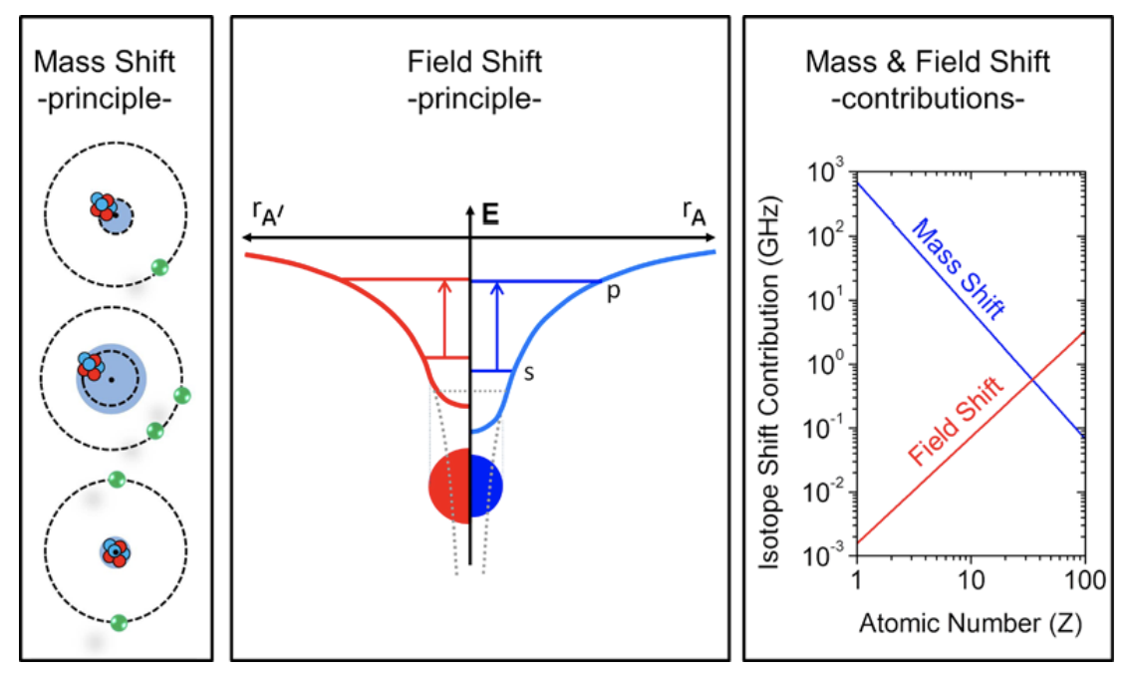
Nuclear charge radius
isotope-dependent frequency shift
mass shift contribution
field shift contribution
$$δν^{A, A′}=δν_{MS}^{A, A′}+δν_{FS}^{A, A′}$$
obtained from atomic-structure calculations
measured empirically
$$δν_{FS}^{A, A′}=Fδ{\left\langle r^{2}\right\rangle }^{A,A′}$$
Adapted from Wilfried Nörtershäuser and Christopher Geppert
field shift coefficient
relative nuclear charge radius
Notes:
Thanks to recent progress in atomic theory, here’s how we can derive nuclear charge radius:
The isotope dependent frequency shift can be obtained from spectroscopy measurements, which I’ll discuss later. This frequency shift consists of two component – the mass shift and the field shift contribution. Here I’d like to draw your attention to the diagram on the left. Let’s talk about the mass shift contribution first, shown in the left-most column. The top most figure represents the normal mass shift, in a one-electron system. The electron repulses the nucleus, giving it a nudge away, and this “nudge” is the mass shift in this system. The two lower figures represents the two cases of specific mass shift, in a two-electron system. In one case, the two electrons work together to repulse the nucleus, giving it an even bigger nudge, causing the mass shift, while in the other case shown in the bottom figure, the two electrons’ repulsion on the nucleus cancel each other out, and there’s barely any mass shift at all. The heavier the system is and the more electrons there are, the repulsion from the electrons are more likely to cancel each other out, and the less mass shift the nucleus experiences. So the mass shift contribution decreases in heavier systems. This is why atomic theory can calculate the mass shift contribution to a higher degree of precision for heavier systems, and not for lighter systems.
So, the other contributing factor to the frequency shift is the field shift contribution. Different from the mass shift, the field shift increases with the size of the nucleus. This is explained in the middle column. If we assume the nucleus to be point like, so infinitely small, the pure Column potential approaches infinity, shown in the dotted line, and the energy for the bound electron is shown in the flat dotted line. However, if we don’t make the point-like assumption, the electrostatic potential deviates from the pure column potential, following the red curve, and the energy is here.
This is shown in the middle column in the figure. With increasing size of the nucleus,

Slide 9
Extreme ultraviolet (EUV) spectroscopy
Absolute nuclear charge radius measurement
Charge breed elements into a specific charge state
Compatible with an EBIT setup
Access to optical port for decay spectroscopy
Notes:
The method that we have in mind to use alongside our EBIT set up is the extreme ultraviolet (EUV) spectroscopy. The advantage of this is that it provides absolute nuclear charge radius measurement,
E.g. one of the measurement candidates we’re interested in is Francium. We can charge breed Fr to the same electronic configuration as lead, since the nuclear charge radius is exquisitely well known for lead,

Slide 10
EUV spectroscopy at TITAN

Slide 11
Status
EBIT is operational
Charge breeding to Na-like for any element
Long storage time (over 30 seconds)
EUV spectrometer
Ray-tracing simulations
Finalizing spectrometer design
Discussion with manufacturer at McPherson Inc.
Atomic theory is capable of all relevant calculations for H-like, Li-like, and Na-like atoms
ISAC capable of delivering Fr, Ra at sufficient yields (over 10⁷ pps)
Notes:
We have an operational EBIT and I’m learning how to operate it
We are even making some upgrades to the EBIT to take its efficiency to the next level: gun, etc.

Slide 12
Summary: absolute nuclear charge radius
Novel technique to measure absolute nuclear charge radius of radioactive ions through ion trapping at TITAN
Installation and off-line tests with stable ions: end of 2022
First on-line experiment with RIB: 2023
First science cases: ²¹¹Fr, ²²⁵Ra
Searches for electric dipole moment (EDM)
Physics beyond the standard model
Relevant for nuclear structure investigations and nuclear astrophysics
Notes:
Demonstrated at stable beam facility – Livermore SuperEBIT, NIST EBIT
We’re unique: with RIB
Novel: only for nuclear physics

Slide 13
Notes:
Clemson, Roshani’s place, FRIB, NIST

Slide 14
Additional Information

Slide 15
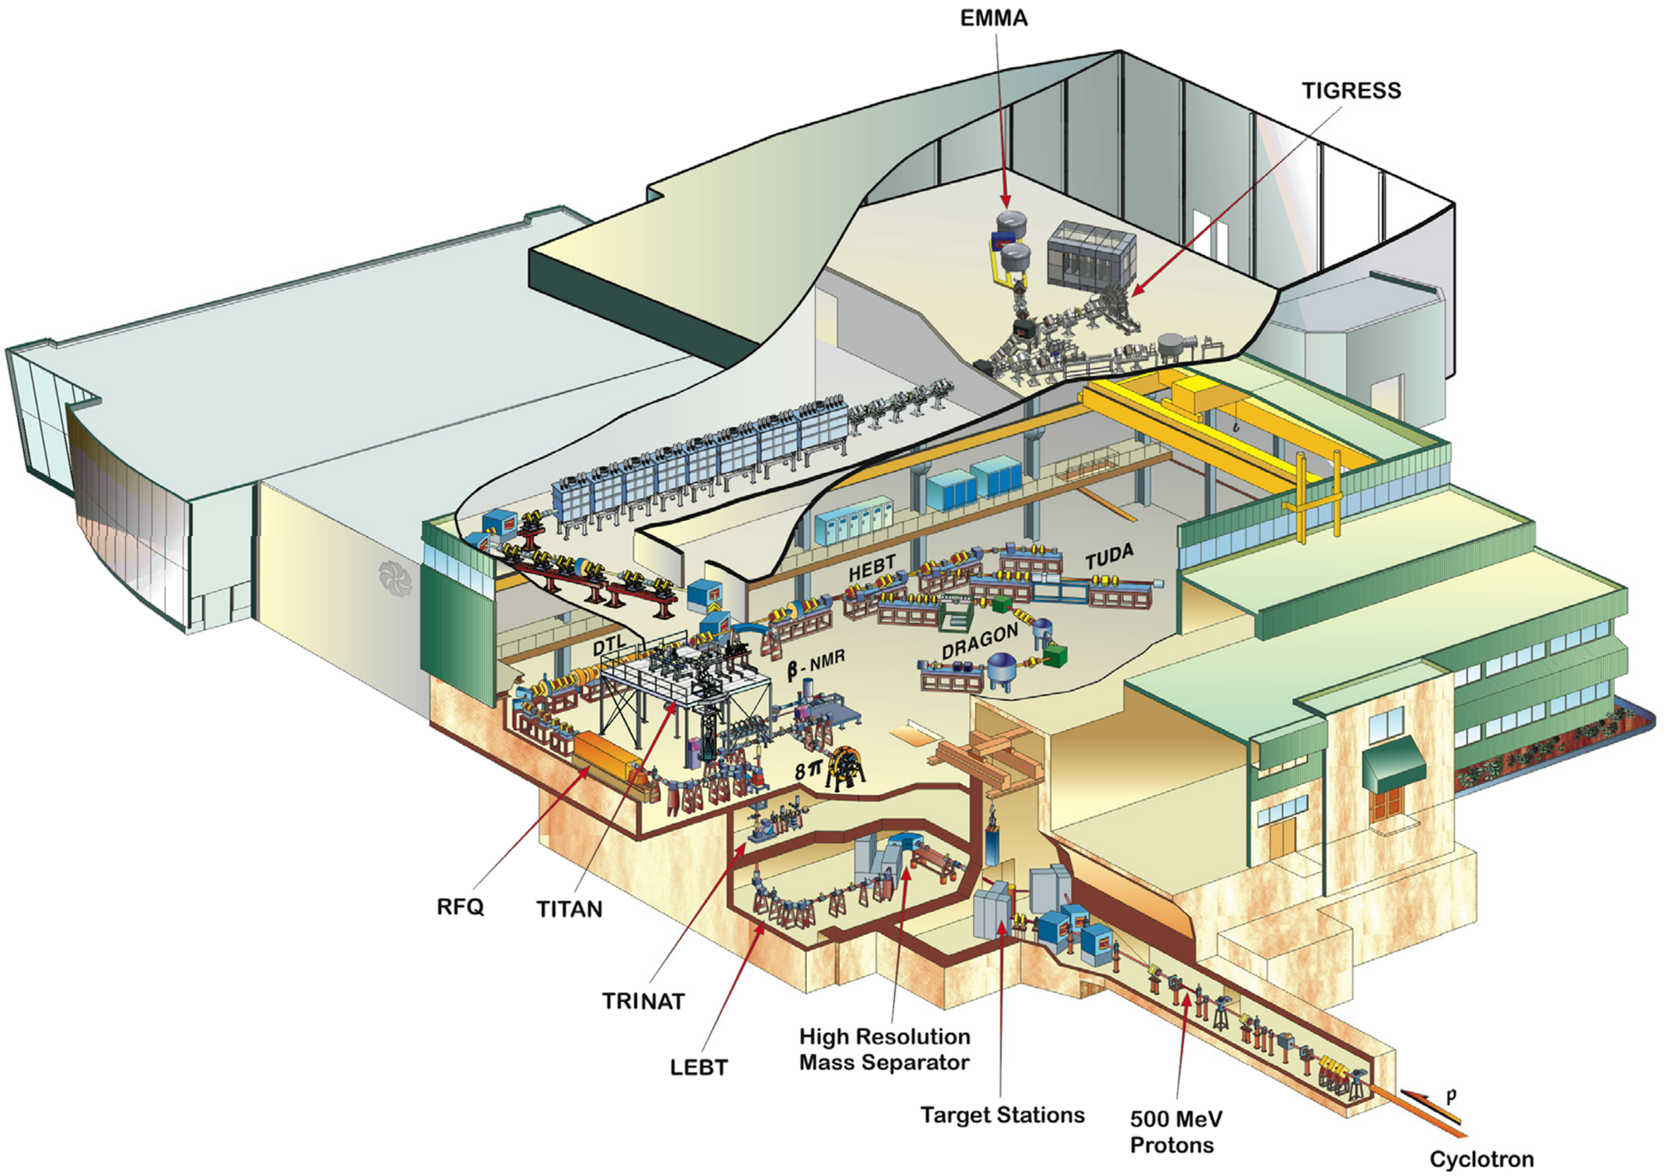
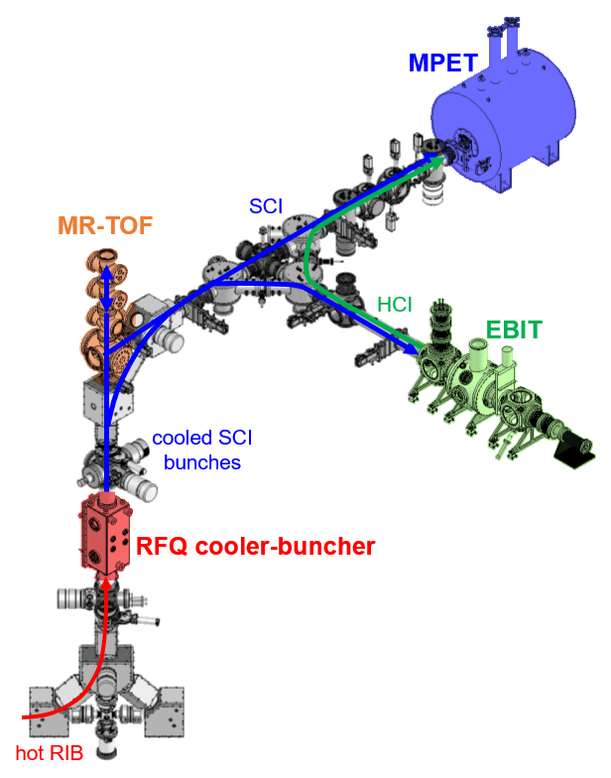
TRIUMF’s Ion Trap for Atomic and Nuclear science (TITAN)
Notes:
I’m a part of the TITAN group at TRIUMF, where we do precision mass measurements of short-lived isotopes with ion trapping techniques. We receive our radioactive ion beam from the Isotope Separation and Acceleration (ISAC) experimental hall, which receives proton beams from the TRIUMF cyclotron.
At TITAN, the mass measurement of short-lived nuclei is done with the Measurement Penning Trap. But before the beam reaches MPET, there are several pre-processing steps along the TITAN beamline that are designed to help optimize the MPET performance. One of these is the Electron Beam Ion Trap, which is the part of TITAN that my work focuses on.
======
At l, radioactive ion beam (RIB) is produced from
receives the proton beam,
ADD A FIGURE
Triumf cyclotron produces radioactive isotope
Study of short-lived isotopes with ion trapping techniques
Mass of unstable isotopes with millisecond half-lives can be precisely measured to an accuracy of $\frac{\delta m}{m}\leq 10^{-8}$
The Isotope Separator and Accelerator (ISAC):
RIB production: isotope separation on-line (ISOL) technique
Up to 100 $μ$A beam of 500 MeV protons

Slide 16
TITAN Experimental Set-up
Radio-frequency quadrupole (RFQ)
Multi-reflection time-of-flight (MR-TOF) spectrometer
Electron-beam ion trap (EBIT)
Measurement Penning trap (MPET)
Notes:
RFQ: buffer gas cooling and bunching the low-energy ion beam
MPET: 3.7T
EBIT: create highly charged ions, and can perform decay spectroscopy on trapped radioactive nuclei
NEED NEW DIAGRAM WITH MR-TOF MS

Slide 17
Typical measurement methods
Method | Limitations
Elastic electron scattering | Require macroscopic samples, beyond the amount of short-lived radioactive isotopes that ISAC can deliver
Muonic-atom spectroscopy
Collinear laser spectroscopy | Different measurement species require different lasers with appropriate ranges of optical wavelengths Only provide relative, not absolute, charge radius
Notes:
There are some typically used measurement methods out there for nuclear charge radius. However, some are only feasible for longer lived isotopes among other experimental constraints, and can only provide relative nuclear charge radius, not the absolute value.

Slide 18
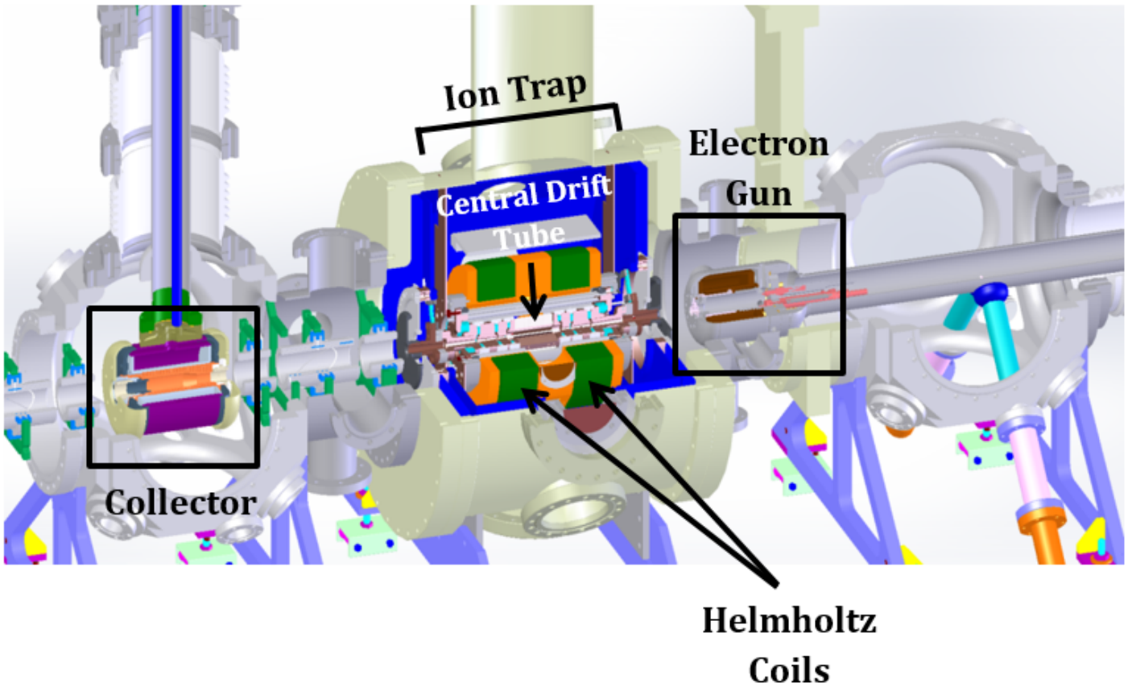
Electron Beam Ion Trap (EBIT)
Electron gun
Trap
Collector
Notes:
- Integrated into the TITAN experimental setup in 2008 to overcome MPET mass measurement precision limitations

Slide 19
EUV spectroscopy at TITAN

Slide 20
Nuclear charge radius
isotope-dependent frequency shift
mass shift contribution
field shift contribution
$$δν^{A, A′}=δν_{MS}^{A, A′}+δν_{FS}^{A, A′}$$
obtained from atomic-structure calculations
measured empirically
$$δν_{FS}^{A, A′}=Fδ{\left\langle r^{2}\right\rangle }^{A,A′}$$
Adapted from Wilfried Nörtershäuser and Christopher Geppert
field shift coefficient
relative nuclear charge radius
Notes:
Thanks to recent progress in atomic theory, here’s how we can derive nuclear charge radius:
The isotope dependent frequency shift can be obtained from spectroscopy measurements, which I’ll discuss later. This frequency shift consists of two component – the mass shift and the field shift contribution. Here I’d like to draw your attention to the diagram on the left. Let’s talk about the mass shift contribution first, shown in the left-most column. The top most figure represents the normal mass shift, in a one-electron system. The electron repulses the nucleus, giving it a nudge away, and this “nudge” is the mass shift in this system. The two lower figures represents the two cases of specific mass shift, in a two-electron system. In one case, the two electrons work together to repulse the nucleus, giving it an even bigger nudge, causing the mass shift, while in the other case shown in the bottom figure, the two electrons’ repulsion on the nucleus cancel each other out, and there’s barely any mass shift at all. The heavier the system is and the more electrons there are, the repulsion from the electrons are more likely to cancel each other out, and the less mass shift the nucleus experiences. So the mass shift contribution decreases in heavier systems. This is why atomic theory can calculate the mass shift contribution to a higher degree of precision for heavier systems, and not for lighter systems.
So, the other contributing factor to the frequency shift is the field shift contribution. Different from the mass shift, the field shift increases with the size of the nucleus. This is explained in the middle column. If we assume the nucleus to be point like, so infinitely small, the pure Column potential approaches infinity, shown in the dotted line, and the energy for the bound electron is shown in the flat dotted line. However, if we don’t make the point-like assumption, the electrostatic potential deviates from the pure column potential, following the red curve, and the energy is here.
This is shown in the middle column in the figure. With increasing size of the nucleus,

