Slide 1
Simon Fraser University/The ATLAS Collaboration
Quark/Gluon Jet Response from different Event Topologies at ATLAS
Winter Nuclear and Particle Physics Conference

Slide 2
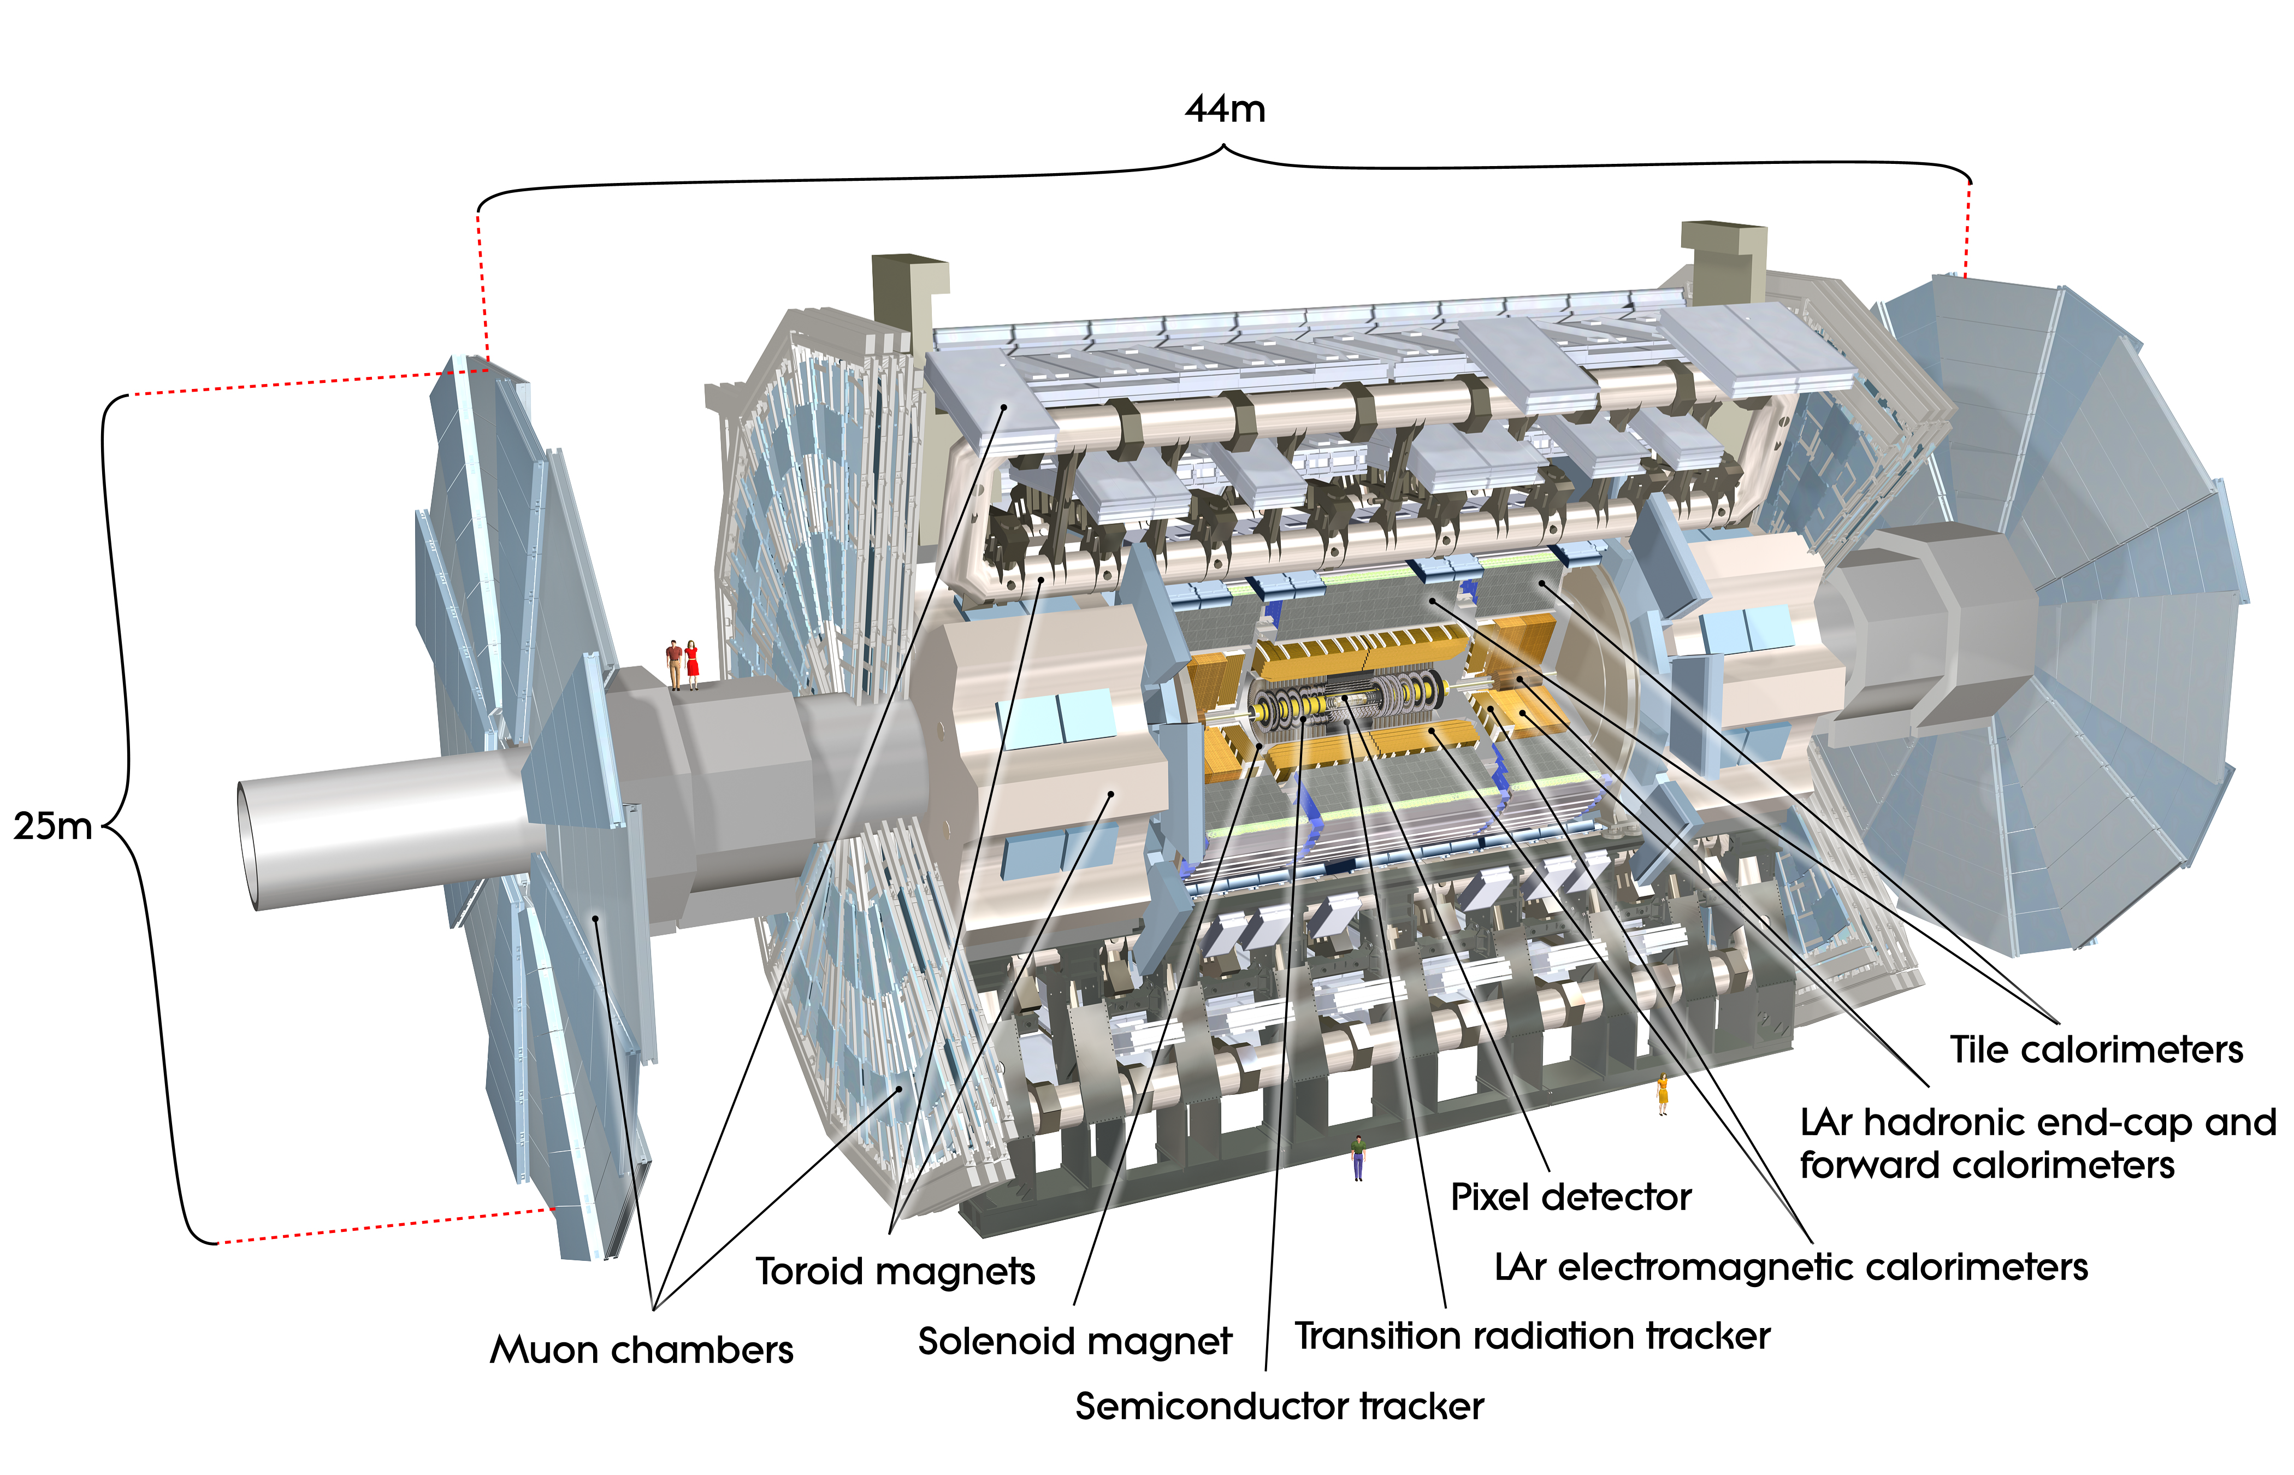
ATLAS
The largest general purpose particle detector at the LHC.
Inner detector for tracking, Calorimeters for energy measurement, outer muon spectrometer.
Jets can be defined from the calorimeter, or from a combination of the calorimeter and the tracker
Joao Pequenao
Joao Pequenao
Notes:
-Try not to spend too long on the intro slides

Slide 3
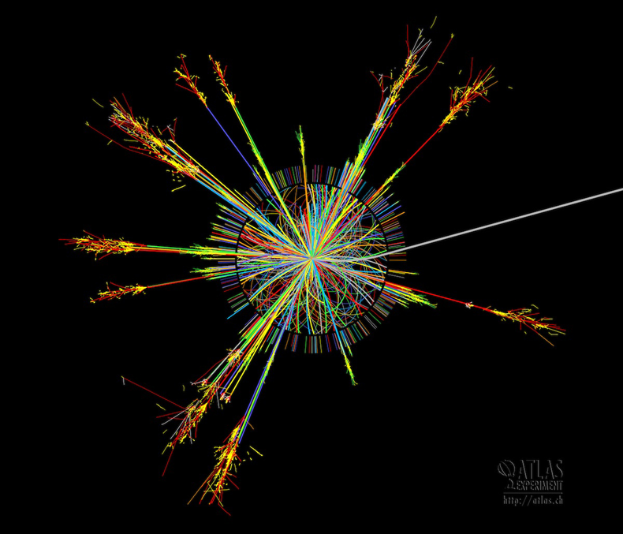
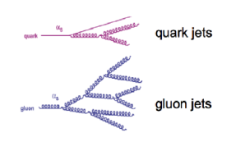
Jets
QCD confinement: partons produced in collisions have color charge, which cannot exist freely.
Iterative quark/gluon production, combine to form color neutral streams of hadrons, called jets.
Jets can originate from quarks or gluons; Different width, depth, particle count and particle energy
Notes:
-cover the different properties of quark/gluon jets. Penetration, number particles, width…

Slide 4
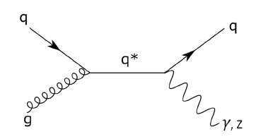

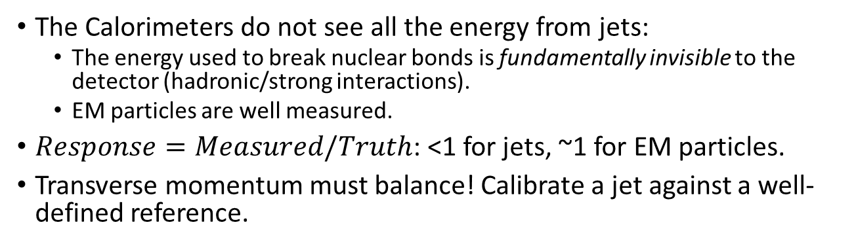
Calibration
The Calorimeters do not see all the energy from jets:
  The energy used to break nuclear bonds is fundamentally invisible to the detector (hadronic/strong interactions).
  EM particles are well measured.
$Response=Measured/Truth$: <1 for jets, ~1 for EM particles.
Transverse momentum must balance! Calibrate a jet against a well-defined reference.
Initial quark/gluon have no transverse momentum.
Quark jet and reference object are “back-to-back in phi”, momentum must balance to 0
Initiates Jet
Notes:
The calorimeters are calibrated to EM scale by test beams

Slide 5
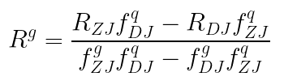


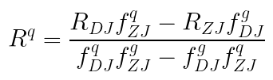
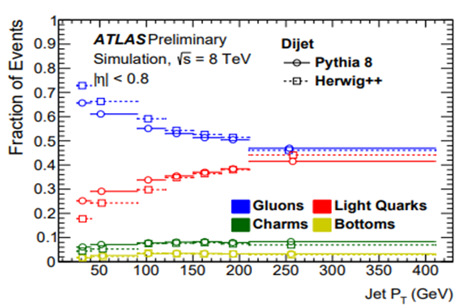
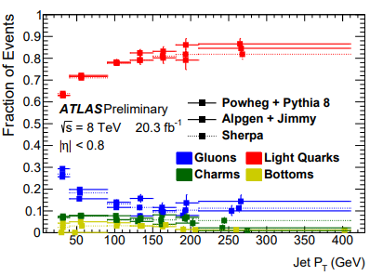
Quarks & Gluons
How does the response of quark jets differ from that of gluon jets?
Compare different event topologies: determine event responses and particle fractions.
Particle fractions from MC:
Z+jet
Notes:
-Why the dijet is needed
-how we go from topologies to quarks/gluons

Slide 6
Response
We saw how to get the response for Z/gamma + jets, but we also need it for Dijets.
No well-defined reference!
2016 study [4] used run 1 data to outline a method for correcting one of the jets (we benefit from the larger run 2 dataset).
Jet
“Easy”
Z boson or γ (reference)
Recoil
Not so easy
Notes:
-The primary goal: quark vs gluon response.
-The primary problem: dijets cannot be calibrated as easily as jet plus reference.
-A basic explanation of calibrating jets, can’t really dive into MPF

Slide 7
Adapting Dijets
Can use the characteristics of jets to determine the response, allowing a jet to be used as a reference object in calibration.
  Sort jets into high and low response groups (such as R>0.9, R<0.7), save jet variables in these groups
  Determine which variables are most sensitive to differences in response, sort for correlation
  Combine the best variables into a Likelihood function
Doing this in MC, where response is known, allows us to create a “look-up table” to use in determining the response in data.
  Want to see a correlation between likelihood and response.
Once the response of one jet is known, it can be used as a reference for the other!
Notes:
-Outlining the 2016 method.
-specify that the first portion is done with MC, then th
Doing this in MC, where response is known, allows us to create a “look-up table” to use in determining the response in data.
e later portion with data using the resp V like as a reference for response.

Slide 8
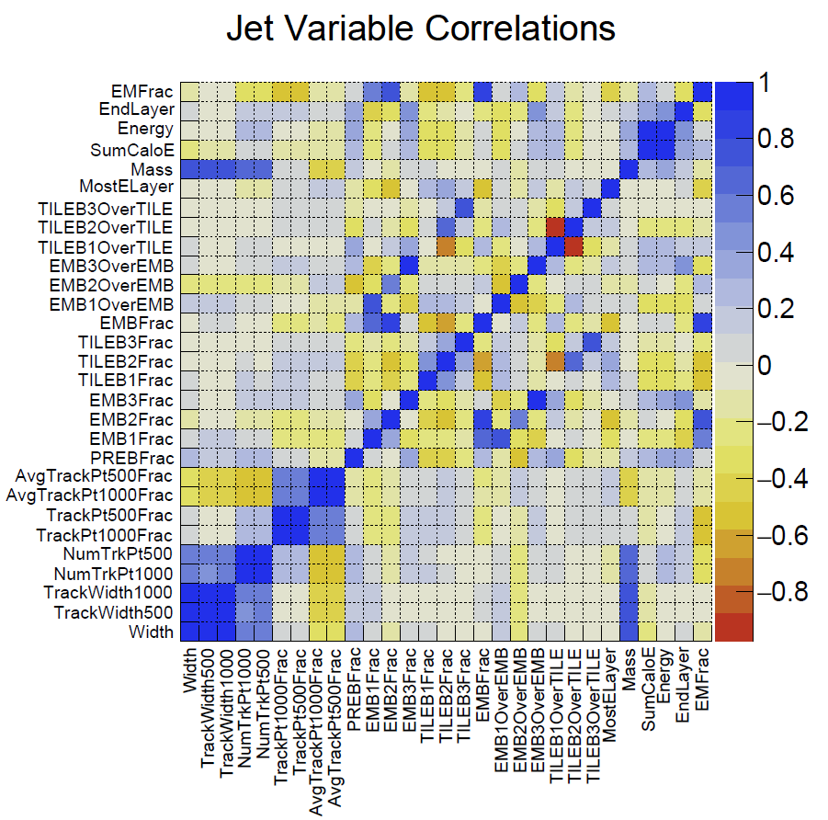
Ranking Variables
Multiple statistical tests used to rank variables.
Highly (anti)correlated (such as + 0.4) variables removed.
  EX: TILEB2OverTILE Vs. TILEB1OverTILE (red square)
Combine the best variables into the likelihood function
Multiple likelihood functions created by varying high and low response cut, correlation cut
Notes:
-lots of good examples for highly correlated: width/trackwidth EMB1F/EMB1O… best anti correlated is TILEB1O/TILEB2O
-between this and next: clarify that we are not just picking the top six of what's left, but that in many bins only 6 remain.

Slide 9
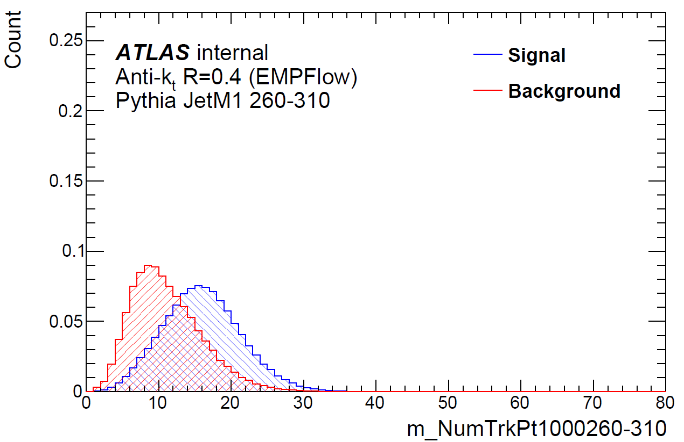
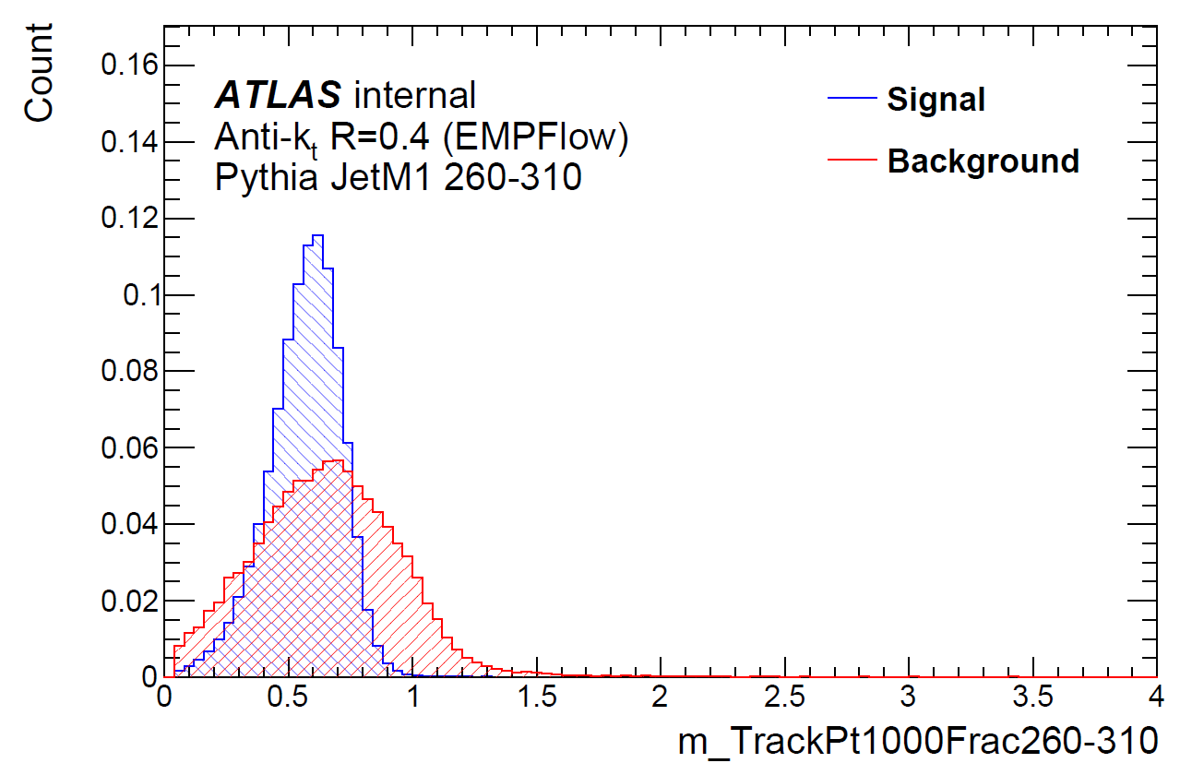
A “Final List” Example
Example: High response >= 0.95, Low <= 0.75, Correlation cut + 0.4
  reco pT 260-310 GeV.
6 variables in list, two of the best:
  NumTrkPt1000: how many tracks have momentum of 1GeV+?
  TrackPt1000Frac: Fraction of jet momentum carried by tracks with 1GeV+.
Work in progress

Slide 10
Summary/Next steps
Response of quark- and gluon-initiated jets can be determined from the responses of different event types.
  Jet variables used to create a reference in dijet events
  All event types calibrated to get response
From event responses and particle fractions, determine quark and gluon jet responses.
In the process of plotting likelihood against response to determine correction factors.
Variation of correlation and response gave large uncertainty to previous work, can it be improved?
Good results could improve ATLAS analyses and help with understanding of QCD.
Notes:
I mentioned run 1 vs 2 earlier, will the increase in data lower the uncertainties?

Slide 11
References
[1] ATLAS Collaboration. “Jet Energy Scale and Resolution Measured in Proton-Proton Collisions at $\sqrt{s}=13$ TeV with the ATLAS Detector.” ArXiv:2007.02645 [Hep-Ex], July 6, 2020. http://arxiv.org/abs/2007.02645.
[2] Cacciari, Matteo, Gavin P Salam, and Gregory Soyez. “The Anti- k _{t} Jet Clustering Algorithm.” Journal of High Energy Physics 2008, no. 04 (April 16, 2008): 063–063. https://doi.org/10.1088/1126-6708/2008/04/063.
[3] Singh, Sundeep. “Determining the Jet Energy Scale for ATLAS in the Z+Jet Channel.” MSc Thesis, Simon Fraser University, 2020.
[4] Beare, James W. “Reconstructing a Quark and Gluon Jet Response at ATLAS.” MSc Thesis, Simon Fraser University, 2016.
[5] ATLAS Collaboration. “Discrimination of Light Quark and Gluon Jets in $pp$ collisions at $\sqrt{s} = 8$ TeV with the ATLAS Detector.” July 2016. http://cds.cern.ch/record/2200202

Slide 12
Backup Slides

Slide 13
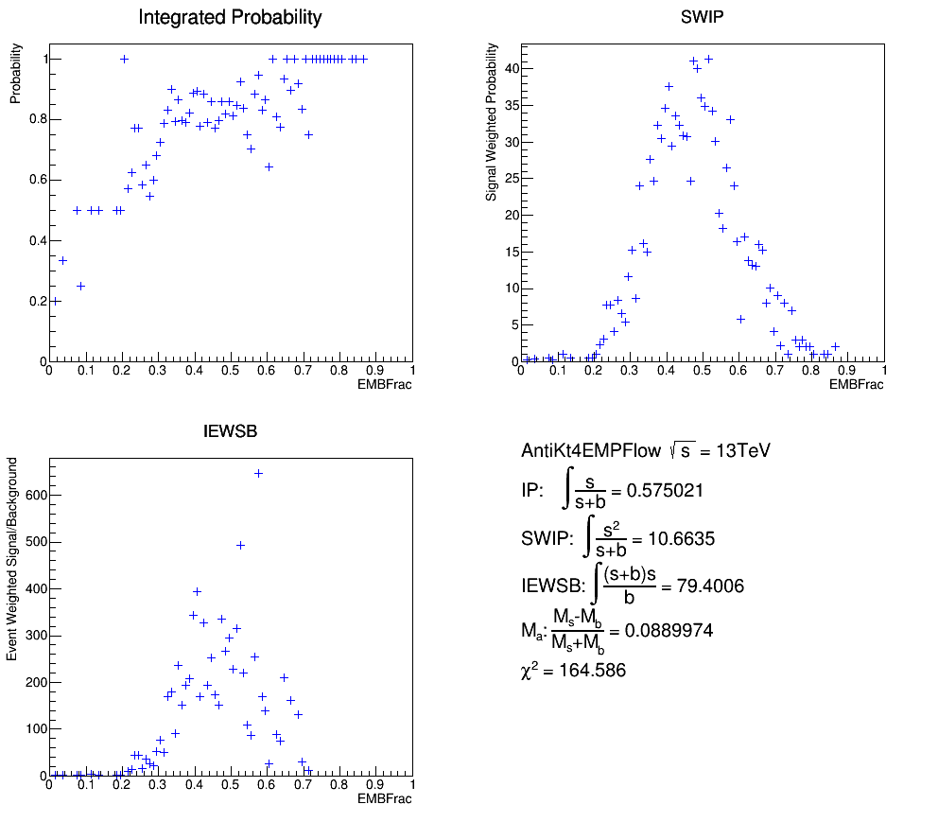
Statistical tests
High/Low response cut is somewhat arbitrary, vary and repeat.
Five statistical test to determine most separated variables
  IP
  SWIP
  IEWSB
  Mean Asymm
  Chi2
Ex: EMBFrac is the portion of jet energy deposited in the EM barrel. The high scoring region of the variable changes with different tests.
Notes:
-5 tests used to eliminate issues with each other. Fig. shows how the three s/b tests clean up one after the other.

Slide 14
A “Final List” Example
Example: High response >= 0.95, Low <= 0.75, Correlation cut + 0.4
Top 6 variables, reco p_{T} 260-310:
  NumTrkPt1000
  MostELayer
  EndLayer
  EMB1Frac
  TrackPt1000Frac
  TILEB2OverTILE
Work in progress
Notes:
-NumTrk is very good for outlining the likelihood function
-physics explanation for each variable (why would this var show good separation)

