Slide 1


WNPPC2022 close out
& award ceremony
Tim Friesen
on behalf of the organizing committee
Calgary

Slide 2
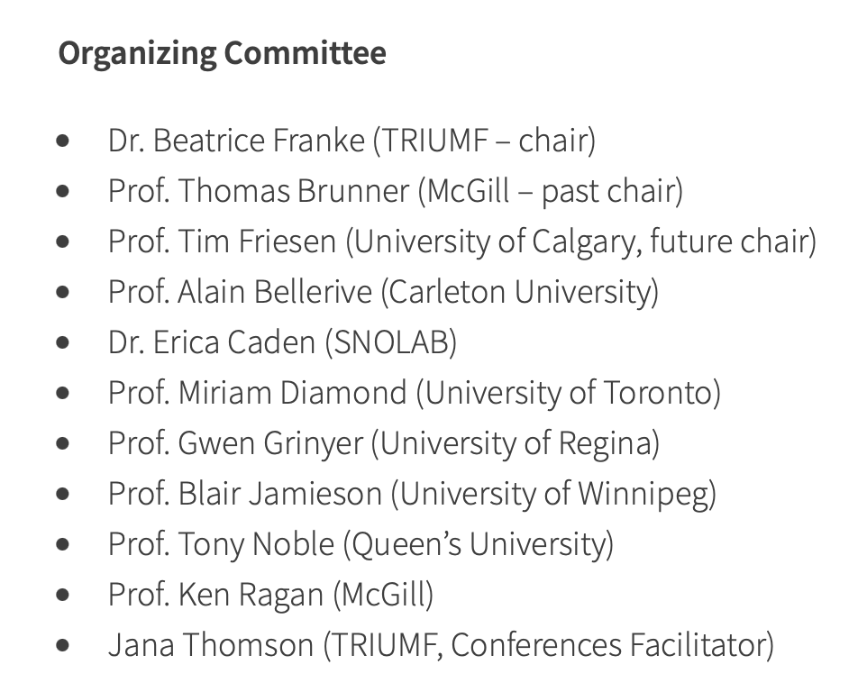







Thanks to our sponsors & supporters!
Big thanks to all helpers in front of and behind the scenes:
Derek Fujimoto
Aoife Hanley
Lorraine King
Erin Madill
Allayne McGowan
Michael Miller
Polina Shopina
All session chairs
All student judges
Particle Physics Division (PPD)

Slide 3

Reminder:
If you haven’t activated your meal credit yet,
it’s valid until Sunday, Feb 20th!
Information on how to redeem your credit can be found here:
https://meetings.triumf.ca/event/269/page/83-ubereats-business-account-instructions
For any UberEats related questions, please contact Jana at wnppc@triumf.ca (no support guaranteed during the weekend!)

Slide 4
Student prizes!
Best Undergraduate Presentation
Alicia Postuma
Best Presentation in Theoretical Physics
1st Prize: Javier Acevedo
2nd Prize: Amalia Madden
Best Presentation in Experimental Physics
1st Prize: Emma Ellingwood
2nd Prize: Pooja Woosaree
3rd Prize: Shroff Maheyer
Best Overall Student Presentation
Frank Wu
We thank our student prize sponsors:

Slide 5
Thanks for being a part of
WNPPC2022!
Group pictures will be circulated by email next week!
Notes:
ALTERNATIVE SLIDE: see slide 57

Slide 6




Thank you
Merci
See you in 2023!
www.triumf.ca
Follow us @TRIUMFLab

