Slide 1
The User Facility Radiation Source ELBE @ HZDR
Peter Michel
e-Linac Reliability Workshop (ERW), May 9-10, 2022, virtual
HZDR
ELBE facility
Management and user aspects
Accelerator R&D @ ELBE

Slide 2
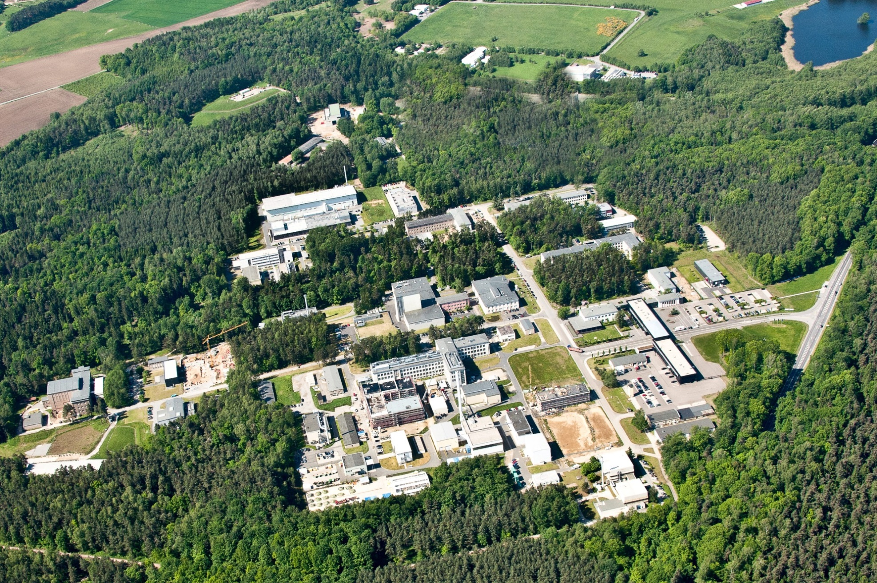
ELBE Center for High Power Radiation Sources
Electron Linear accelerator with high Brilliance and low Emittance
Helmholtz-Zentrum Dresden-Rossendorf
member of the Helmholtz Association since 2011
~ 1,100 . employees incl. ~ 350 scientists + 150 PHD
research Sites : DRESDEN, Leipzig, Freiberg, Schenefeld near Hamburg, Grenoble (FR)
Dresden
HELMHOLTZ ZENTRUM DRESDEN-ROSSENDORF (HZDR)

Slide 3
ELBE concept
nano scale systems
ultra fast dynamics of solids
i.p.correlated syst., low dimensional syst.
(future: soft matter…biol. samples)
nuclear structure (nuclear & astro physics)
defect analysis (material research)
nuclear data (nucl. science & technology)
detector technology
radio biology
detector technology
radiation hardness studies
Terahertz and Infrared
Bremsstrahlung
Positrons
ELBE Electron Accelerator
Neutrons
Electrons

Slide 4
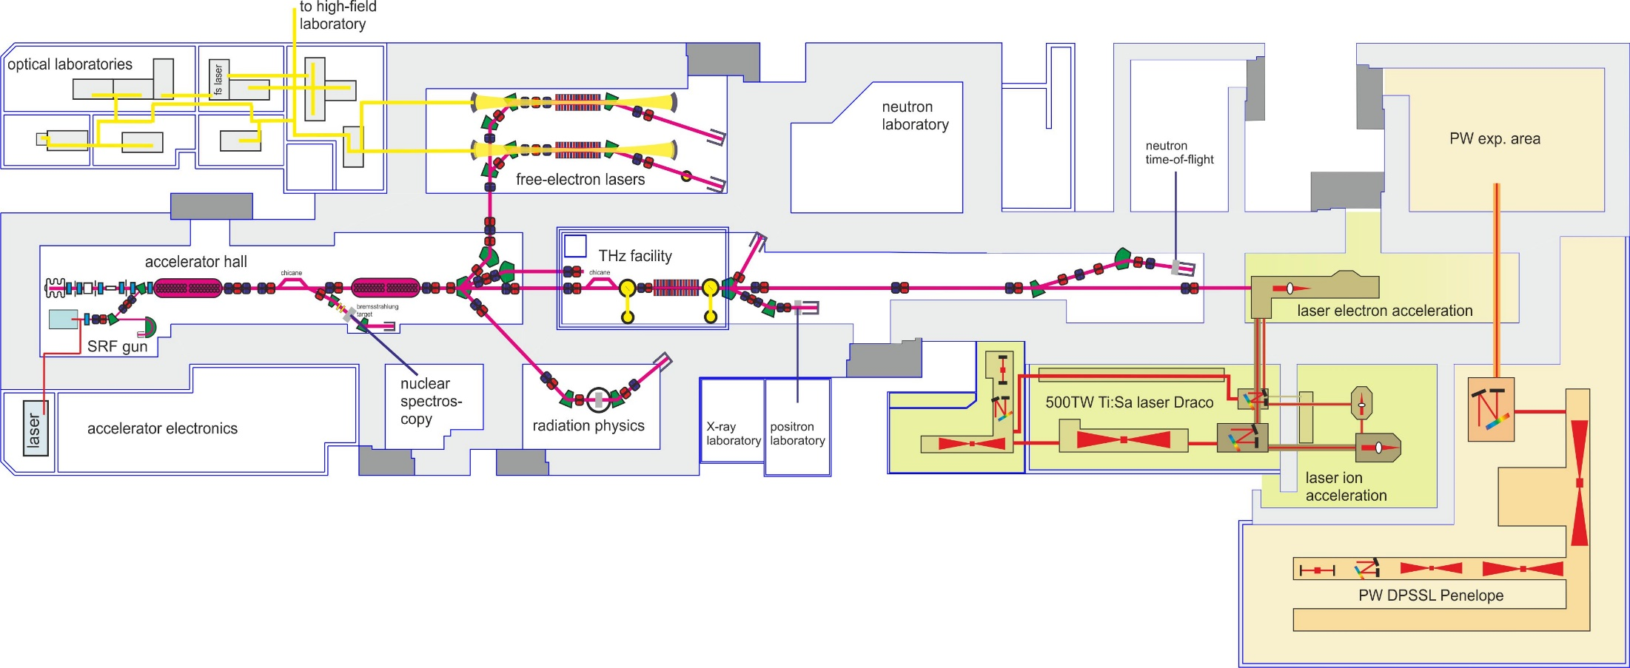
ELBE Layout
~ 100 M€ investment
~ 50 FTE
~ 8 M€/y operating cost
1mA, 40MeV CW electron accelerator
coherent IR-radiation 5 – 250 µm
THz radiation
100 µm – 3 mm
Bremsstrahlung
0 – 17 MeV
electrons
30 – 34MeV
pulsed, mono-energetic
positrons 0.2 – 30 keV
electron laser interaction

Slide 5
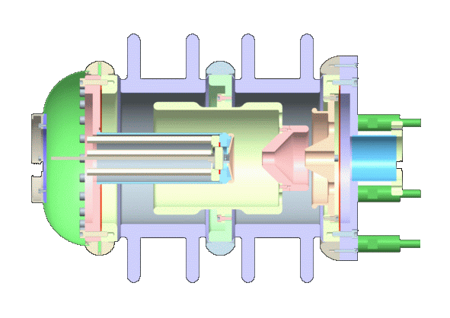
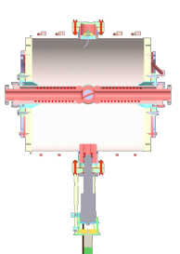
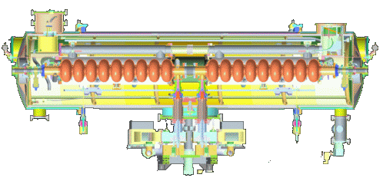
ELBE Electron Accelerator
250 kV DC gun
77 pC
10 mm mrad
RF bunch
compressor
magnetic bunch
compressor
1.3 GHz sc linac
18 MeV
1.3 GHz sc linac
18 MeV
3 MeV SRF photo gun
~ 200 pC 1 nC
3 mm mrad
26 MHz – kHz
1-10 ps
250fs
100µs – 36ms
0 – 1s
1 - 2³¹ bunches
CW
macro pulse
single pulse

Slide 6
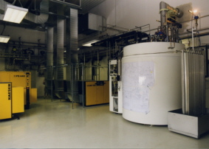
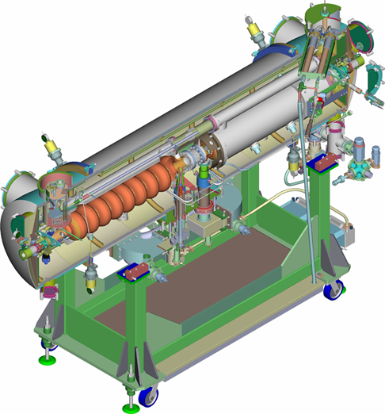
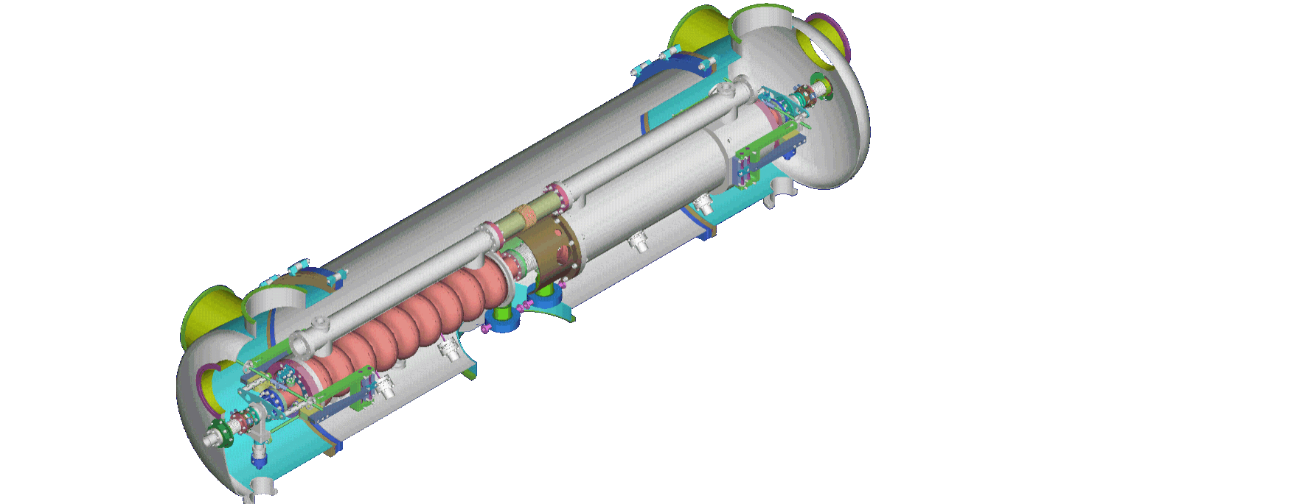
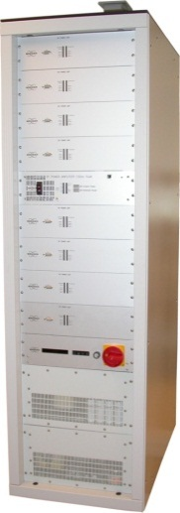
Helium Liquifier LINDE
ELBE CW-Linac Module
18 MeV, 1 mA
License Agreement on the Twin Cavity Module with HZDR/Rossendorf
200 W @ 1.8 K
2 K Helium vessel
Isolation Vacuum / LN₂-Shield
4 GLS /Daresbury UK
TARLA /Turkey
MESA/Uni Mainz Germany
POLFEL/Poland
2x10kW SSA
Bruker
250 keV, 1 mA
Tuning System
9-cell Tesla Cavity
1,3 GHz

Slide 7
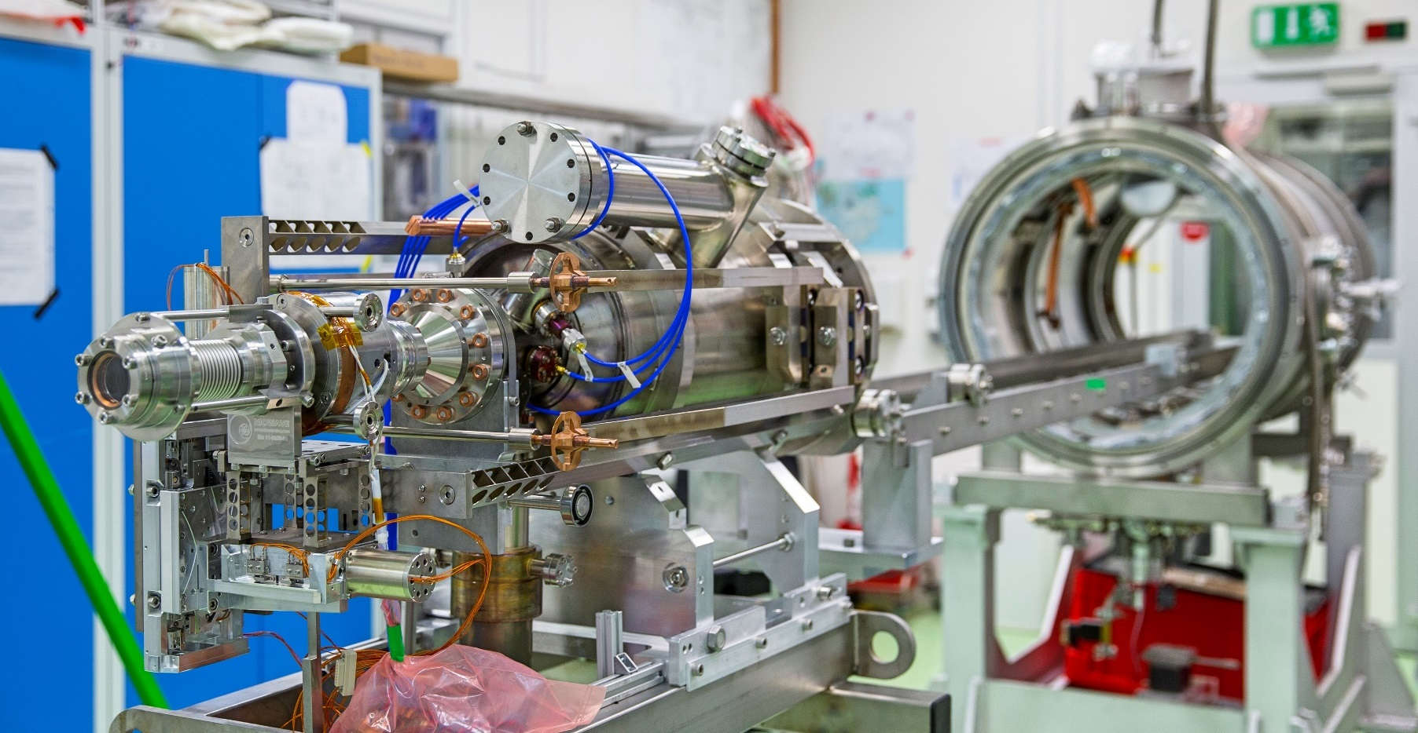
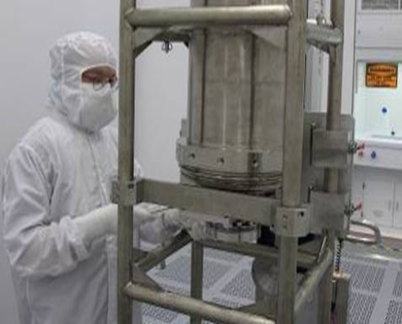
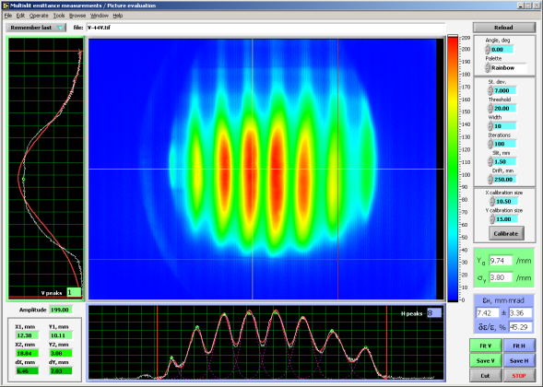
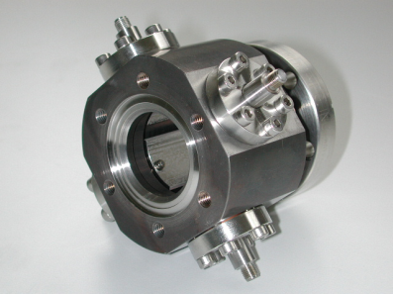
Technological challenges at ELBE
Superconducting gun + accelerator
High beam power
High demands on electron beam quality
low emittance
extremely short pulses < ps
high bunch charge
High precision beam diagnostics

Slide 8
What is unique at the ELBE accelerator ?
bunch charge / pC
high charge, adjustable pulse distance (>µs)
cTHz, nTOF, positrons
1000
full CW accelerators
ELBE
pulsed superconducting
accelerators
FLASH, XFEL
optical resonator FEL
SRF gun
normal conducting accelerators
FELIX, FLARE, CLIO, FHI…
100
thermionic gun
10³
10⁴
10⁵
10⁶
10⁷
bunches / s

Slide 9
Beam time statistics 2020/2021 (Run II/20-RunII/21 !)
hours in total:
Scheduled 6736
Used 6426
Reliability 94%
External users: 70 %
External/Internal use (beamtime)
reliability

Slide 10
Beam time management at ELBE
Call for proposals twice per year
Beamline scientist evaluate for feasibility of proposed experiments
Proposal evaluation by ELBE SAC (provides ranking , over booking factor 2…3)
Beam time allocated for a six month block of shifts
Beamline scientists support users
Proposal application/evaluation/reporting through GATE portal (internet)

Slide 11
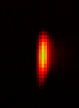
ELBE Timeline
2001
2004
2008
SRF Gun operation
Since 2016
?
THz-Upgrade
2010-14
2022
Comm.
& test
operation
2 shift
user
operation
ELBE
Follow up
DALI
24/7 user operation
First Beam
May 21st 2001
6MeV 5µA
~ 20 years with cavities at 2 K
~ 120.000 hours operation
> 100 kC accelerated charge

Slide 12
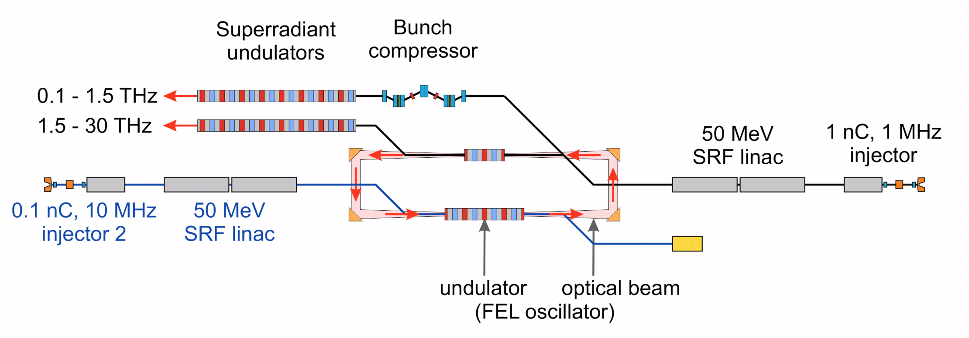
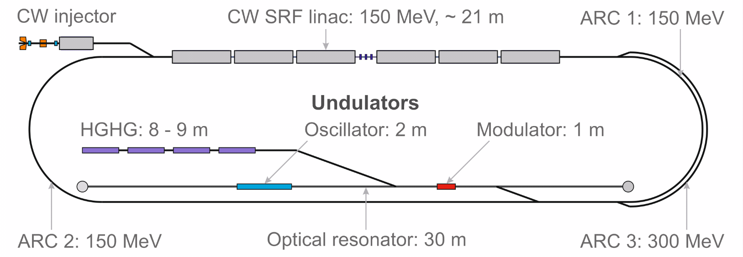
Overall concept for THz/IR source DALI
P. Evtushenko et al., FEL 2019 Conference

Slide 13
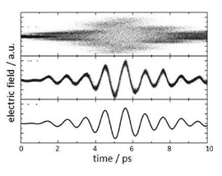
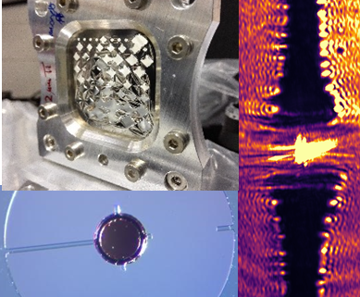
Accelerator Research and Development @ HZDR
Sc RF photo injectors for CW
Ultra short beams, diagnostic & control
Laser Particle acceleration
SRF gun cavity optimization
gun cryostat development
photo cathodes for SRF guns
long term studies
THz based e-beam diagnostic
Advanced beam diagnostics for short pulse & high power cw beams
Synchronization , stabilization & feed-back , digital LL RF control
Controlled injection at high
peak current electron beam
Single-shot ultrafast probing of
plasma waves and beam
characterization
Advanced radiation sources
Plasma target development
Computing & simulations

Slide 14
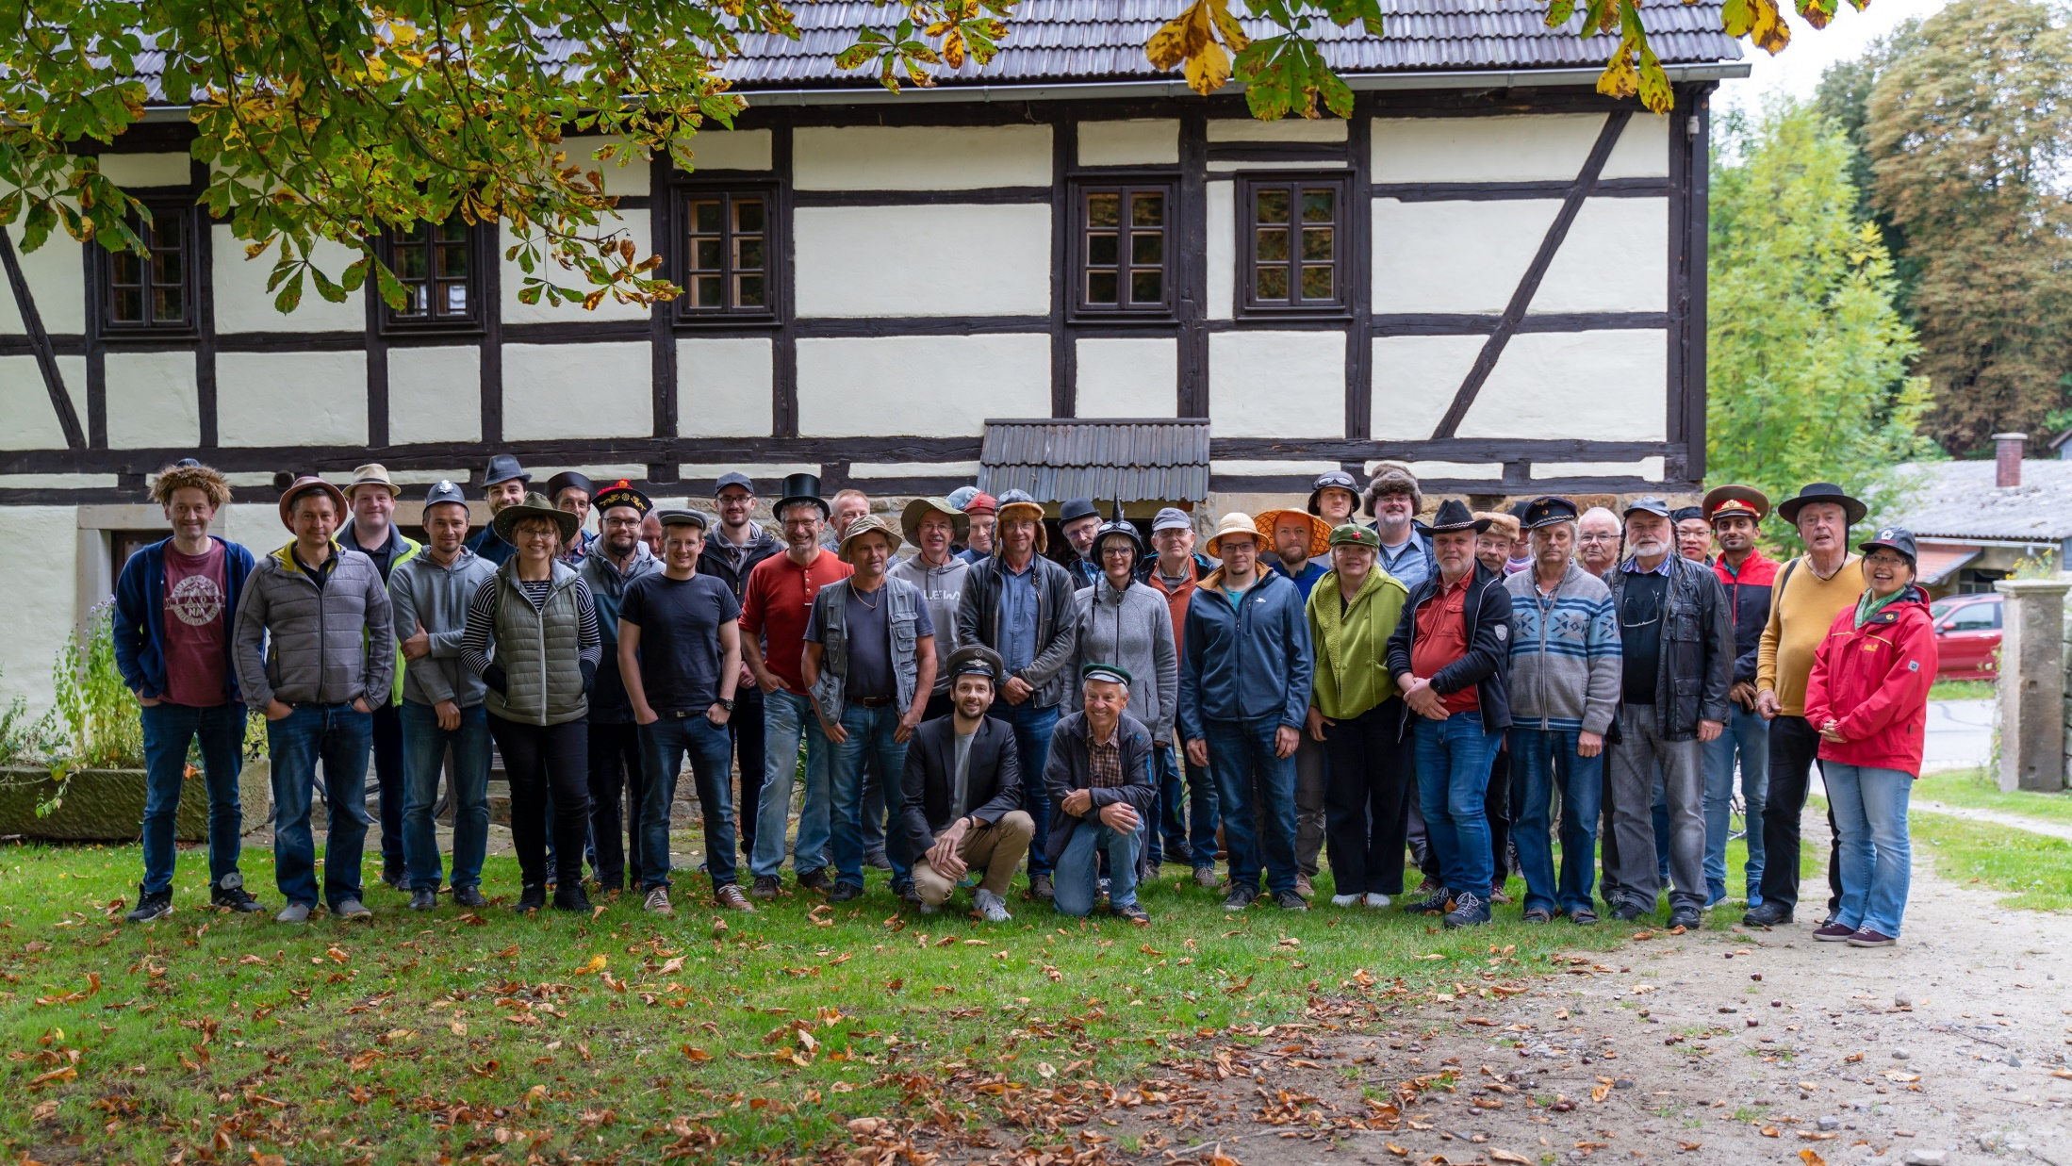
Thank you for your attention

