Slide 1
Operation at e-Linac
Brandon Humphries and Stephanie Rädel
Accelerator Division

Slide 2
ERW Operations Topics
Operational model
Maintenance schedule
Spares strategy
Automation of procedures – user interface
Failures – lessons learned

Slide 3
Operational model (part 1)
Experts
Ran focused tests
Seconded Operator
Single point of contact
Shared
Operators being trained to perform most tasks
Lacked consistency in operation
Wrote procedures and training
Others with expert guidance

Slide 4
Staff availability and time limitations (Operational model part 2)
8 am
Driver Control Room (DCR)
4 pm
Cyclotron (main)
E-Linac
Remote
Case 1:
3 Operators on shift
Expert online or in DCR
Case 2:
2 Operators on shift
Expert needs to be in DCR
During Covid 19:
occupancy restriction
3-person limit in DCR
Notes:
Staff availability limitations:
Driver operators are often busy and require a 3 person shift to spare someone to run the E-Linac.
E-Linac is not polished for tuning, so requires full focus
3 beam experts that can operate the E-Linac, who also have other priorities.
Operation is mostly between 8am-4pm due to expert availability and system run time (due to batteries).
COVID protocols restricted the number of people allowed in the Driver Control Room for the last couple years.

Slide 5
Tuning and Downtime (Operational model part 3)
Tuning
Focusing elements set and left at “theory” using an envelope application
Downtime
Tracking tested previously for first beam user (CTS) as the schedule was defined
Tune by adjusting RF elements and steerers while watching diagnostic equipment
Not currently tracked as the schedule is fluid
Automated “time tracker” was created

Slide 6
Maintenance schedule (part 1)
Maintenance/Beam schedule is announced in a weekly “technical” meeting
Activities from the past week are discussed
A plan for the next week is coordinated
The schedule and minutes are sent out by email
Schedule is updated in a shared calendar (new)
Maintenance is not regular; it’s scheduled as needed

Slide 7
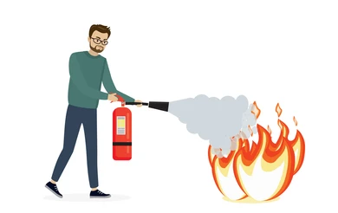
Maintenance is mostly reactive to faults and issues (Maintenance schedule part 2)
Updated Maintenance Schedule
Too few items scheduled for regular maintenance.
Identify items that require scheduled maintenance.
Scheduling falls to the group responsible for the system.
System Reliability

Slide 8
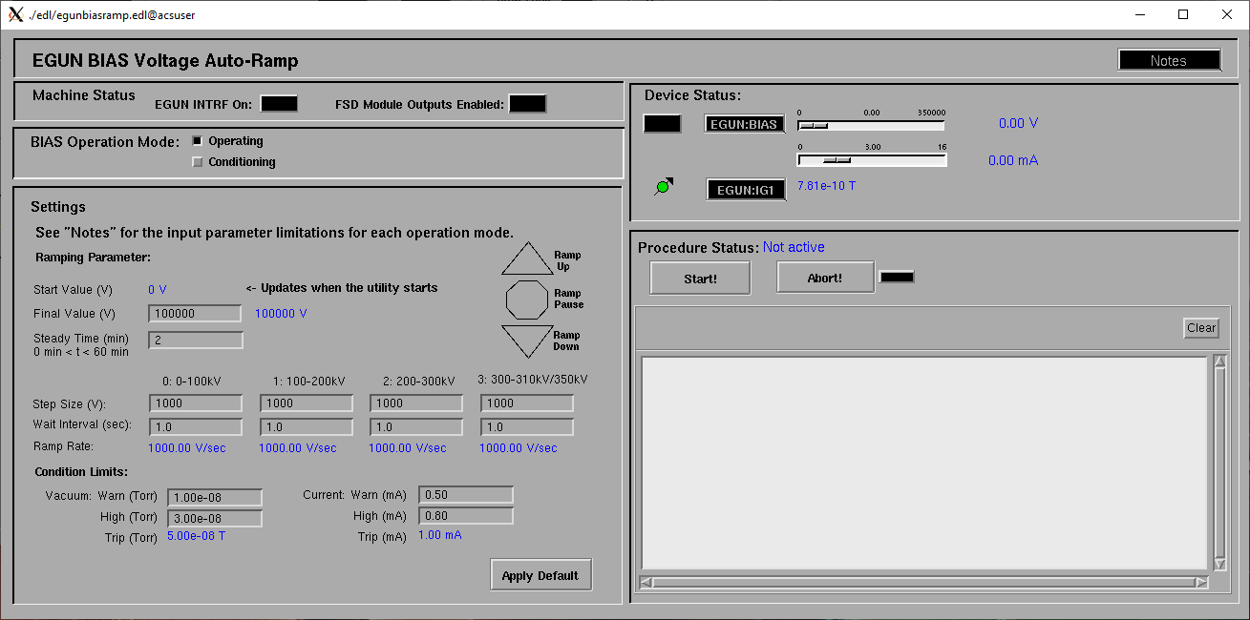
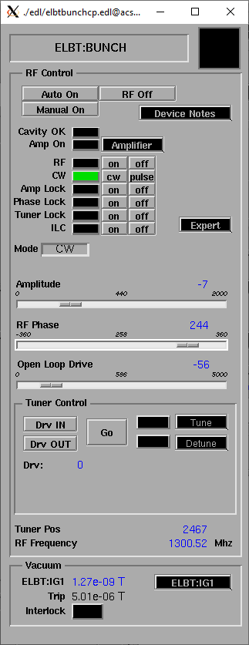
Automation of procedures – user interface (part 1)
User interface is EPICS ➔ EDM (EPICS display manager) pages
Automated ramping utility:
Automated utility created for ramping the EGUN HV
Provides reproducibility of ramping and one less simple task for operators
Buncher and EINJ RF can be started using “Auto-On”, EACA RF “Auto-On” is in development
Removes reliance on RF experts to start/recover systems
RF bunch page
with "Auto ON" button

Slide 9
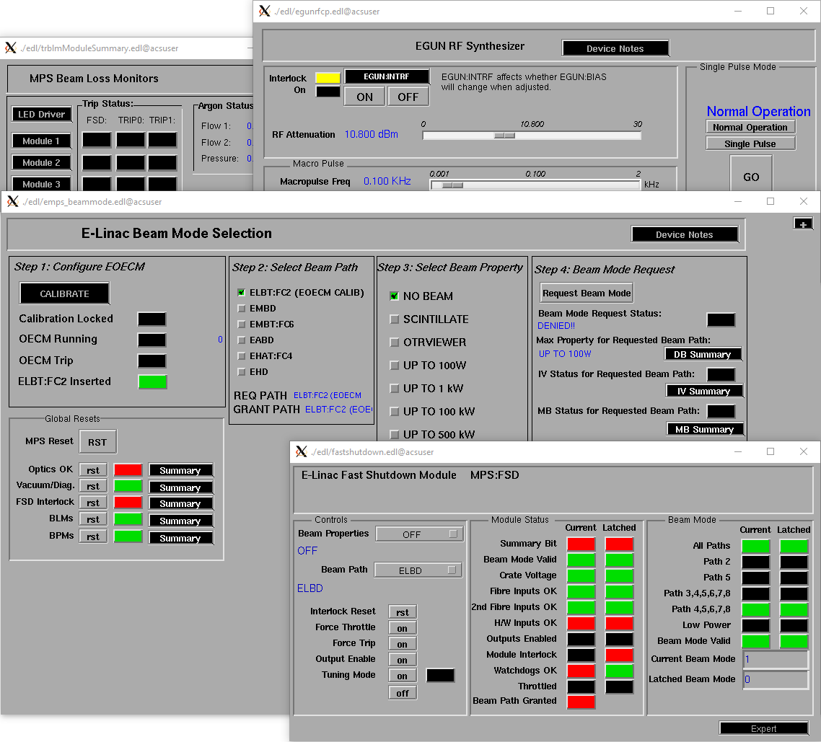
Need for further automation/simplification (Automation of procedures – user interface part 2)
Starting EINJ/EACA requires running around
KPS operation (set-up, resetting of trips) must be done locally
Water temperature must be in a specific range
Many “clicks” required to tune, even for simple tasks
Finding the alarm/cause of trip requires digging
Leads to operator fatigue
Collaborating with Controls group to improve
Pages needed to turn beam on and off (and on again)

Slide 10
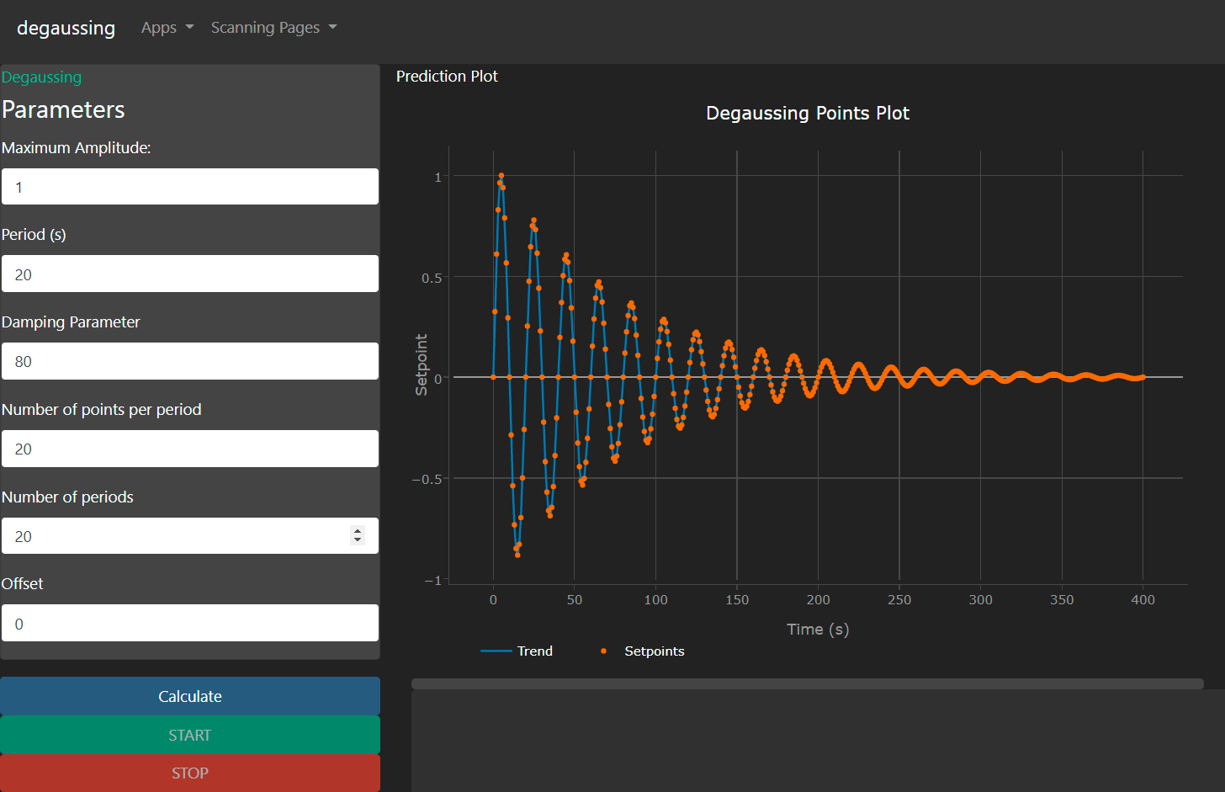
High Level Applications – s (Automation of procedures – user interface (part 3)
HLAs created to assist with automation of procedures.
HLA development required partially due to the Controls group being overloaded
HLAs provide automation for adjusting devices and performing data collection & processing outside of the Control system.
HLAs are web-based applications.

Slide 11
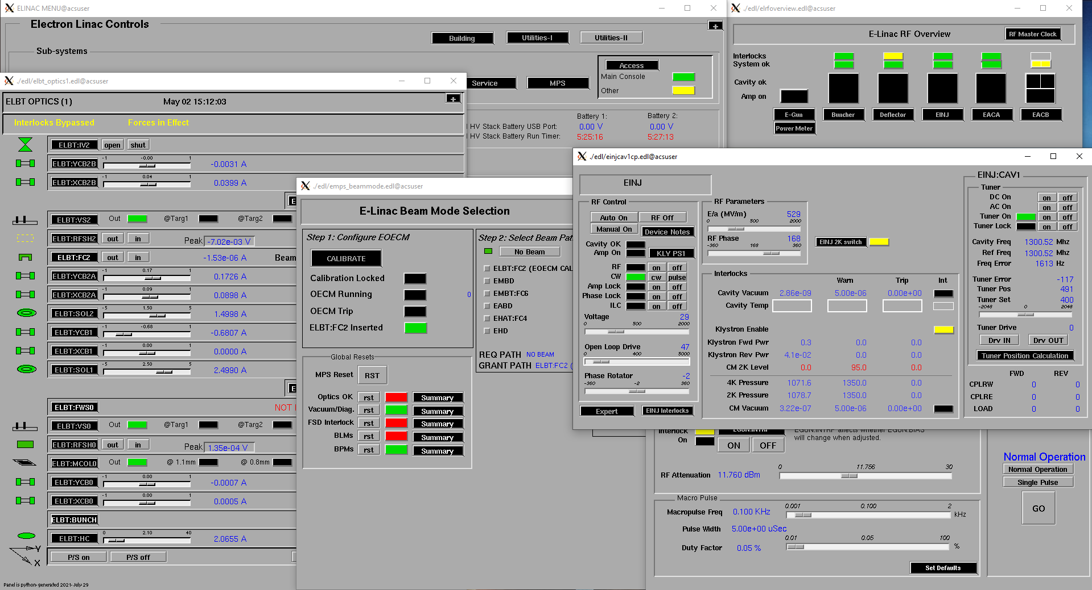
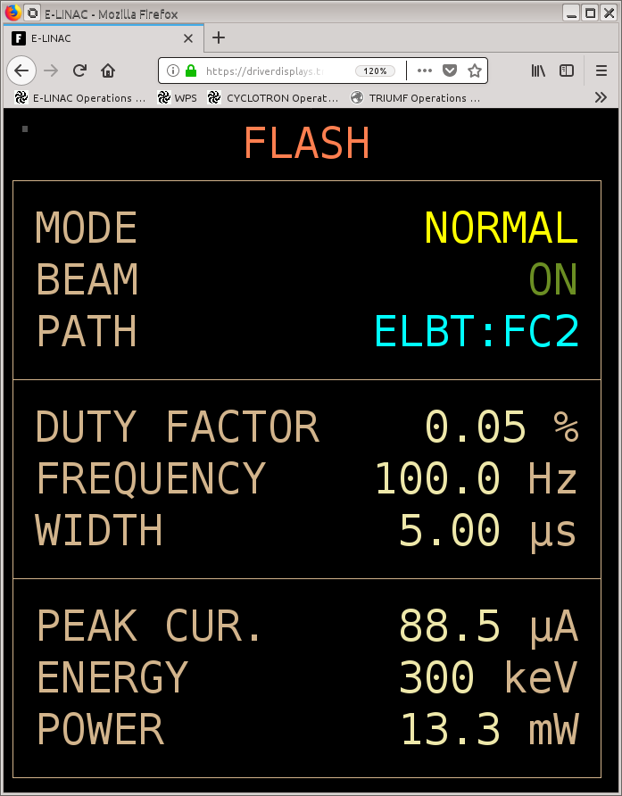
Automation of procedures – user interface (part 4)
HLA available to create custom browser interfaces
Helps increase visibility since EPICS signals are small and difficult to read
EPICS - EDMs
HLA browser window

Slide 12
Thank you Merci
www.triumf.ca
Follow us @TRIUMFLab

