Slide 1
Nuclear Theory at TRIUMF
Jason D. Holt
Scientist, Theory Department
Science Week
July 20, 2022

Slide 2
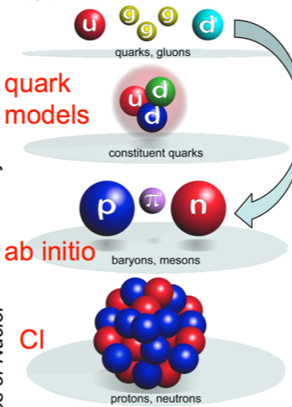

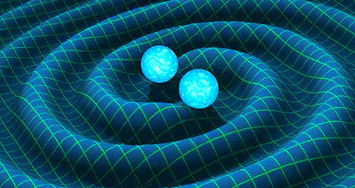
TRIUMF Nuclear Theory
Quantum Chromodynamics
(QCD)
First principles or ab initio nuclear theory
  Input NN+3N interactions from chiral EFT
  Solving many-nucleon Schrodinger equation
    Quantum many-body problem
  Ultimately connecting to nuclear astrophysics
Unique to TRIUMF nuclear theory:
  Unified approach to nuclear structure and reactions for light nuclei: No-Core Shell Model with Continuum (NCSMC)
  Powerful valence-space method for medium mass nuclei: Valence-Space In-Medium Similarity Renormalization Group (VS-IMSRG)
Large-scale high-performance computation
  Massively parallel codes
  Summit@ORNL, Quartz@Livermore Computing, Cedar@Compute Canada
Chiral Effective
Field Theory
(parameters fitted
to NN data)
Current ab anitio
nuclear theory
Nuclear astrophysics
Origin of elements

Slide 3
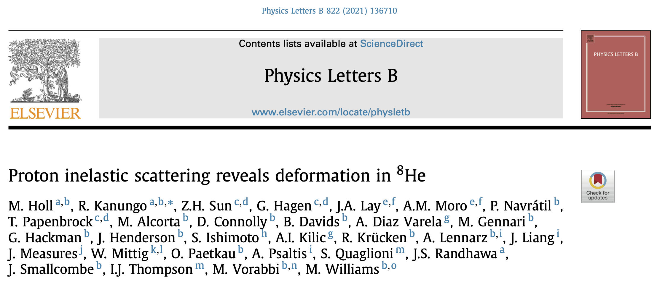
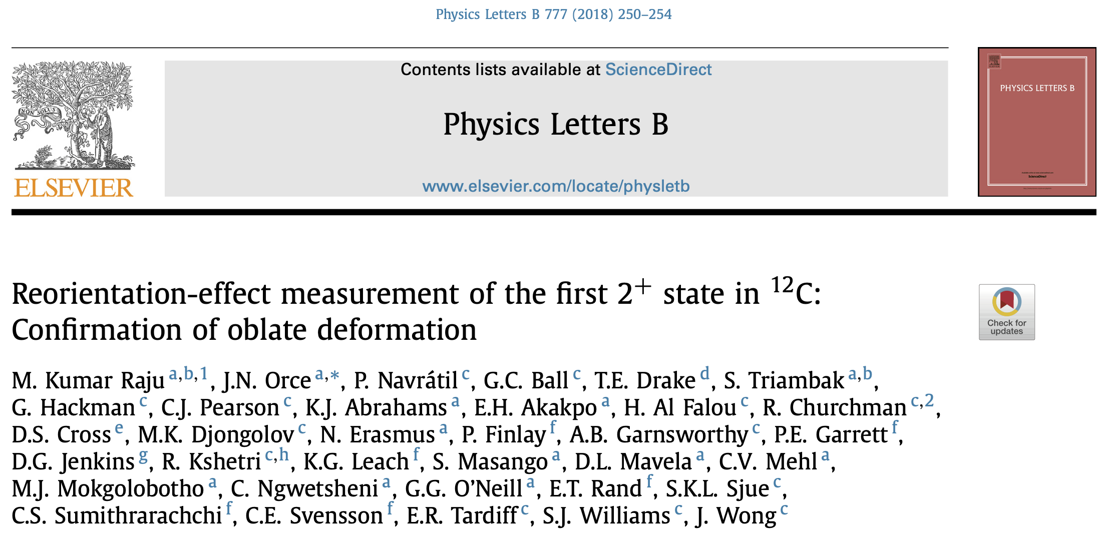
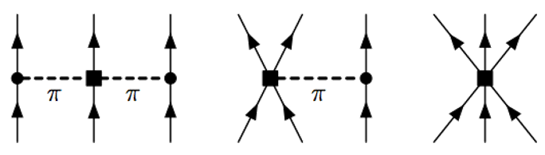
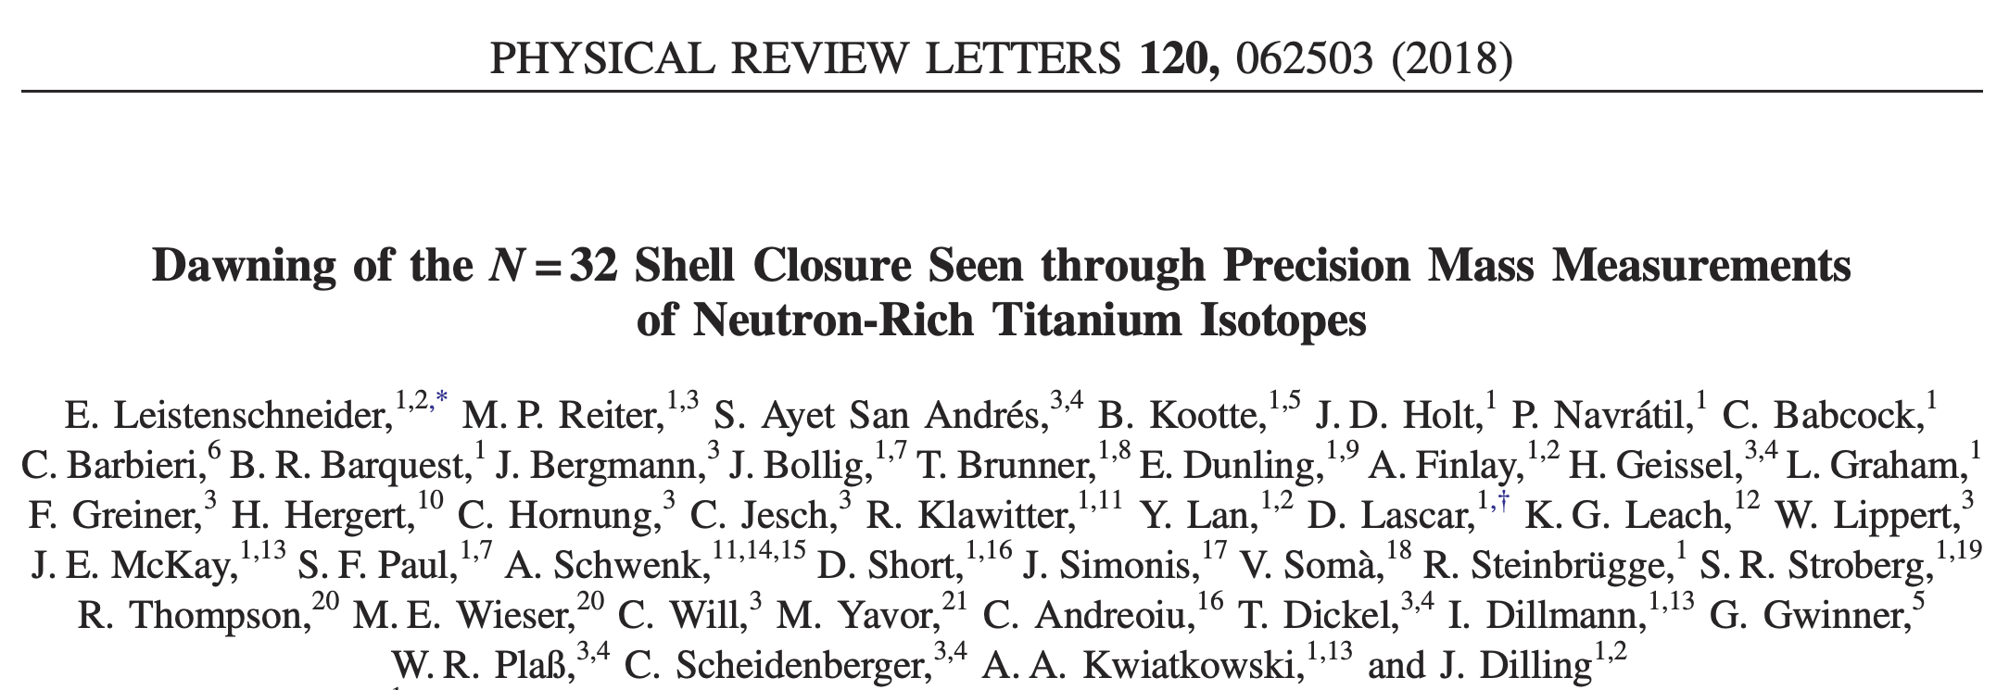
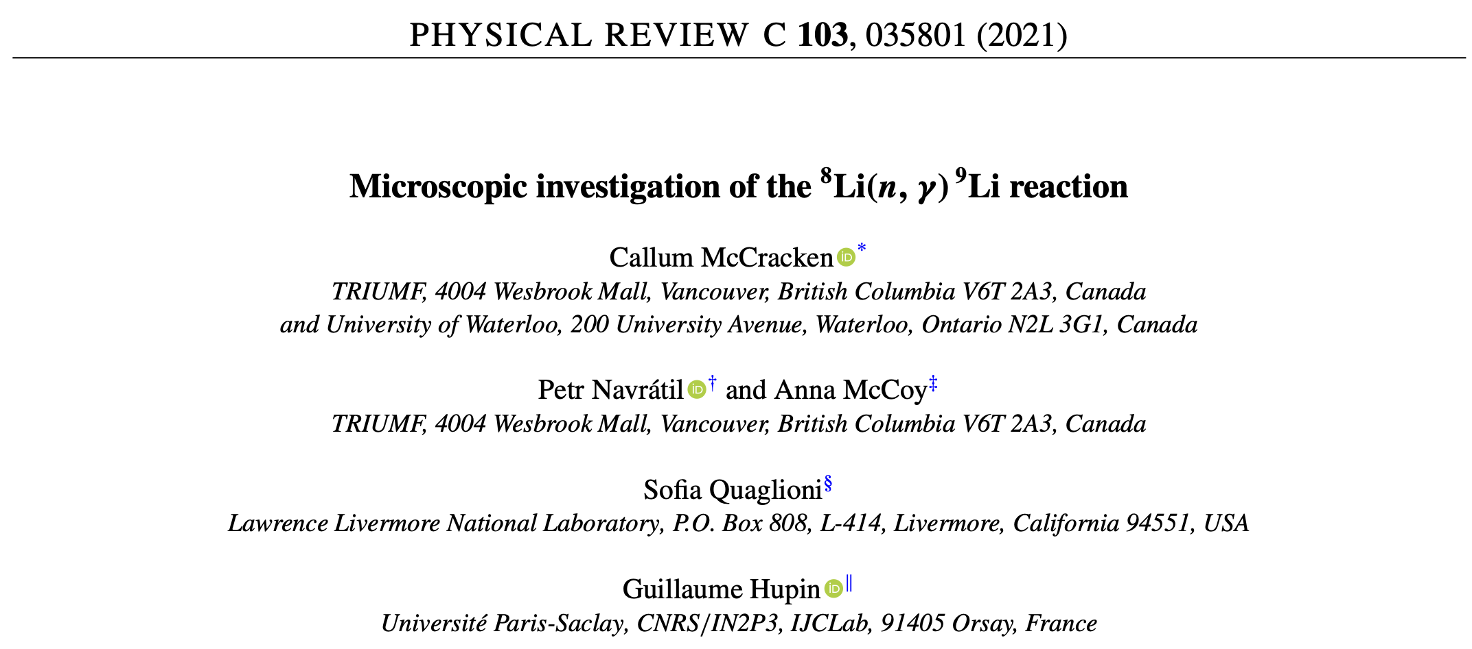
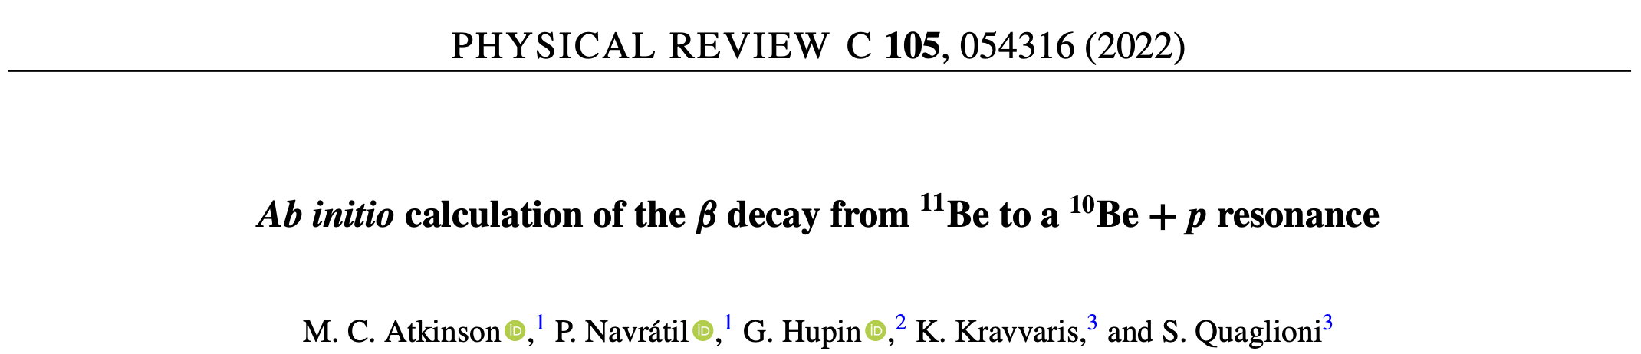
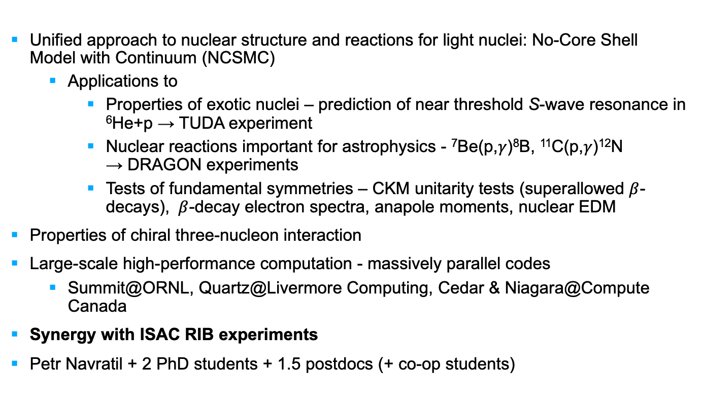
Ab initio nuclear theory at TRIUMF Theory Department
Unified approach to nuclear structure and reactions for light nuclei: No-Core Shell Model with Continuum (NCSMC)
  Applications to
    Properties of exotic nuclei – prediction of near threshold S-wave resonance in ⁶He+p → TUDA experiment
    Nuclear reactions important for astrophysics - ⁷Be(p,$γ$)⁸B, ¹¹C(p,$γ$)¹²N → DRAGON experiments
    Tests of fundamental symmetries – CKM unitarity tests (superallowed $β$-decays), $β$-decay electron spectra, anapole moments, nuclear EDM
Properties of chiral three-nucleon interaction
Large-scale high-performance computation - massively parallel codes
  Summit@ORNL, Quartz@Livermore Computing, Cedar & Niagara@Compute Canada
Synergy with ISAC RIB experiments
Petr Navratil + 2 PhD students + 1.5 postdocs (+ co-op students)
+
To be measured at TRISR?

Slide 4
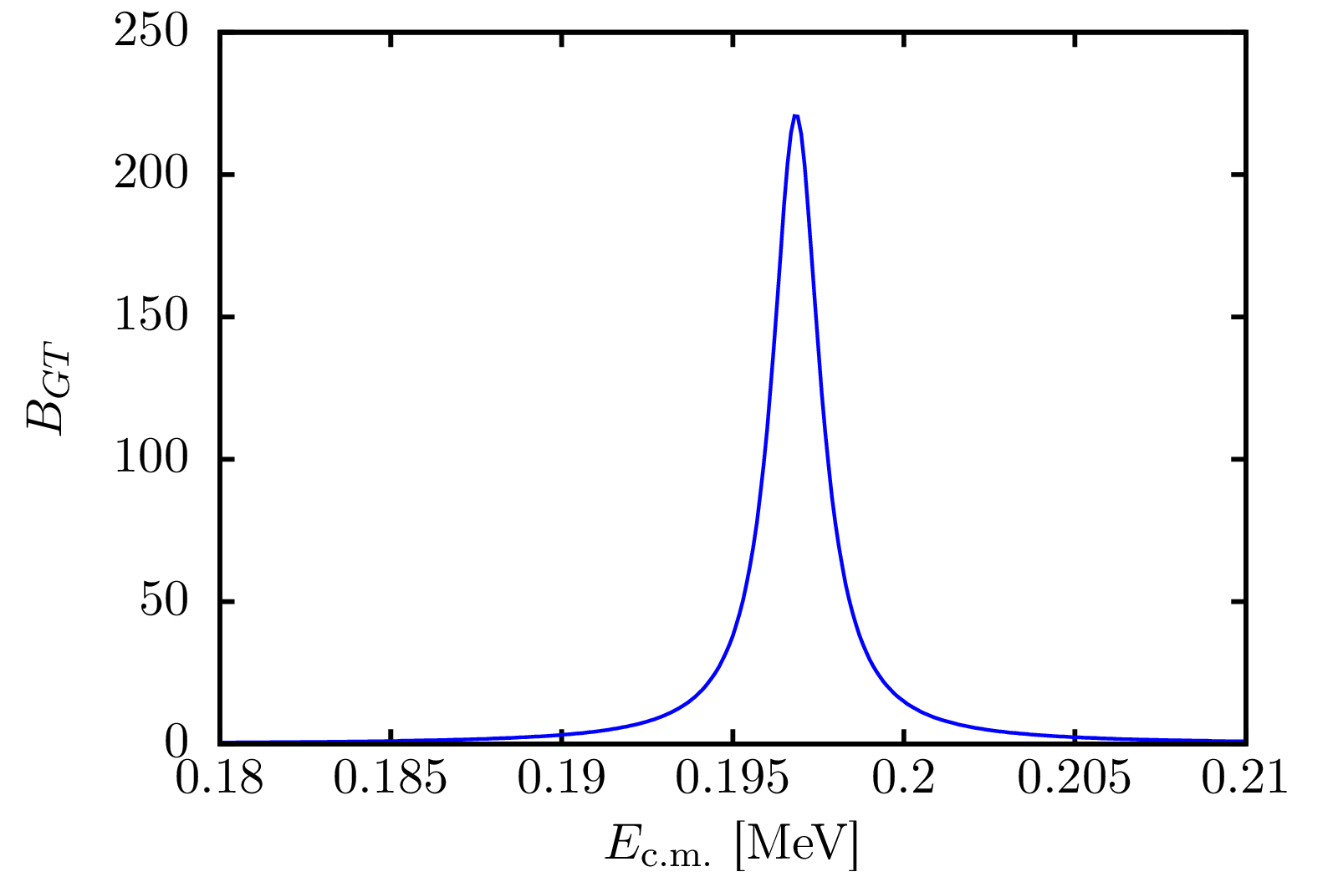
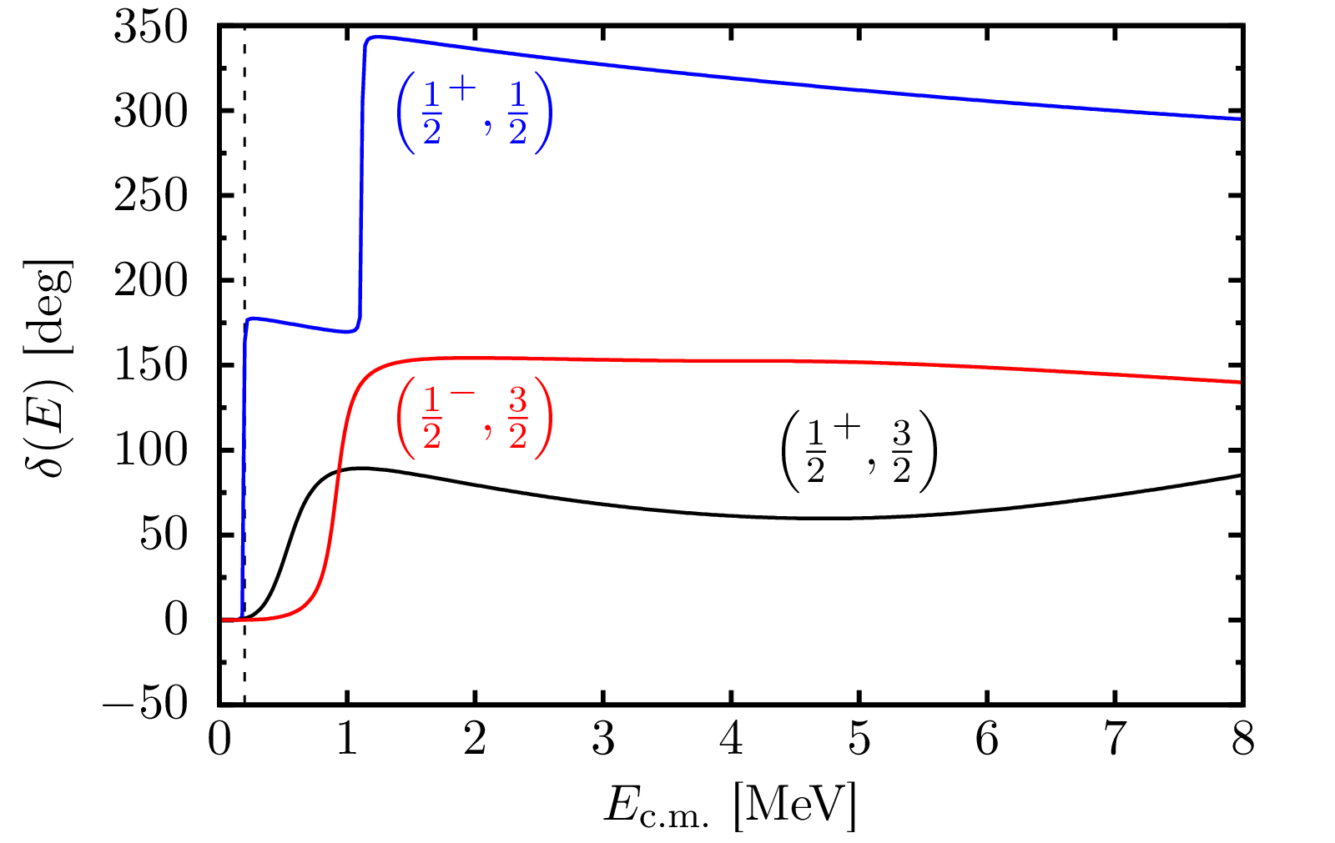

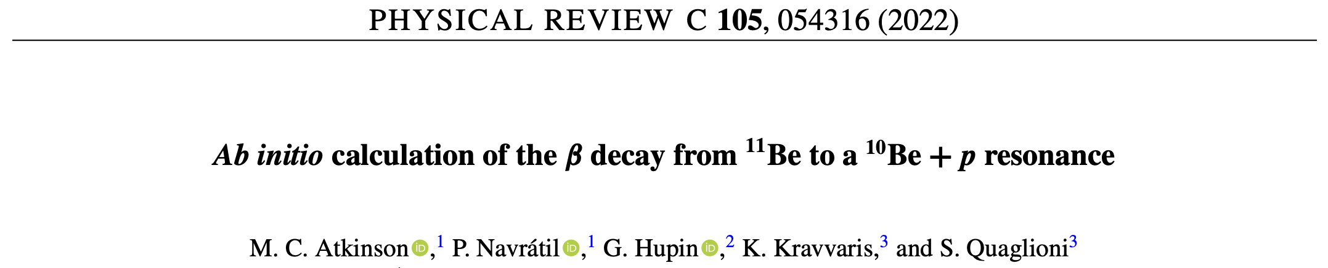


NCSMC extended to describe exotic ¹¹Be $β$p emission, supports large branching ratio due to narrow ½⁺ resonance (TRIUMF experiment by Ayyad et al., Phys. Rev. Lett. 123, 082501 (2019))
¹¹Be $→$ (¹⁰Be+p) + $β^{−}$+${ \overline{ν}}_{e}$ GT transition
p+¹⁰Be Scattering Phase Shifts
b_{p} = (1.3 ± 0.5) × 10⁻⁶
Resonance now independently confirmed!

Slide 5
TRIUMF Nuclear Theory
Quantum Chromodynamics
(QCD)
First principles or ab initio nuclear theory
  Input NN+3N interactions from chiral EFT
  Solving many-nucleon Schrodinger equation
    Quantum many-body problem
  Ultimately connecting to nuclear astrophysics
Unique to TRIUMF nuclear theory:
  Unified approach to nuclear structure and reactions for light nuclei: No-Core Shell Model with Continuum (NCSMC)
  Powerful valence-space method for medium/heavy mass nuclei: Valence-Space In-Medium Similarity Renormalization Group (VS-IMSRG)
Large-scale high-performance computation
  Massively parallel codes
  Summit@ORNL, Quartz@Livermore Computing, Cedar@Compute Canada
Chiral Effective
Field Theory
(parameters fitted
to NN data)
Current ab anitio
nuclear theory
Nuclear astrophysics
Origin of elements

Slide 6
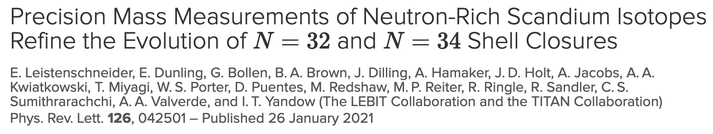
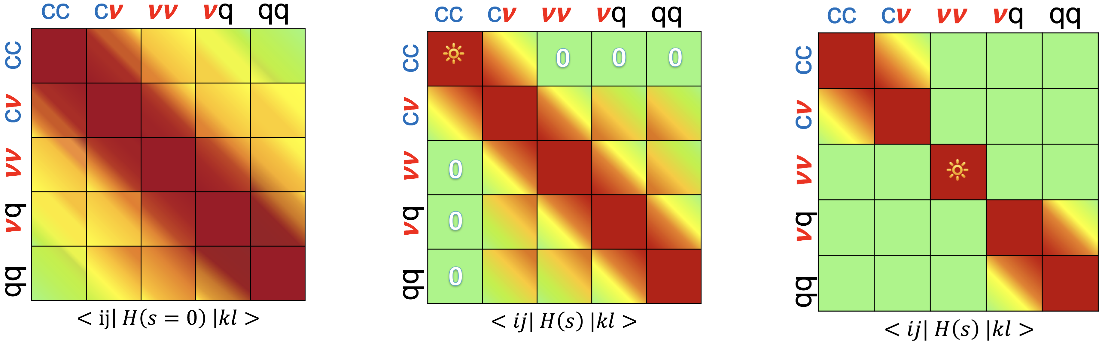

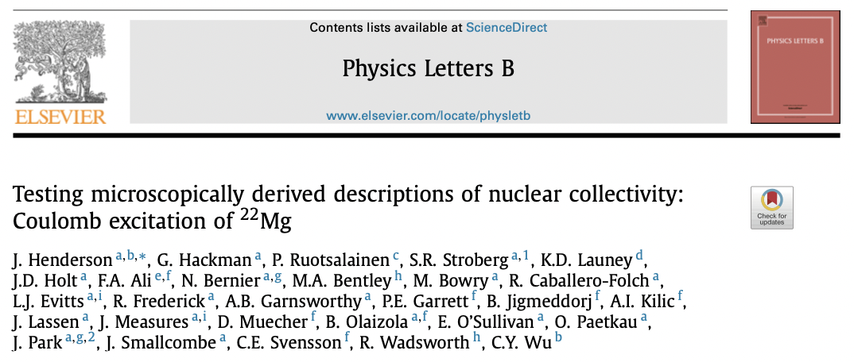
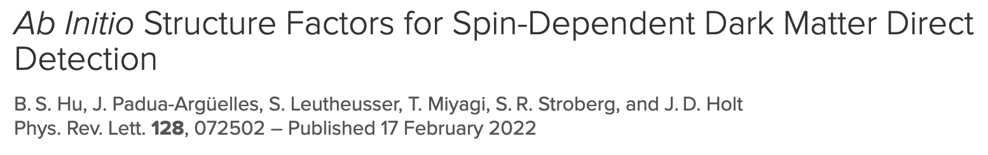
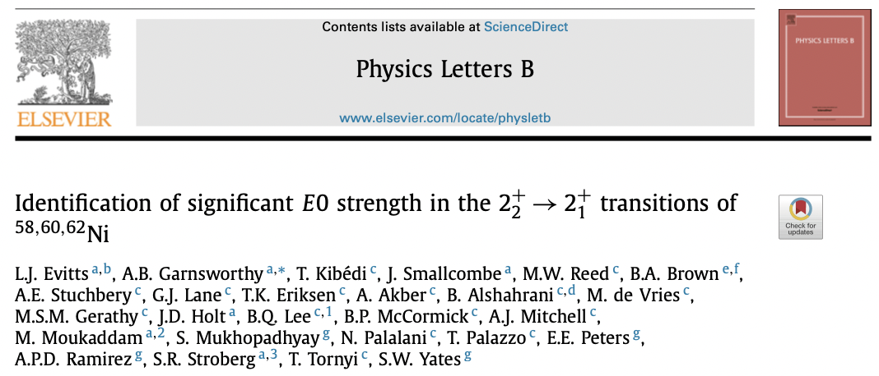
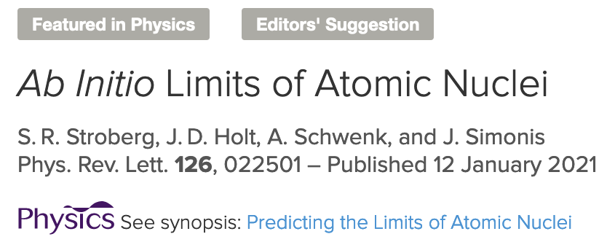
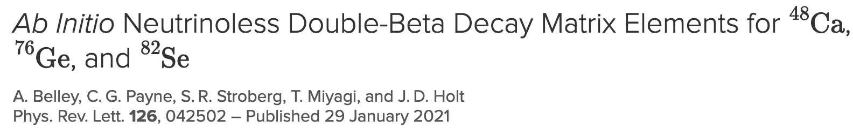
Ab initio nuclear theory at TRIUMF Theory Department
Novel approach to calculate essentially all open-shell medium/heavy mass nuclei: Valence-Space in-medium similarity renormalization group (VS-IMSRG)
  Applications to
    Exotic nuclei: nuclear driplines, continuum, shell structure, r-process
    BSM Physics: 0νββ decay, dark matter detection, neutrino scattering
    Fundamental symmetries: CKM unitarity, anapole moments, EDM
Properties to constrain nuclear EOS: neutron skin and dipole polarizability in ²⁰⁸Pb
Extension to atomic systems in progress, e.g., for laser spectroscopy
Large-scale high-performance computation: Cedar@Compute Canada
Synergy with ISAC and worldwide RIB experiments + Art McDonald Institute/SNOLAB
Jason D. Holt + 2 PhD students + 2 MSc student + 2 postdocs (+ many co-op students)

Slide 7
Ab initio nuclear theory at TRIUMF Theory Department
Novel approach to calculate essentially all open-shell medium/heavy mass nuclei: Valence-Space in-medium similarity renormalization group (VS-IMSRG)
  Applications to
    Exotic nuclei: nuclear driplines, continuum, shell structure, r-process
    BSM Physics: 0νββ decay, dark matter detection, neutrino scattering
    Fundamental symmetries: CKM unitarity, anapole moments, EDM
Properties to constrain nuclear EOS: neutron skin and dipole polarizability in ²⁰⁸Pb
Extension to atomic systems in progress, e.g., for laser spectroscopy
Large-scale high-performance computation: Cedar@Compute Canada
Synergy with ISAC and worldwide RIB experiments + Art McDonald Institute/SNOLAB
Jason D. Holt + 2 PhD students + 2 MSc student + 2 postdocs (+ many co-op students)

Slide 8
Dripline Predictions to Fe Isotopes
First predictions of proton and neutron driplines from first principles
From few body data only:
Known drip lines largely predicted within uncertainties (artifacts at shell closures)
Provide ab initio predictions for neutron-rich region

Slide 9
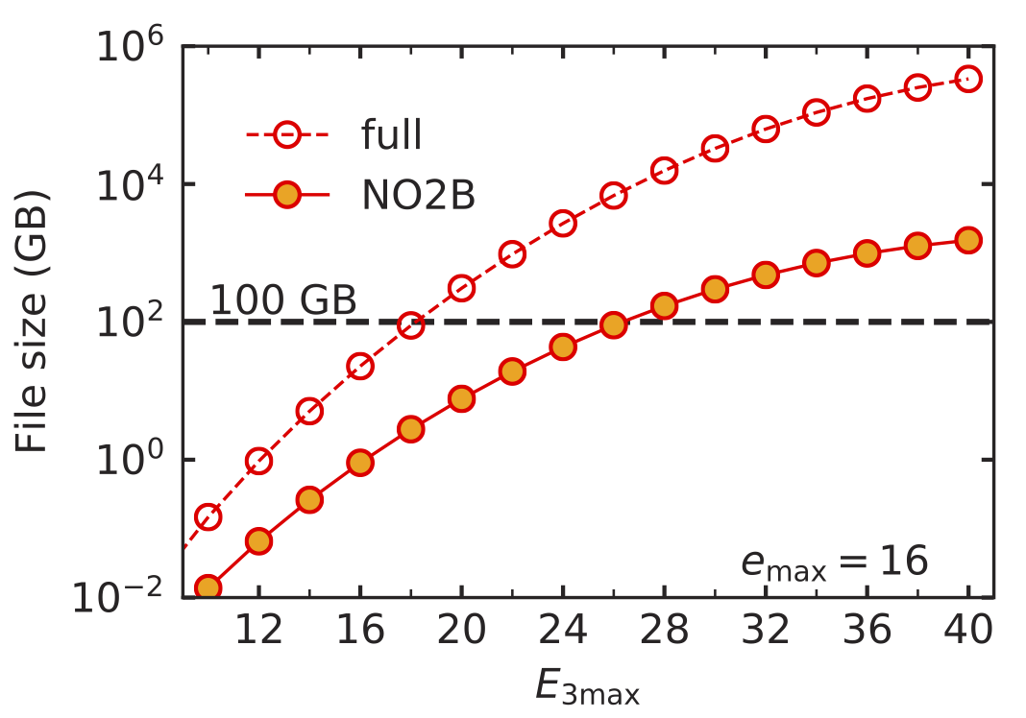
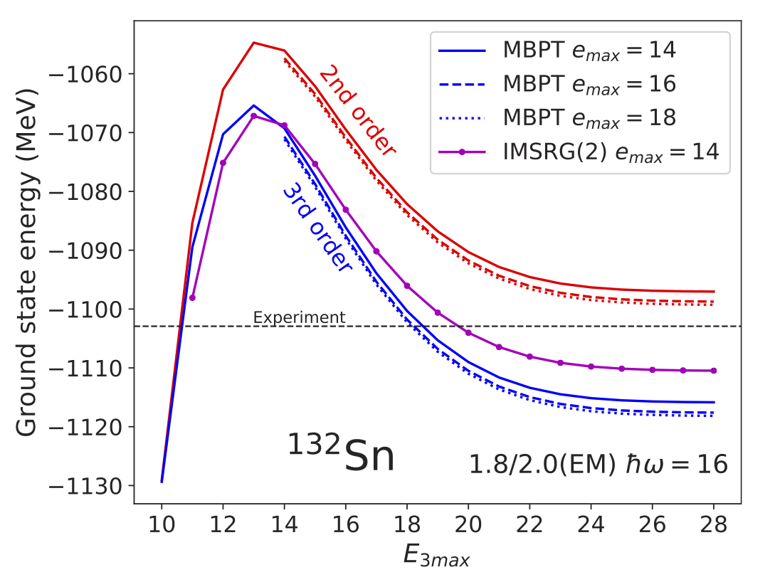
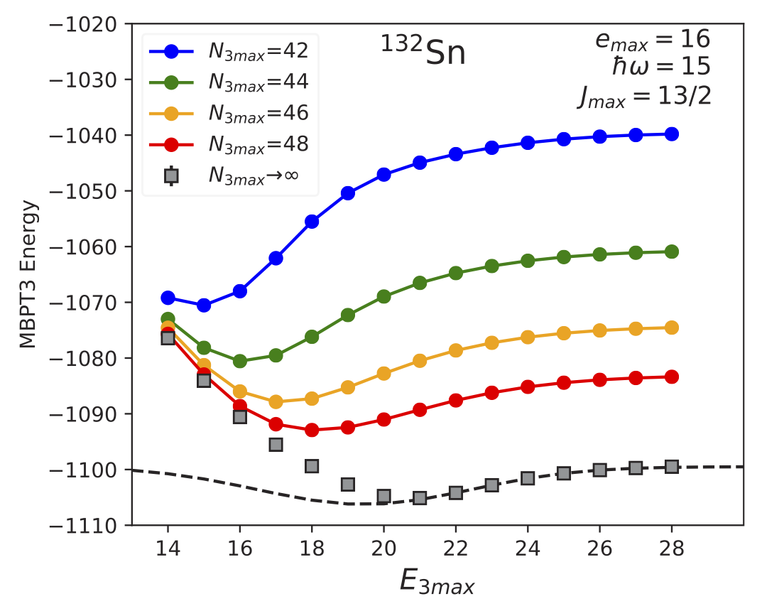
Ab initio calculations for heavy nuclei
Challenge: Convergence with respect to the number of three-nucleon (3N) force matrix elements
Breakthrough in storage achieved
Opens possibilities for calculations of ¹³²Sn, ²⁰⁸Pb, … superheavy isotopes?!?
Ground-state energy of ¹³²Sn with chiral NN+3N 1.8/2.0 (EM) & NN N³LO+3N_{lnl}

Slide 10
Neutron Skin of ²⁰⁸Pb
TRIUMF/ORNL/Chalmers collaboration
Machine learning: calibrate on light nuclei (green)
10⁸ calculations spanning EFT parameter space
34 non-implausible NN+3N interactions (with uncertainties)
Validate for ⁴⁸Ca (blue) + ²⁰⁸Pb predictions (pink)
E/A, 2⁺, radii, dipole polarizability
Final prediction for neutron skin with systematic uncertainty
R_{skin}(²⁰⁸Pb)= 0.15-0.19 fm
Mild tension with new PREX measurement
PREX II
B. Hu, W. Jiang, T. Miyagi, Z. Sun et al., Nature Phys. (in press)

Slide 11
Large-Scale Efforts for Ab Initio GT Transitions
Calculate large GT matrix elements
Light, medium, and heavy regions
Benchmark different ab initio methods
Wide range of NN+3N forces
Consistent inclusion of 2BC
Coupled Cluster
VS-IMSRG
No-Core Shell Model

Slide 12

Solution to g_{A}-Quenching Problem
Comparison to standard phenomenological shell model
Ab initio calculations across the chart explain data with unquenched g_{A}
Refine results with improvements in forces and many-body methods
Gysbers et al., Nature Phys. (2019)

Slide 13
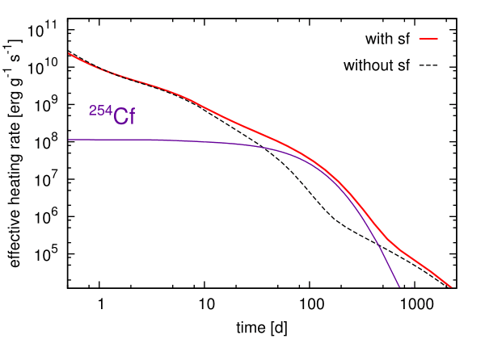
Nuclear Astrophysics Theory
Studies of possible fission signatures: universality of r-process abundances? ²⁵⁴Cf and actinide heating in neutron star merger kilonova light curves?
Research program focuses on the origin of heavy elements with an emphasis on the impact of unknown nuclear physics on observables
Statistical methods to predict masses of neutron-rich rare-earths using Solar abundances
Vassh+20
Zhu+18
Sm (Z=62)
LIGO merger rate + nuclear physics uncertainties: are NSNS mergers the source of Solar system heavy elements? Can LIGO disfavor some nuclear models?
Vassh+21
r-process path (most abundant)
PRELIMINARY
See Côté+18

Slide 15
Nuclear Astrophysics Theory
Research program focuses on the origin of heavy elements with an
emphasis on the impact of unknown nuclear physics on observables
Statistical methods + rare-earth nuclei work ongoing (in prep work exploring impact of Solar data uncertainties; theory support for two accepted proposals at ANL to measure more n-rich rare-earth masses (ex ¹⁶⁴Nd))
Work on the impacts and signatures of fission in nucleosynthesis ongoing (in prep sensitivity study for neutron-induced fission; theory support for accepted Hubble Space Telescope proposal to measure abundances of possible fission products in metal-poor stars)
Work to use LIGO data to pin down heavy element origins and search for disfavored nuclear models ongoing (in prep work extending NSNS merger study to elements other than Eu, in prep work incorporating NSBH mergers)
Future directions and synergies with the TRIUMF team
Interest in reducing nuclear data uncertainties near N=82 to pin down predicted shape of 2nd r-process peak (connection to TITAN capabilities)
Interest in expanding program to other processes such as supernova nucleosynthesis and i-process (connections with DRAGON and future TRISR neutron storage ring)
Interest in the strength of the N=126 shell closure to refine predictions for 3rd peak element (ex gold) production in NSMs (connection with ab initio nuclear theory (newly started N=126 project w/ J. Holt))
Interest in dark matter and neutrino physics in explosive events such as NSMs and SN (connection with particle theorists (newly started dark neutron project w/ D. McKeen))

Slide 16
New initiatives: Establishment of Theory Centres
Ab Initio Nuclear Theory Centre Strengthen TRIUMF nuclear ab initio program
  Require additional nuclear theorist with associated postdoc position
    Quantum many-body theory (in the future quantum computing?)
    Intersection of nuclear and quantum chemistry ab initio theory
    Increasing reach to heavy nuclei – connection to r-process modeling, Radioactive Molecules
  Increase synergy with ARIEL program and the newly proposed AMO/Precision/Quantum centre
  Build on existing strength → bigger impact
TRIUMF Workshop/Visitor/Education Centre
  Model based on very successful centres such as the Institute for Nuclear Theory (INT)
  Host multiple in-house workshop and collaboration programs year-round – cover all lab topics!
  Program proposals would be submitted externally and reviewed by an evaluation committee
  True workshop format: office space for participants, 2-week timeline, limited presentations.
  Allow extended student and scientist visits from member universities/expand outreach

Slide 17
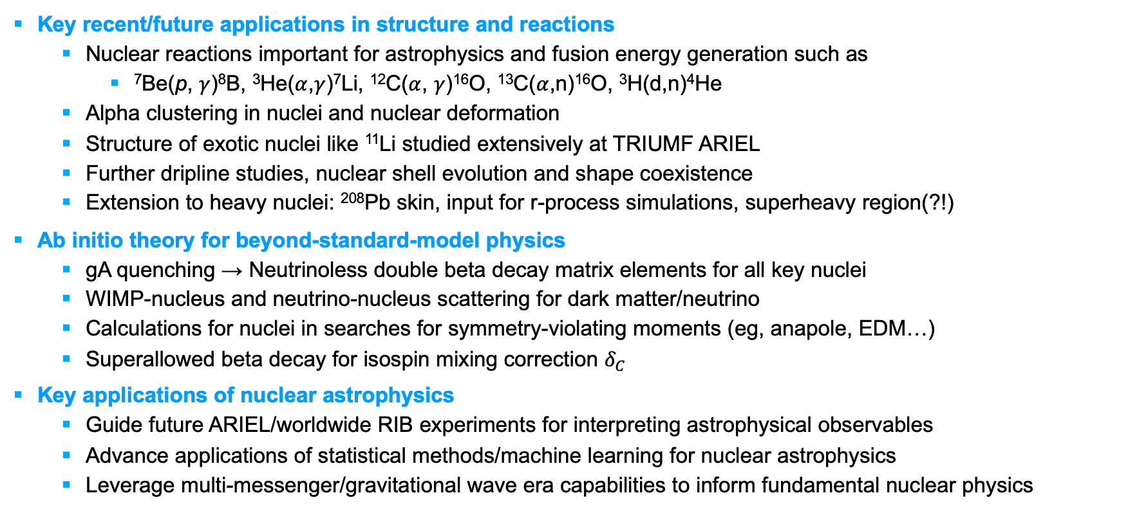
Future of Theory @ TRIUMF: Unified first-principles approach to all nuclei
Key recent/future applications in structure and reactions
  Nuclear reactions important for astrophysics and fusion energy generation such as
    ⁷Be(p, $γ$)⁸B, ³He($α$,$γ$)⁷Li, ¹²C($α$, $γ$)¹⁶O, ¹³C($α$,n)¹⁶O, ³H(d,n)⁴He
  Alpha clustering in nuclei and nuclear deformation
  Structure of exotic nuclei like ¹¹Li studied extensively at TRIUMF ARIEL
  Further dripline studies, nuclear shell evolution and shape coexistence
  Extension to heavy nuclei: ²⁰⁸Pb skin, input for r-process simulations, superheavy region(?!)
Ab initio theory for beyond-standard-model physics
  gA quenching → Neutrinoless double beta decay matrix elements for all key nuclei
  WIMP-nucleus and neutrino-nucleus scattering for dark matter/neutrino
  Calculations for nuclei in searches for symmetry-violating moments (eg, anapole, EDM…)
  Superallowed beta decay for isospin mixing correction $δ_{C}$
Key applications of nuclear astrophysics
  Guide future ARIEL/worldwide RIB experiments for interpreting astrophysical observables
  Advance applications of statistical methods/machine learning for nuclear astrophysics
  Leverage multi-messenger/gravitational wave era capabilities to inform fundamental nuclear physics
In synergy with experiments, ab initio nuclear theory is the leading approach to understand low-energy properties of atomic nuclei

