Slide 1
The BeEST Implantation Chamber
Ryan Abells

Slide 2
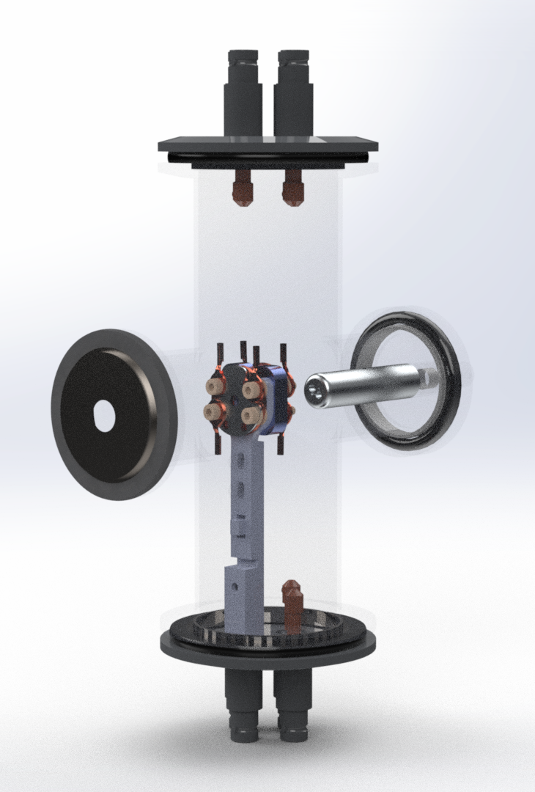
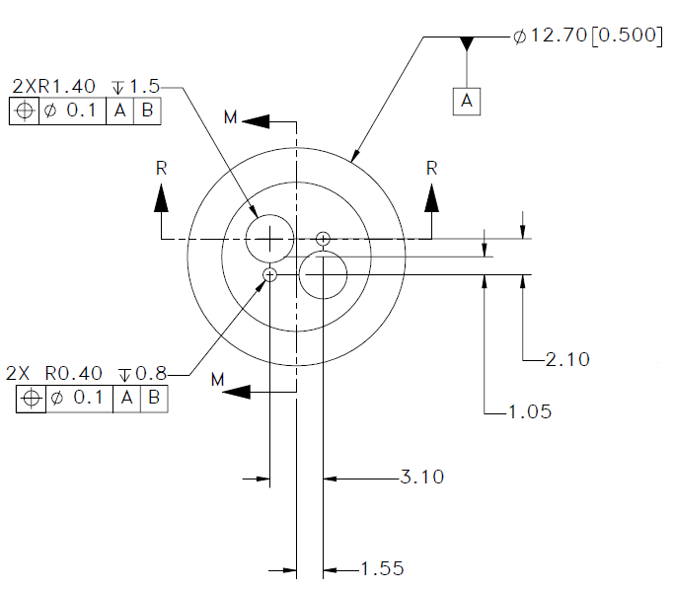
The Beryllium Electron capture in Superconducting Tunnel junctions Experiment
Detection of sterile neutrinos
Method of aligning beam
Minimum use of plastic
Maximum flexibility
Next steps
Automation
Multiple targets

