Slide 1
The S matrix of elastic $α$-${}_{}^{12}C$ scattering at low energies in effective field theory
Shung-Ichi Ando
Sunmoon University
arXiv:2208.02404

Slide 2
Outline of talk
Introduction
Formalism:
S matrix, effective Lagrangian, and scattering amplitudes
Numerical results:
Phase shifts of elastic alpha-carbon-12 scattering
for l=0,1,2,3,4,5,6
Results and discussion

Slide 3
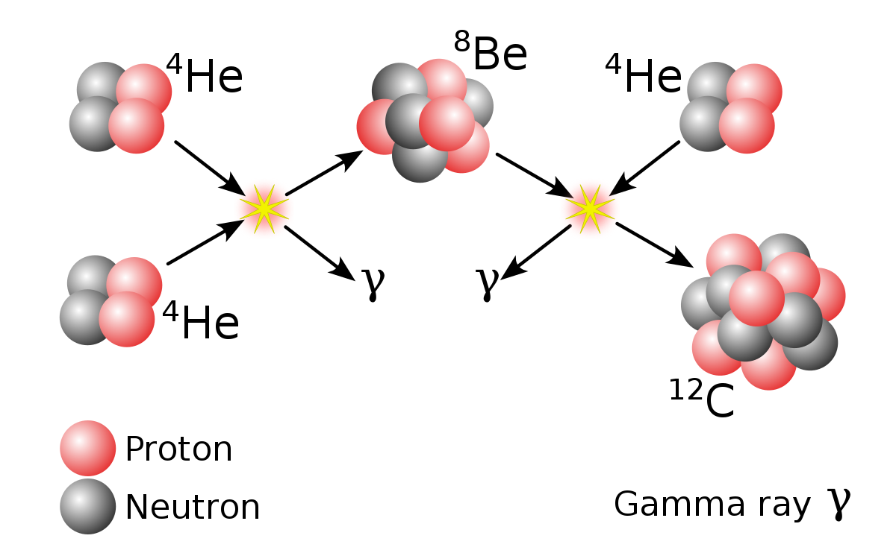
Introduction 1
Helium burning process in red giant stars (at $E_{G}=0.3$ MeV)
Main nuclear reaction is triple alpha process

Slide 4
When stars undergo the helium burning ($E_{G}=0.3$ MeV), the reaction
$α+ {}_{}^{12}C→ {}_{}^{16}O+ γ$
is also possible. This converts pre-existing or freshly
synthesized carbon-12 to oxygen-16.
The C/O ration that results in the core of a helium-burning star greatly influences its future evolution. It determines the luminosity of runaway thermonuclear burning in the white dwarfs involved in type Ia supernovae, which are used as standard candles by cosmologists.
This reaction has one of the most important uncertainties in stellar astrophysics.

Slide 5
Introduction 2
Elastic alpha-cabon-12 scattering at low energies
1) Important input to estimate the S factors of radiative alpha capture on carbon-12 for helium-burning process to extrapolate the radiative capture rate to the Gamow peak energy, $E_{G}=0.3$MeV.
2) Many subthreshold and resonant states of oxygen-16 appear below proton-nitrogen-15 open channel
Precise phase shift data of the elastic alpha-carbon-12 scattering at 2.6 < Ea < 6.62 MeV for l = 0,1,2,3,4,5,6 are reported by Teschhauser et al. (2009).

Slide 8
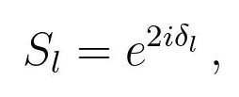
Formalism
S matrix

Slide 9
EFT
Choose a large scale
Choose relevant degrees of freedom at low energy
Write down the effective Lagrangian up to a given order (Derivative expansion in the Lagrangian)
Calculate the amplitude from the effective Lagrangian
Fix the coefficients from the experimental data
Extrapolate the reaction rate to low energy

Slide 10
EFT for alpha-carbon-12 system at low energies
A large scale: proton-nitrogen-15 breakup energy
Relevant degrees of freedom: alpha and carbon-12 as elementally-like fields
Introducing alpha-cabon-12 composite fields for the sub-threshold and resonant states of oxygen-16: effective range expansion
Coulomb interaction is included non-perturbatively
Modification of the counting rules for the momentum expansion: p^6 order for l=0,1,2,4,5,6 and p^8 order for l=3
The parameters are fitted to the phase shift data

Slide 11
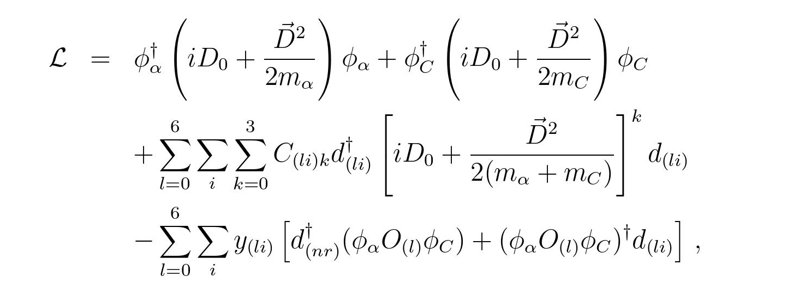
Effective Lagrangian

Slide 12
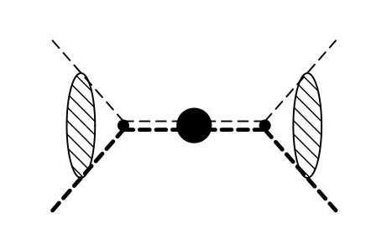
Amplitudes

Slide 13
Amplitude for bound states

Slide 14
Amplitudes for resonant states

Slide 15
S factor

Slide 16
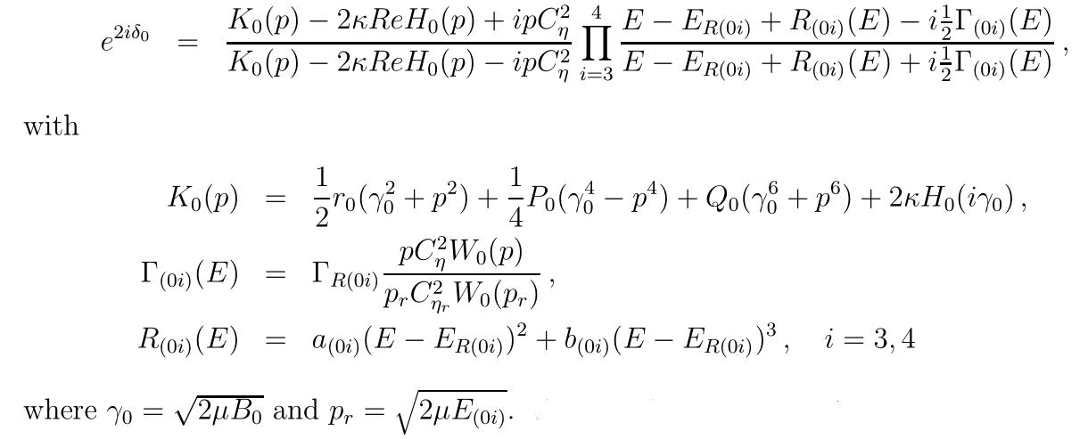
Numerical results (preliminary)
l=0 ($0_{2}^{+}; 0_{3}^{+}; 0_{4}^{+}$)

Slide 17
Fitted parameters
$E_{R\left(04\right)}=6.870\left(15\right) MeV, Γ_{R\left(04\right)}=185\left(35\right) keV$
${χ^{2}}/N=0.013, N=252$

Slide 19
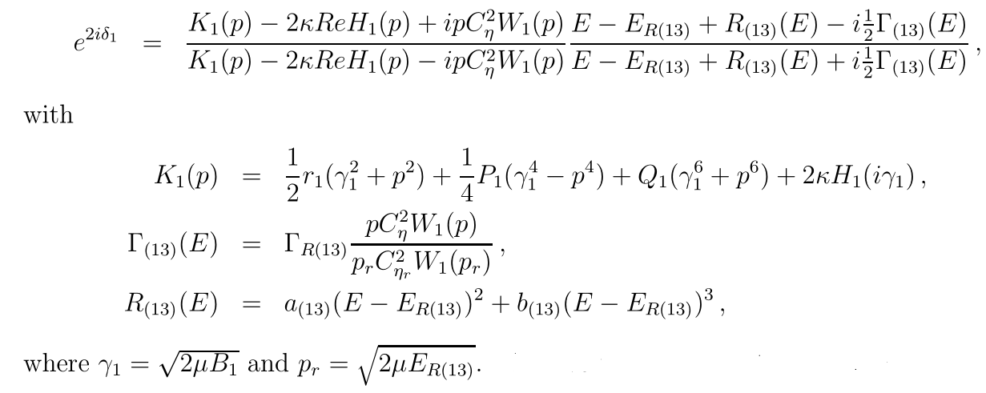
l=1 ($1_{1}^{−}; 1_{2}^{−}; 1_{3}^{−}$)

Slide 20
Fitted parameters
$E_{R\left(13\right)}=5.278(2) MeV, Γ_{R\left(13\right)}=91\left(6\right) keV$
${χ^{2}}/N=0.089, N=252$

Slide 22
l=2 ($2_{1}^{+}; 2_{2}^{+}, 2_{3}^{+}; 2_{4}^{+}$)

Slide 23
Modification of the counting rules
Phase shift data $δ_{2}=−0.0116$ deg at Ea = 2.6 MeV

Slide 24
Fitted parameters
$E_{R\left(24\right)}=5.858(10) MeV, Γ_{R\left(24\right)}=150(10) keV$
${χ^{2}}/N=0.66, N=252$

Slide 26
l=3 ($3_{1}^{−}; 3_{2}^{−}; 3_{3}^{−}$)

Slide 27
Fitted parameters
$E_{R\left(33\right)}=5.967\left(10\right)MeV, Γ_{R\left(33\right)}=110\left(30\right)keV$
${χ^{2}}/N=0.87, N=252$

Slide 29
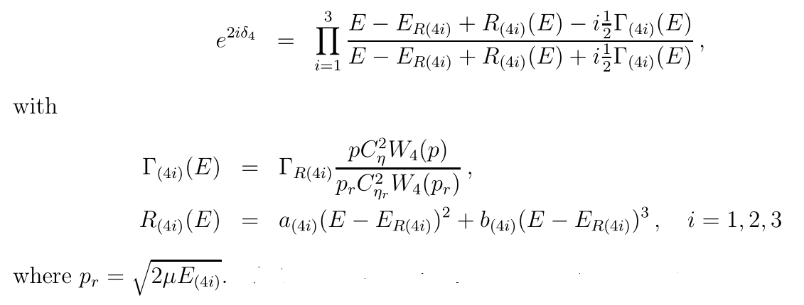
l=4 ( ;${ 4}_{1}^{+}, 4_{2}^{+}; 4_{3}^{+}$)

Slide 30
Fitted parameters
$E_{R\left(43\right)}=6.707\left(20\right)MeV, Γ_{R\left(43\right)}=89\left(2\right)keV$
${χ^{2}}/N=0.47, N=252$

Slide 32
L=5 ( $; ; 5_{1}^{−}$)

Slide 33
Fitted parameters
$E_{R\left(51\right)}=7.498\left(2\right)MeV, Γ_{R\left(51\right)}=670\left(15\right)keV$
${χ^{2}}/N=0.094, N=243$

Slide 35
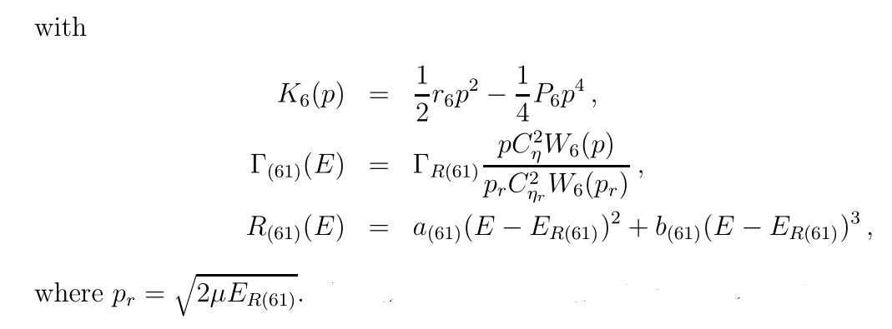
L=6( (bg)$; ; 6_{1}^{+}$)

Slide 36
Fitted parameters
$E_{R\left(61\right)}=7.653\left(160\right)MeV(?), Γ_{R\left(51\right)}=70\left(8\right)keV$
${χ^{2}}/N=0.026, N=186$

Slide 38
Results and discussion
The simple and transparent expression of the S matrix to describe some sub-threshold and resonant states is discussed.
The formalism of the S matrix is applied to the study of elastic alpha-carbon-12 scattering at low energies. We find that the precise phase shift data are descried very well by using the method.
It is interesting to apply the present method to the study of other nuclear/hadronic reactions.
Future plans
1) E2 transition of radiative alpha capture on carbon-12
2) Cabon-12-cabon-12 fusion (?)
3) Nuclear reactions in CNO cycle (next page)

Slide 39
CNO cycle

