Slide 1
Higgs Boson Production via Bottom Quark mediated Gluon Fusion
Sneh Modi
Supervisor: Prof. Alexander A. Penin
February 17th, 2023

Slide 2
Motivation and Background
Sudakov radiative corrections for the electron scattering amplitudes at high energies in QED ($∝α_{e}^{n} \ln^{2n}⁡(m_{e}^{2}/q^{2})$) [1]
Extension to other processes, sub-leading logs, non-Abelian amplitudes as well as power suppressed amplitudes at high energies (different origin from Sudakov logs) [2]
The leading deviation in the QFT amplitudes from the classical results in the asymptotic region [2]
Necessary for accurate theoretical prediction for all major processes at LHC, Drell-Yan scattering, Deep Inelastic Scattering etc.
Generalization to higher orders in small mass expansion is a challenging problem

Slide 3
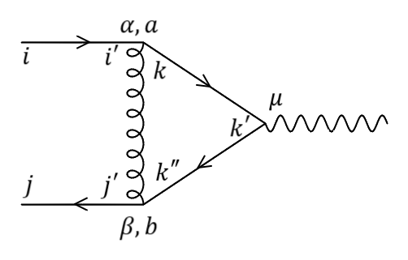
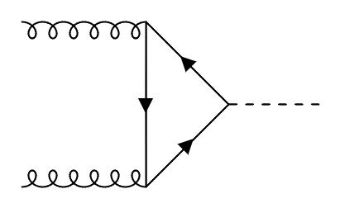
Motivation and Background
Example 1: Quark Scattering by color singlet gauge field
Double log contribution to Dirac FF at all orders of $α_{s}$ in leading order of small mass approximation $(∝m_{q}^{2})$
Pauli FF for sub-leading order in mass $\left(∝m_{q}^{4}\right)$ was not considered
Important for $t \overline{t}$ pair production at future electron positron collider
Example 2: Higgs production via quark mediated gluon fusion
top quark dominates ($∝m_{H}^{2}$) while bottom quark amplitude suppressed by ($∝m_{b}^{2}/m_{H}^{2}$)
With logarithmic enhancement $\left(\ln^{2}\left(m_{b}^{2}/m_{H}^{2}\right)α_{s}≈40α_{s}\right)$
$𝒪\left(m_{b}\right)$ amplitude already calculated, focus now on $𝒪\left(m_{b}^{3}\right)$

Slide 4
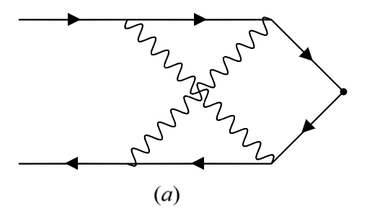
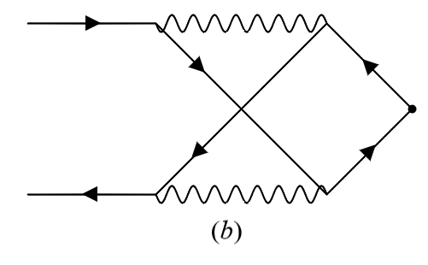
Origin of the double logs
Sudakov
Non-Sudakov
Gauge boson(s) exchange
Eikonal fermion and soft gauge boson propagators
Not mass-suppressed
Exponentiate
Fermion(s) exchange
Soft fermion and eikonal gauge boson propagators
Mass-suppressed
Requires systematic Evaluation

Slide 5
Higgs Production via Gluon Fusion
Higgs production via gluon fusion process must have loops [3]
$ℳ_{ggH}^{q}=T_{F}\frac{α_{s}}{π}\frac{y_{q}m_{q}}{m_{H}^{2}}\left(p_{1}^{ν}p_{2}^{μ}−g^{μν}p_{2}p_{1}\right)$ $A_{μ}^{m}\left(p_{1}\right) A_{ν}^{m}\left(p_{2}\right) H M_{ggH}^{q}$
Top loop dominates $\left(M_{ggH}^{q}=−\frac{2}{3ρ}=−\frac{2m_{H}^{2}}{3m_{t}^{2}}\right)$ but theoretical uncertainty comes from the bottom loop
Asymptotic series expansion of the FF: $M_{ggH}^{q}=Z_{g}^{2}\sum_{n=0}^{∞}{ρ^{n}M_{ggH}^{\left(n\right)}}$ with universal Sudakov factor for external gluons $Z_{g}^{2}=\exp\left(−\frac{C_{A}s^{−ε}}{ε^{2}}\frac{α_{s}}{2π}\right)$ and $ρ=m_{q}^{2}/m_{H}^{2}$

Slide 6
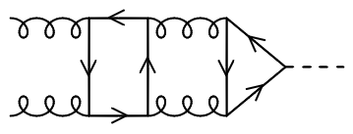
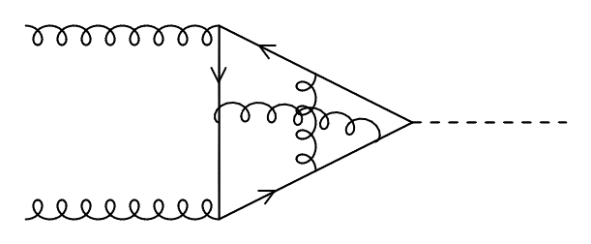
Higgs Production via Gluon Fusion
Leading coefficient $M_{ggH}^{\left(0\right)}$ (sub-leading in mass) was calculated [2], attention now on $M_{ggH}^{\left(1\right)}$
3 groups of diagrams contribute at this order
Single soft quark exchange
Triple soft quark exchange
Non-factorizing diagrams with single soft quark exchange
On-shell conditions and double log variable:
$p_{1}^{2}=p_{2}^{2}=0$, $q^{2}={\left(p_{1}+p_{2}\right)}^{2}=2p_{2}p_{1}=m_{H}^{2}$
$z=\left(C_{A}−C_{F}\right)x=\left(C_{A}−C_{F}\right)\frac{α_{s}}{4π}\ln^{2}{ρ}$

Slide 7
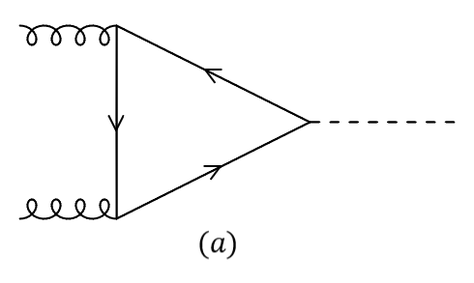
Higgs Production: Single Soft Quark Exchange
$ℳ_{ggH,1L}^{μν,mn}=−g_{s}^{2}y_{q}\int{\frac{d^{4}l_{1}}{{\left(2π\right)}^{4}}}\frac{tr N_{ggH,1L}^{μν,mn}}{D_{1L}}$
$D_{1L}=\left(l_{1}^{2}−m^{2}\right)\left\{{\left(p_{1}−l_{1}\right)}^{2}−m^{2}\right\}\{{\left(l_{1}+p_{2}\right)}^{2}−m^{2}\}$
Sudakov parameterization: $l_{1}=u_{1} p_{1}+v_{1} p_{2}+{l_{1}}_{⊥}$
Approximations in soft quark limit $(m_{q}≪l≪q)$
$l_{1}^{2}−m_{}^{2}≈{\left[−2iπ δ\left(q^{2}u_{1}v_{1}+{l_{1}}_{⊥}^{2}−m_{}^{2}\right)\right]}^{−1}$
${\left(p_{1}−l_{1}\right)}^{2}−m^{2}≈−2p_{1}l_{1}≈−2p_{1}p_{2}v_{1}=−q^{2}v_{1}$
${\left(p_{2}+l_{1}\right)}^{2}−m^{2}≈2p_{2}l_{1}≈2p_{2}p_{1}u_{1}=q^{2}u_{1}$
Additional mass factors for $𝒪(m^{3})$ related to $l_{1}^{2}=m^{2}$, and not the chirality flip

Slide 8
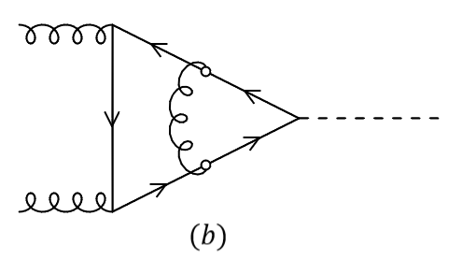
Higgs Production: Single Soft Quark Exchange
1-loop result:
$$M_{ggH}^{q,1L}=\left(1−4ρ\right)\ln^{2}{ρ}⇒\left\{\begin{aligned}M_{ggH}^{\left(0\right),1L}=\ln^{2}{ρ} \\ \\ {\left[M_{ggH}^{\left(1\right),1L}\right]}_{1q}=−4\ln^{2}{ρ}\end{aligned}\right.$$
Resummation with the effective diagram:
$M_{ggH}^{\left(0\right)}=\ln^{2}{ρ}g\left(z\right)$
${\left[M_{ggH}^{\left(1\right)}\right]}_{1q}=−4\ln^{2}{ρ}g(z)=−4 M_{ggH}^{\left(0\right)}$
$g\left(z\right)=2\int_{0}^{1}{dη_{1}}\int_{0}^{1−η_{1}}{dξ_{1}}e^{2zη_{1}ξ_{1}}$

Slide 9
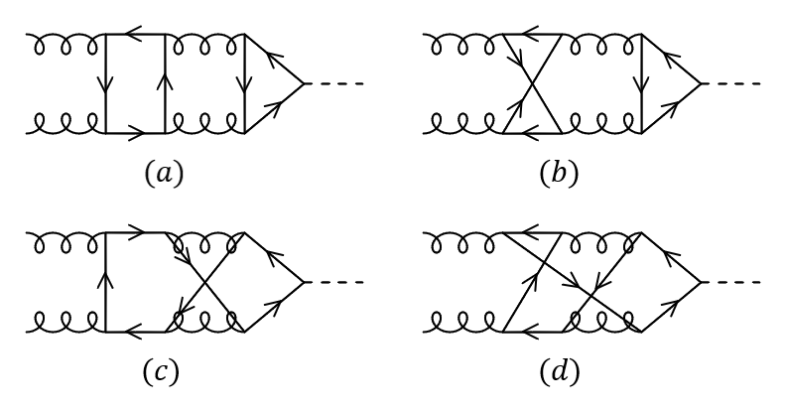
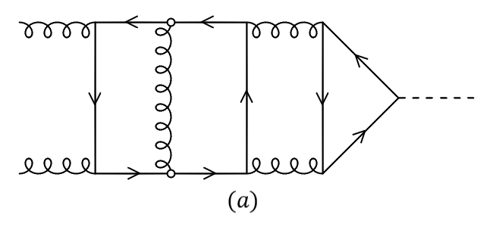
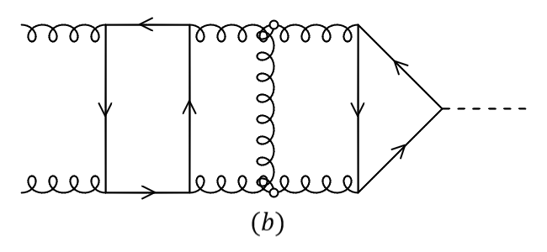
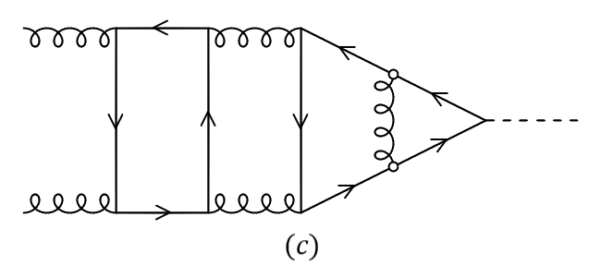
Higgs Production: Triple Soft Quark Exchange
Only $(a)$ contributes: ${\left[M_{ggH}^{\left(1\right),3L}\right]}_{3q}=\frac{x^{2}T_{F}C_{F}}{45}\ln^{2}{ρ}$
Effective diagrams give ${\left[M_{ggH}^{\left(1\right)}\right]}_{3q}=\frac{x^{2}T_{F}C_{F}}{45}\ln^{2}{ρ}h\left(z\right)$ where $h\left(z\right)=6!\int_{0}^{1}{dη_{1}}\int_{0}^{1−η_{1}}{dξ_{1}}\int_{0}^{η_{1}}{dη_{2}}\int_{0}^{ξ_{1}}{dξ_{2}}$ $\int_{0}^{η_{2}}{dη_{3}}\int_{0}^{ξ_{2}}{dξ_{3}}\left(e^{2zη_{1}ξ_{1}}e^{−2zη_{2}ξ_{2}}e^{2zη_{3}ξ_{3}}\right)$

Slide 10
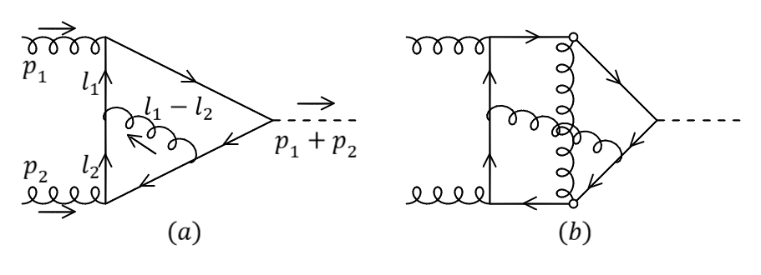
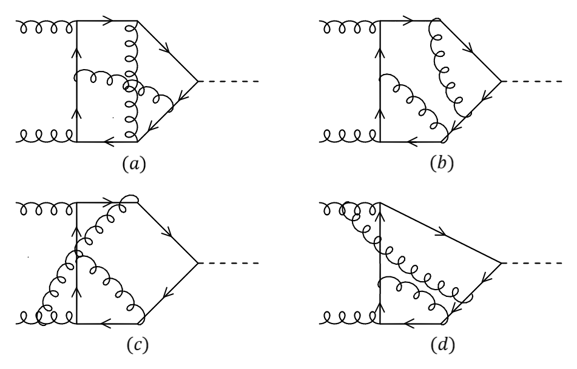
Higgs Production: Non-Factorizable
Eikonal gluon, necessary structure not present at two loops
At three loops:
$\left(b\right)$ cancels specifically at this order
$\left(c\right)$ and $\left(d\right)$ factorize and don’t contribute
Only $(a)$ with effective vertices contributes
$${\left[M_{ggH}^{\left(1\right),3L}\right]}_{NF}=−\frac{x^{2}\left(C_{A}−C_{F}\right)\left(C_{A}−2C_{F}\right)}{9}\ln^{2}{ρ}$$
Resummation requires systematic treatment of self-interacting gluons

Slide 11
Higgs Production : Complete NNLO Result
Estimate ${\left[M_{ggH}^{\left(1\right)}\right]}_{NF}=−\frac{x^{2}\left(C_{A}−C_{F}\right)\left(C_{A}−2C_{F}\right)}{9}\ln^{2}{ρ}j\left(z\right)$ where $j\left(z\right)= ?$
$M_{ggH}^{\left(1\right)}=\left[−4g\left(z\right)+x^{2}\left\{\frac{T_{F}C_{F}}{45}h\left(z\right)−\frac{\left(C_{A}−C_{F}\right)\left(C_{A}−2C_{F}\right)}{9}j\left(z\right)\right\}\right]\ln^{2}{ρ}$
For QCD with $N_{c}→∞$, $M_{ggH}^{\left(1\right)}≈−4g\left(z\right)\ln^{2}{ρ}$
Opposite abelian limit $C_{A}=0$, $z=−C_{F}x$
$j^{ab}\left(z\right)=72\int_{0}^{1}{dη_{1}}\int_{0}^{1−η_{1}}{dξ_{1}}\int_{0}^{1−ξ_{1}}{dη_{2}}\int_{0}^{1−η_{2}−ξ_{1}}{dξ_{2}}$ $\{η_{1}ξ_{2}$ $e^{2zη_{1}(ξ_{1}+ξ_{2})}\}$ $\left[1+\frac{e^{−2zη_{1}ξ_{1}}−1}{2}+\frac{e^{−2zη_{1}ξ_{1}}−1+2zη_{1}ξ_{1}}{4zη_{1}ξ_{2}}\right]$

Slide 12
Higgs Production: Complete NNLO Result
Asymptotic behavior as $z→∞$, $g\left(z\right)\sim {\left(\frac{2πe^{z}}{z^{3}}\right)}^{1/2}$ and $g\left(−z \right)\sim \frac{γ_{E}+\ln{2z}}{z}$
Large $N_{c}$ limit, $M_{ggH}^{\left(1\right)}=−4\ln^{2}{ρ}g\left(\frac{N_{c}x}{2}\right)$ i.e., exponential enhancement
Abelian limit: $g\left(−z\right)∝\frac{1}{z}$, $h\left(−z\right)∝\frac{1}{z^{3}}$, $j^{ab}\left(−z\right)∝\frac{1}{z^{2}}$ $⇒$ reduces to $g(−z)$
$1+ρ\left[−4+\frac{x^{2}}{g\left(z\right)}\left\{\frac{T_{F}C_{F}}{45}h\left(z\right)−\frac{\left(C_{A}−C_{F}\right)\left(C_{A}−2C_{F}\right)}{9}j\left(z\right)\right\}\right]$
For b-quark $ρ≈1.6×{10}^{−3}⇒−0.64\%$ universal (same for QCD and QED) correction with respect to leading order [3]

Slide 13
Thank you!
Questions

Slide 14
References
[1] V.V. Sudakov. Vertex parts at very high-energies in quantum electrodynamics. Sov.Phys. JETP 3 (1956), pp. 65–71.
[2] T. Liu and A. Penin, “High-energy limit of mass-suppressed amplitudes in gauge theories”, Journal of High Energy Physics, vol. 2018, Nov 2018.
[3] T. Liu, S. Modi, and A. A. Penin, “Higgs boson production and quark scattering amplitudes at high energy through the next-to-next-to-leading power in quark mass,” Journal of High Energy Physics, vol. 2022, p. 170, Feb 2022.

