Slide 1
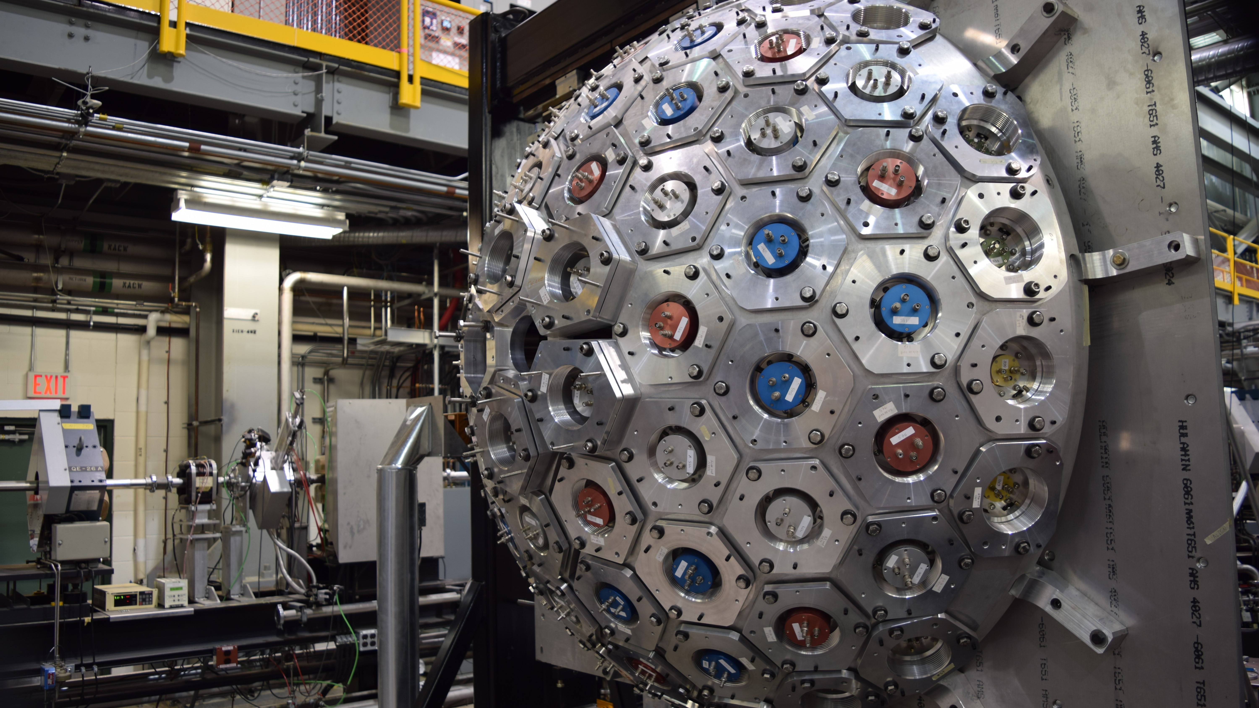
Investigating the Nuclear Shell Evolution in Neutron-Rich Calcium
Robin Coleman – University of Guelph
WNPPC 2023

Slide 2
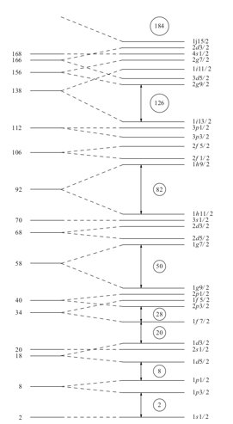
Nuclear Shell Model
Binding energy
Analogous to Electron Shells, Nucleons occupy energetic shells
Starting from a Woods-Saxon Potential adding a spin orbit coupling reproduces observed shells
Protons
Neutrons

Slide 3
Nuclear Shell Model
Tensor force of occupied proton shells attract/repel corresponding neutron orbital
Removing protons from orbital causes these shells to drift away from stability
J'<
J'>
J>
Protons
Neutrons

Slide 4
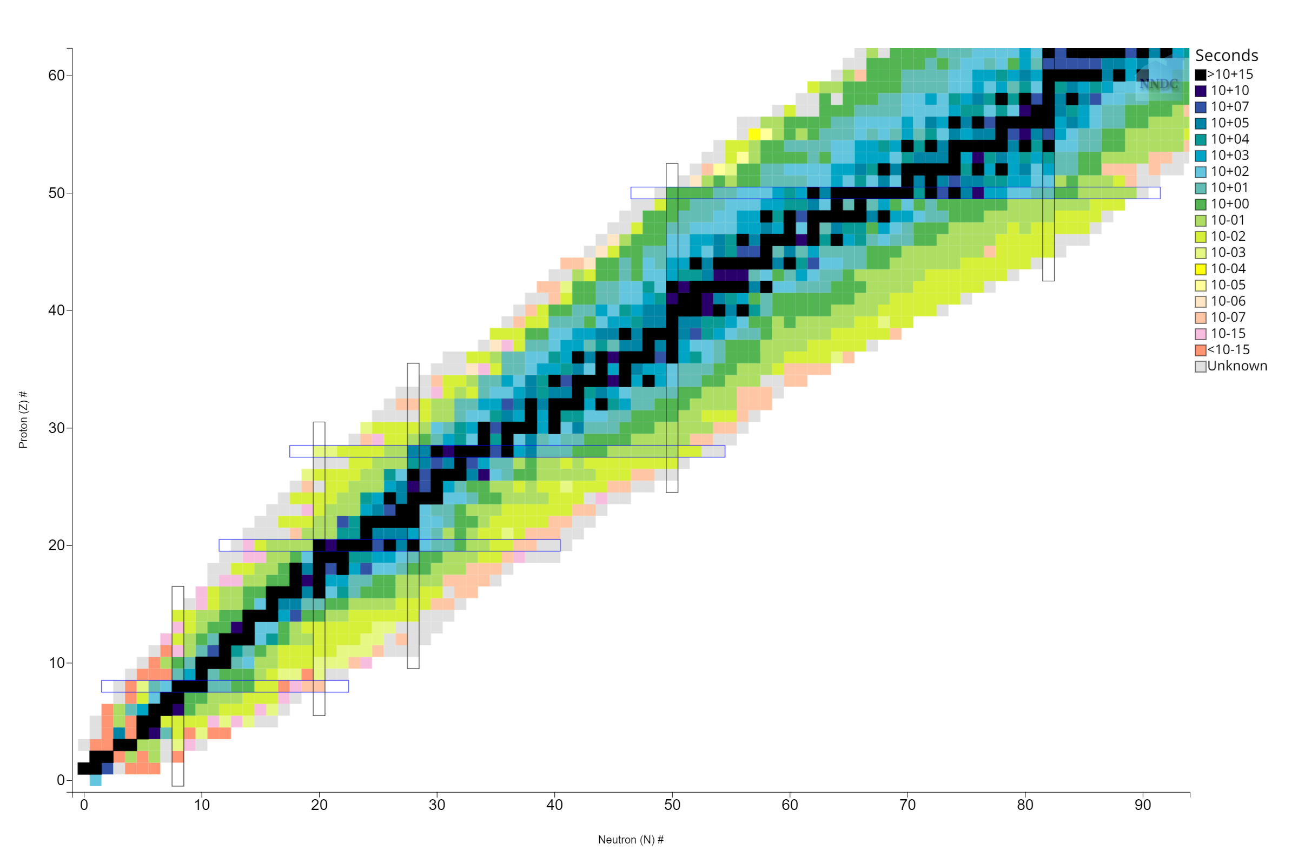
Shell Model Evolution
Single particle energies drift away from β-stability
Creates new magic numbers

Slide 5
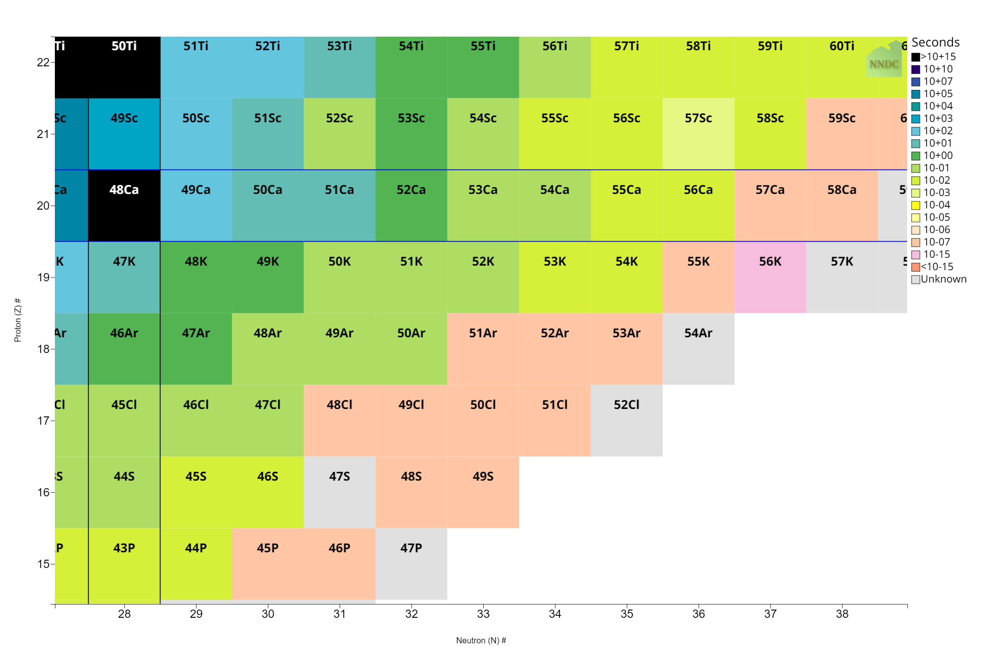
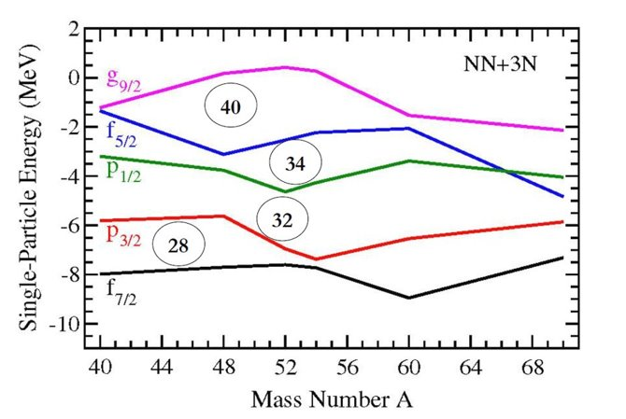
Shell Model Evolution
J. D. Holt, J. Menéndez, J. Simonis, and A. Schwenk, Physical Review C 90 (2014).​

Slide 6
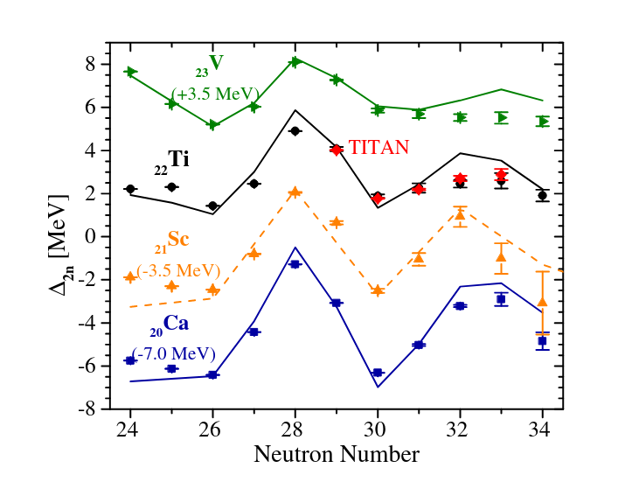
Shell Model Evolution
E. Leistenschneider et al. Phys. Rev. Lett. 120, 062503 (2018)

Slide 7
Shell Model Evolution
E. Leistenschneider et al. Phys. Rev. Lett. 120, 062503 (2018)
M. Rosenbusch et al. Phys. Rev. Lett. 114, 202501 (2015)

Slide 8
Shell Model Evolution
E. Leistenschneider et al. Phys. Rev. Lett. 120, 062503 (2018)
M. Rosenbusch et al. Phys. Rev. Lett. 114, 202501 (2015)
D. Steppenbeck et al., Nature 502, 207 (2013).

Slide 9
Shell Model Evolution
Clear evidence for a new shell closure at N=32 and sub-shell closure at N=34

Slide 10
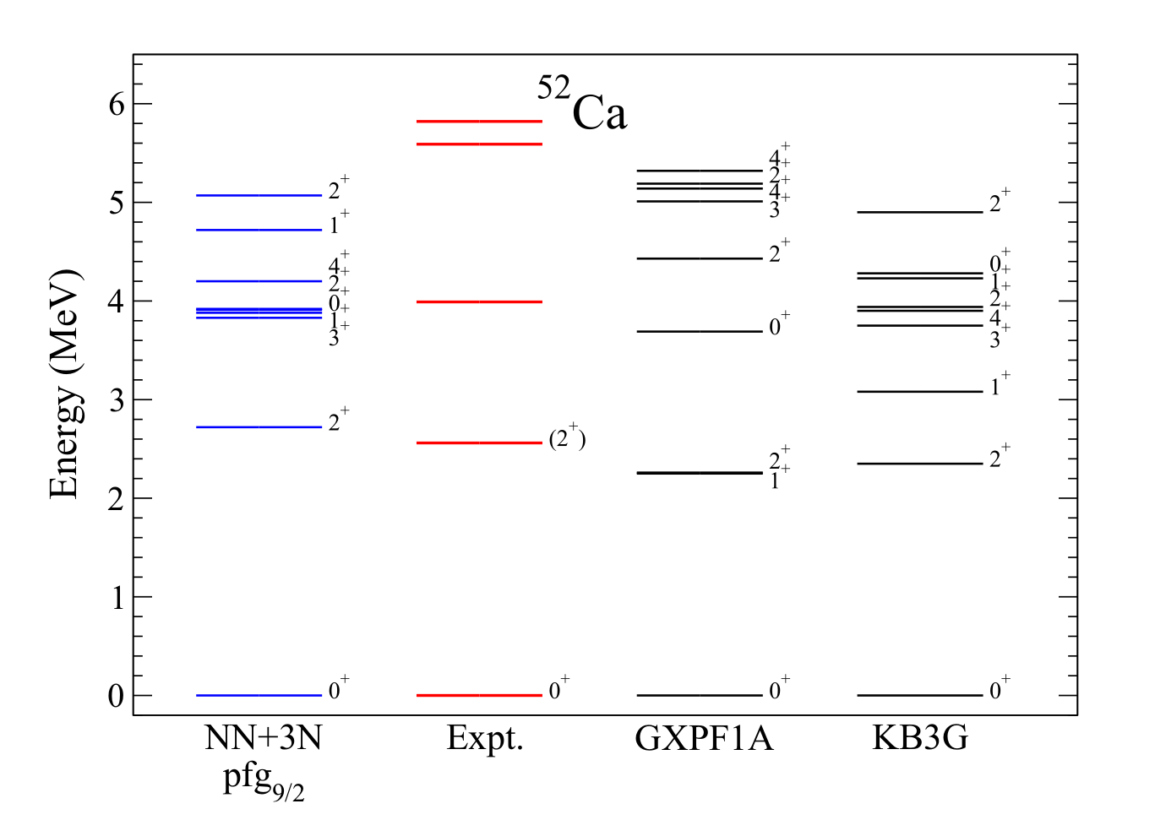
Shell Model Evolution
Various Interactions can describe this behavior
Phenomenological models require spectroscopic validation
J. D. Holt, J. Menéndez, J. Simonis, and A. Schwenk, Physical Review C 90 (2014).​

Slide 11
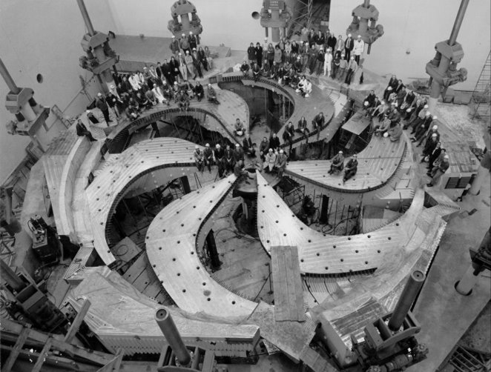
TRIUMF
TRI-University Meson Facility
Isotope Separation On Line (ISOL) Facility
520 MeV Cyclotron
UCx Target
“GRIFFIN Collaboration,” triumf.ca

Slide 12
GRIFFIN + DESCANT
Gamma-Ray Infrastructure For Fundamental Investigation of Nuclei (GRIFFIN)
12 HPGe clover detectors
DEuterated SCintillator Array for Neutron-Tagging (DESCANT)
69 detectors installed downstream

Slide 13
Beta Detectors
Beta Detectors
SCintillating Electron Positron Tagging ARray (SCEPTAR)
Zero Degree Scintillator (ZDS)
Isotopes Delivered
⁵²K ~ 200 pps
⁵³K ~ 20 pps
⁵⁴K ~ 2 pps

Slide 14
Isotopes Produced
⁵¹Cr
⁵²Cr
Neutron emission probabilities are >70% for all potassium isotopes delivered
Large Q-value of beta-n branch can kick some of the daughter nuclei out of mylar tape
⁵¹V
⁵²V
Beta Decay
Neutron Emission
⁵⁰Ti
⁵¹Ti
⁵²Ti
⁵⁰Sc
⁵¹Sc
⁵²Sc
⁵⁰Ca
⁵¹Ca
⁵²Ca
⁵²K

Slide 15
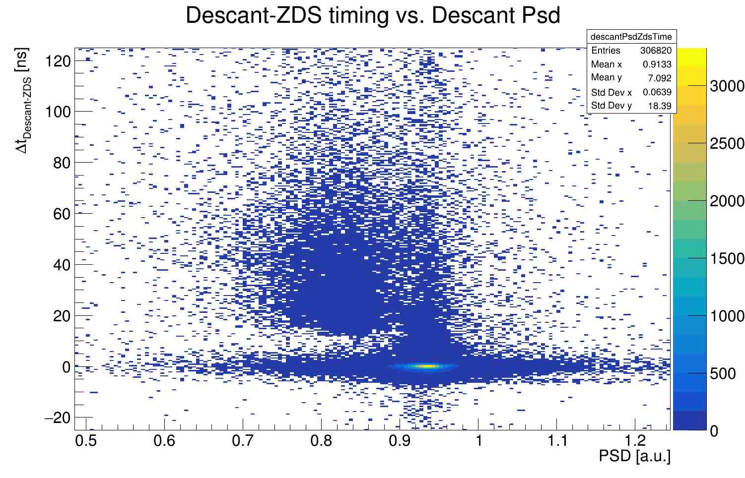
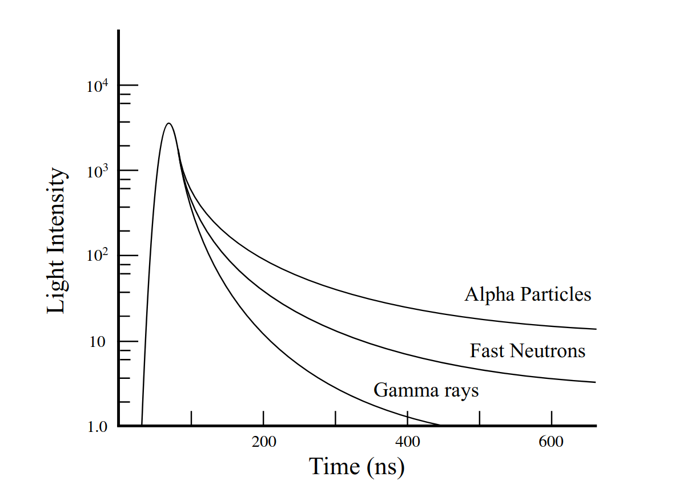
Neutron Selection
Time of Flight
ZDS starts the clock
Pulse Shape Discrimination

Slide 16
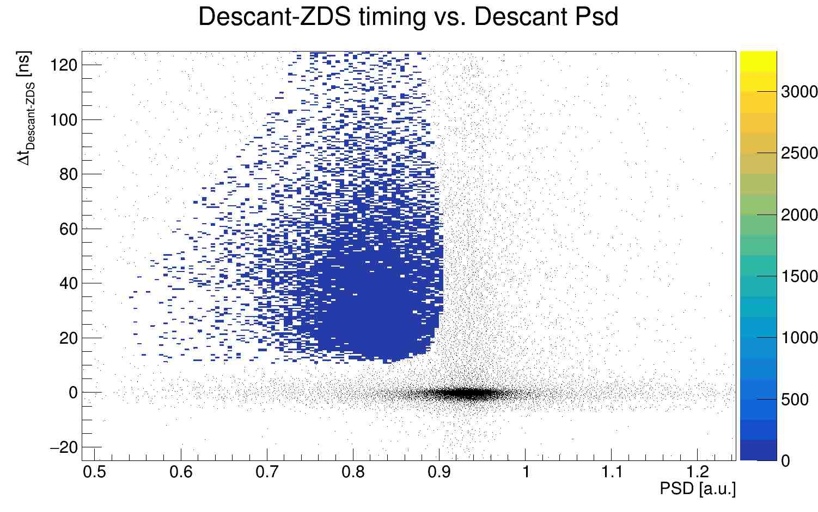
Neutron Selection
Time of Flight
ZDS starts the clock
Pulse Shape Discrimination

Slide 17
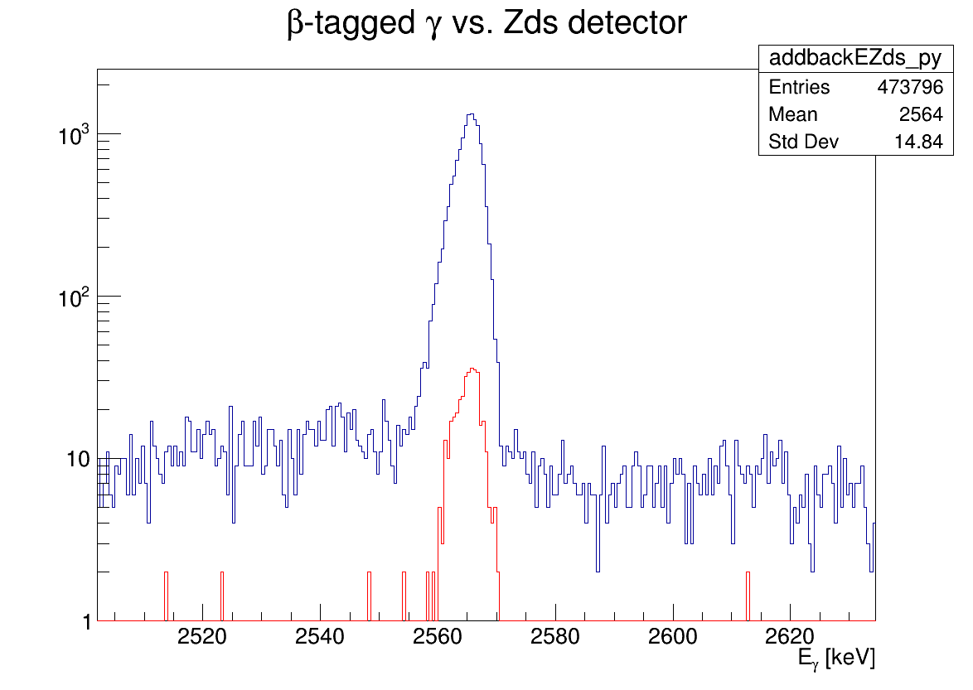
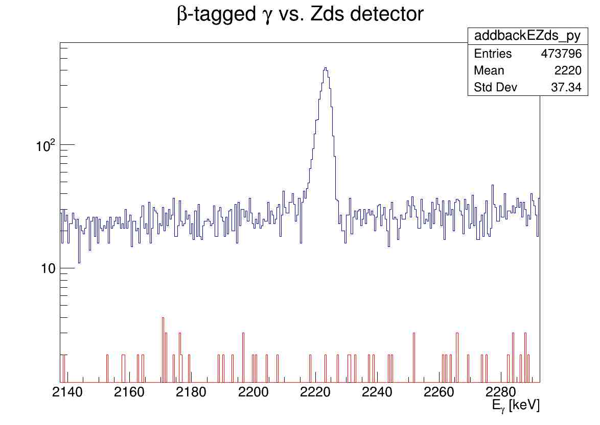
GRIFFIN Results
⁵³K Beam
⁵²Ca Peak
ZDS tagged
⁵³K Beam
⁵³Ca Peak
ZDS tagged
Neutron tagged
Neutron tagged

Slide 18
Level Schemes

Slide 19
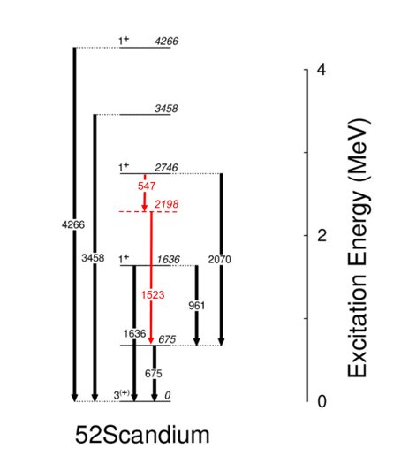
Level Schemes
⁵¹Sc
⁵²Sc

Slide 20
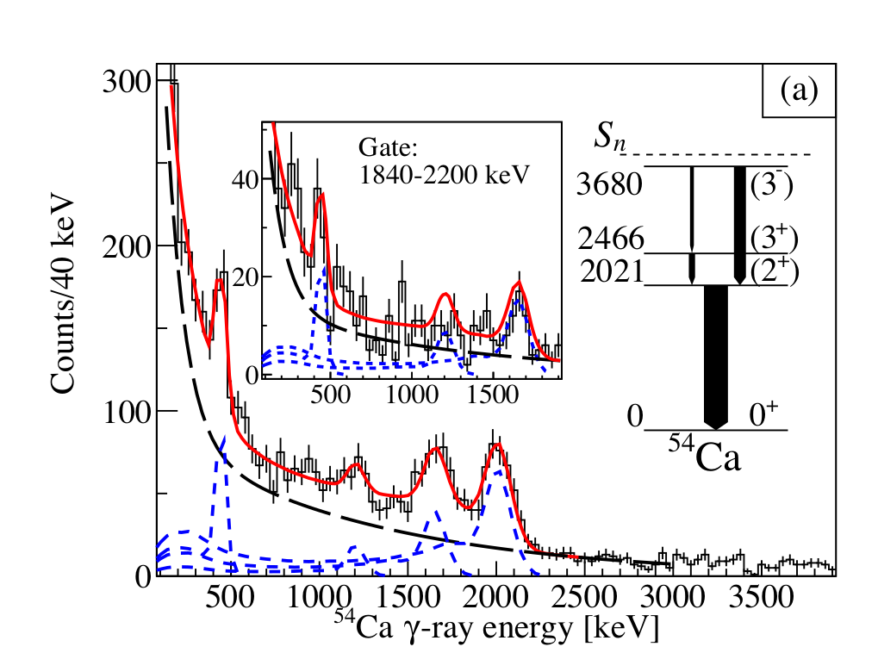
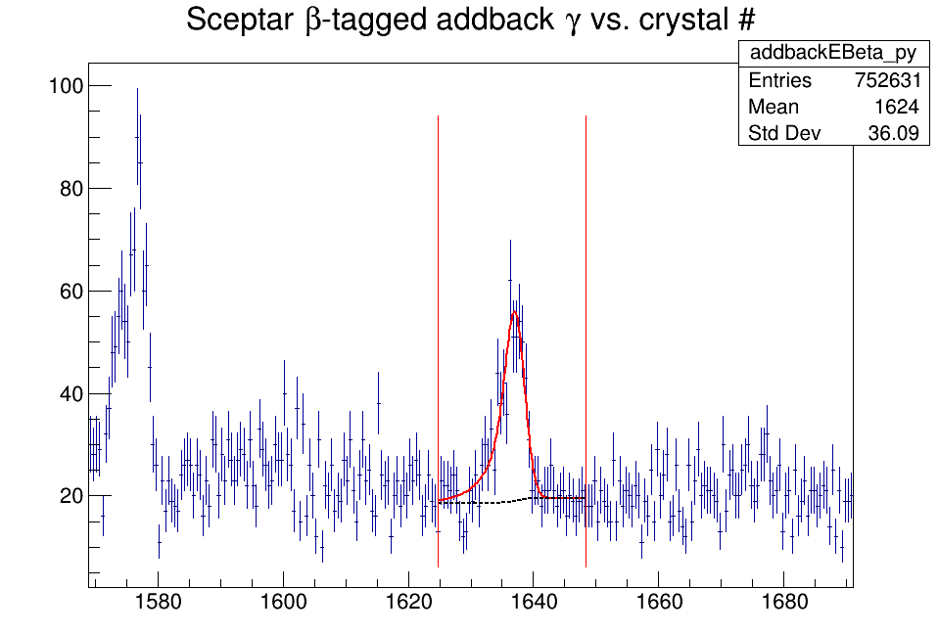
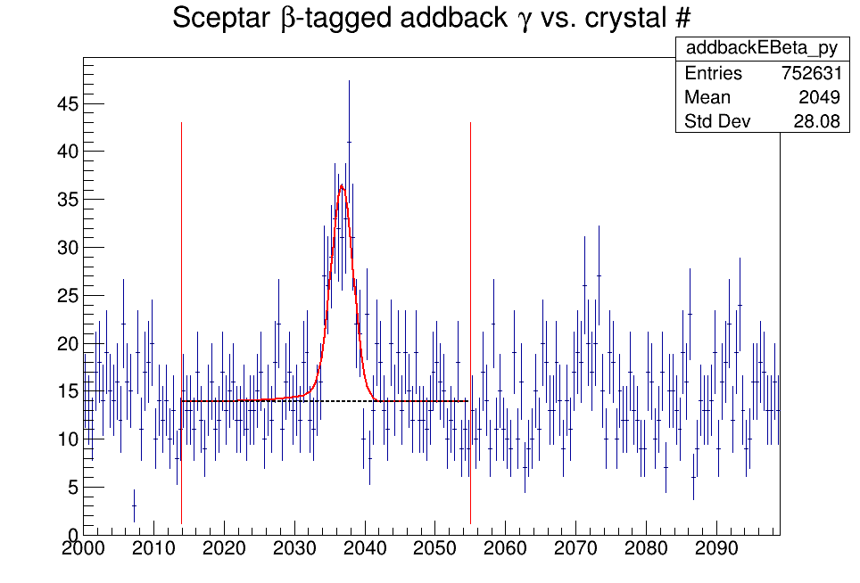
Level Schemes
F. Browne et al. PHYSICAL REVIEW LETTERS 126, 252501 (2021)

Slide 21
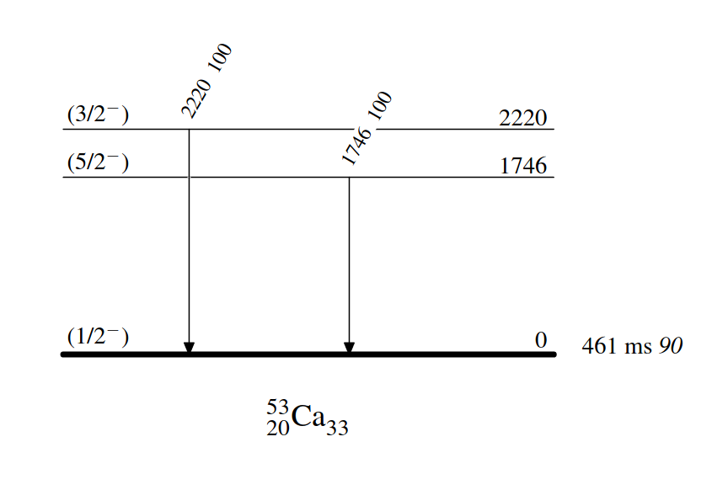
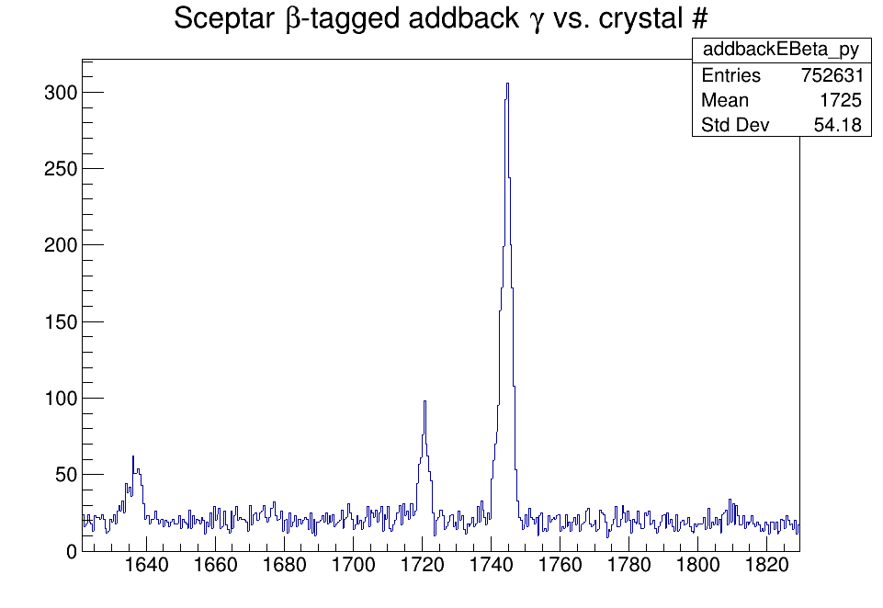
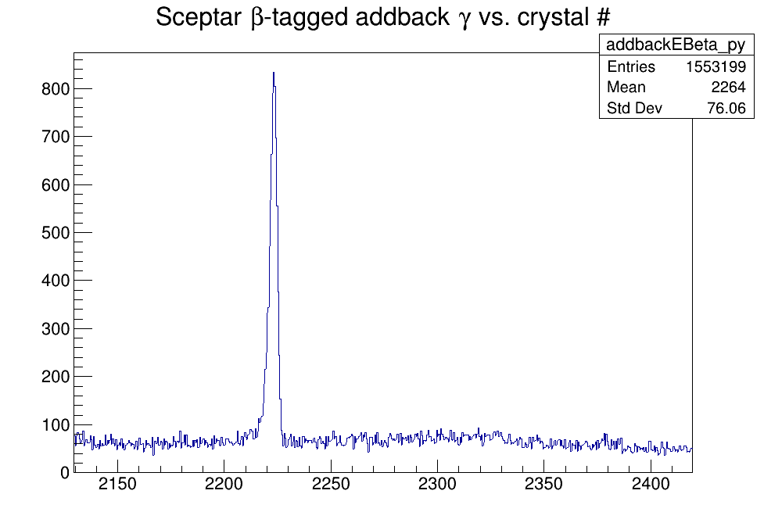
Level Schemes
54K Beam
1746 keV peak
⁹Be(⁵⁵Sc,⁵³Caγ)
Source: ENSDF
53K Beam
2220 keV Peak

Slide 22
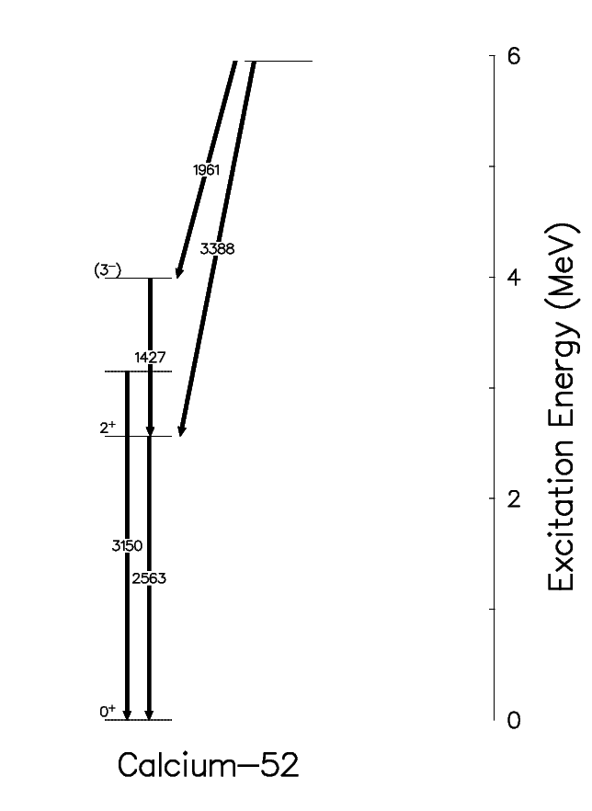
Shell Model Evolution
6.16(8)
5951
5034
PRELIMINARY
4102
6.42(6)
3990
7.78(6)
3153
5.73(4)
2563
2563
log ft
⁵²Ca

Slide 23
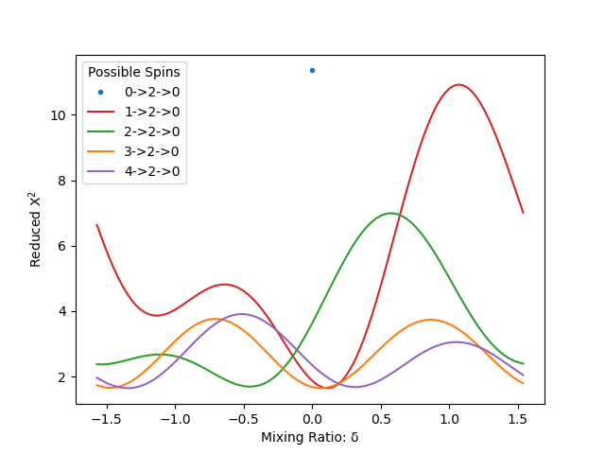
Angular Correlations
Angular correlation between coincident gamma rays
Illustrates spin assignments of the states in the cascades
PRELIMINARY
??
3990
1427
2+
2563
2563
0+
0

Slide 24
Summary and Next Steps
5951
Expanded Level Schemes
⁵²Ca
Scandium Isotopes
Beta and Beta-n population of states in ⁵³Ca and ⁵⁴Ca
Next Steps
Assign Spins where possible through angular correlations
Adapted from J.D. Holt, J. Menéndez, J. Simonis, and A. Schwenk, Physical Review C 90 (2014).​

Slide 25
Acknowledgements
G.C. Ball
S.S. Bhattacharjee
G. Carpenter
A.B. Garnsworthy
C. Griffin
R.S. Lubna
R. Lafleur
B. Olaizola
C. Paxman
C. Porzio
V. Vedia
D. Yates
C. Andreoiu
F.H. Garcia
M.S. Martin
K. Whitmore
F. Wu
G.F. Grinyer
S. Sharma
A. Talebitaher
M. Hanley
C.R. Natzke
F. Sarazin
S. Shadrick
C.E. Svensson
H. Bidaman
V. Bildstein
S. Buck
P.E. Garret
A.T. Laffoley
A.D. MacLean
A.J. Radich
M. Rocchini
T. Zidar

Slide 26
Thank You
Any Questions?

Slide 27
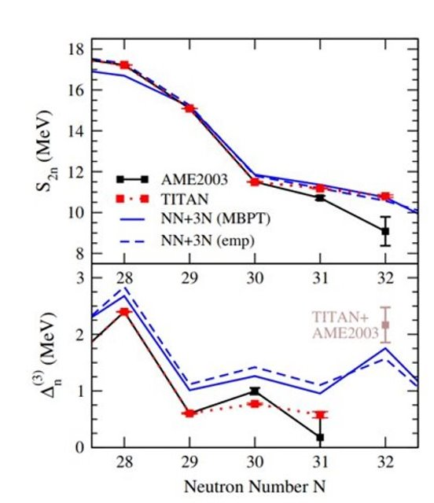
Observables
R.F. Garcia Ruiz et al., Nature 12, 594 (2016).​
A. T. Gallant et al. Physical Review Letters 109, 032506 (2012)​

Slide 28
Nuclear Shell Model
Particle Hole excitations create type II shell evolution which can alter the shell structure
J'<
J'>
J>
J''>
Protons
Neutrons

Slide 29
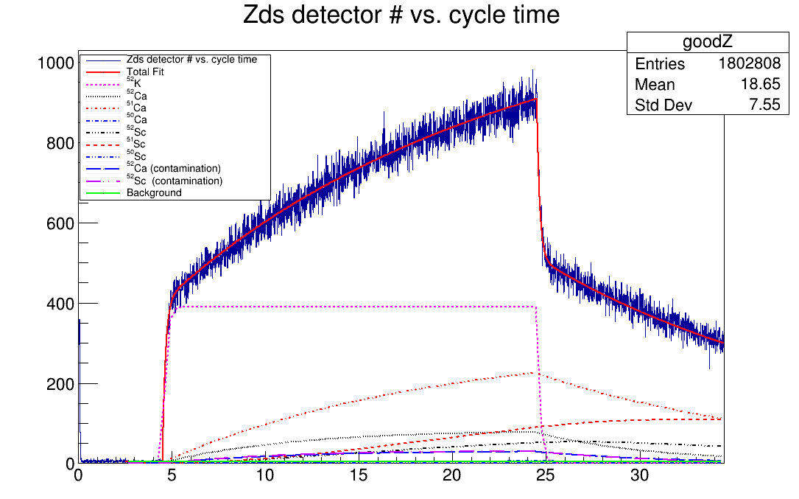
Beta Data
Dependent on
Half lives
β-n probabilities
Relative efficiencies for nuclei
Cycle Time (s)

Slide 30
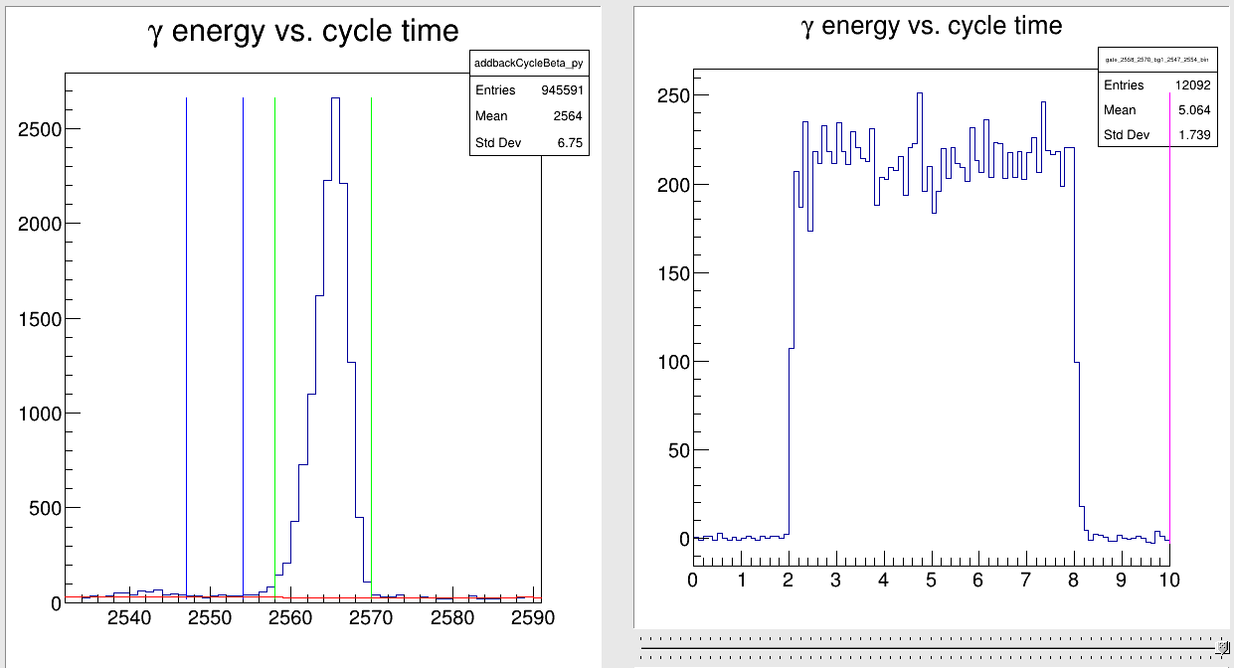
Beta Data
Dependent on
Half lives
β-n probabilities
Relative efficiencies for nuclei

Slide 31
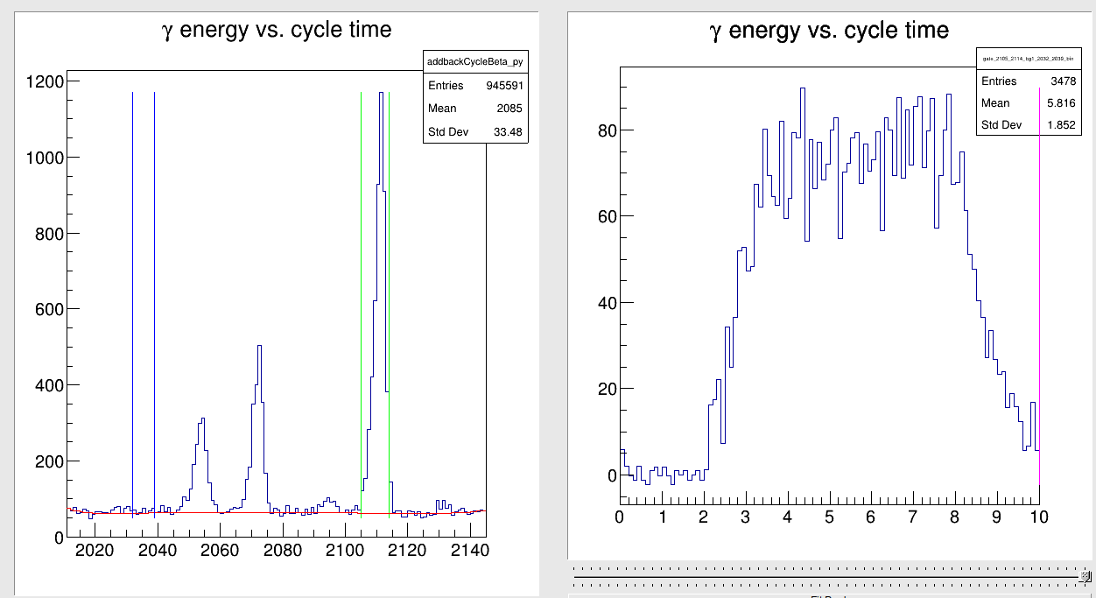
Beta Data
Dependent on
Half lives
β-n probabilities
Relative efficiencies for nuclei

Slide 32
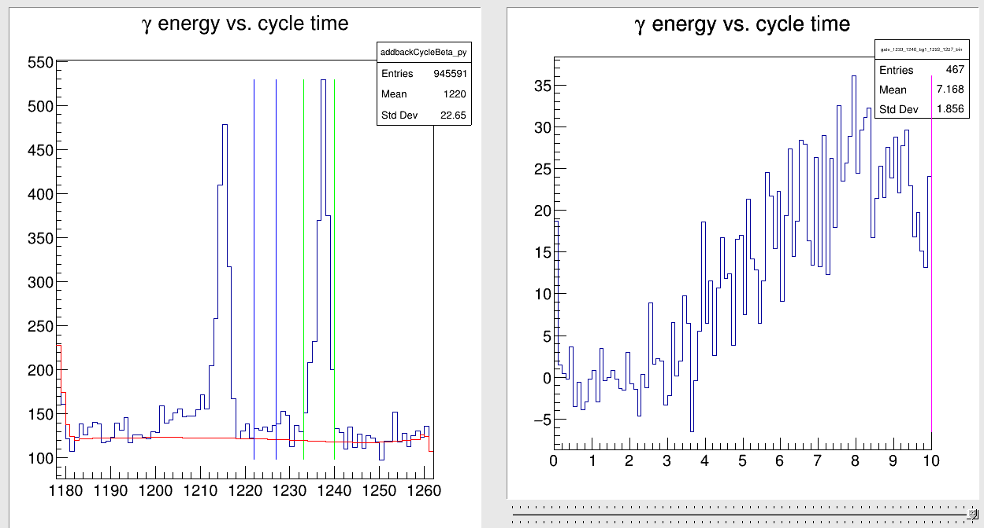
Beta Data
Dependent on
Half lives
β-n probabilities
Relative efficiencies for nuclei

Slide 33
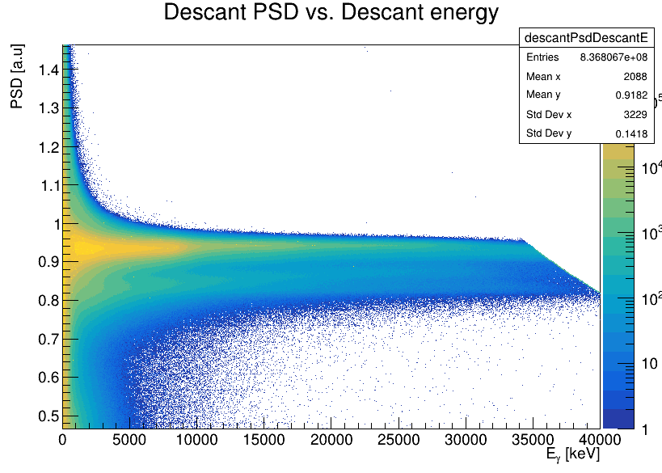
DESCANT
DESCANT PSD vs Energy
Selects higher energy neutrons than time-of-flight vs. PSD cut
Removes any inherent timing selection

Slide 34
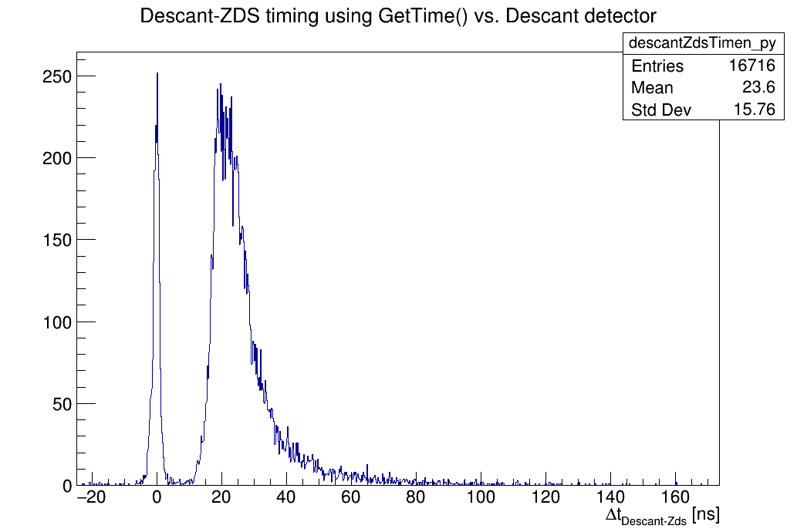
DESCANT ToF
53K Data
Target to Detector Distance: 50cm
18 ns ~ 4 MeV
24 ns ~ 2.5 MeV
40 ns ~ 0.8 MeV
Qβ-Sn = 9.1 MeV

Slide 35
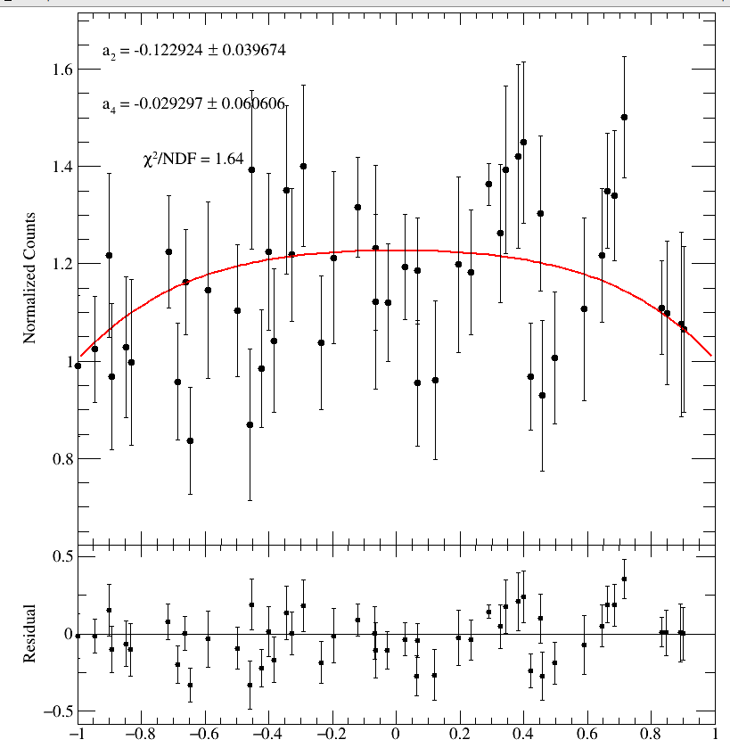
Angular Correlations
Angular correlation between coincident gamma rays
Illustrates spin assignments of the states in the cascades
PRELIMINARY

