Slide 1
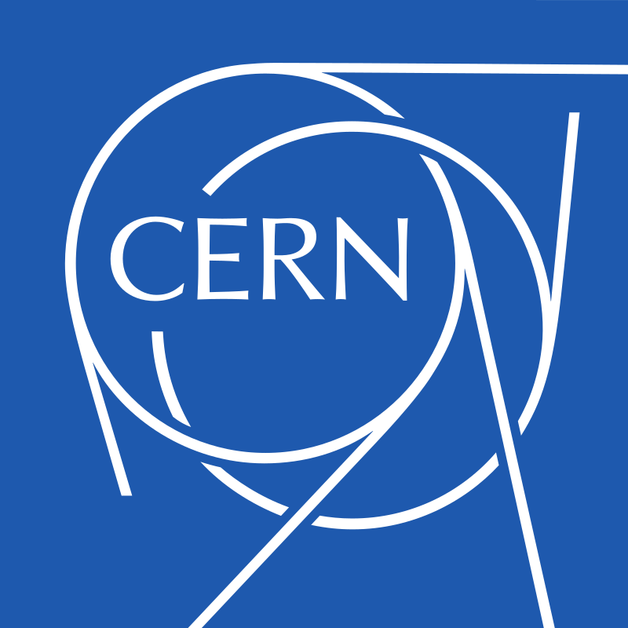
MIRACLS at ISOLDE and Paul trap commissioning
Louis Croquette
McGill University
Supervisors: Stephan Malbrunot-Ettenauer, Fritz Buchinger

Slide 2
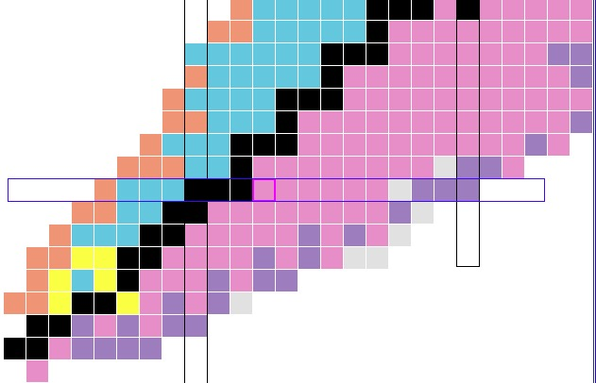
Motivation
Nuclear chart:
Studies at modern radioactive ion beam (RIB) facilities
disappearance of established shell closures
emergence of new ones
MIRACLS technique
Multiple Ion Reflection Apparatus for Collinear Laser Spectroscopy
Probe magnesium nuclei
²⁰Mg - Shell closure near N = 8
³³⁻³⁴Mg - Island of inversion at N = 20
N=20
Z=12
protons
Z=8
N=20
disappears
Shell Model of Nuclei
N=8
neutrons
Notes:
Nuclear shell model
Analogous to atomic shell model in many ways, but magic numbers differ
Explains very well most of the nuclide chart, but some anomalies
MIRACLS is looking to help answer some of these anomalies
Focus on Magnesium isotopes

Slide 3
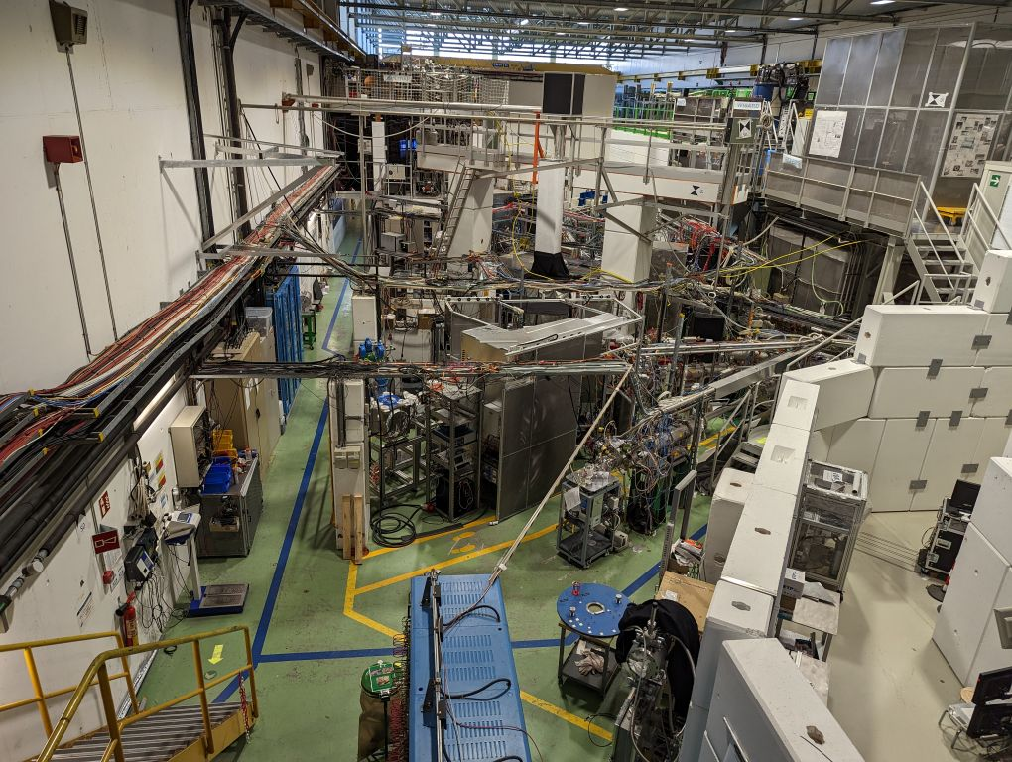
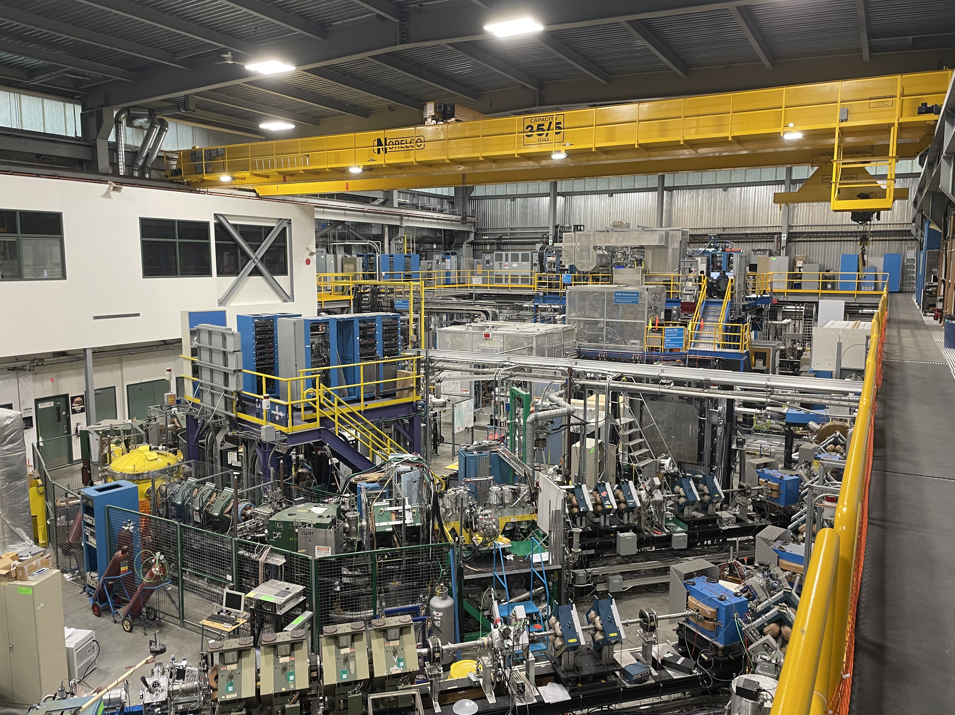
Radioactive Ion Beams facilities
²⁰Mg
17 ion/s, 91 ms
ISOLDE – 1.7 GeV proton beam
$\sim$1300 different isotopes
Continuous beam delivered at up to 50 keV
³⁴Mg
140 ion/s, 45 ms
MIRACLS
ISAC at TRIUMF – 520 MeV proton beam
Notes:
We want to access isotopes far from the valley of stability
Exotic isotopes have short half-lives
* Studying them necessitates the use of radioactive ion beam facilities, to give experiments on demand access to these short lived radionuclides
Two examples of Radioactive Ion Beam facilities – ISOLDE at CERN, and ISAC at TRIUMF
Exotic isotopes produced by impinging proton beam onto a target, and then diffusing the radionuclides and ionizing them
* Accelerated to 50 keV
Beams are typically delivered to a variety of experiments in a continuous beam
Note that the yields for the isotopes of interest are quite low, only a few 10s or 100s of ions per second

Slide 4
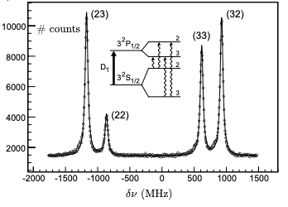
Collinear Laser spectroscopy (CLS)
Access nuclear properties by probing atomic hyperfine spectra
Atomic nucleus impression on electron cloud
Nuclear electromagnetic moments, nuclear charge radii, etc…
Measure fluorescence photons as a function of laser frequency
Doppler broadening - $σ_{ν}\sim \frac{σ_{E}}{\sqrt{E}}$
[Neugart 2017]
[Yordanov 2007]
Notes:
MIRACLS uses CLS as a core technique
Atomic nucleus imprints on its surrounding electron cloud
By probing the electron cloud, we can deduce certain nuclear properties
* certain properties such as spin, charge radii, and nuclear electromagnetic moments
How to probe?
Overlap a continuous beam with a laser
Excite ion for a chosen transition using a laser, ion then emits a fluorescence photon
Detect photons in optical detection region with PMTs
Can form a hyperfine spectra by scanning the measuring the photon counts as a function of laser frequency
Two ways to improve measurement
use bunched beams to reduce background contamination (gate signal)
Fast, well-resolved ion beams to minimize Doppler broadening and maximize sensitivity ($δv= \frac{δE}{\sqrt{E}}$)
Conventional CLS has only one pass in an optical detection region

Slide 5
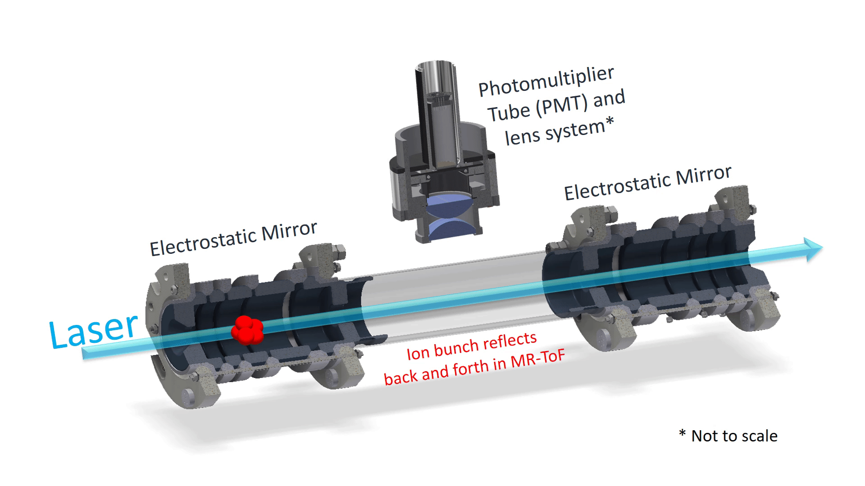
Why CLS inside an MR-ToF?
Multiple-Reflection Time-of-Flight
Probe ions several thousand times
Improvement factor of $\sim$30-700 [Maier 2019]
Reach more exotic radionuclides
Concept of CLS in MR-ToF device demonstrated in 1.5 keV offline lab [Sels 2020, Lagaki 2021]
Ejection from Paul trap
Ejection from MR-ToF
Conventional CLS
MIRACLS improvement
Notes:
What is an MR-ToF?
two electrostatic mirrors separated by a drift tube
MIRACLS puts an optical detection region in the drift tube
Access entire lifetime of isotope of interest, so can excite multiple times!
Trap ions in MR-ToF, and revolve through optical detection region
Probe several thousand times, greatly improved signal to noise
Access more exotic radionuclides (short half lives, low yields at RIBs)
However, need bunched beam for MR-ToF, but ISOLDE delivers a continuous beam – SOLUTION Paul trap

Slide 6
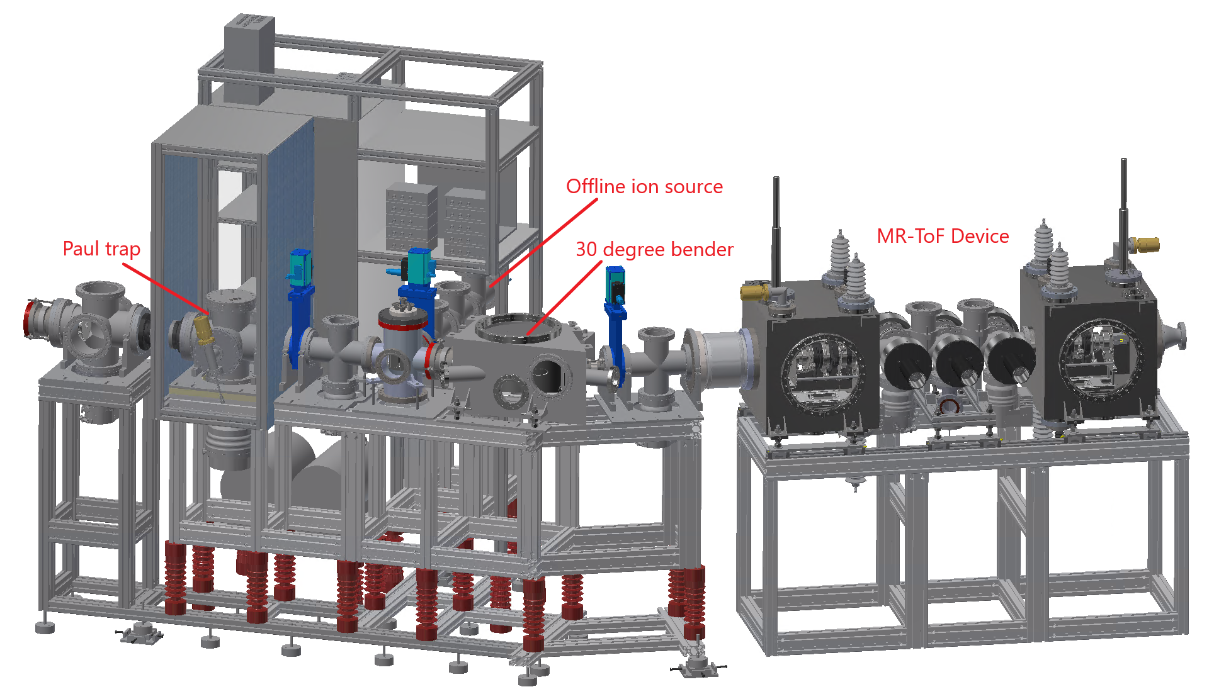
30 keV MIRACLS setup
[Maier 2023]
Notes:
ISOLDE beam comes in from the left
Offline ion source is located after the Paul trap due to space constraints
MRToF device is at the end after a variety of beam optics

Slide 7
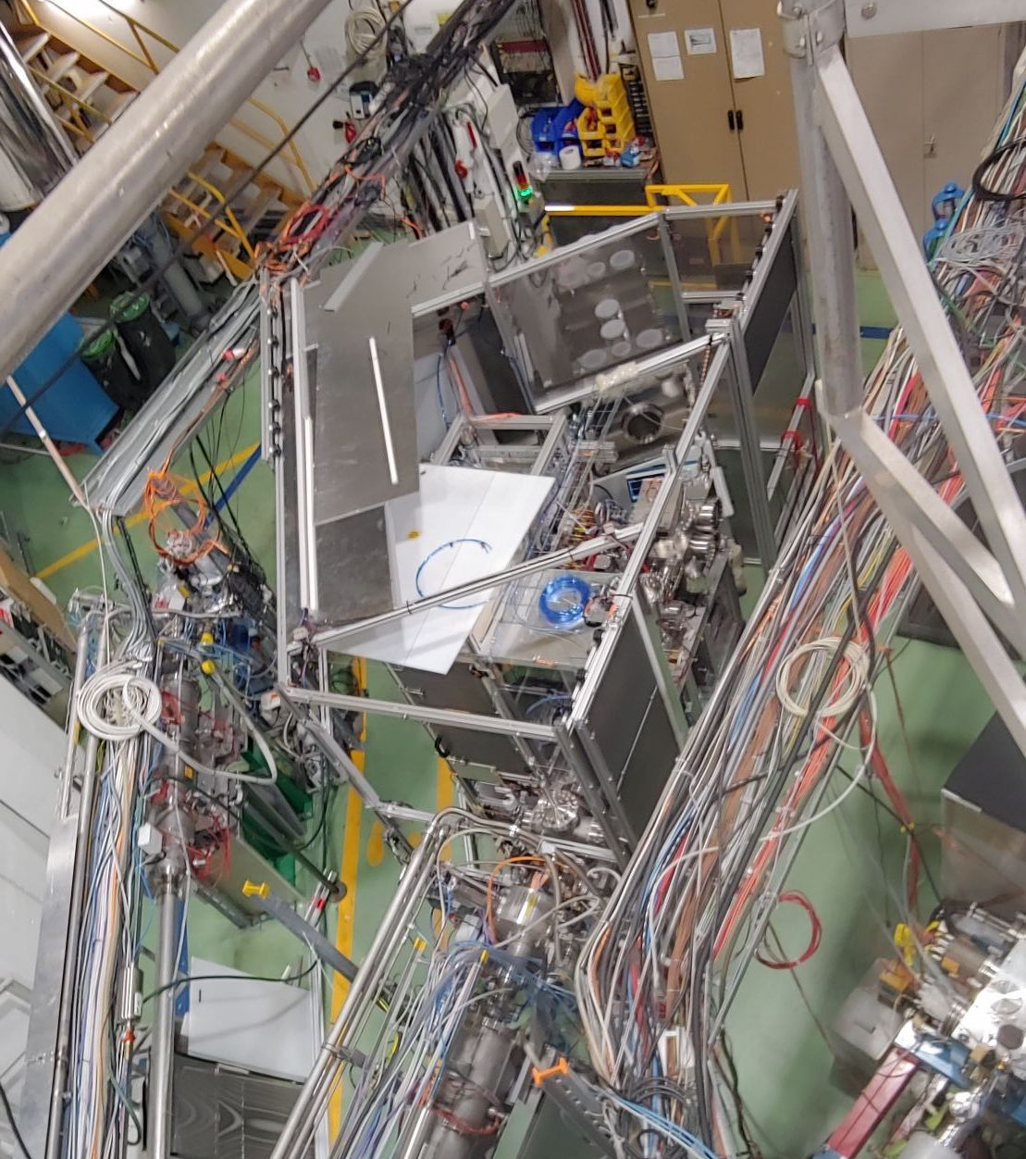
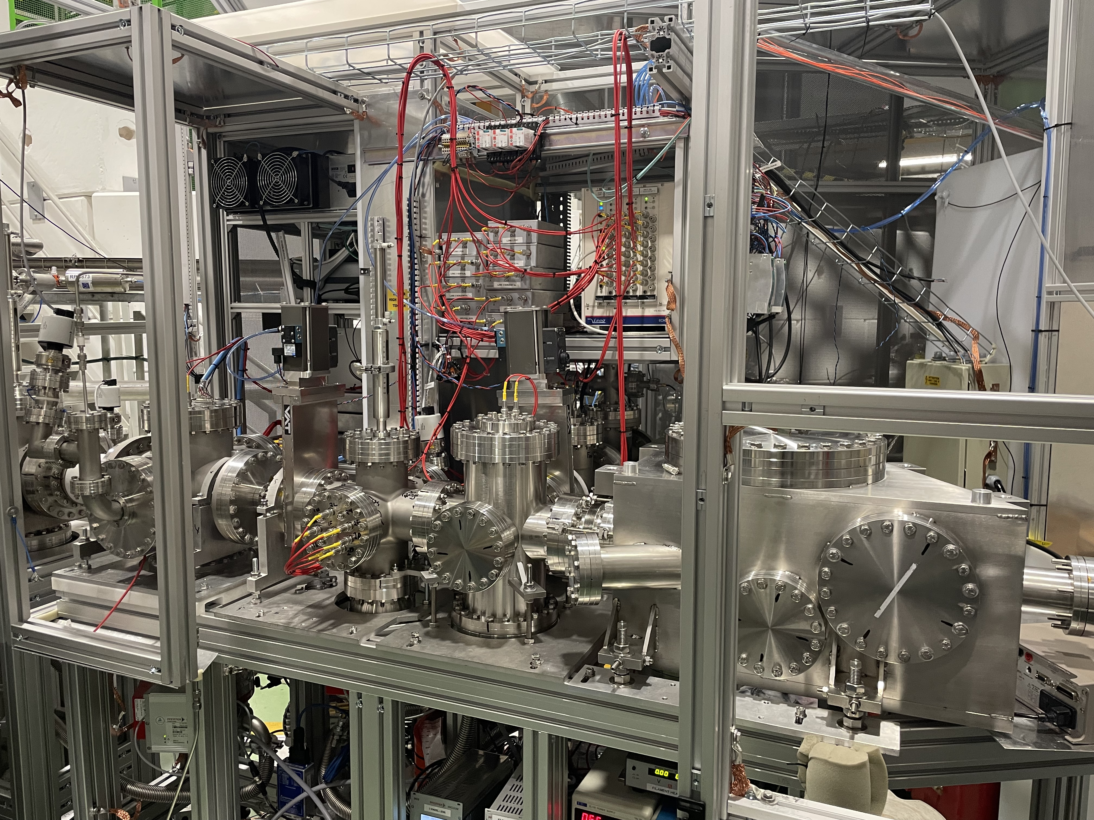
30 keV MIRACLS setup
2.7 m
Paul trap
[Maier 2023]

Slide 8
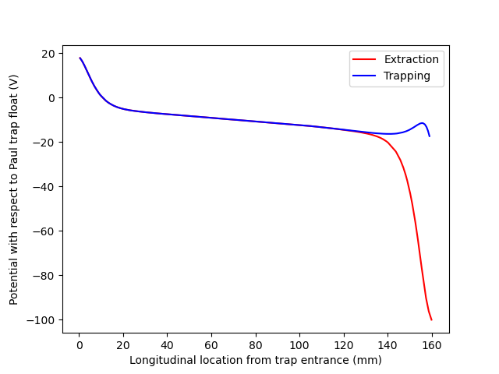
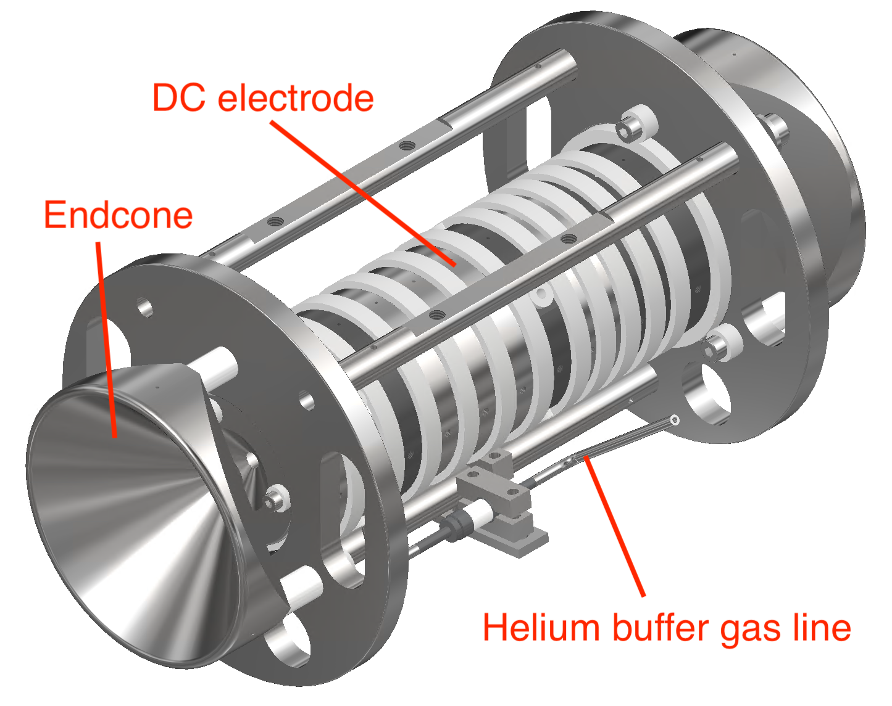
Paul trap principles and design
Stability parameter – q
RF amplitude
RF frequency
Ion mass
Notes:
Paul trap needs to do two things: bunch and cool
Confine ions in 3 dimensions
Longitudinal well formed by DC electrodes (trapping mode)
Axial trapping with a rotating RF field (looks like a Pringle chip)
* Picture a ball on a saddle
Too slow it falls down, too fast it flies out
Just right! It stays trapped (perpetually falling towards the minimum)
For cooling, we add in a buffer gas for cooling (lowering emittance, which leads to decreased energy spread)
Once ions are bunched and cooled, lower end potential and extract

Slide 9
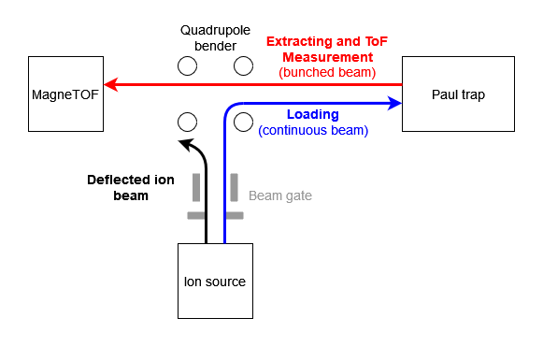
MIRACLS Paul trap and test setup
Bunch and cool ISOLDE beam
Strict requirements for MR-ToF operation
< 500 ns temporal bunch width
< 1eV energy spread
Tested with offline source
Ion detector
Notes:
To verify that are Paul trap meets the exigent MRToF requirements, need to test it
Here is a schematic of our test setup

Slide 10
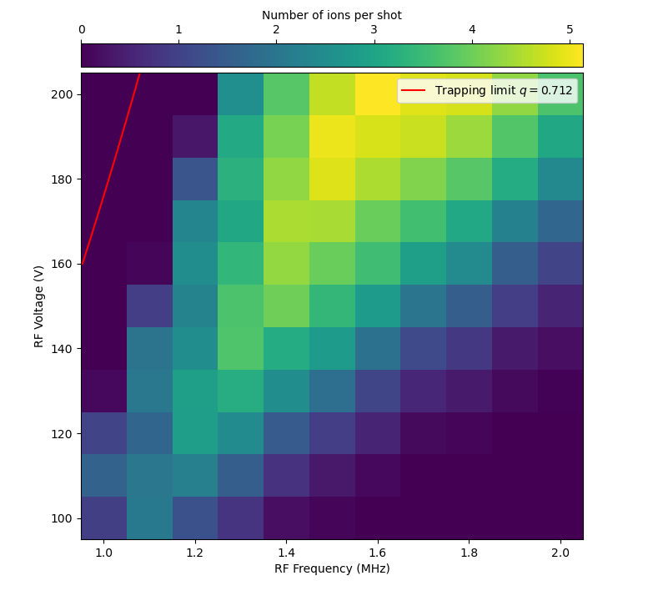
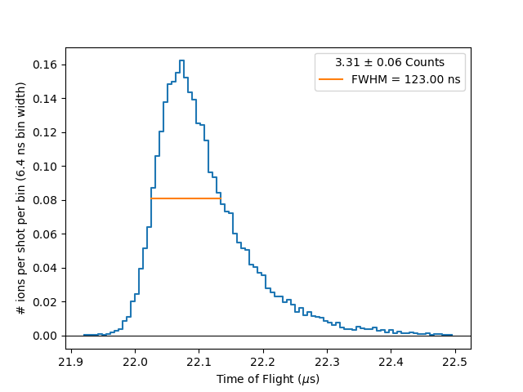
Paul trap commissioning and results
Number of ions per shot
Successful commissioning
Best ToF width – 123 ns
RF Amplitude (V)
RF Frequency (MHz)
Notes:
Successful commissioning!
Very pleased with the results, best ToF width is 123 ns
Stability diagram on the right, see a valley with higher trapping rates
Moving away from the valley (and thus a non-optimal q-value) leads to decreased bunched size

Slide 11
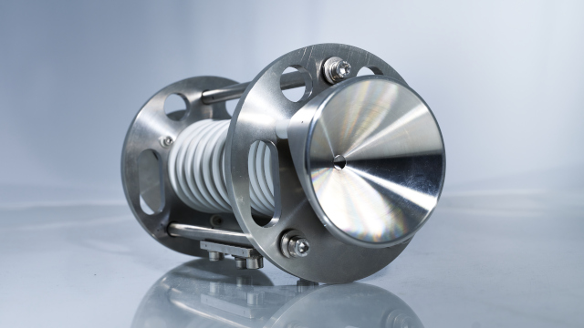
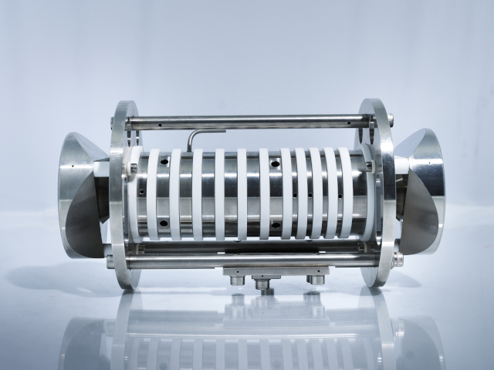
Summary and Outlook
CLS in MR-ToF can significantly increase experimental sensitivity
MIRACLS Paul trap satisfies requirements for 50 keV beam
Full MIRACLS setup is nearing completion
First radioactive Mg runs planned in Summer 2023
Pictures, not 3D renders!

Slide 12
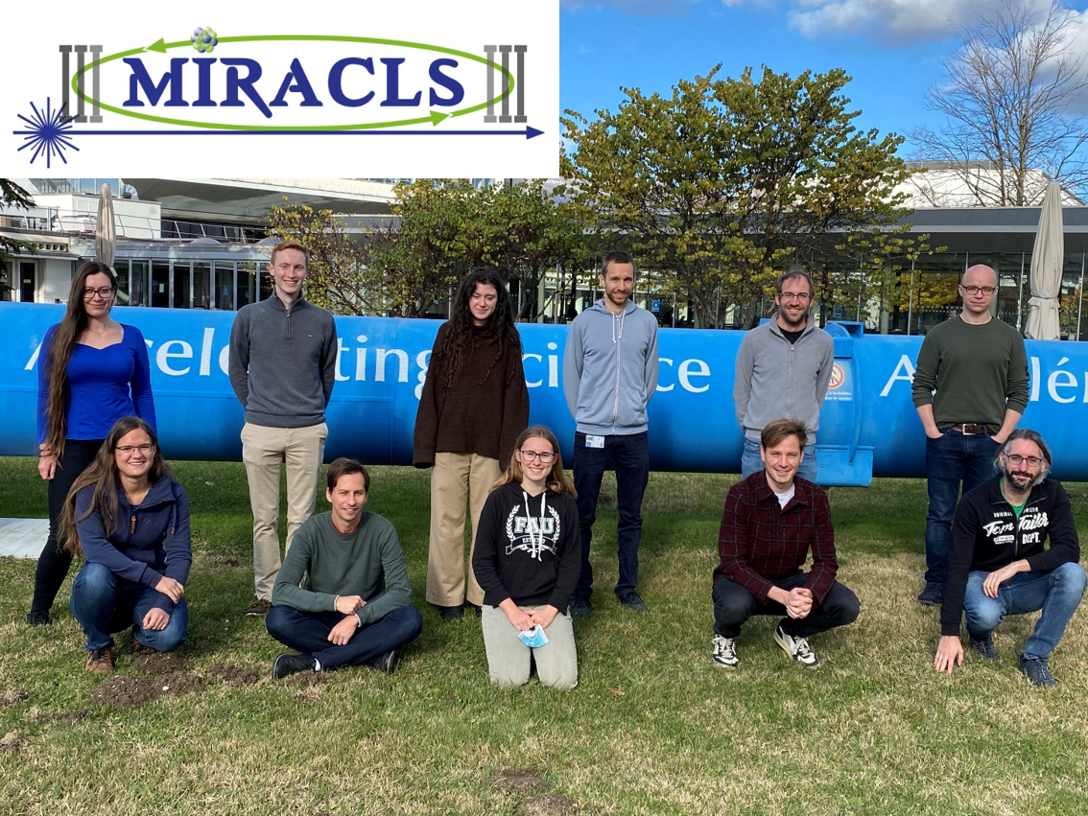
Acknowledgements
L. Bartels, I. Belosevic, F. Buchinger, P. Fischer, F. Hummer, C. Kanitz, V. Lagaki, S. Lechner, E. Leistenschneider, F. M. Maier, W. Nortershauser, P. Plattner, A. Roitman, L. Schweikhard, S. Sels, R. Simpson, M. Vilen, F. Wienholtz, & S. Malbrunot-Ettenauer

Slide 13
References
[Neugart 2017] R Neugart et al 2017 J. Phys. G: Nucl. Part. Phys. 44 064002
[Yordanov 2007] Yordanov, D. T. From 27Mg to 33Mg: transition to the Island of inversion PhD thesis (KU Leuven, Faculteit Wetenschappen, Departement Natuurkunde an Sterrenkunde, Instituut voor Kern- en Stralingsfysica, 2007)
[Sels 2020] S. Sels, P. Fischer, H.Heylen, V. Lagaki, S.Lechner, F. M. Maier, P. Plattner, M. Rosenbusch, F. Wienholtz, R. N. Wolf, W. Nörtershäuser, L. Schweikhard, S. Malbrunot-Ettenauer. Nucl. Instrum. Meth. B, Vol 463 (2020) 310-314
[Lagaki 2021] V. Lagaki, H. Heylen, I. Belosevic, P. Fischer, C. Kanitz, S. Lechner, F.M. Maier, W. Nörtershäuser, P. Plattner, M. Rosenbusch, S. Sels, L. Schweikhard, M. Vilen, F. Wienholtz, R.N. Wolf, S. Malbrunot-Ettenauer. Nucl. Instrum. Meth. A, Vol 1014 (2021) 165663
[Maier 2023] F. M. Maier, M. Vilen, I. Belosevic, F. Buchinger, C. Kanitz, S. Lechner, E. Leistenschneider, W. Nörtershäuser, P. Plattner, L. Schweikhard, S. Sels, F. Wienholtz, S. Malbrunot-Ettenauer. Nuclear Instrum. Meth. A, Vol 1048 (2023) 167927
[Maier 2019] F. M. Maier, “Laser spectroscopy of short-lived- radionuclides in an ion trap: MIRACLS’ proof-of-principle experiment and the simulation of the future 30-kev mr-tof device,” Master’s thesis, Johannes Kepler University Linz, 2019.
[Wolf 2013] R.N. Wolf, F. Wienholtz, D. Atanasov, D. Beck, K. Blaum, Ch. Borgmann, F. Herfurth, M. Kowalska, S. Kreim, Yu. A. Litvinov, D. Lunney, V. Manea, D. Neidherr, M. Rosenbusch, L. Schweikhard, J. Stanja, K. Zuber, “ISOLTRAP's multi-reflection time-of-flight mass separator/spectrometer”, International Journal of Mass Spectrometry, Volumes 349–350, 2013, Pages 123-133, ISSN 1387-3806
[Wolf 2012] Wolf, Robert & Marx, Gerrit & Rosenbusch, Marco & Schweikhard, Lutz. (2012). Static-mirror ion capture and time focusing for electrostatic ion-beam traps and multi-reflection time-of-flight mass analyzers by use of an in-trap potential lift. International Journal of Mass Spectrometry. 313. 8-14. 10.1016/j.ijms.2011.12.006.

Slide 14
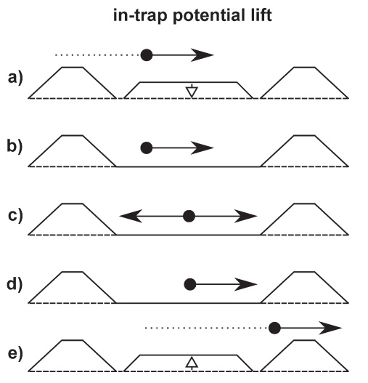
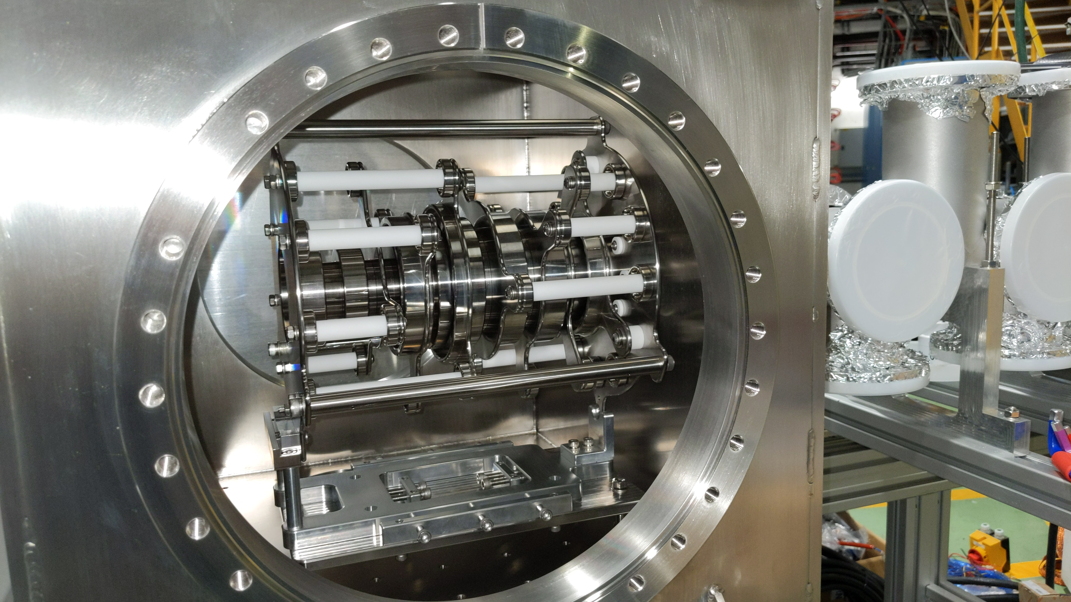
MR-ToF devices
Two electrostatic mirrors separated by drift tube
Primarily used for mass measurements and separation
$R= \frac{m}{Δm}=\frac{t}{2Δt}$
Require small temporal width
Adapted from [Wolf 2013]
From
[Wolf 2012]

Slide 15
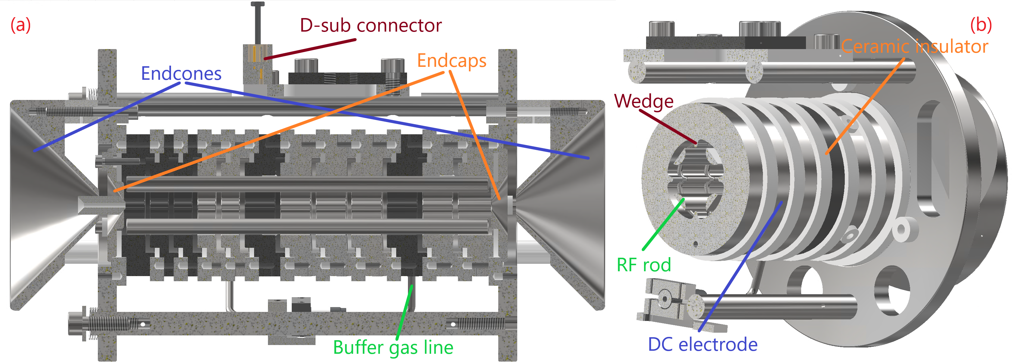
Paul trap design

Slide 16
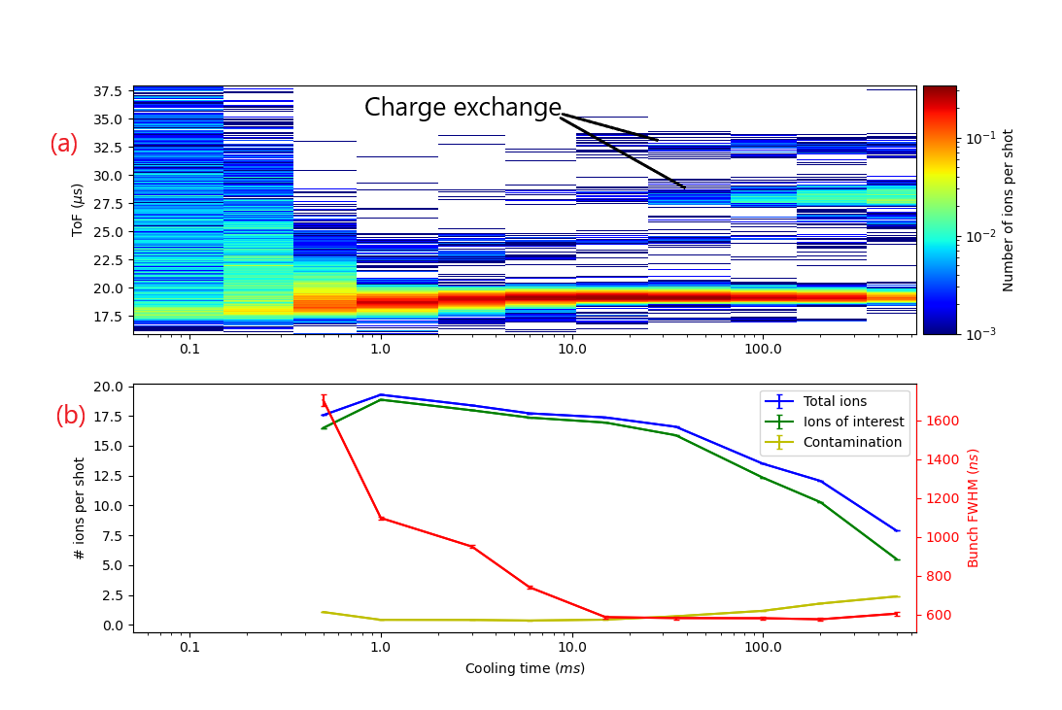
More results

Slide 17
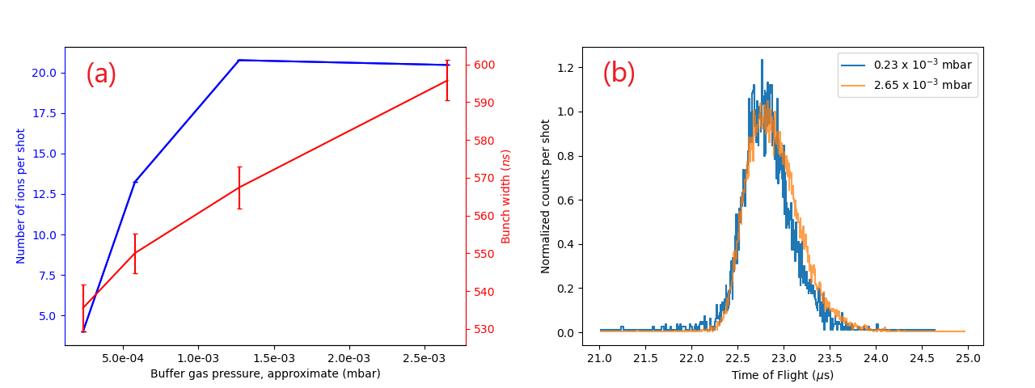
More results (cont.)

Slide 18
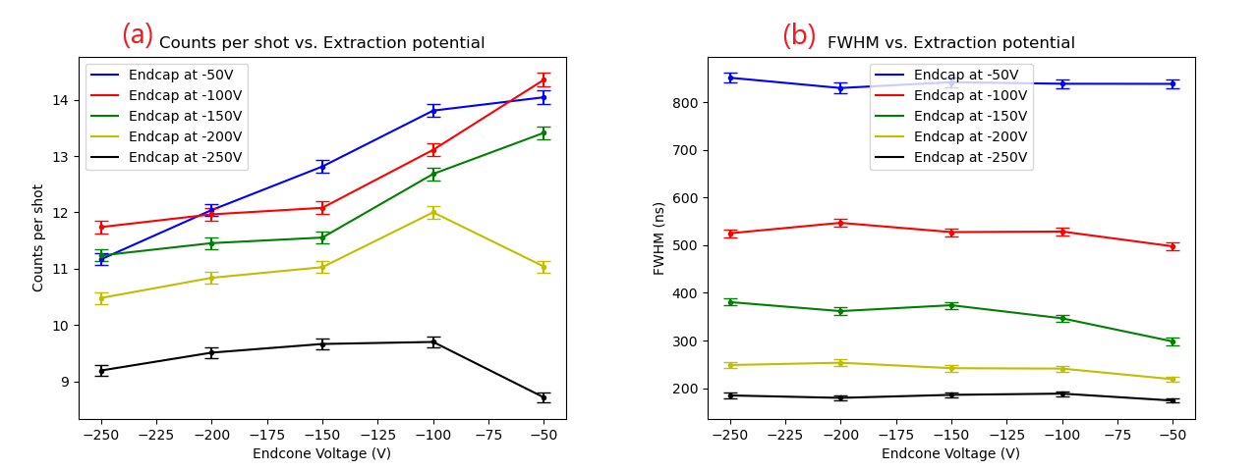
More results (cont. x2)

