Slide 1
SuperCDMS HVeV Detector Characterization
Musaab Al-Bakry
WNPPC 2023

Slide 2
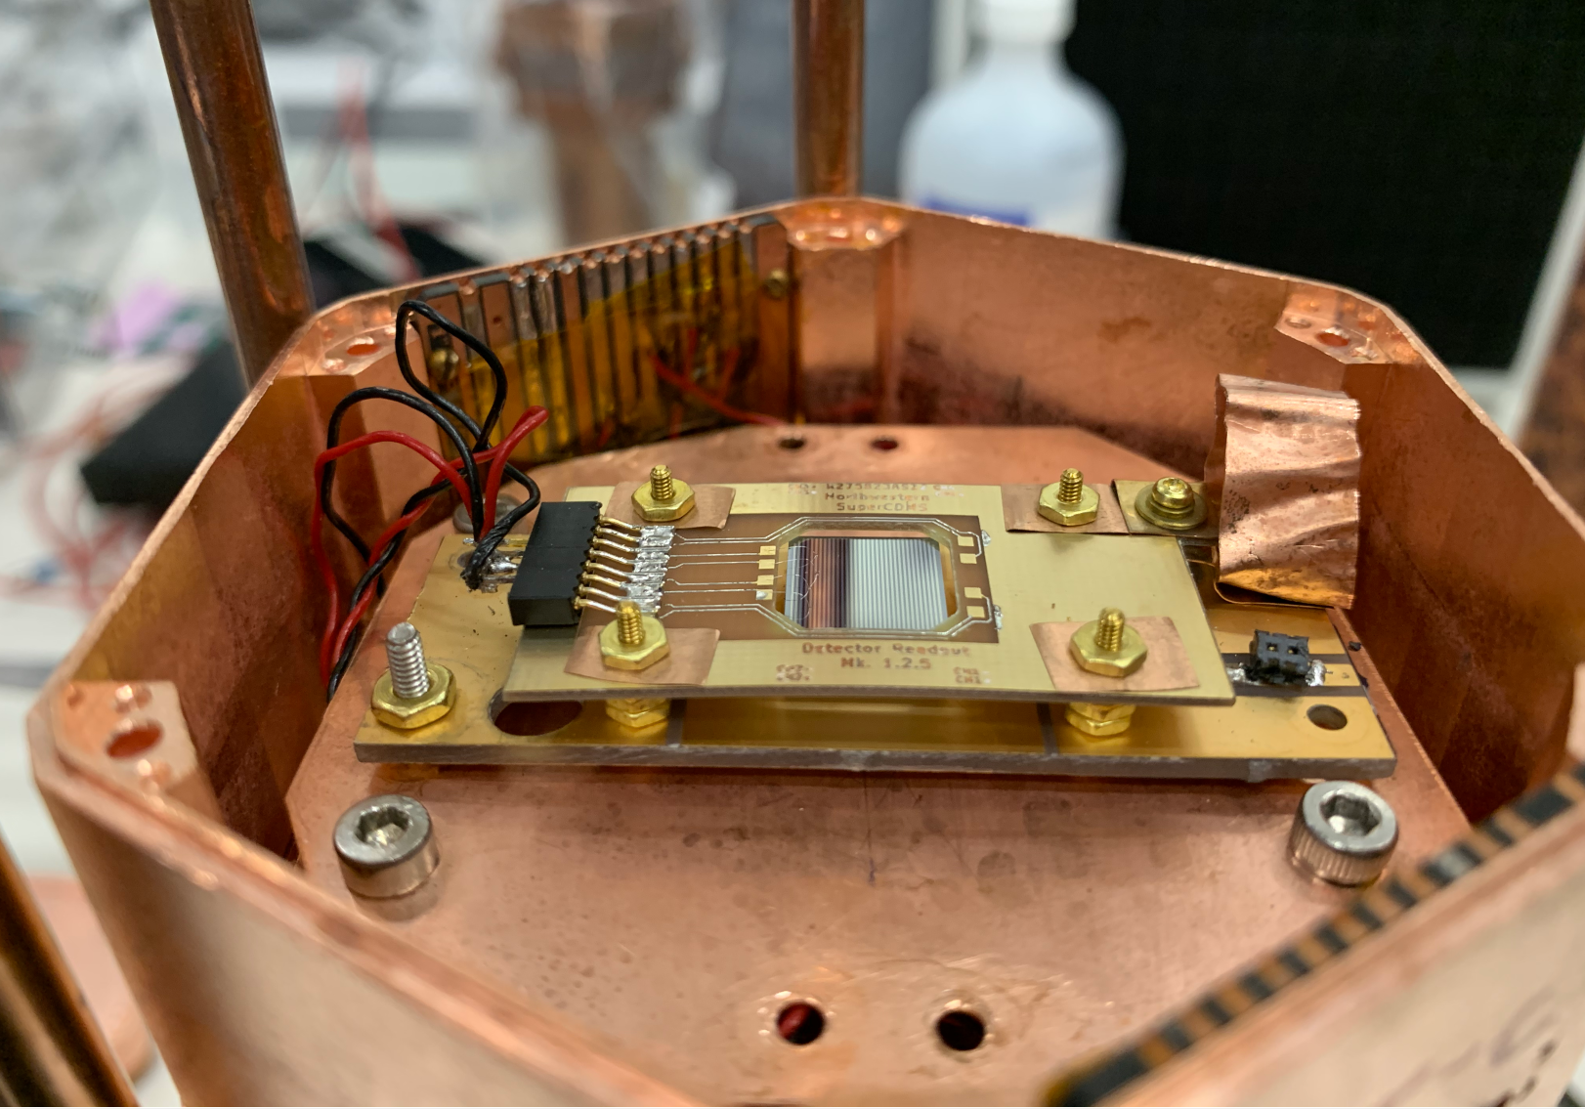
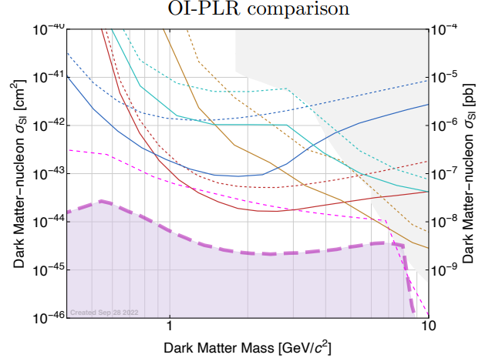
Super Cryogenic Dark Matter Search (SuperCDMS) Assumptions and Hopes
HVeV
Dark matter may interact with regular matter weakly
Can interact with the bulk of the detector through electron or nuclear recoil
With low/controlled background environment, this interaction can be measured.
In SuperCDMS, one detector type is the HV detector
Cryogenic Ge and Si crystals to measure phonons via QETs
Large HV detectors for sufficient exposure and small HVeV with better resolution

Slide 3
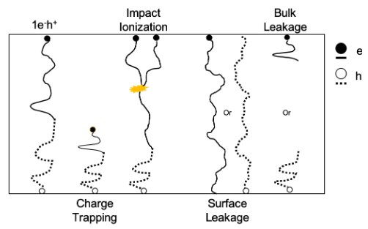
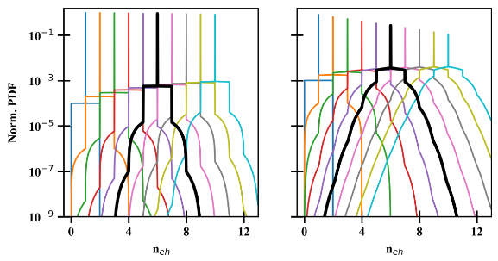
HVeV Detectors and NTL Effect
High-purity Si or Ge lattice
High bias voltage (100-200V)
NTL amplification
e/h pairs drift across lattice and produce phonons
Measured energy quantized by phonon-mediated amplification of charge carriers
Additional crystal effects
Charge trapping
Impact ionization
Background
Random coincidence from external backgrounds

Slide 4
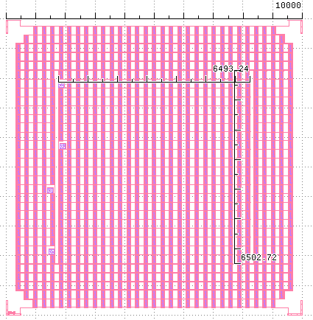
HVeV NF-C Detector at TRIUMF

Slide 5
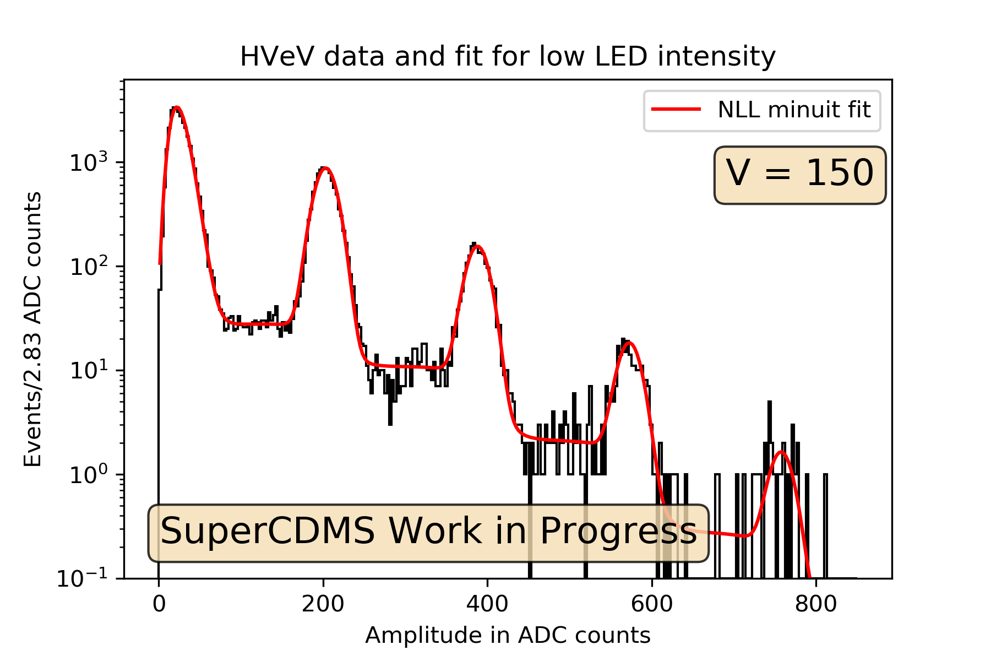
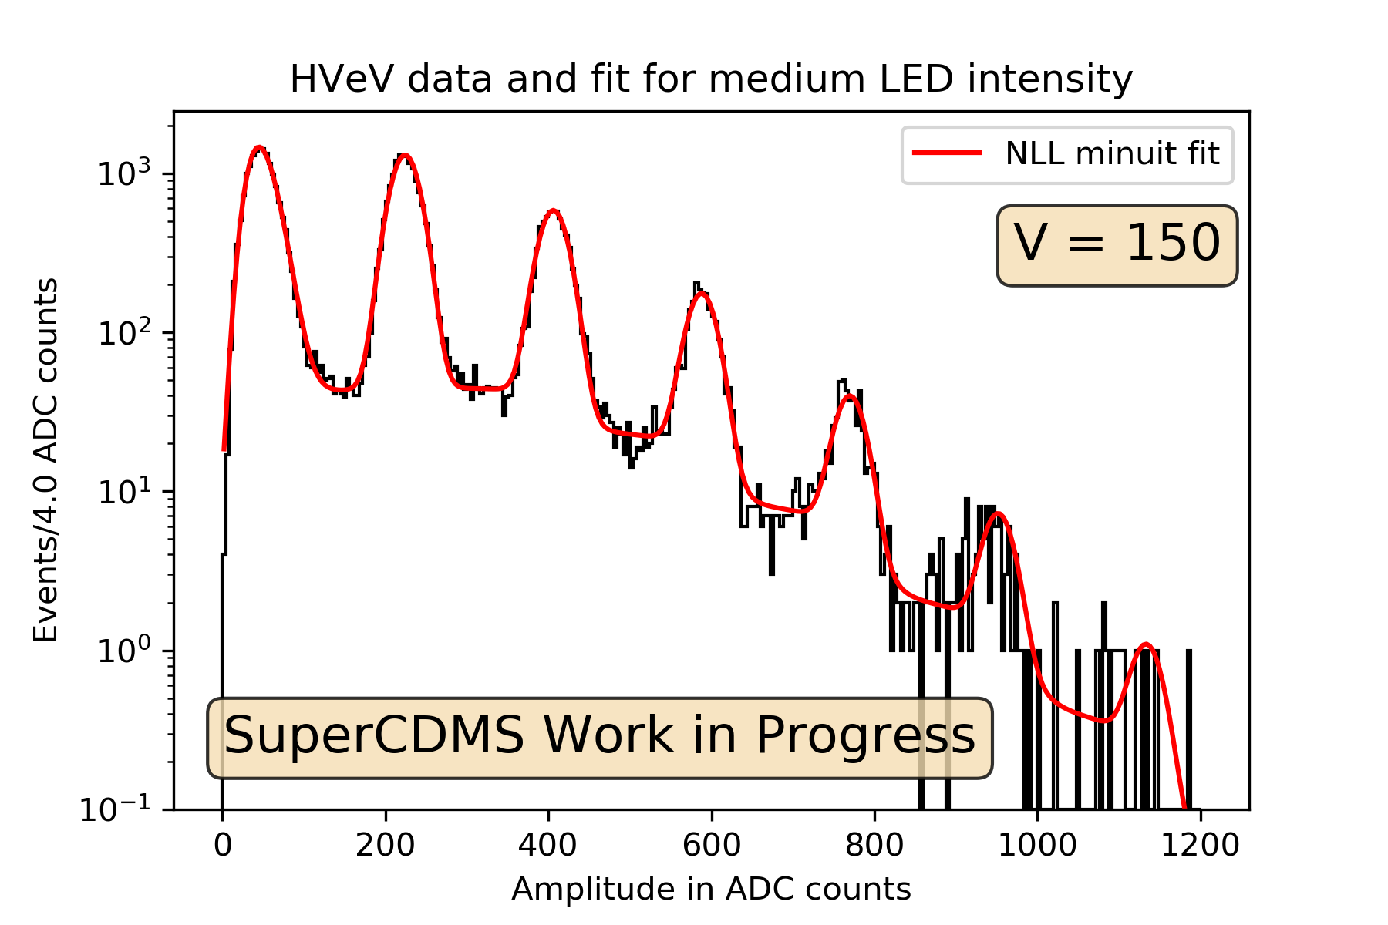
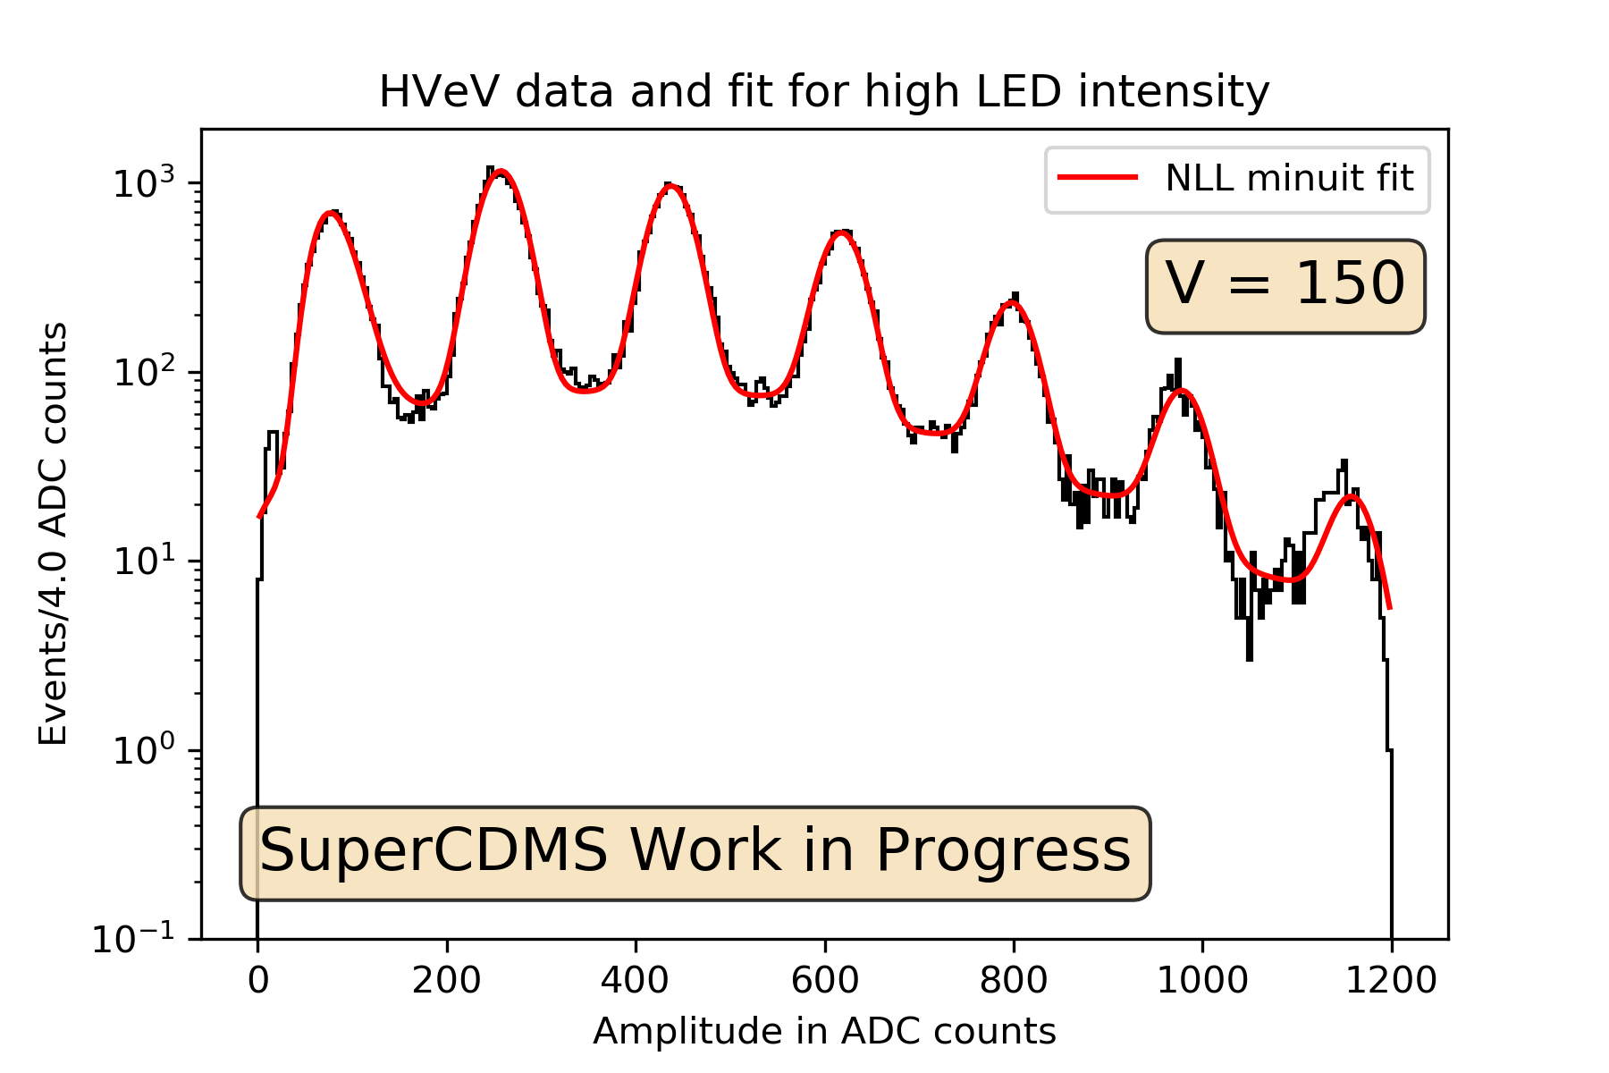
HVeV Calibration Data from TRIUMF
Calibration using UV LED (~4 eV) at different intensities
Shone towards center of detector
2 channels (inner and outer)
Model fit on aggregate of both channels for total phonon signal

Slide 6
Fit Results for Different LED Intensities
Fit for Poisson lambda (LED intensity), detector resolution (width of peaks), charge trapping and impact ionization, background, etc.
Puzzle: detector resolution and peak positions change with LED intensity?

Slide 7
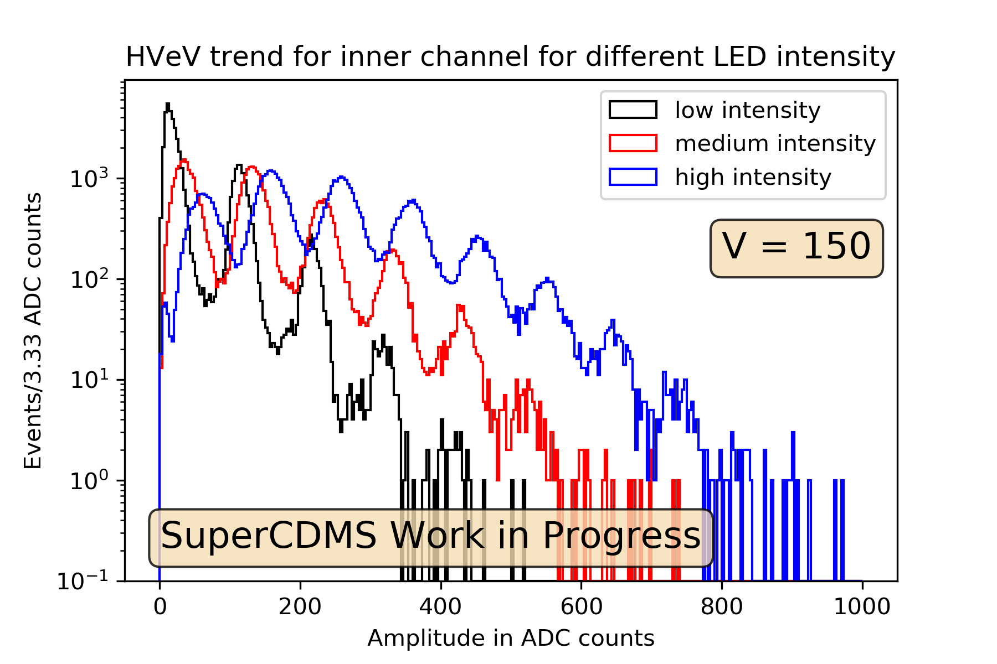
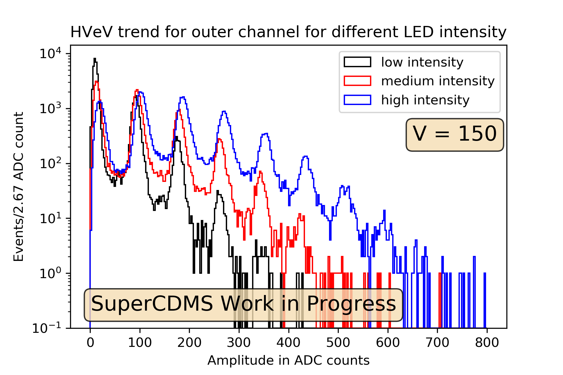
Inner Channel vs. Outer Channel Spectra
LED is collimated on the center of detector (inner channel).
More photons are hitting inner channel vs. outer channel.
Peak positions variation is more pronounced for inner channel.
Peak width (detector resolution) also varies!
Phenomenon is based on # photons hitting detector.

Slide 8
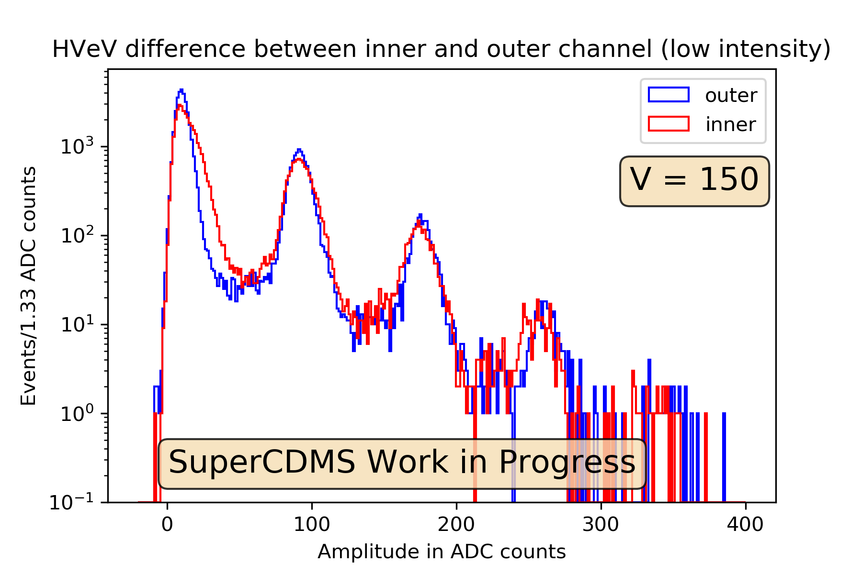
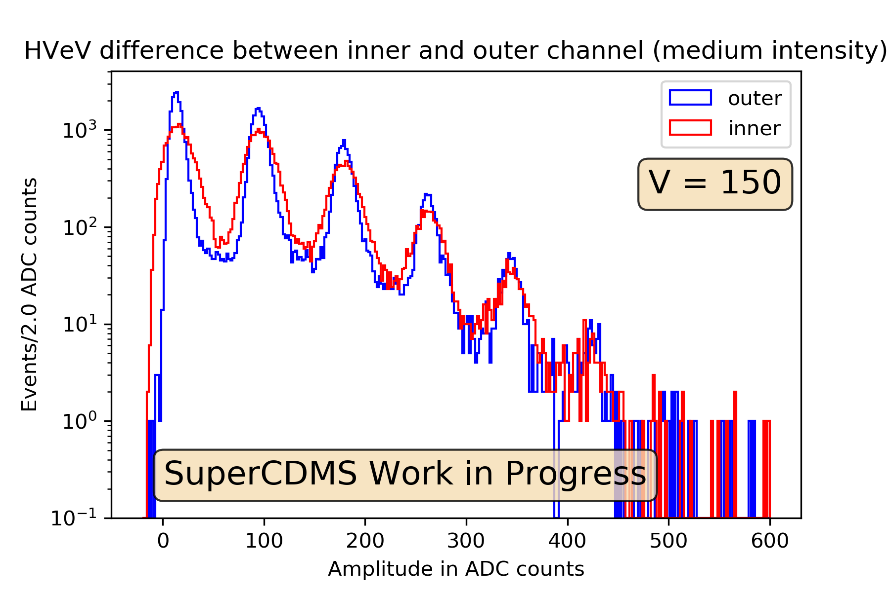
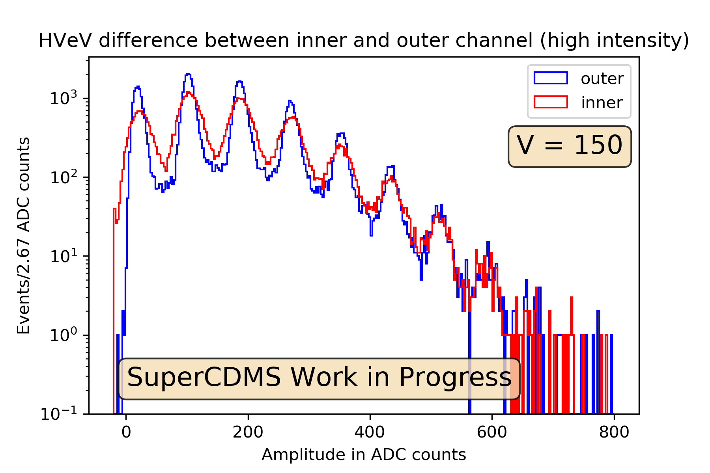
Inner Channel vs. Outer Channel Spectra
Clear variation in peak widths
Worse resolution for higher LED intensities
What is going on here?

Slide 9
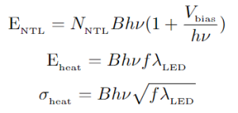
Non-Quantized Heating Model
Hypothesis:
Some photons are absorbed as heat with no e/h pairs (follows Poisson process)
High statistics => Gaussian
Expectation:
Linear increase for peak position
Square-root increase for peak width
N_{NTL} - # of e/h pairs produced
B - conversion factor from eV to ADC counts
V_{bias} - bias voltage across the crystal
hv - energy of a single calibration photon in eV
f - conversion factor from Poisson lambda to # of photons

Slide 10
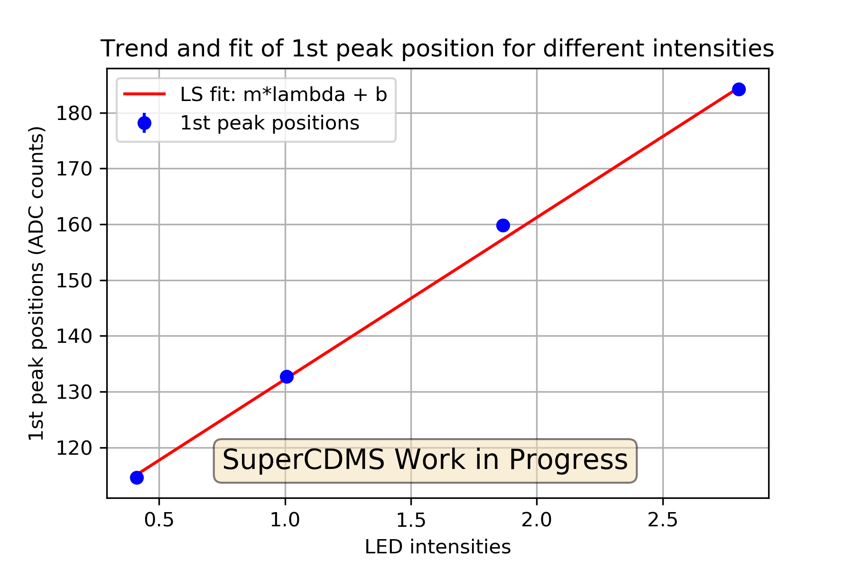
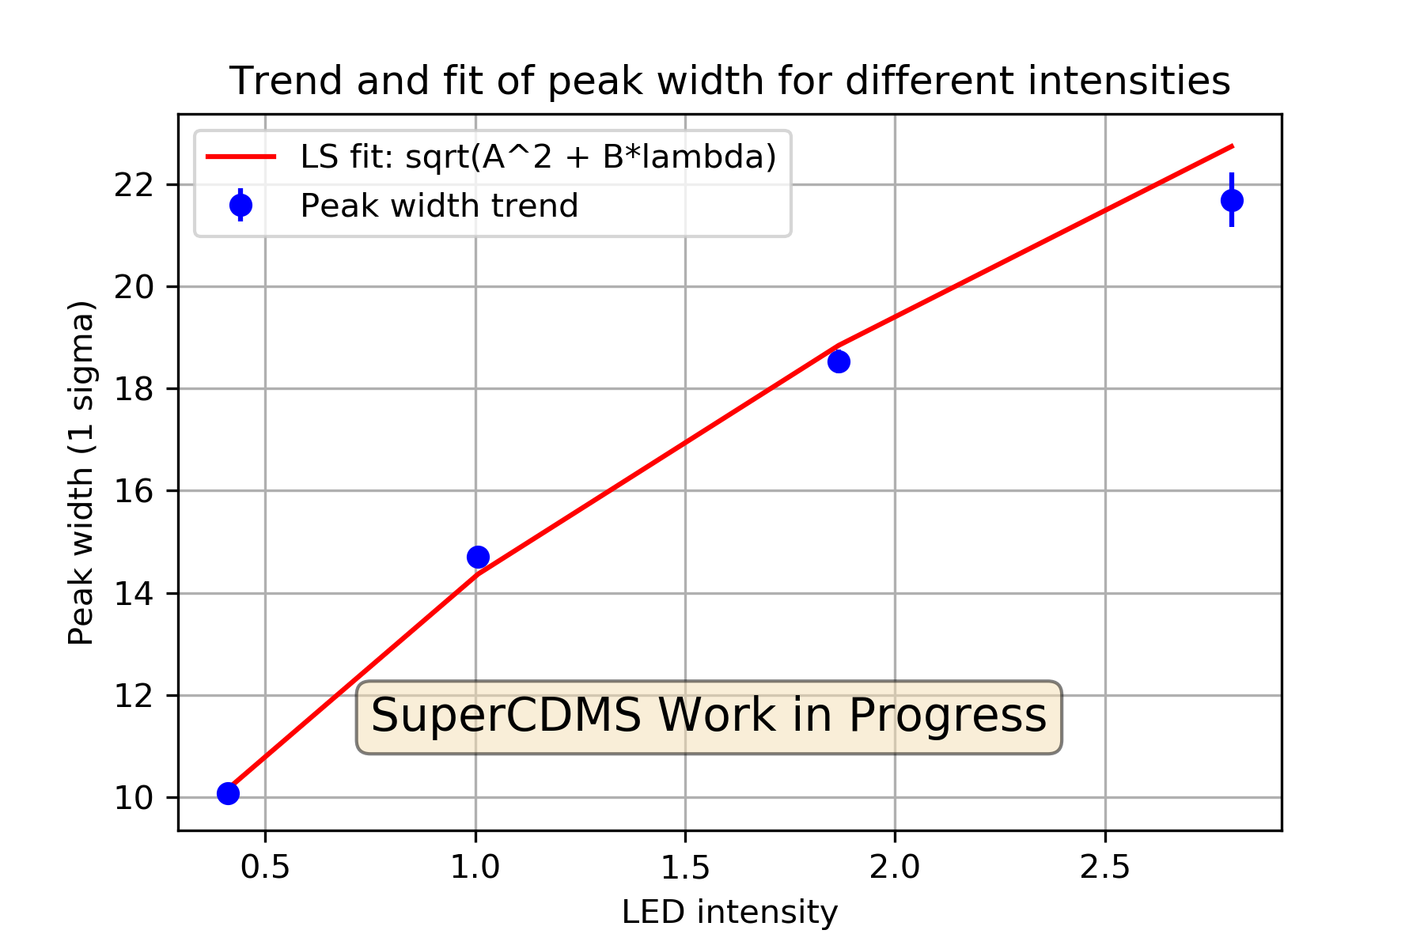
Non-Quantized Heating Model Verification
Fits for peak positions and widths resemble the data
Compute the constants in the formulation (e.g. B, f)
Dark Matter limit (LED intensity => 0)
Estimation of detector resolution for Dark Matter

Slide 11
Non-Quantized Heating Sources and Future Testing
Hypothesis 1: Some photons are absorbed in the QET
QET: Quasi-particle trap-assisted Electrothermal feedback Transition edge sensor
QET covers 50% of detector surface
QET has higher sensitivity to photons (QET efficiency)
LED was collimated at QET side
Hypothesis 2: Some e/h pair are trapped on the surface
UV penetration depth on Si is 0.01 um
Simulation suggests trapping of e/h pairs on the near surface
Trapped e/h pairs may be reabsorbed as heat before amplification
Future testing:
Shining the LED on the backside of detector (no QET)
Using other colors and look for correlation
Test different polarities (e.g. +/- 150 V)
Current runs at TRIUMF aim at answering these questions

Slide 12
Thank you!

Slide 13
Backup Slides

Slide 14
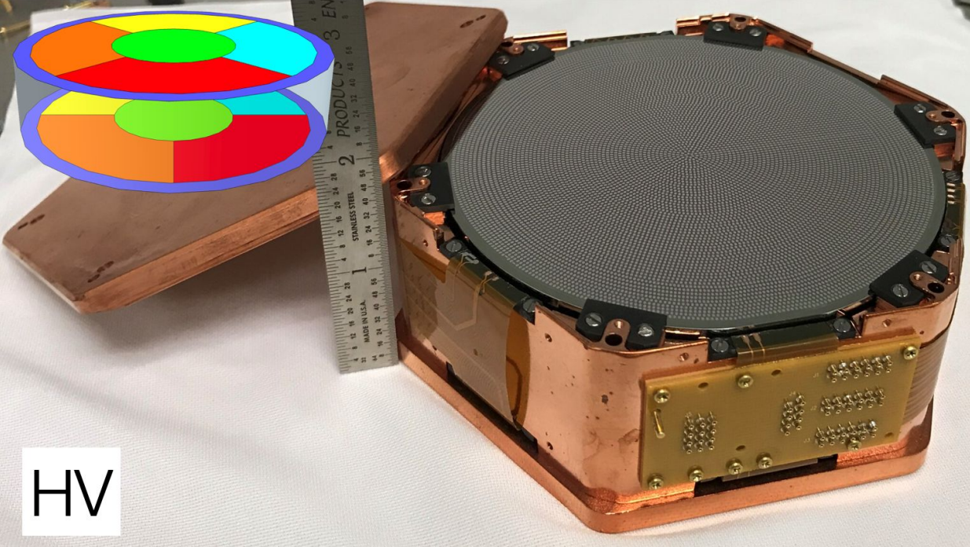
Appendix 1: HV Detectors

Slide 15
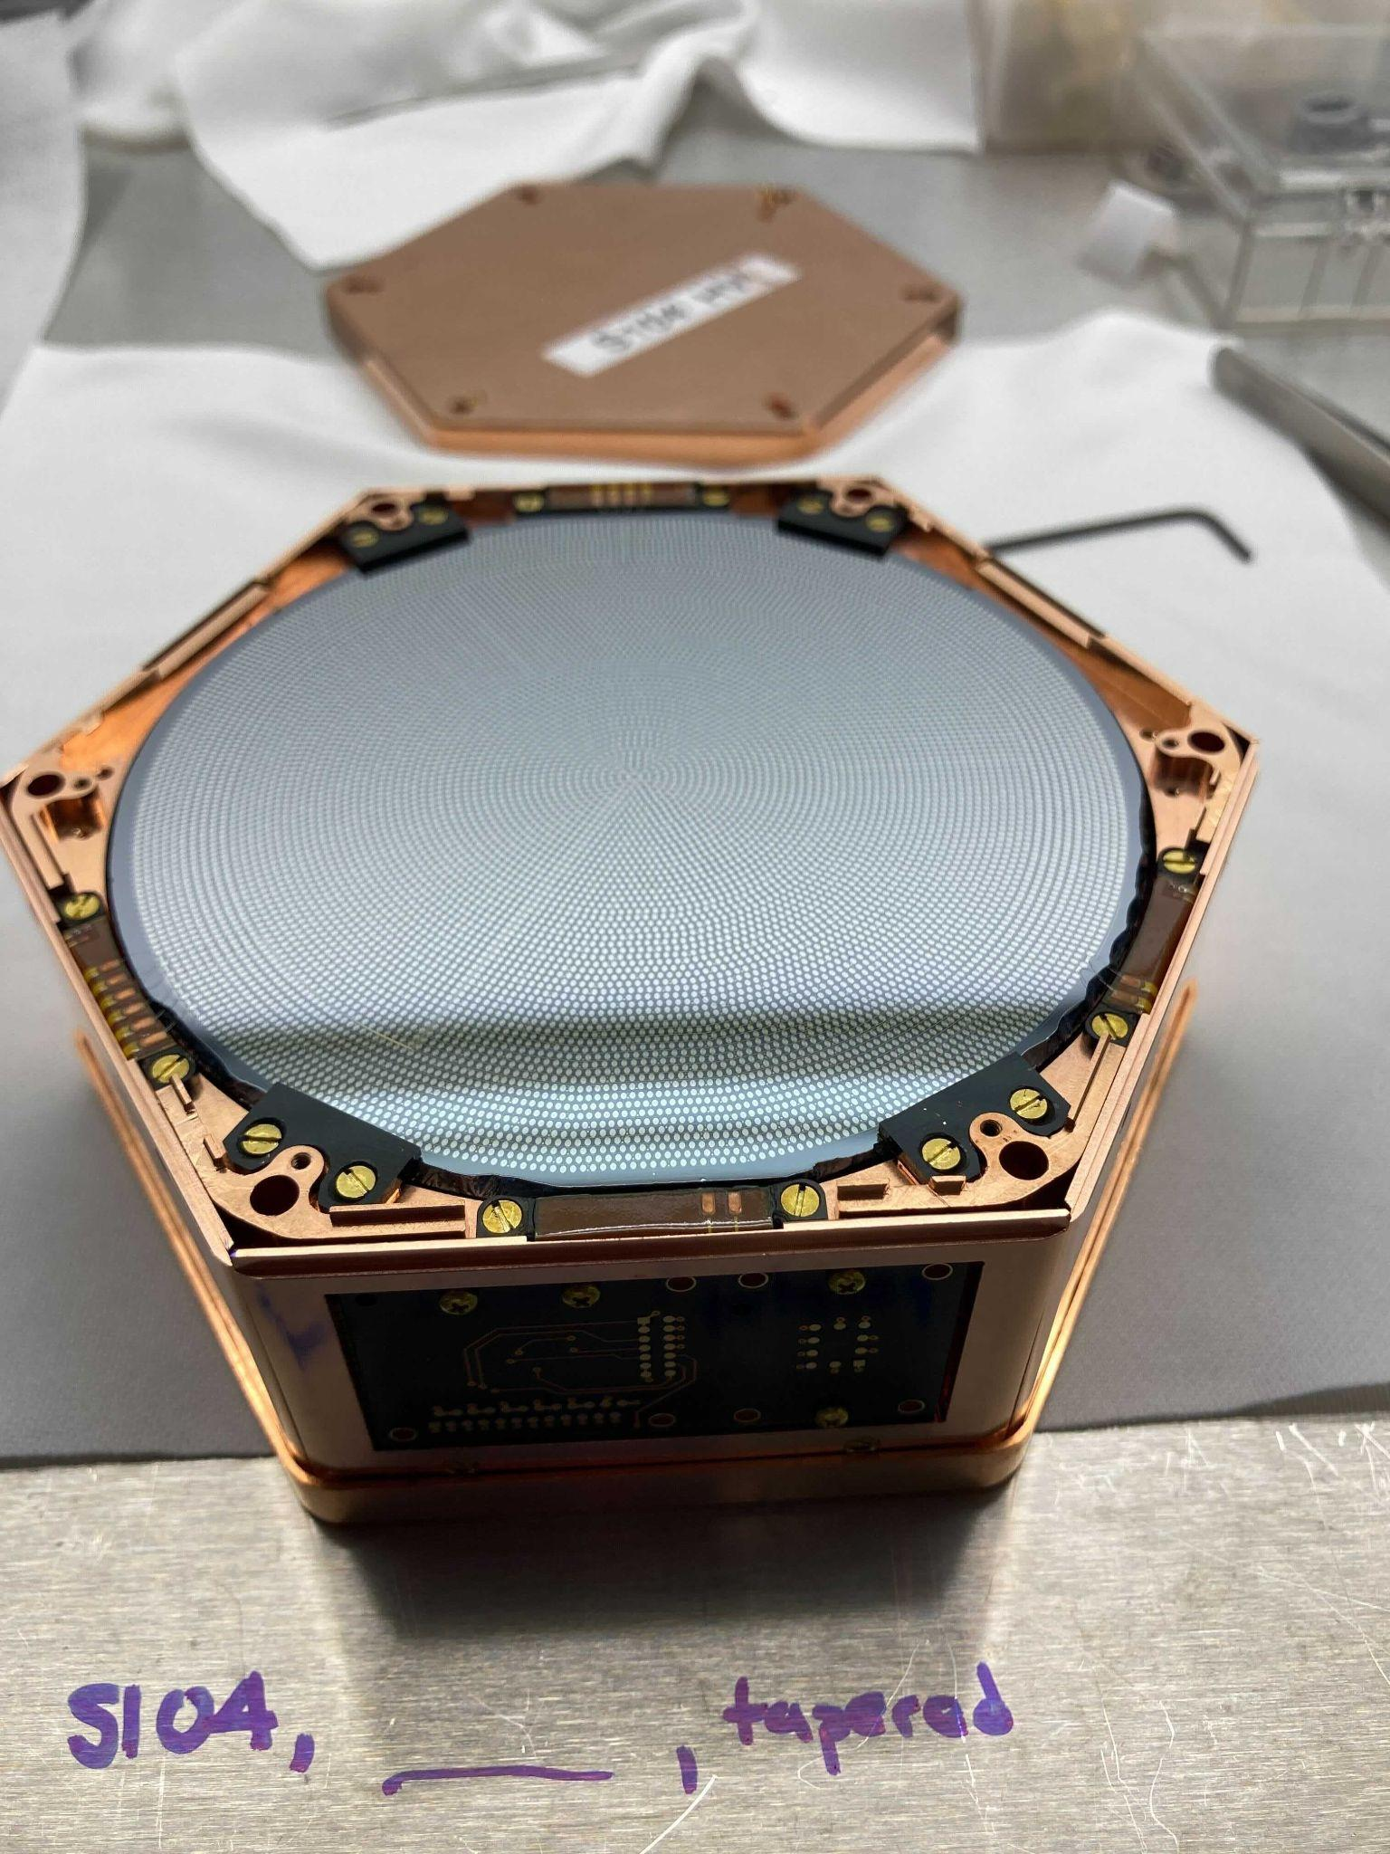
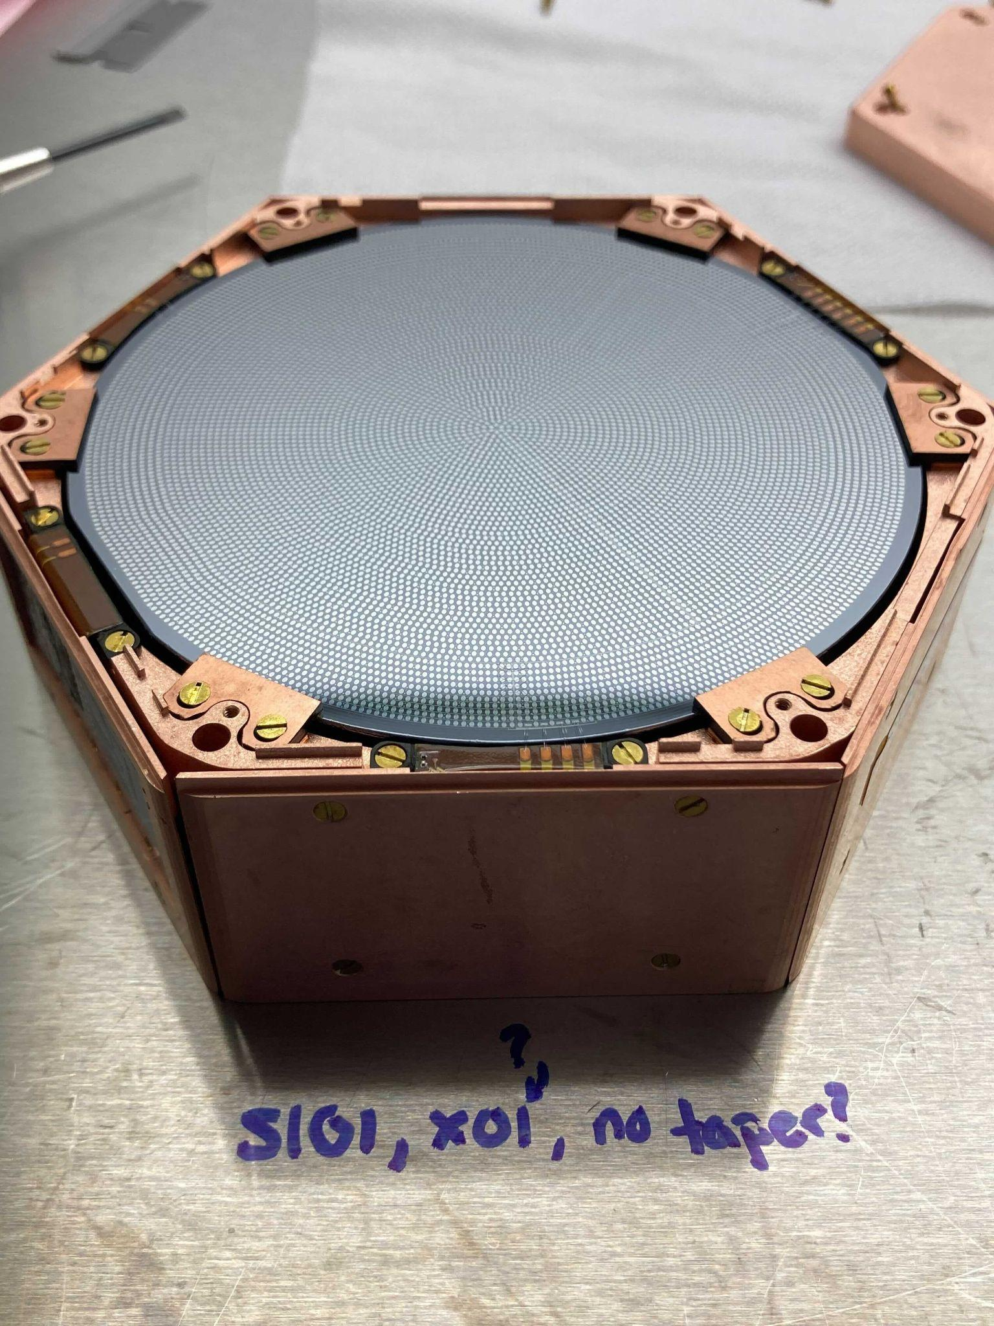
Appendix 2: More HV Detectors

Slide 16
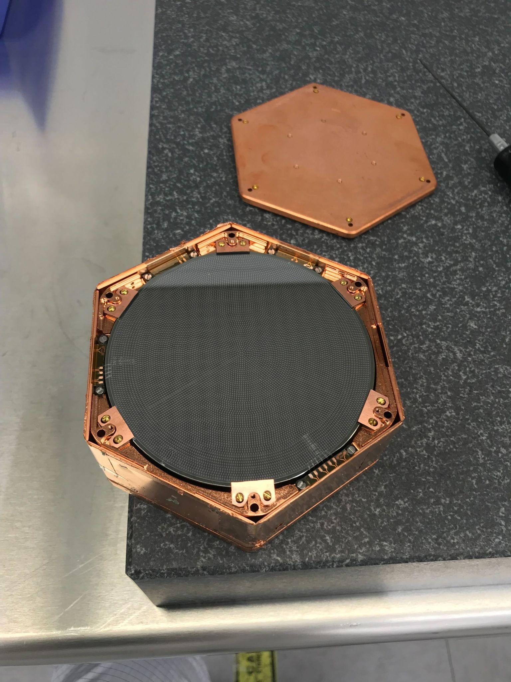
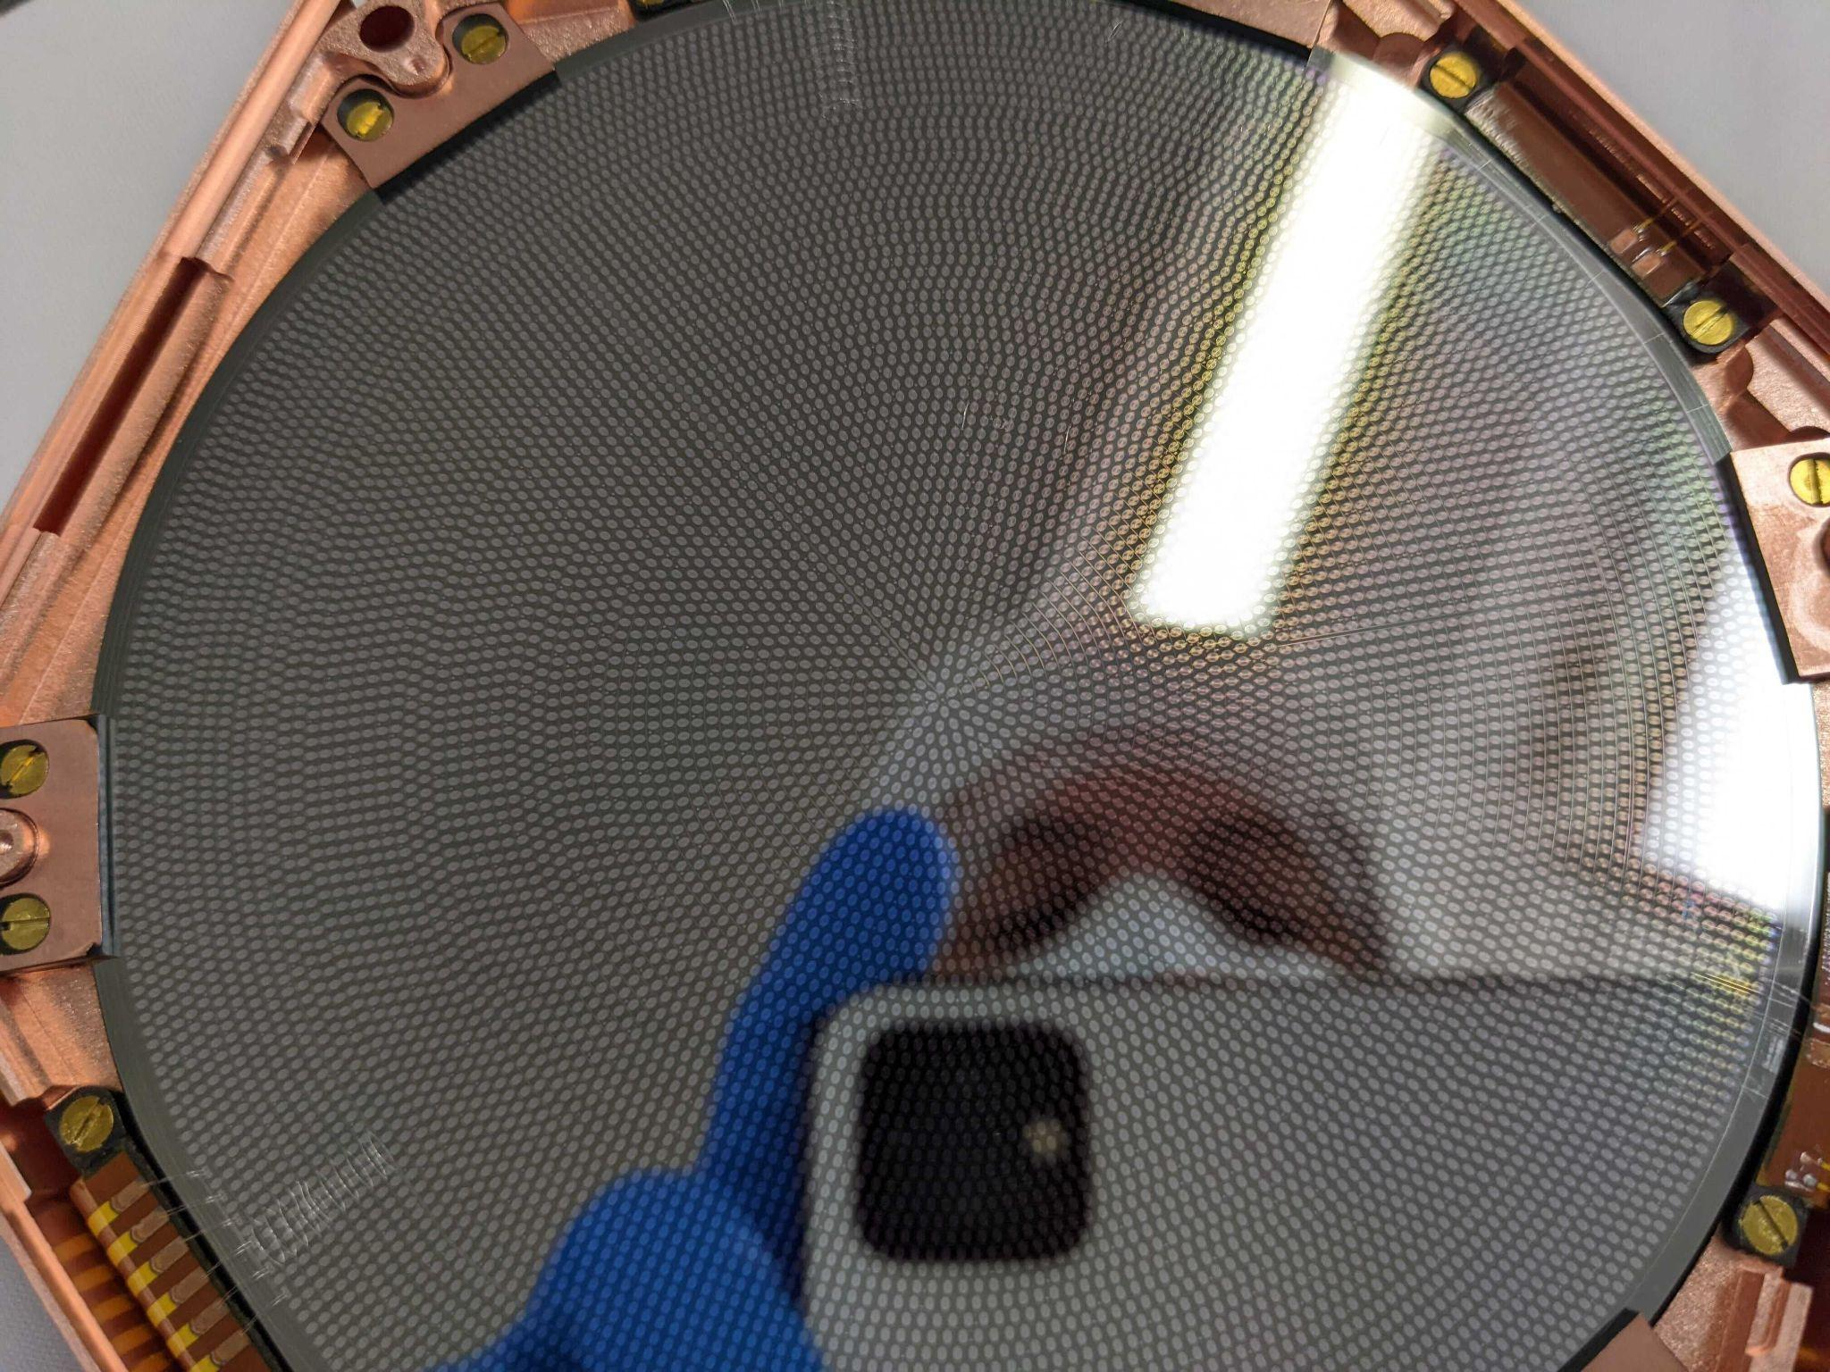
Appendix 3: Even More HV Detectors

Slide 17
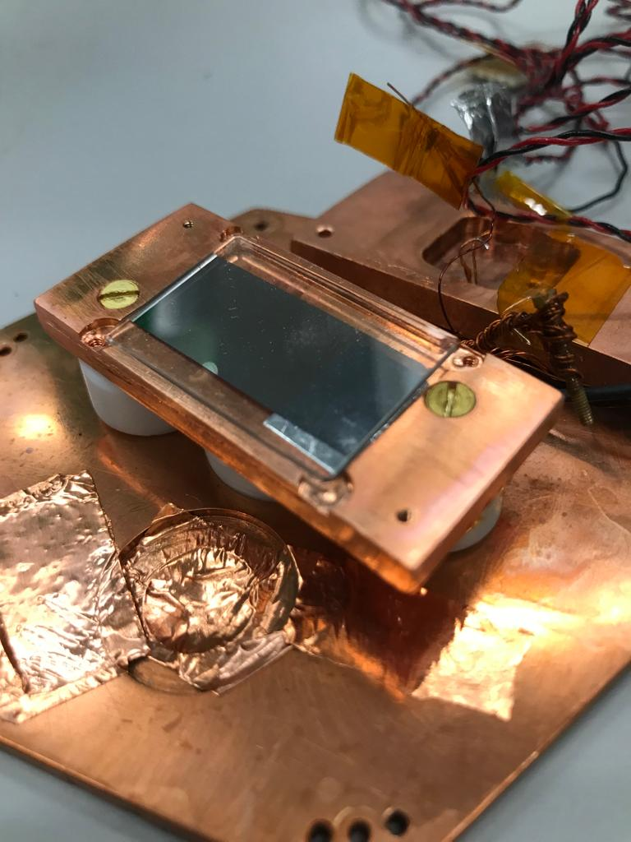
Appendix 4: UV LED and filter
UV LED is 4 eV => 310 nm
UV LED is shining through thin Al film (~20 nm). UV that makes it through the Al film passes through UV transparent glass.
The LED is shining through small hole to centered at the inner channel of the detector.

