Slide 1
The Experimental Study of Shape Coexistence in ¹¹⁴Sn via GRIFFIN
Dominic W.B. Annen
The Andreoiu Group
Simon Fraser University, Burnaby BC
WNPPC 2023 - Banff, Alberta
February 18th 2023

Slide 2
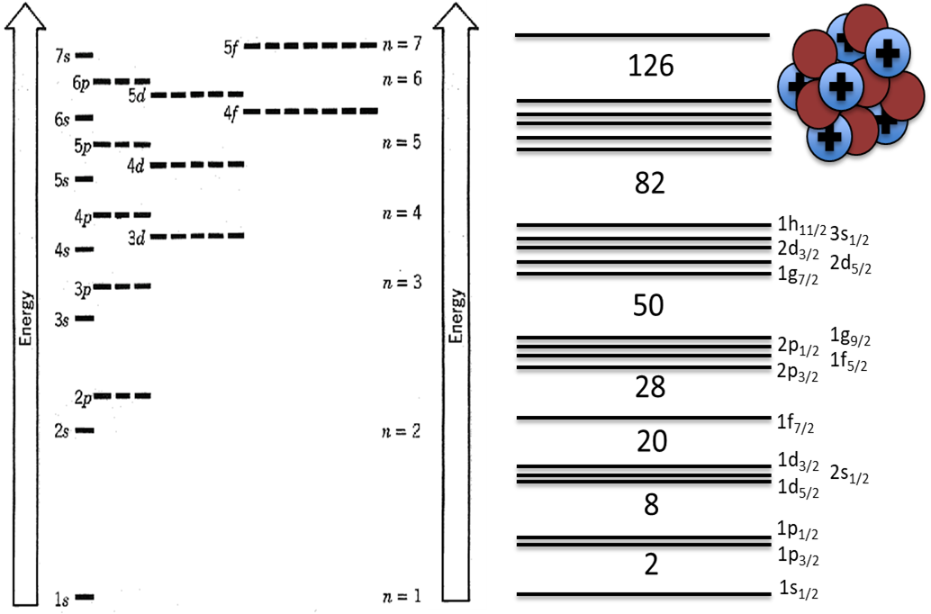
Shell Model and “Magic” Nuclei
ELECTRONS
NUCLEONS
Nucleons arranged in respective shells
Filled valence shells are associated with increased stability
“Doubly- / Singly-Magic”
“Magic” nuclei characteristically spherical in ground state
Atomic properties attributed to valence electrons
Nuclear properties attributed to interactions between valence nucleons
Notes:
To introduce nuclear structure first we must briefly aknowledge the shell model and magic nuclei.
-Analogous to atomic electron configuration, nucleons are arranged in respective shells.
-Filled valence shells = increased stability
-Sn is magic with Z=50
-Magic nuclei including Tin are characteristically spherical in GS

Slide 3
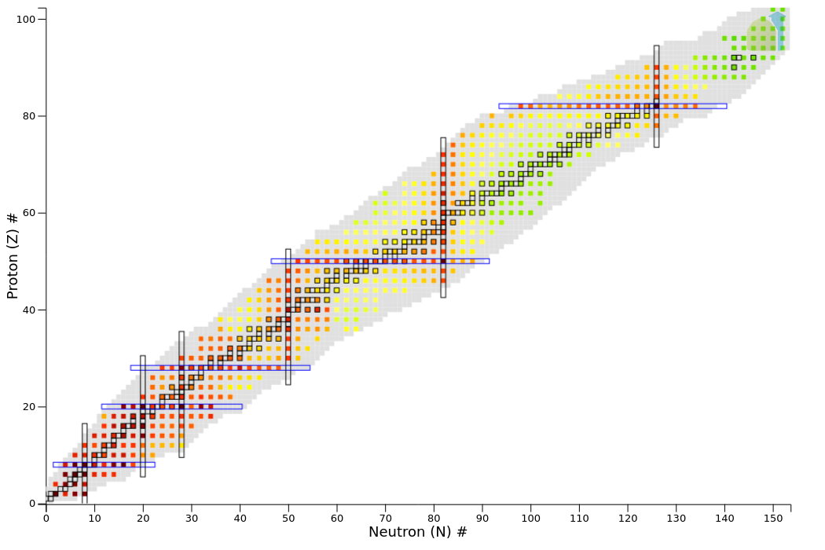
Quadrupole Deformation
Oblate (earth)
Prolate (rugby ball)
Spherical
Excitation energy of the 2₁⁺ state in even-even nuclei from NNDC NuDat
Notes:
-Nuclidic chart (Z,N) colour representing excitation energies of the first excited 2+ states
-Magic numbers / closed shells boxed in blue -> Spherical GS, + higher excitation energy of first excited 2+
-Most nuclei are deformed, (ie. not spherical in GS) ((don’t have magic numbers))
-Quadrupole deformation is most prevalent deformation across the chart of nuclides.
-Q-pole manifests as Oblate (Earth shaped) or prolate (rugby ball)
-FROM interactions between protons and neutrons in the nuclear valence space.
-This is seen further away from the closed shells where the nuclei become more deformed from the collective interactions in the valence space.

Slide 4
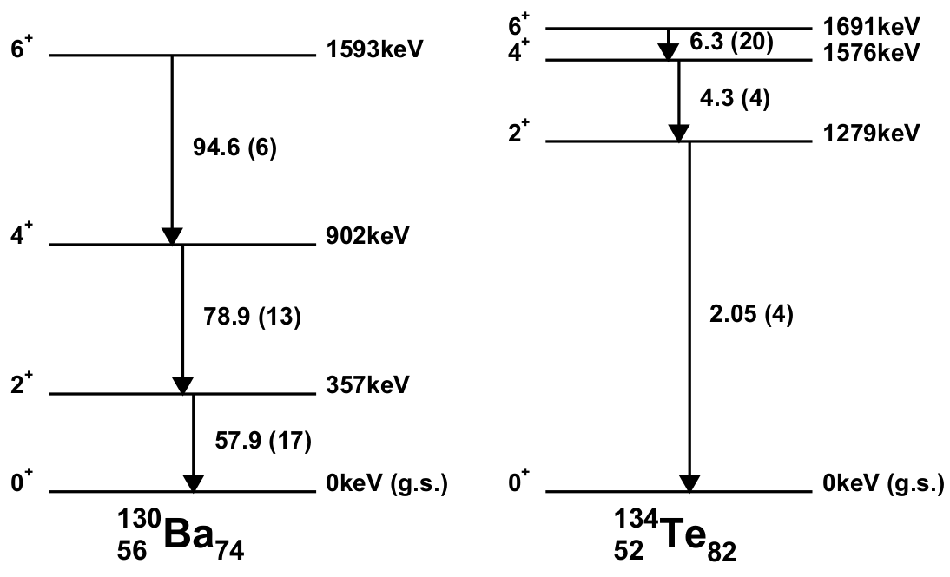
Signatures of Nuclear Shape: B(E2)
Non-magic ¹³⁰Ba shows highly collective excitations
High B(E2) values
Indicative of the rotational band and deformed nuclear shape
Singly-magic ¹³⁴Te shows non-collective excitations
Low B(E2) values
Seniority scheme implies sphericity
Rotational Band
Seniority Scheme
Notes:
-Signature of shape comes from reduced transition probability or B(E2) value measured in W.u.
-With higher B(E2) inferring highly collective excitations from deformation of nuclear shape.
-We measure quadrupole deformation by extracting these BE2 values via the intensity of these transitions and the lifetimes of the states.
-In 130-Barium large B(E2) values indicate that excitations are highly collective, as a result of the deformed shape.
-In semi-magic 134-Tellurium has a closed neutron shell with n=82 and just above z=50 shell @ z=52,
-Tellurium Level scheme is very different from the barium excitation corresponds to the breaking of a pair of protons. Excitations w/ small Be2 values non-collective

Slide 5
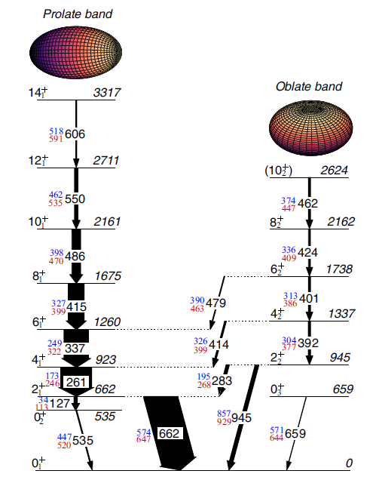
¹⁸⁶Pb and Shape Coexistence
Z=82 closed proton shell implying spherical shape in g.s.
Shape coexistence is Two or more states having distinct properties and different intrinsic shapes within a narrow energy range
Characterized by rotational bands of excited states allowed by deformed shapes (prolate & oblate, etc.)
Ojala, J. et al. Reassigning the shapes of the 0⁺ states in the ¹⁸⁶Pb nucleus. Commun Phys 5, 213 (2022)
Notes:
Curious case of186-Pb ( singly magic nucleus) Z=82 closed proton shell
Would therefore expect 186-Pb to be spherical in it’s ground state
Level scheme shows two rotational band structures, uncharacteristic of spherical shapes
These bands correspond to a difference in nuclear shape vs GS
These structures arise from Particle-hole excitations across the shell gap, introducing the proton-neutron interaction in the nuclear valence space, leading to the deformed shapes.

Slide 6
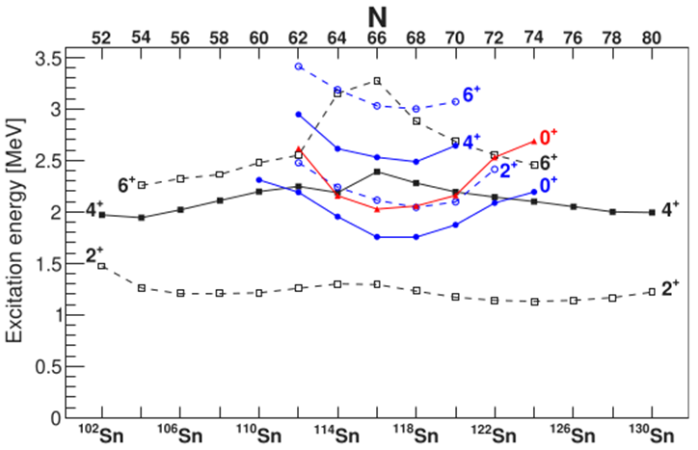
Shape Coexistence in Sn Isotopes
Closed proton shell @ Z=50
Near spherical g.s.
First excited 2⁺ corresponds to a non-collective breaking of neutron-pair
Excitation E ≈ 1.3 MeV
Low B(E2;2₁⁺→0₁⁺)
Mid-shell rotational band built upon 2p-2h configuration
Hypothesised to be built upon 0₂⁺ state (blue)
Garrett P. E. et al. An experimental view on shape coexistence in nuclei. Progress in Particle and Nuclear Physics 124, (2022), 103931
Notes:
Closed proton shell @ z=50
Near spherical GS
First excited 2+ corresponds to breaking of neutron pair (excitation energy >1 MeV)
Low BE2 -
Mid-shell rotational band, built upon an intruder configuration (2p2h??)
Current hypothesis is that this band is built upon the 2nd 0+ state (BLue)
We also see the 3rd 0+

Slide 7
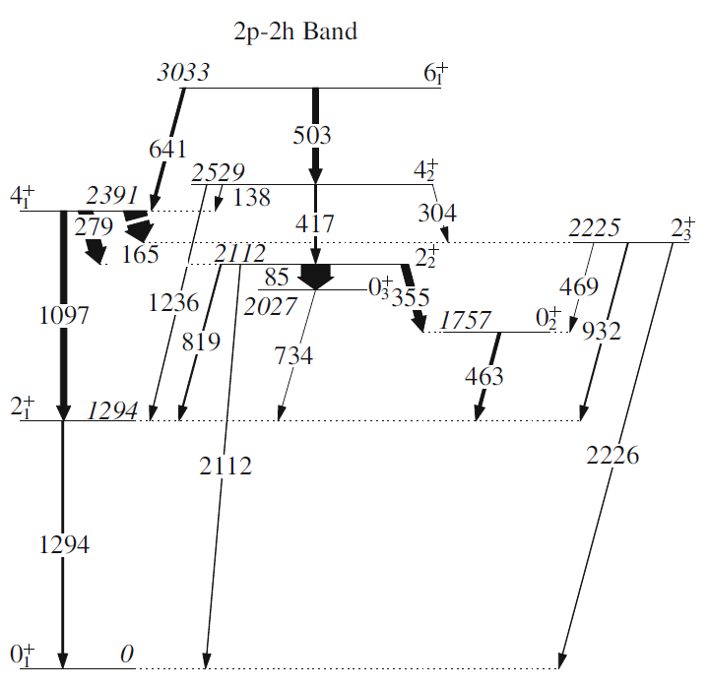
¹¹⁶Sn Shape Coexistence
Findings from Pore et. al (2016) regarding ¹¹⁶Sn suggest a reevaluation of the head of the 2p-2h band within this nucleus
B(E2;2⁺₂→0⁺₃) / B(E2;2⁺₂→0⁺₂) ≈ 2.2
Based upon intensity measurement of very weak 85-keV transition
Notes:
-Performed with GRIFFIN predecessor 8pi
-level scheme (Showing very weak 85-keV transition)
-Show BE2 values from 2+ to the different 0+s
-Provoking a reevaluation of the band-head
~2.2 ratio of BE2

Slide 8
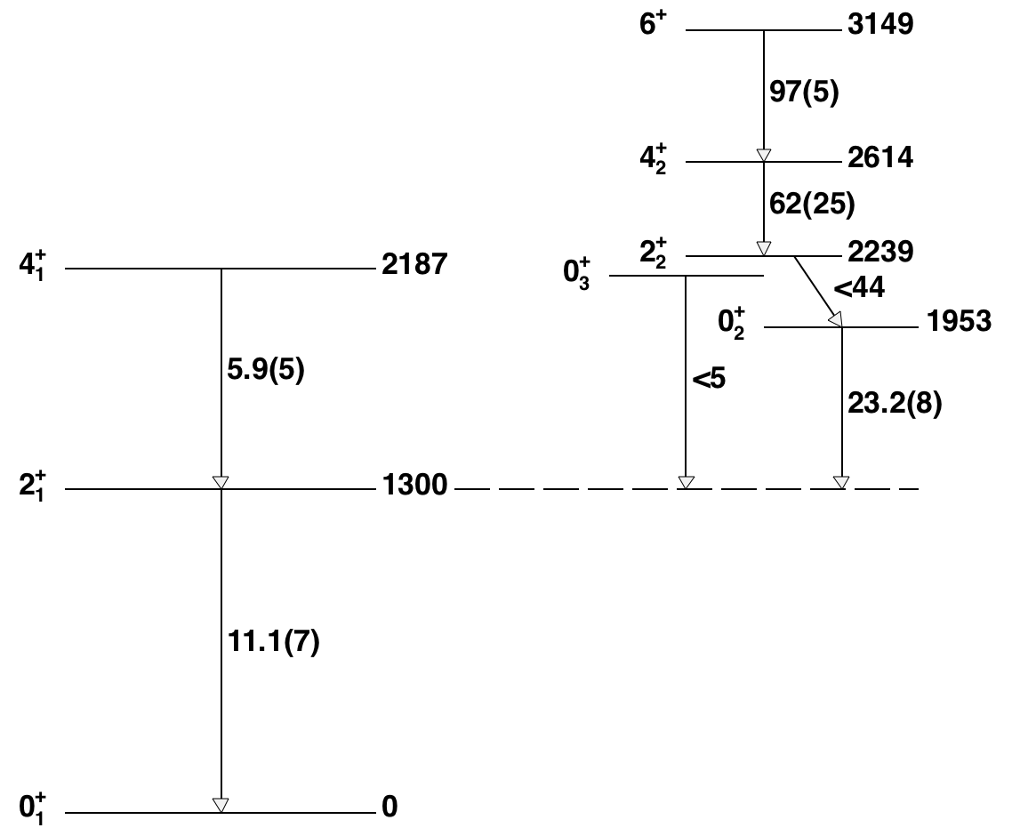
A Case for ¹¹⁴Sn Inquiry
¹¹⁴Sn level scheme is highly similar to that of ¹¹⁶Sn and other mid-shell Tin isotopes
Missing observation of key 2₂⁺→0₃⁺ transition
No established lifetime or branching ratios from 2₂⁺ state of interest
Existing lifetime lower limit of 𝜏 > 2.1 ps
Most recent 𝛽-decay study of ¹¹⁴Sb→¹¹⁴Sn was M. E. J. Wigmans et. Al, Phys. Rev. C 14, 229 (1976)
Notes:
Calc lower limit for lifetime of BE2s
No lifetime of actual state - lower limit of 2.1 ps
Can therefore only get upper limit on B(E2)
-missing key transition (2.2+->0.3+) (~82keV transition)
Last Beta-decay study of 114sb->114sn was in 1976 (M.E.J. wigmans et al. PRC14)

Slide 9
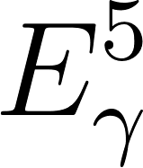
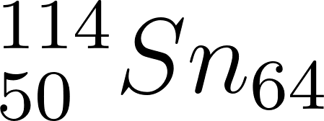
Challenge of the 82-keV Transition
Eqn. 1 – Decay rate ratio of competing 2₂⁺→0₃⁺(82keV) to 2₂⁺→0₁⁺(2239keV) transitions via single particle estimate
For E2 transitions, transition rate is proportional to
Energetic favourability of 2239-keV transition depopulating the 2₂⁺ state is predicted to occur 1.52 x10⁷ times for each 82-keV transition
If consistent with Pore et. al’s measurements the relative intensity of the 82-keV transition is predicted to be increased by a factor of 10³
Notes:
-Due to energetic favourability, the larger 2239-keV transition depopulating the 2-2-+ state is predicted to occur 1.52 x 10^7 times for each 82-keV transition.
-If BE2 found to translate from 116Sn, relative intensity could in fact be 1000x greater than predicted solely based off the single particle estimate from Eqn.1
-82-keV is also favourable for Internal Conversion Electron decay

Slide 10
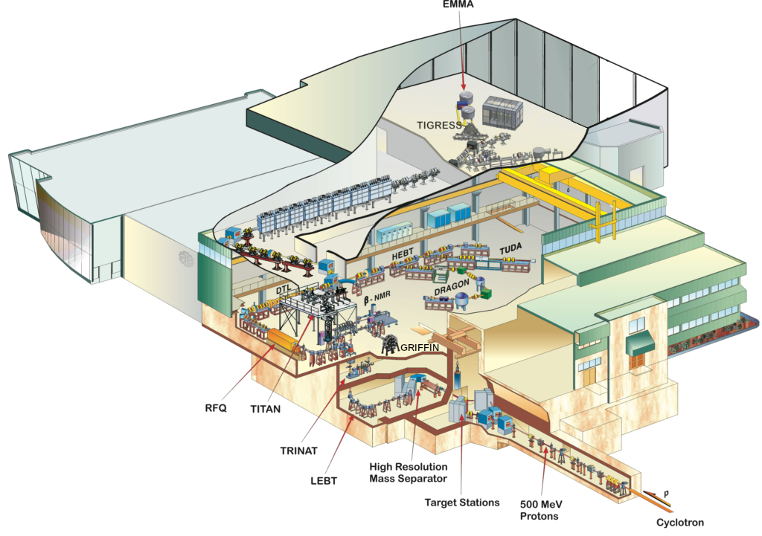
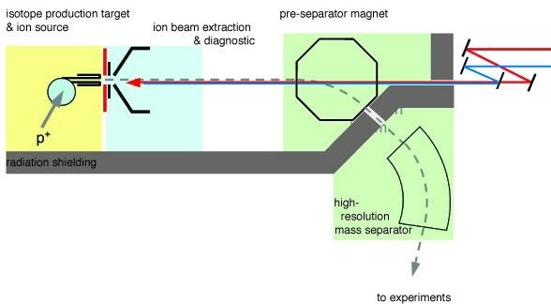
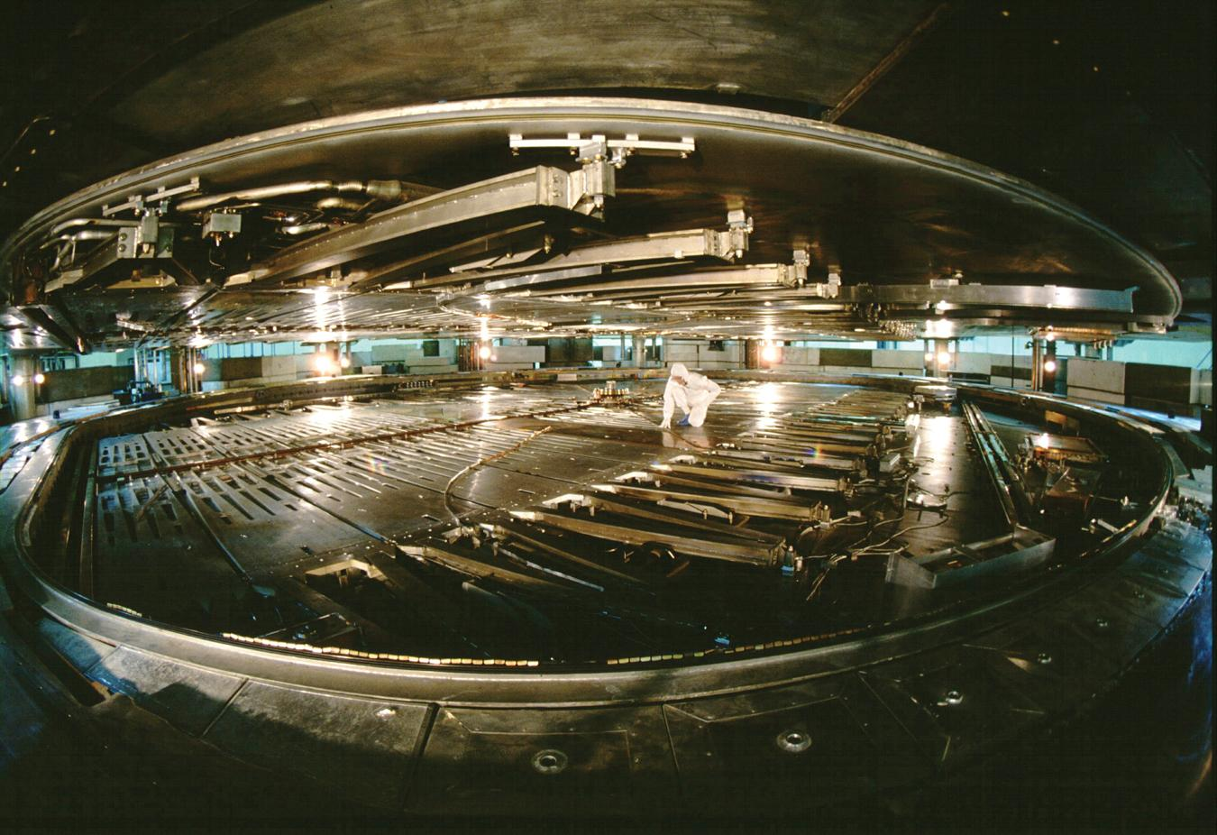
ISAC @ TRIUMF

Slide 11
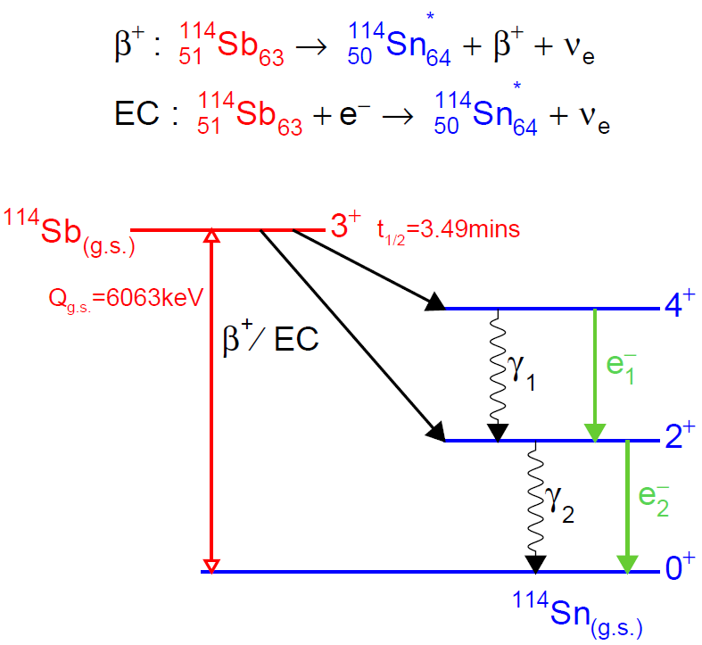
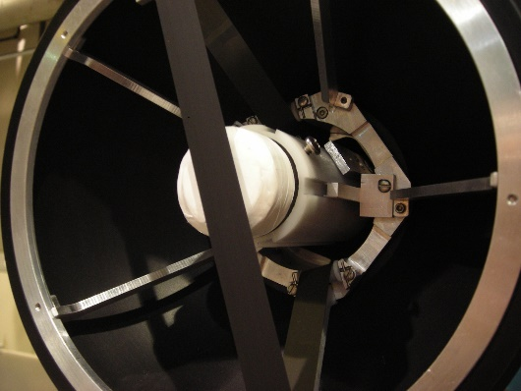
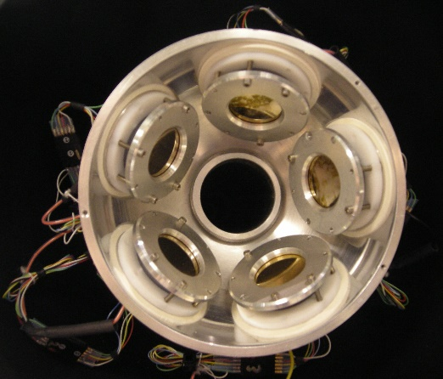
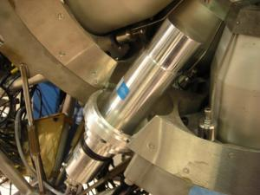
GRIFFIN Spectrometer
Notes:
Ground-state 3+ of Sb populates the states of interest well as a result of beta-selection rules. (3+,2+,4+)
Clockwise from top-left:
ZDS x1 = Zero-degree-scintillator for Beta-particle detection
PACES = 5x SiLi detectors for Conversion electrons
LaBr = 8x LaBr3 detectors for measurements of lifetimes between ~10ps – 10ns
GRIFFIN HPGe = 15x GRIFFIN Hyper-pure Germanium detectors used for their superior energy resolution

Slide 12
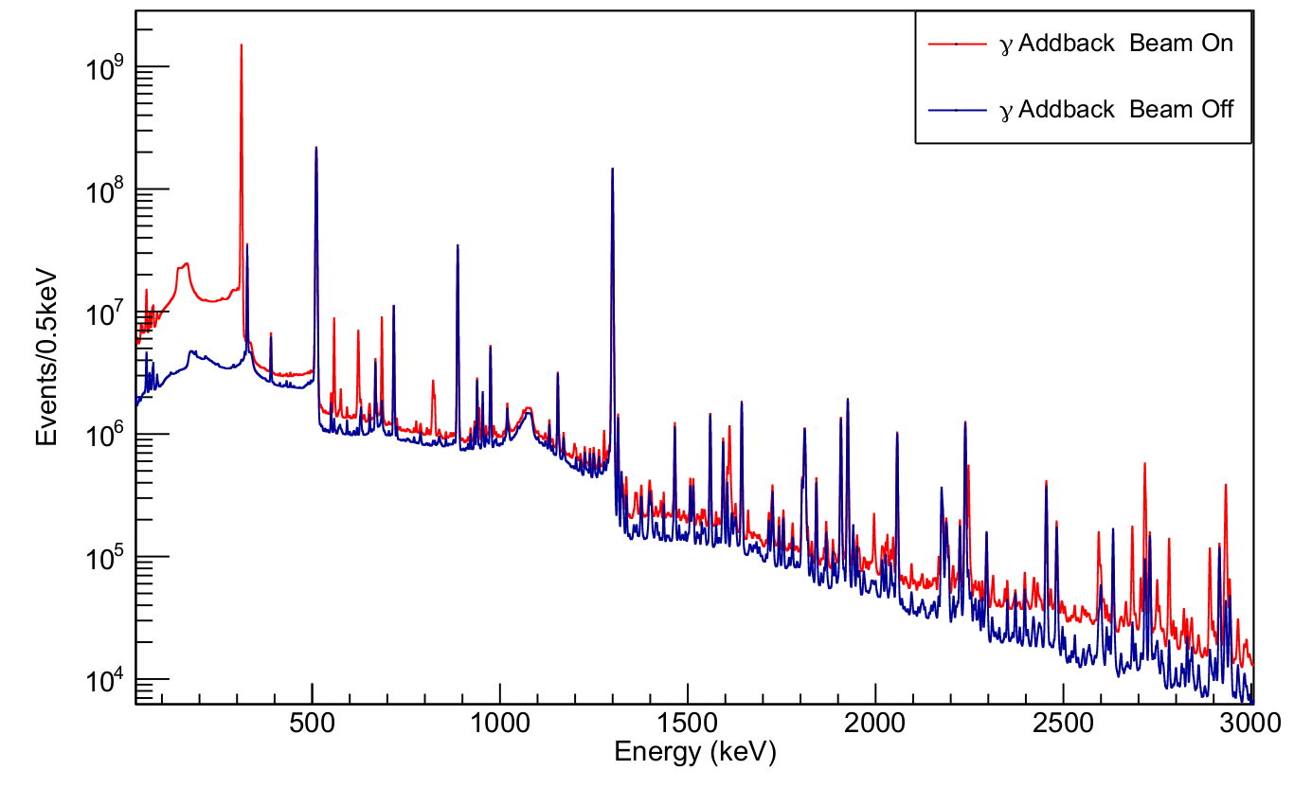
𝛾-Events
¹¹⁴In
High intensity of ¹¹⁴In imposed significant limitations on DAQ
⁹⁵Sr
 | Proposal | Experiment
Beam Intensity | 1.0E6 pps | 5.0E5 pps
t_{implantation} | 2100 s | 390 s
t_{decay} | 210 s | 390 s
Notes:
~37 billion gamma events recorded over ~48hrs of experiment
Beam intensity = 5.0E5 pps , Proposed 1E6
Tape cycle was adjusted to have equal 114Sn events in Beam Off and Beam On, in order to identify shorter/longer lived contaminants.
Real Implant = 390s vs. proposed ~2100s
Real Decay = 390s vs. proposed 210s
~10x less statistics
Contamination present from 95Sr->95Y(685.6keV) & 114In->114In(311.7keV)
Add t-1/2 from indium and strontium and Antimony(Sb)
add implantation /intensity

Slide 13
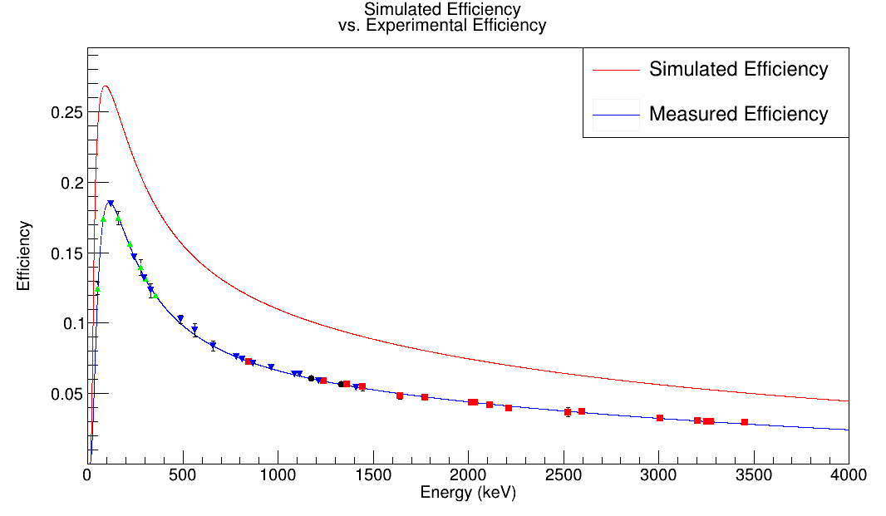
𝛾-Efficiency
Notes:
-Proposal was based on simulated efficiency
-Measured efficiency was ~9% less at peak efficiency than the GEANT4 simulation

Slide 14
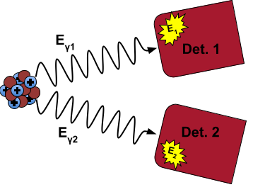
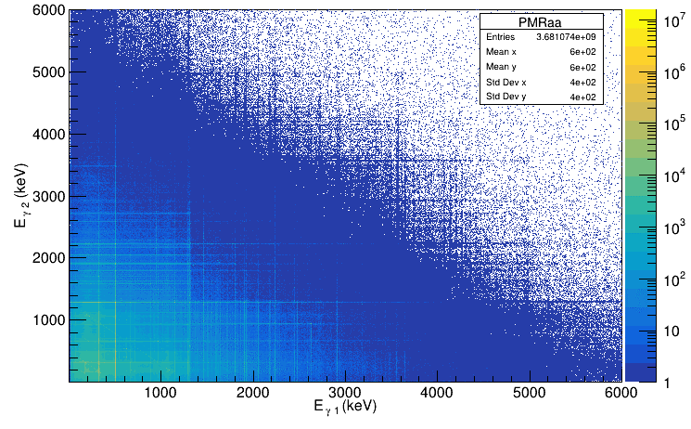
𝛾-𝛾 Coincidence
Notes:
~3.7 billion coincident transitions.
~200ns coincidence window.

Slide 15
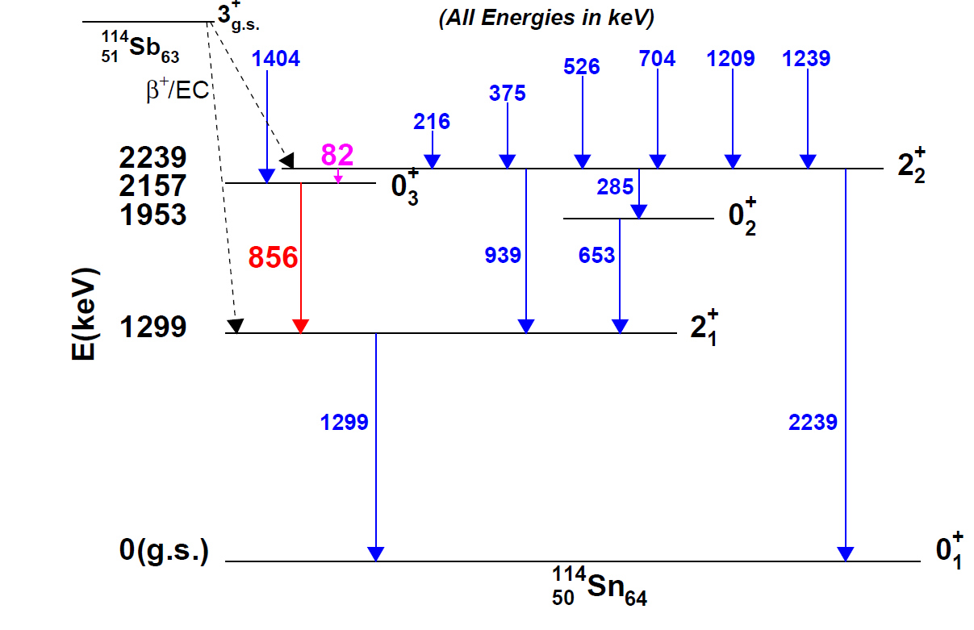
Partial Level Scheme of ¹¹⁴Sn

Slide 16
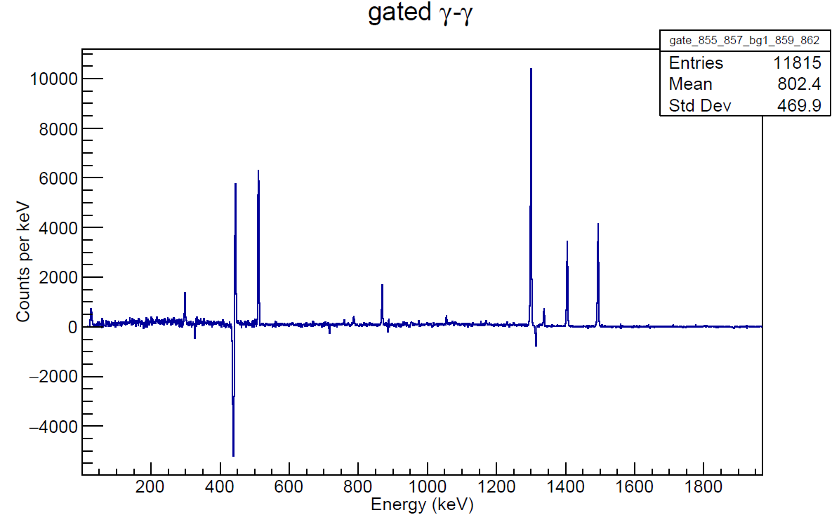
856-keV Gate

Slide 17
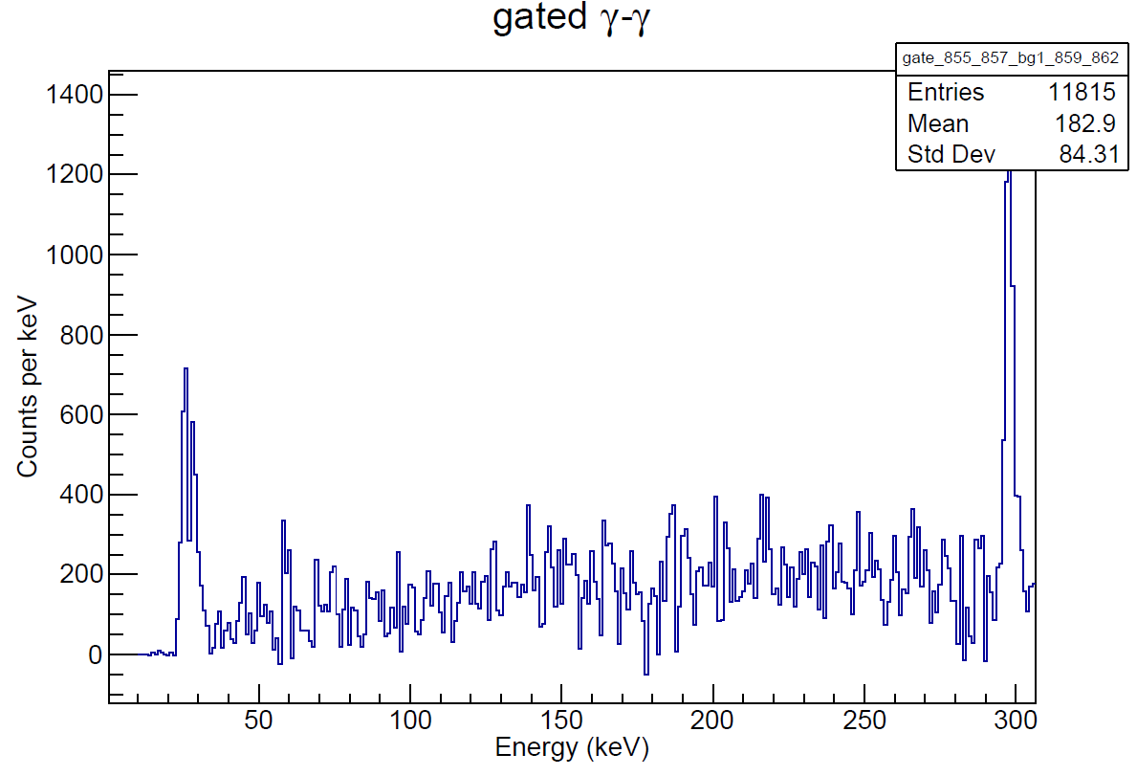
856-keV Gate (zoom)

Slide 18
Conclusions and Outlook
¹¹⁴Sn* populated via ¹¹⁴Sb decay to GRIFFIN w/ intensity of 5E5 pps over ~48 hour experiment
5.7 TB of data collected over ~48 hours of beam-time
Preliminary analysis of γ-γ coincidences did not observe the weak 2⁺₂→0⁺₃ transition
Established the upper limit B(E2;2⁺₂→0⁺₃) / B(E2;2⁺₂→0⁺₂) ≤ 10
Established upper limit on Branching ratio (2⁺₂→0⁺₃) / (2⁺₂→0⁺₂) ≤ 0.0207
E0 transitions, γ-γ-γ coincidences, and feeding ratios still to be investigated
A large number of γ-γ coincidences have been collected
Extend level scheme of ¹¹⁴Sn
γ-γ angular correlation measurements
Fast-timing measurements with LaBr₃ (Ce) detectors
Significant amount of analysis ahead
Notes:
-Populated the second 2+ associated w/ the 2p-2h band, did not observe the transition of interest 2.2+->0.3+
-Will look at paces to look at ICE associated with weak transition
-From looking at gamma gamma matrix, we should be able to extend level scheme
-YY angular correlation to assign spin to observed states or one's with no current assigned spin
-Fast-timing measurements to determine better limits of second 2+ state and perhaps others.
B(E2;2⁺₂→0⁺₃) / B(E2;2⁺₂→0⁺₂) ≤ 10
E0 transitions, γ-γ-γ coincidences, and feeding ratios still to be investigated

Slide 19
Acknowledgements
The Andreoiu Group - SFU Dept. of Chemistry:
Dr. Corina Andreoiu
Dr. Pietro Spagnoletti
Kevin Ortner
Frank Wu
Further Contributions from:
Heinz Asch (SFU Dept. of Physics)
Nicole Chieshlivi (CSM Dept. of Engineering)
Madison Daignault (SFU Dept. of Chemistry)
Isaiah Djianto (SFU Dept. of Chemistry)
Matthew Martin (SFU Dept. of Physics)
Dr. Krzysztof Starosta (SFU Dept. of Chemistry)
Elliot Wadge (SFU Dept. of Physics)

Slide 21
Nuclear Shapes*
Described by a multipole expansion in 𝜆:
Multipole order: 2^{𝜆}
2⁰ = monopole - breathing mode
2¹ = dipole - center of mass shift
2² = quadrupole - reflection symmetric deformation
Oblate (earth)
Prolate (rugby ball)
Deformed nuclear shape arises from long-range multipole-multipole interactions between protons and neutrons in the nuclear valence space
Notes:
Multipole expansion in the spherical harmonics Eqn.
First multipole order where a change of shape is observed is quadrupole

Slide 22
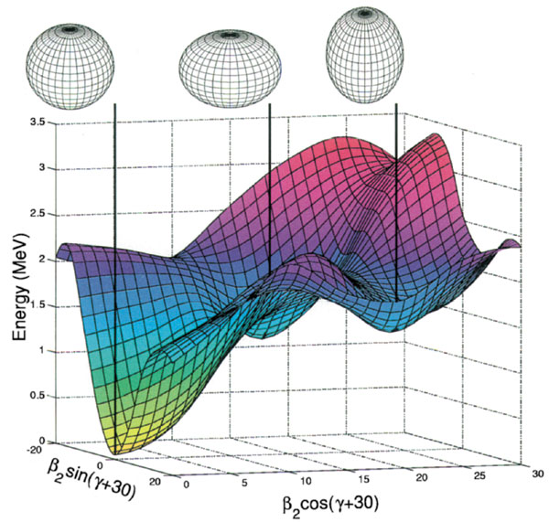
¹⁸⁶Pb Shape Coexistence*
Two or more states having distinct properties and different intrinsic shapes within a narrow energy range
Characterized by rotational bands of excited states allowed by deformed shapes (prolate & oblate, etc.)

Slide 23
Decay of ¹¹⁴Sb to ¹¹⁴Sn**
β⁺-decay
Protons are spontaneously converted to neutrons, releasing a positron and an electron neutrino
Electron Capture (EC)
Proton spontaneously captures an atomic electron, converting it to a neutron and neutrino

Slide 24
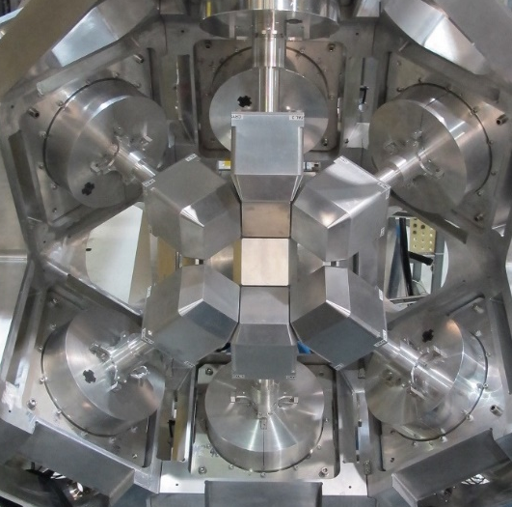
GRIFFIN Spectrometer*
Notes:
Clockwise from top-left:
ZDS x1 = Zero-degree-scintillator for Beta-particle detection
PACES = 5x SiLi detectors for Conversion electrons
LaBr = 8x LaBr3 detectors for measurements of lifetimes between ~10ps – 10ns
GRIFFIN HPGe = 15x GRIFFIN Hyper-pure Germanium detectors used for their superior energy resolution

Slide 25
GRIFFIN Spectrometer*

Slide 26
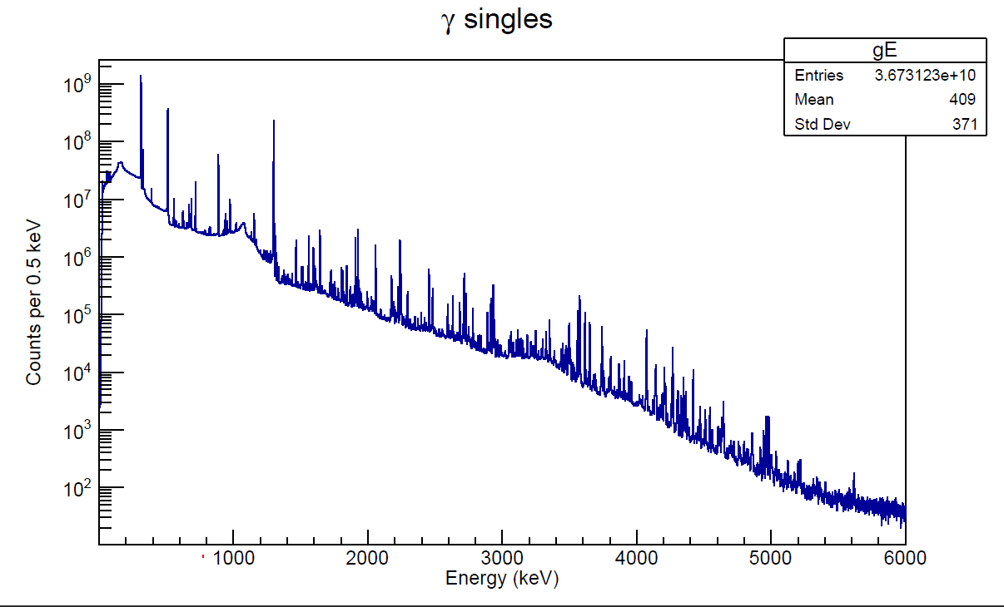
𝛾-Events*
Notes:
~37 billion gamma events recorded over ~48hrs of beam-time
Contamination present

