Slide 1


Exploring Low-Rank Structures in the IMSRG Framework
B. Zhu^{a,b}, H. Hergert^{a,b}, Y. Udiani^{a,b}, K. Yu^{a,b}, R. Wirthª
ª Facility for Rare Isotope Beams, Michigan State University, East Lansing, MI 48824-1321
^{b} Department of Physics & Astronomy, Michigan State Univeristy, East Lansing, MI 48824-1321
This work is supported in part by the U.S. Department of Energy, Office of Science, Office of Nuclear Physics under Awards No. DE-SC0017887, DE-SC0023516, as well as DE-SC0018083, DE-SC0023175 (SciDAC NUCLEI Collaboration). Computing resources were provided by the Institute for Cyber-Enabled Research at Michigan State University.

Slide 2

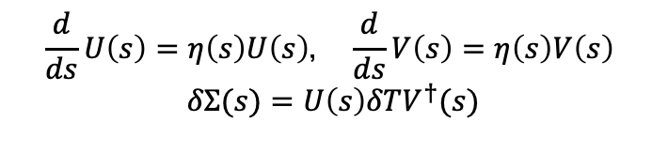
SRG Factorization of Flow Equations
The (free-space) SRG is a continuous unitary transformation. To implement the continuous unitary transformation, we take the derivative w.r.t. s to obtain SRG flow equation.
$$\frac{d}{ds}H\left(s\right)=\left[η\left(s\right), H\left(s\right)\right] η\left(s\right)≡\left[T, H\left(s\right)\right]$$
Given the low-rank structure in $V_{NN}$, it could be SVD decomposed
$$\overline{V}\left(0\right)=U\left(0\right)Σ\left(0\right)V^{†}\left(0\right)$$
and the flow equations can be derived. [1]
$$\frac{d}{ds}U\left(s\right)=η\left(s\right)U\left(s\right)， \frac{d}{ds}V\left(s\right)=η\left(s\right)V\left(s\right)$$
$$δΣ(s)=U\left(s\right)δTV^{†}(s)$$
[1]. B. Zhu et al., PRC 104(4), 044002

Slide 3
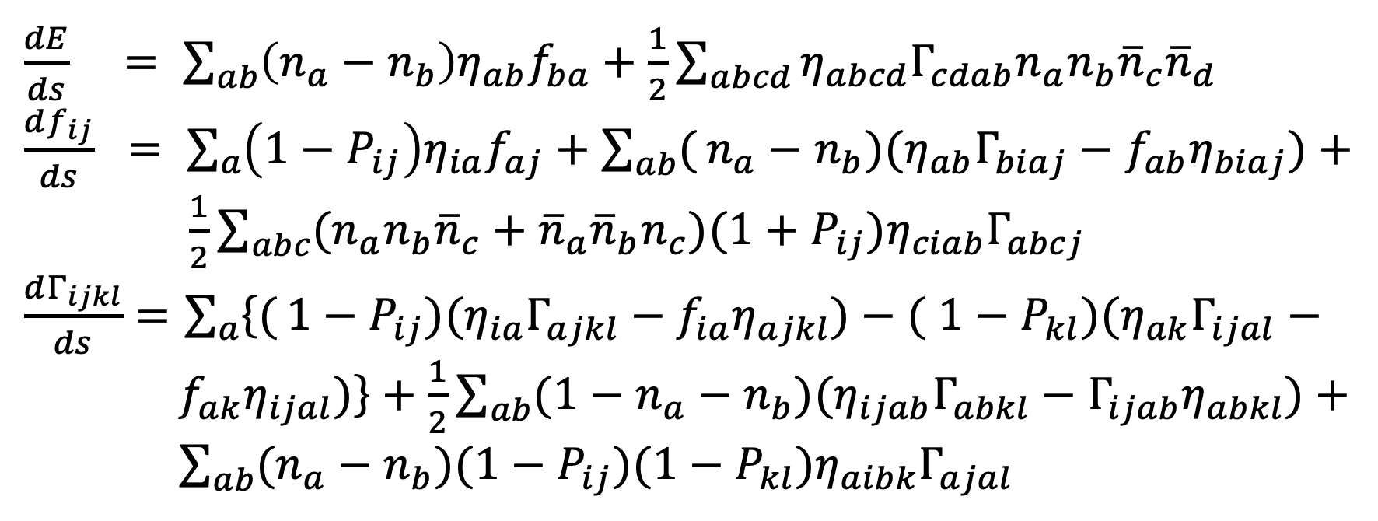
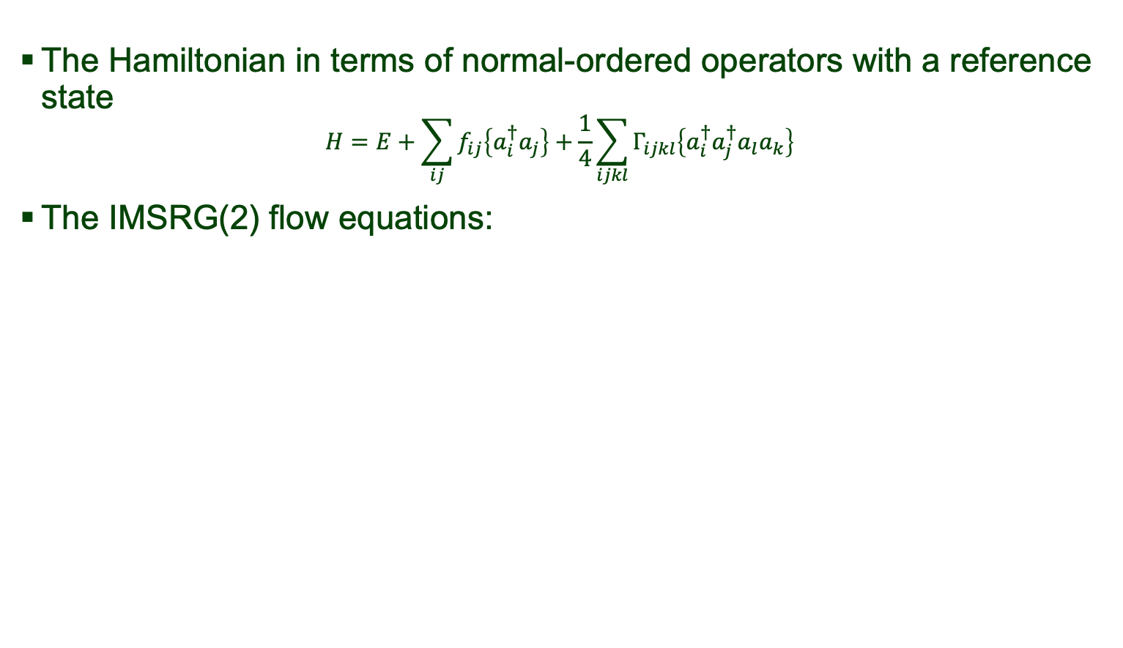
IMSRG(2) flow equations
The Hamiltonian in terms of normal-ordered operators with a reference state
$$H=E+\sum_{ij}{f_{ij}\left\{a_{i}^{†}a_{j}\right\}+\frac{1}{4}}\sum_{ijkl}{Γ_{ijkl}\left\{a_{i}^{†}a_{j}^{†}a_{l}a_{k}\right\}}$$
The IMSRG(2) flow equations:
scales as O(N⁶)

Slide 4
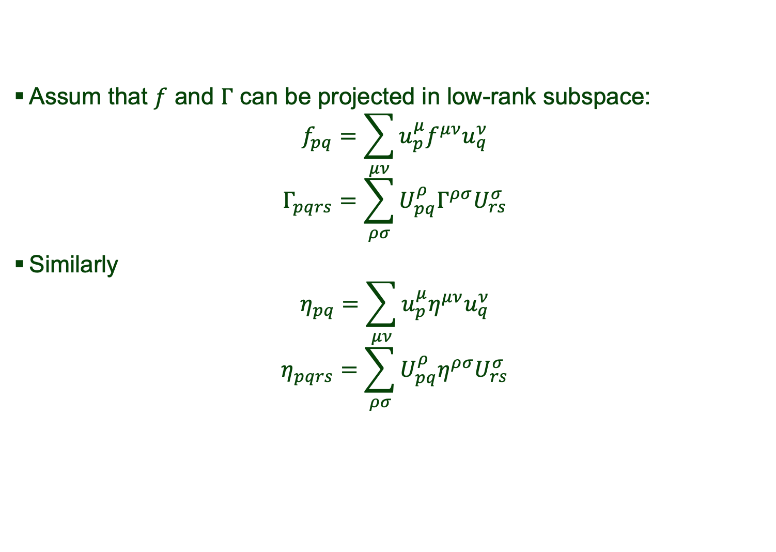
IMSRG(2) and SVD
Assum that $f$ and $Γ$ can be projected in low-rank subspace:
$$f_{pq}=\sum_{μν}{u_{p}^{μ}f^{μν}u_{q}^{ν}}$$
$$Γ_{pqrs}=\sum_{ρσ}{U_{pq}^{ρ}Γ^{ρσ}U_{rs}^{σ}}$$
Similarly
$$η_{pq}=\sum_{μν}{u_{p}^{μ}η^{μν}u_{q}^{ν}}$$
$$η_{pqrs}=\sum_{ρσ}{U_{pq}^{ρ}η^{ρσ}U_{rs}^{σ}}$$

Slide 5
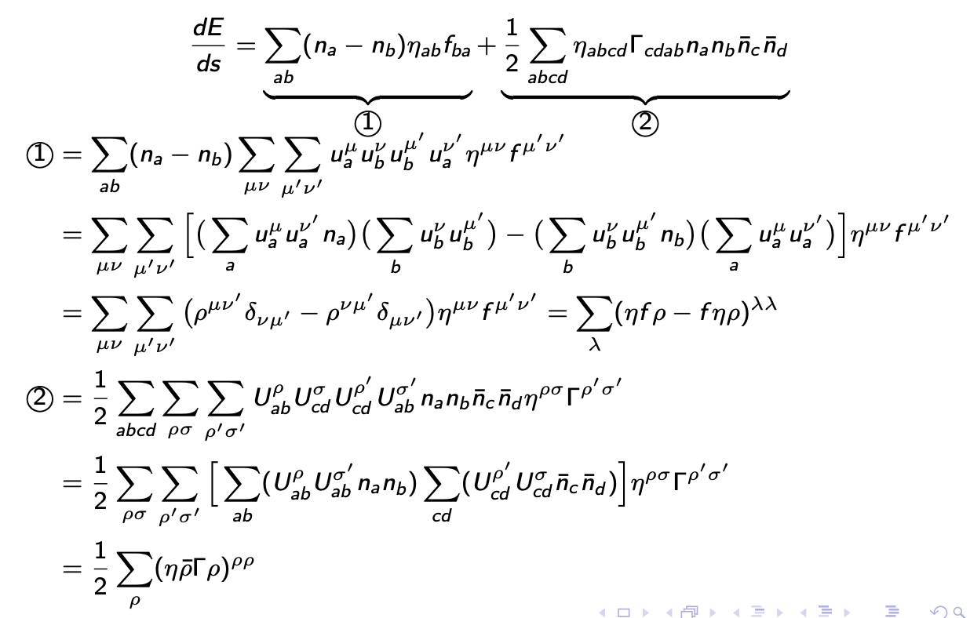
SVD-IMSRG(2)

Slide 6

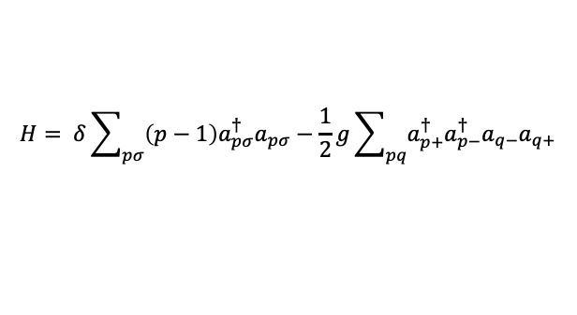
Application in Pairing Model
$$H= δ\sum_{pσ}{\left(p−1\right)a_{pσ}^{†}a_{pσ}−\frac{1}{2}g\sum_{pq}{a_{p+}^{†}a_{p−}^{†}a_{q−}a_{q+}}}$$
$$δ=1.0, g=0.5$$

Slide 7
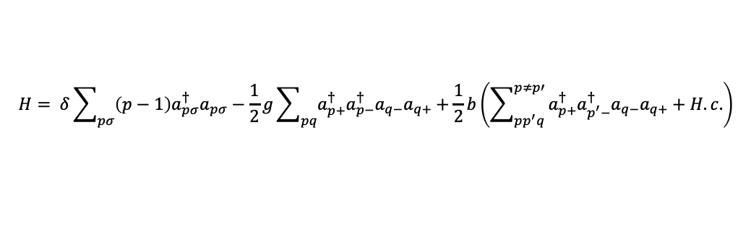
Application in Pairing + Particle-Hole Model
$$H= δ\sum_{pσ}{\left(p−1\right)a_{pσ}^{†}a_{pσ}−\frac{1}{2}g\sum_{pq}{a_{p+}^{†}a_{p−}^{†}a_{q−}a_{q+}}}+\frac{1}{2}b\left(\sum_{pp^{′}q}^{p≠p′}{a_{p+}^{†}a_{p^{′}−}^{†}a_{q−}a_{q+}+H.c.}\right)$$
Ground-state energy as a function of pair-breaking strength
Can truncate ph term and perform
SVD-IMSRG(2)

Slide 8
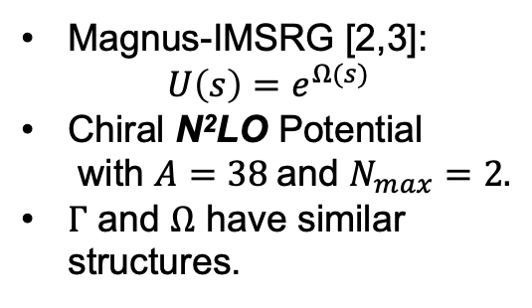
Infinite matter in m-scheme
Magnus-IMSRG [2,3]:
$$U\left(s\right)=e^{Ω(s)}$$
Chiral N²LO Potential
with $A=38$and $N_{max}=2.$
$Γ$ and $Ω$ have similar
structures.
[2]. H. Hergert et al., Phys. Rept. 621
[3]. H. Hergert, Phys. Scripta 92, 023007

