Slide 1
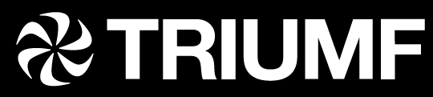

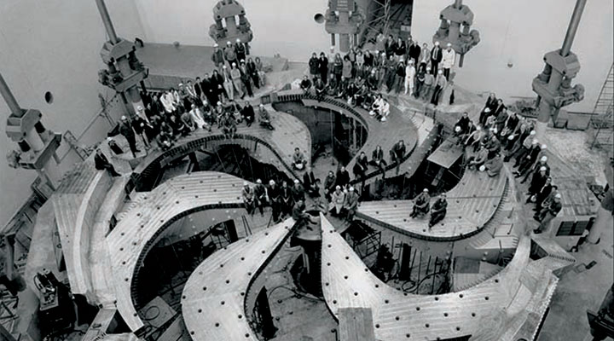
MR-TOF-MS for yield and mass measurements during the p2n target commissioning
Ali Mollaebrahimi
Justus-Liebig-Universität Gießen, Germany
TRIUMF accelerator Centre, Canada
2023, July

Slide 2
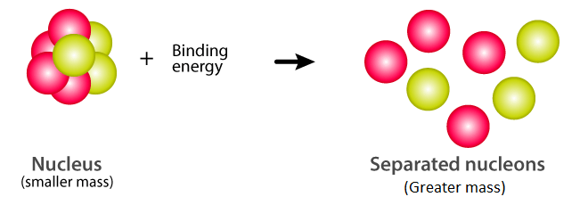

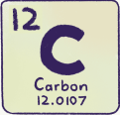

Mass and binding energy
Mass is one of the most fundamental properties of particles which reflects the binding energy of a bound system and can reveal information about its properties.
E=mc²
The mass of a neutral atom:
Mass
$Z:$ number of protons/electrons
$N:$ number of neutrons
$m_{p}$ and $m_{n}$: mass of free protons and neutrons
$m_{e}:$ mass of free electron
$B_{nucleus}:$ binding energy of nucleons
$B_{atom}:$ binding energy of electrons
$c:$ speed of light

Slide 3

Mass Measurement in Nuclear Physics
Nuclear
Structure
Nuclear
Astrophysics
Fundamental symmetries
and interactions
Evolution of shell closure and sub-shell
Nuclear deformation
p/n driplines
Decay properties
Halo nuclei
Etc.
Nuclear Synthesis models:
r-process
s-process
rp-process
Abundance of heavy elements
Etc.
Physics beyond Standard Model
CKM matrix elements
Neutrino Physics
Double beta decay
Interactions
Etc.
δm/m ≈ 10⁻⁶ - 10⁻⁷
δm/m ≈ 10⁻⁷
δm/m ≈ 10⁻⁹
MR-TOF-MS
Storage Ring
MR-TOF-MS
Storage Ring
Penning Trap

Slide 4
Nuclear Structure and Astrophysics
Studying nuclear structure and astrophysics within the r-process path
At the limit of facilities or beyond
Need for continues developments and upgrades
Stable nuclei
Experimentally identified nuclei
Bound nuclei (Not in reach yet)
S_{p}=0
s-process
Protons
S_{n}=0
r-process
rp-process
Closed shells
Neutrons

Slide 5
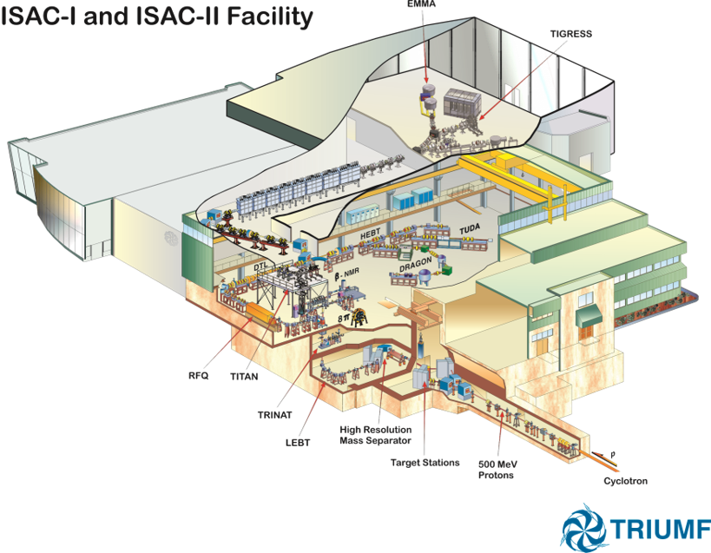
RIB beam at TRIUMF
Programs in
Nuclear structure & reactions
Nuclear astrophysics
Electroweak interaction Studies
Material science
Life science
ISOL facility with highest primary beam intensity (100 μA, 500 MeV p)

Slide 6
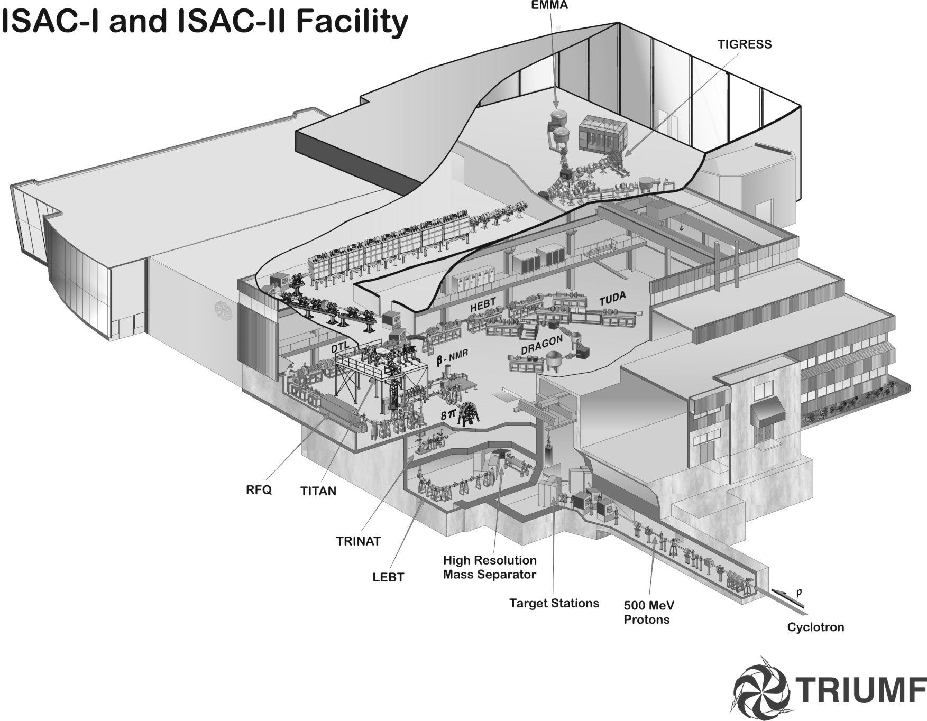


TITAN and Yield Station at ISAC/TRIUMF
TRIUMF’s Ion Trap for Atomic and Nuclear Science
High-precision mass measurements
Yield measurements
TITAN
+
Yield station
Target station
Low-energy beam
transport
Cyclotron
Mass
Separator
R~2500
500 MeV
protons
H⁻
ISOL facility with highest primary beam intensity (100 μA, 500 MeV p)
Notes:
Very quic overview

Slide 7
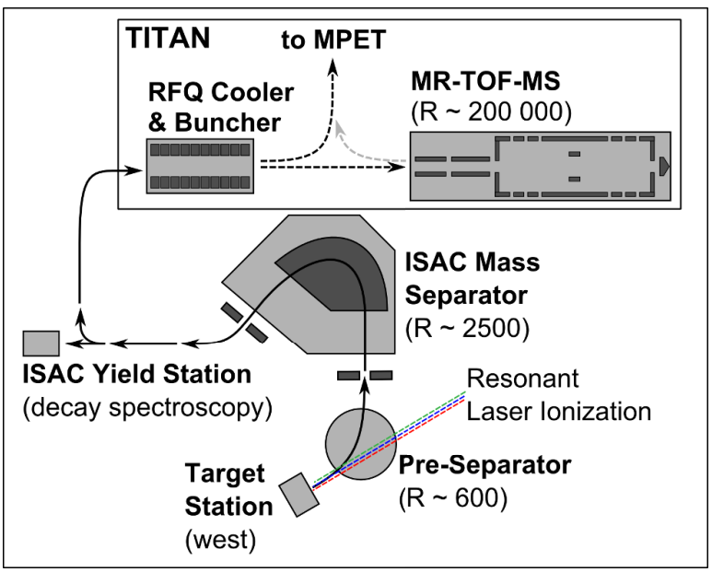
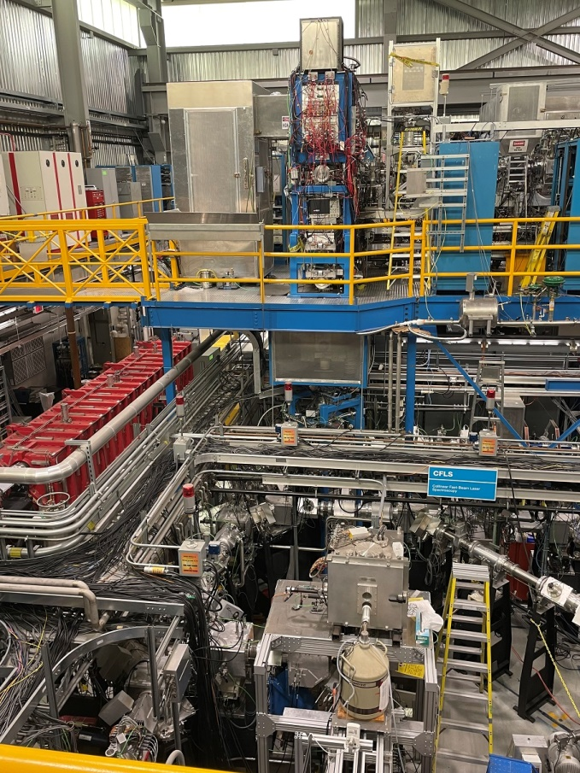
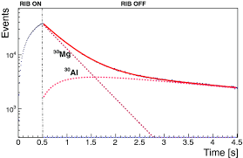
Yield measurements at ISAC I
TITAN
M.P. Reiter et al., NIMB 463 (2020)
Yield station
Decay spectroscopy
P. Kunz et al., Rev. Sci. Instrum. 85 (2014)

Slide 8
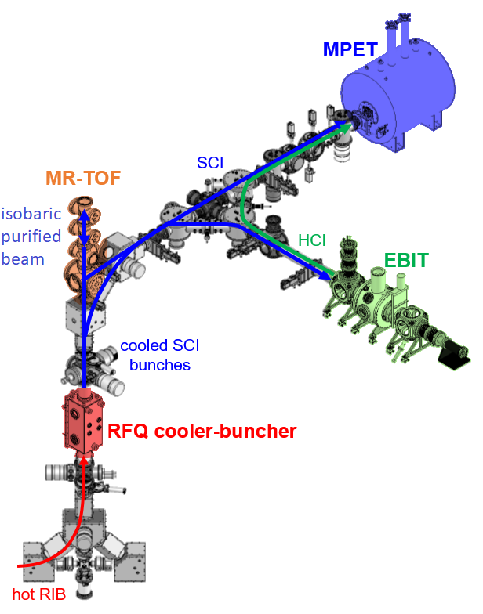















TITAN ion traps
MR-TOF:
Mass measurements
Beam diagnostic & yields
RIB beam purification
MPET:
Penning trap for mass measurements
$$\frac{δm}{m}∝\frac{1}{qBT_{RF}\sqrt{N_{ions}}}$$
EBIT:
Charge State Breeding
and
decay spectroscopy
1.3-2.2 keV
RFQ:
Accumulation, cooling, and bunching
20 keV
J. Dilling et al., NIMB 204 (2003) 492,
C. Jesch et al., Hyperfine Interact. 235 (2015) 97
M. P. Reiter et al., NIMA 1018 (2021) 165823

Slide 9
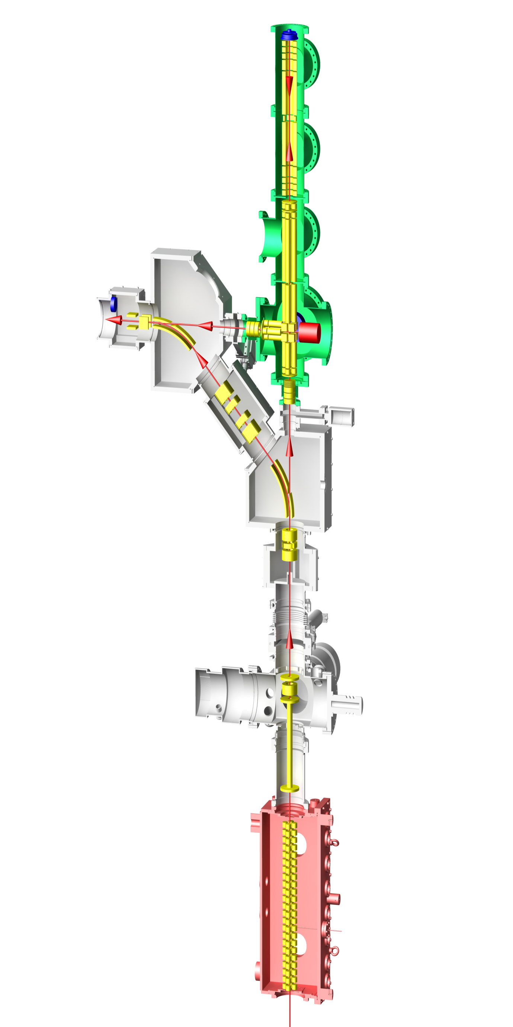
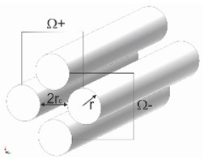
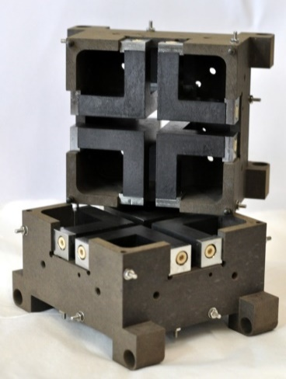
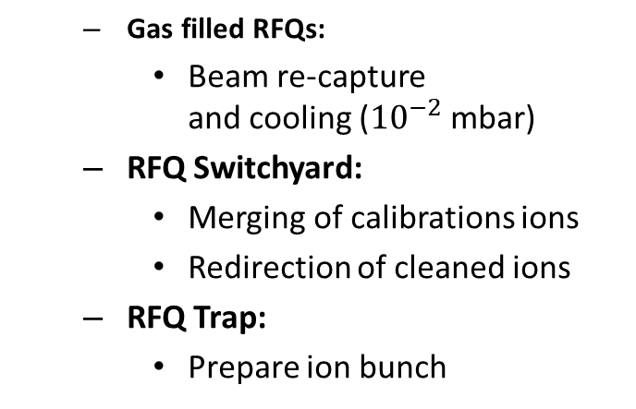
Low-energy beam transport to MR-TOF-MS
MagneTOF
RFQ
  Gas filled RFQs:
    Beam re-capture
    and cooling (${10}^{−2}$ mbar)
  RFQ Switchyard:
    Merging of calibrations ions
    Redirection of cleaned ions
  RFQ Trap:
    Prepare ion bunch
RF Injection Trap
RF
Accum. Trap
RFQ
Switchyard
Calibrant
source
Beam from
TITAN RFQ
Cooler Buncher
C. Jesch et al., Hyperfine Interact. 235 (2015) 97
M. Yavor et al., Int. J. Mass Spec. 381 (2015) 1-9
T. Dickel et al., J. ASMS 28 (2017) 1079

Slide 10
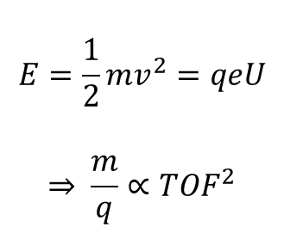
Multiple-Reflection Time of Flight Mass Spectrometer
MagneTOF
TOF analyzer
MagneTOF
Detector
Measurement of mass-to-charge ratio by measurement of time-of-flight:
Ion mirror 2
$$E=\frac{1}{2}mv^{2}=qeU$$
$$\overset{⇒}{ } \frac{m}{q}∝{TOF}^{2}$$
RF Injection Trap
RF
Accum. Trap
Ion mirror 1
Yield Measurements
Isobaric separator and beam purification for itself and other traps
Beam from
TITAN RFQ
Cooler Buncher
C. Jesch et al., Hyperfine Interact. 235 (2015) 97
M. Yavor et al., Int. J. Mass Spec. 381 (2015) 1-9
T. Dickel et al., J. ASMS 28 (2017) 1079

Slide 11
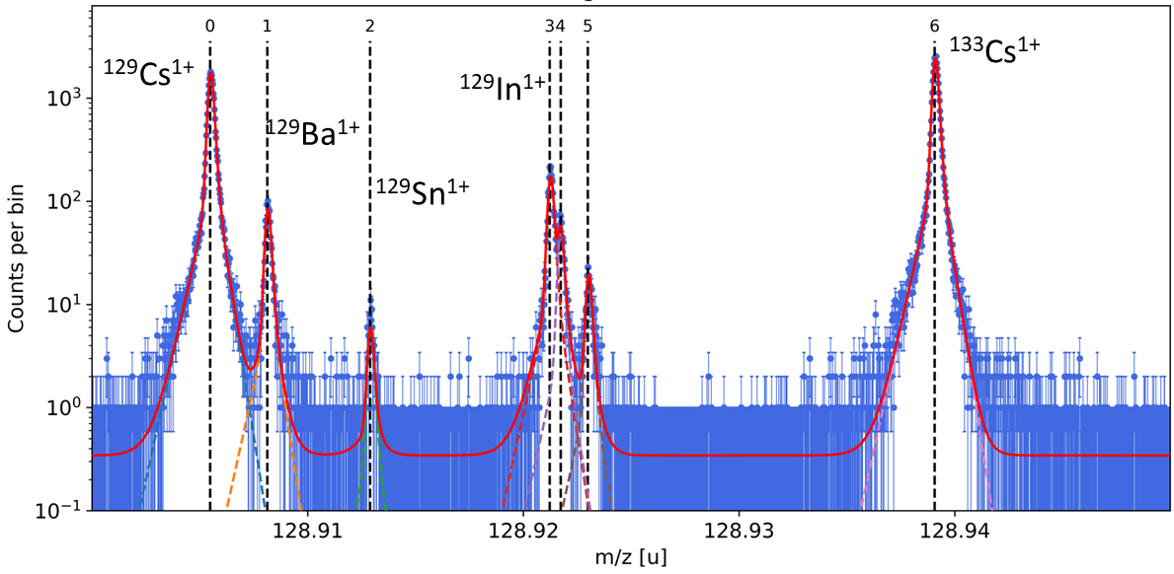
Multiple-Reflection Time-of-Flight Mass Spectrometer
MagneTOF
TOF analyzer
MagneTOF
Detector
Measurement of mass-to-charge ratio by measurement of time-of-flight:
Ion mirror 2
$$E=\frac{1}{2}mv^{2}=qeU$$
$$\overset{⇒}{ } \frac{m}{q}∝{TOF}^{2}$$
RF Injection Trap
Typical
Spectrum
RF
Accum. Trap
Ion mirror 1
Isobaric separator and beam purification for itself and other traps
Powerful tool for yield measurements with isobarically-resolved peaks
Beam from
TITAN RFQ
Cooler Buncher
C. Jesch et al., Hyperfine Interact. 235 (2015) 97
M. Yavor et al., Int. J. Mass Spec. 381 (2015) 1-9
T. Dickel et al., J. ASMS 28 (2017) 1079

Slide 12
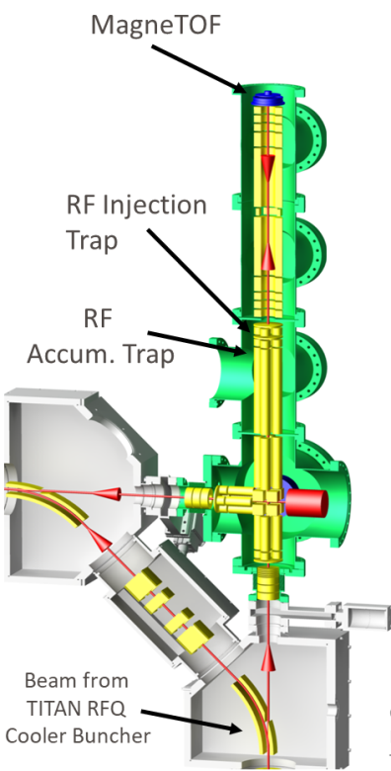
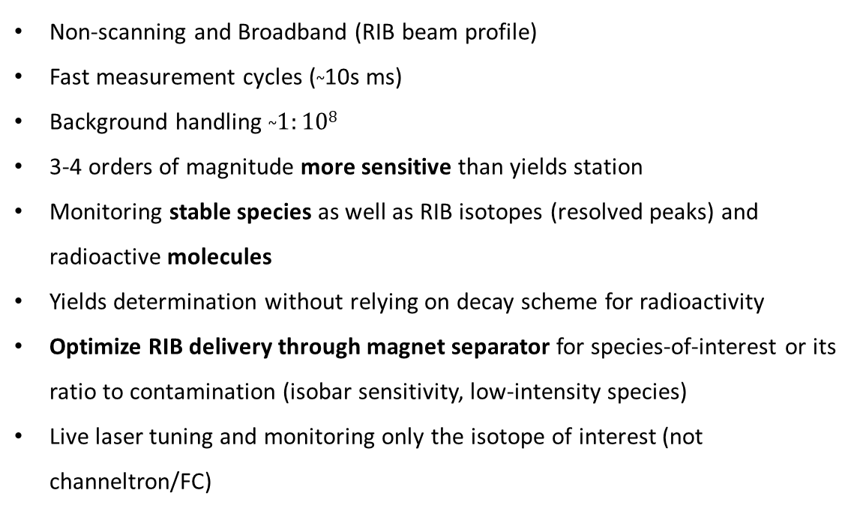
MR-TOF-MS complementary to the yield station
Non-scanning and Broadband (RIB beam profile)
Fast measurement cycles (~10s ms)
Background handling ~$1:108$
3-4 orders of magnitude more sensitive than yields station
Monitoring stable species as well as RIB isotopes (resolved peaks) and radioactive molecules
Yields determination without relying on decay scheme for radioactivity
Optimize RIB delivery through magnet separator for species-of-interest or its ratio to contamination (isobar sensitivity, low-intensity species)
Live laser tuning and monitoring only the isotope of interest (not channeltron/FC)
MR-TOF-MS
Complements the present capabilities at ISAC for yields determination and beam delivery
Yield station is well suited for high-intensity species through their radioactivity

Slide 13
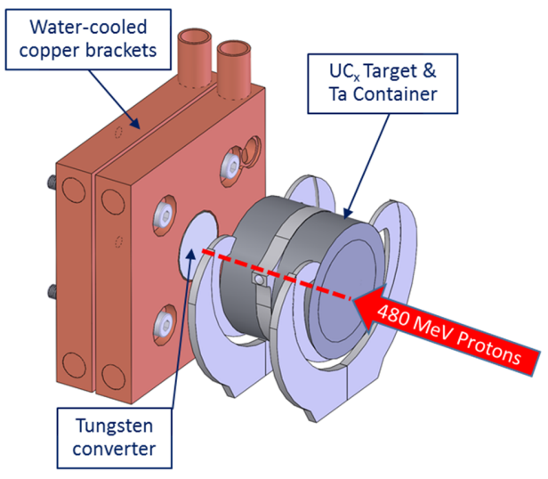
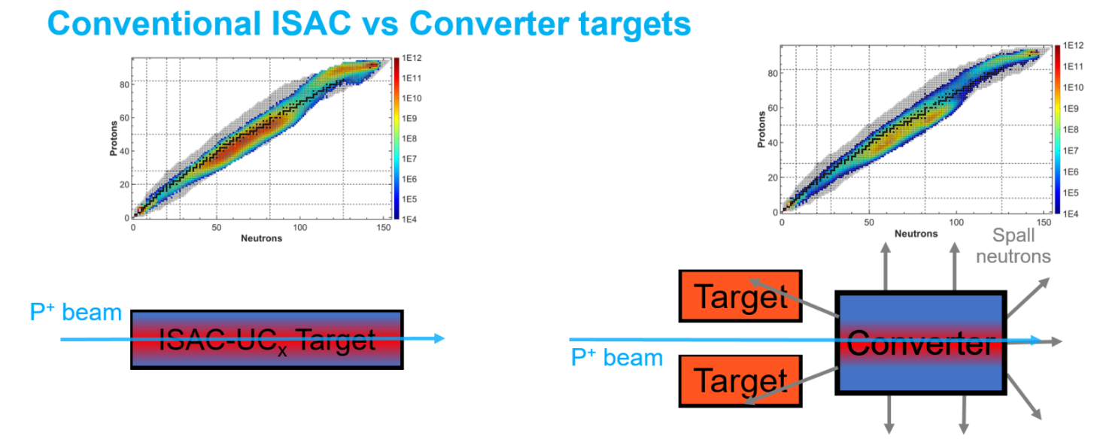
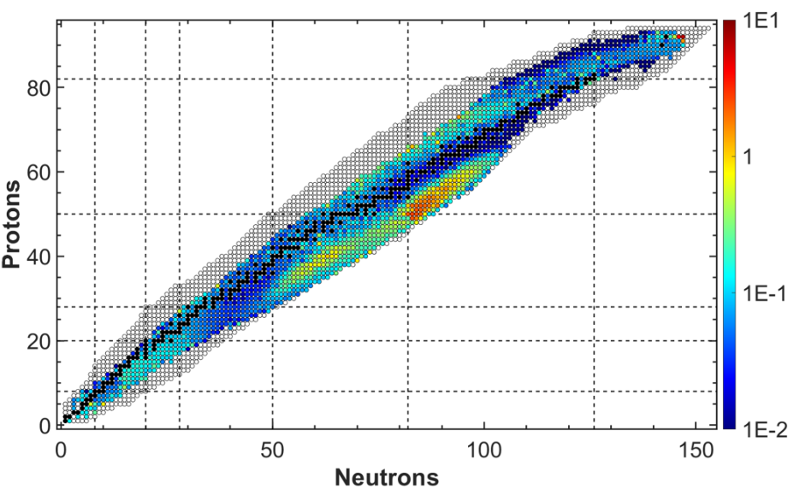
P2n target commissioning
L. Egoriti et al., J. Phys.: Conf. Ser. 1067 (2018)
Plots from Luca Egoriti
(recently presented in “All Hands Meeting”)

Slide 14
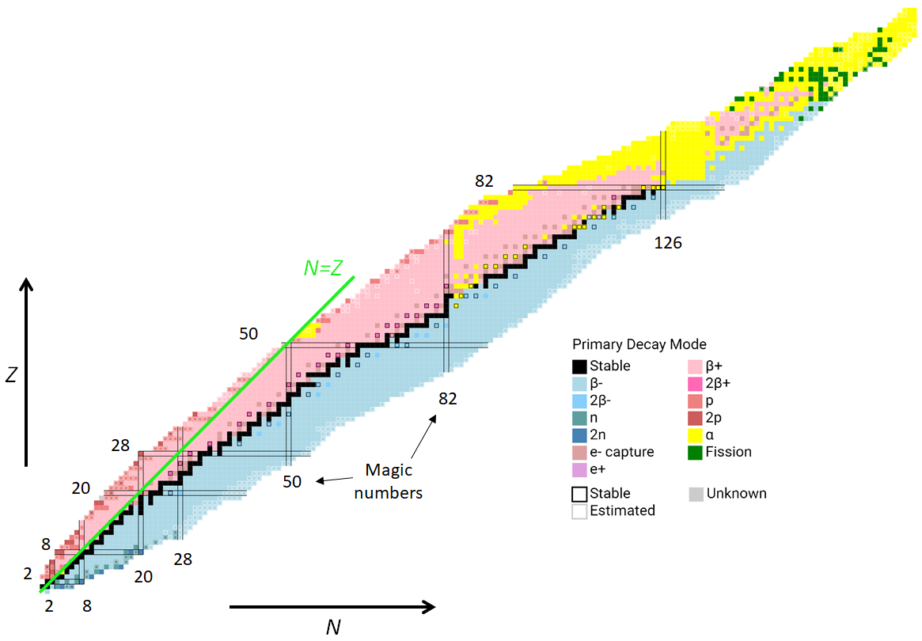

Win-win game (Yield and mass measurements)
2021 (take 1):
Cs, Rb (yields)
Zn, Cs (masses)
2022 (take 2):
Sn, Rb, Cs (yields)
Sn, Cs, Ba, Ga (masses)
^{g,m}In isomers-to-ground- state ratios
L. Egoriti et al., J. Phys.: Conf. Ser. 1067 (2018)
MR-TOF-MS
Cs, Ba
10 new mass measurements
Sn, In
Rb
Zn, Ga

Slide 15
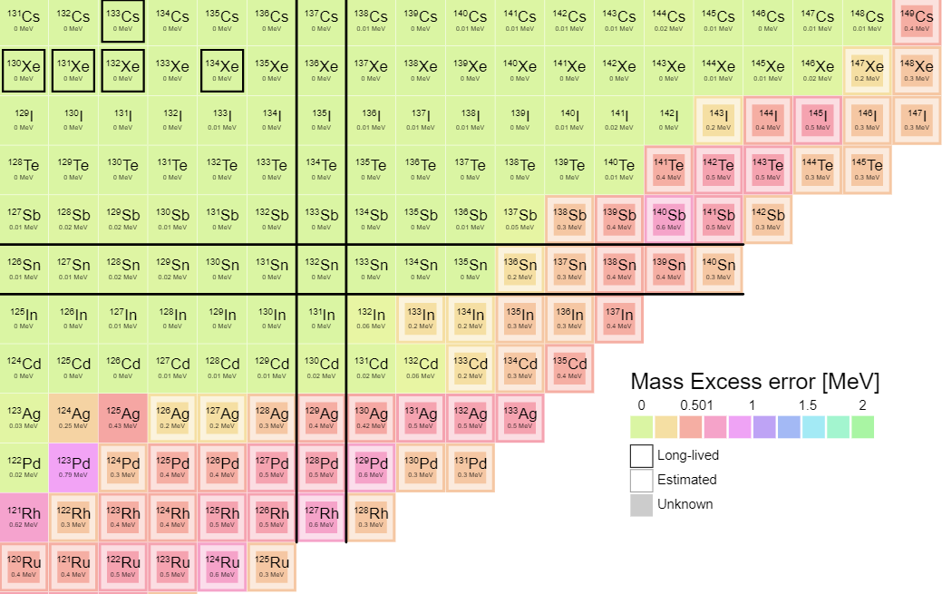
First mass measurement of neutron-rich Sn isotopes
N=82
Penning trap (CPT, JYFLTRAP)
TITAN MR-TOF-MS
Z=50
J. Hakala et. al, Phys. Rev. Lett. 109 (2012)
J. Van Schelt et al., Phys. Rev. Lett. 111 (2013)

Slide 16
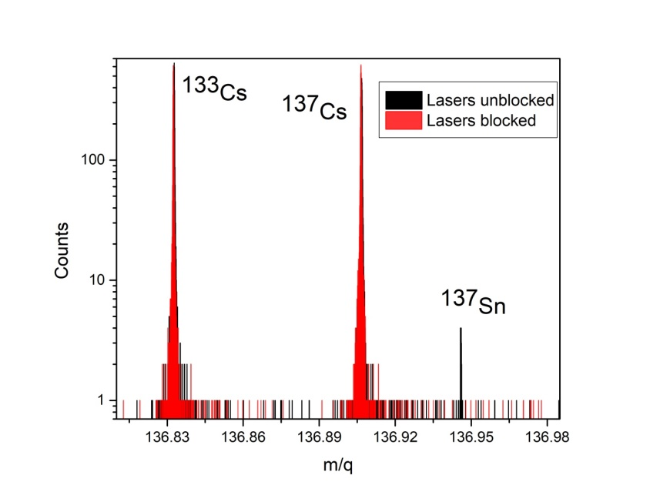
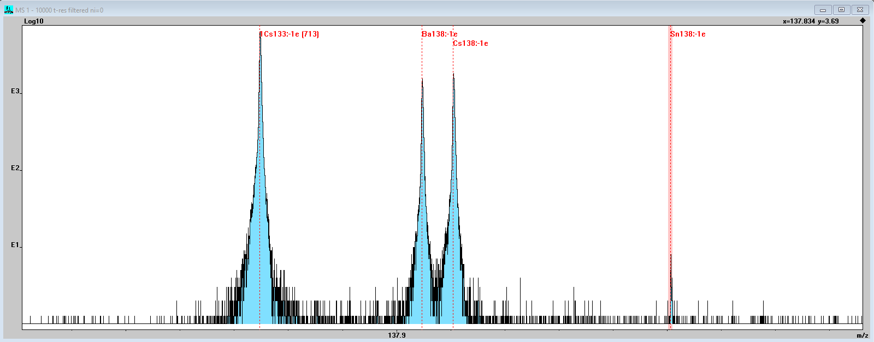
Neutron-rich Sn isotopes
TRILIS Laser ions source (ionization of Sn isotopes)
Laser Block/unblock for identification
Cs and Ba as mass calibrants (surface ionization)
¹³³Cs
¹³⁸Ba
¹³⁸Cs
¹³⁸Sn

Slide 17
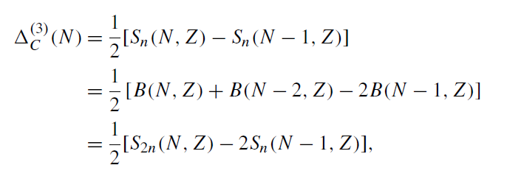
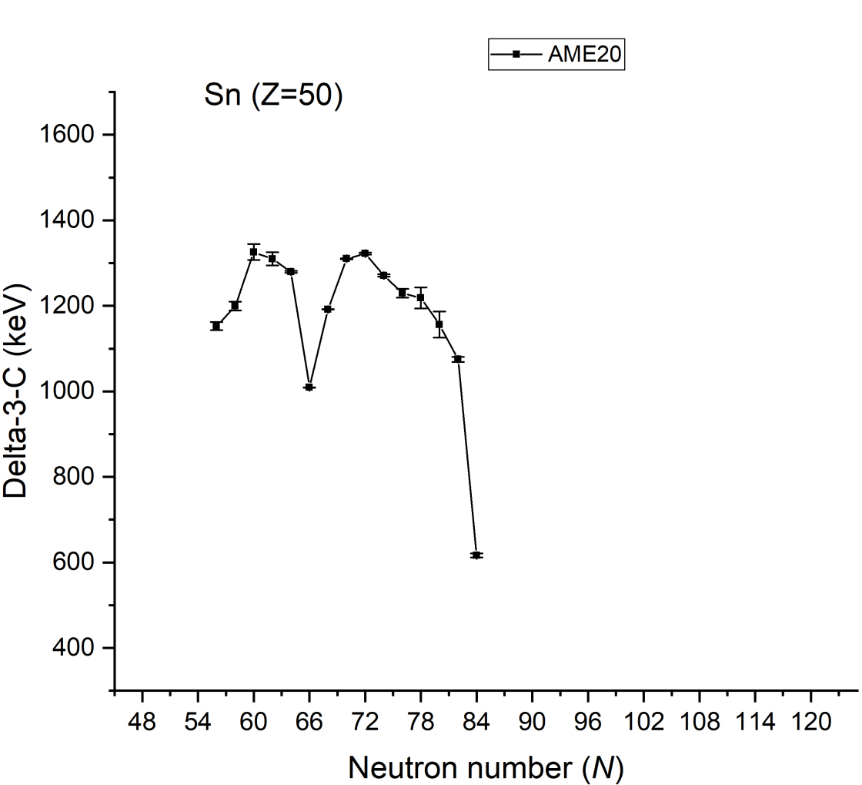
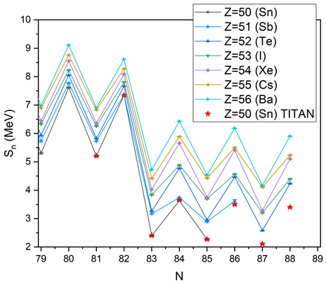

Nuclear structure beyond N=82
$$S_{n}=M\left(N−1,Z\right)−M\left(N,Z\right)+M_{n}$$
One neutron separation energy
Neutron paring gap
Preliminary
Neutron number (N)
Notes:
A=146 took 13000 CPU hours for ab-initio calculation. Cannot go beyond as dimensions exceed 10^10.

Slide 18
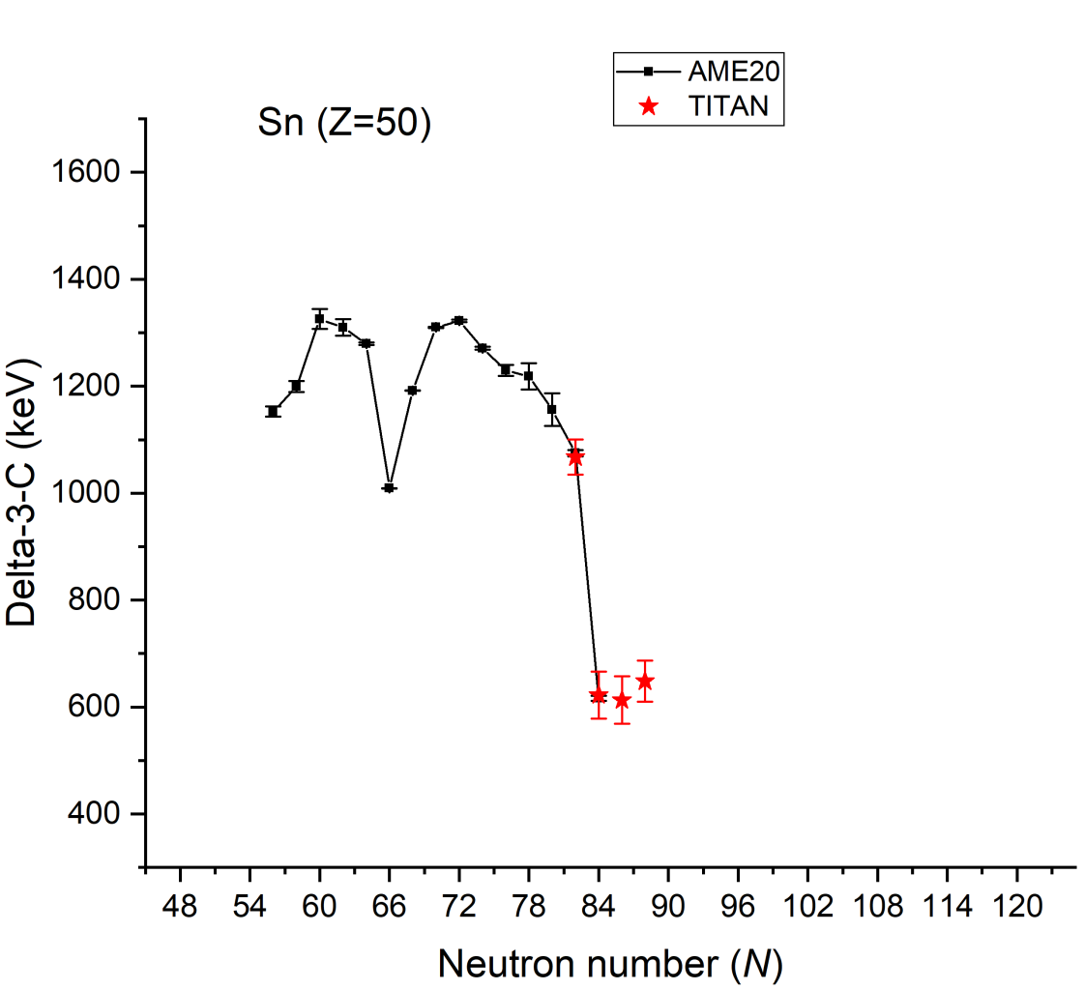
Nuclear structure beyond N=82
$$S_{n}=M\left(N−1,Z\right)−M\left(N,Z\right)+M_{n}$$
One neutron separation energy
Neutron paring gap
Preliminary
Preliminary
Neutron number (N)
Notes:
A=146 took 13000 CPU hours for ab-initio calculation. Cannot go beyond as dimensions exceed 10^10.

Slide 19
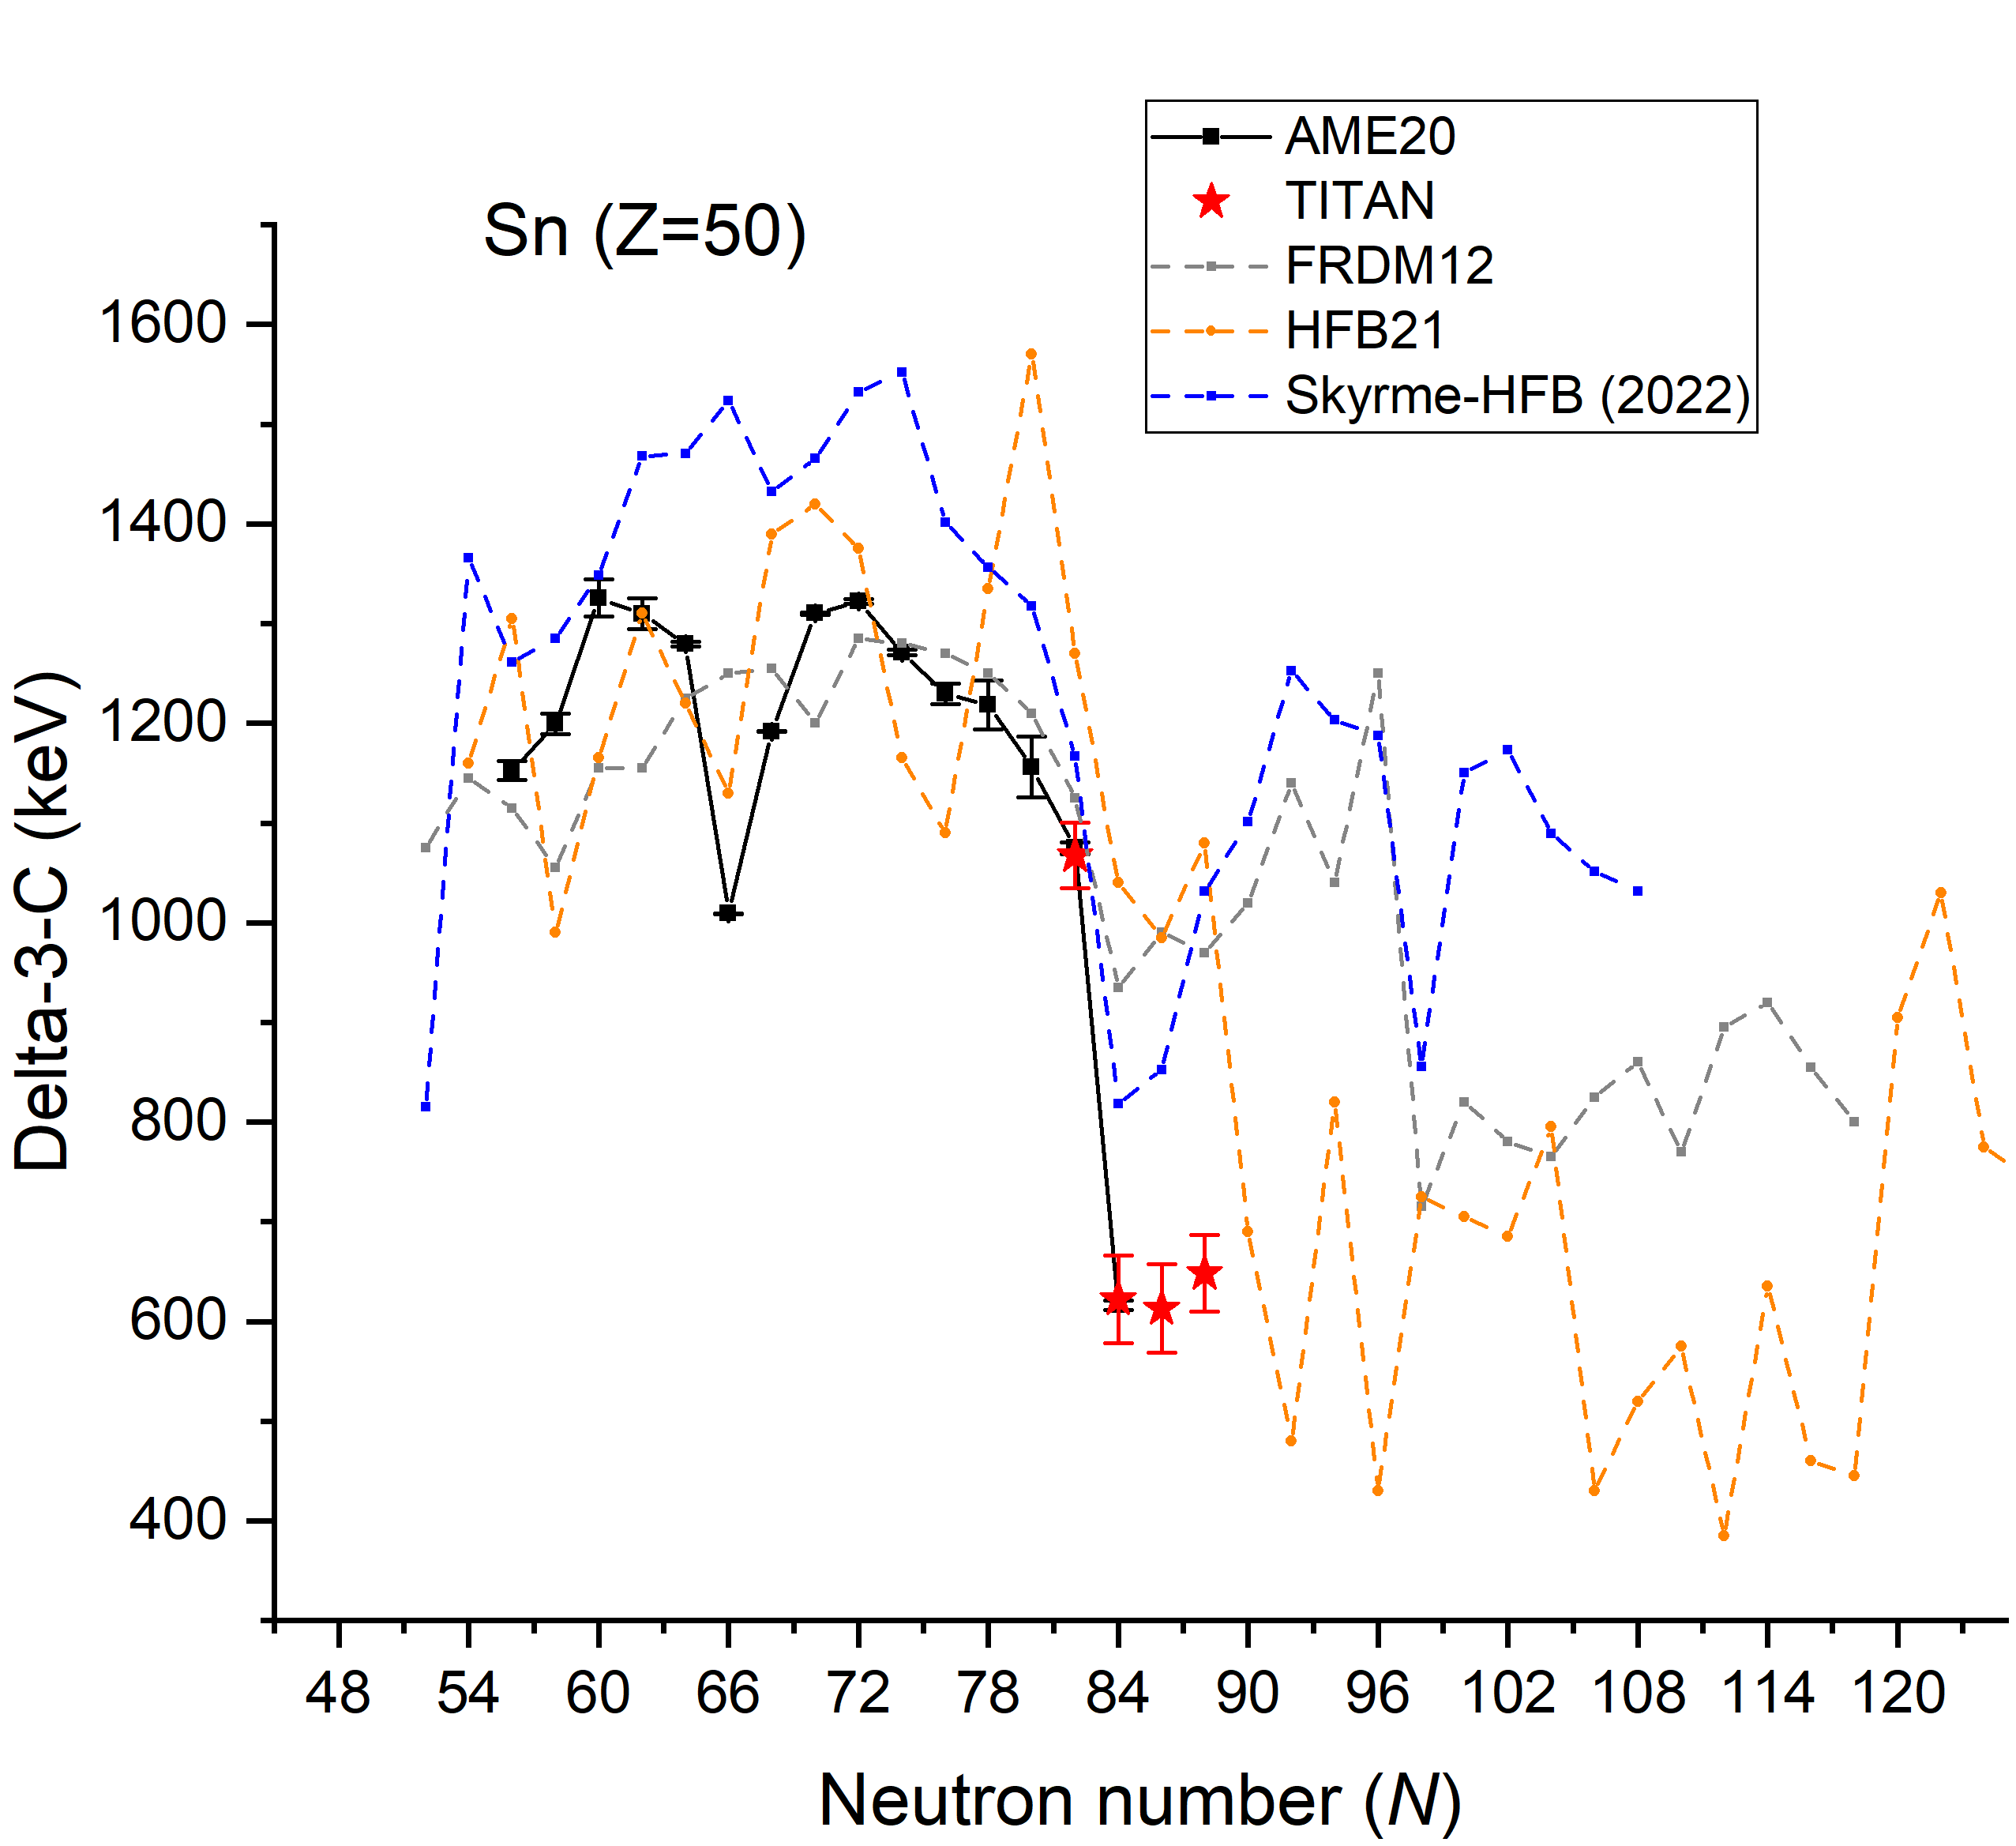
Nuclear structure beyond N=82
$$S_{n}=M\left(N−1,Z\right)−M\left(N,Z\right)+M_{n}$$
One neutron separation energy
Neutron paring gap
Preliminary
Preliminary
Neutron number (N)
Notes:
A=146 took 13000 CPU hours for ab-initio calculation. Cannot go beyond as dimensions exceed 10^10.

Slide 20
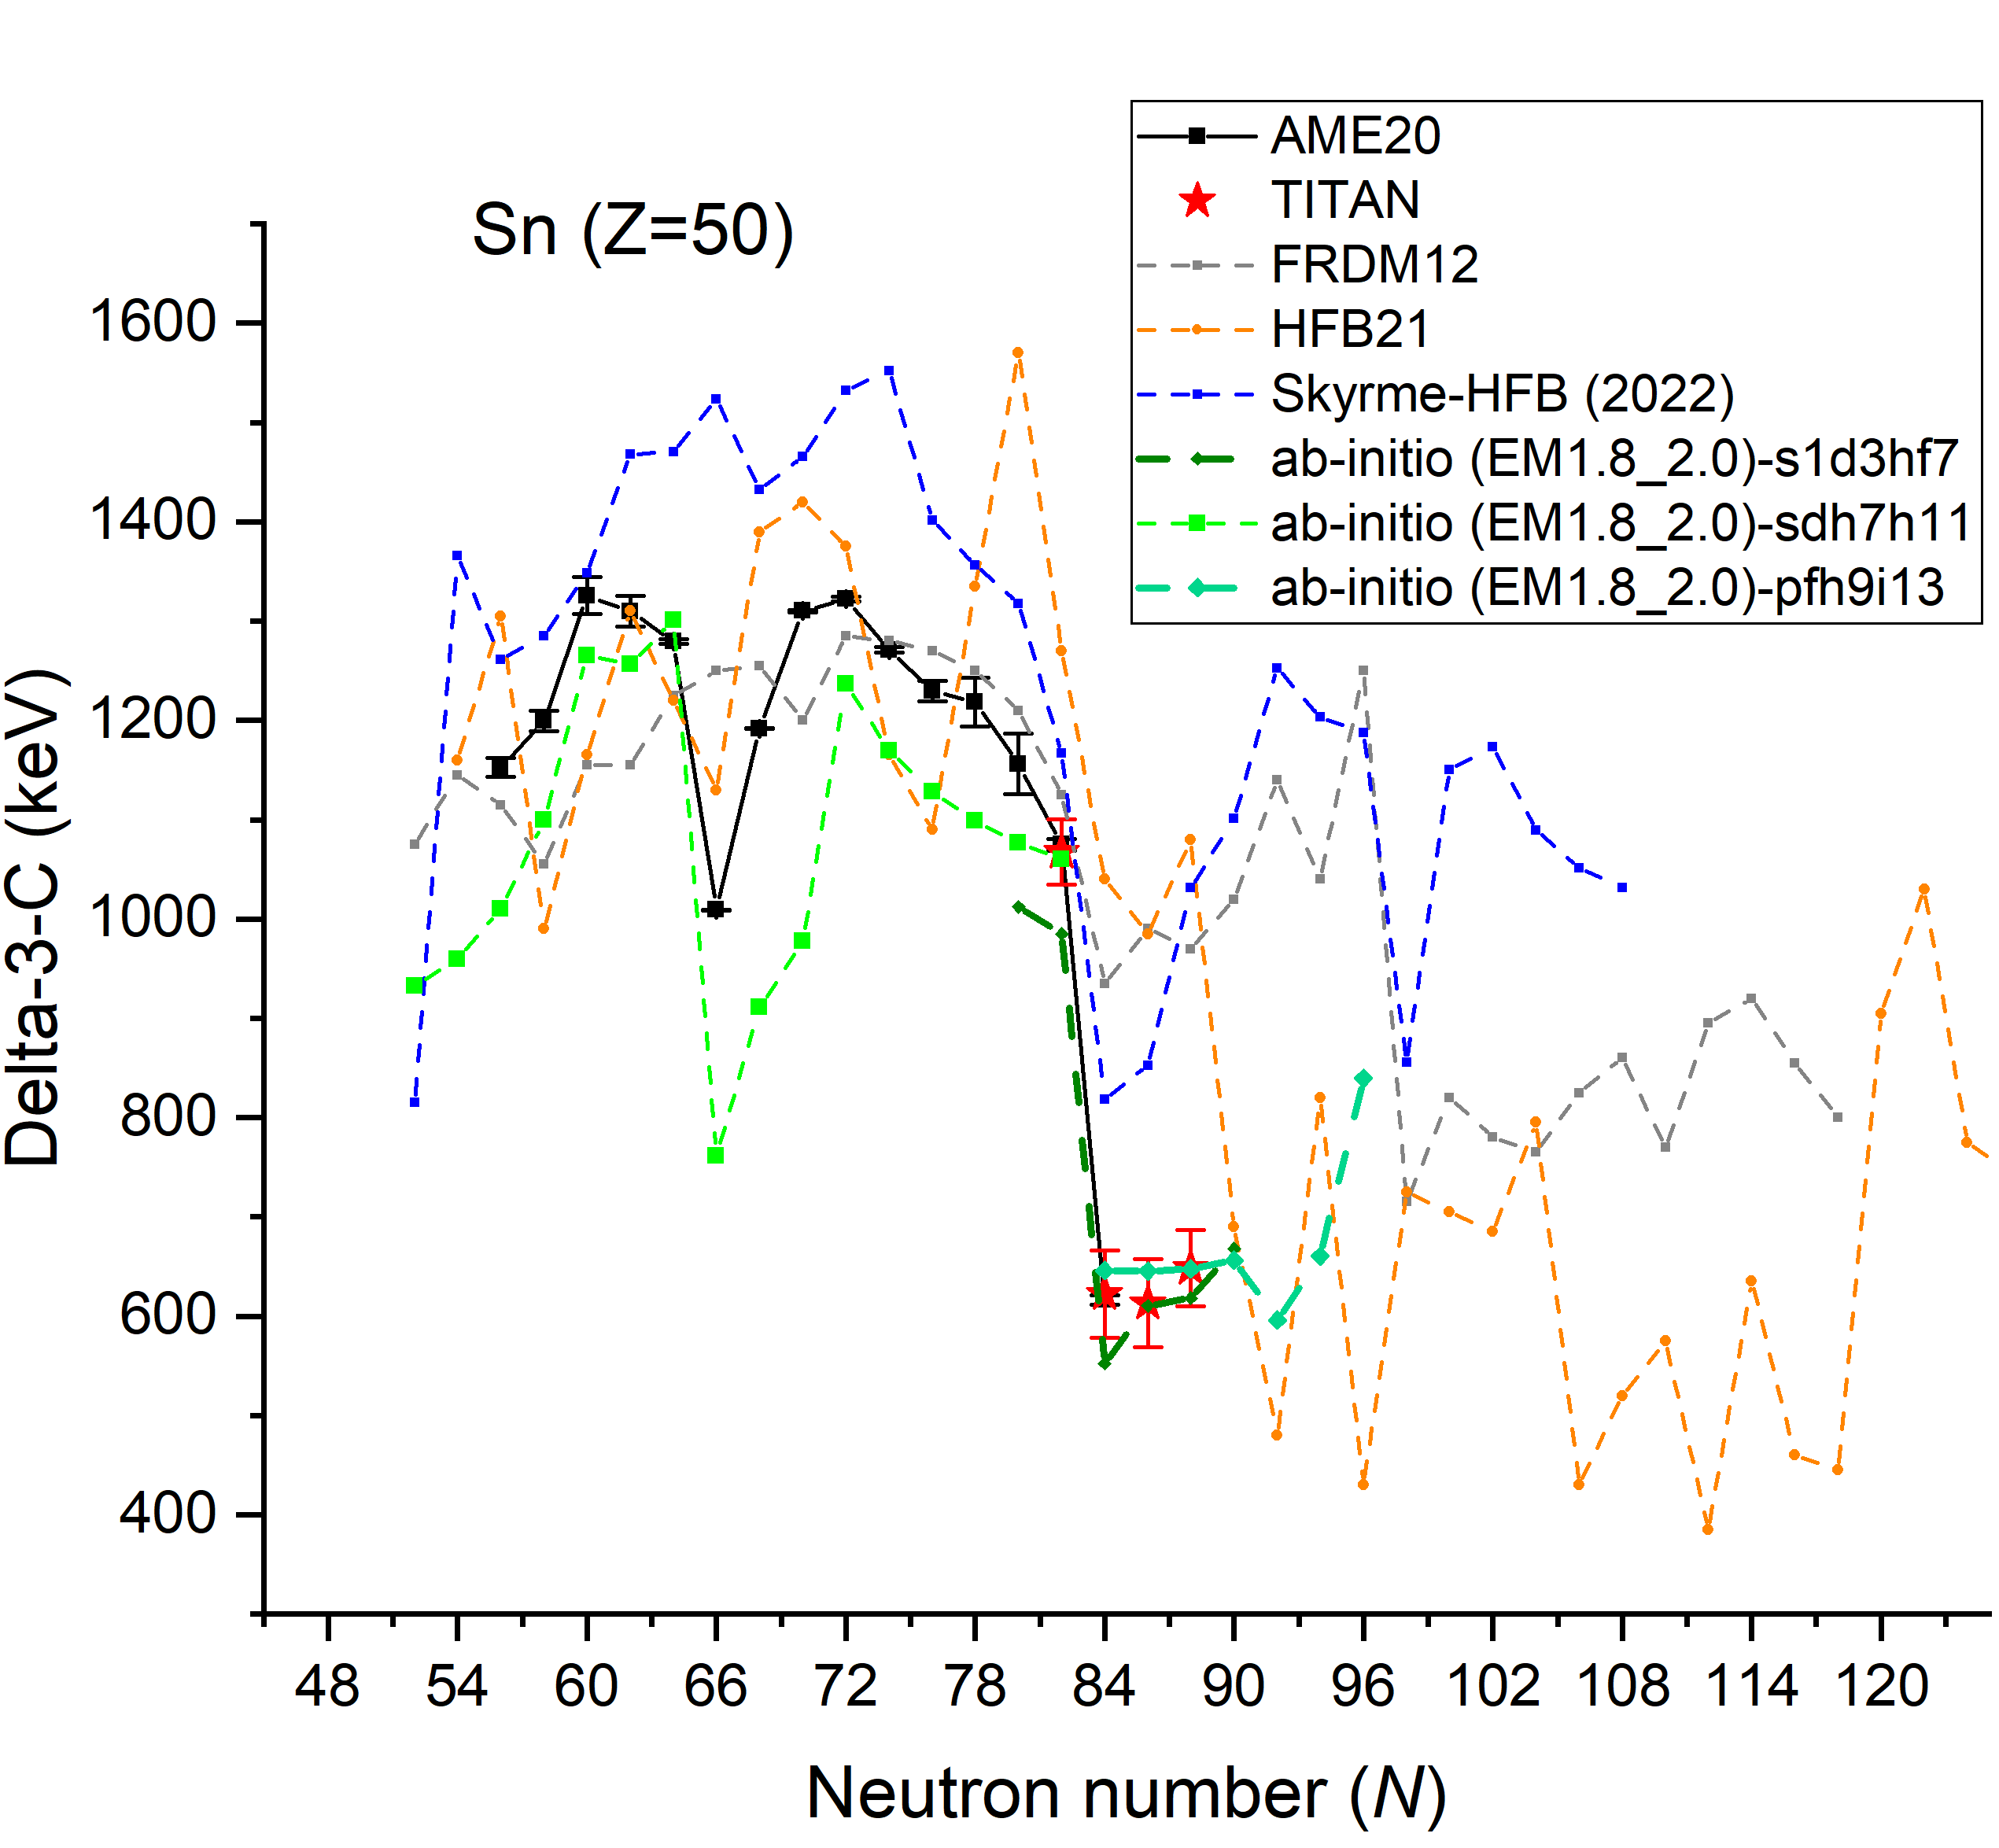
Nuclear structure beyond N=82
$$S_{n}=M\left(N−1,Z\right)−M\left(N,Z\right)+M_{n}$$
One neutron separation energy
Neutron paring gap
13k CPU hours
Preliminary
Preliminary
Neutron number (N)
ab-initio calculations in house: Jason Holt, Takayuki Miyagi
Notes:
A=146 took 13000 CPU hours for ab-initio calculation. Cannot go beyond as dimensions exceed 10^10.

Slide 21
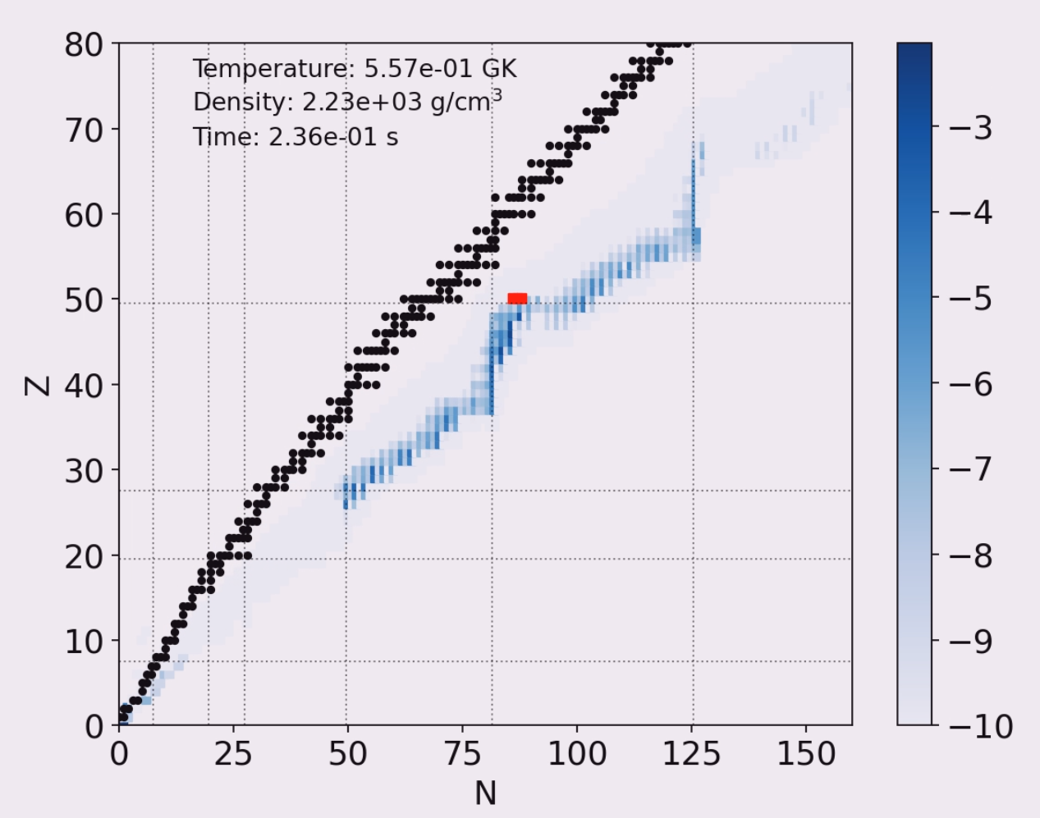
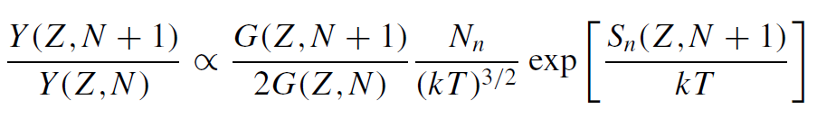
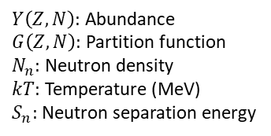

Nuclear Astrophysics (r-process)
Path-line and abundance
Calculations:
N capture cross sections
Decay modes
Half-lives
Branching ratios
Binding energies
New mass
measurements
r-process
Preliminary
Saha equation:
Gabriel Mrtinez and Andre Sieverding
$$S_{n}(Z,N+1)$$
$Y\left(Z,N\right):$ Abundance
$G\left(Z,N\right):$ Partition function
$N_{n}:$ Neutron density
$kT:$ Temperature (MeV)
$S_{n}:$ Neutron separation energy
M.R. Mumpower et. al, Phys. Rev. C 92 (2015)

Slide 22
Summary and Outlook
MR-TOF-MS
TITAN’s MRTOF-MS with a complementary role at ISAC I
MR-TOF-MS contribution to p2n target commissioning
Win-win game (yields and masses)
Sn isotopic chain got extended including three new
mass measurements
Nuclear structure (neutron pairing gap)
Impact on “Nuclear Astrophysics” in calculations (r-process)

Slide 23

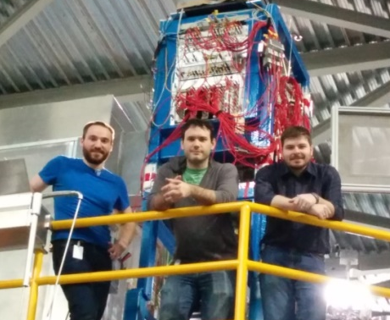





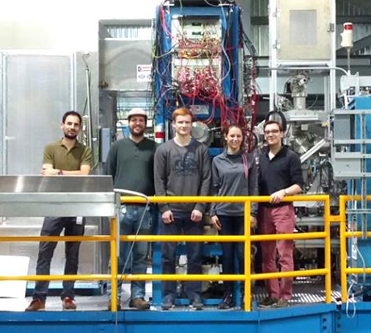






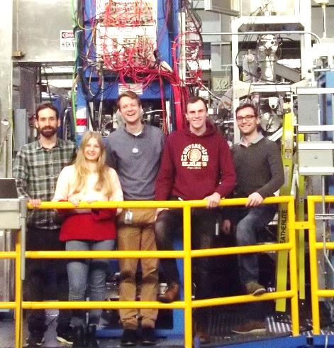
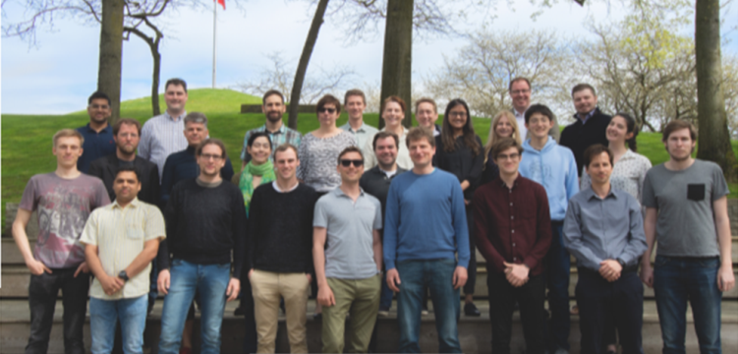
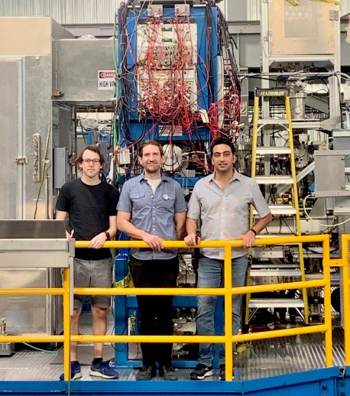
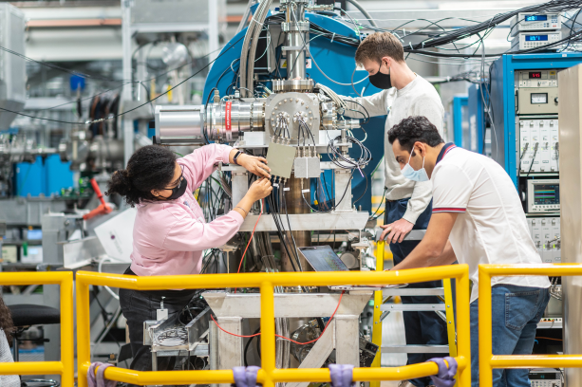
MR-TOF Students
Thanks!
2016
On behalf of TITAN’s Collaboration
2017
2018 - 2019
2023

Slide 24
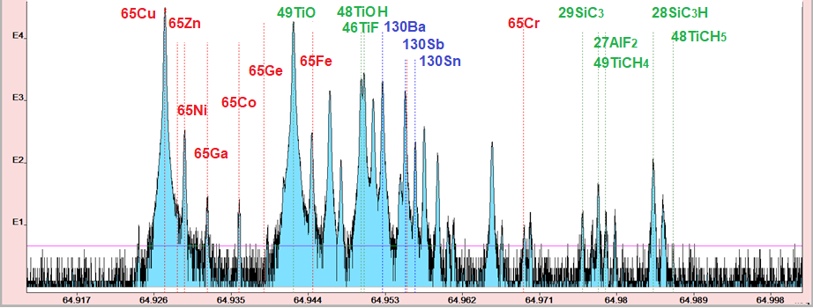
ISOL beams at TRIUMF
Beam composition after the dipole separator (R=2500)
A/q=65
UCx target
TRILIS ion source
Singly charged ions
Doubly charged ions
Molecular ions
Counts
m/q
Need for a more powerful separation method

Slide 25
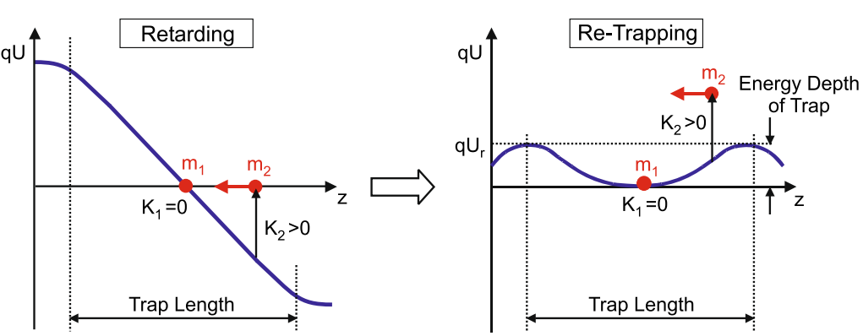
Mass selective re-trapping
TOF analyzer
MagneTOF
Detector
1
2
Ion mirror 2
Ion mirror 2
Use the MR-TOF-MS as its own beam purifier
Combined isobar separation and mass measurements
MRS
Ion mirror 1
Ion mirror 1
Injection Trap
T. Dickel et. al, JASMS, (2017) 28:1079-1090

Slide 26
Mass selective re-trapping
TOF analyzer
MagneTOF
Detector
1
Ion mirror 2
Ion mirror 2
Use the MR-TOF-MS as its own beam purifier
Combined isobar separation and mass measurements
Provide isobarically-purified beam for downstream experiments (e.g., for Penning trap)
MRS
Ion mirror 1
Ion mirror 1
Injection Trap
Boost in dynamic range
Selection of High-lying isomer/ isobars
Improve precision in mass measurement mode
2
Send purified beam
to
MPET, EBIT
T. Dickel et. al, JASMS, (2017) 28:1079-1090

