Slide 1
SRF Development at TRIUMF
Philipp Kolb
RF/SRF Group
Science Week, Jul. 31, 2023

Slide 2
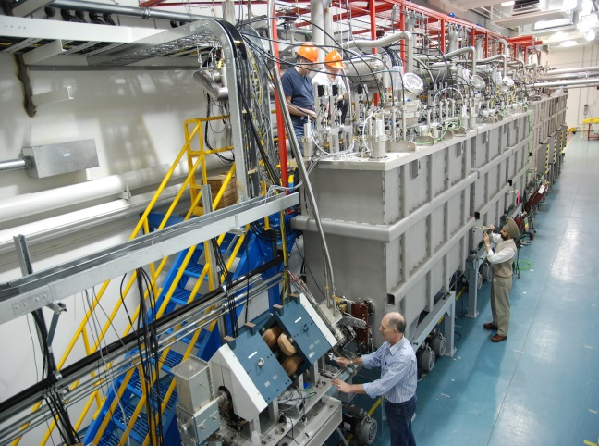
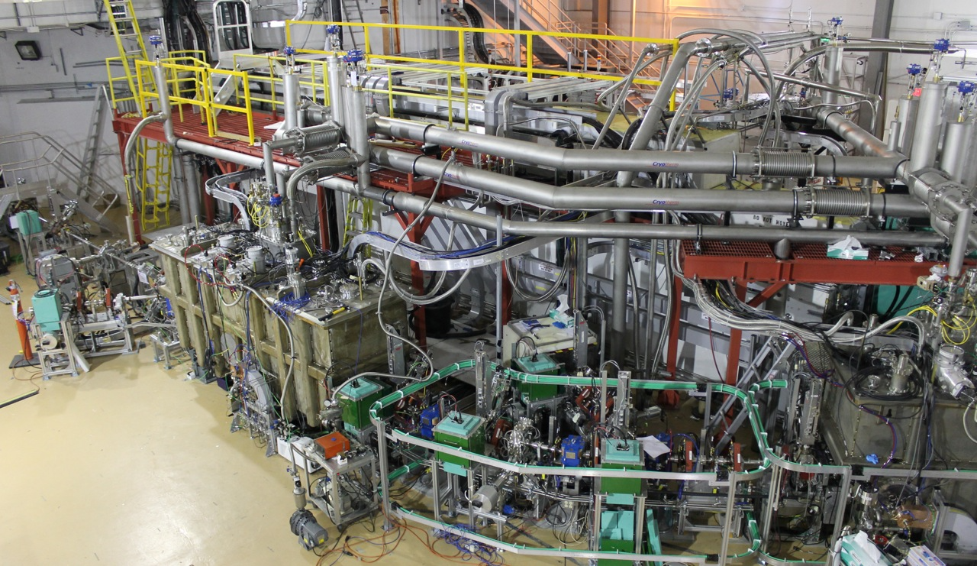
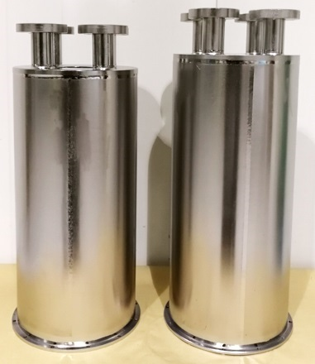
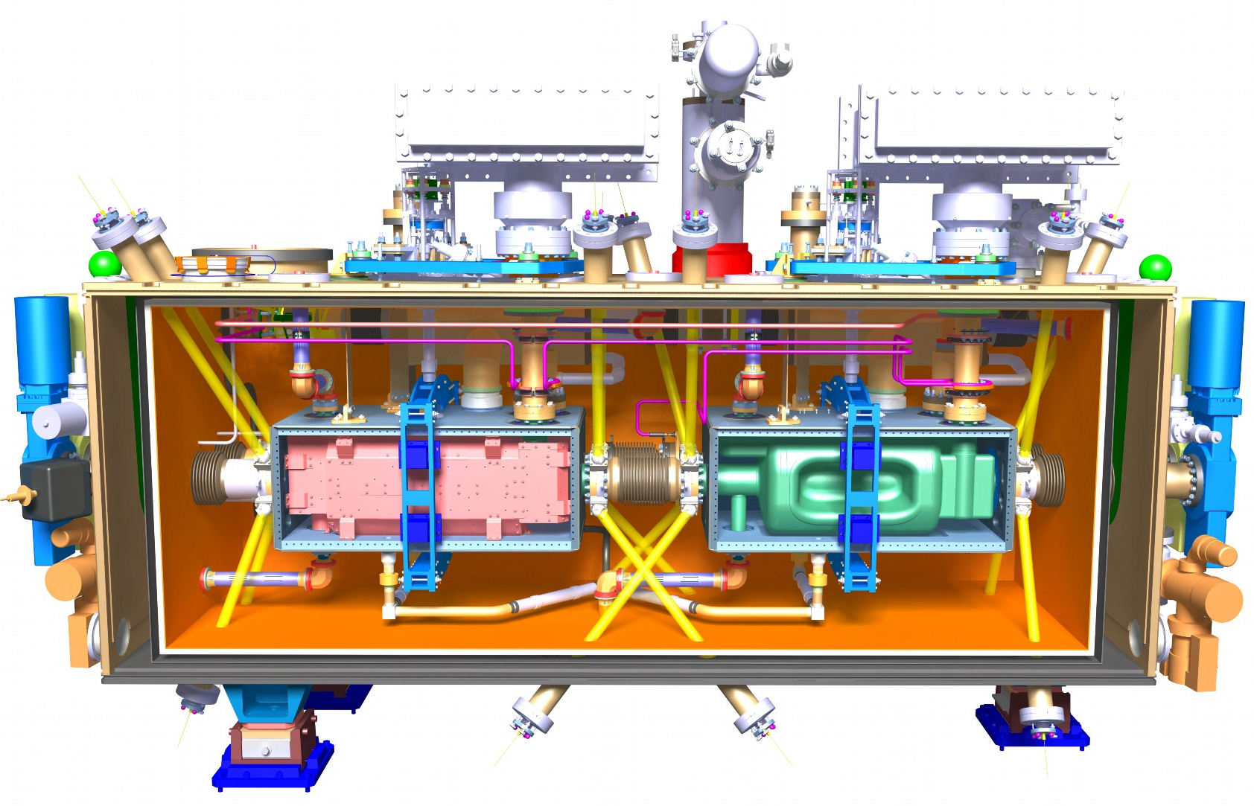
Outline
SRF Overview
  ISAC-II
  ARIEL eLINAC
Research
  Coax. Cavities
  SRF Materials
SRF collaborations
  VECC
  Hi-Lumi LHC Crab Cavity Module
Future
  ISAC-II: Beyond 40MV
  eLINAC: reliable 30MeV
  EIC Crab Cavity

Slide 3
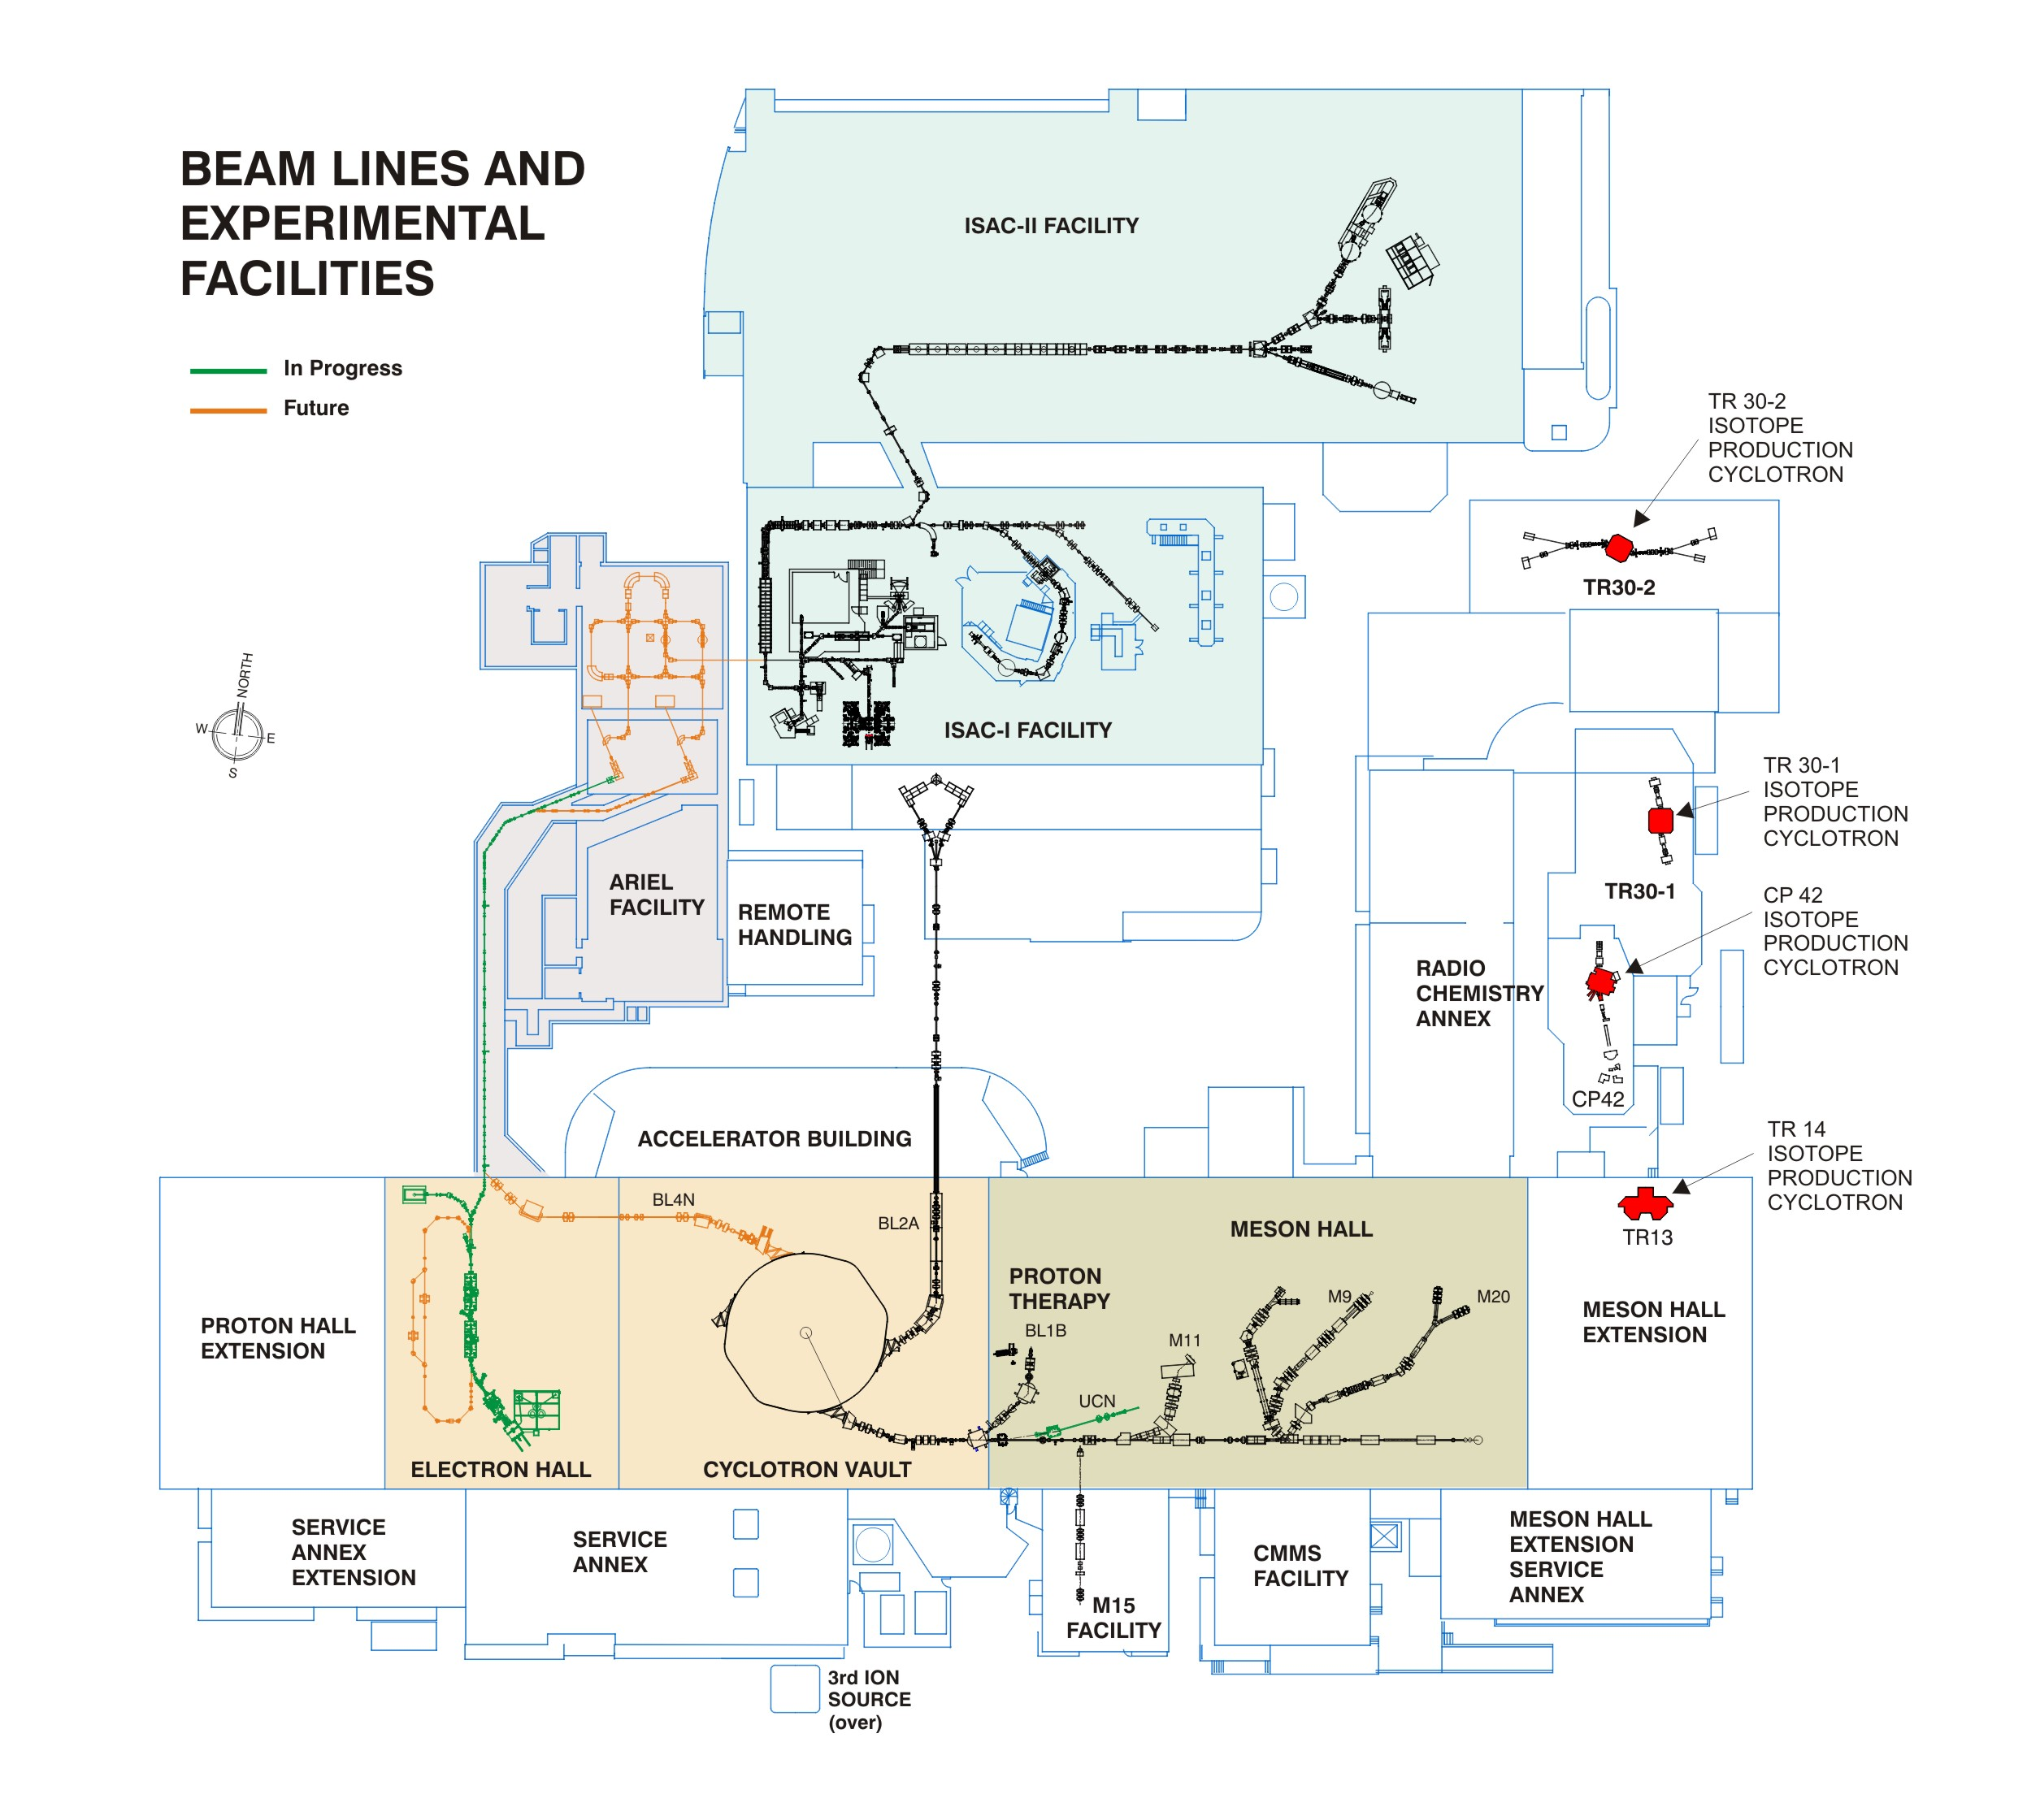
RF Systems
30MV 1.3GHz electron Linac
ISAC-II
ISAC-I
40MV Heavy Ion Linac
Medical Cyclotrons
e-Linac
Cyclotron

Slide 4
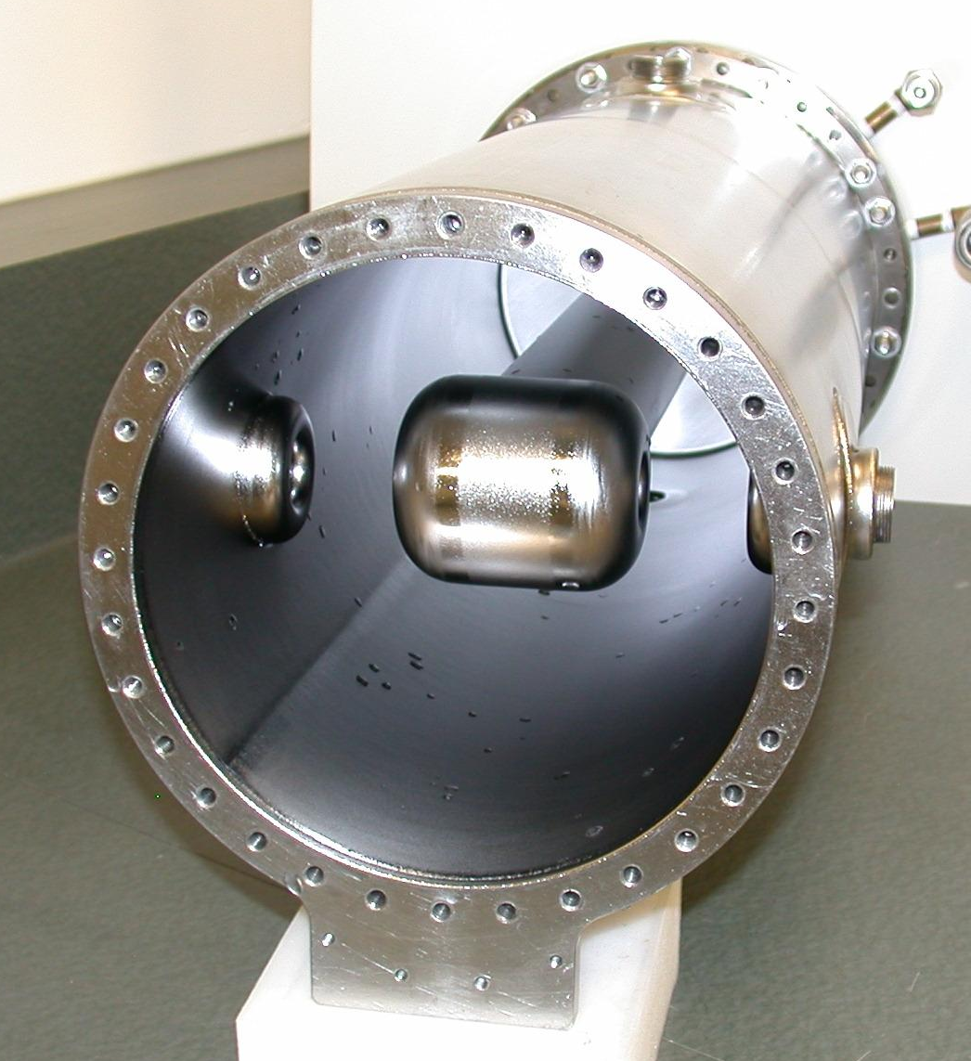
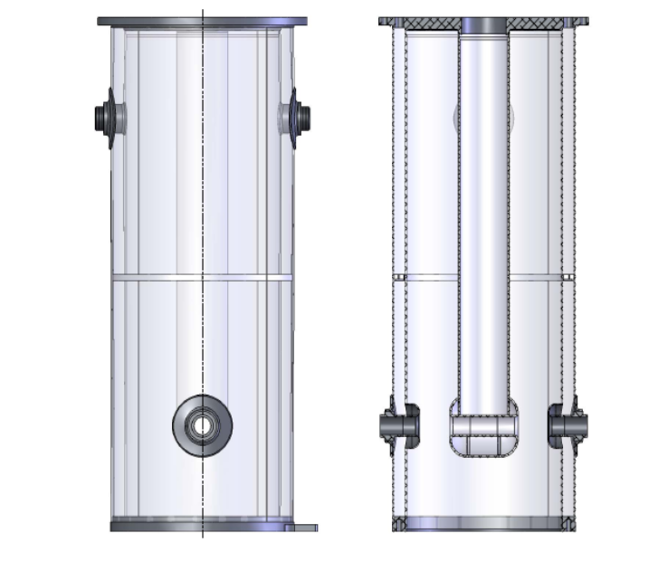
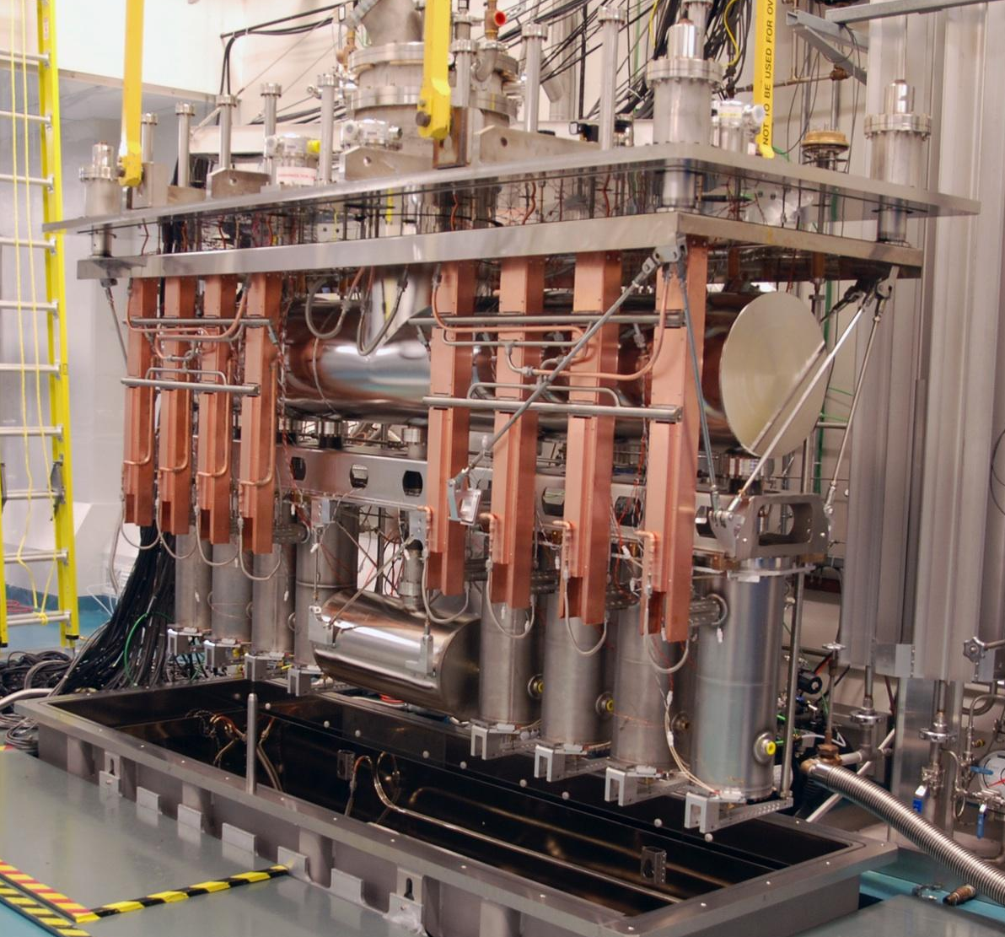
ISAC-II Superconducting Linac
~20cm
141MHz QWR
~1m
40MV SC Linac with 40 106/141MHz Quarter-Wave Resonators (QWRs), operating at 4.2K
To accelerate Radioactive Ion Beams (RIB)
Each cavity provides ~1MV of accelerating voltage
In operation since 2006 – first 20 cavities
Full 40 cavities installed in 2010
~2300 hrs / year operation
Ongoing upgrade/maintenance program to maintain reliability
SCC3 Cryomodule

Slide 5
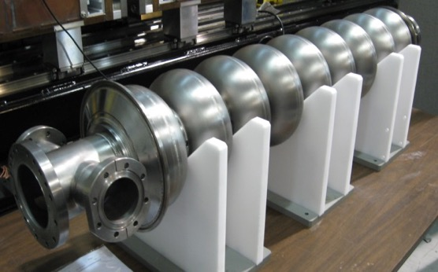
ARIEL e-Linac
1.3GHz elliptical 9cell cavity
Based on 1.3GHz technology used in XFEL / LCLS-II / ILC
Driver Linac for photo-fission to produce RIB
Operation at 2K
3 cavities, each providing 10MV
High beam power – currently up to 10kW but capable of more
Transitioning currently from Commissioning to Operation
30MV 1.3GHz electron Linac

Slide 6
Research & Student Programs
Using the strengths and unique capabilities of TRIUMF to fill research voids and covering niche research topics with high impact
Coaxial cavities studies
Material science for next generation of SRF materials

Slide 7
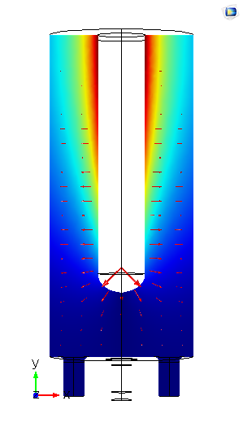
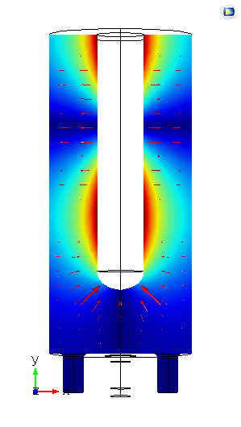
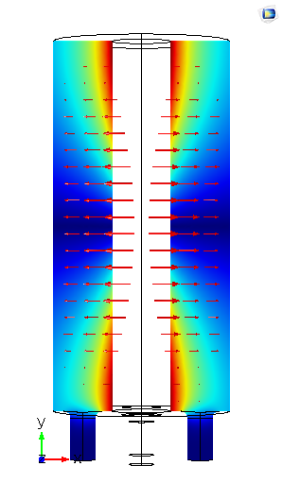
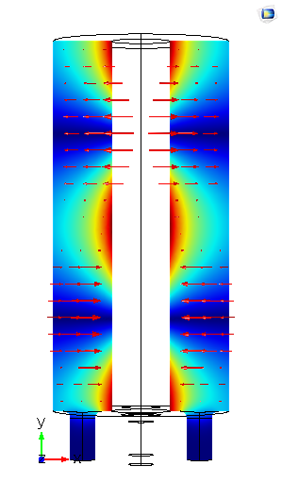
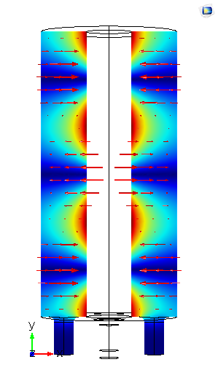
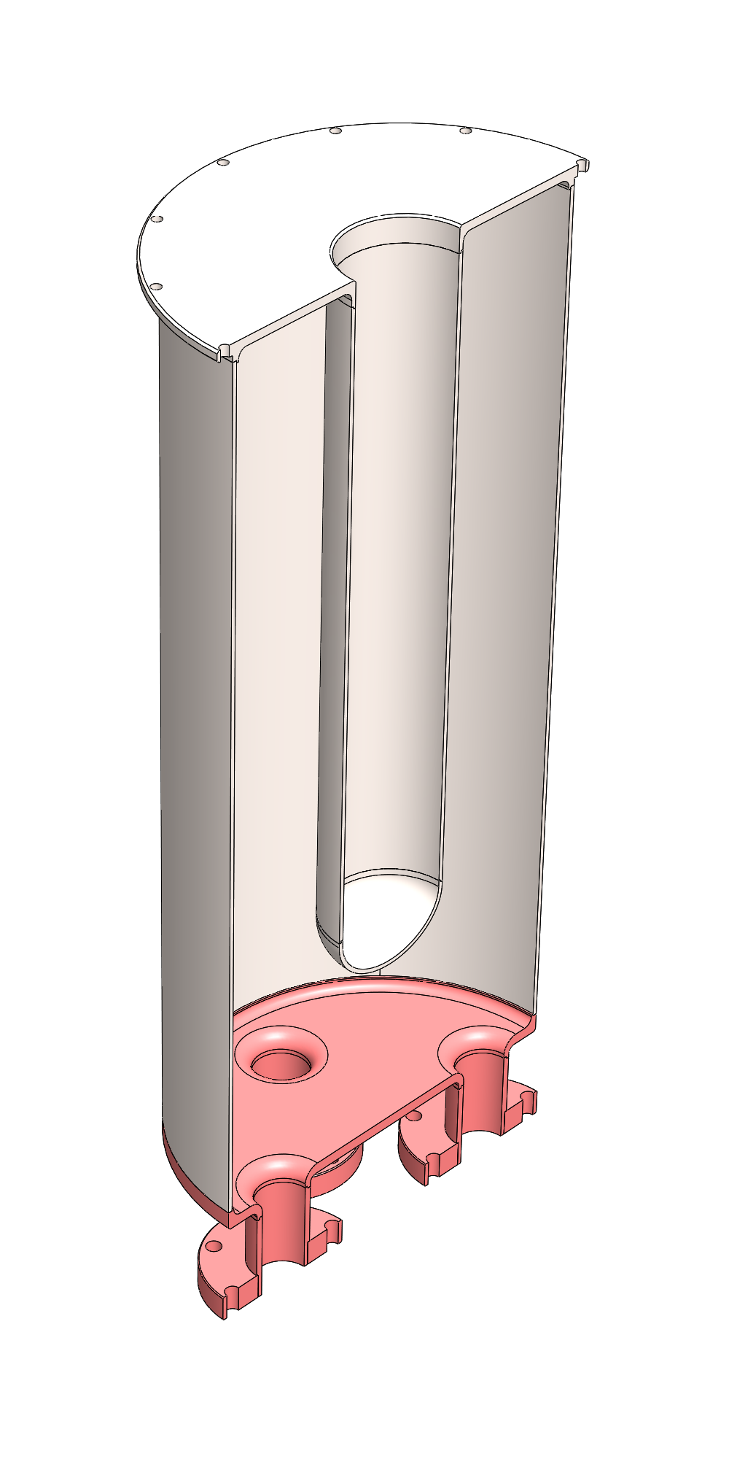
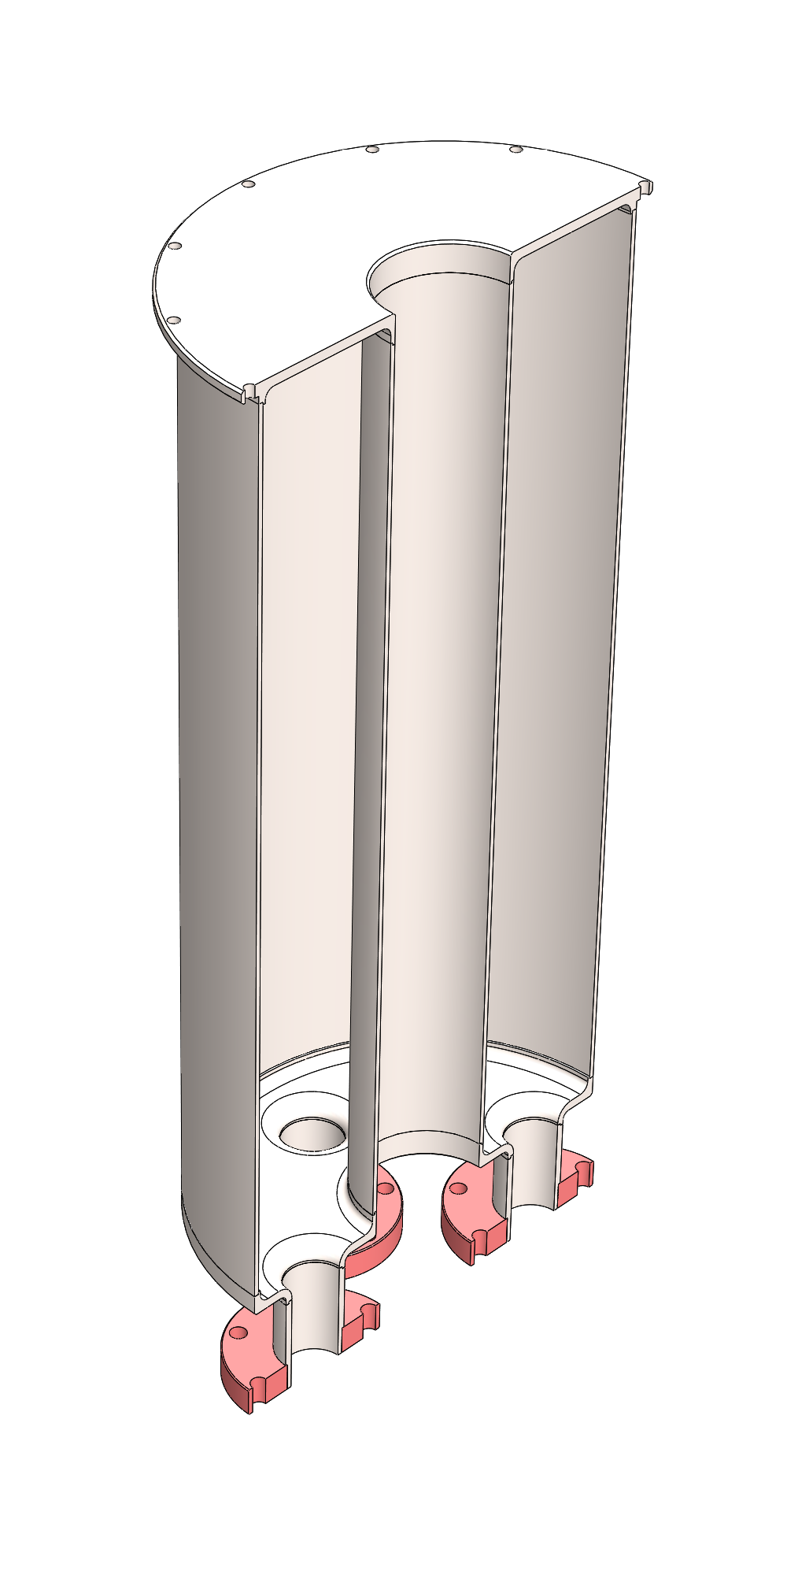
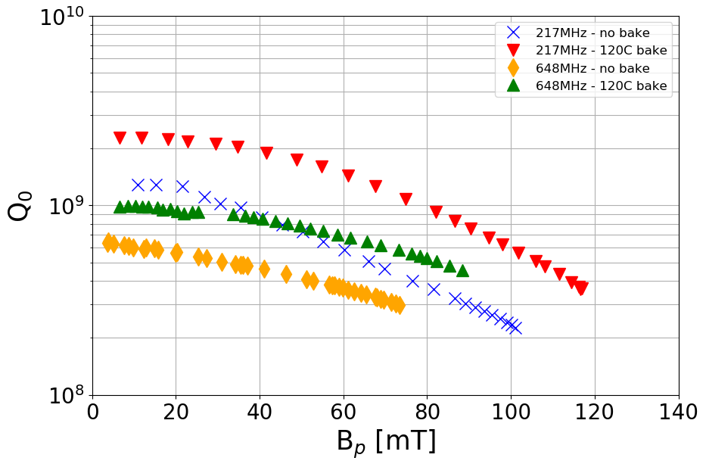
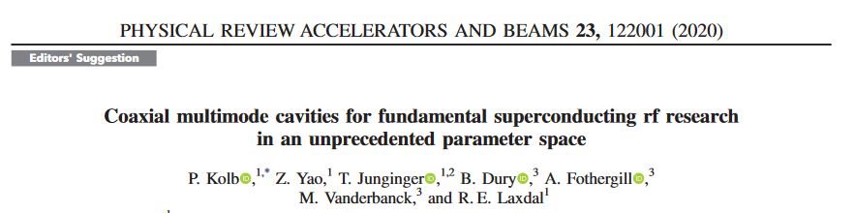
Coaxial Cavity Program
Multi-mode cavities allow frequency resolved measurement of cavity performance without changing cavities
Exploring how surface treatments impact performance – informs ISAC-II cavity retreatment, but also fundamental SRF interest
Niche, but important research for SRF community
217MHz
648MHz
389MHz
778MHz
1166MHz
* Follow-up paper in peer review

Slide 8
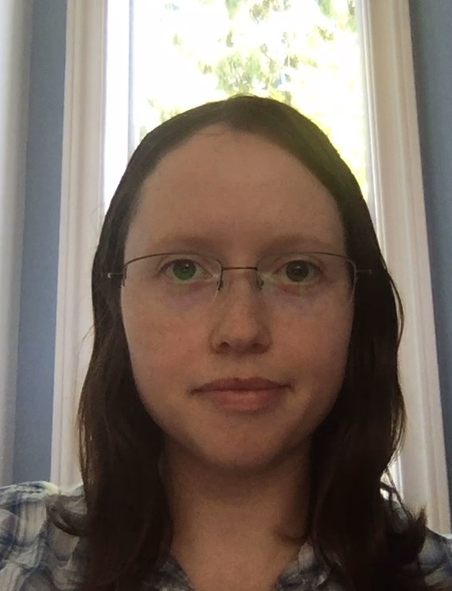
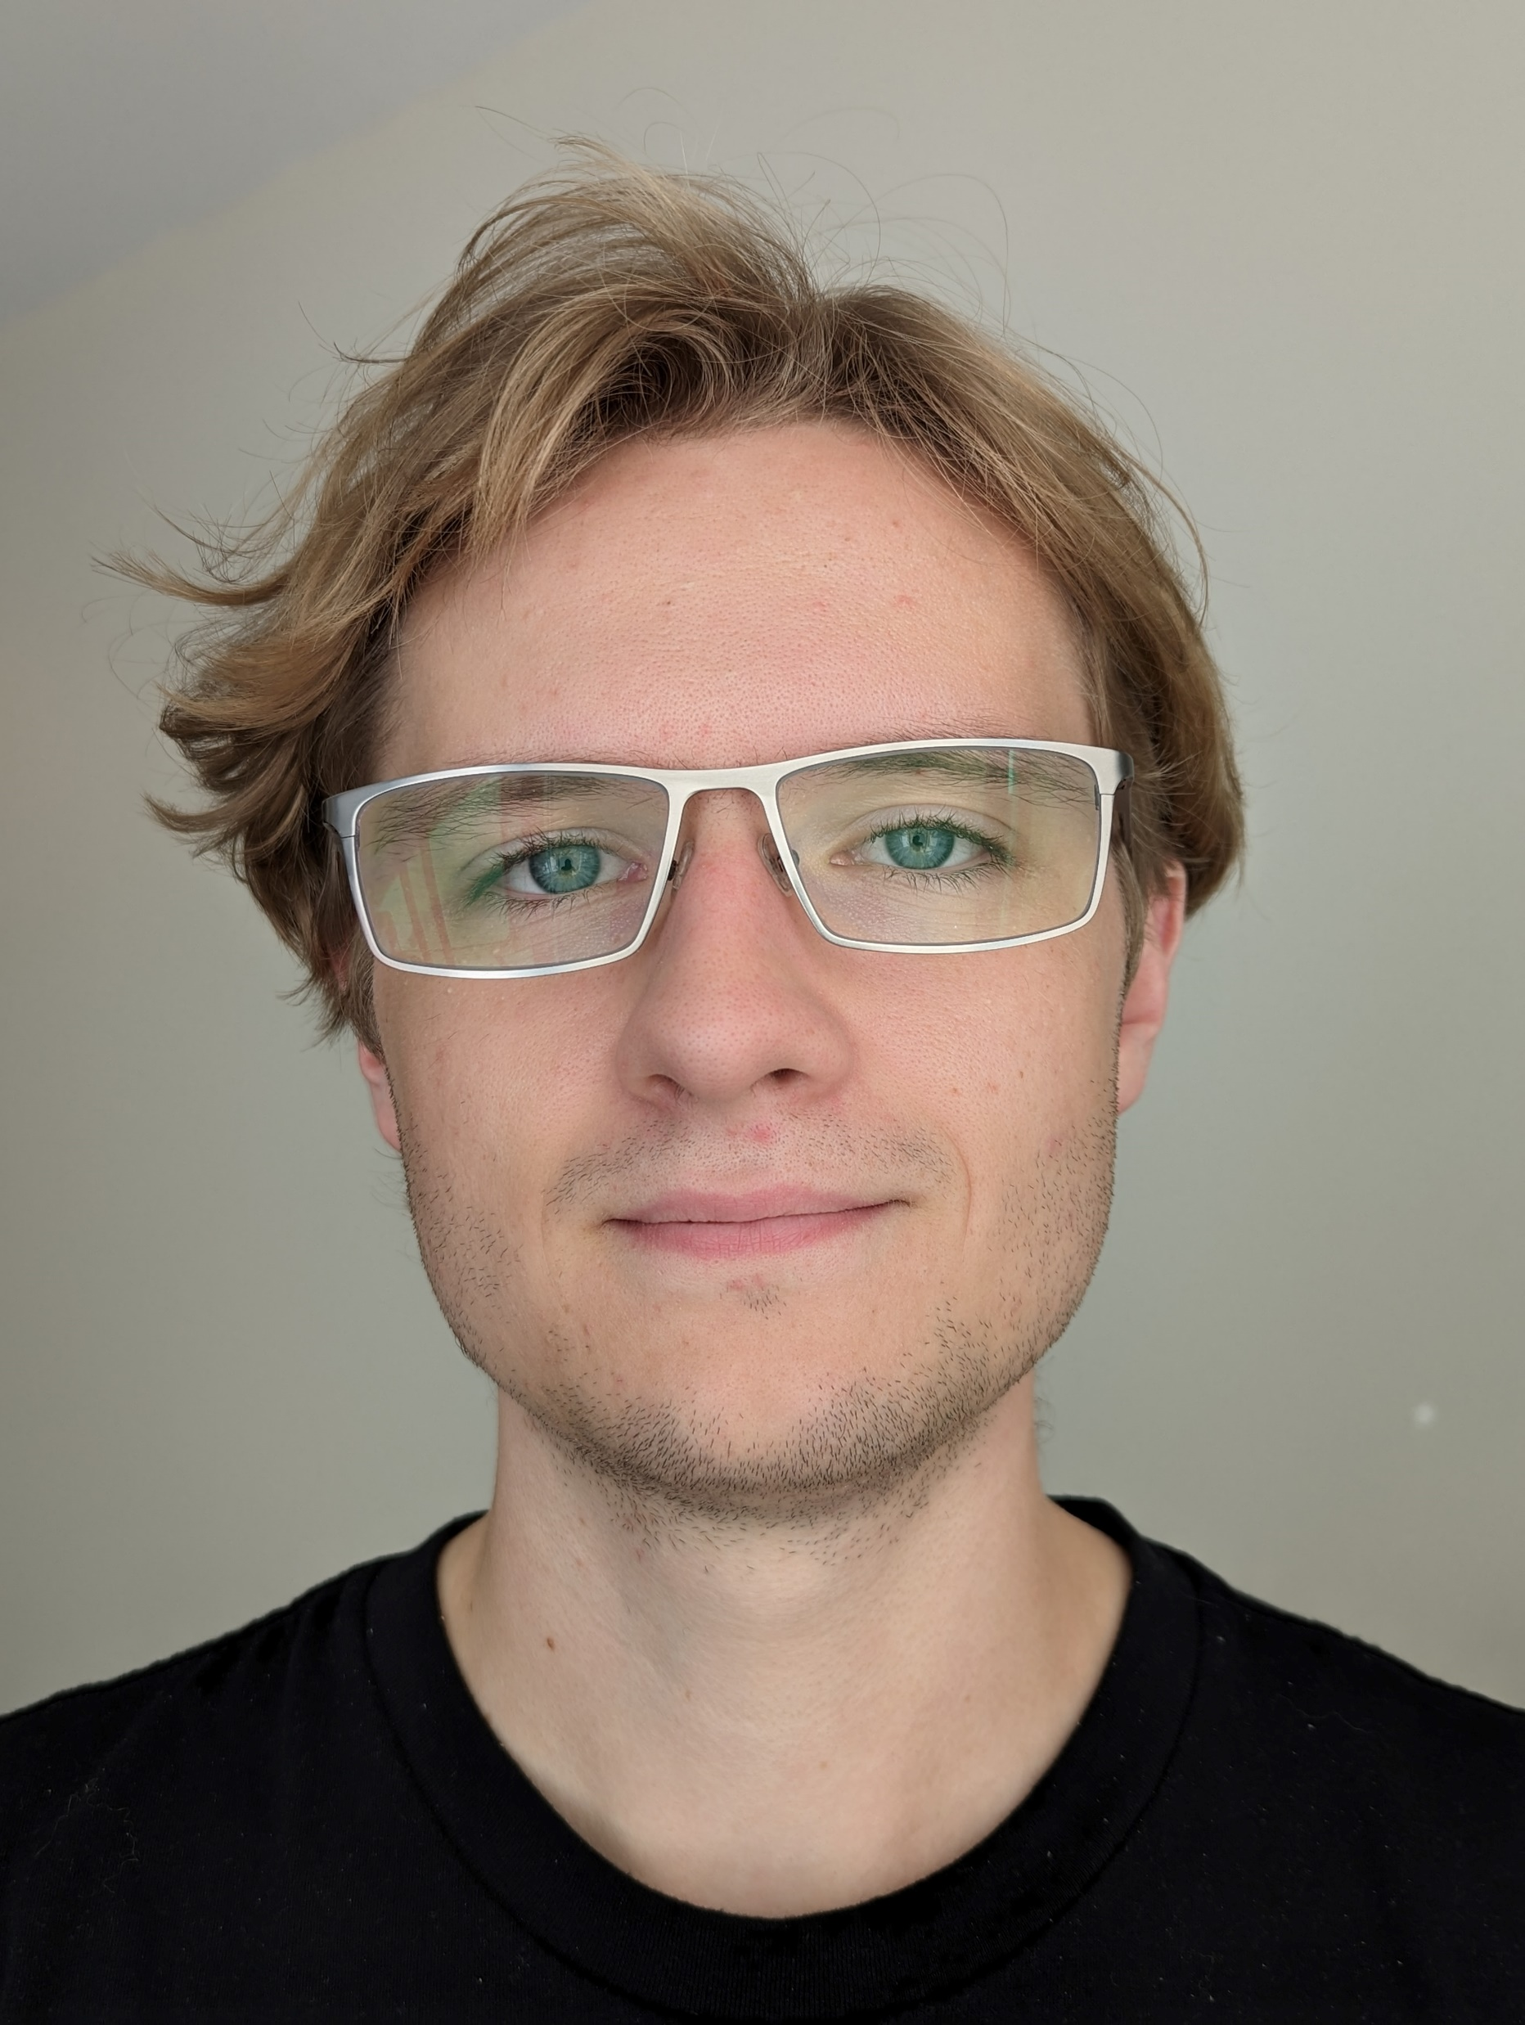
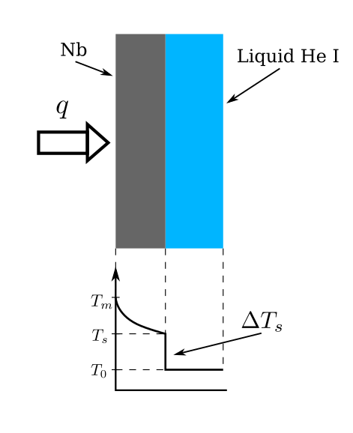
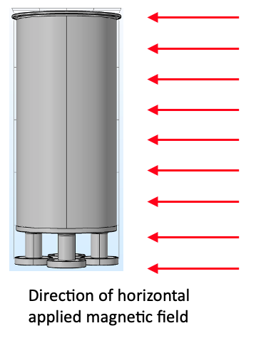
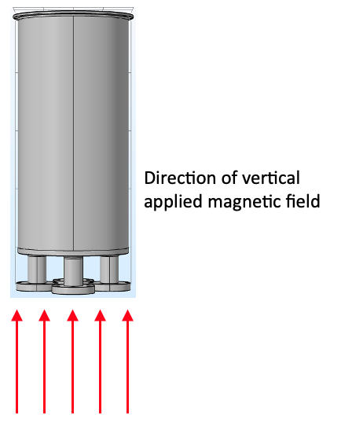
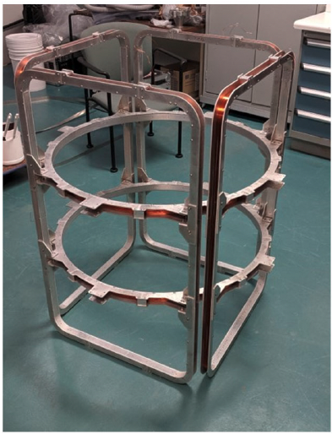
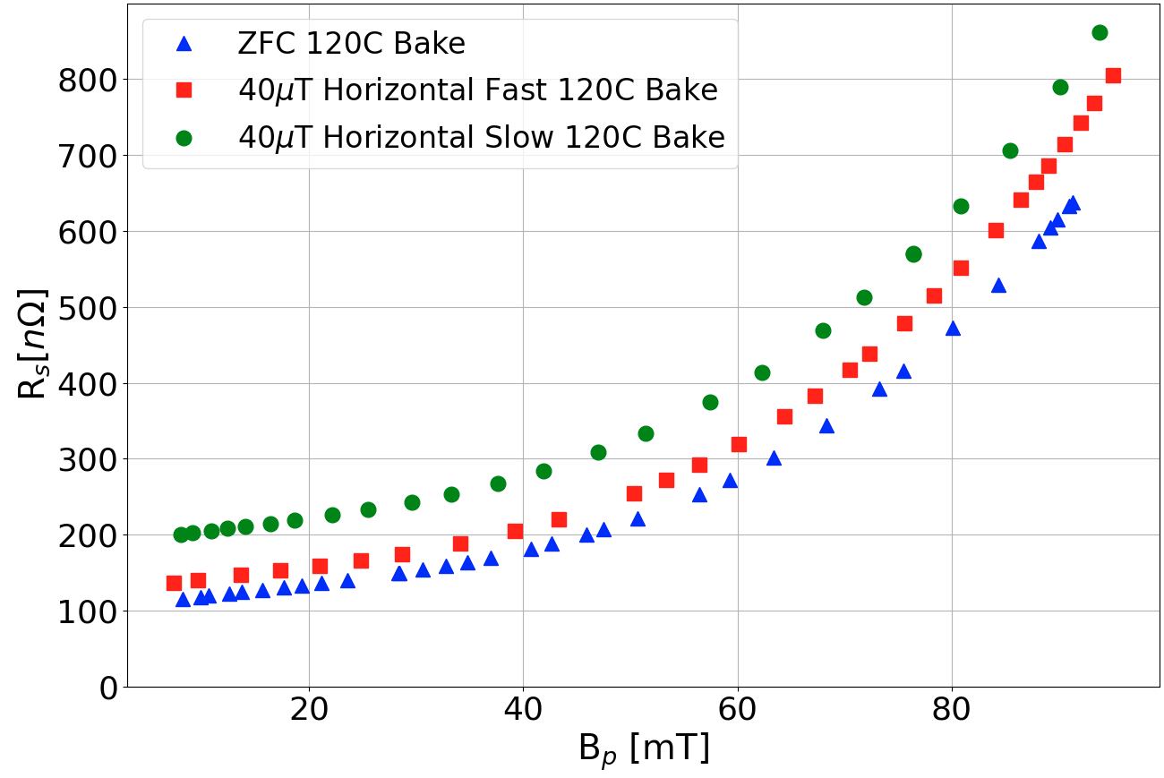
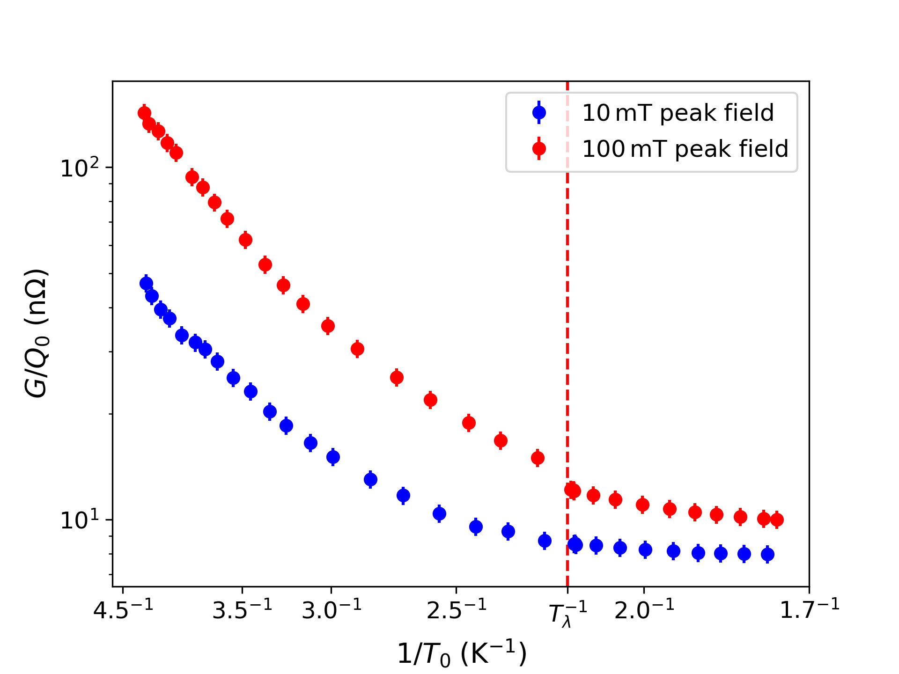
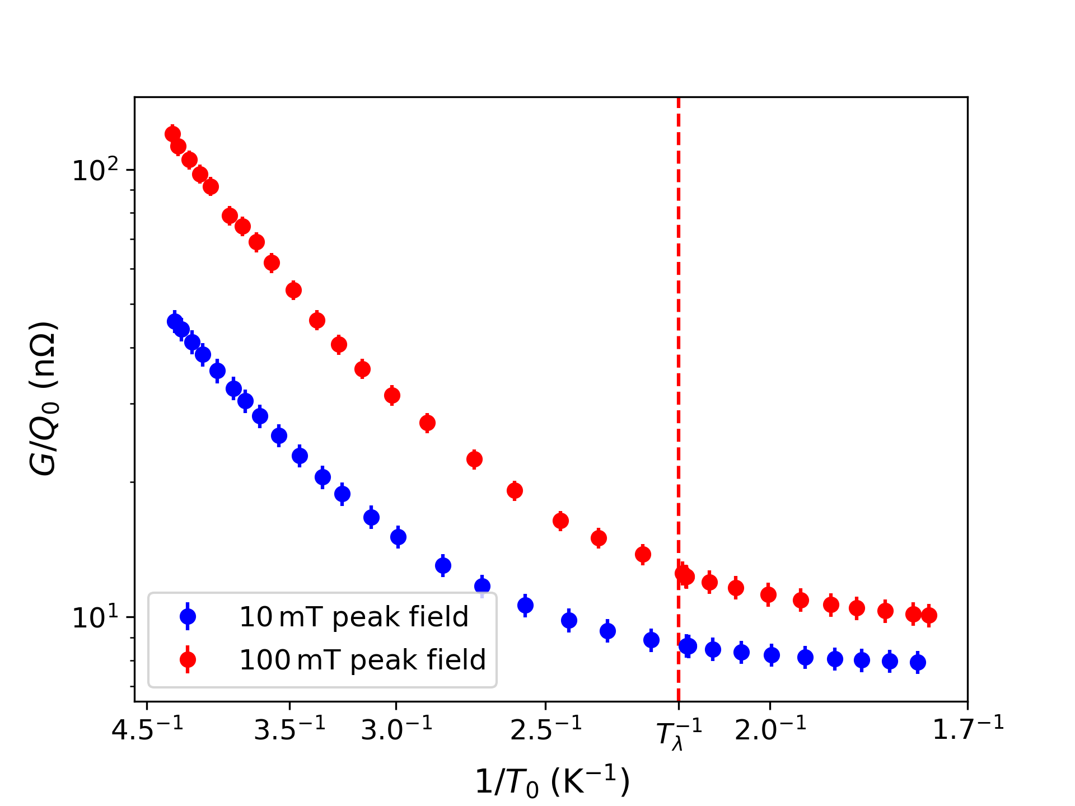
SRF MSc Student Projects
Modelling thermal feedback in surface resistance studies on coaxial SRF cavities
Mattias McMullin (MSc, UVic)
Magnetic Flux Expulsion Studies on Coaxial Resonators
Ruth Gregory (MSc, UVic)
External magnetic flux can negatively impact cavity performance.
Question: How does cavity shape, cavity frequency, field direction and cooldown speed impact flux trapping and performance?
The rf surface resistance is highly dependent on the surface temperature
Question: How can we determine the RF surface temperature compared to the bath temperature?
New data + model eliminates discontinuity when cooling regime changes.
Recognized at SRF 2023 conf with Student Poster Award (1st place)
Poster available during the poster session on Wednesday! Please come talk to Ruth there.

Slide 9
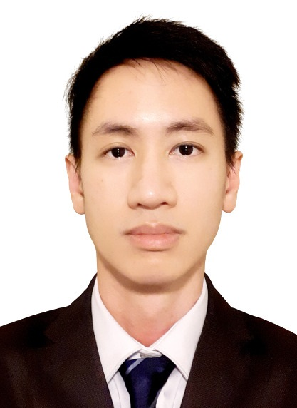
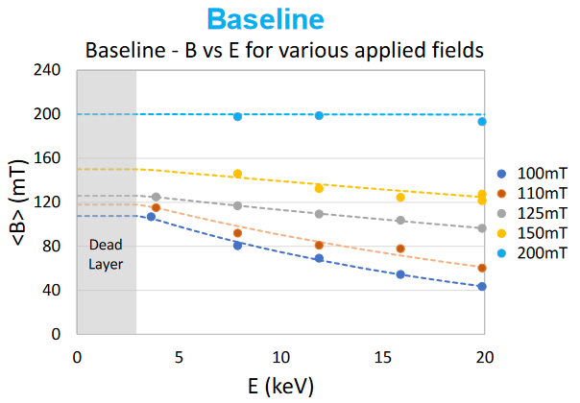
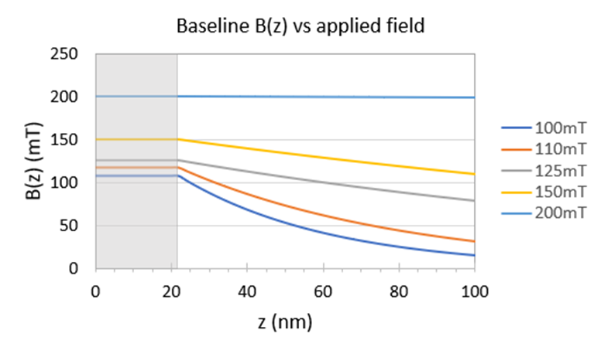
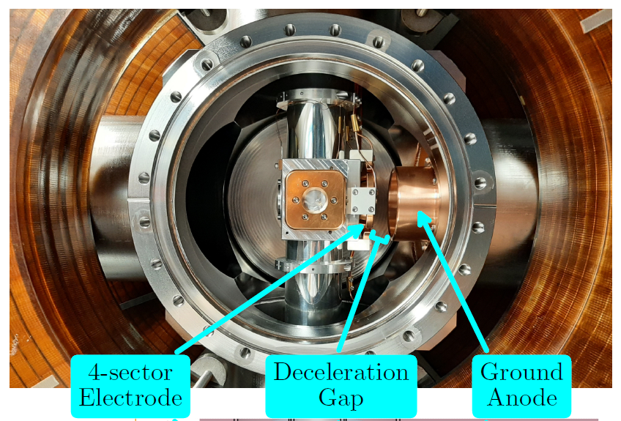
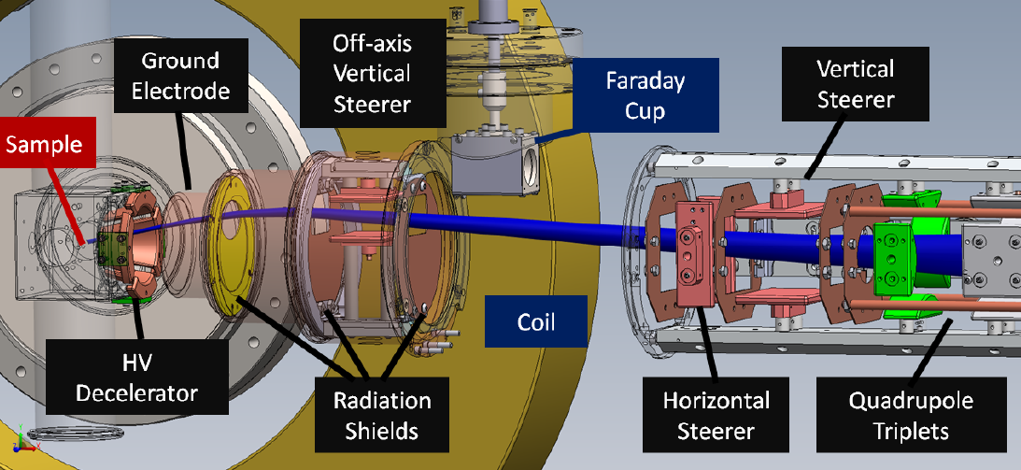
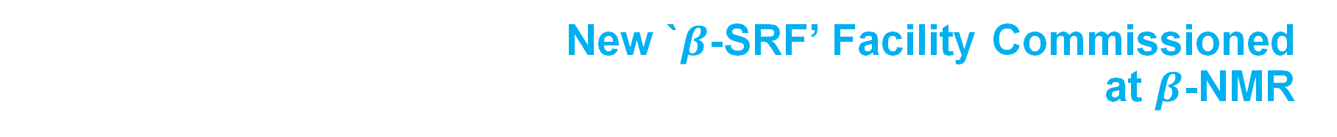
New `$β$-SRF’ Facility Commissioned
at $β$-NMR
New beamline extension installed at β-NMR facility for SRF materials characterization
Unique facility in the world for depth profiling materials in parallel magnetic fields up to 200mT – SRF regime – critical field of Nb
Collaboration between Accelerator Division and CMMS
Commissioning and first experiments completed
Edward Thoeng
(PhD, UBC)
Magnetic field screening for
various applied fields
First paper
E. Thoeng, et al:
A New High Parallel-Field Spectrometer at TRIUMF’s 𝛽-NMR Facility,
Rev. Sci. Instr. *Editors Pick*
Edward was recognized at SRF2023 with the Early Career Presenter Award.
Helmholtz coil

Slide 10
SRF Collaborations
Supporting the SRF community and engaging in cutting edge projects
VECC cryomodules
CERN Hi-Lumi crab cavity modules

Slide 11
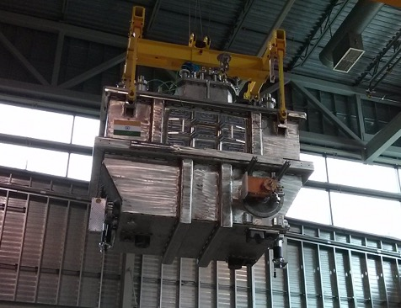
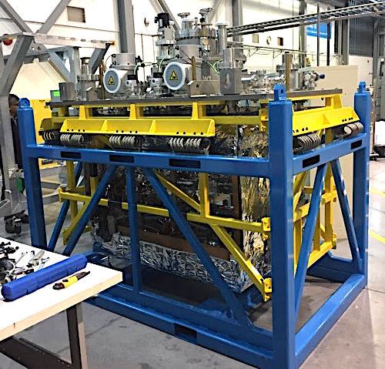
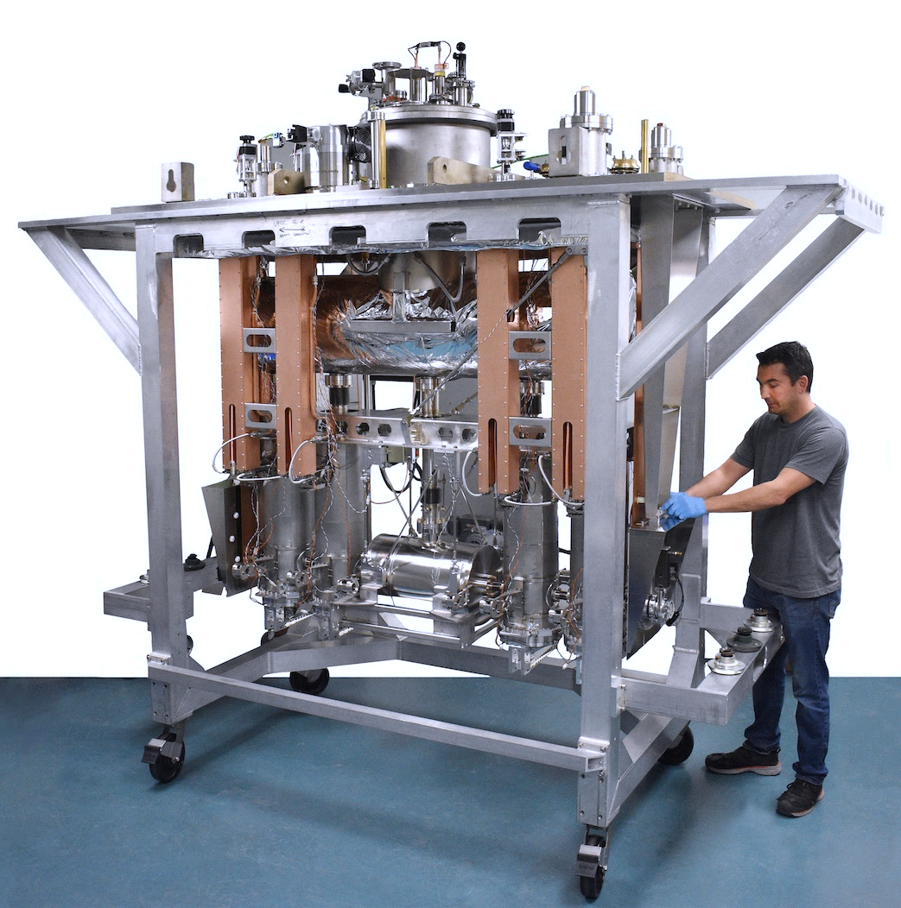
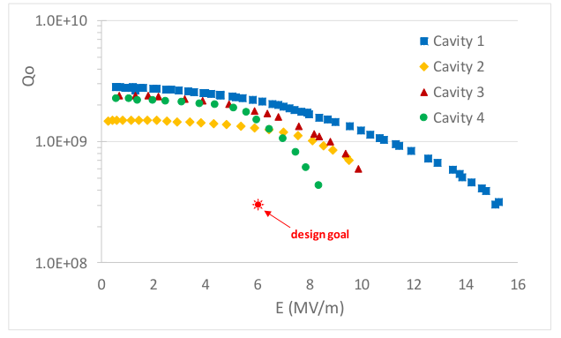
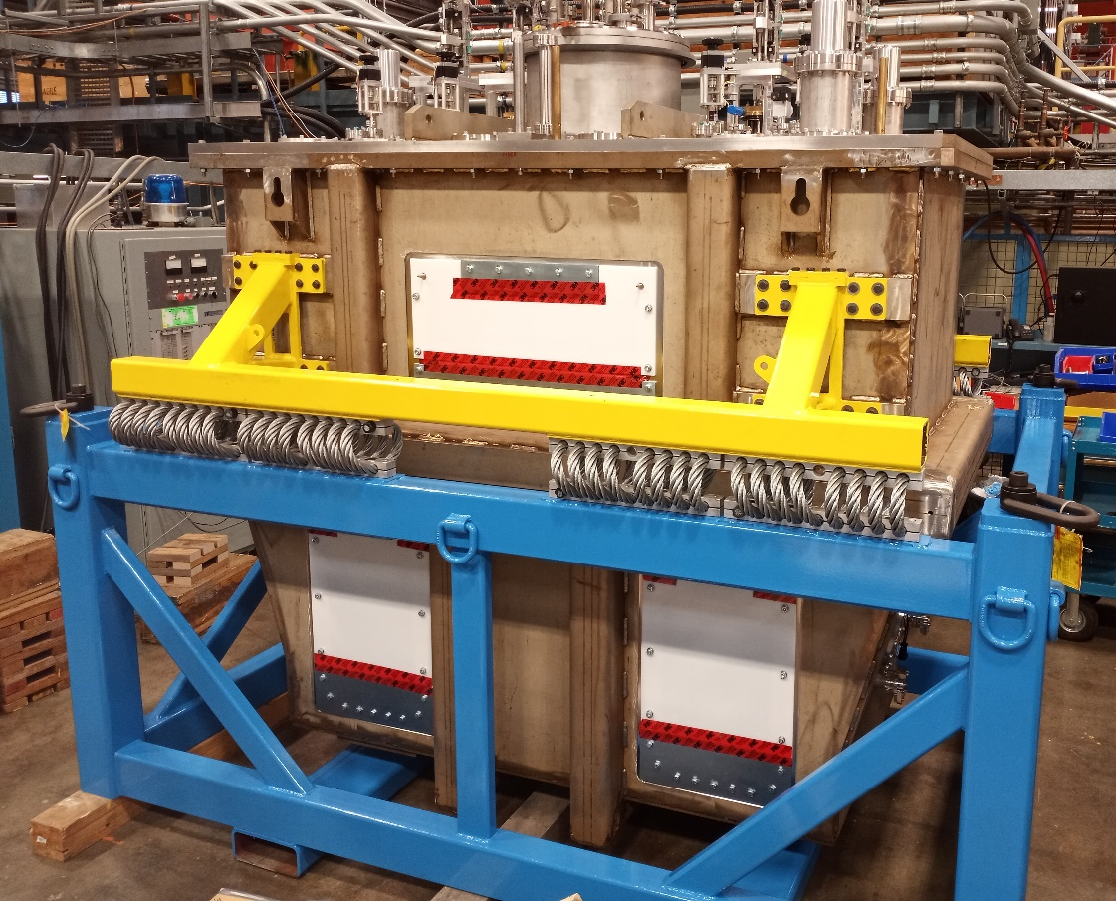
VECC Cryomodules, India
1.3 GHz Injector Cryomodule
TRIUMF and VECC (Kolkata) have had an active collaboration since 2008
As part of the collaboration TRIUMF has completed two cryomodules, a 1.3GHz electron SRF module (ICM) and a 110MHz heavy ion module (QWR)
The ICM was shipped in 2019 and the QWR will be shipped in December 2022
TRIUMF is also completing RIB production modules for VECC
Quarter-wave Resonator Heavy Ion Cryomodule

Slide 12
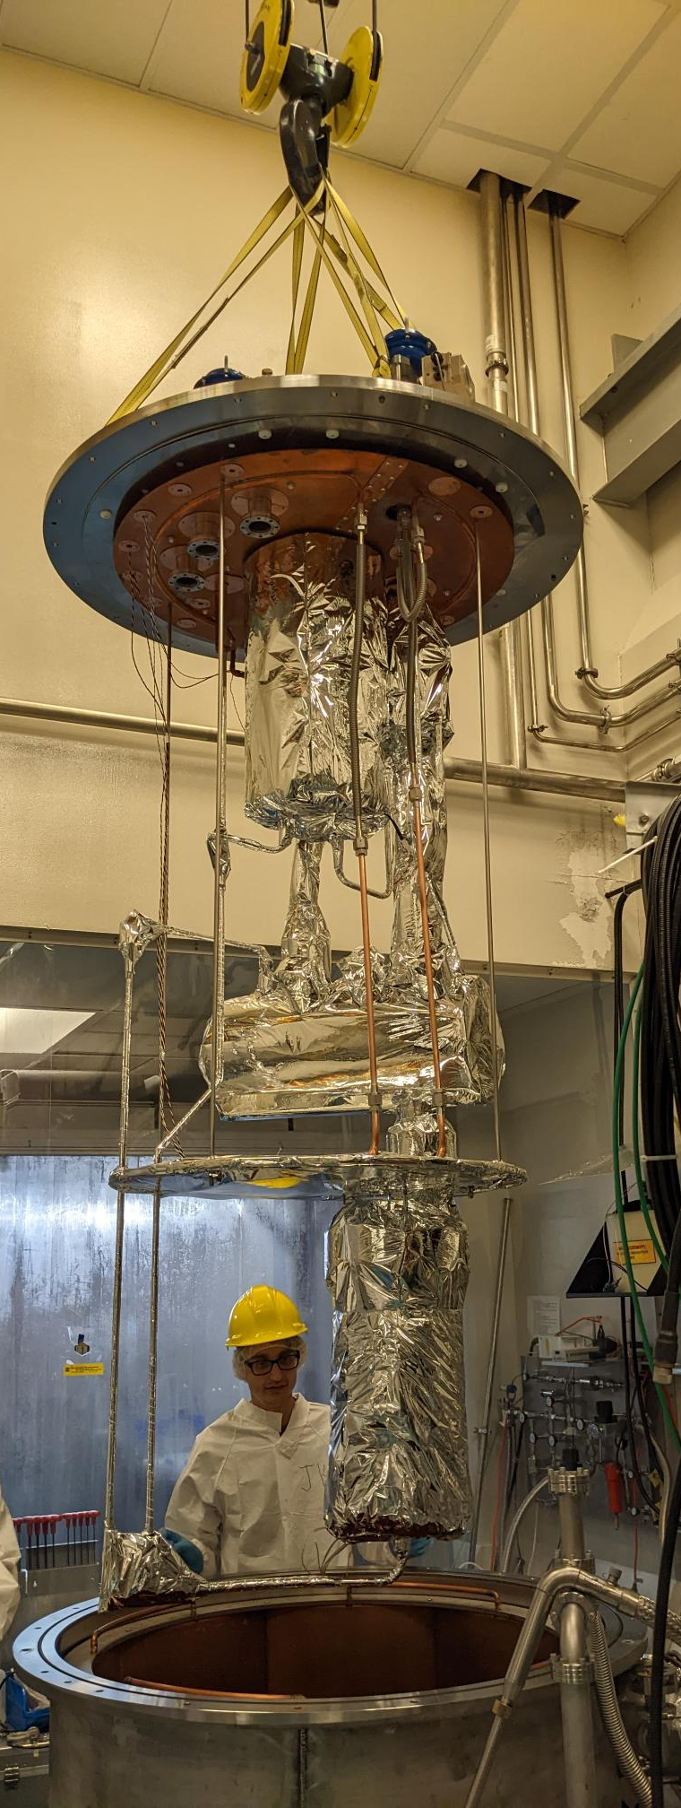
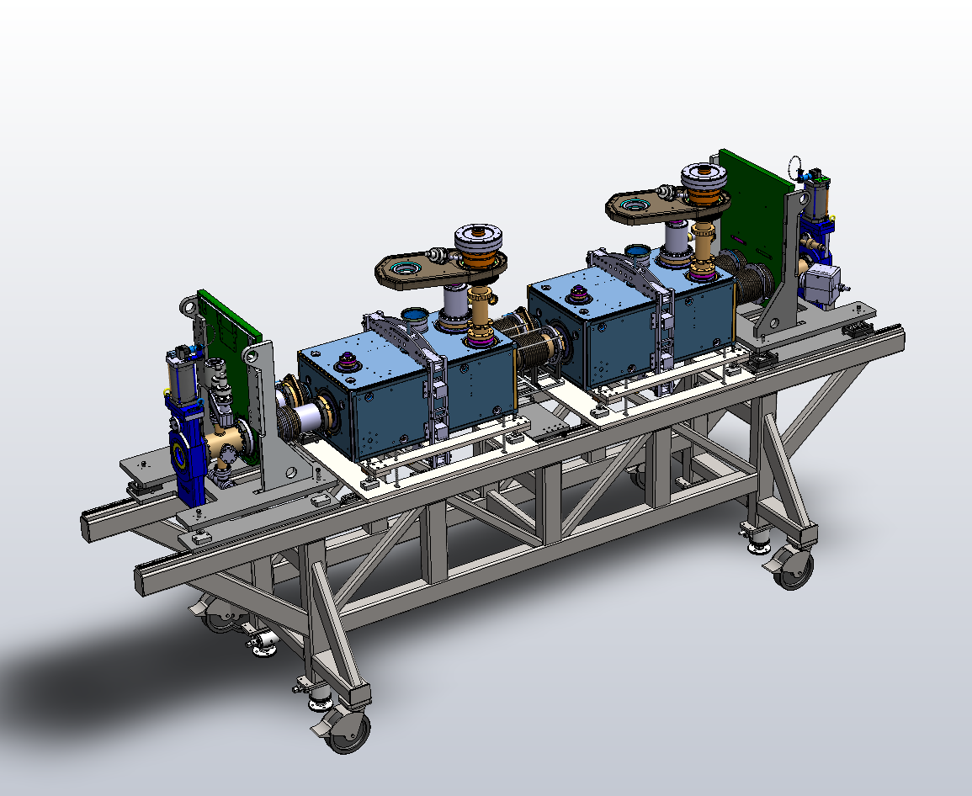
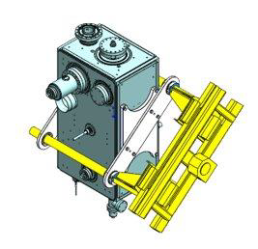
CERN Hi-Lumi LHC Upgrade
TRIUMF was funded to produce and qualify 5 RF Dipole (RFD) cryomodules as in-kind contribution
Preparing to build prototype cryomodule (TCM0) and to receive first cavities in 2023
Procurement is in progress.
Series production CMs will follow in 2024 and 2025
Also Beam Physics collaboration – Hui Wen in next talk for more details
RFD cryomodule
Cavity handling
4K/2K unit
String assembly cart

Slide 13
Outlook into the Future
ISAC-II: Beyond 40MV
eLinac: Reliable 30MeV operation
Electron-Ion Collider Crab Cavity

Slide 14
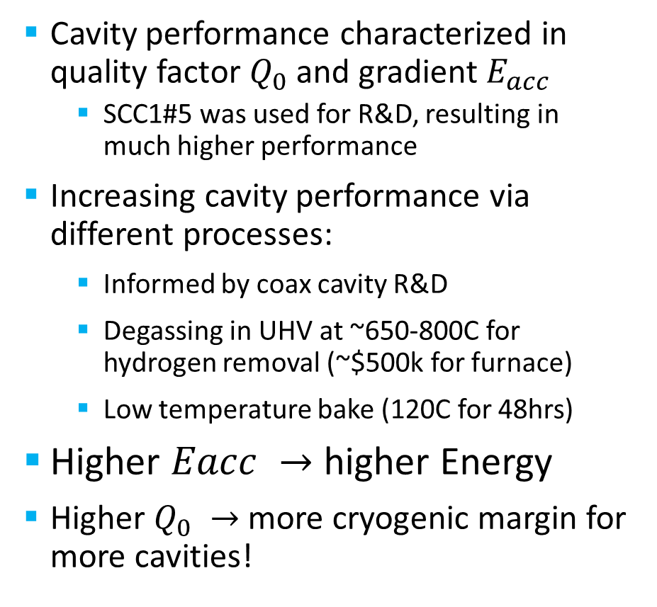
ISAC-II: Beyond 40MV – Increasing Q₀ & E_{acc}
Cavity performance characterized in quality factor $Q_{0}$ and gradient $E_{acc}$
  SCC1#5 was used for R&D, resulting in much higher performance
Increasing cavity performance via different processes:
  Informed by coax cavity R&D
  Degassing in UHV at ~650-800C for hydrogen removal (~$500k for furnace)
  Low temperature bake (120C for 48hrs)
Higher $Eacc →$ higher Energy
Higher $Q_{0} →$more cryogenic margin for more cavities!
Performance of SCC1 cavities
SCC1#5
7W of cavity wall losses = cryogenic losses
Typical operating curve for ISAC-II

Slide 15
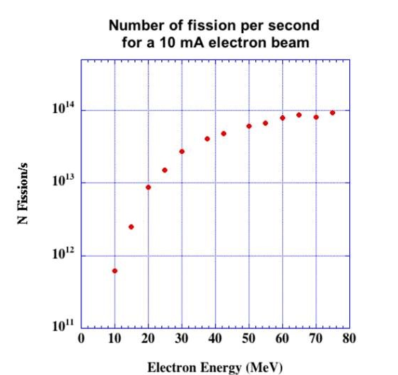
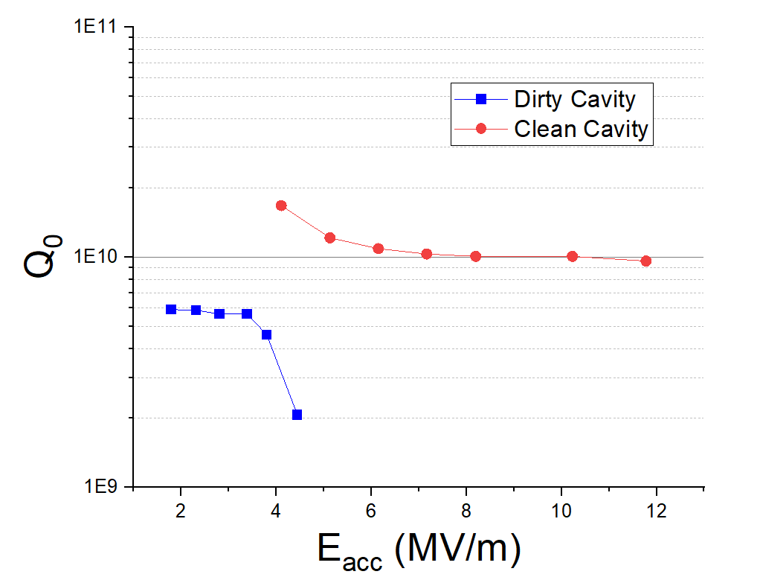

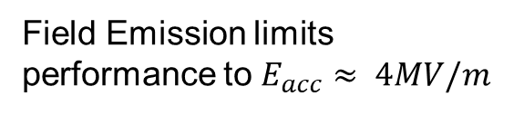
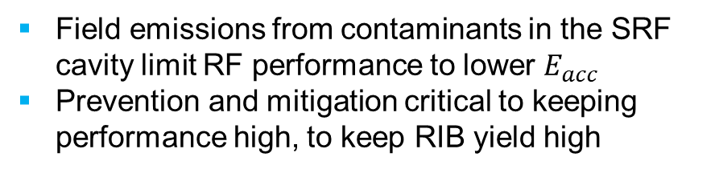
eLINAC: Reliable 30MeV Operation
Stable 30MeV operation is critical for RIB production:
RIB yield is strongly dependent on beam energy
We’re operating at 30MeV – at the lower end of the yield curve
Field emissions from contaminants in the SRF cavity limit RF performance to lower $E_{acc}$
Prevention and mitigation critical to keeping performance high, to keep RIB yield high
Clean cavity reaches $E_{acc}>10 MV/m$
Field Emission limits performance to $E_{acc}≈ 4MV/m$

Slide 16
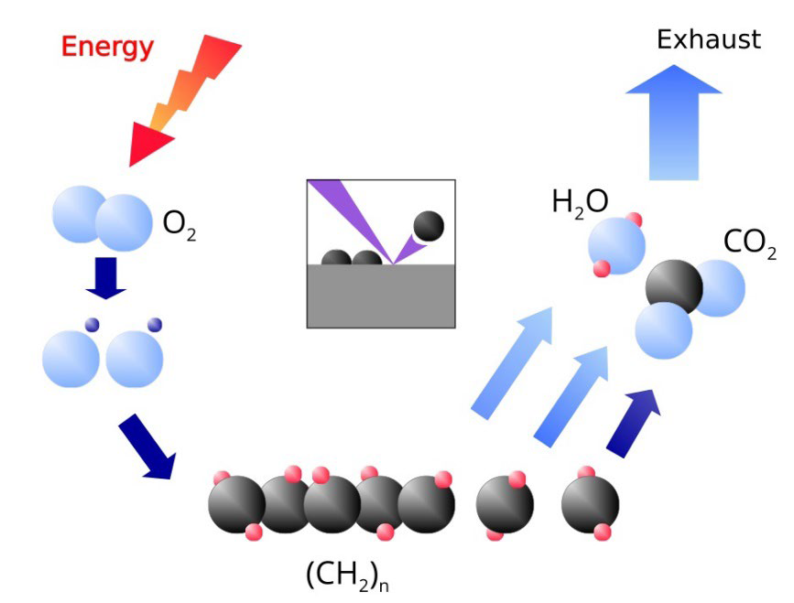

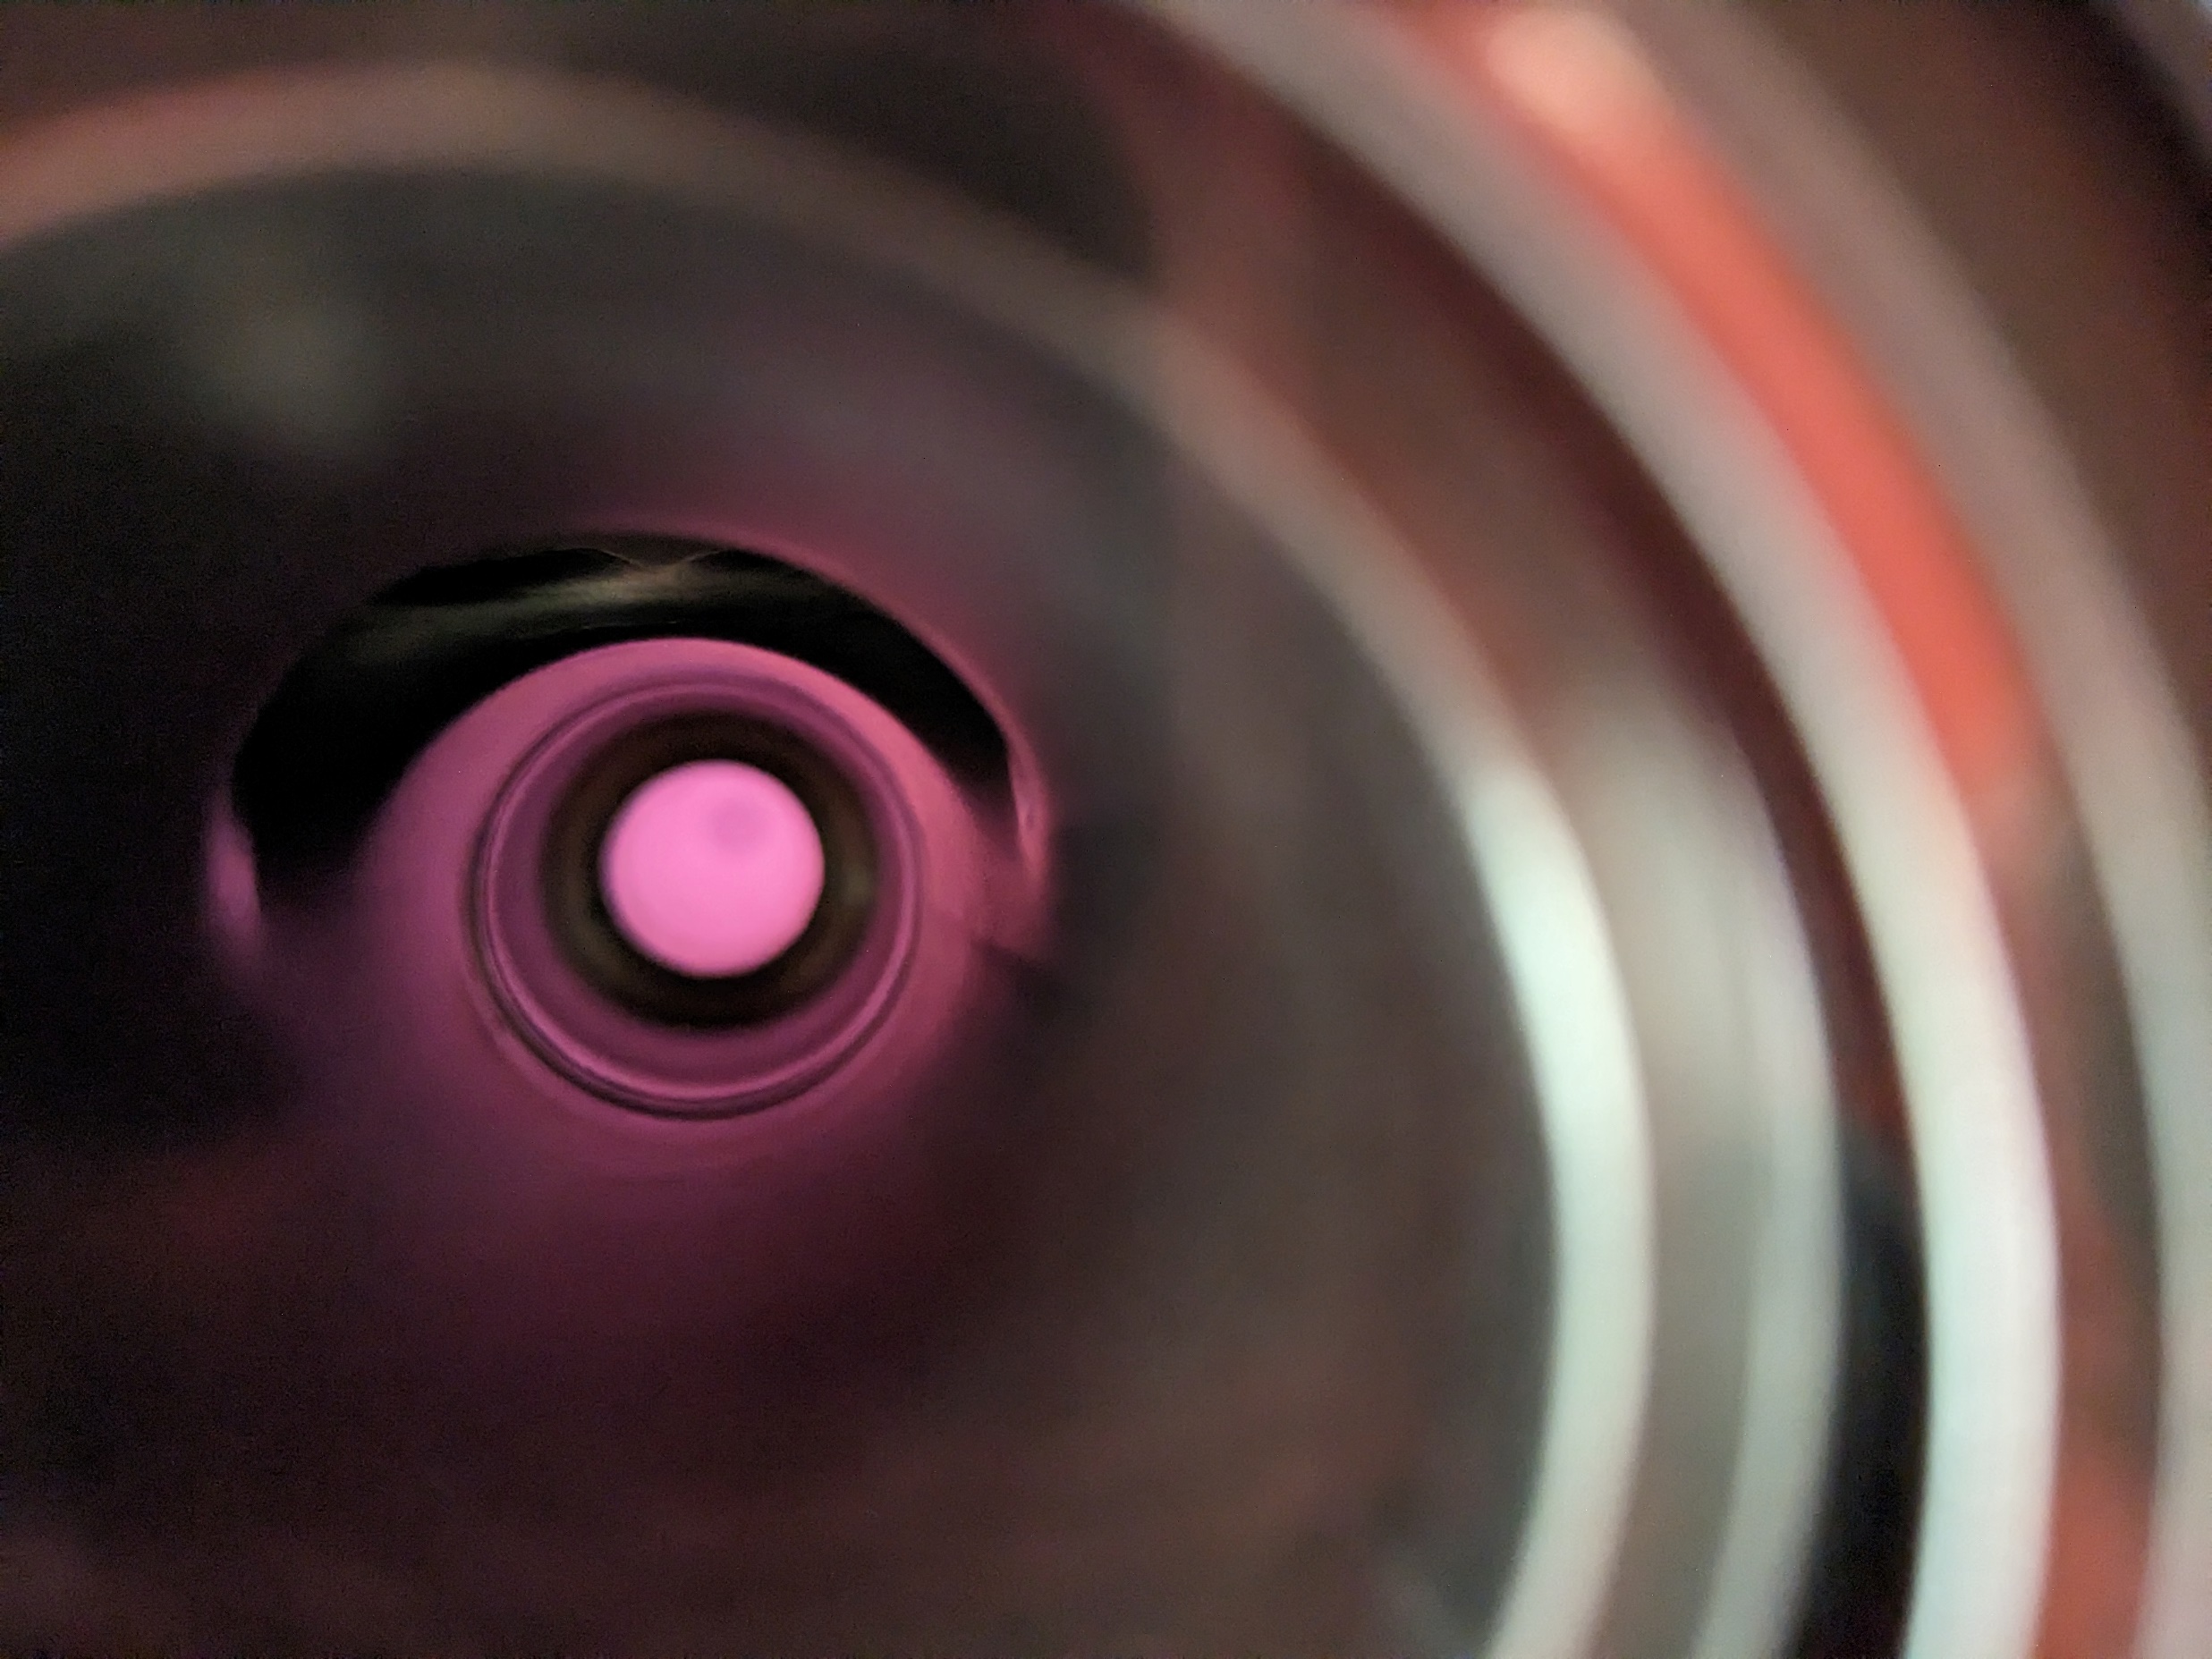
Development: Plasma Processing
Daniel Hedji (MSc – Uvic)
Plasma processing with an Ar/O mixture can break up hydro-carbon based particulates and remove them.
Would allow cavity cleaning without taking module off beamline (1 week instead of 2-3 months of work)
First Plasma ignition in a single cell cavity at TRIUMF.
Results from JLab show decreased FE after plasma processing

Slide 17
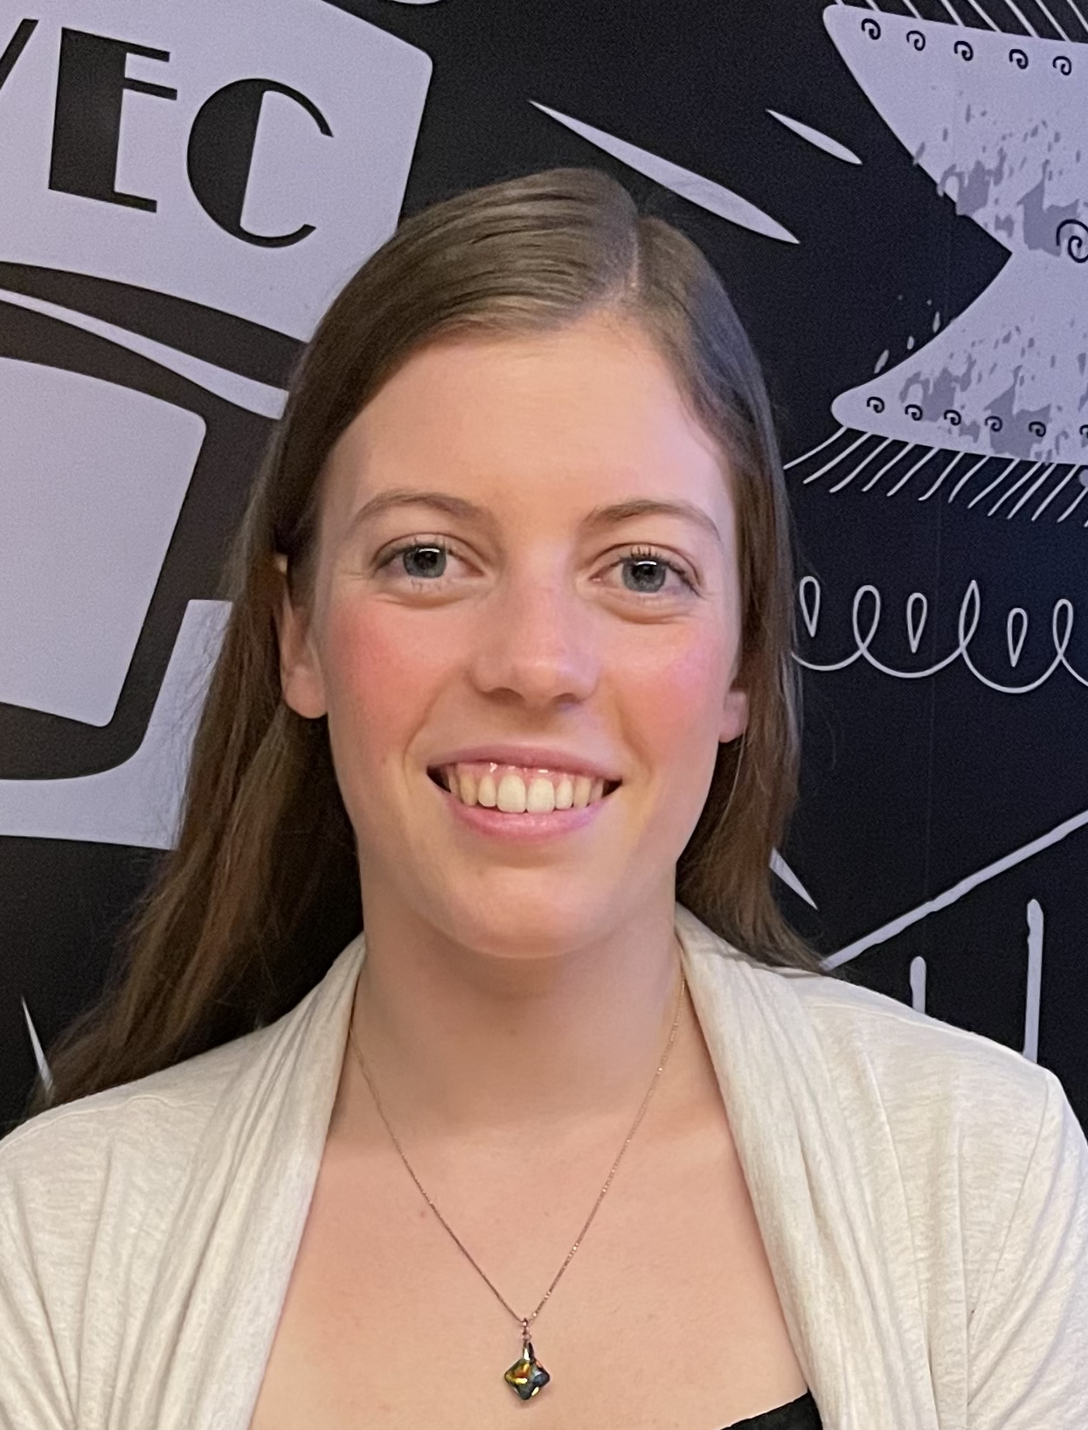
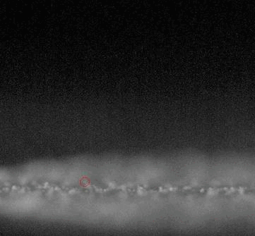


Study: Field Emission and Dust migration
Aveen Mahon (MSc - Uvic)
To prevent particulate migration, we need to know how they move
Collaboration with CERN at the LHC and the University of Boulder, CO, to study the field emission and dust migration
Samples are placed inside beamline near SRF accelerators and collected periodically to characterize the particulates

Slide 18



Electron-Ion Collider
A major new collider facility scheduled to be built at BNL to explore subatomic physics.
TRIUMF working with EIC-Canada to seek Canadian funding to support in-kind contributions.
TRIUMFs SRF group started work on the design of the 394MHz crab cavity – similar size to HL-LHC 400MHz crab cavity
Challenging HOM design due to high beam current
540mm
360mm

Slide 19

Summary
Supporting SRF accelerators
  ISAC-II
  ARIEL eLINAC
Training students and Post-Docs
  Research program on Coax Cavities
  SRF material science at $β$NMR
Contributing to SRF community
  VECC
  HL-LHC
  EIC

Slide 20
Thank you
Merci

Slide 21

Beyond 40MV – more SRF
3 simultaneous RIBs to experiments
New RFQ to 400keV/u for A/q<7
SCA w/ 7 QWRs @ 71MHz, β 4.1%
18m
to HE area
RFQ
SCA
Booster
Low energy area
to ME area
to LE area
Increase RIB energy
Booster w/ 8 QWRs @ 141MHz, β 16%
Adding 16MV

