Slide 1

Muon-spin rotation/relaxation under hydrostatic pressure: outlook and perspectives
Rustem Khasanov :: Instrument Scientist :: Paul Scherrer Institut
TIUMF science week, July 31st – August 4th

Slide 2
Quantum materials
Quantum materials is an umbrella term in condensed matter physics that encompasses all materials whose essential properties cannot be described in terms of semiclassical particles and low-level quantum mechanics. These are materials that present strong electronic correlations or some type of electronic order, such as superconducting or magnetic orders, or materials whose electronic properties are linked to non-generic quantum effects – topological insulators, Dirac electron systems such as graphene, as well as systems whose collective properties are governed by genuinely quantum behavior, such as ultra-cold, cold excitons, polaritons, and so forth. On the microscopic level, four fundamental degrees of freedom – that of charge, spin, orbit and lattice – become intertwined, resulting in complex electronic states;^{[1]} the concept of emergence is a common thread in the study of quantum materials.^{[2]}
Quantum materials exhibit puzzling properties with no counterpart in the macroscopic world: quantum entanglement, quantum fluctuations, robust boundary states dependent on the topology of the materials' bulk wave functions, etc.^{[1]} Quantum anomalies such as the chiral magnetic effect link some quantum materials with processes in high-energy physics of quark-gluon plasmas.
Quantum materials -- Wikipedia

Slide 3
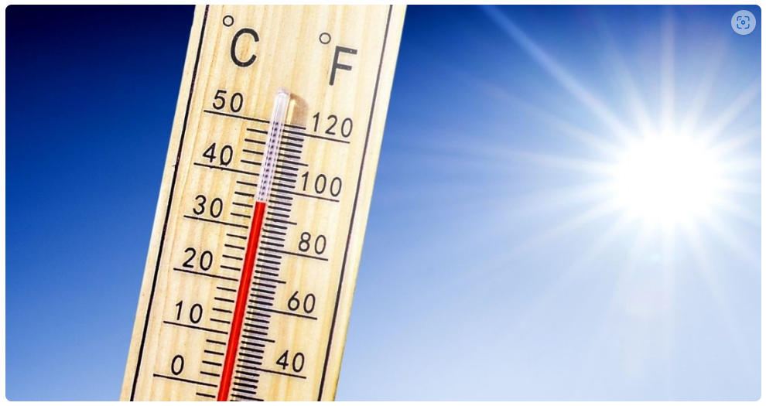
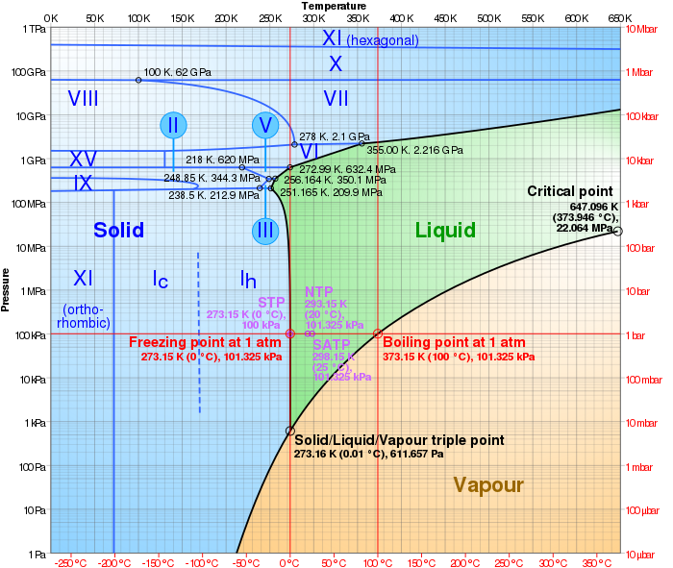
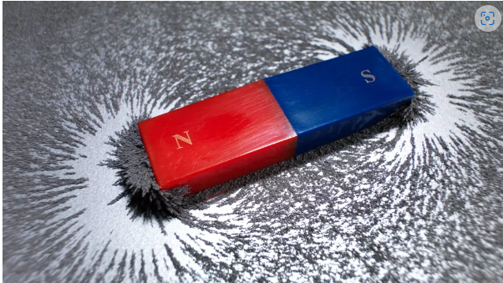
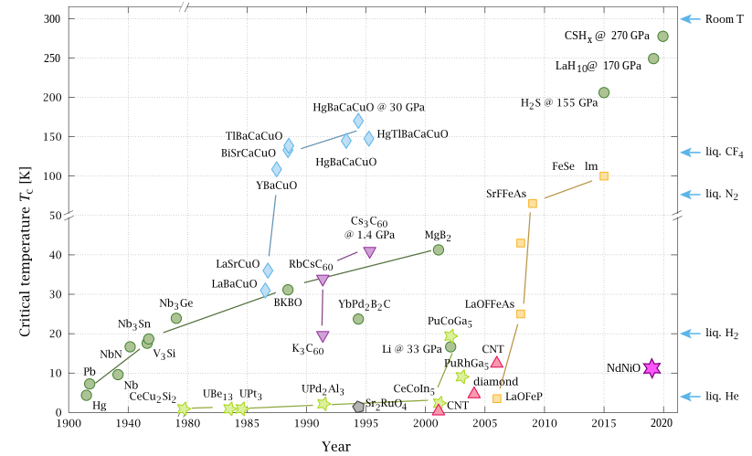
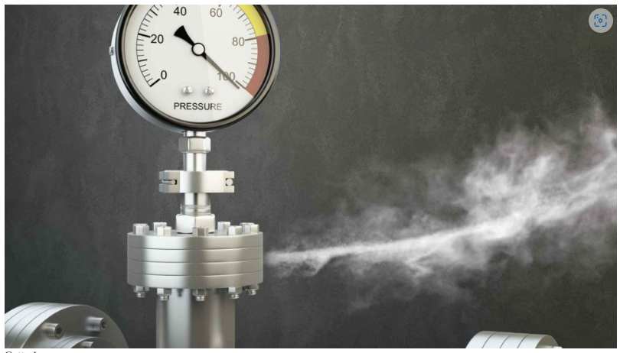
Common tuning parameters
P-T phase diagram of water
T
B
P
Room temperature superconductivity
Wikipedia

Slide 4
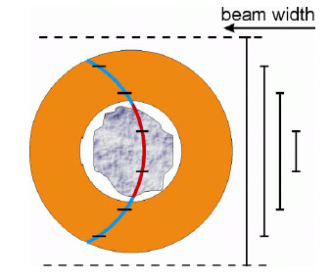
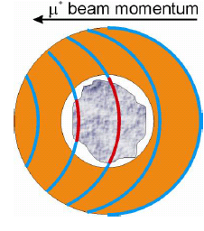
μSR under pressure
Muon momentum tuning
Beam-width tuning
Khasanov et al., High Pr. Res. 36, 140-166 (2016)

Slide 5
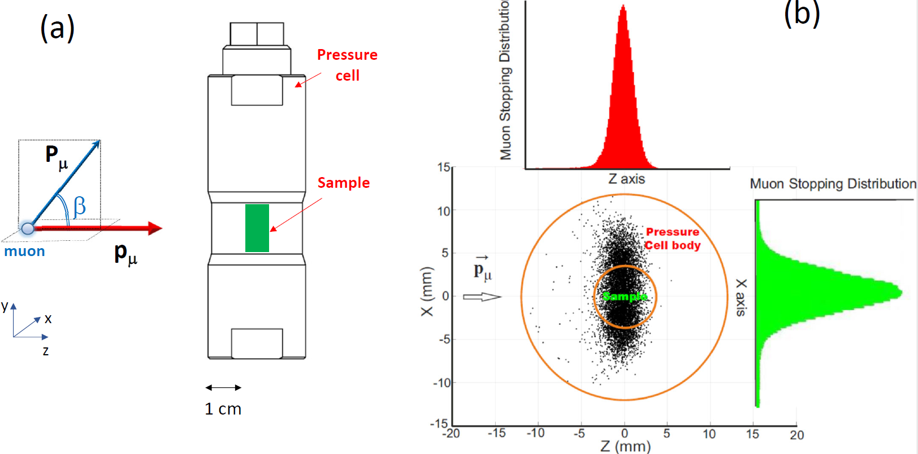
μSR under pressure: basic principles
R. Khasanov, Journal of Applied Physics 132, 190903 (2022)

Slide 6
μSR under pressure
Muon beam-line – fast muons with tunable energy
μSR Spectrometer
μSR pressure cells

Slide 7
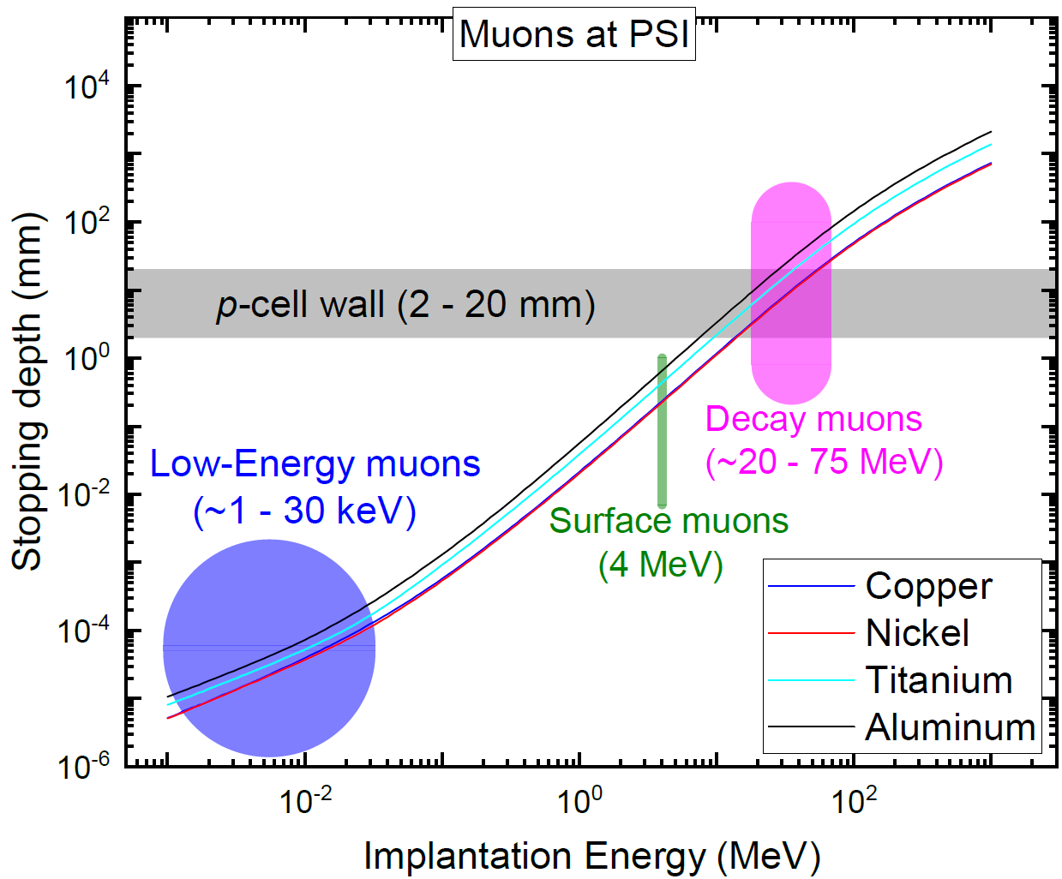
Muon beam
R. Khasanov, Journal of Applied Physics 132, 190903 (2022)

Slide 8
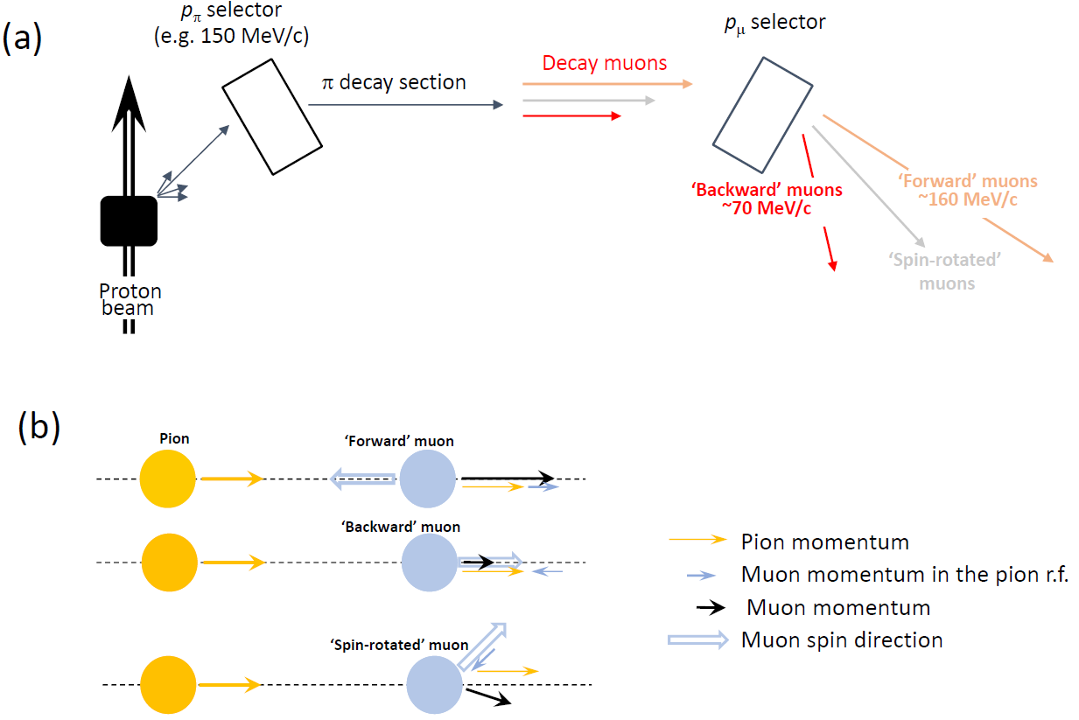
Decay muon beam-line
R. Khasanov, Journal of Applied Physics 132, 190903 (2022)

Slide 9
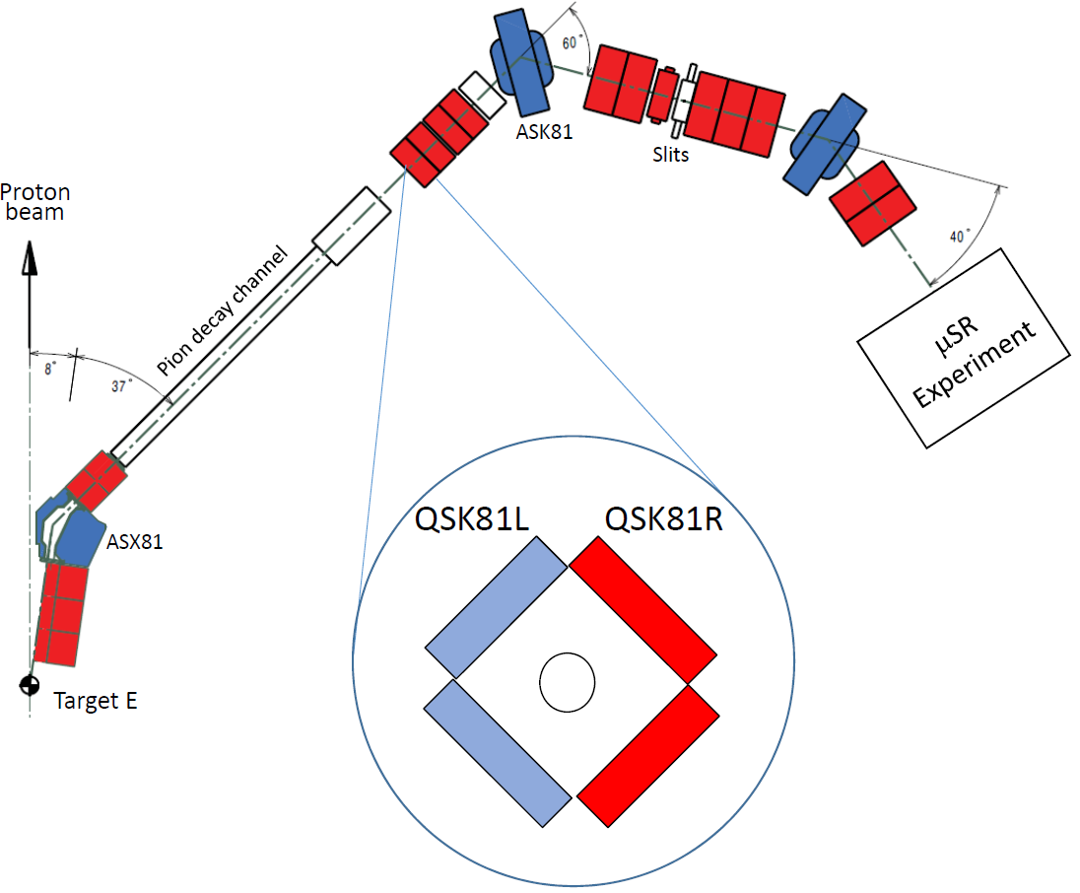
μE1 decay beam-line at PSI
The use of the spllited Quadrupolar magnet (QSK81) allows to collect muons with turned spins. This a unique possibility which is accessible for decay muon beam-lines only.
The first spin-rotation experiments were conducted in TRIMF at M9B beamline
R. Khasanov, Journal of Applied Physics 132, 190903 (2022)

Slide 10
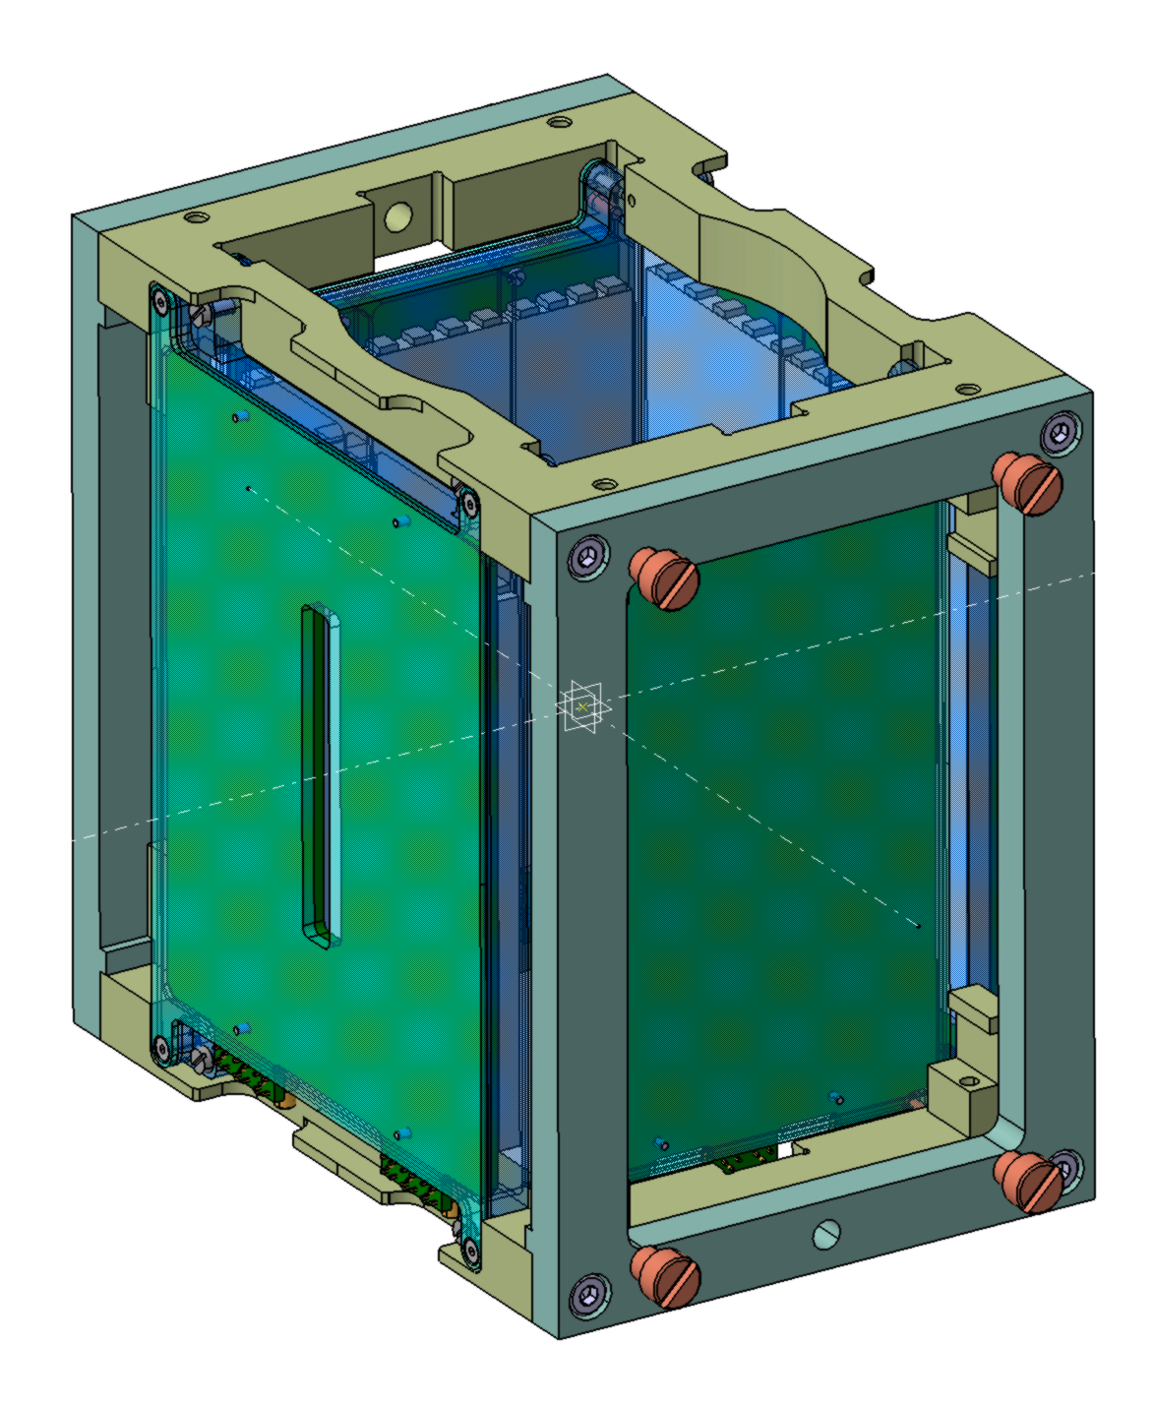
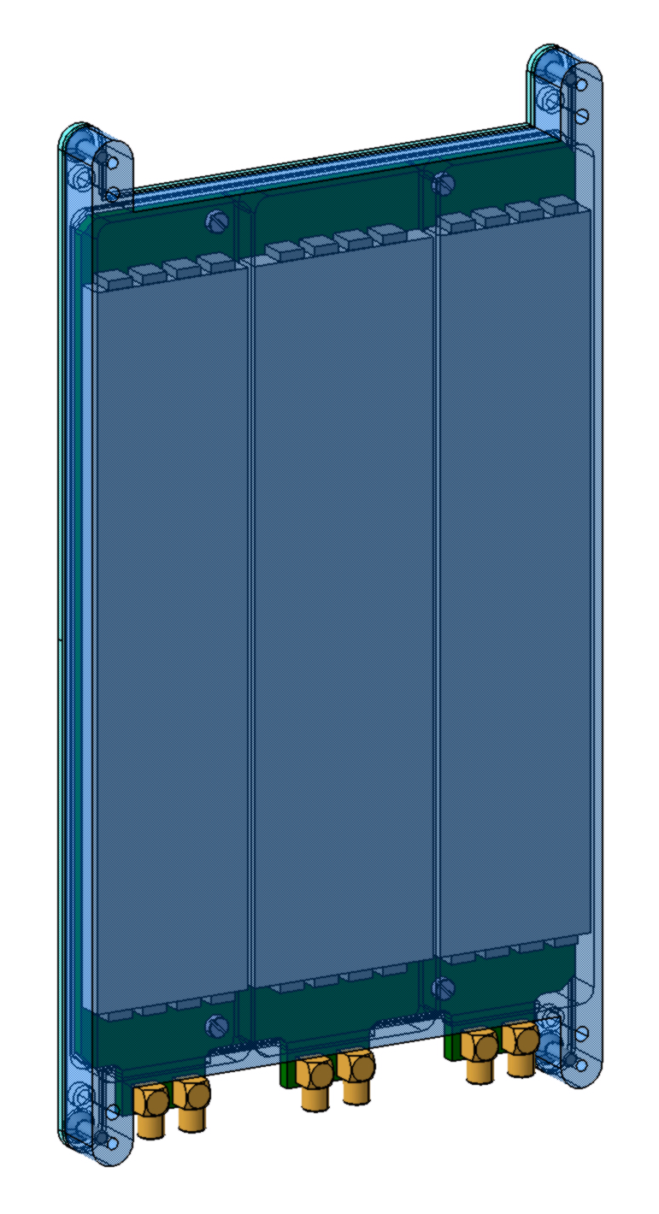
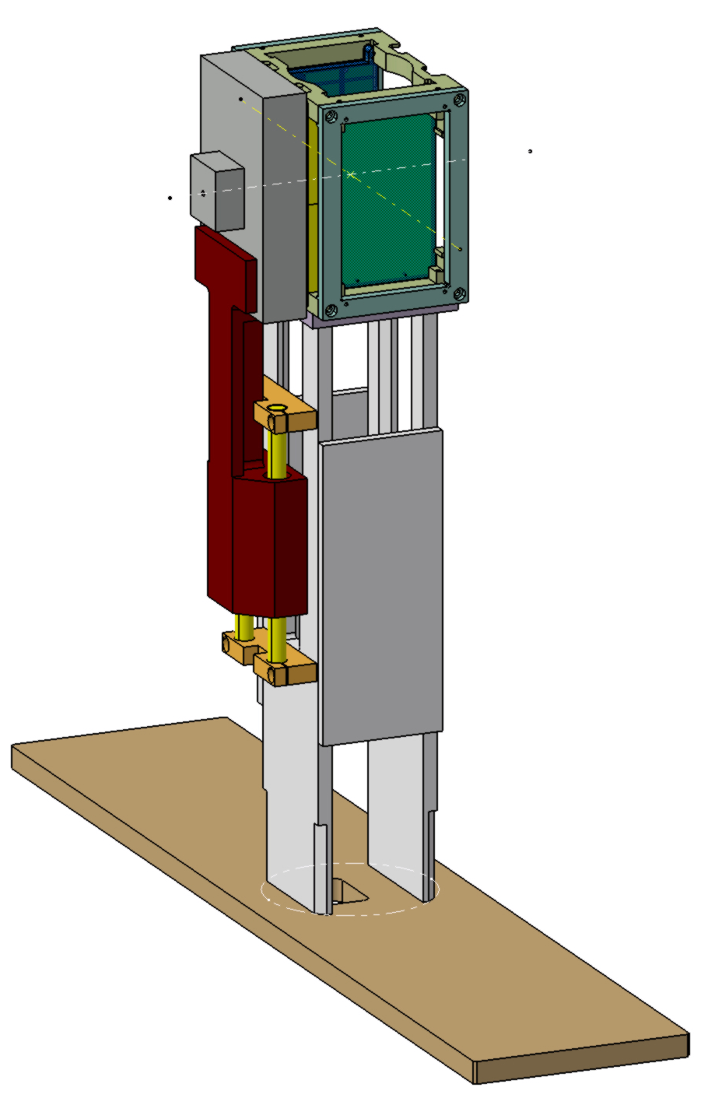
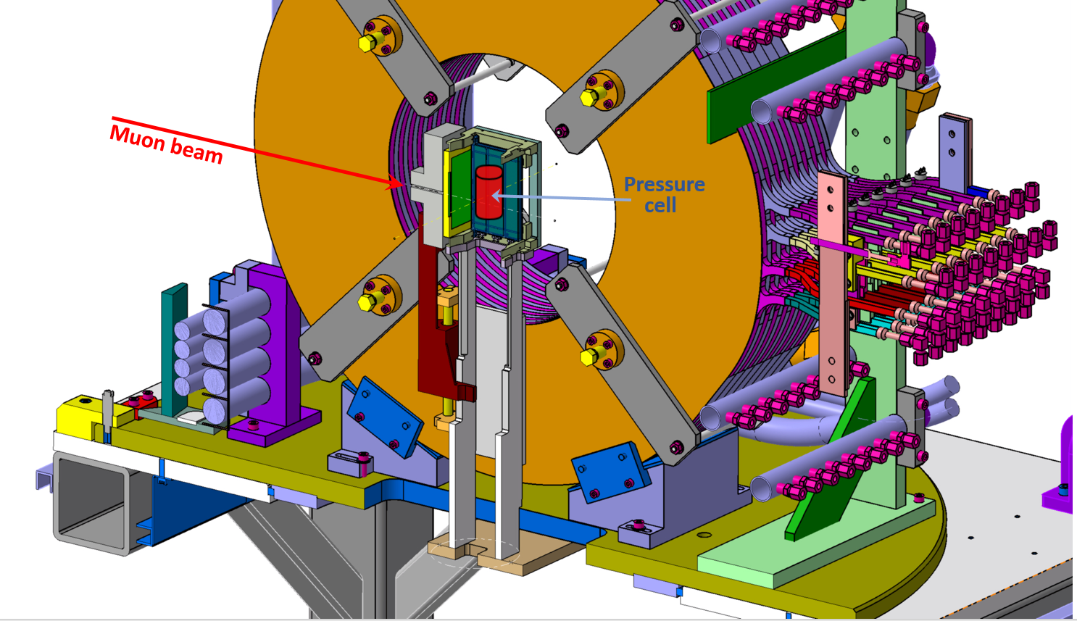
Detectors, GPD Spectrometer (2017)
Individual Detector
Detector head
Detector setup
GPD spectrometer

Slide 11



Pressure cell construction: compound cylinder
Single wall cell
Double wall cell
Three wall cell
a
c₁
b
c
c₂
$$pmax ∝\frac{1}{2}−\frac{a^{2}}{2 b^{2}}$$
$$pmax ∝1−\frac{a^{2}}{2 c^{2}}−\frac{c^{2}}{2 b^{2}}$$
$pmax ∝ \frac{3}{2}−\frac{a^{2}}{2 {c1}^{2}} − \frac{{c1}^{2}}{2 {c2}^{2}}$ $−$ $\frac{{c2}^{2}}{2 b^{2}}$
For a=6 mm and b=24 mm, p_{max}^{s} ÷ p_{max}^{d} ÷ p_{max}^{t} = 1 / 1.6/ 1.96
Khasanov et al., High Pr. Res. 42, 29 (2022)

Slide 12
Construction material suitable for μSR
Nonmagnetic Alloys
 | CuBe | TiAl₆V₄ | NiCrAl | MP35N
Yield strength | 1.1 Gpa (300 K) | 1.05 Gpa (300 K) | 2.06 Gpa (300 K) | 2.15 GPa (300 K)
Young modulus | 131 GPa (300 K) | 97 Gpa (300 K) | 190 Gpa (300 K) | 215 Gpa (300 K)
Sintered materials
 | WC | cBN | SiC | ZrO₂-Y₂O₃ | Al₂O₃-ZrO₂ | Si₃N₄
Compressive strength | 5.0-11.0 Gpa | 2.9 GPa | 7.6-8.3 GPa | 2.20 GPa | 4.7 GPa | 5.1-5.5 GPa
Young modulus | 600-670 Gpa |  | 918 GPa | 210 Gpa | 357 GPa | 241 GPa
Strong enough to hold the pressure
Should not have “strong” μSR response
Should have temperature independent response
Khasanov et al., High Pr. Res. 42, 29 (2022)

Slide 13
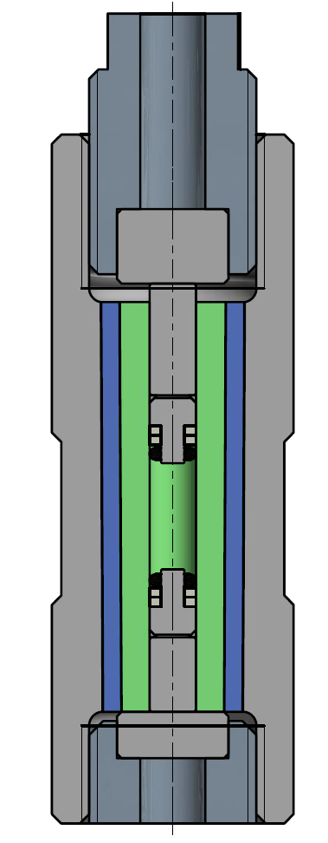
Three-wall pressure cell construction
Bottom fixation bolt
Sample volume
Top fixation bolt
Pressure seals
p_{max}(RT) ~3.3 Gpa, p_{max} (LT) ~ 3.0 GPa
Khasanov et al., High Pr. Res. 42, 29 (2022)

Slide 14
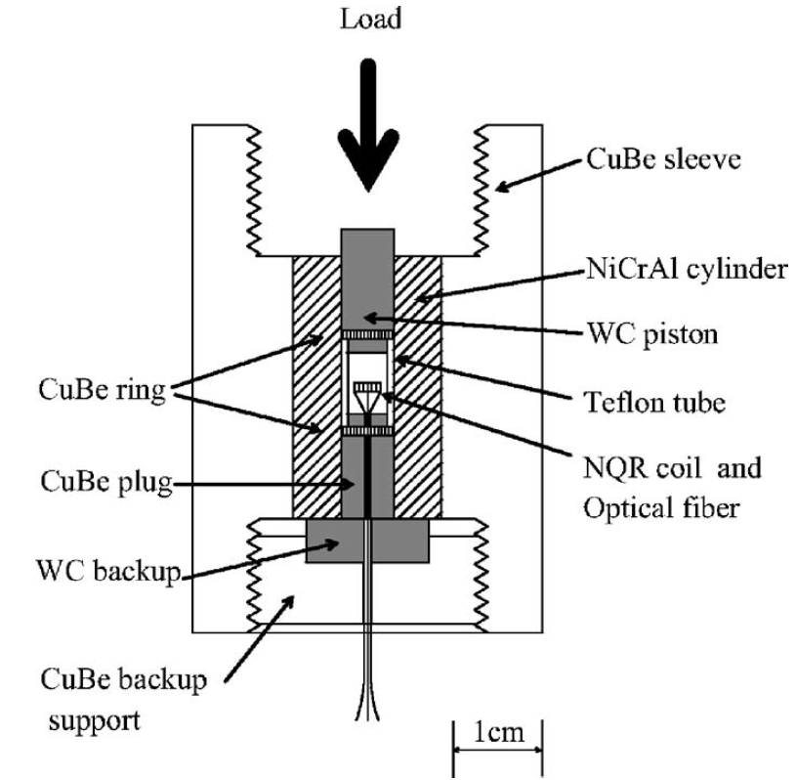
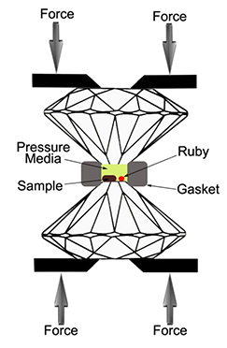
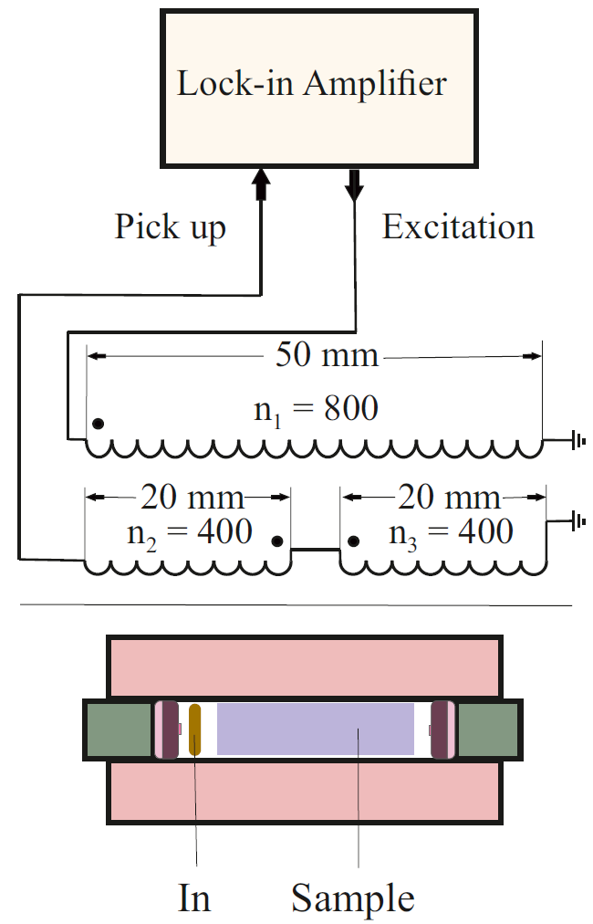
Pressure determination, pressure probes
Contact (feedthroughs)
Contactless
Resistivity, AC susceptibility, NMR, NQR,
specific heat, optical …
Optical, AC susceptibility, NMR, NQR, specific heat,
Neutron scattering (equation of state)…
Substantial part of the pressure cell volume is occupied by the pressure indicator

Slide 15
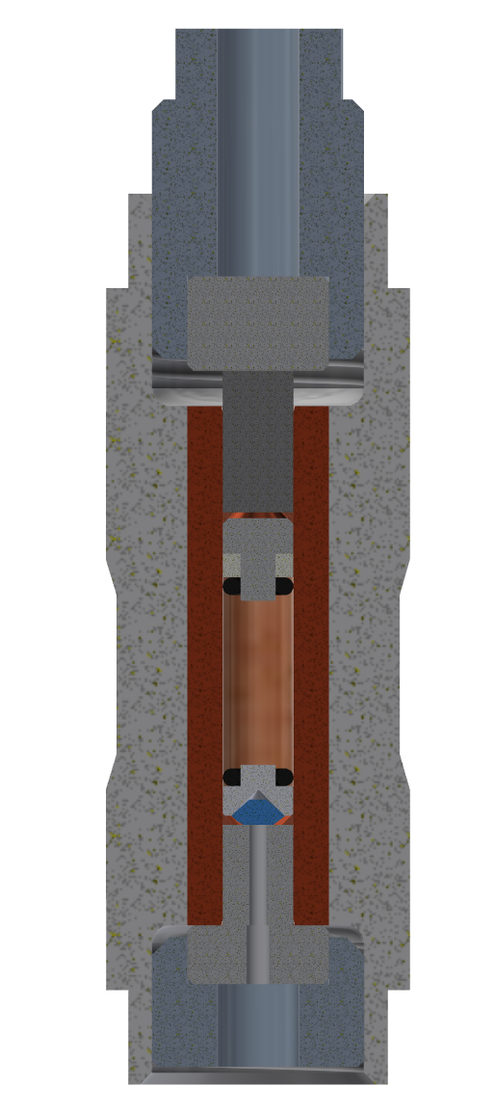
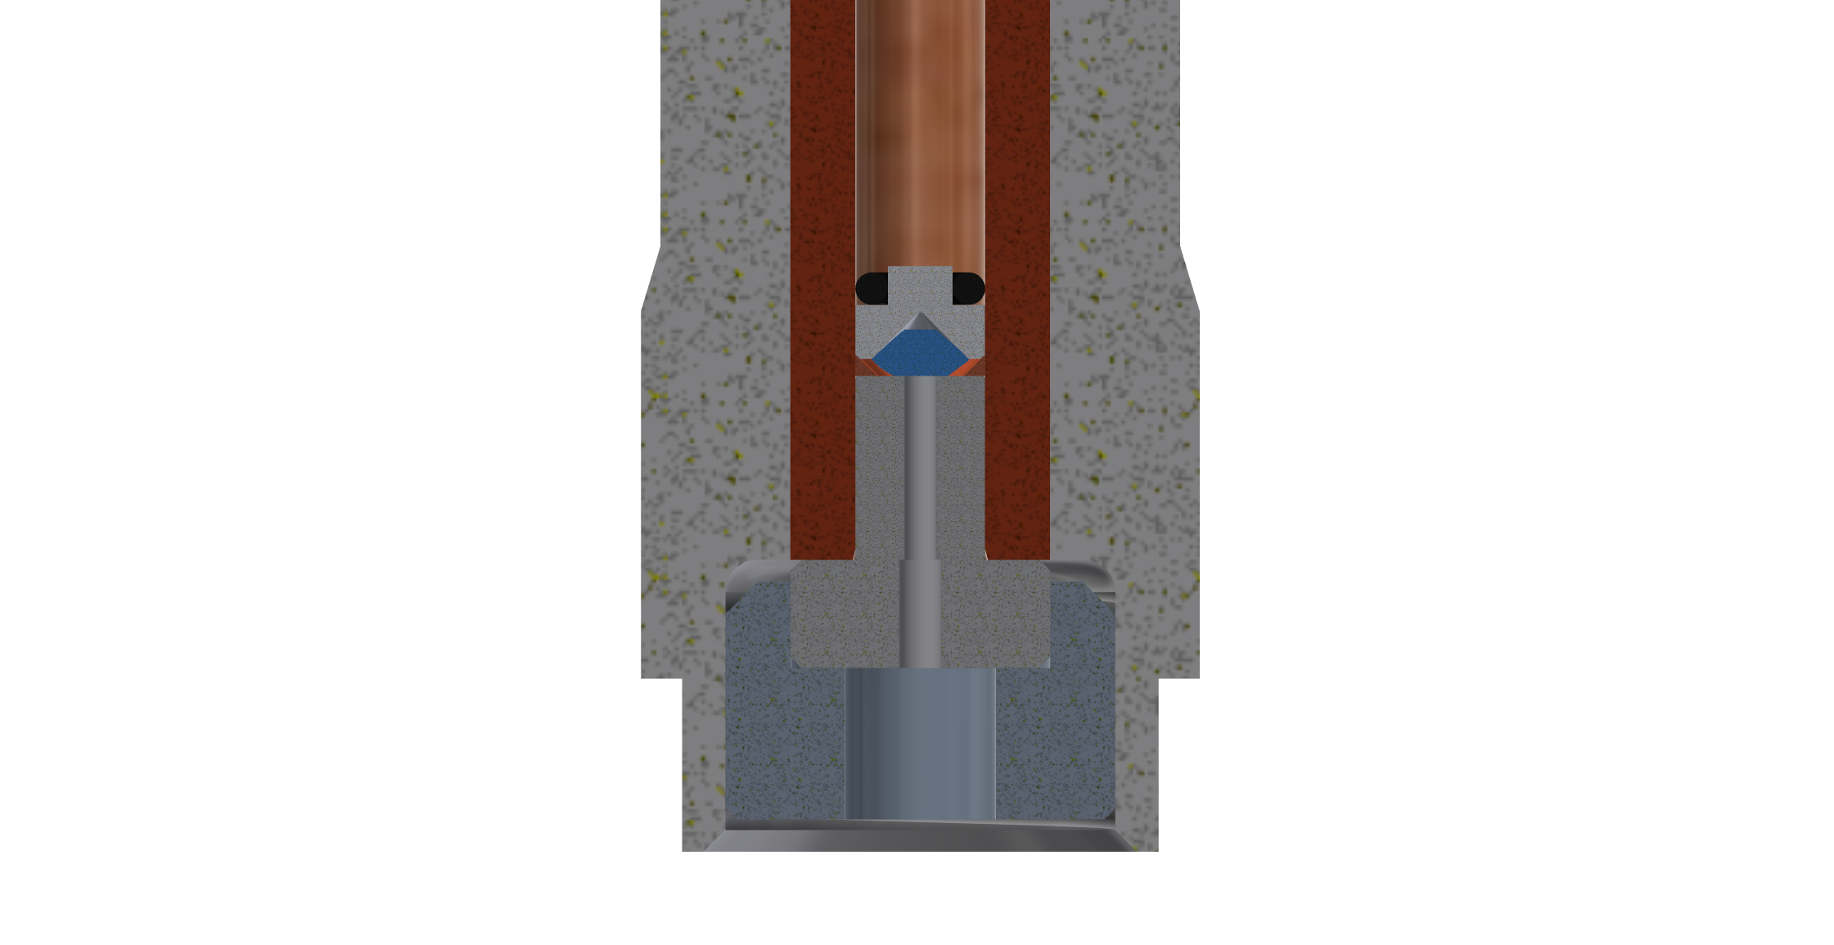
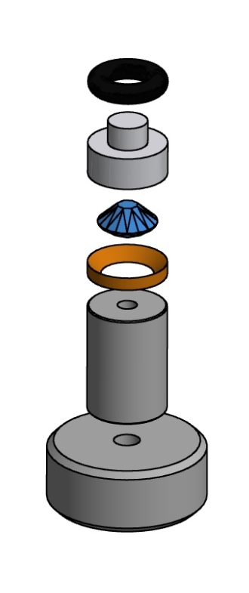
Double volume piston-cylinder cell
Sample volume
Optical volume
Teflon mushroom
Optical window
Piston
Naumov … Khasanov*, Phys. Rev. Applied 17, 024065 (2022)

Slide 16
Double‐volume pressure cell
Optical spectrometer (Ocean Optics HR400 or HR4PRO)
Control PC
520 nm pigtailed laser (PLM520.0MMF01)
USB
Naumov … Khasanov*, Phys. Rev. Applied 17, 024065 (2022)

Slide 17
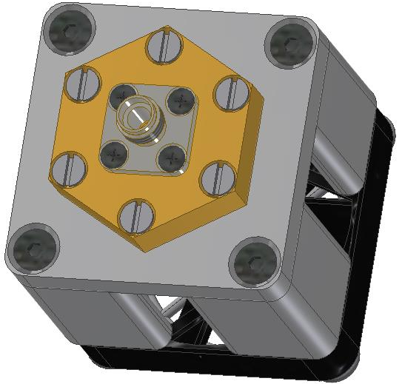
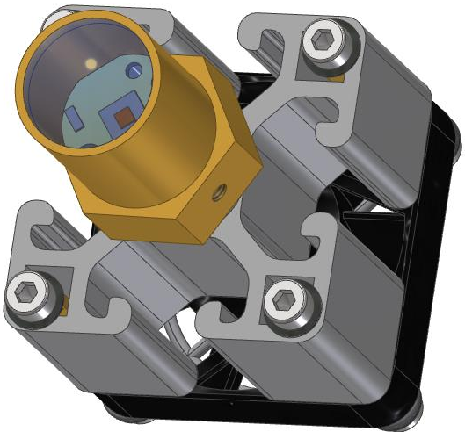
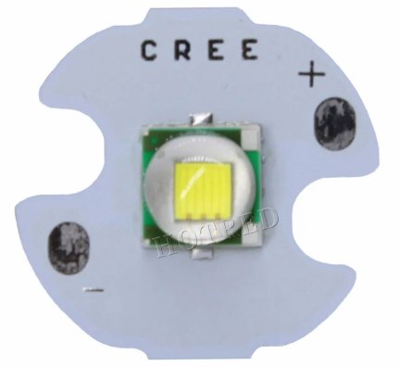
Safety concern: Laser vs. LED light
(a)
(b)
(c)
lens
LED
fiber plug
(SMA905)
lens holder
heatsink
~1.5mm
cooling fan
Khasanov et al., High Pr. Res. (2023)

Slide 18
LED light sources for fluorescense

Slide 19
Ruby and Sr tetraborite

Slide 20

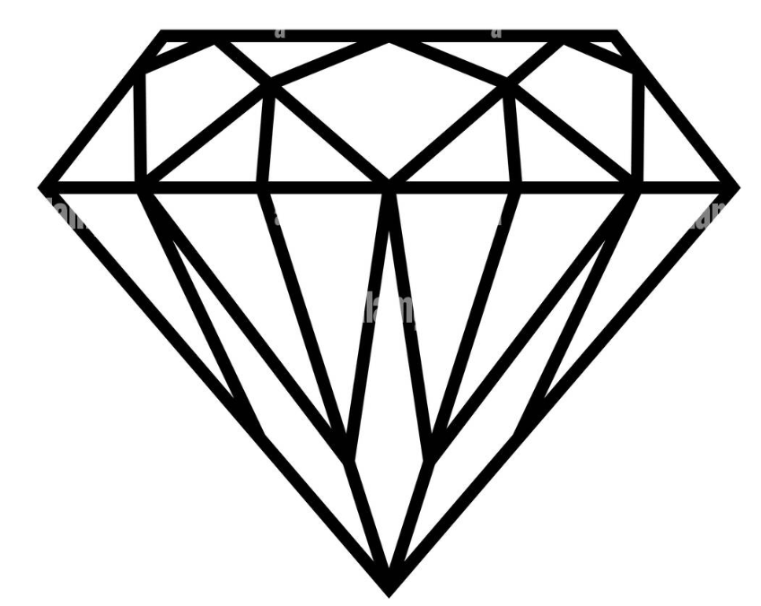
Diamond anvil setup
Optical
spectrometer
LED
source
Khasanov et al., High Pr. Res. (2023)

Slide 21
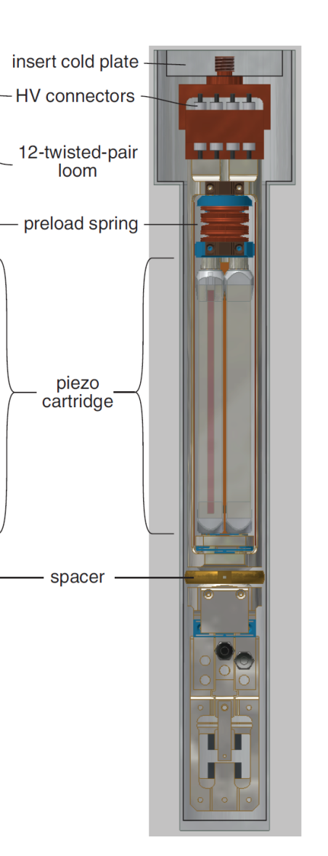



Strain cell – uniaxial pressure
Hubertus Luetkens
Zurab Guguchia
Matthias Elender
Hans-Henning Klauss Rajib Sarkar
Vadim Grinenko
Shreenanda Ghosh
Clifford Hicks
Goosh et al., Rev Sci Instrum 91, 103902 (2020)

Slide 22
Scientific examples
The uniaxial and hydrostatic pressure effects on TRSB in Sr₂RuO₄
Pressure-induced critical and multicritical points in frustrated spin liquid

Slide 23
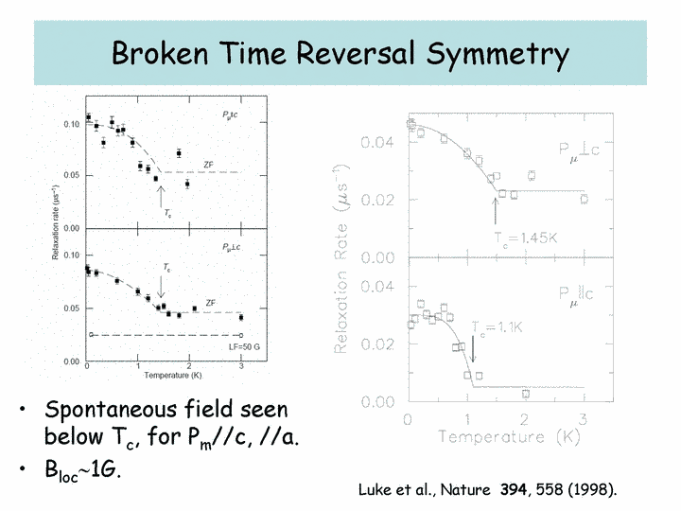
Time-reversal symmetry breaking in Sr₂RuO₄

Slide 24
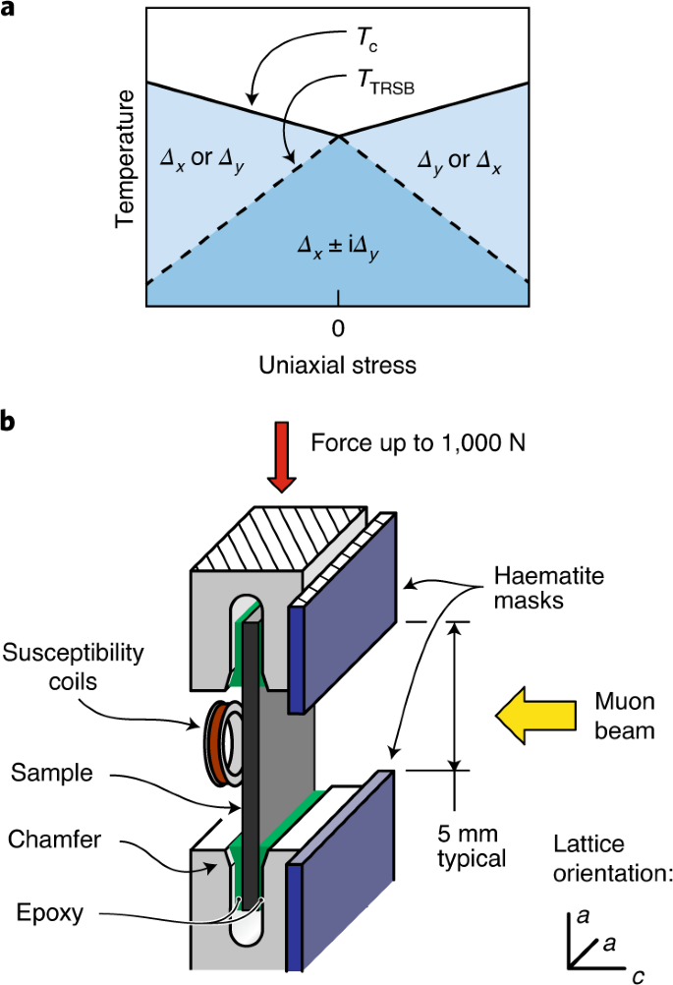
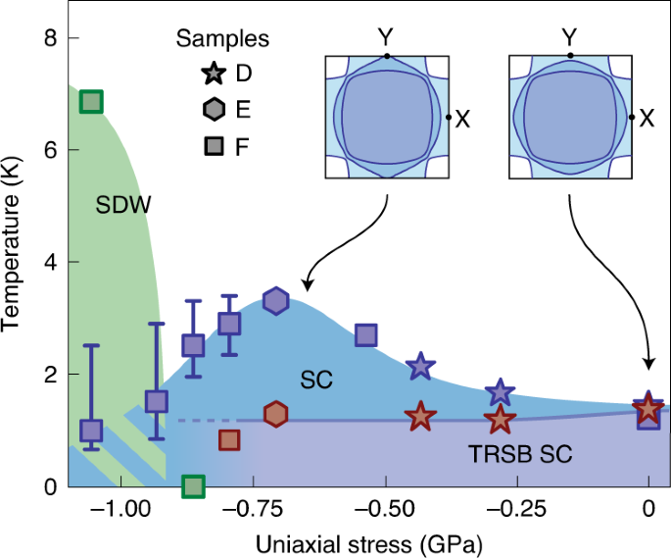
Uniaxial strain
Grinenko et al., Nature Phys. 17, 748 (2021).

Slide 25
Hydrostatic pressure experiments
Grinenko… Khasanov*, Nature Comm. 12, 3920 (2021).

Slide 26
Combined graph data
Grinenko… Khasanov*, Nature Comm. 12, 3920 (2021).

Slide 27
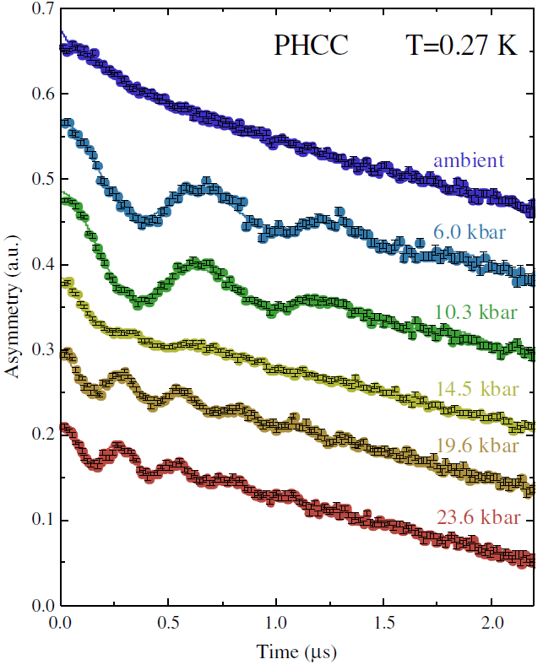
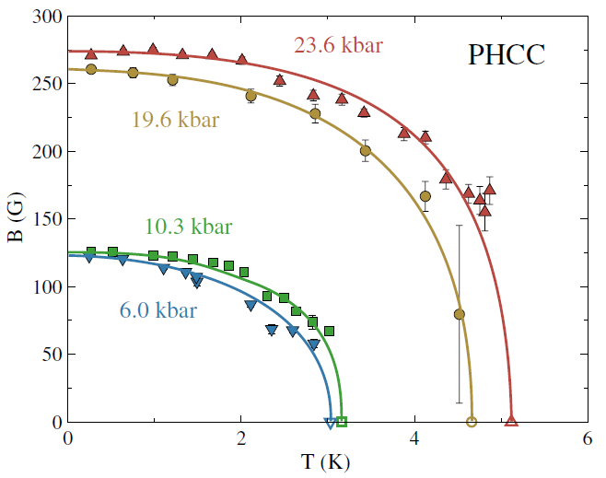
(C₄H₁₂N₂)Cu₂Cl₆ (PHCC)
Thede et al., Phys. Rev. Lett. 112, 087204 (2014).

Slide 28
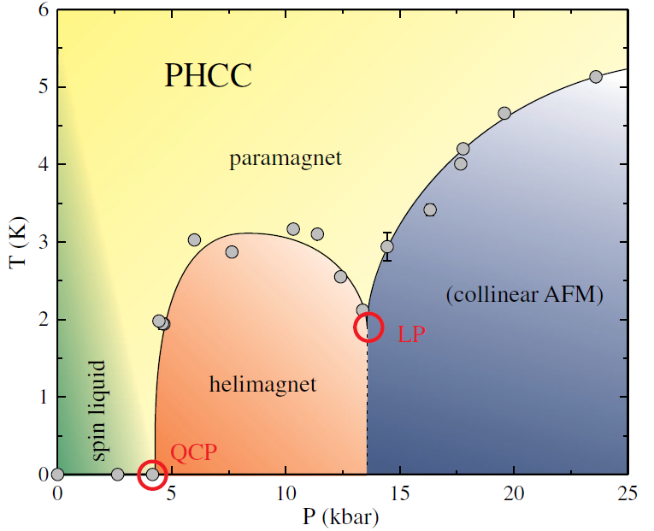
p-T phase diagram of PHCC
Thede et al., Phys. Rev. Lett. 112, 087204 (2014).

Slide 29

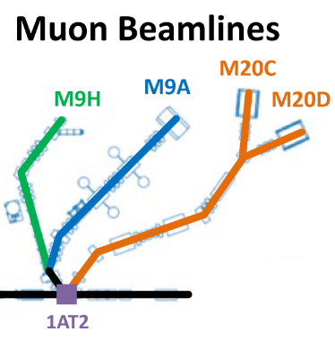
Wir schaffen Wissen – heute für morgen
μSR under pressure suppose to be powerful technique for condensed matter research.
Hope, we would be able to share our knowledge with physicists from TRIUMF at the new M9H beamline

Slide 30
Wir schaffen Wissen – heute für morgen
My thanks go to
Matthias Elender
Alexander Maisuradze
Zurab Shermadini
Zurab Guguchia
Debarchan Das
Ritu Gupta
Gediminas Simutis
Stefan Klotz
Mark Janoschek
Alex Amato
Hubertus Luetkens

