Slide 1


TRIUMF / VECC collaboration towards ARIEL / ANURIB
Arup Bandyopadhyay
arup@vecc.gov.in
Head – Accelerator Physics Group
Variable Energy Cyclotron Centre, Kolkata, India
Professor – Homi Bhabha National Institute (HBNI)
TRIUMF Science week – July 31st to August 4th , 2023

Slide 2
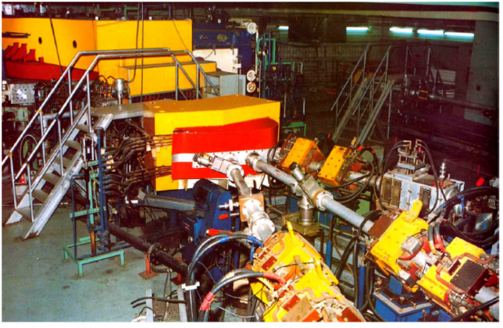
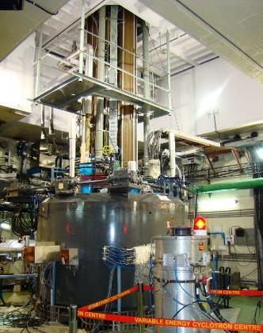
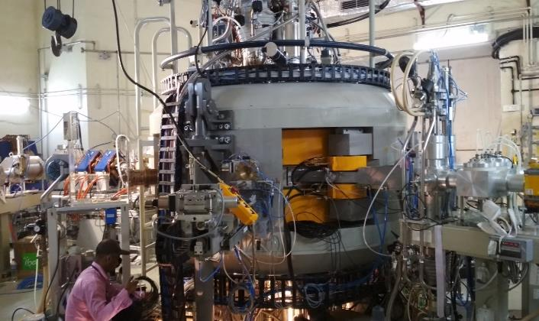










Variable Energy Cyclotron Centre (VECC) – Our cyclotrons
Room Temperature Cyclotron: June 1977
Superconducting Cyclotron: Dec 2020
Medical Cyclotron – September 2018
Proton |  | 7-12.5
Alpha |  | 28-50
Nitrogen |  | 105-140
Oxygen |  | 116-160
Neon |  | 145-192
Sulphur |  | 218
Nitrogen |  | 252
Oxygen |  | 309
Neon |  | 360 - 436
$${}_{1}^{1}H$$
$${}_{7}^{14}N$$
Proton |  | 15-30 MeV 350 µA
$${}_{1}^{1}H$$
$${}_{2}^{4}{He}$$
$${}_{8}^{16}O$$
$${}_{7}^{14}N$$
$${}_{10}^{20}{Ne}$$
$${}_{8}^{16}O$$
$${}_{10}^{20}{Ne}$$
Beam energies are in MeV
$${}_{16}^{32}S$$

Slide 3
Research goals of Variable Energy Cyclotron Centre (VECC)
Basic Sciences:
Exp. Nuclear Physics ( Low & High energy) using Accelerators
Theoritical Nuclear Physics
Accelerator based applied research:
Material Science
Radiation damage studies
Technology development:
RF / SRF
Detector & DAQ
Instrumentation
Power Electronics
Mechanical
Cryogenics
Computer, IT & Computer control
Accelerator research:
Indigenous accelerator development
R&D on Advanced Accelerators
Accelerator applications:
Medical cyclotron for radioisotope production

Slide 4


Collaboration

Slide 5




Distance 11,431 km
Flying time 14h 20m + 2h
Advanced Rare Isotope Laboratory (ARIEL)
Applied and NUclear Research using
Rare Isotope Beams (ANURIB)
ISOL Post-accelerator type of RIB Facility
Cyclotron and e-LINAC are primary accelerators
Specialised target stations and Separation stage
Linear accelerators (NC & SC) as post-accelerators

Slide 6
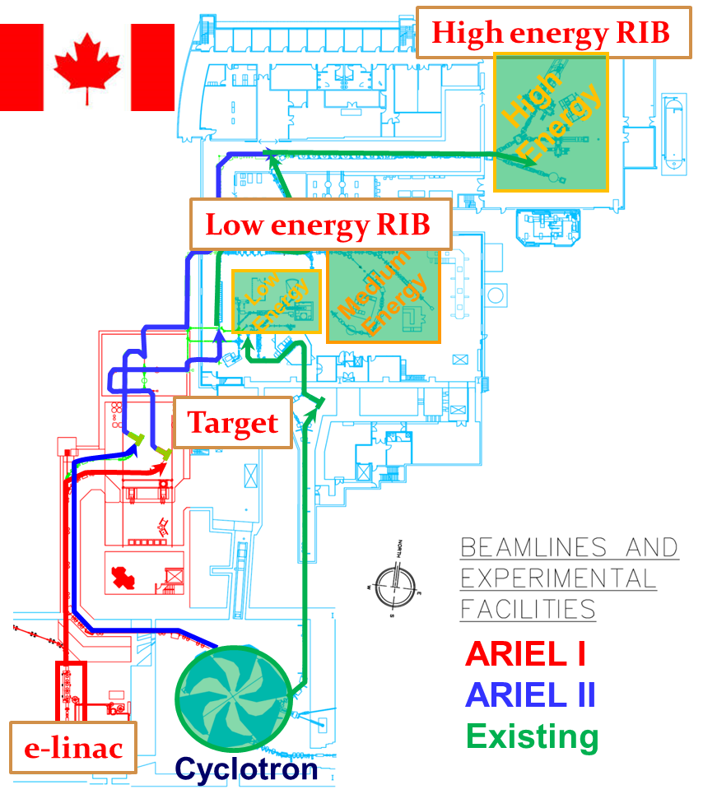
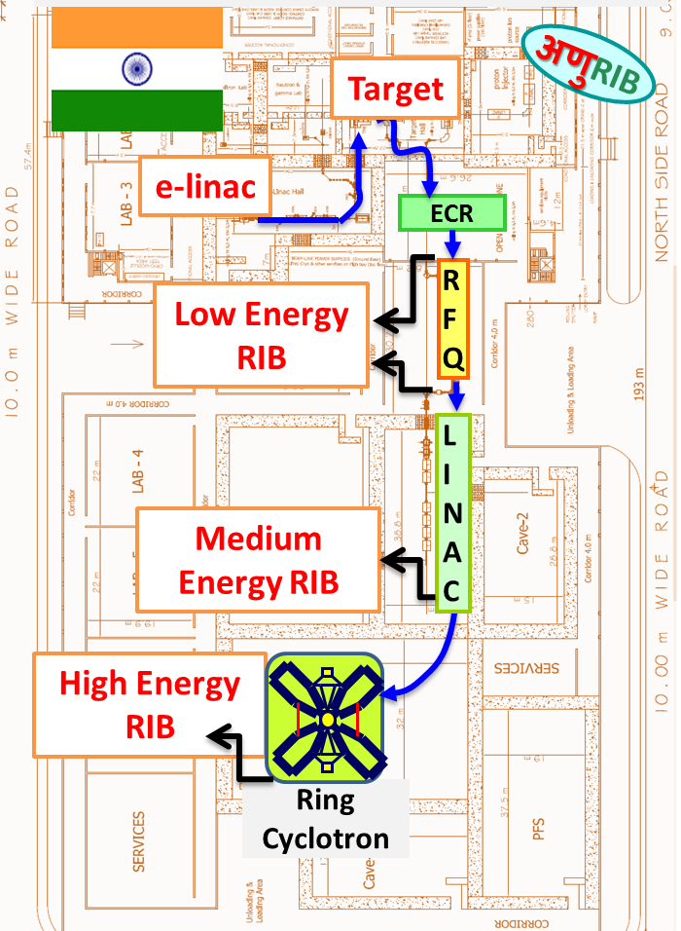

Slide 7
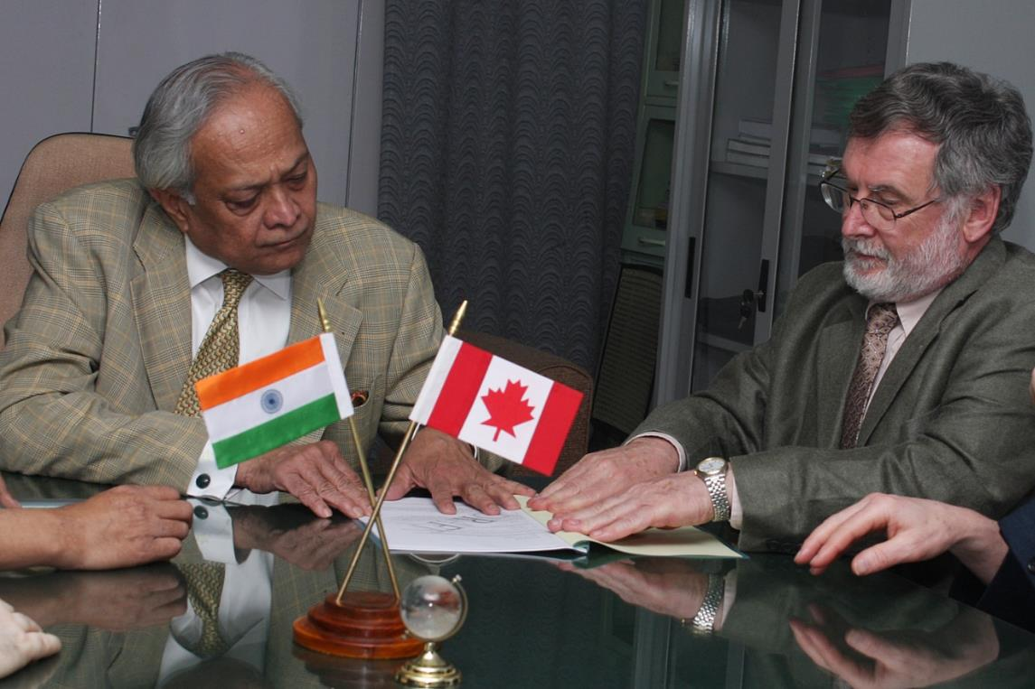
International workshop on Production of Radioactive Ion Beams (PRORIB-2001), Puri, India
ISAC operations
Beam dynamics simulation
For ISAC QWRs
Design of IH LINAC for VECC
Bikash Sinha
Paul Schmor

Slide 8
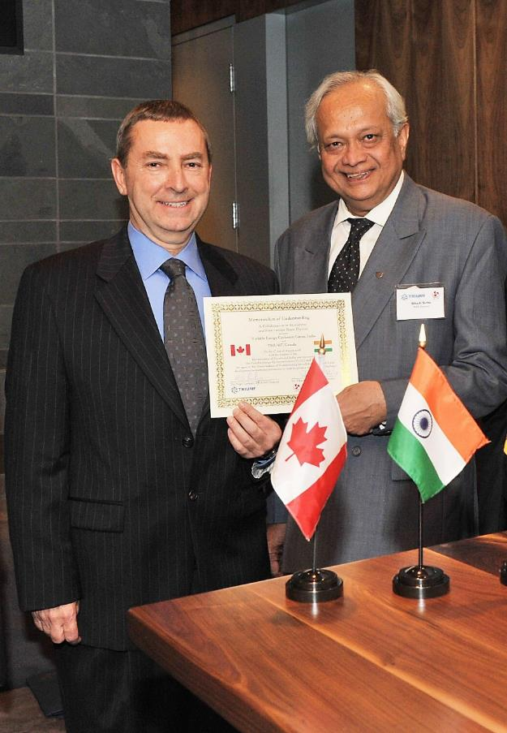
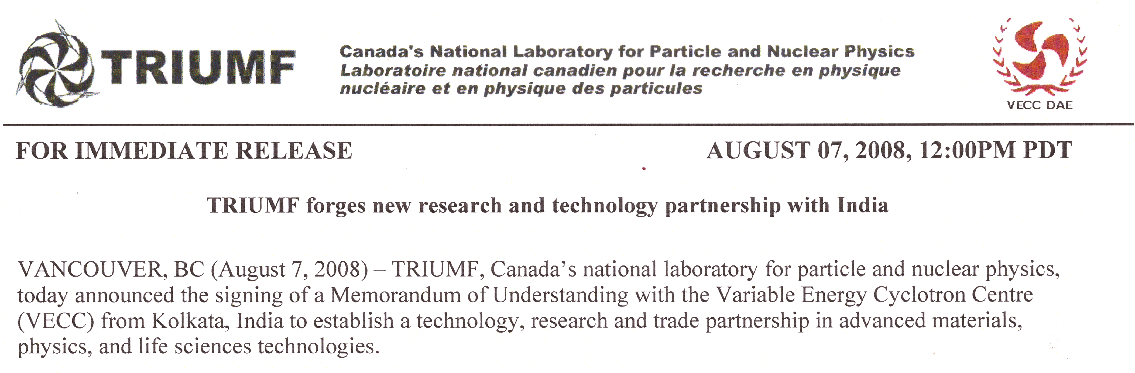
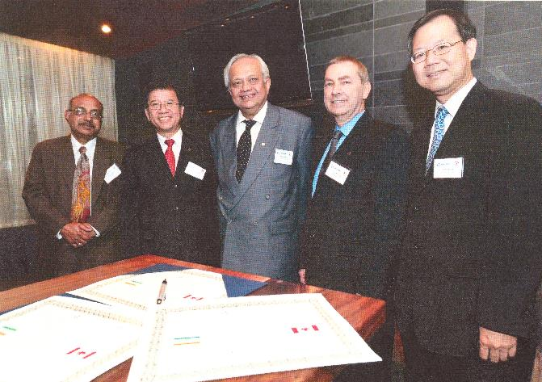
Umbrella MOU between VECC and TRIUMF → August 7th, 2008
Addendum-1 to MOU
Nigel Lockyer
Bikash Sinha

Slide 9
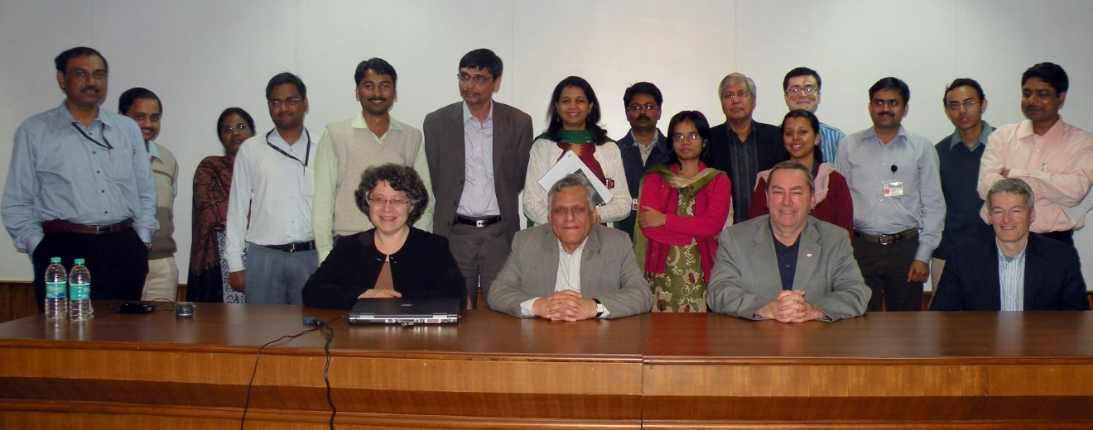
Addendum-2 to MOU between VECC and TRIUMF → July 9th, 2009
Goal of Addendum-2 to the MOU was to jointly develop & test Injector Cryo-module at TRIUMF – two units will be built & tested - One for VECC & for TRIUMF
Total project cost : 6.264 M CAN $ Timeline : April -2012
Alok
Vaishali
Amiya
Arup
L. Merminga
R. Bhandari
N. Lockyer
R. Laxdal

Slide 10
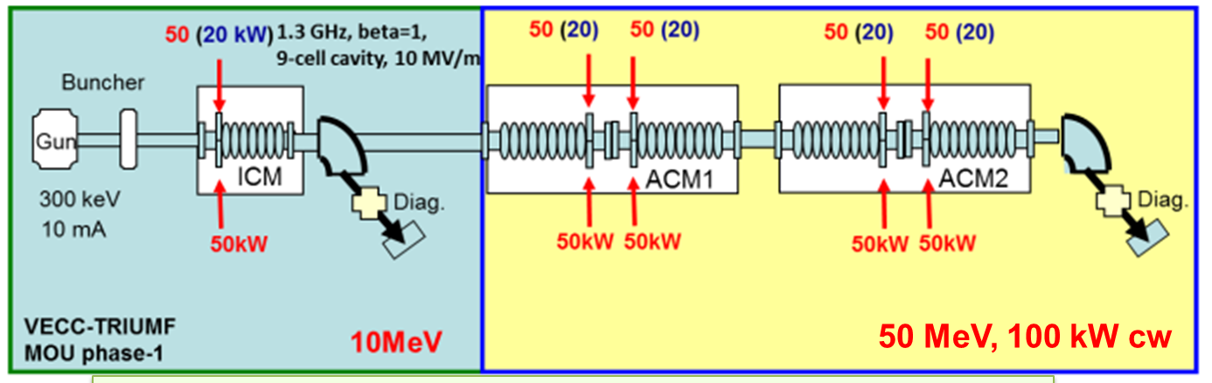
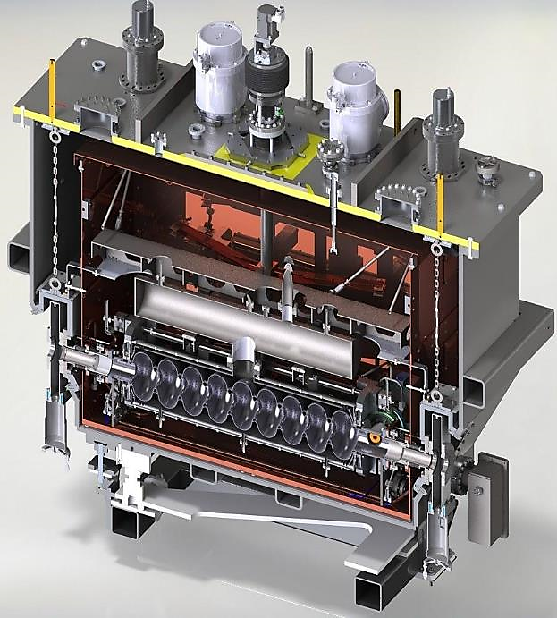
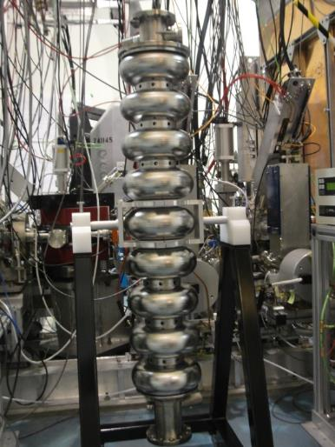
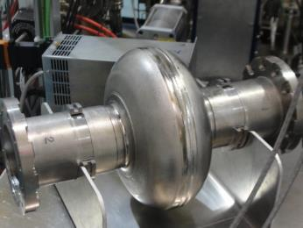
Super-conducting electron LINAC Development
Nine cell SC electron LINAC for production of RIBs using photofission route
Acc. Grad ~ 10 MV/m
Vacuum vessel
ICM
Beam
Single cell cavity
LHe bath
77K thermal shield
9-cell cavity
Cavity

Slide 11
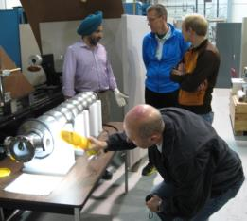
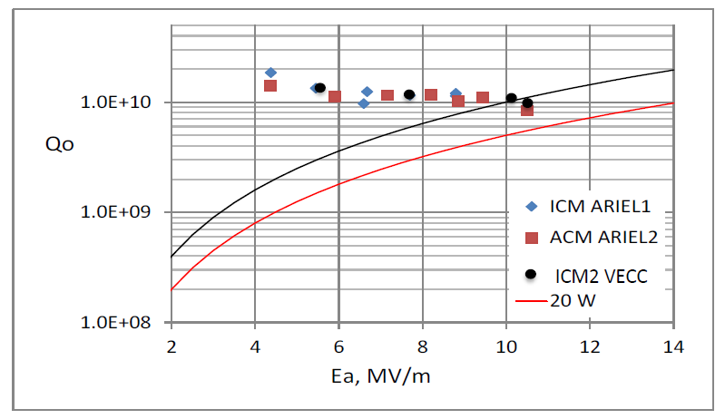
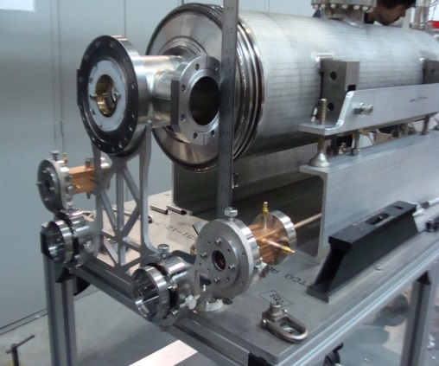
SC e- LINAC Development
9-cell cavity inspection
Dressed 9-cell cavity

Slide 12
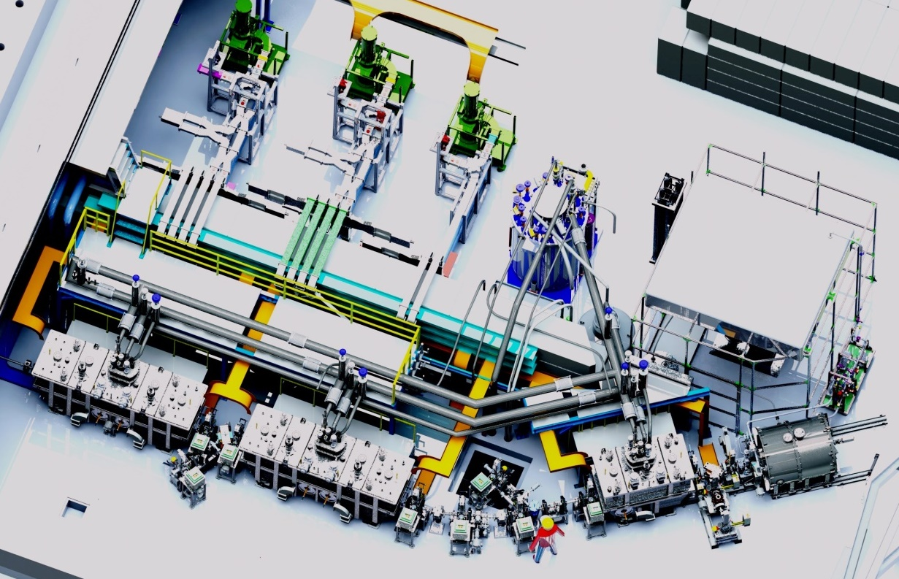
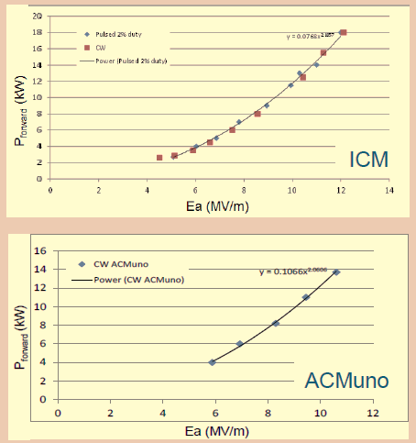
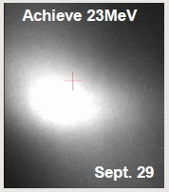
Super-conducting electron LINAC Development
klystrons
Cold box
300 kV supply
12 MV/m (cw)
ACM2
(not installed)
e-gun (300 keV)
ACM1
(one 9-cell)
ICM
10 MV/m (cw)
First beam accelerated to 22 MeV / 10 µA on 29th Sept 2014
Beam test of VECC cavity was done on 28th Oct 2016

Slide 13
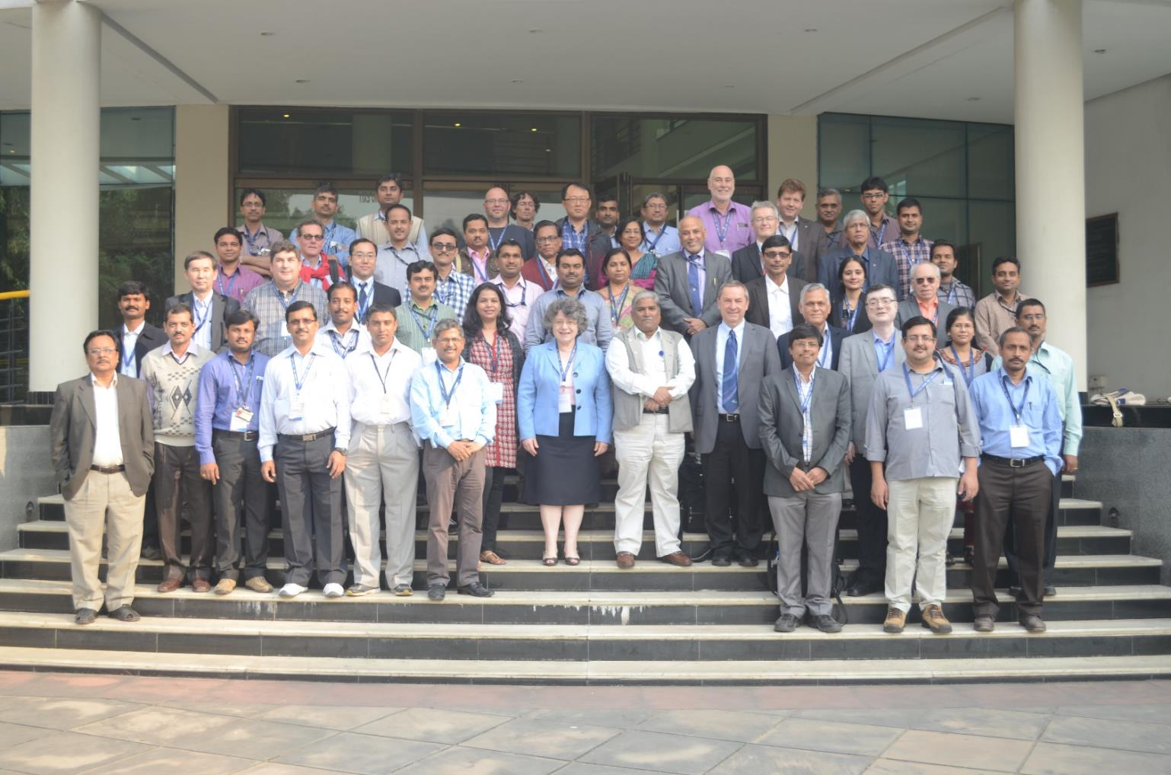
Science with rare isotope beams (SCRIBE) organized at VECC in year 2012 & 2014

Slide 14
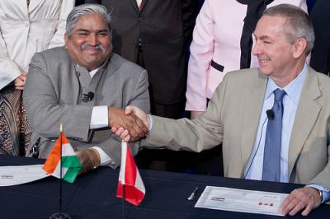
Addendum-3 to MOU between VECC and TRIUMF → August 8th, 2013
The goal of Addendum-3 to the MOU is to jointly design, develop and test
high power Actinide target/ converter modules – two numbers
Radioactive ion extraction systems – two numbers
Actinide target R&D, simulations and experiments
One low beta heavy ion LINAC cryomodule
Total project cost : 6.3 M CAN$ Timeline : Dec -2016
D.K. Srivastava
N. Lockyer

Slide 15
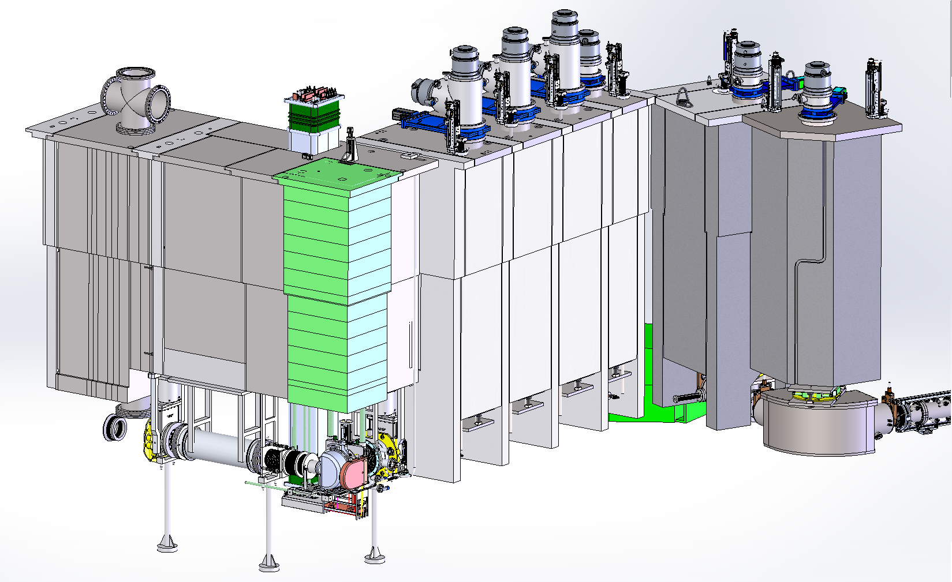
Target and Radioactive Ion Extractor Module
Highly active – Inaccessible
Reliability
All service connections are through shielding
Upstream RIB Module
Downstream Interface Access Plugs
Target Vessel Retrieval Plug
Entrance Module
Interface Modules
Electron Beam
RIB
Converter Module
Downstream RIB Modules
Target Vessel
Pre-separator Magnet

Slide 16
Target and Radioactive Ion Extractor Module
TISA front end
Pillow seal
ES Quad Triplets
Diagnostics

Slide 17
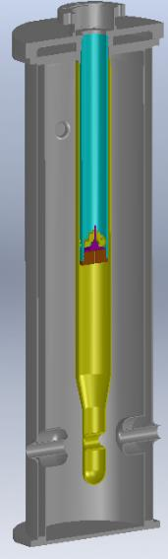
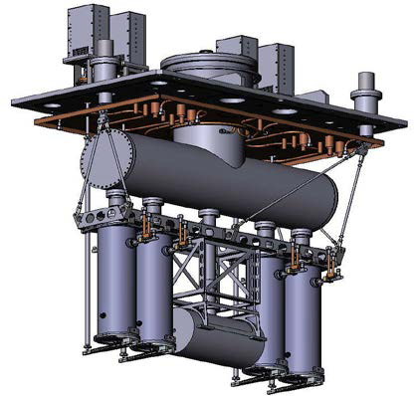
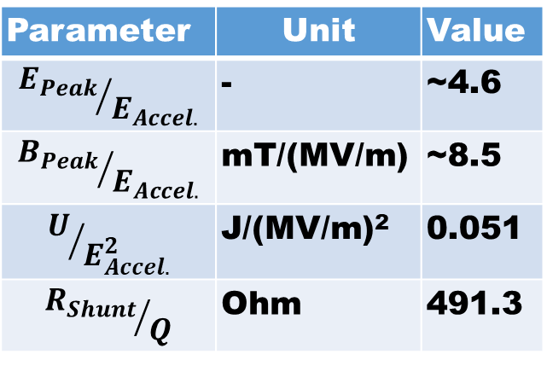
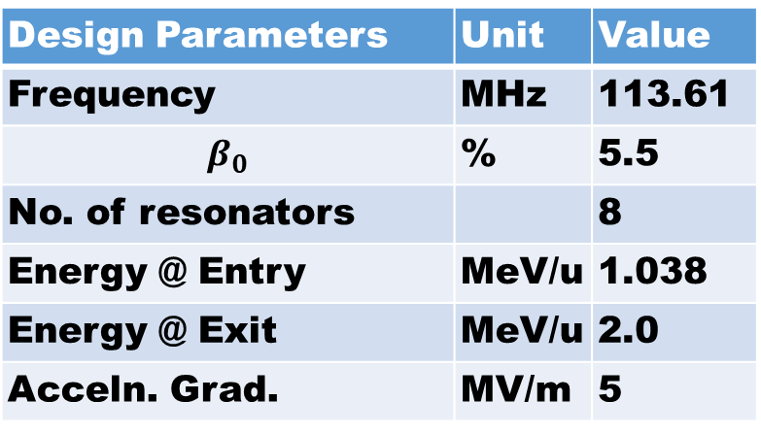
Super-conducting Quarter Wave Resonator (QWR) Development
Design Parameters | Unit | Value
Frequency | MHz | 113.61
$$β_{0}$$ | % | 5.5
No. of resonators |  | 8
Energy @ Entry | MeV/u | 1.038
Energy @ Exit | MeV/u | 2.0
Acceln. Grad. | MV/m | 5
Thermal shield
Helium Tank
Parameter | Unit | Value
$${E_{Peak}}/{E_{Accel.}}$$ | - | ~4.6
$${B_{Peak}}/{E_{Accel.}}$$ | mT/(MV/m) | ~8.5
$$U/{E_{Accel.}^{2}}$$ | J/(MV/m)² | 0.051
$${R_{Shunt}}/Q$$ | Ohm | 491.3
QWR-1
QWR-4
SC-Solenoid

Slide 18
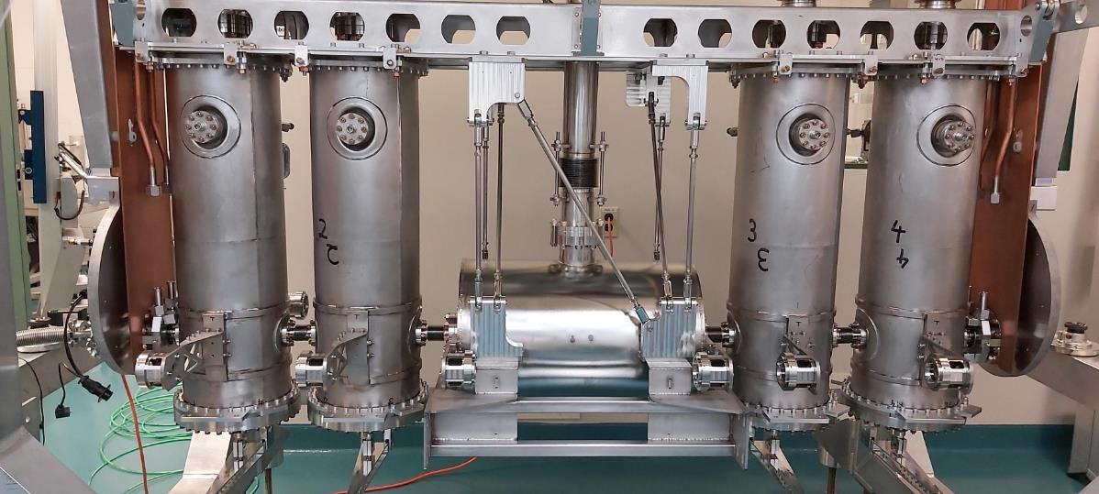
Super-conducting Quarter Wave Resonator (QWR) Development
The cryo-module vacuum and beam space vacuum are separate: Helps to avoid contamination of RF surfaces & long time performance degradation (??)
Only the “cold mass” needs to be assembled on the “strong back” & sealed inside class-100 clean room
The assembly within the cryo-module can be done inside class-1000 room with required infrastructure.
Pickup
QWR-1
QWR-4
Coupler
Hermetic coupling
SC-Solenoid
Alignment Target

Slide 19
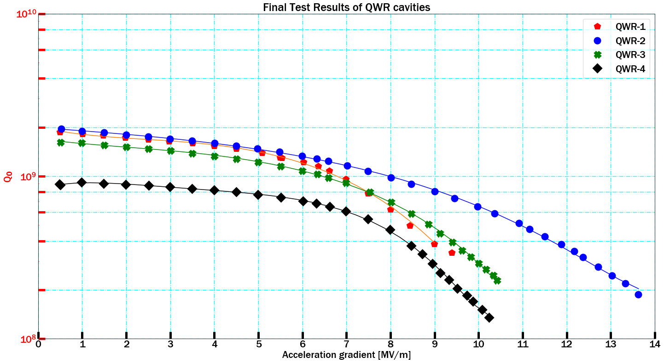
Super-conducting Quarter Wave Resonator (QWR) Development
Static heat load | Quantity
LN2 (l/h) | 5.08 (Flow rate)
Liq-He (W) | 9.28 (Falling level)
Dynamic heat load | Quantity
QWR-2 | 1.59 W @E_{accln}=6.6 MV/m
QWR-1 quenched @9.4 MV/m, QWR-3 & 4 did not quench till 10.2 MV/m and QWR-2 performed best – did not quench even at 13.5 MV/m.

Slide 20


Present Status of RIB Facility at VECC

Slide 21
Variable Energy Cyclotron Centre (Bidhan Nagar)
Rare Ion Beam Facility
K=130 Cyclotron
Gas Jet Recoil Transport
Multiple
Thin Targets
Charge Breeder
Separator
1.7 keV/u
RFQ
q/A ≥ 1/14
Rebuncher-1
99 keV/u
LINAC-1 &2
Rebuncher-2&3
LINAC-3
Charge Stripping
Rebuncher-4&5
414 keV/u
LINACs 4-5
1.043 MeV/u
37.87 MHz
q/A ≥ 1/7
SC QWR : 1-8
75.74 MHz
2 MeV/u
113.61 MHz

Slide 22
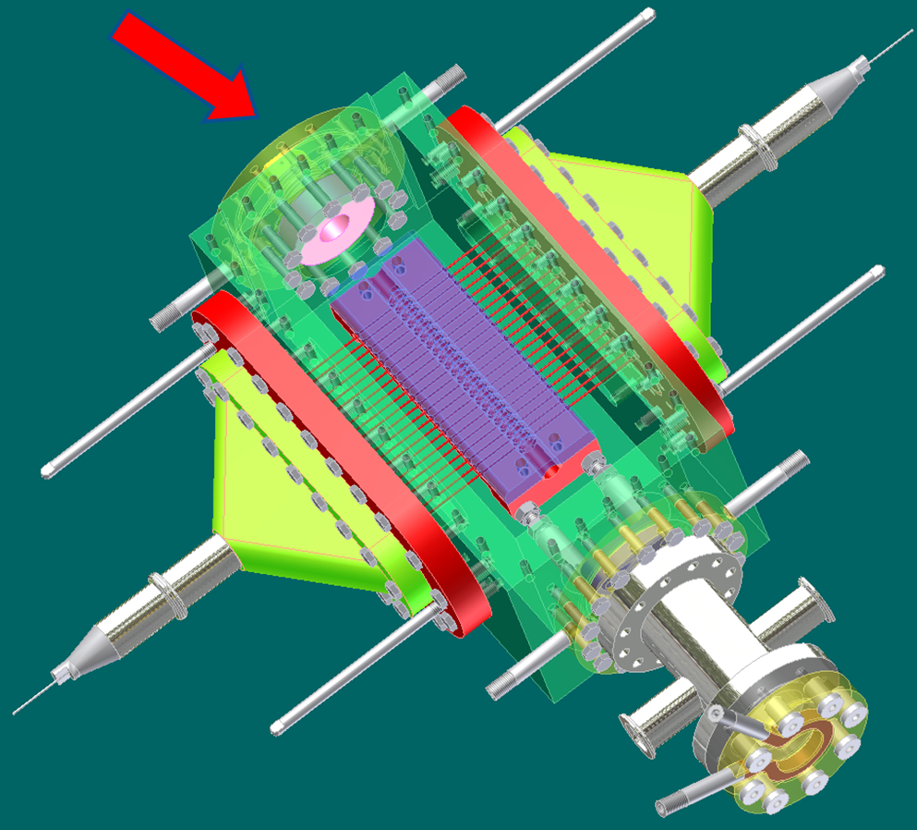



RIB facility in VECC-Bidhan Nagar Campus
RIB Production & Transport
Primary beam accelerator
RIB production target chamber is located inside cyclotron vault
Multiple thin targets are used to maximize the RIB intensity
Primary Target
RIBs
Ion source(s)
Isotope separator
RIB
(1.5 keV/u)
$$I_{RIB}=I_{Pri}N_{t}ση$$
RIB
Post- Accelerator(s)

Slide 23
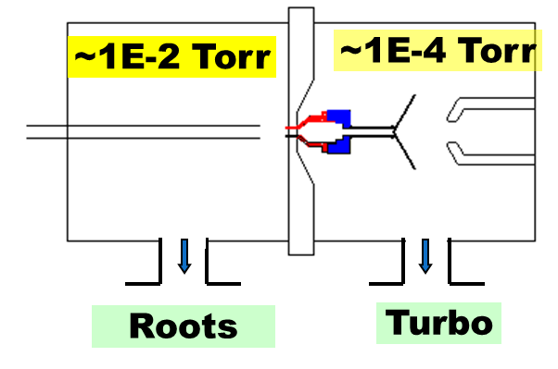
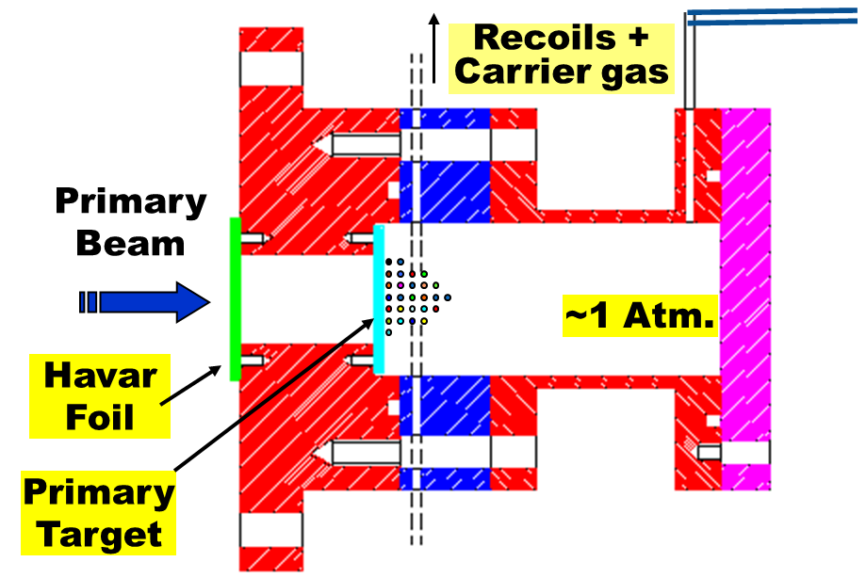
RIB facility in VECC-Bidhan Nagar Campus
RIB Transport→ Gas jet recoil transport technique
Primary beam accelerator
Thermalisation of recoils
Transport due to differential pumping
Tr. Eff. is almost element independent.
Fast → ~ 100 ms for a dis. 6m.
Primary Target
RIBs
Ion source(s)
Isotope separator
RIB
(1.5 keV/u)
RIB
Post- Accelerator(s)
Aerosole generator
Carrier gas
Target Chamber

Slide 24
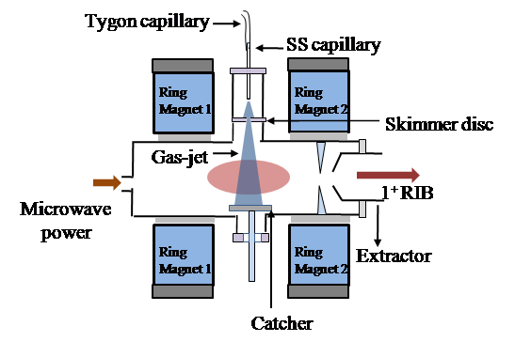
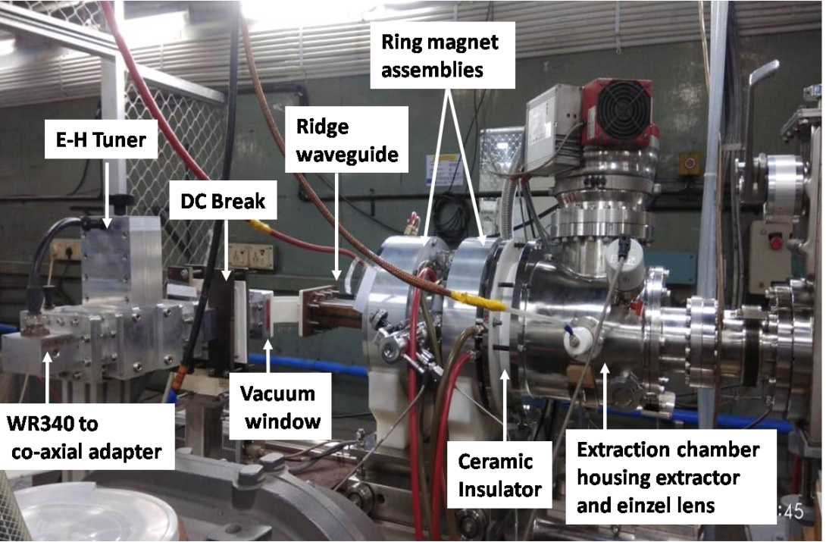
RIB facility in VECC-Bidhan Nagar Campus
Ionisation: 1⁺ Ion Source
Primary beam accelerator
Primary Target
RIBs
Ion source(s)
1⁺ ECR
Frequency | 2.45 GHz
Microwave source | 450 W (SS µ-wave generator)
Axial confinement | Permanent magnets B_in=1.84 kG B_ext=1.35 kG
Radial confinement | 1.2 kG @r=45 mm
(2021)
Isotope separator
A
RIB
(1.5 keV/u)
RIB
Post- Accelerator(s)

Slide 25
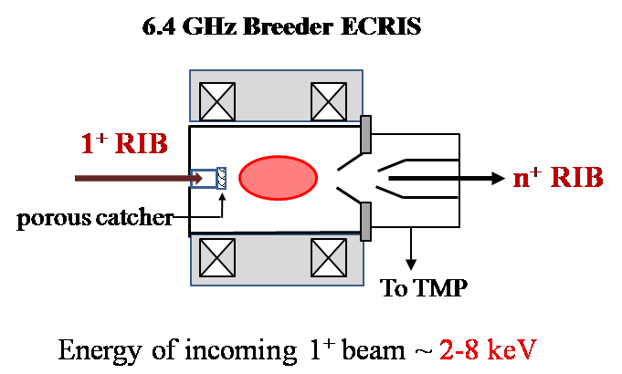
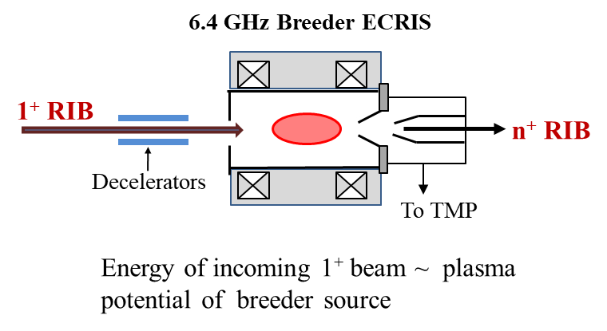
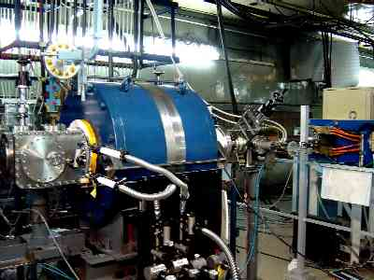

Scheme 1
Scheme 2
RIB facility in VECC-Bidhan Nagar Campus
RIB Production & Ionisation
Primary beam accelerator
Primary Target
RIBs
Ion source(s)
Decelerated to 20 - 30 eV → Inject into ECR plasma
Decelerated to 2-8 keV → fall on porous catcher → Diffusion
n⁺ ECR
Frequency | 6.4 GHz
Microwave source | 3 kW (Klystron)
Axial confinement | Solenoid coils B_in=0.95 T B_ext=0.7 T
Radial confinement | Permanent magnets 0.7 T @r=50 mm
Isotope separator
RIB
(1.5 keV/u)
RIB
Post- Accelerator(s)
(2002)

Slide 26
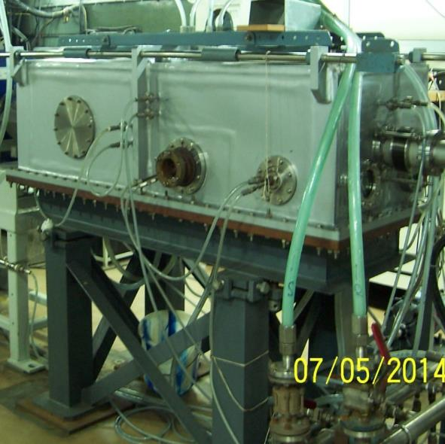
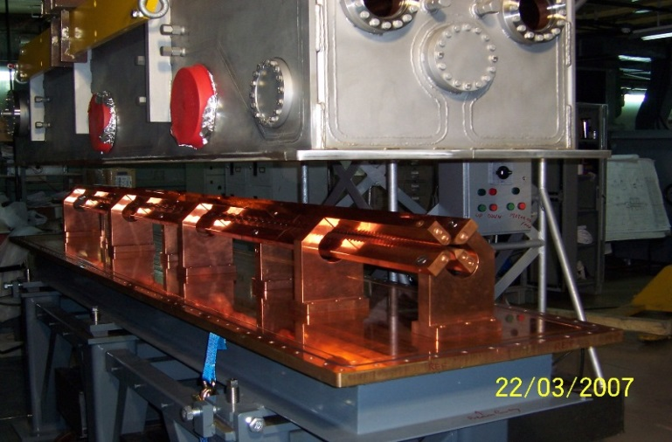
RIB facility in VECC-Bidhan Nagar Campus
Radio Frequency Quadrupole (RFQ)
Primary beam accelerator
Primary Target
RIBs
Ion source(s)
Isotope separator
Freq. : 33.7 MHz
q/A ≥ 1/16
Freq.: 37.8 MHz
q/A ≥ 1/14
RIB
(1.5 keV/u)
Energy : 1.38 → 29 keV/u
Energy : 1.73 → 98.8 keV/u
RIB
Post- Accelerator(s)
Commissioned in 2005
Commissioned in 2008

Slide 27
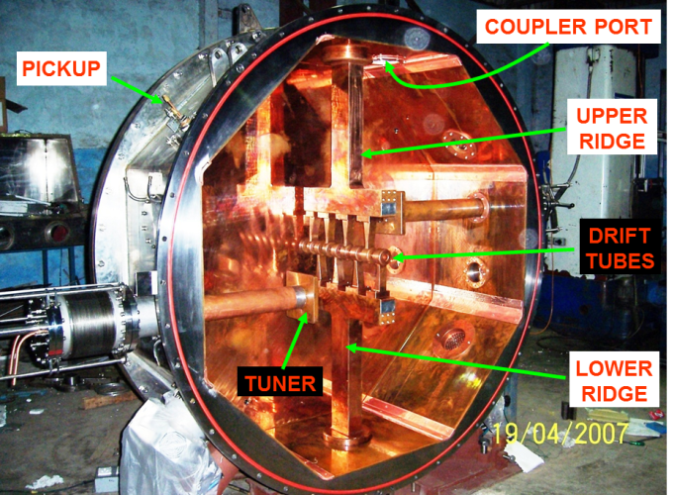
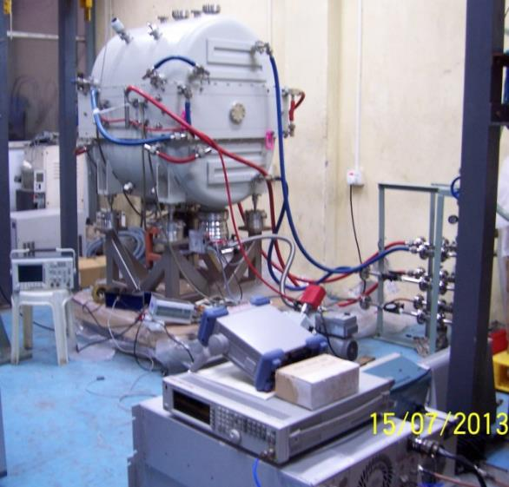
RIB facility in VECC-Bidhan Nagar Campus
IH LINACs
Primary beam accelerator
Primary Target
RIBs
Ion source(s)
Isotope separator
IH LINAC Accelerators for accelerating from 99 kev/u to 1.04 MeV/u
IH #1 | 98.8 → 186.2 keV/u | 37.87 | Copper cladded steel | Conventional LINAC beam dynamics | 2009
IH #2 | 186.2 → 289.1 keV/u | 37.87 |  |  | 2010
IH #3 | 289.1 → 413.9 keV/u | 75.74 |  |  | 2012
IH #4 | 413.9 → 717.8 keV/u | 75.74 | Copper plated MS | KONUS beam dynamics | 2023
IH #5 | 717.8 → 1038.0 keV/u | 75.74 |  |  | 2024
RIB
(1.5 keV/u)
RIB
Post- Accelerator(s)

Slide 28
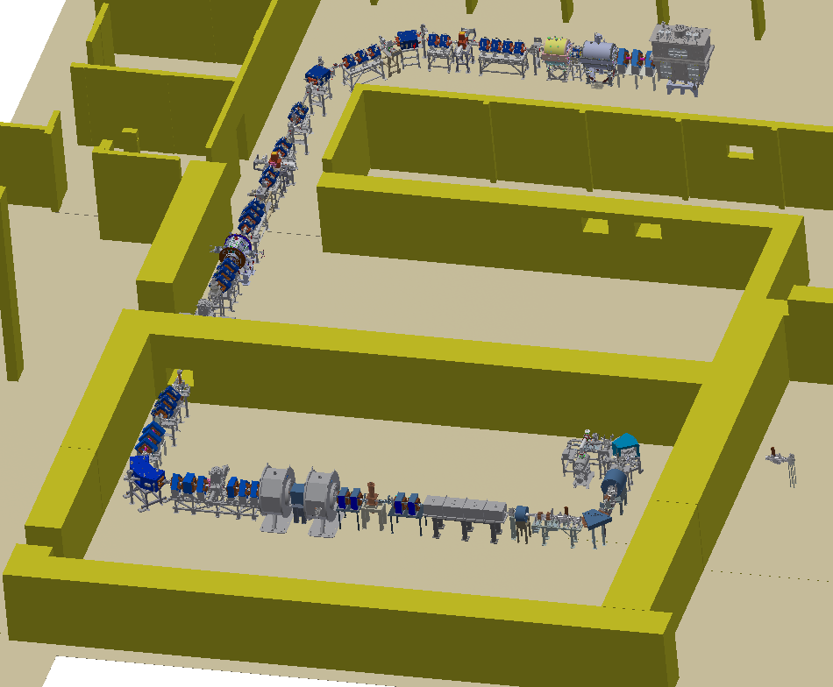
RB4
L4
L5
QWR 1-4
RB4
RIB Building
Charge stripping
L3
RB3
HR Cave-I
Primary target
1⁺ ECR
n⁺ ECR
HR Cave-II
Cyclotron Beam
RB2
L2
L1
RB1
RFQ
Cyclotron vault

Slide 29
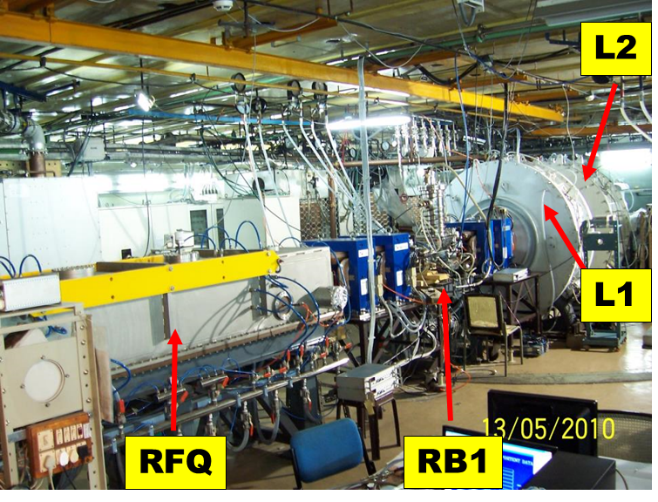
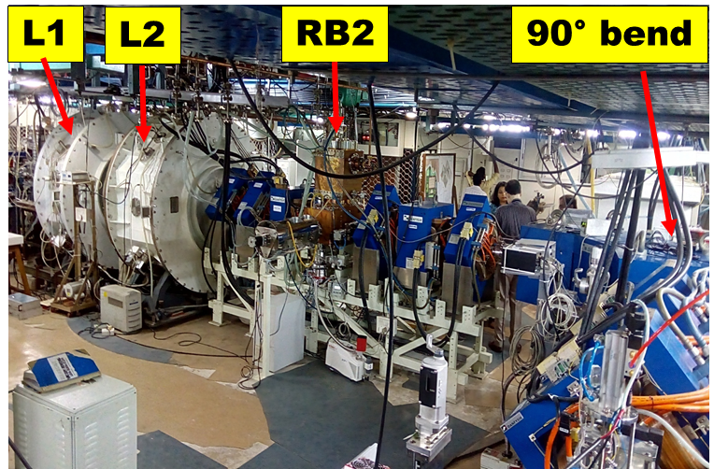
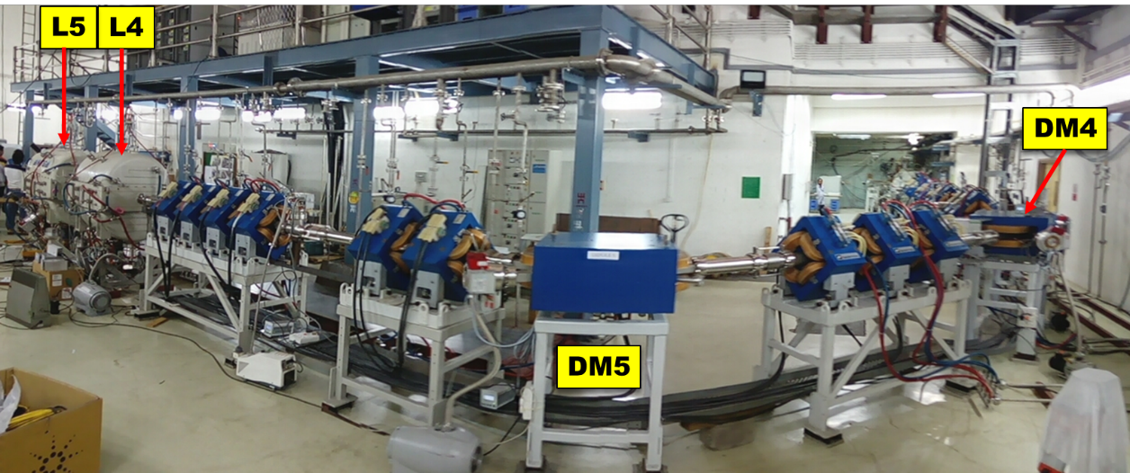
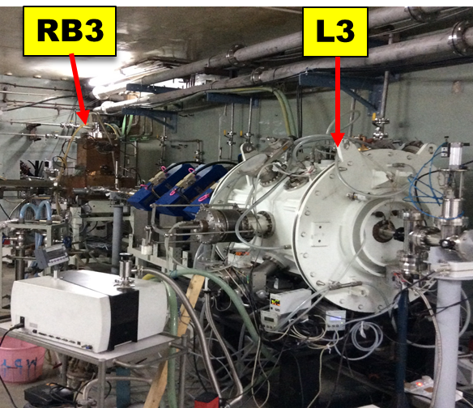
Walking around the facility

Slide 30
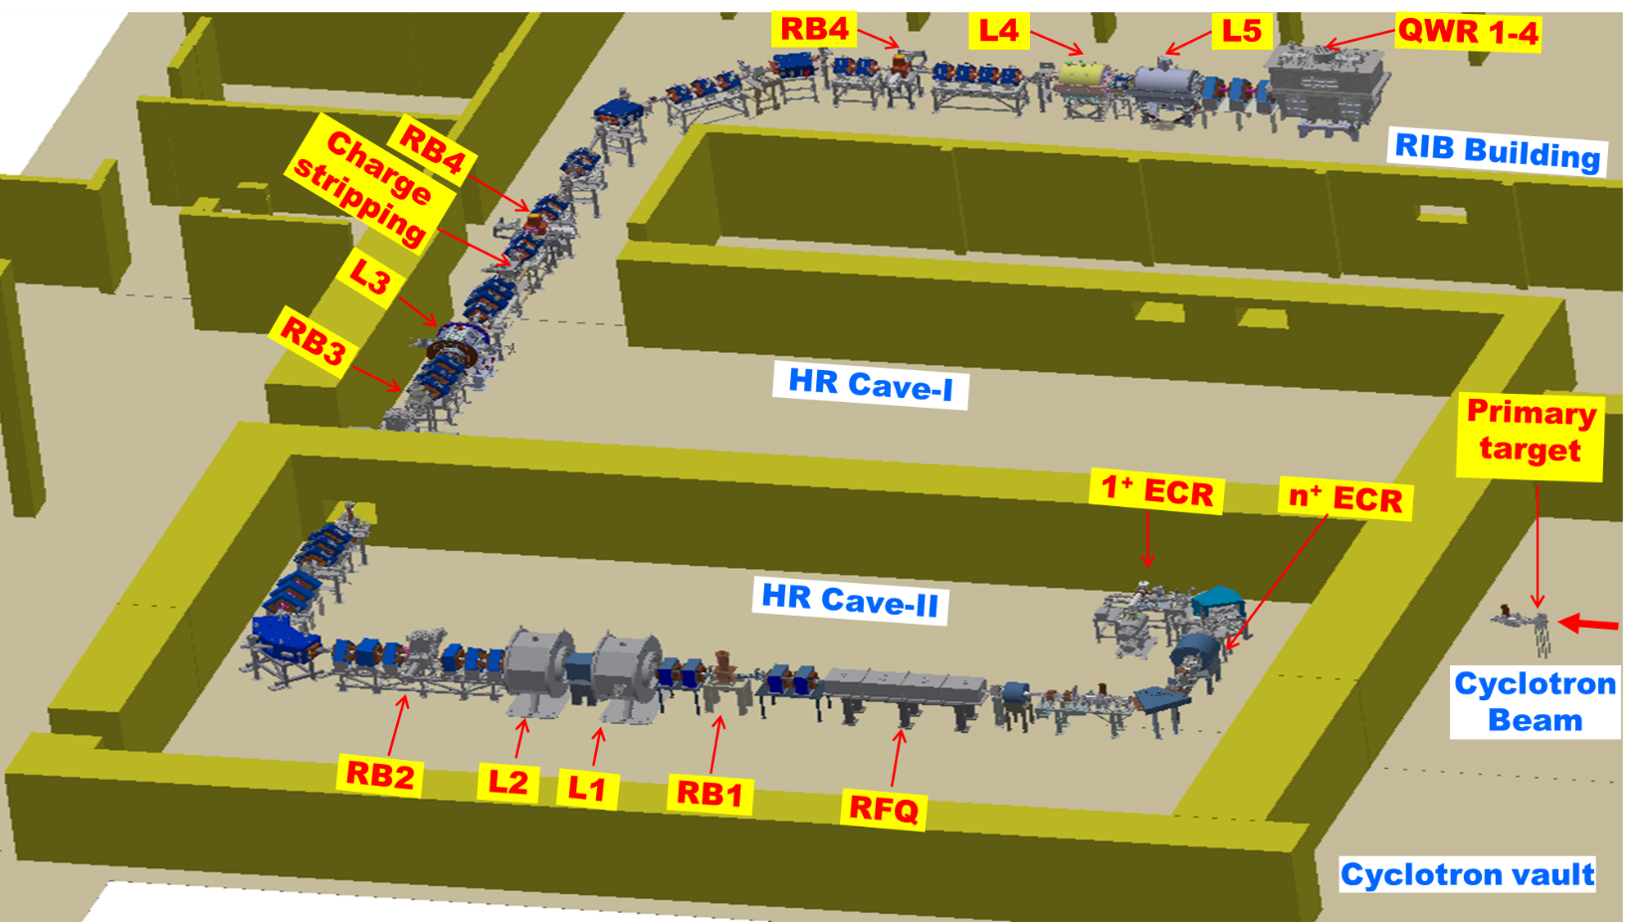

Measurement results for stable beam acceleration
Energy [kev/u] | Location | I [nA]
1.5 | After ECR | 1100
99.2 | After RFQ | 800
188.4 | After L-1 | 800
289.6 | After L-2 | 750
415.3 | After L-3 | 200
$$N^{4+}$$
Regulatory clearance up to 415 keV/u (L-3)
C-12, N-14, O-16, He-4, Ar-40, Fe-56, Ni-58, In-115, Zn-64, B-11 : Currents ~ 0.01 – 100 µA Typ.

Slide 31



















RIB produced to demonstrate commissioning of low energy facility
RIB | T_1/2 | PPS | Reaction
 | 20.3 m | 5x10³
 | 71 s | 5x10³
 | 12.4 h | 2.7x10³
 | 22.3 h | 1.2x10⁵
 | 109 m | 1.3x10³
 | 2.8 d | 1.6x10⁵
$${}_{6}^{11}C$$
$${}_{7}^{14}{N(p,α)}$$
$${}_{8}^{14}O$$
$${}_{7}^{14}{N(p,n)}$$
3.2E3 after RFQ
$${}_{19}^{42}K$$
$${}_{18}^{40}{Ar(α,pn)}$$
$${}_{19}^{43}K$$
$${}_{18}^{40}{Ar(α,p)}$$
$${}_{18}^{41}{Ar}$$
$${}_{18}^{40}{Ar(α,2pn)}$$
$${}_{49}^{111}{In}$$
$${}_{47}^{Nat}{Ag(α,xn)}$$
A few possibilities
Rare ion beams up to 415 keV/u (Regulatory clearance) for a few cases – the list will grow as and when we can increase the intensity in the production stage
RIB | T_1/2 | Reaction
 | 2.03 m
 | 76 m
 | 4.3 m
 | 9 h
 | 32 m
$${}_{8}^{15}O$$
$${}_{7}^{14}{N(d,n)}$$
$${}_{36}^{87}{Kr}$$
$${}_{37}^{90}{Rb}$$
$${}_{92}^{232}{U(α,f)}$$
$${}_{54}^{135}{Xe}$$
$${}_{55}^{138}{Cs}$$

Slide 32
Applied and NUclear Research using Rare Isotope Beams (ANURIB)

Slide 33
Applied and NUclear Research using Rare Isotope Beams (ANURIB)
n
Spectroscopy of r-process, n-rich exotic nuclei
e-
Neutron Beam Facility
Low Energy Experimental Facility
SC e- LINAC
50 MeV / 2mA
e-
γ
1+ RIB
TRAP
1⁺ Ion Source
HR separator
RFQ Cooler + MR-TOF
Ta
1⁺ Ion Source
LASER SPECTROSCOPY
β+
Target
Stable isotope
injection
HC Injector
Low Energy Positron Facility
Proton cyclotron 50 MeV / 200 µA
Separator
1.5 keV/u
Material Science & biological studies with stable & RIBs

Slide 34
Applied and NUclear Research using Rare Isotope Beams (ANURIB)
n
Spectroscopy of r-process, n-rich exotic nuclei
e-
Neutron Beam Facility
Low Energy Experimental Facility
SC e- LINAC
50 MeV / 2mA
e-
γ
1+ RIB
TRAP
1⁺ Ion Source
HR separator
RFQ Cooler + MR-TOF
Ta
1⁺ Ion Source
LASER SPECTROSCOPY
β+
Target
Stable isotope
injection
HC Injector
Low Energy Positron Facility
Proton cyclotron 50 MeV / 200 µA
Separator
1.5 keV/u
Material Science & biological studies with stable & RIBs
Material Science & biological studies with stable & RIBs
RFQ
0.1 MeV/u
Nuclear Astrophysics
1.5 MeV/u
LINAC
Low energy Phase-1

Slide 35
Applied and NUclear Research using Rare Isotope Beams (ANURIB)
n
Spectroscopy of r-process, n-rich exotic nuclei
e-
Neutron Beam Facility
Low Energy Experimental Facility
SC e- LINAC
50 MeV / 2mA
e-
γ
1+ RIB
TRAP
1⁺ Ion Source
HR separator
RFQ Cooler + MR-TOF
Ta
1⁺ Ion Source
ECR IS
ECR IS
LASER SPECTROSCOPY
β+
Target
n+ RIB
Stable isotope
injection
HC Injector
Low Energy Positron Facility
Separator
1.5 keV/u
Proton cyclotron 50 MeV / 200 µA
Material Science & biological studies with stable & RIBs
RFQ
0.1 MeV/u
Nuclear Astrophysics
1.5 MeV/u
LINAC
Low energy Phase-1

Slide 36
Applied and NUclear Research using Rare Isotope Beams- Technology Readiness Level
1 | Primary Accelerator | Cyclotron |  |  |  | Research | Development
2 |  | e-LINAC |  |  |  | Development | Deployment
3 | RIB Production & Transport | Multiple thin target & Gas jet transport |  |  |  | Deployment
4 |  | Thick target methodology |  |  |  | Research
5 | Ionisation | 1+ ion source |  |  |  | Deployment
6 |  | n+ ion source |  |  |  | Deployment
7 |  | Charge breeding |  |  |  | Development
8 | Separation | On-line isotope separator |  |  |  | Development
9 | Post-acceleration | Radio Frequency Quadrupole |  |  |  | Deployment
10 |  | IH LINACs |  |  |  | Deployment
11 |  | Super-conducting Quarter Wave |  | Resonators |  | Development |  | Deployment
12 |  | Rebunchers |  |  |  | Deployment
Low Energy Experimental Facility
HR separator
RFQ Cooler + MR-TOF
TRAP
LASER SPECTROSCOPY

Slide 37
Applied and NUclear Research using Rare Isotope Beams (ANURIB)
n
Spectroscopy of r-process, n-rich exotic nuclei
e-
Neutron Beam Facility
Low Energy Experimental Facility
SC e- LINAC
50 MeV / 2mA
e-
γ
1+ RIB
TRAP
1⁺ Ion Source
HR separator
RFQ Cooler + MR-TOF
Ta
1⁺ Ion Source
ECR IS
LASER SPECTROSCOPY
β+
Target
n+ RIB
Stable isotope
injection
HC Injector
Low Energy Positron Facility
Separator
1.5 keV/u
Proton cyclotron 50 MeV / 200 µA
Material Science & biological studies with stable & RIBs
RFQ
0.1 MeV/u
Nuclear Astrophysics
1.5 MeV/u
LINAC
Low energy Phase-1
7 MeV/u
LINAC booster
Facility for Coulomb Barrier physics
Nucl. structure, Elastic/ Inelastic scattering, Coulomb barrier physics, SHE
Accelerators
Experimental Facility

Slide 38
Applied and NUclear Research using Rare Isotope Beams (ANURIB)
n
Spectroscopy of r-process, n-rich exotic nuclei
e-
Neutron Beam Facility
Low Energy Experimental Facility
SC e- LINAC
50 MeV / 2mA
e-
γ
1+ RIB
TRAP
1⁺ Ion Source
HR separator
RFQ Cooler + MR-TOF
Ta
1⁺ Ion Source
ECR IS
LASER SPECTROSCOPY
β+
Target
n+ RIB
Stable isotope
injection
HC Injector
Low Energy Positron Facility
Separator
1.5 keV/u
Proton cyclotron 50 MeV / 200 µA
Material Science & biological studies with stable & RIBs
RFQ
0.1 MeV/u
Nuclear Astrophysics
1.5 MeV/u
LINAC
Low energy Phase-1
7 MeV/u
LINAC booster
Facility for Coulomb Barrier physics
Nucl. structure, Elastic/ Inelastic scattering, Coulomb barrier physics, SHE
Accelerators
Experimental Facility

Slide 39
Applied and NUclear Research using Rare Isotope Beams (ANURIB)
n
Spectroscopy of r-process, n-rich exotic nuclei
e-
Neutron Beam Facility
Low Energy Experimental Facility
SC e- LINAC
50 MeV / 2mA
e-
γ
1+ RIB
TRAP
1⁺ Ion Source
HR separator
RFQ Cooler + MR-TOF
Ta
1⁺ Ion Source
ECR IS
LASER SPECTROSCOPY
β+
Target
n+ RIB
Stable isotope
injection
HC Injector
Low Energy Positron Facility
Separator
1.5 keV/u
Proton cyclotron 50 MeV / 200 µA
Material Science & biological studies with stable & RIBs
RFQ
0.1 MeV/u
Nuclear Astrophysics
1.5 MeV/u
LINAC
Low energy Phase-1
7 MeV/u
LINAC booster
Facility for Coulomb Barrier physics
Nucl. structure, Elastic/ Inelastic scattering, Coulomb barrier physics, SHE
Accelerators
RIB
Experimental Facility
Stripper
Target
Stable Beam
Studies on drip line & near drip line nuclei
Exotic fragments
PFS
Ring Cyclotron
100 MeV/u
Future High energy phase
RIB

Slide 40
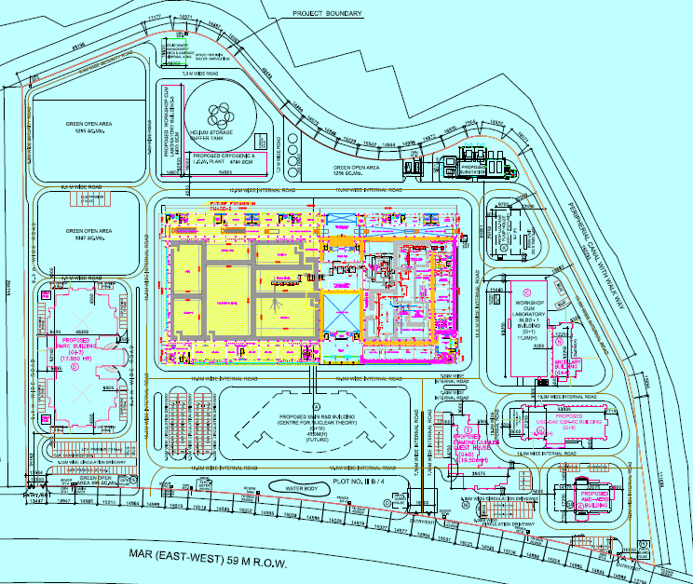
VECC Rajarhat Campus Masterplan
25 acres greenfield campus
Workshop (proposed)
LCW/Cryo plant (proposed)
33kV Sub-station
ANURIB site (proposed)
100mx200m
Lab-1
Multi-purpose Engg Hall
Radiation Medicine Research Centre (RMRC/BARC)
MC18 test facility (proposed)
UGC-DAE CSR
Main building (proposed)
Guest-house
AMD/
AERB

Slide 41
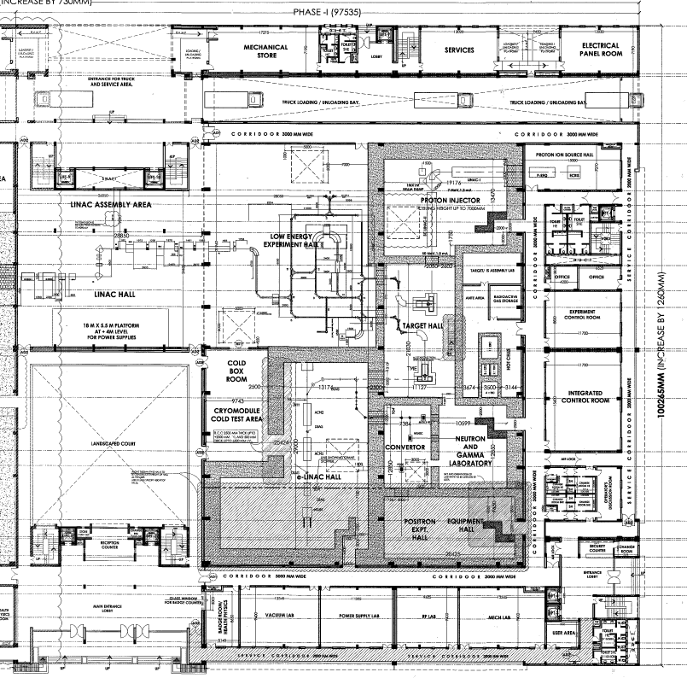
Low energy expt. Hall 30x28
Linac Hall 35x28
Proton Hall 19x15
ANURIB
building
Floor plan
Target Hall 11x23
Cold box room
Control room
E-Linac Hall 29x13
Court yard
Cryomodule test area
Entrance

Slide 42
ANURIB building radiation zoning
Zone 1
Zone 3
Zone 3 no access when beam on ; Zone 2 conditional access when beam on; Zone 1 open
Zone 2
Zone 1

Slide 43
Cost estimate & phasing
Sl. No. | Major Activity | Cost (Rs. Crore) | Cost (Rs Bilion)
1 | ANURIB Phase-I including building | 675.00 | 6.75
2 | Acceleration of RIB to 7 MeV/A | 140.00 | 1.4
3 | Beam transport lines to caves | 185.00 | 1.85
 | Total (Rs. in Crore) | 1000.00 | 10
161 M CAN $
Time-line | Major Activity
T=0 | Financial Sanction of project
T+5 Y | Building & Services / Bringing all activities to deployment level
T+10 Y | Installation & commissioning In phases Primary accelerators Low energy experimental facilities Post-accelerators
T+12 Y | Beam delivery & first experiment

Slide 44
Very productive Collaboration so far
Injector Cryo-module for e-LINAC, QWRs & Cryo-module for VECC, Target & RIE module
Present status of RIB development at VECC
Plan for ANURIB in VECC
Collaboration

Slide 45


Slide 46
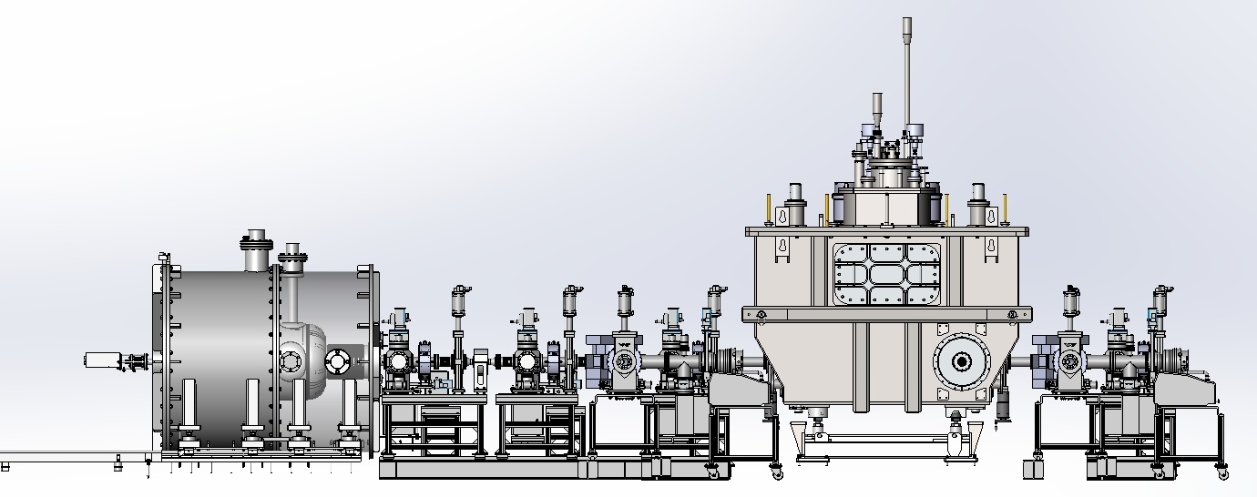


E-Linac Test area for 10 MeV Injector Cryomodule
E-Linac test area (ground floor)
Indigenous
Indigenous
TRIUMF
300 kV Electron gun Low Energy Beam Transport (LEBT) line Injector Cryo-Module Analyzing section
Cryogenic plant, IOT, HV power supply installed on 1st floor; Injector Cryomodule at ground floor
Cryo-transfer line
60m LHe
150m LN2
30m Sub-atm
PDI completed at
Shell & Tube Pune
Cryo-plant
Injector Cryo-
Module
Liquid Helium Plant 540 [W], 115 [l/h]

Slide 47
Electron gun and low energy beam transport line
LEBT

Slide 48

vacuum jacketed, LN2 cooled Liq. Helium transfer line

Slide 49


50 MeV proton cyclotron for anurib
Current Density | 0.56 A/mm²)
Ampere-turns/coil | 30697.3
No of coils | 2
Coil ID | 209 cm
Coil OD | 247 cm
Coil Height | 29 cm
Coil Width | 19 cm
No of turns | 504
Operating Current | 61 A
Magnet OD | 343 cm
Magnet Height | 160 cm
Iron Weight | 77 Ton
Key points:
Size is compact (R = 101.5 cm)
Tune values away from resonance
Frequency error less than 0.04 %
Integrated phase shift within ± 5⁰
Accelerated Orbit up to 50 MeV

Slide 50




proton cyclotron magnet design
Parameter | Value
No of sector | 4
Hill Gap (mm) | 30
Valley Gap (mm) | 800
Hill field (max) | 17 KG
Pole radius | 101.5 cm
Valley field (approx) | 1 KG
Ion revolution frequency | 16 MHz
Harmonic mode | 4
RF Frequency | 64 MHz
Required Dee voltage | 50 kV
No of Dee | 2
Horizontal betatron tune
Magnet model in Opera 3D
Vertical betatron tune

Slide 51




Slow positron beam from 10 mev electrons
1-2 kV
e- beam
Moderator
Converter
Estimate of moderated positron for 100μA , 10 MeV electron beam ~ 8x10⁷ e+/s
Magnetic transport of extracted positrons
Helmholtz Coil
Wall
Variable energy DC
Accelerator
1-2 kV
extracted e+
Detectors
Possible schematic layout (not to scale)
Sample Station

Slide 52

Neutron beam from the electron accelerator
Nuclear Data Measurements:
n-cross section measurement (total, capture, fission,
elastic, scattering γ ray, n production) for fission, fusion
materials, ADS, transmutation of minor actinides and s
process nucleo-synthesis.
Solid State Physics: n provides access to magnetic structure and dynamics of solid
Material Science:
n sensitive imaging will provide new information
pertaining to real scale tomography & radiography
Neutron Scattering :
Diffraction data for structural modes of crystals, glass &
liquids
Biology & Biotechnology :
n sensitive to dynamics of molecules & single atoms
Estimated neutron flux from 1 mA, 50 MeV electron beam at a measurement station ~ 4m away from converter

