Slide 1
Nuclear Magnetic Resonance
Nuclei with non-zero spin have a magnetic moment
Provides a subatomic probe of the magnetic field
In materials, the local field at a nucleus depends on the surrounding electrons
A local (real space) probe of solids
Extensive use in chemistry, condensed matter physics, medicine (MRI), …
First observed in 1940s,
see Bloch and Purcell Nobel (1952)

Slide 2
βNMR in the Age of ARIEL
TSW, Aug. 3, 2023
W.A. MacFarlane
Chemistry Department
University of British Columbia, Vancouver

Slide 3
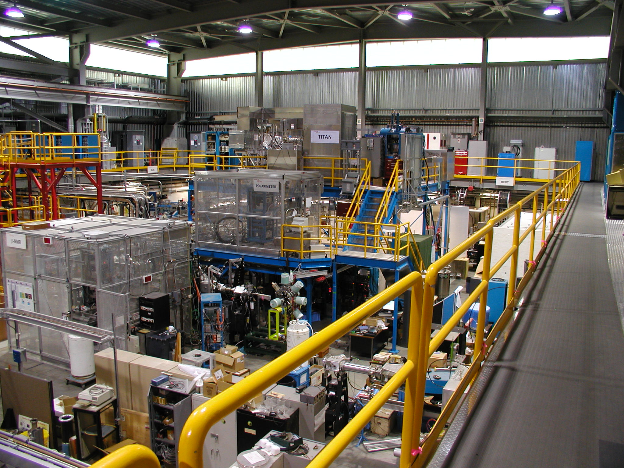
ISAC-1 Low Energy Area
Titan
βNQR
βNMR
Osaka
Notes:
Different approach to PSI LEM: deceleration potential generated by biasing the entire spectrometer, not just the sample stage
ISAC: single user facility. We compete directly with nuclear physics users for time: we have 5 weeks beam per year (30 shifts)
Two spectrometers: beam can be switched from one to the other quickly

Slide 4
Scientific Objectives
Local magnetic probe with
nanometre depth resolution
(thin films, multilayers, propagation of surface effects into the bulk)
38 nm Film on LSAT
G. Cristiani
MPI-FKF Stuttgart

Slide 5
Solid Interfaces
atomic
resolution
A
B
B
A
B
B
A
B
B
B
A
A
B
B
A
A
B
B
B
A
A
B
B
B
A
A
B
B
A
A
B
B
B
A
A
B
B
B
A
A
B
B
A
A
B
B
B
A
B
B
B
A
A
B
B
B
B
A
B
Notes:
MAIN motivation is to study interface effects, thin films etc

Slide 6
An Example
p-type Si
n-type Si
V
-
-
-
+
+
+
carrier
conc.
electrons
holes
A
B

Slide 7
This is a DIODE
p-type Si
n-type Si
A
B

Slide 8
Further Objectives: NMR when NMR is not Possible
Isolated ideally dilute defects
(including atomic mobility)
Unfavorable isotopes ³¹Mg vs ²⁵Mg

Slide 9
Why is ⁸Li the Best βNMR Nucleus
lightest βNMR isotope
easy to polarize
easy to make a very pure high intensity beam
can be produced by many different targets
convenient lifetime 1.2 sec
effectively single step decay: leaves only α
significant experience is available
chemically simple Li⁺

Slide 10
β−decay of ⁸Li
Nuclear Properties Spin=2, Q=+32 mb
γ =6.3 MHz/T
Asymmetry=-1/3 τ= 1.2s
⁸Li ⁸Be + e⁻ + ν_{e}
θ
beta spectrum
N(E)
E
polar plot of the anisotropic beta emission
13 MeV
Notes:
SIMILARITY with muSR – but lifetime x 1 million: sense different phenomena

Slide 11
Context: Production of ⁸Li
⁷Li (n,γ)
Tilted Foil Reactions
⁷Li (d,p)
ISAC Fragmentation
p⁺→Ta→ ⁸Li→Collinear Polarizer→Sample
High intensity, highly polarized, keV beams
Stopping on the nm scale, e.g. in thin films

Slide 12
Production of ⁸Li at ARIEL
Photonuclear
Ion Source
Converter
e – → γ → ⁹Be → ⁸Li → Polarizer → Sample
High intensity, highly polarized, keV beams
Stopping on the nm scale, e.g. in thin films

Slide 13
Present Status (BL2A/ISAC)
5 weeks of ⁸Li beamtime per year
for the entire programme
~1 week per year developing other isotopes like ³¹Mg

Slide 14
A Typical Experiment
Variables: Temperature, Implantation Energy, Magnetic Field, …
24 – 48 hours for a single sample

Slide 15
A Typical Beam Period
Typically a block of ~10 days
1 day is spent obtaining tunes which are always a compromise between tuning time and measurement time
Retuning is almost always necessary after maintenance
Some 5-10 different experiments are scheduled

Slide 16
Compromises
Very few control measurements
Tunes are not fully optimized (especially limiting for systematic depth dependence)
Very little time for technical development
Very little time to pursue unexpected behaviour

Slide 17
The Bright Future: ARIEL will provide (3×) more weeks of ⁸Li beam
addresses the primary bottleneck in scientific productivity

Slide 18
What This Will Require
Running the polarizer more
More systematic semi-automated tuning
Better diagnostics
Resources from CMMS, DAQ, Controls, …
Investment in end-station capabilities
To make the transition to a real user facility

Slide 19
The End

