Slide 1
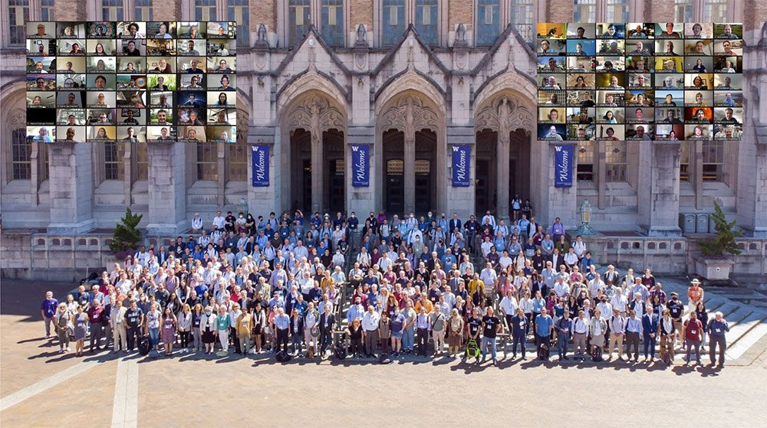
Enabling a Green & Sustainable Particle Collider at the Energy Frontier
Particle accelerators and colliders for high-energy physics and from an Early-Career perspective.
Many open questions on the fundamental laws of our universe.
Particle colliders are an important discovery tool that may provide some answers.
HEP colliders are large machines (>km, ↑) with a large environmental footprint (↑).
Require support from society
Major obstacle used to be their cost, more recently environmental impact and sustainability become increasingly important issues / concerns also due to climate change and rising energy prices.
I believe that it is our duty and ambition to minimize their footprint.
Snowmass Community Planning Workshop 2022 (Seattle)

Slide 2
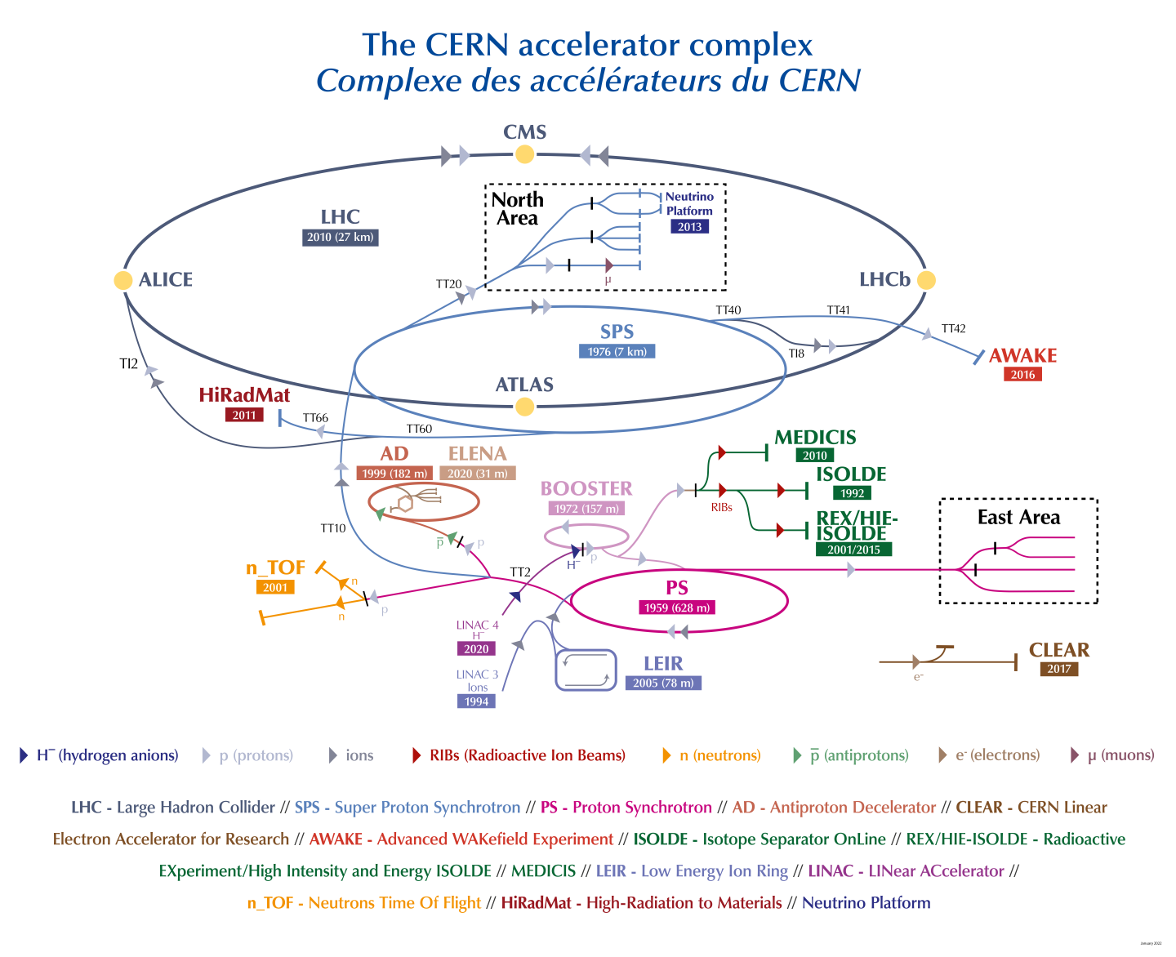
Powering CERN’s Accelerators
CERN uses:
1.3 terawatt hours of electricity annually
CERN uses about 80-200 megawatts of power
When in operation, the LHC is responsible for some 55% of CERN’s energy consumption.
For Reference:
The total electrical energy production in the world is around 20000 TWh,
in the European Union 3400 TWh,
Power plants:
~1 GW for a typical nuclear power plant
~500 MW for coal power plants
What are the main drivers (intrinsic losses, relations between performance and consumption)?
How to reduce consumption?
The CERN accelerator complex (Image: CERN)

Slide 3
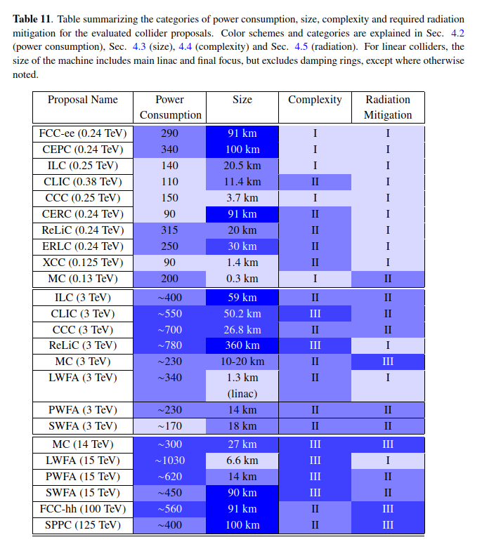
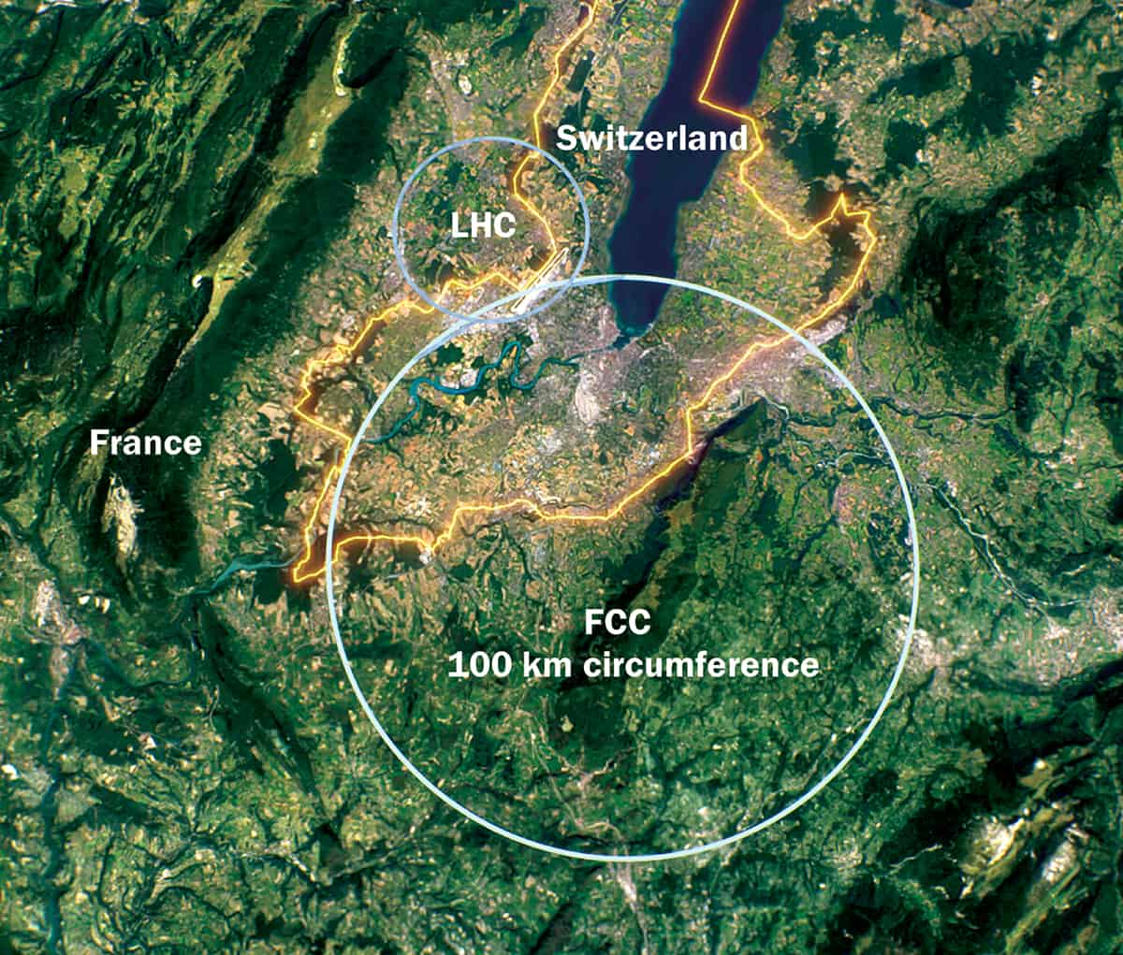
A Glimpse into the Future
[MW]
Trend is clear: larger colliders, more energy consumption,
more costly, more complex…
CLIC
Higgs factory
Especially future energy frontier machines will likely require even more power and energy to operate energy.
3 TeV lepton
Can we justify building a power plant for a collider?
> 10 TeV center of mass
From Snowmass ITF report

Slide 4
Recent Strategy Reports Highlight Sustainability as a Key Issue
Snowmass 2021 Report:
European Strategy 2022 Accelerator R&D Roadmap:
Given the high beam power, maximization of the efficiency of future accelerators is mandatory to guarantee the sustainability and affordability of the research conducted with these machines in view of reducing the carbon footprint and contain the operation costs, particularly in the present international context of increasing energy prices.
We need to give high priority to the realisation of sustainable concepts, particularly when the next generation of large accelerator-based facilities is considered
A carbon footprint analysis in the design phase of a new facility can help to optimise energy consumption for construction and operation.

Slide 5
Work package 1.7 Sustainability and Environmental Impact (Advanced Accelerator Community)
D. Voelker (DESY)
M. Turner (CERN)
Proposed scope of work
Development of guidelines that allow comparison of the environmental impact of proposed collider design.
Application of the developed guidelines for the environmental impact comparison to proposal.
Communicate, share and spread analysis results. Establish platforms that enable networking, exchanges and cooperation between accelerator physics, other scientific areas and industry.
Identify highest impact R&D that would allow to reduce the environmental footprint of future accelerators.

Slide 6
Examples of Efforts to Reduce Consumption & Environmental Impact
Energy Recovery
Idea: reuse energy stored in beams instead of dumping them.
Shorter tunnels (more compact accelerators)
Tunnel found to be the largest CO2 footprint for CLIC 3 TeV
Novel accelerator technologies (plasma, muons,…)
From 2022 Accelerator R&D Roadmap :
Low loss superconducting resonators, efficient radio-frequency sources, permanent magnets, highly efficient cryogenic systems, superconducting electrical links…
Careful choice on what materials are used in what quantities and how these materials are sourced.
→ Improvements could also benefit current accelerators

Slide 7
Conclusions
My personal opinion: it would be exciting to have a next generation collider dedicated to fundamental science.
Trade off between environmental footprint and physics. Need to understand key drivers.
Crucial to have societal support:
Biggest issue used to be cost,
environmental impact is becoming increasingly important due to climate change and rising energy costs.
We must make efforts to minimize the environmental footprint of accelerator construction and operation.
Developing more efficient accelerators will require extensive R&D efforts.
Sustainability recognized as key issue in many recent strategy and planning processes.

