Slide 1
Linking Science and Indigenous Knowledge
Dr. Arzu Sardarli
Professor of Physics and Mathematics
First Nations University of Canada
Indigenous Knowledge and Science

Slide 2
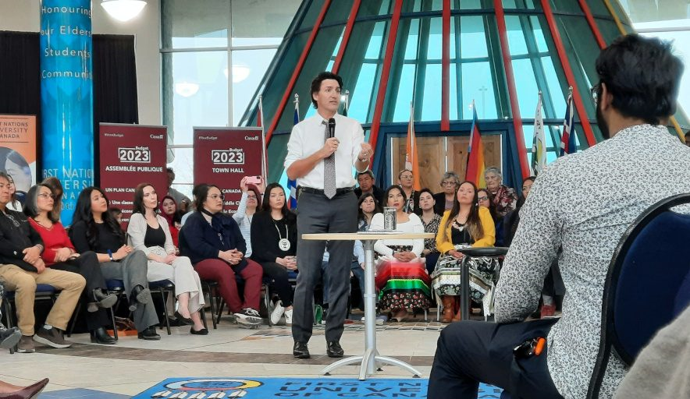
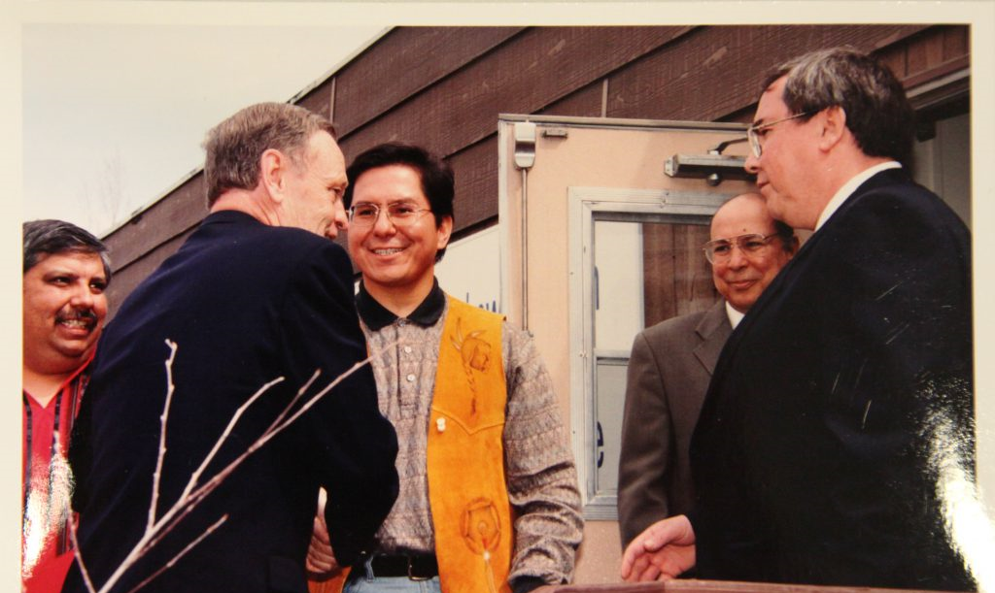
In May 1976, the Federation of Saskatchewan Indian Nations entered into a federation agreement with the University of Regina, to establish the Saskatchewan Indian Federated College (SIFC). On June 21, 2003, the Saskatchewan Indian Federated College officially changed its name to the First Nations University of Canada (FNUniv).

Slide 3
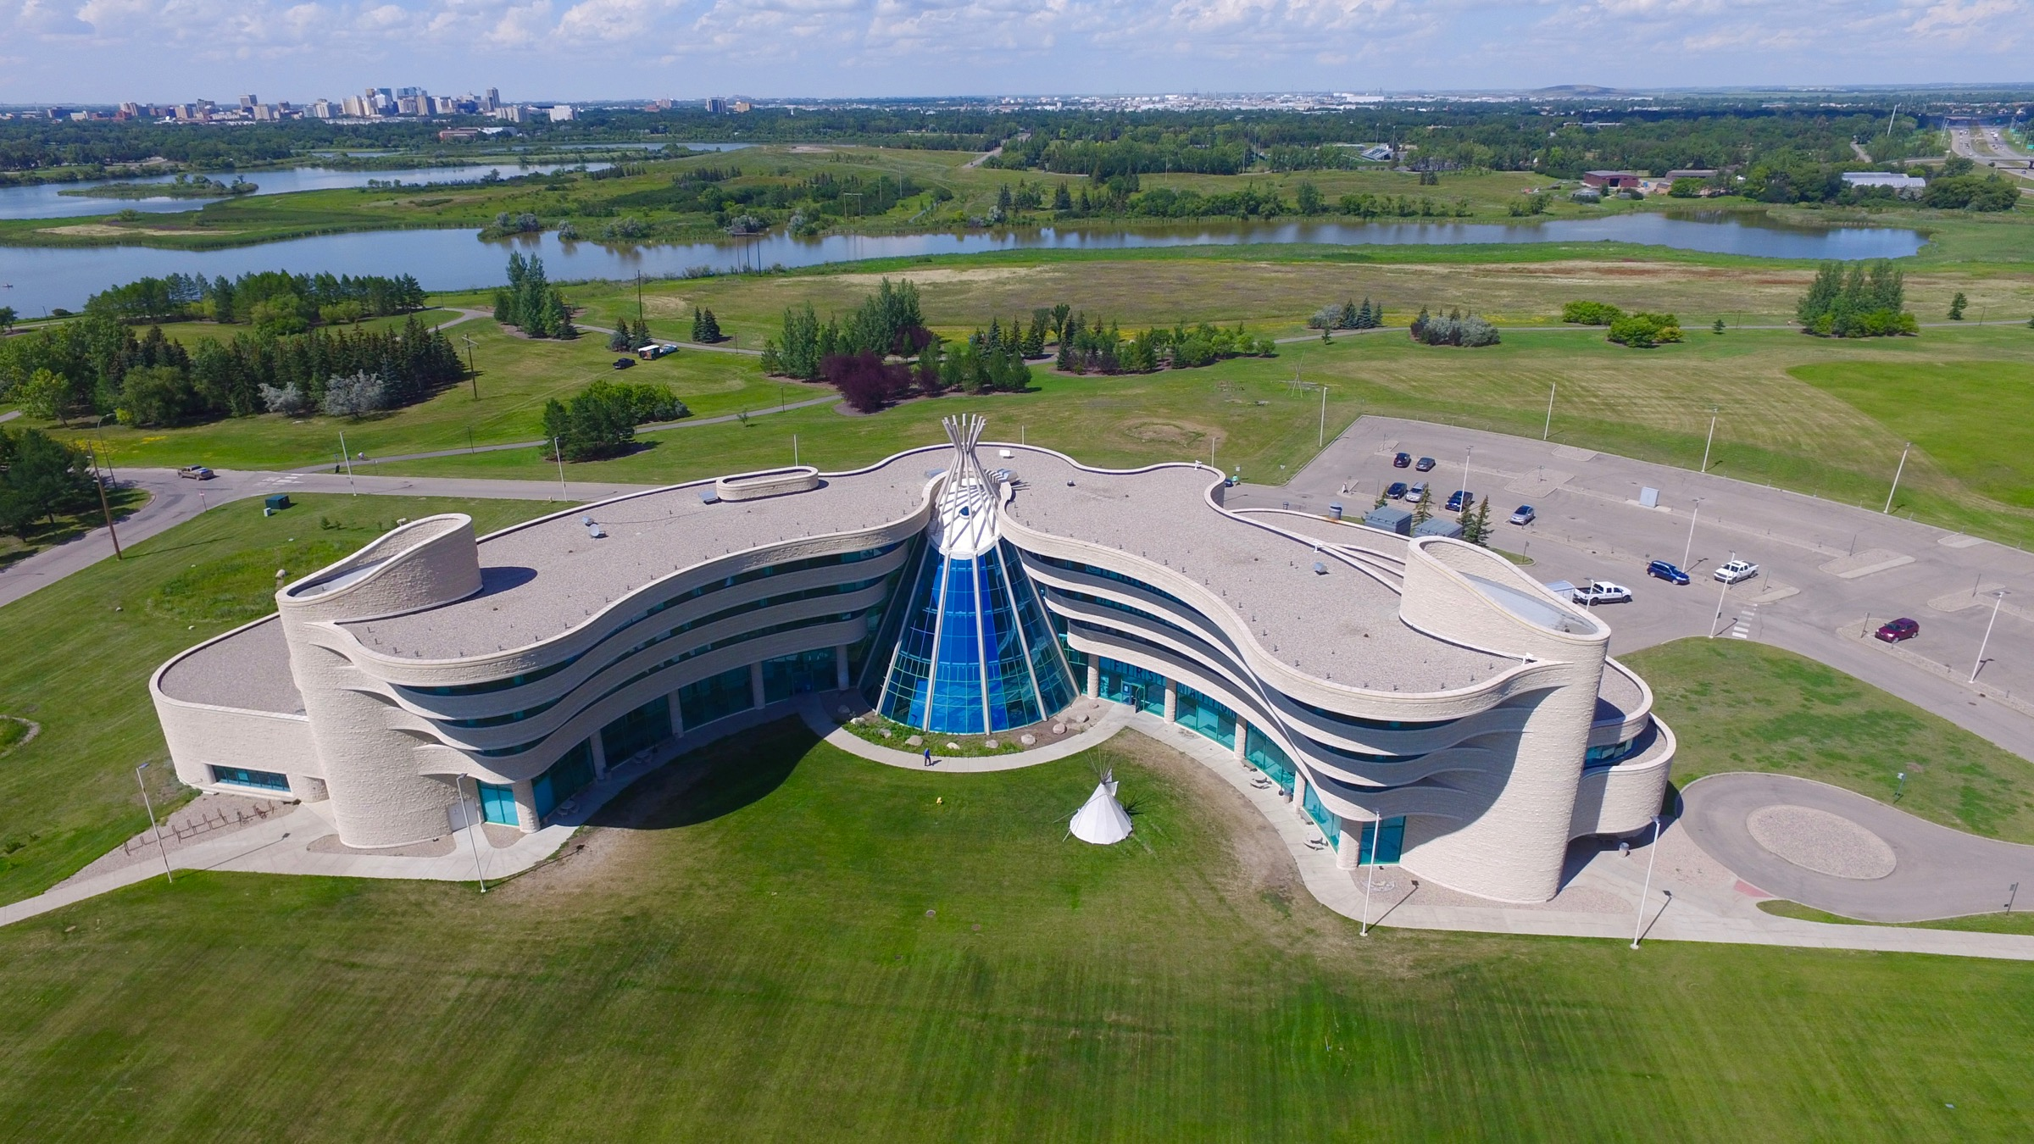
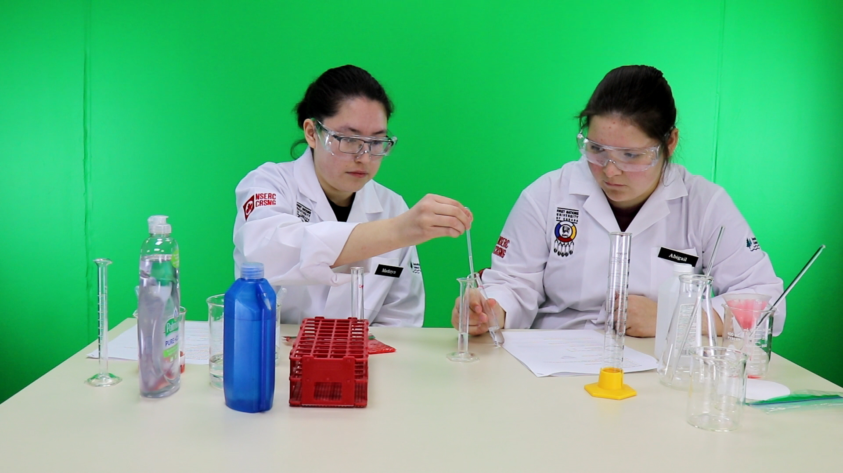
The university offers programs and services on three campuses: Regina, Saskatoon and Prince Albert (Northern Campus). Since 1983, the university has entered into over twenty-five agreements with Indigenous peoples’ institutions in Canada, South and Central America and Asia and signed agreements with academic institutions in Siberia (Russia), Inner Mongolia (China) and Tanzania.

Slide 4
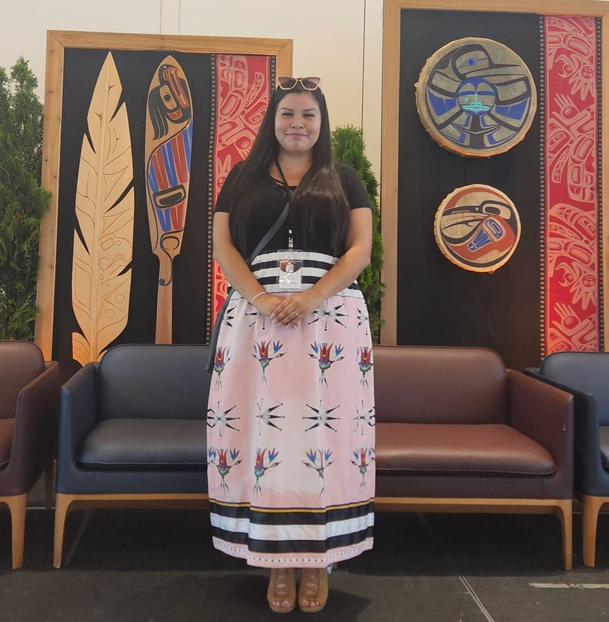
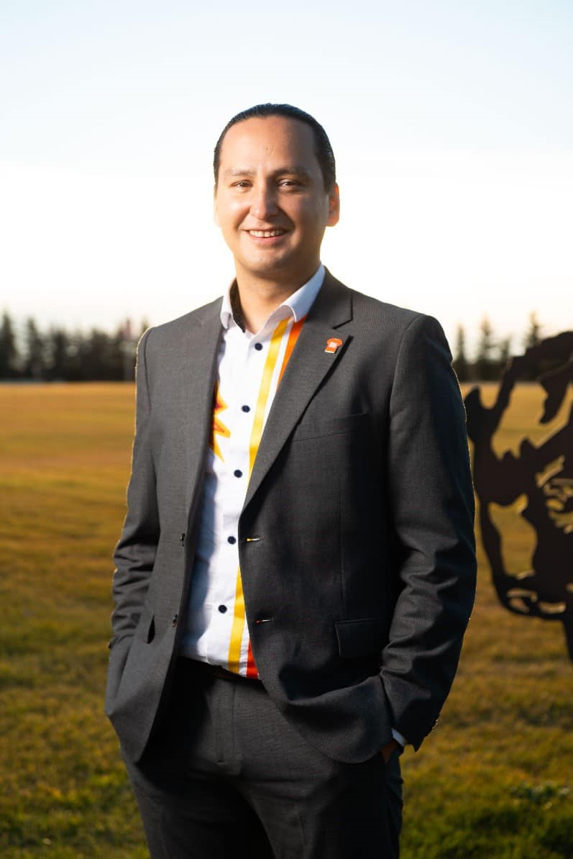
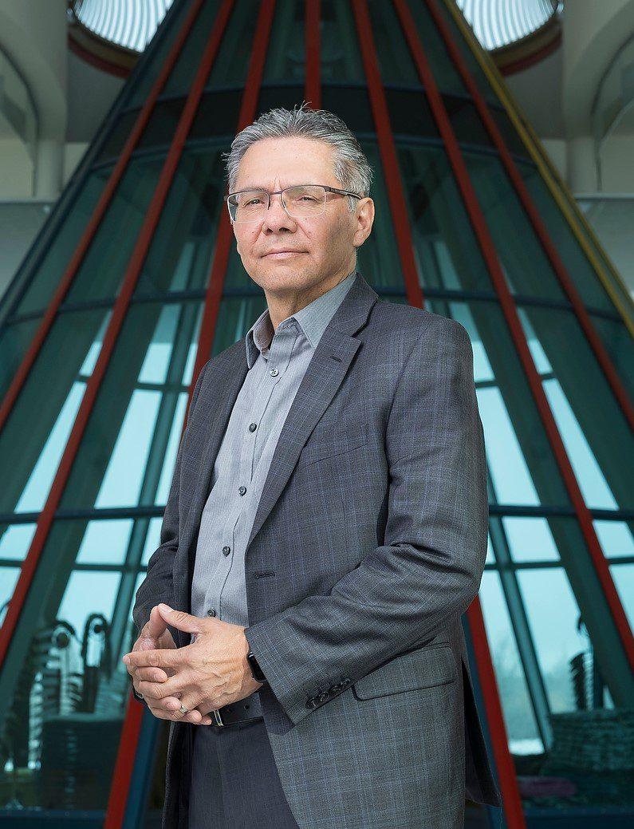
Alumni of First Nations University of Canada
Jana Sasakamoose
First Indigenous female enrolled in science graduate program in Saskatchewan
Cadmus Delorme
Former Chief of Cowessess First Nations, first Indigenous Board Chair of the University of Regina
Dr. Bob Kayseas
Professor at FNUniv

Slide 5
My selected projects
at First Nations University of Canada
2007 - Present
Influence of Cultural Water Quality on Waterborne Diseases at the Calling Lakes, Saskatchewan: Monitoring and Modeling with First Nations Perspectives, 2008 – 2009, Funding agency: Health Canada; National First Nations Environmental Contaminants Program
“Wiseman Mathematics Contest”, 2008 – Present, Funding agency: Natural Sciences and Engineering Research Council of Canada
National Science Laboratory Video Lessons for Aboriginal Youth, 2018 – 2022, Funding agencies: Natural Sciences and Engineering Research Council of Canada, Indigenous and Northern Affairs Canada
Studies of Physical Parameters of Indigenous Artefacts; Collecting and Preserving the Relating Oral Stories, 2018 – 2021, Funding agency: Ministry of Canadian Heritage
Canadian Global Environmental Measurement and Monitoring (GEMM) network initiative (led by Nobel Price Laureate Dr. Donna Strickland and Dr. Andrew Myles (U of A))

Slide 6
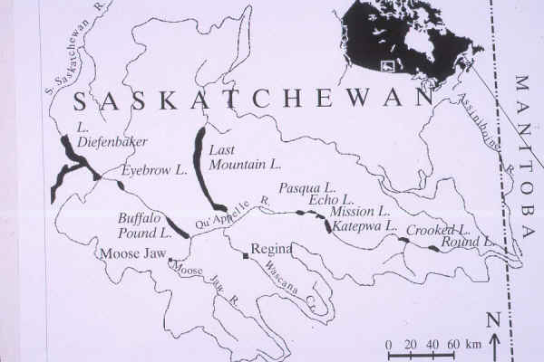
Modeling of Water Quality Dynamics with Indigenous Perspectives
The Calling Lakes (Pasqua, Echo, Mission, and Katepwa Lakes)

Slide 7
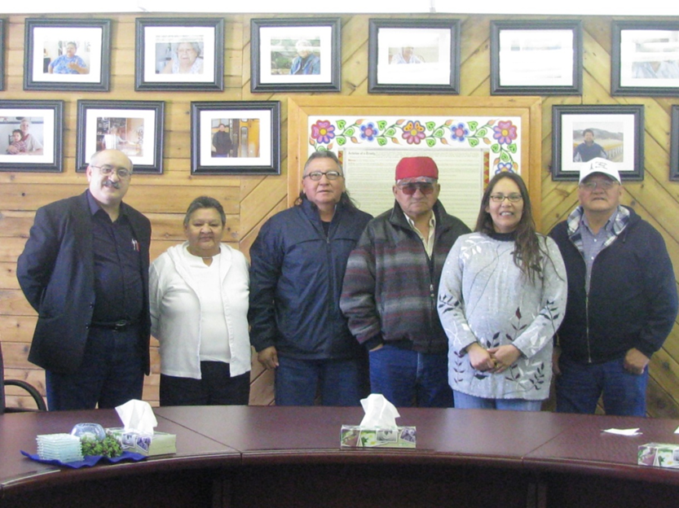
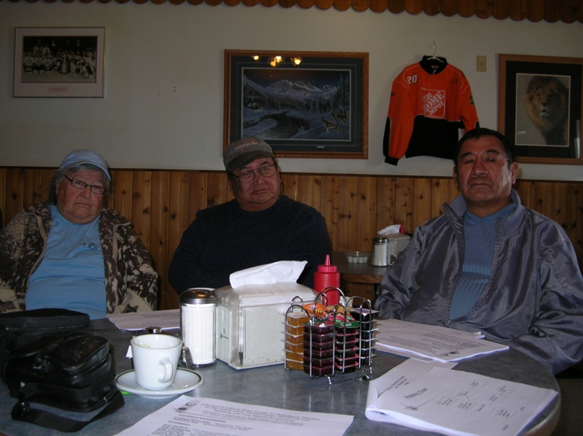
Modeling of Water Quality Dynamics with Indigenous Perspectives
Peepeekisis First Nation
Kahkewistahaw First Nation

Slide 8
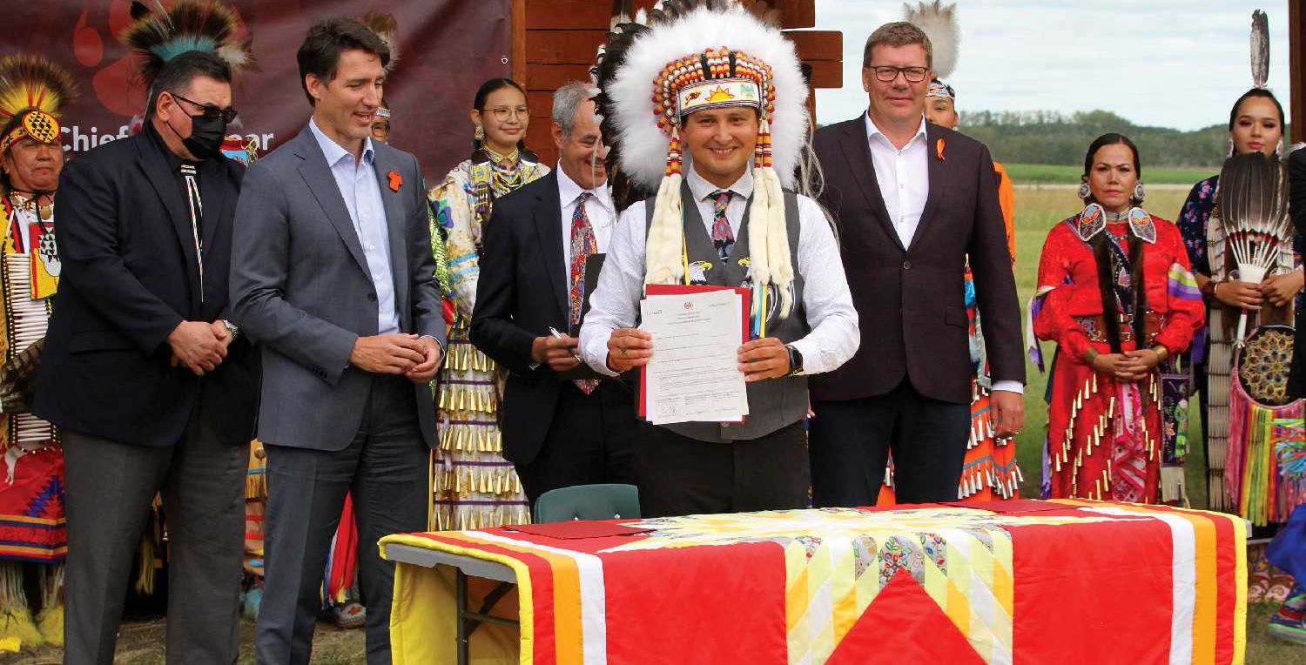
Water Quality Monitoring in Cowessess First Nations
The $21-million Awasis solar project, located on Cowessess First Nation. It will provide 10 megawatts of solar energy to the provincial grid — enough to provide power to 2,500 homes per year on average.
A multimillion-dollar solar power project owned primarily by the Cowessess First Nation.
Awasis Solar is a partnership between Cowessess First Nation and Elemental Energy. Together, they built, own and manage the facility, and will sell the power generated to SaskPower as part of a 20-year Power Purchase Agreement.

Slide 9
Research and Monitoring in First Nations Communities
Research and Environmental Monitoring Protocol
OCAP (Ownership, Control, Access, and Possession) principles
Local (community) traditions and protocols
Problems to discuss:
Monitoring protocol in Indigenous communities does not exist.
Some Elders/Knowledge Keepers consider monitoring as an invasion of Nature.
Research protocols vary in communities.
Permission Procedures
Communities may require different procedures to receive permission to conduct research and monitoring projects.
Not always, newly elected local administrations may make changes to procedures and protocols.
Educational Component
Preparation of research staff from Indigenous (preferably local) communities
Consideration of the use of Indigenous Knowledge in proposed research and monitoring projects

