Slide 1
Beam physics challenges of the TRIUMF E-LINAC
Hui Wen Koay
Accelerator Division

Slide 2
Outline
Introduction
Challenges
High peak current
Short bunches
Conclusions

Slide 3
TRIUMF accelerator complex
Main high-power drivers:
500 MeV Cyclotron
100 kW e-LINAC
Pre-ARIEL science program at e-LINAC:
FLASH
DarkLight
Terahertz
E-LINAC
Cyclotron

Slide 4
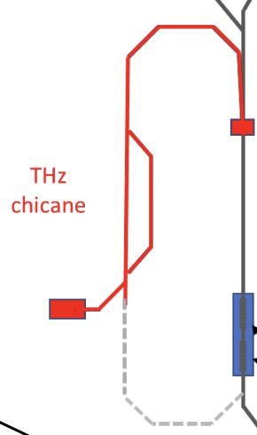
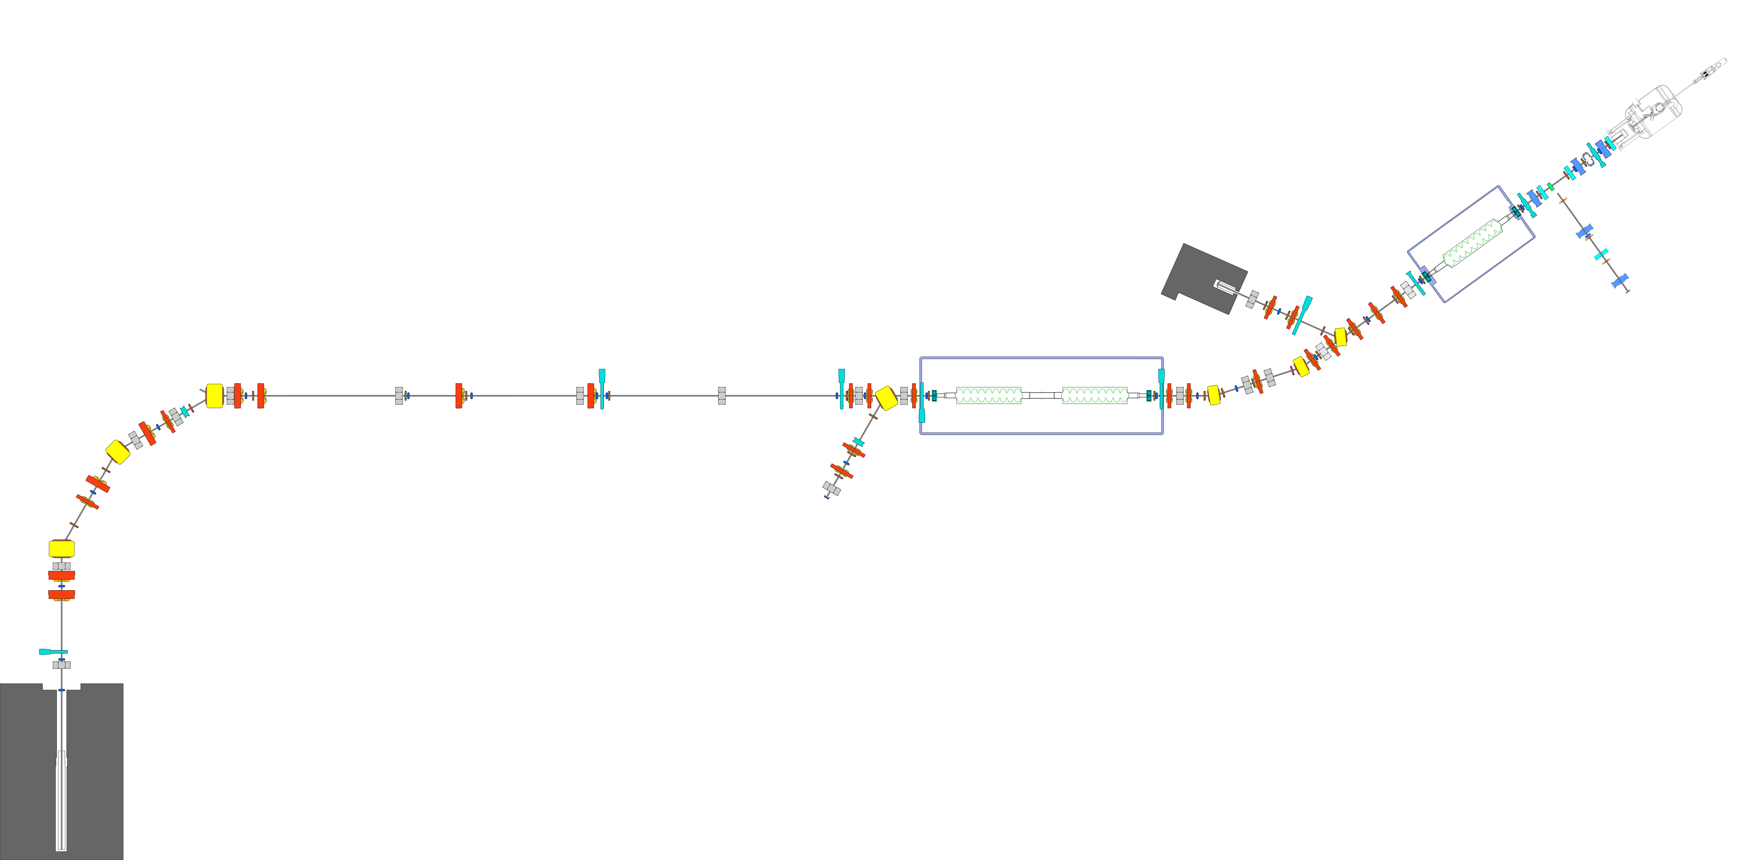
Beamline Layout of TRIUMF e-Linac
DUMP
Possible THz chicane
Low-medium energy section
EHDT
EMBT
EINJ
EACA
EABT
EHAT
ELBT
EGUN

Slide 5
# Challenge 1 : High peak current
- Larger space charge
- Larger beam envelope
- Need more focusing elements (space constraint?)

Slide 6
Envelope equation including space charge(SC)
$$a^{′′}+\left(k_{x}−K_{xSC}\right)a−\frac{ε_{x}^{2}}{a^{3}}=0$$
$K_{xSC}=\frac{e}{4πε_{o}E_{mass}}\frac{Q}{β^{2}γ^{3}}$ $\frac{1}{a^{3}}g\left(\frac{b^{2}}{a^{2}},\frac{c^{2}}{a^{2}}\right)$
$k_{x}$= external focusing
$ε_{x}$= emittance
$E_{mass}$= rest mass energy of particles
$Q$ = bunch charge
$βγ$ = momentum/$mc$
$a,b, c$ = beam envelope (ellipsoid semi-axes in x$,y, z$)
$g\left(u,v\right)$ = form factor (Carlson elliptic integrals)

Slide 7
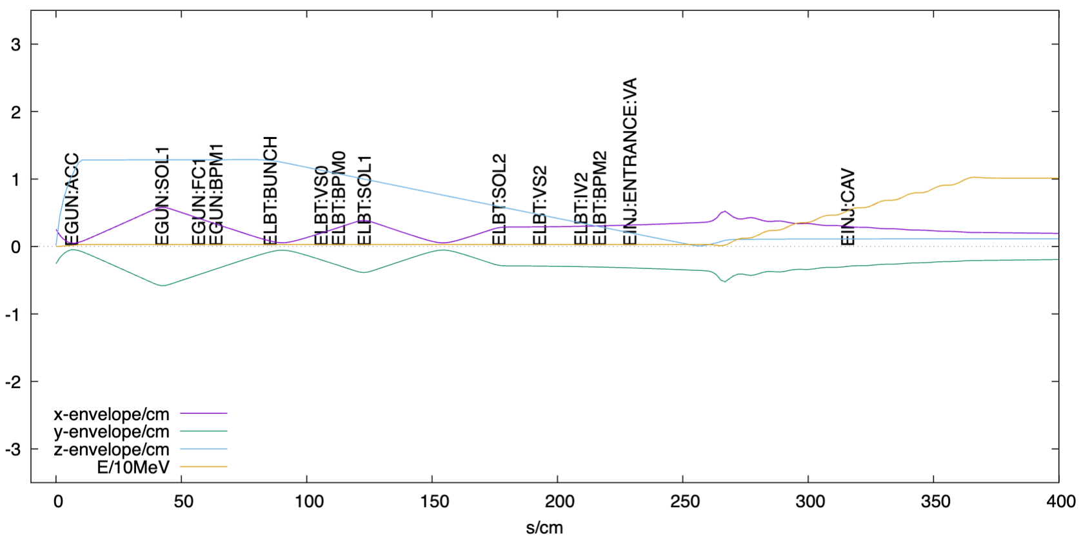
Typical low-medium energy transport at TRIUMF e-LINAC
Q = 0.54 pC
Egun Voltage 300 kV

Slide 8
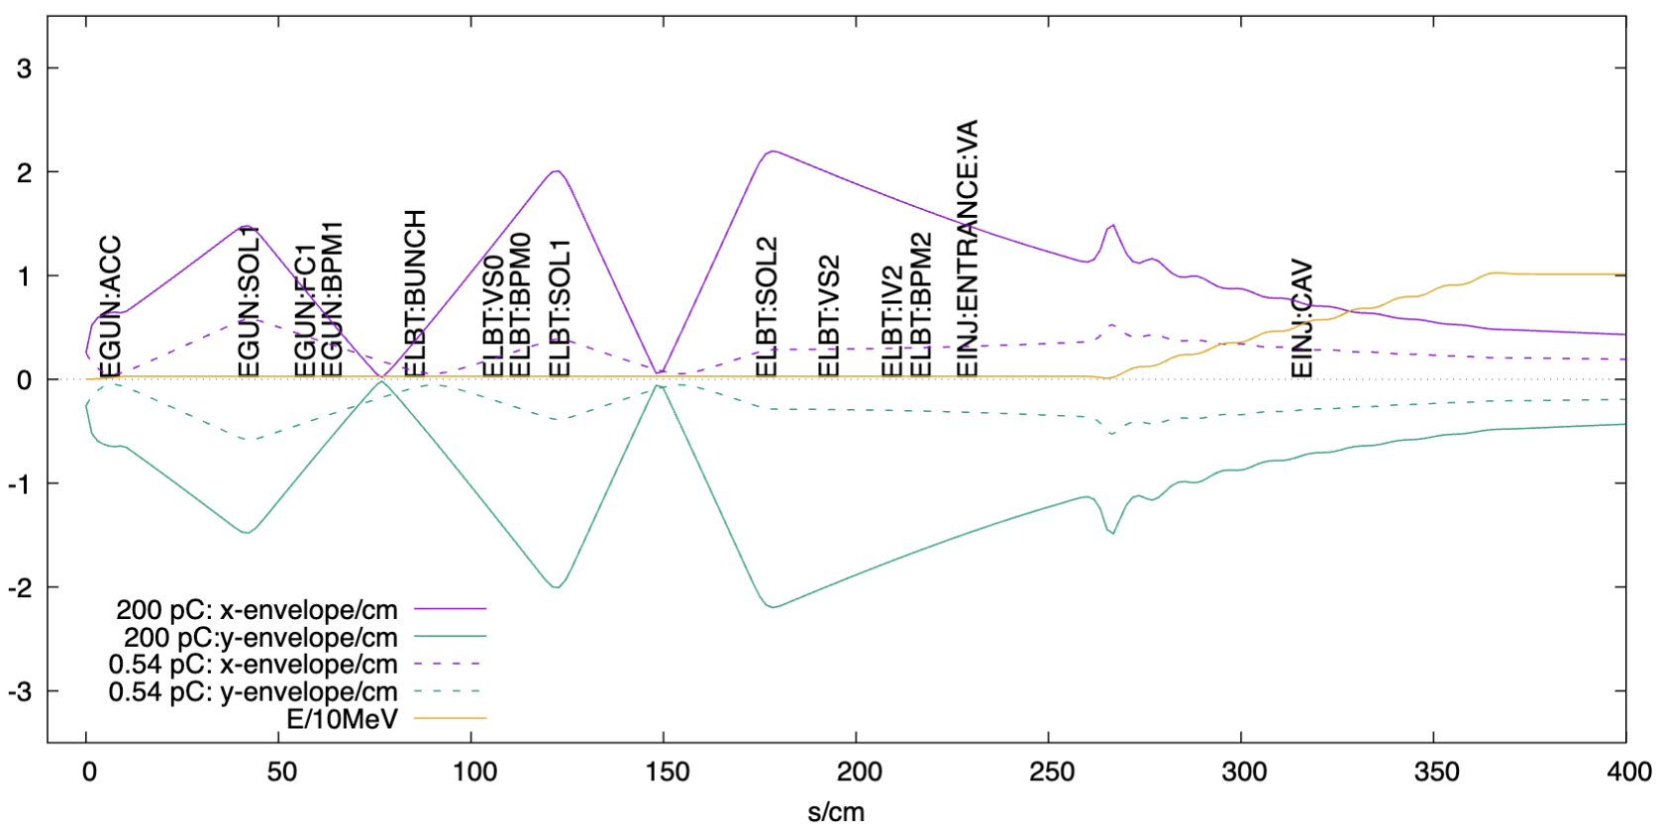
High peak current - larger emittance
Egun Voltage 300 kV

Slide 9
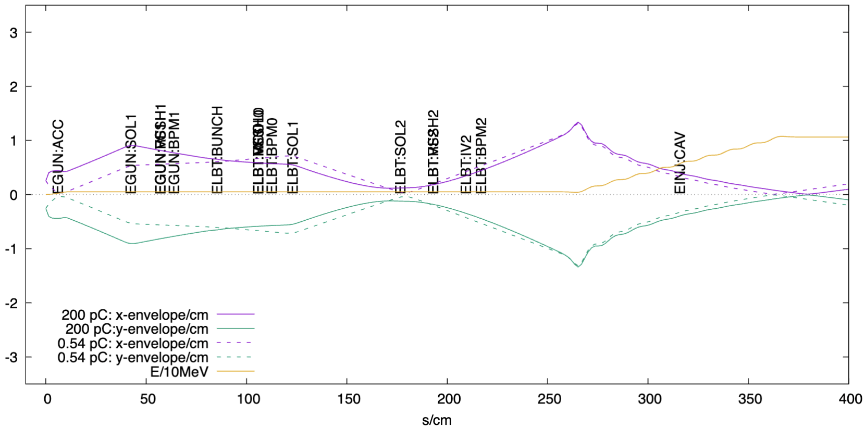
High peak current - larger emittance
Egun Voltage 500 kV

Slide 10
# Challenge 2 : Short bunches
- Larger longitudinal SC
More bunching over a longer trajectory
(especially including a bender)
Limited bunch size to reduce energy spread

Slide 11
Injection Beamline Layout of TRIUMF e-Linac
Plan of new e-gun
Buncher
EINJ
EGUN
ELBT
Bender

Slide 12
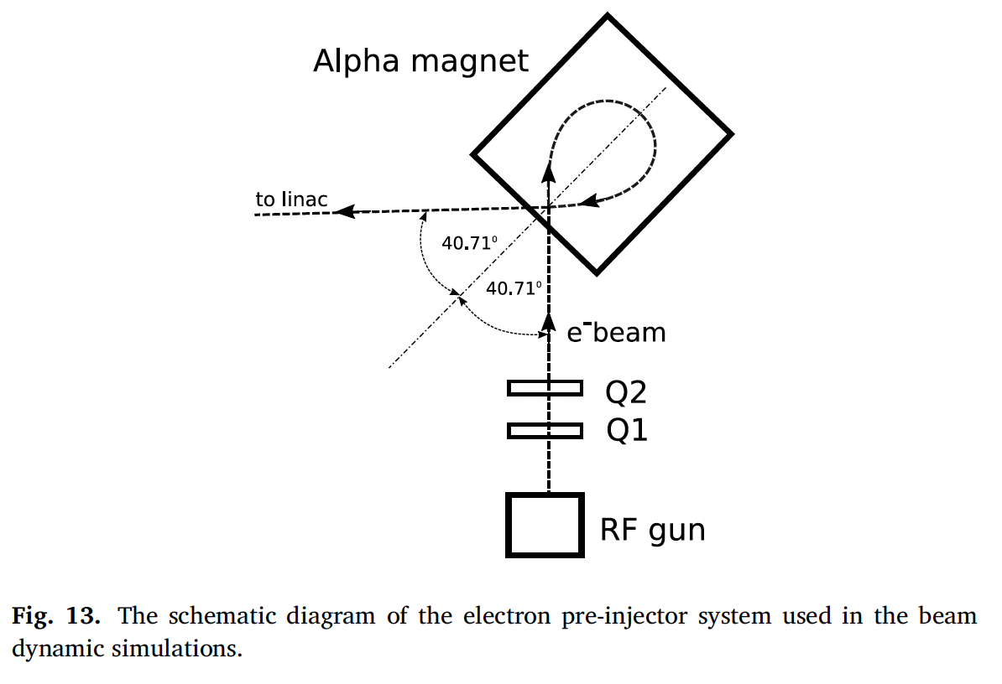
Selection of the most suitable bender
Normal bender
Non-achromatic
Suitable for pre-buncher beam (∆E/E ~ 0 )
Alpha magnet
Achromatic
Suitable after buncher (with ∆E)
Normal dipole
Schematic showing an example application of an alpha magnet in an electron pre-injector system [1].
e⁻ beam with ∆E
Electron gun
Electron gun
[1] C. Saisa-ard, J. Saisut and S. Rimjaem Nuclear Inst. and Methods in Physics Research, A 916 (2019) 102–115

Slide 13
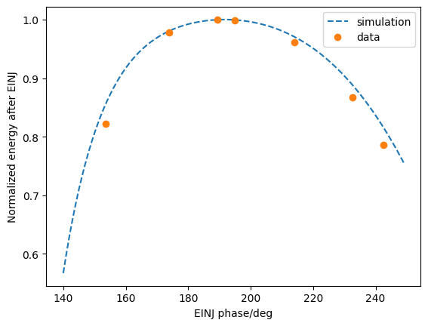
EINJ phase plot
$ΔE\sim 0.2$MeV
Phase acceptance of $\sim ±20°$
($Δz \sim ±11$ mm at 500 keV)

Slide 14
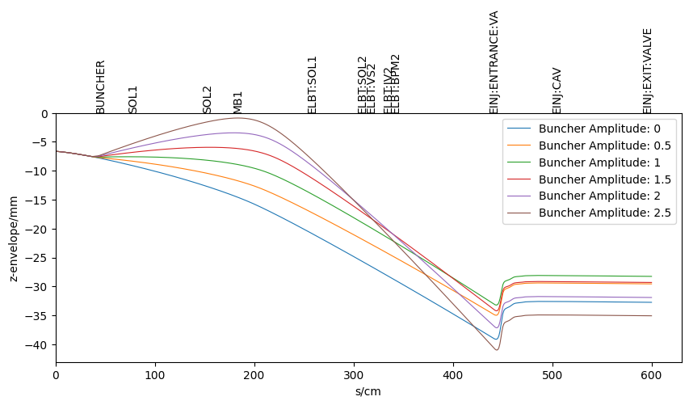
Short bunches – more bunching needed
Q = 200 pC

Slide 15
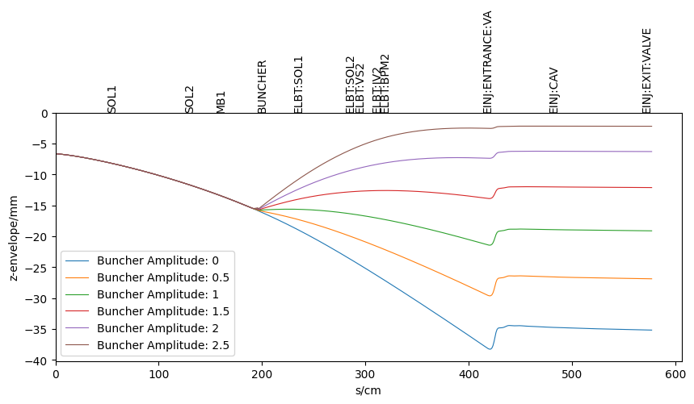
Move the buncher…
Q = 200 pC

Slide 16
Furthermore, a small energy spread is needed…
Study showed an increase of energy spread reduces the terahertz light peak output power
Plot of the terahertz light peak output power vs energy spread [2].
[2] Wu, A., Jia, Q., & Wang, F. (2011). The parameter study of terahertz free-electron laser oscillator based on electrostatic accelerator. WEPD51, PAC, 11(4).

Slide 17
Conclusions
Higher peak current and a shorter bunch cause a larger space charge
More focusing needed in both transverse and longitudinal directions.
Space constraint increases the design difficulty.
An SRF-gun might be a good option resolving this tedious issue.

Slide 18
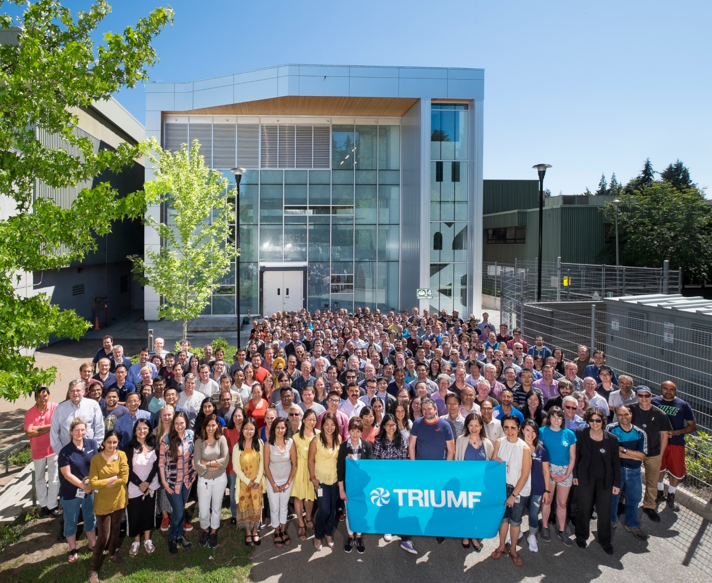
Thank you Merci
www.triumf.ca
Follow us @TRIUMFLab
Discovery,
accelerated

