Slide 1

An SRF gun for TRIUMF
Bob Laxdal
Department Head RF/SRF
Accelerator Division
TRIUMF

Slide 2
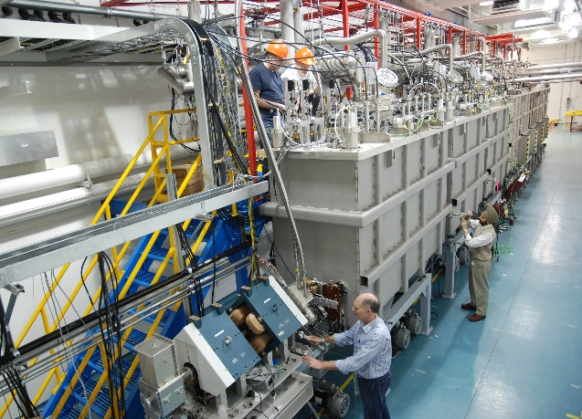
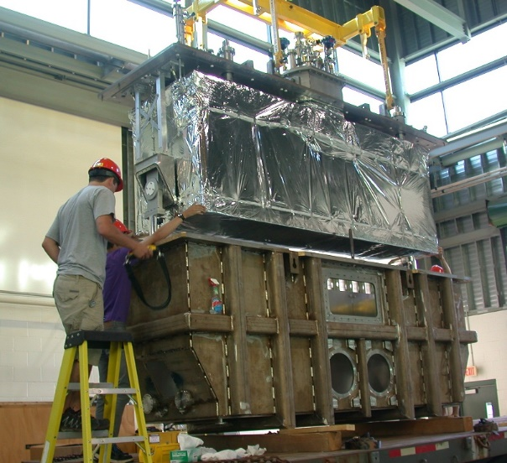
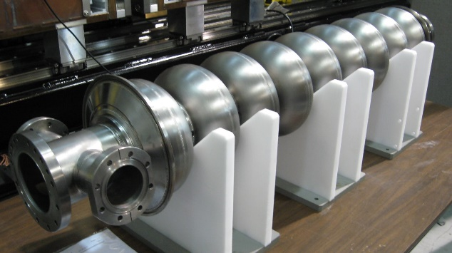
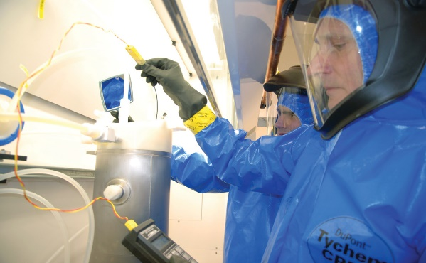
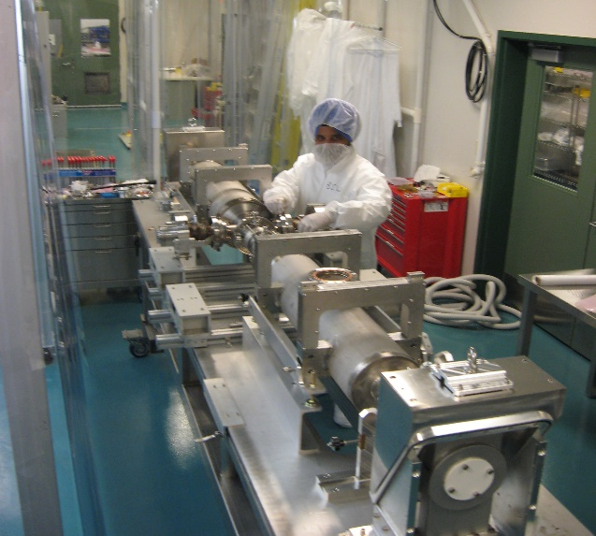
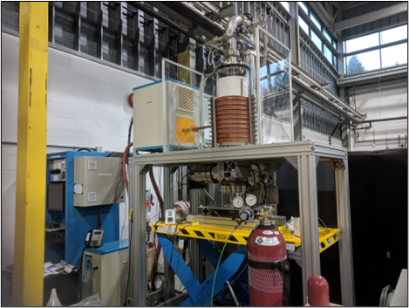
TRIUMF SRF Infrastructure (I)
TRIUMF hosts two SRF linacs (ISAC-II heavy ion lionc and the ARIEL electron linac) and SRF supporting infrastructure.
Activities range from student R&D on test resonators to work for others (prototyping cavities and components) and to full cryomodule assemblies
In addition to in house cryomodules we have also built two cryomodules for VECC in India and we are building 5 cryomodules for CERN
2

Slide 3
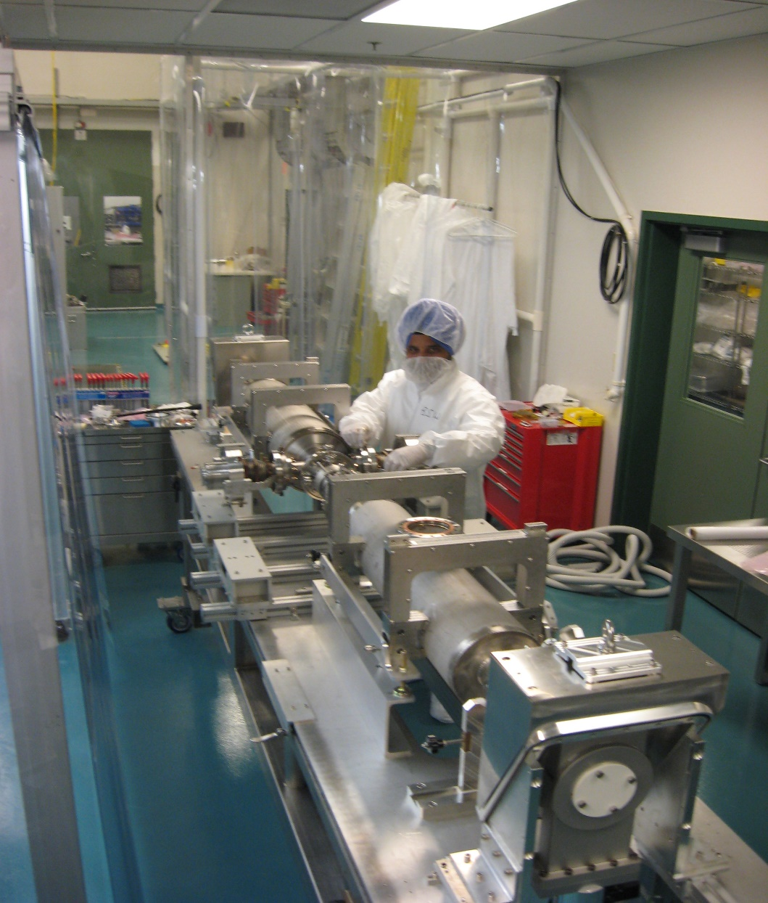
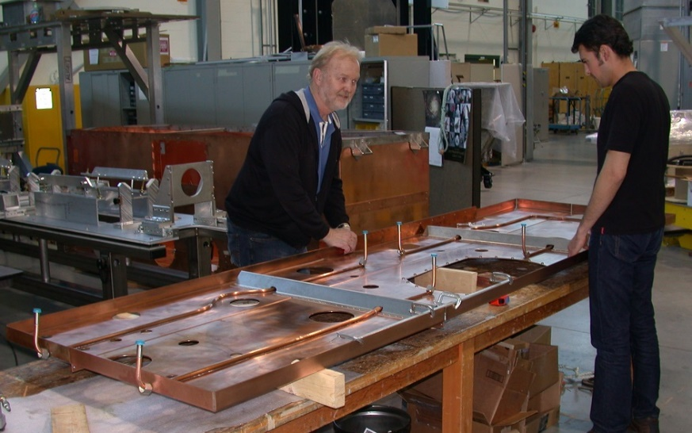
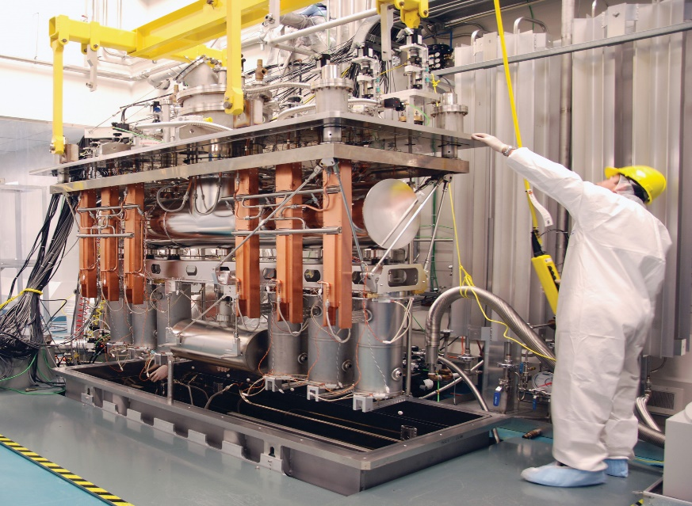



TRIUMF SRF Infrastructure (II)
42m
ISAC-II SCRF Area
RF Controls Lab
TRIUMF SRF test and assembly areas
  500m² of floor space, overhead crane
  US cleaning tanks, HPWR area, cryogenics on tap, cryomodule assembly area (clean room for hermetic string assembly and larger CM assembly space), chemical etching lab (BCP), rf testing
  New clean room being added
  Cryomodule test capability in ISAC-II
    LHe – 100ltr/h in falling level, 200W at 4K, 40W at 2K
    LN2 at 1.5 Bar
    Shielded pit, LLRF, controls
Boot Area
RF Measurments
Water Rinse/Clean Area
17m
Boot-up
RF Meas
Preparation Area
SCRF Test Clean Area
Clean Assembly Area
Chemical Lab
Test Pit
3

Slide 4
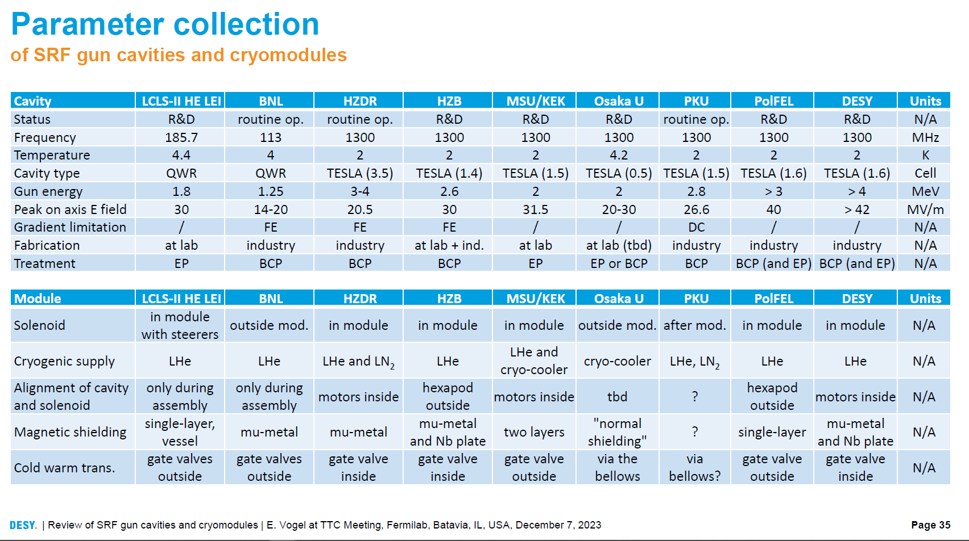
The SRF community has been actively developing SRF guns over the last 20 years.
There are two basic types: 1.3GHz 1.5->3.5 cell elliptical design at 2K and 100-200MHz QWR design operating at 4K
TRIUMF is familiar with both 1.3GHz technology and QWR technology
Variables in the designs are final beam energy, peak field on axis, operating frequency and temperature

Slide 5
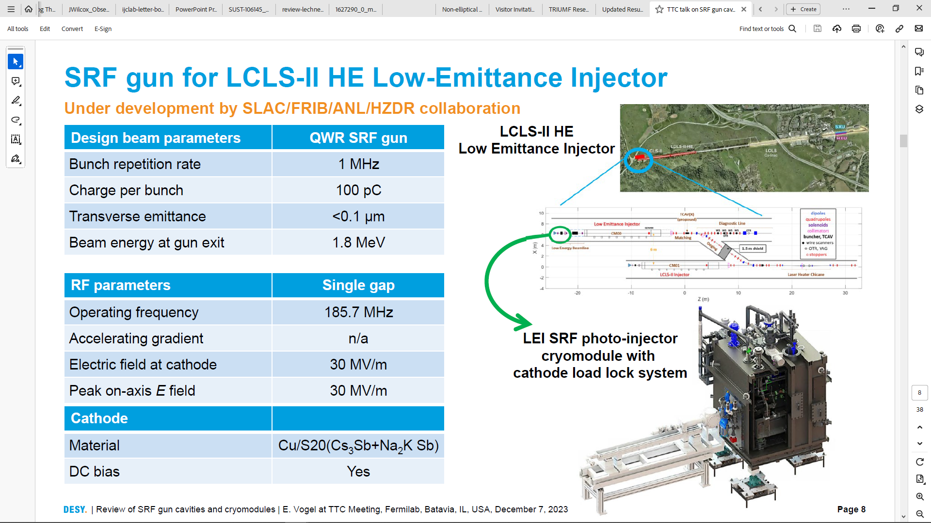
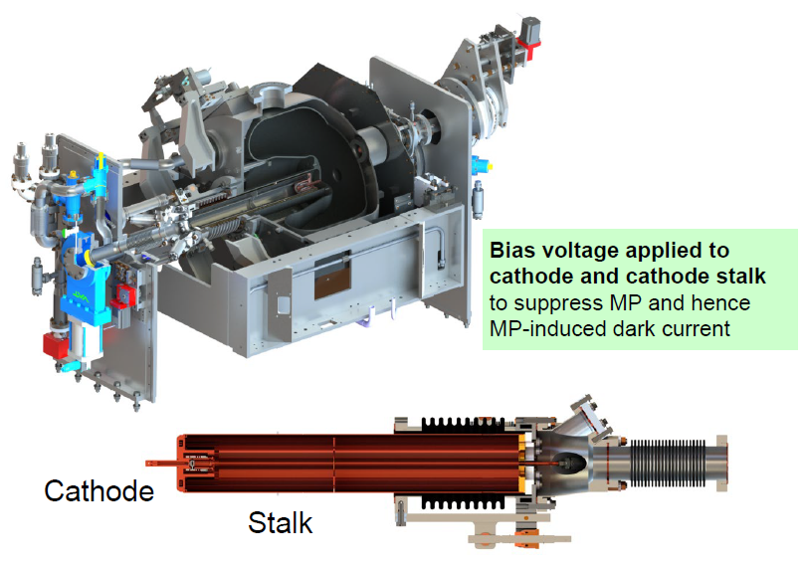

Slide 6
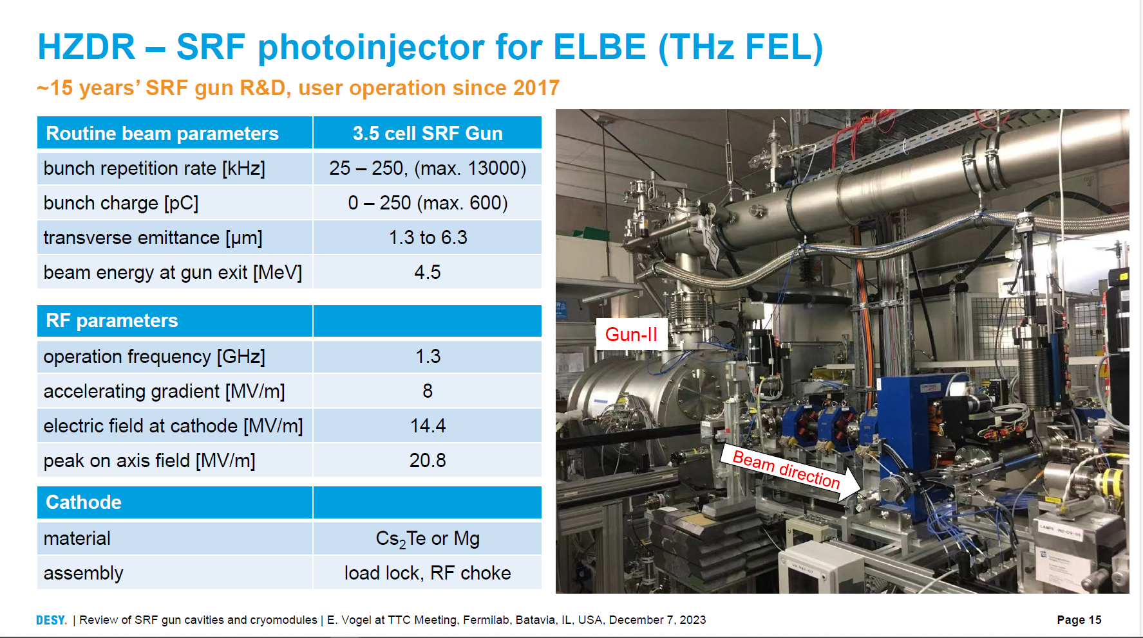
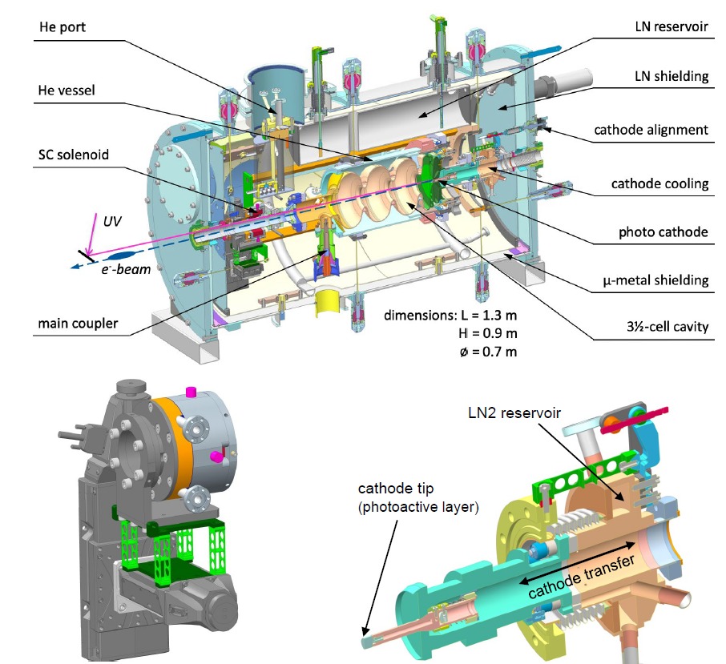

Slide 7
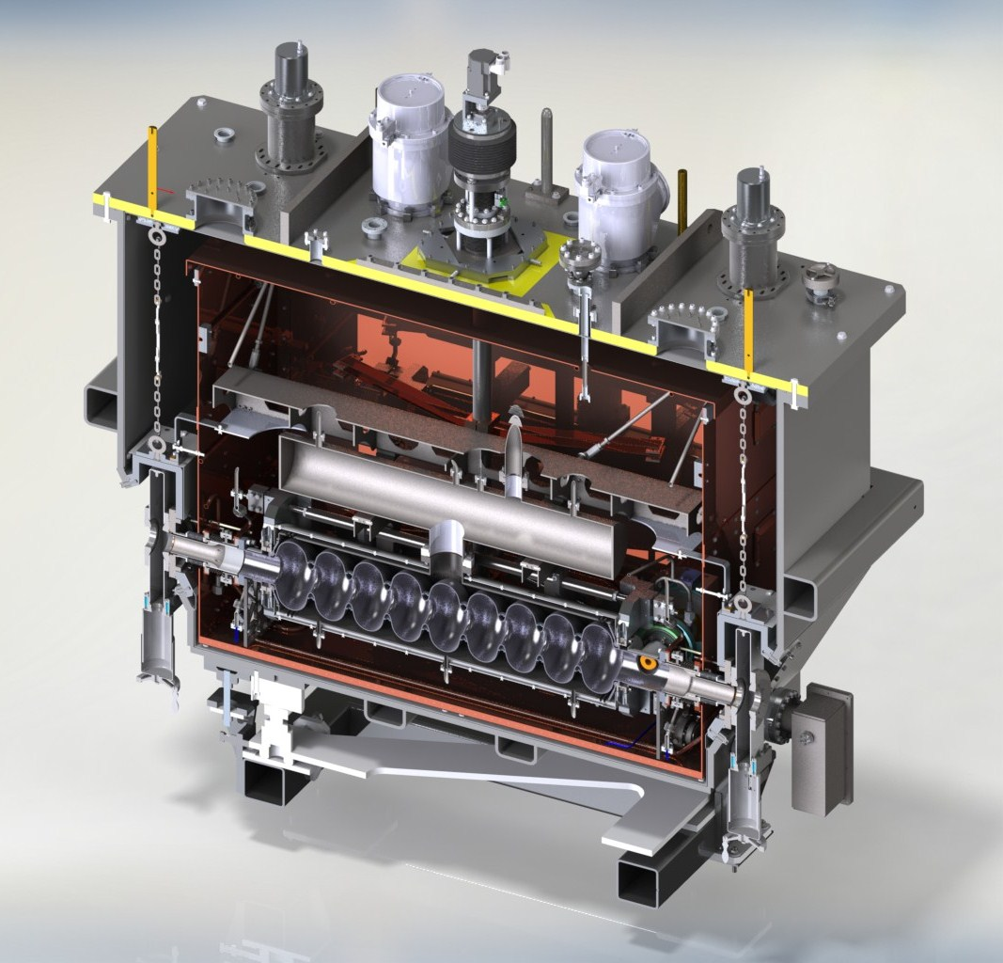
E-Linac Injector Cryomodule ~1.5 m long
Houses
one nine-cell 1.3GHz cavity
Two 50kW power couplers
Features
4K/2K heat exchanger with JT valve on board
Scissor tuner with warm motor
LN2 thermal shield – 4K thermal intercepts via syphon
Two layers of mu-metal
WPM alignment system
Heat exchanger
4K separator
strongback
2K separator
Power coupler
tuner
cavity

Slide 8
Example: ICM-> SRF gun
Houses
1.5-3.5 cell 1.3GHz cavity
one 15kW power coupler
Features
4K/2K heat exchanger with JT valve on board
Scissor tuner with warm motor
LN2 thermal shield – 4K thermal intercepts via syphon
Two layers of mu-metal
SC solenoid
Cathode exchange
Heat exchanger
4K separator
strongback
2K separator
Power coupler
tuner
cavity

Slide 9
Summary
TRIUMF has expertise in designing, assembling , testing and operating SRF systems
SRF guns are a challenging technology but there are examples of SRF guns in routine operation
An SRF gun can deliver high energy, high peak charge, low emittance electrons
TRIUMF has 2K and 4K cryogenics already installed in the electron hall
An SRF gun seems well matched to THz needs and TRIUMF capabilities

