Slide 1
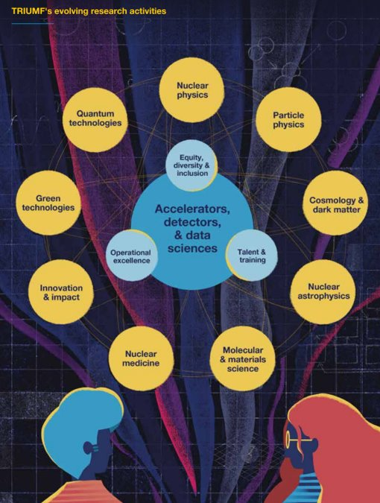
AI Centre
Wojtek Fedorko

Slide 2
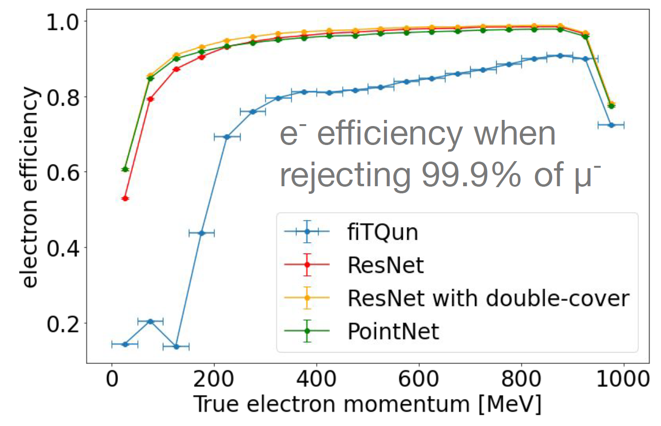
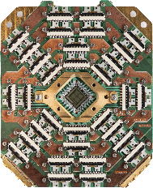
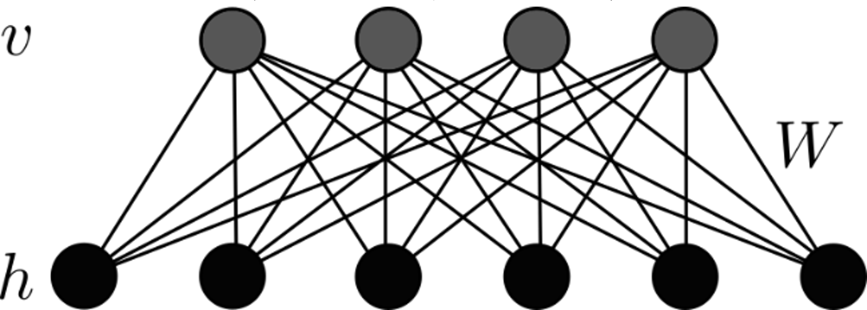
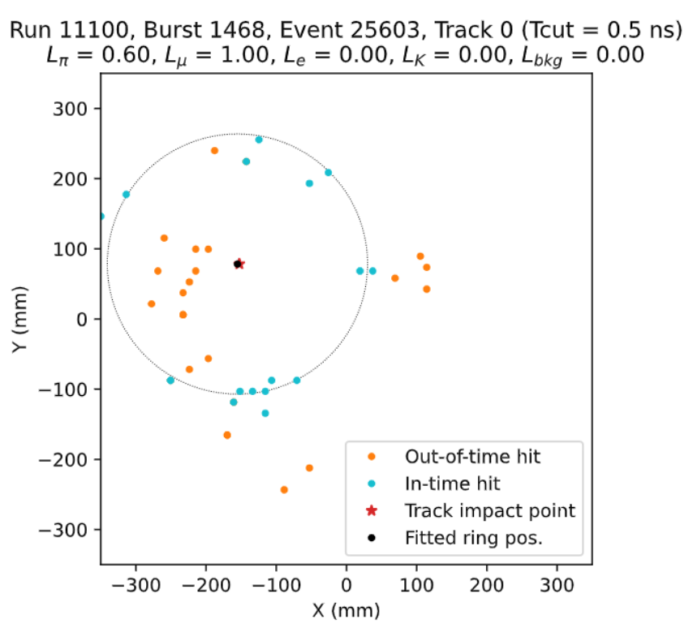
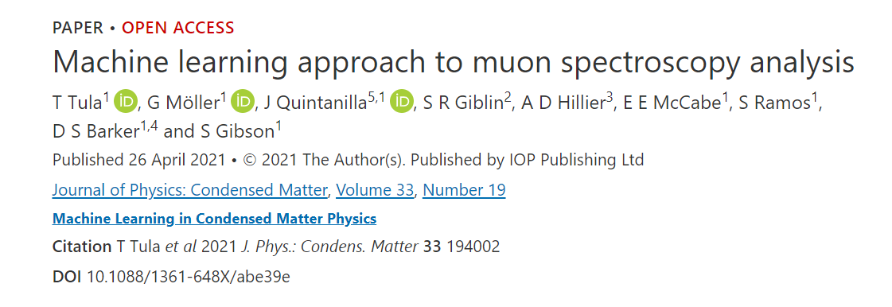
AI things are we doing, not doing, should be doing and why and how
Prior:
Restricted / Quantum Boltzmann Machine
ML engagement recent since 2018
Part of the current TRIUMF strategic plan
Doing:
Particle physics applications → Science!
Bread and Butter – but high impact
Bleeding edge:
Quantum Assisted ML
Trigger/ RT on FPGA
Accelerator; AI-based beam tuning → Operational Excellence!
No active projects:
Nuclear physics
Initial engagements; lecture (series)
CMMS
Life Sciences
Proposed or existing applications exist in literature
Manpower limited
→ AI Centre:
Collaboration between departments and divisions
More talent-power and domain knowledge
Identify and execute specific application
Infrastructure support
Building and expanding on current success
Aligned with 20-year vision
Simulation with misalignment and apertures
Beam center and envelope x y (cm)
Distance along beamline (cm)
Physical Machine: MCIS source ¹⁶O+

Slide 3
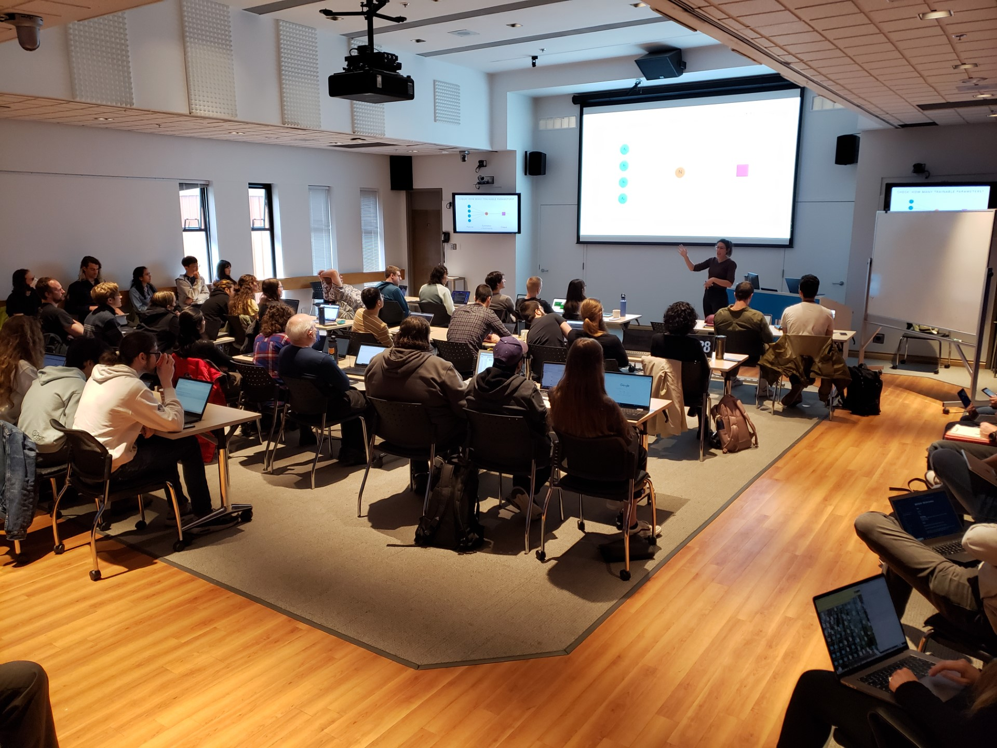
Talent, HQP, Training and Collaboration
HQP Since 2018:
Collaborated with (TRIUMF based):
6 Postdocs
3 Grad students
2 RAs
MITACS GRA/GRI x3 (1 postdoc, 2 grad)
Capstone projects
UBC Master of Data Science x3
BCIT x2
UBC Engineering Physics x2
Coops co-supervised: 16
Demand is there
Drives collaboration national and international (Helmholtz, Water Cherenkov)
TRIUMF Summer Institute: leadership (2020/21) and contributions
Opportunity to exploit in-house technical synergies
→ AI Centre:
enhance AI expertise among grads PDs… with more diverse science background

Slide 4
Connection to Quantum Computing
Potentially transformative for selected core areas
Suggested in the ‘2 pager’ based on survey of applications pursued in the field:
Parton shower modelling
Neutrino-nuclear matrix element calculations
Particle tracking
Radiation treatment design
Potentially of interest in Material and Life Sciences:
Quantum chemistry
Density Functional Theory
@TRIUMF now:
NRC Applied Quantum Computing Challenge: generative Quantum-Assisted AI for Calorimeter simulation
QC explorations for multi-body systems
Speculative and high risk
AI Centre → maintain and expand expertise in QC and Quantum-assisted AI
Vehicle for aligning with the National Quantum Strategy funding opportunities
Pillars:
Research (Alliance Quantum / International / Consortia)
Talent (CREATE / MITACS)
Commercialization Pillar (incl NRC AQC)
Missions:
Quantum computers and software
Quantum Communications
Quantum Sensors

Slide 5
Proposed hiring and resources
3 FTE:
1 existing (WF):
Identify opportunities for ML and QC / QML in particle physics and accelerator complex operations
Execute and support PI initiatives
2 new:
Identify opportunities for ML in Nuclear Physics, Material and Life Sciences
Execute and support PI initiatives
Capital investments
$80k FY2025 in-house rapid development platform replacement
$80k FY2029 in-house rapid development platform replacement

Slide 6
Thank you Merci
www.triumf.ca
Follow us @TRIUMFLab

