Slide 1
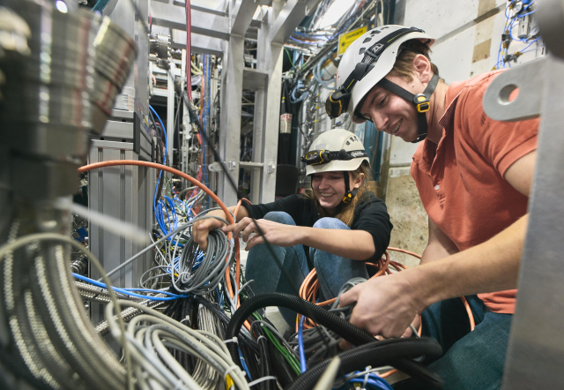

1st TRIUMF Quantum Workshop
March 11, 2024
Quantum Sensors in
Fundamental Physics
(Based in part on my talk
at ICFA Seminar 2023)
Makoto C. Fujiwara
Senior Scientist
Particle Physics, TRIUMF

Slide 2

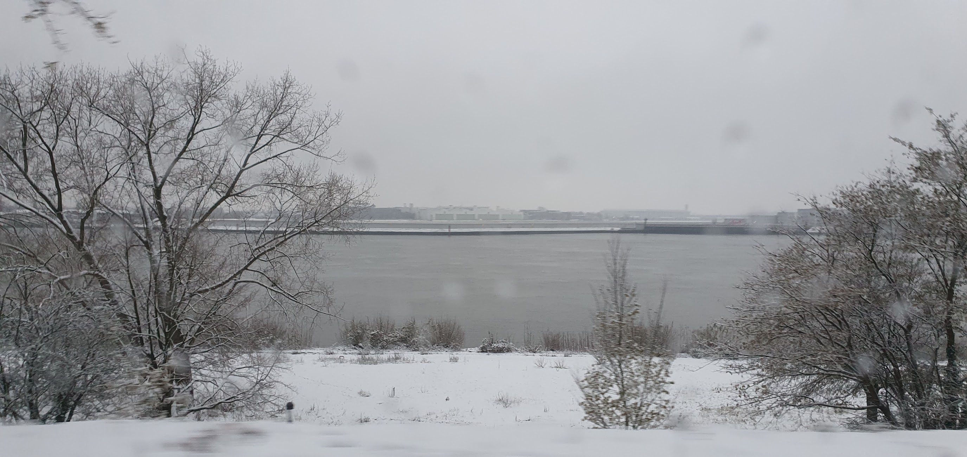
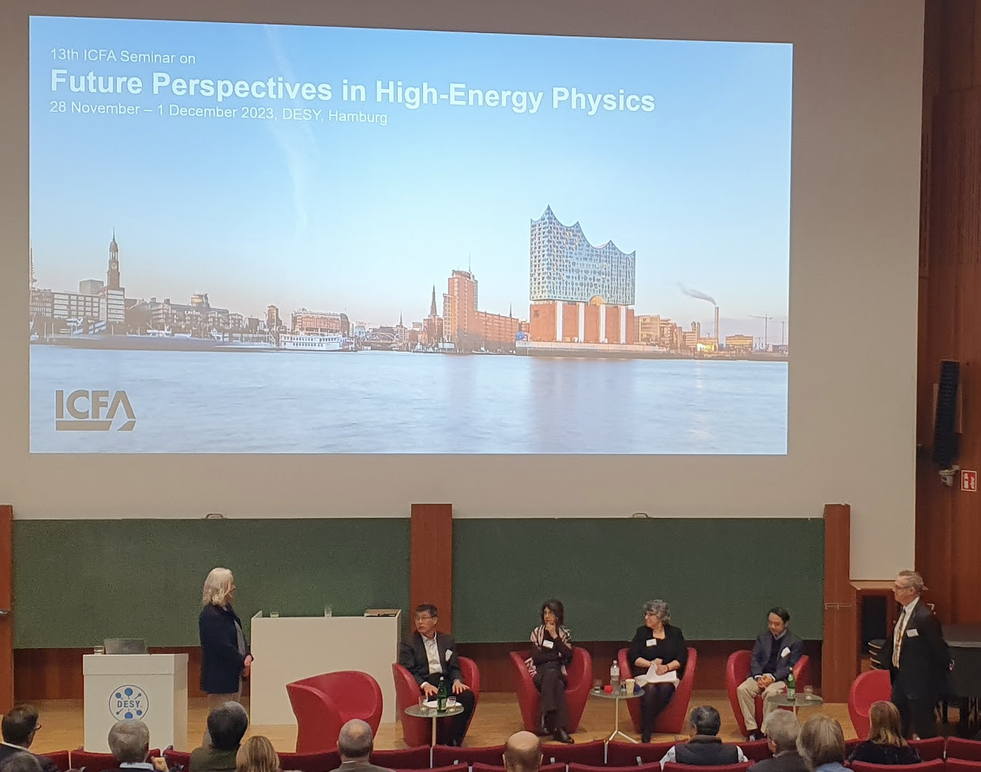

Hawaii?
Northern Germany?
ICFA Seminar 2024
“Quantum sensors and emerging technologies”

Slide 3
Outline: “Quantum Sensors and Emerging Technologies”
Introduction on quantum sensors
Selected world-wide efforts
Selected examples for fundamental physics with Canadian connections
  Atomic Clocks
  Atom Interferometers
Use-inspired” vs ”Fundamental”
Concluding remarks
Disclaimer: This is a vast and expanding field; the choice of topics are completely biased!
Apologies for not mentioning other important works. Please see the list at end for excellent reviews
Special Thanks to many people for input!

Slide 4
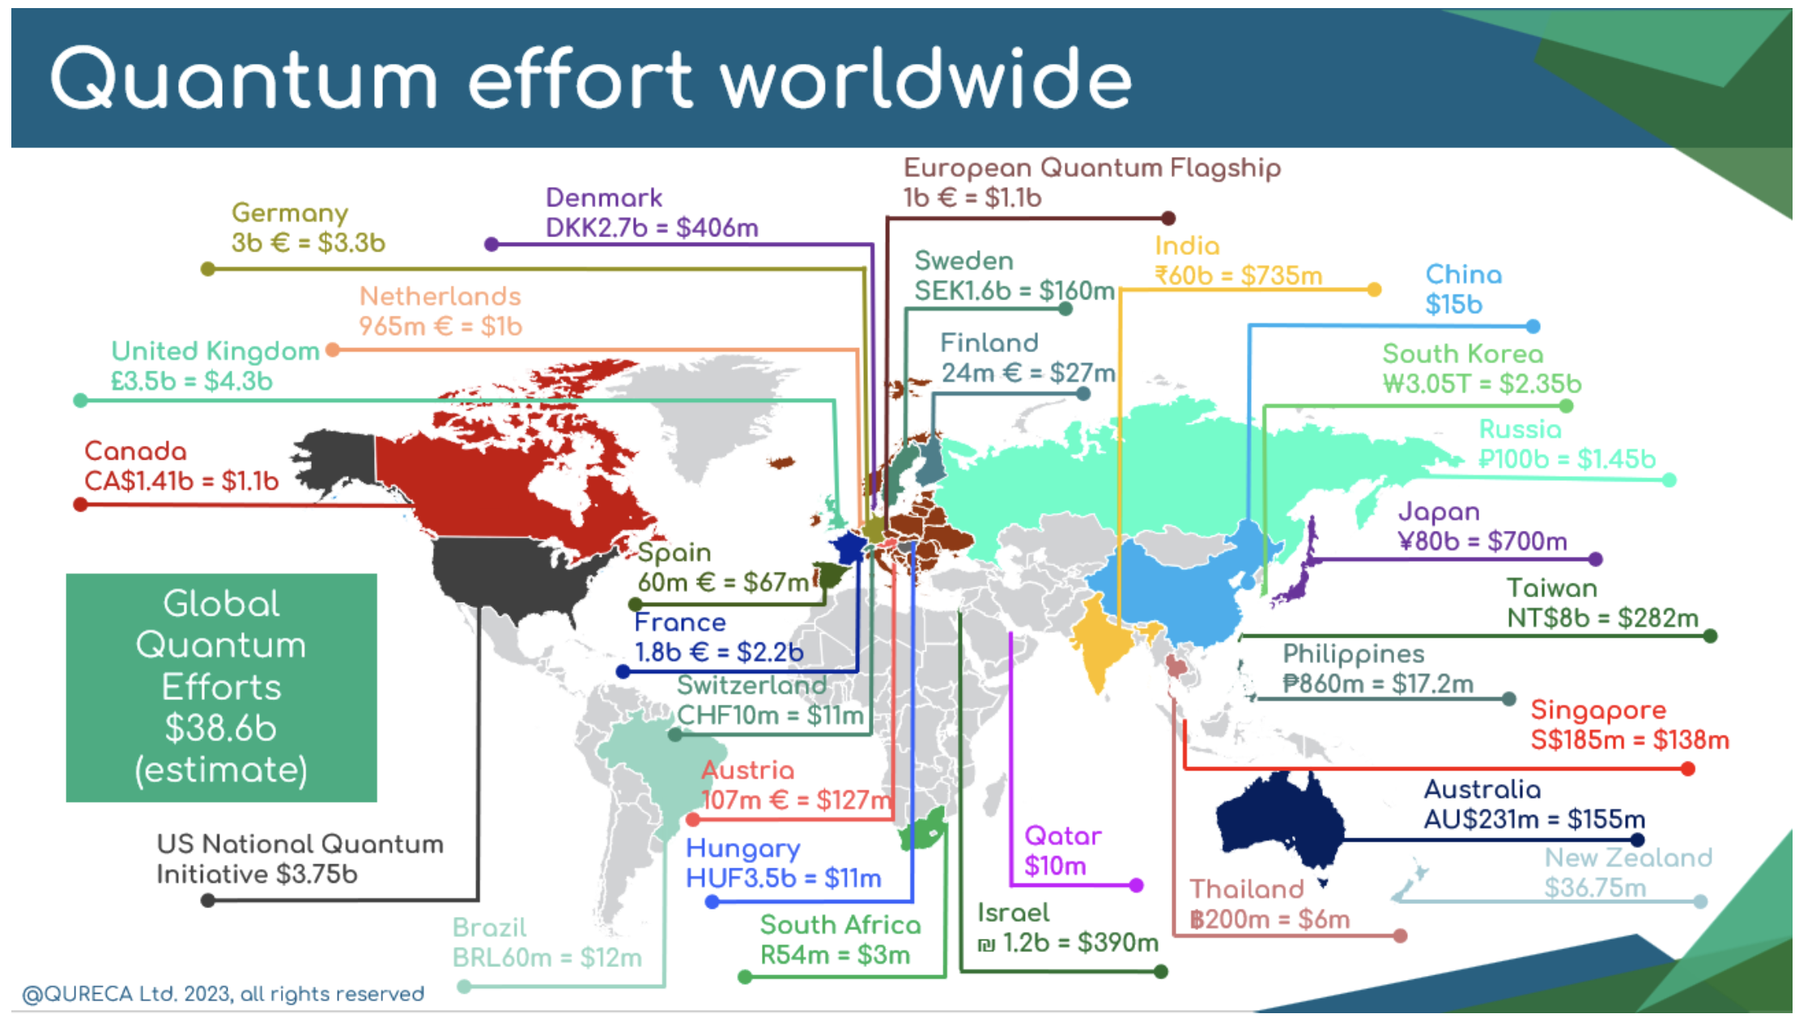

Slide 5
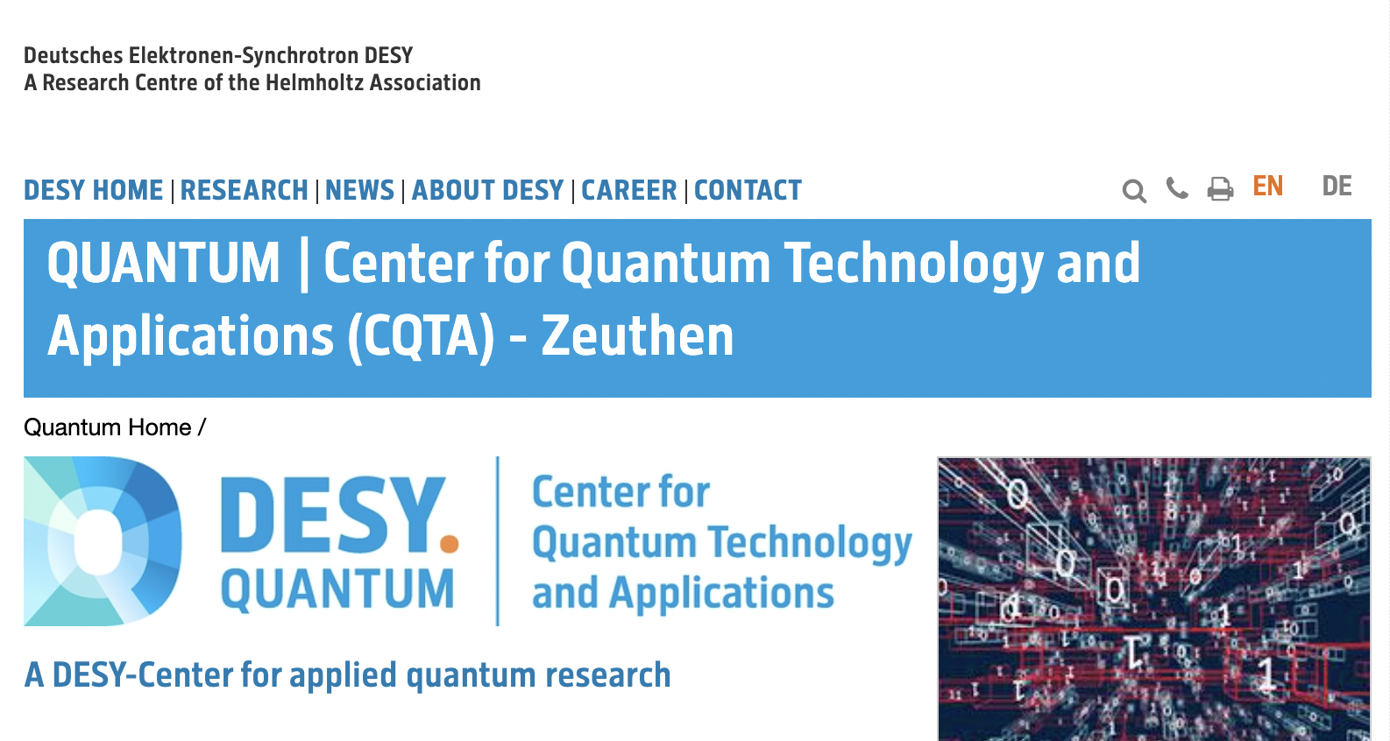
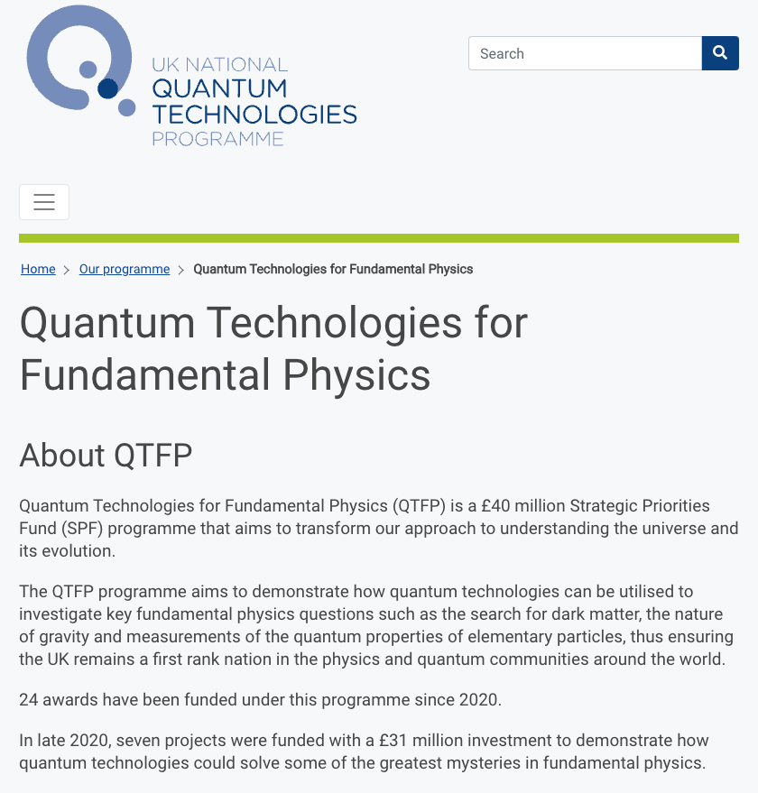
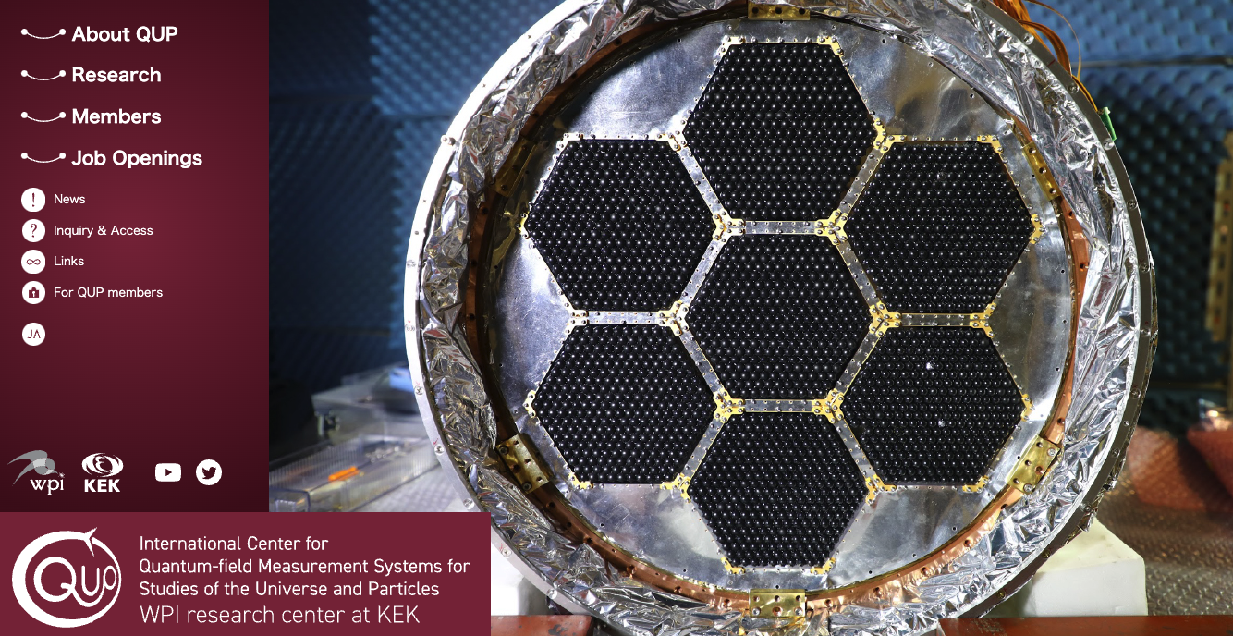
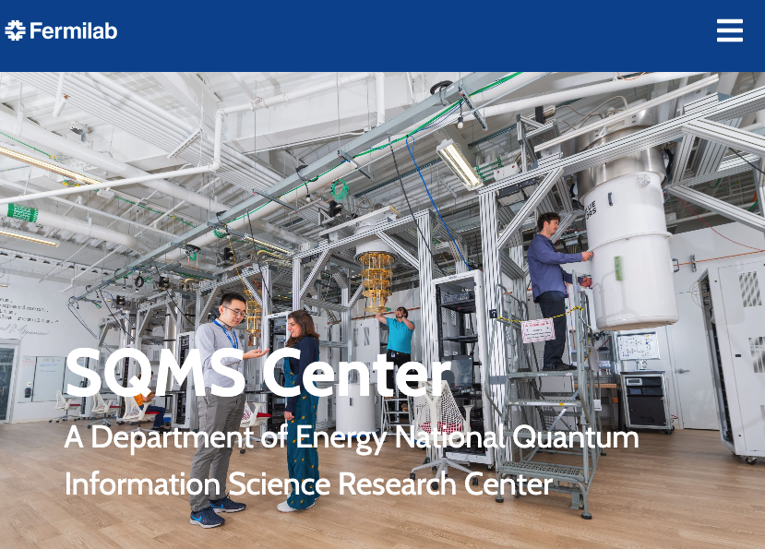
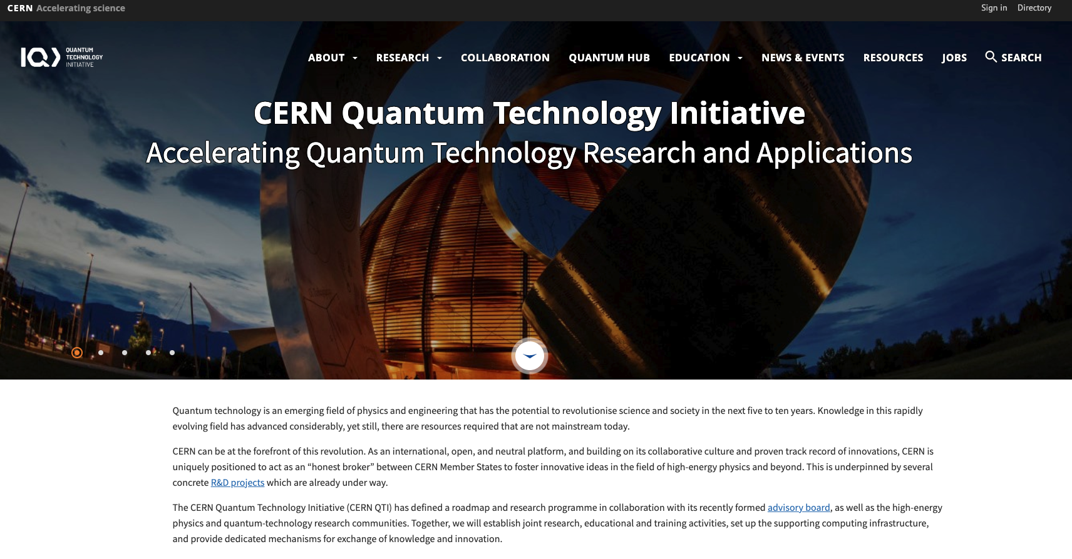
Exploding Interest in Quantum for Fundamental Physics
Notes:
https://uknqt.ukri.org/our-programme/qtfp/
DOE 5 centers
Add stuff from ESP-HEP quantum guy

Slide 6
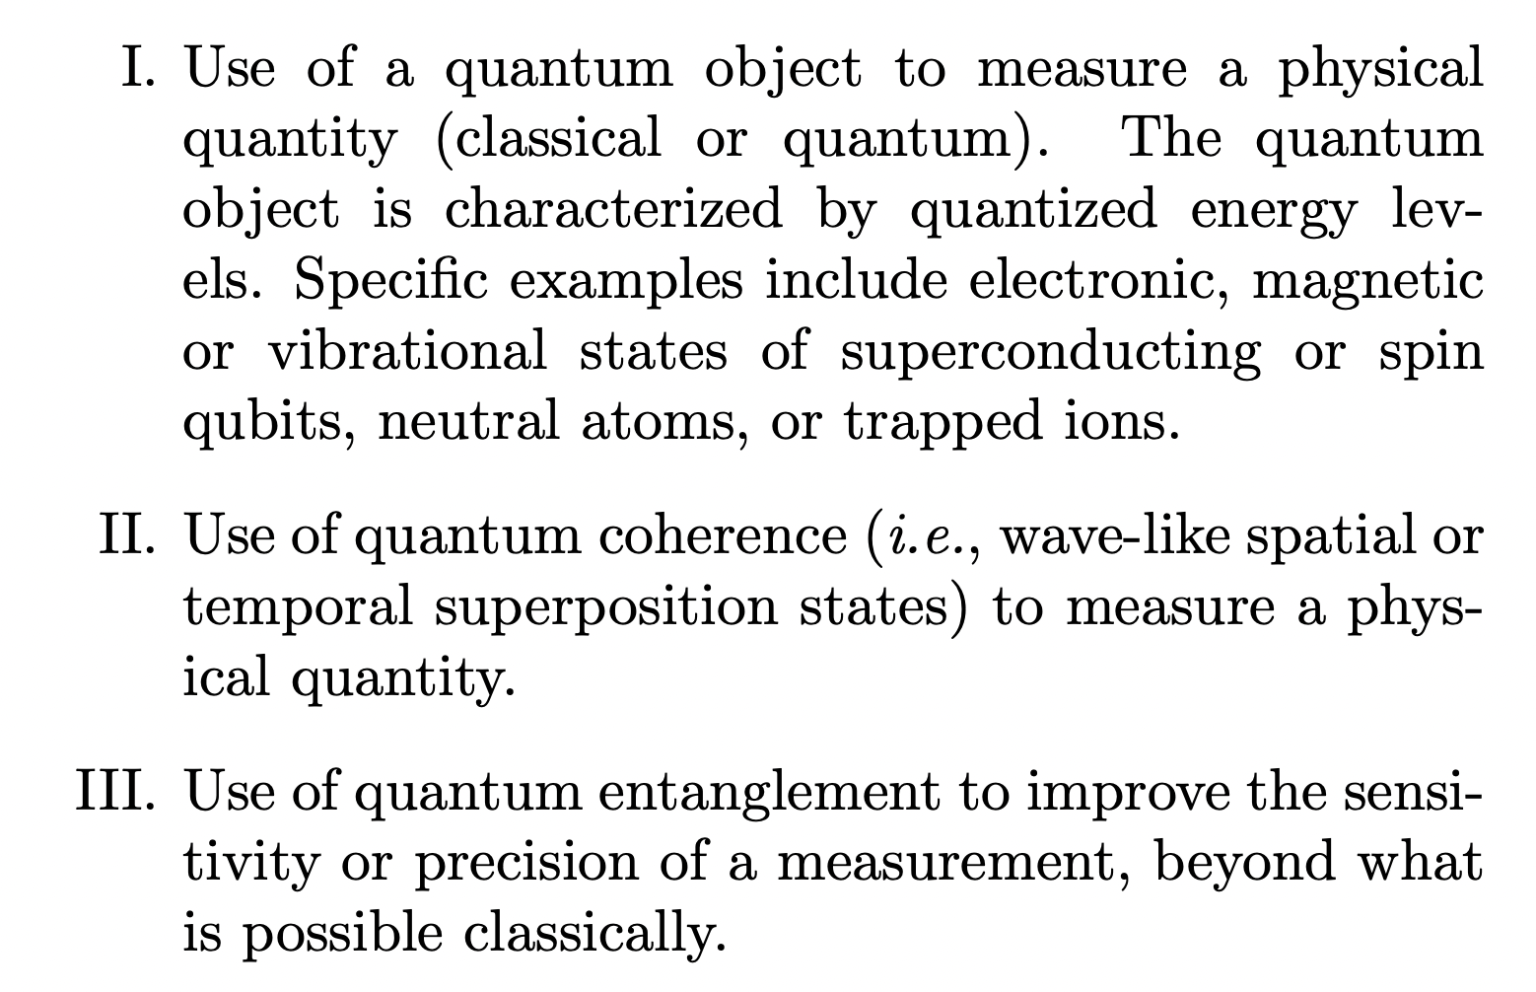
Definition of ”Quantum sensing”
Degen, Reinhard, Cappellaro, Rev. Mod. Phys. 89, 035002 (2017)
Quantum Sensor
Type 1: Use of quantized
energy levels
Type 2: use of coherence
Type 3: use of entanglement
Other types of interesting sensors are also called quantum sensors

Slide 7
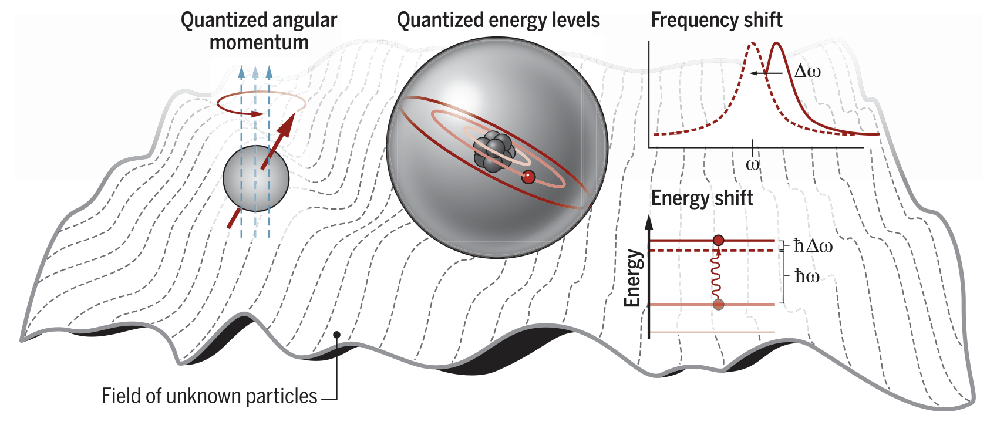
Atom/Molecule as a Quantum Sensor
Atomic quantum sensor
-
|1〉
e
+
E(atom)
p
|0〉
E(atom) = E₀ + ΔE_{ext} + ΔE_{NP}
E₀ ~ m_{e} ⍺ ² + … fn{Q_{e}, Q_{p}, m_{e}, m_{p}, r_{p}, µ_{e} … }
ΔE_{ext} : due to External field, e.g. E, B, Gravity
ΔE_{NP} : due to New Physics, e.g. CPV, DM, 5th force …
DeMille et al., Science 357, 990 (2017)
Quantum Sensors: highly sensitive to low energy phenomena
Fundamental physics applications push the technologies

Slide 8
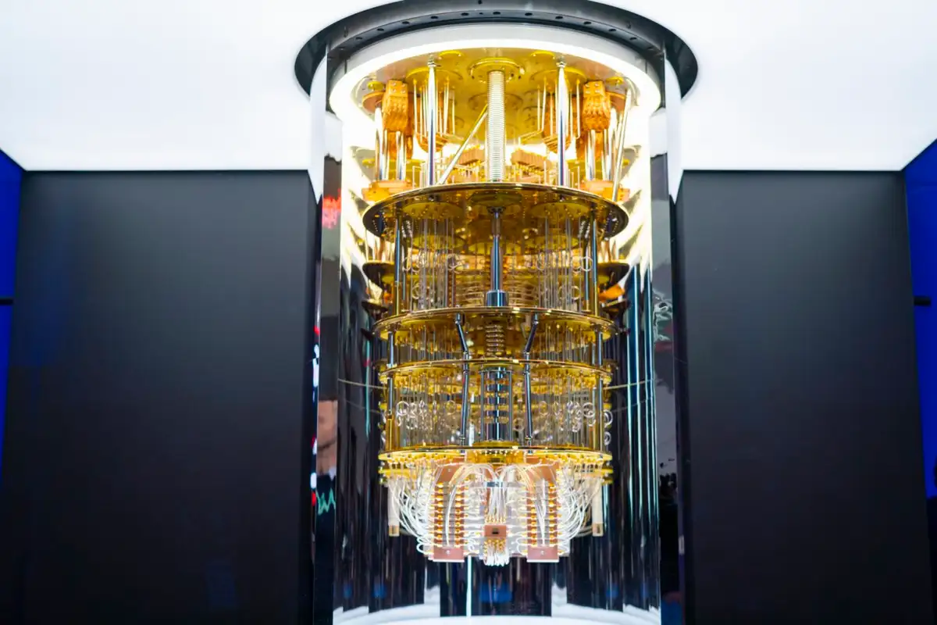
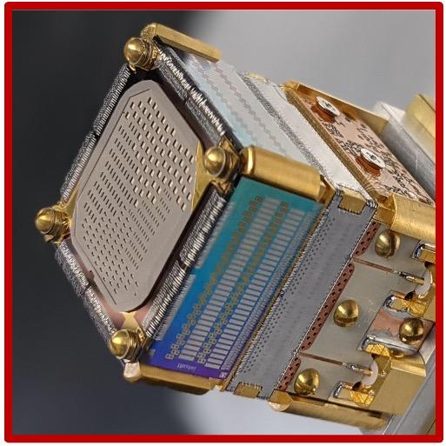
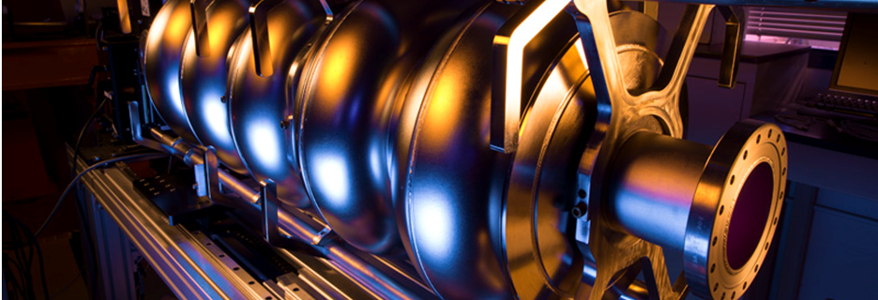
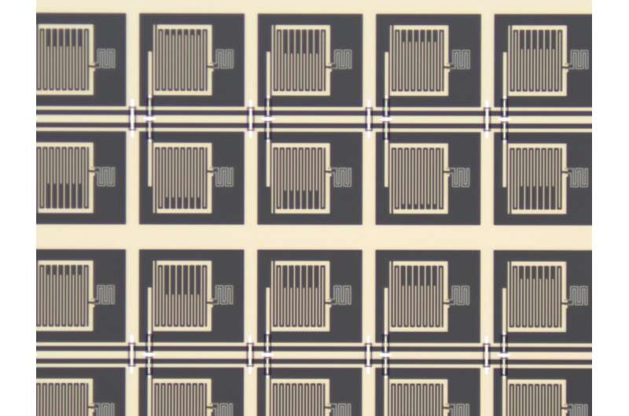
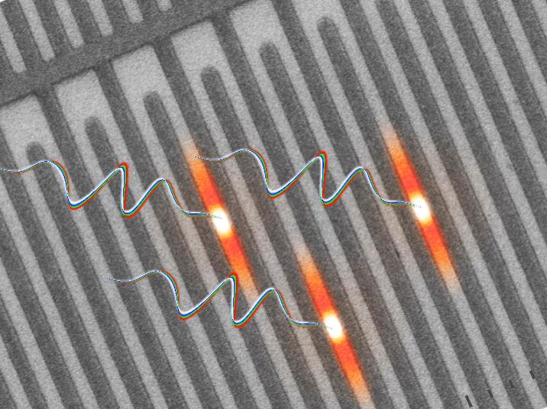
Other types of quantum sensors, e.g. superconducting
Superconducting qubits
Transition Edge Sensors
Superconducting cavities
SNSPD: Superconducting nanowires
Single photon detectors
Kinetic induction detectors

Slide 9

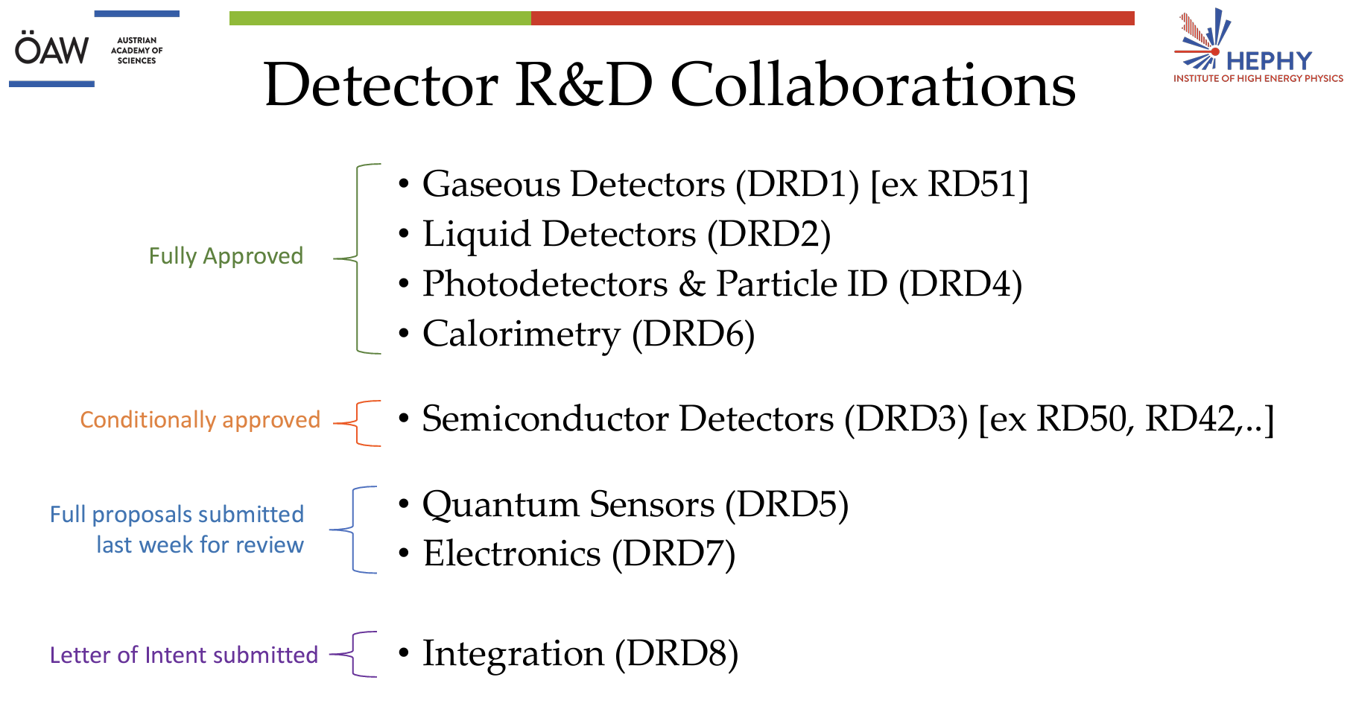
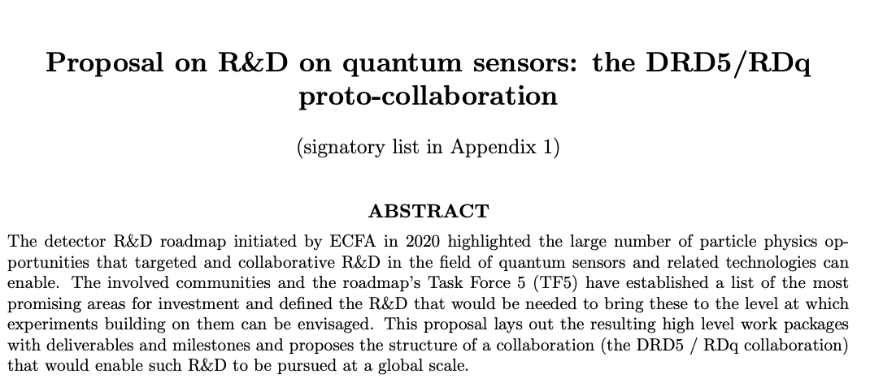
Word-wide efforts in Quantum Sensing for Fund. Physics
European Detector R&D
(based on European Particle Physics strategy 2022)
2nd Meeting of DRD, March 4, 2024 at CERN
Submitted to CERN, Feb 29, 2024

Slide 10
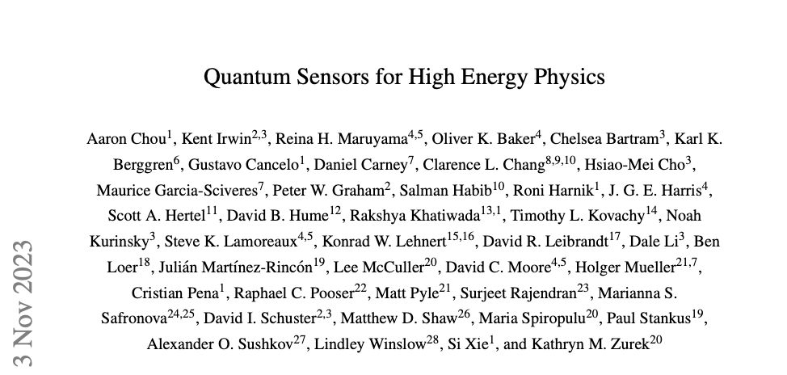

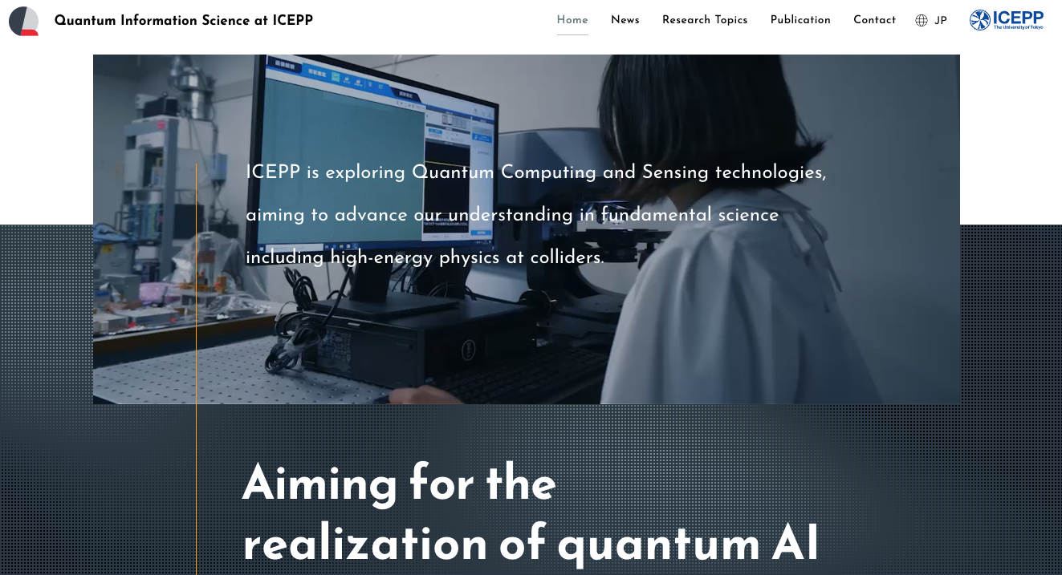
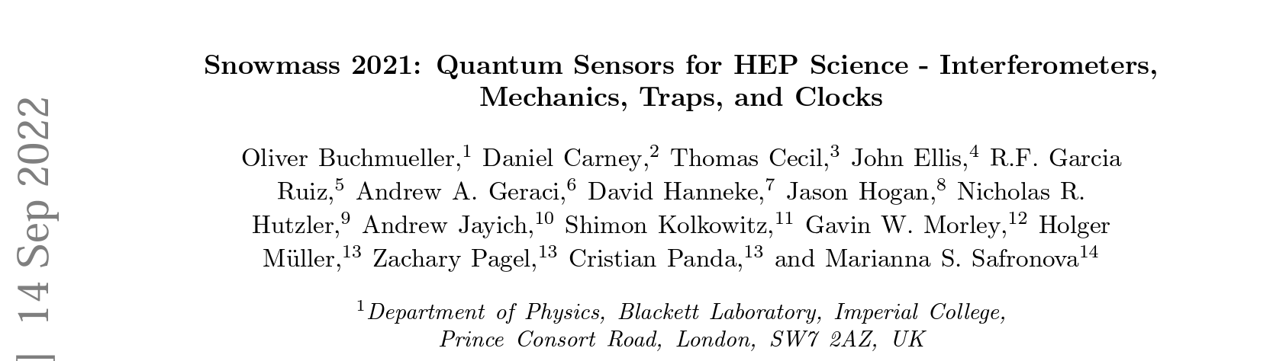
Examples
US efforts
Japanese efforts
KEK
DOE workshop 2023: arXiv:2311.01930
Snowmass: arXiv:2203.07250
U Tokyo

Slide 11
Example: Atomic Clocks

Slide 12
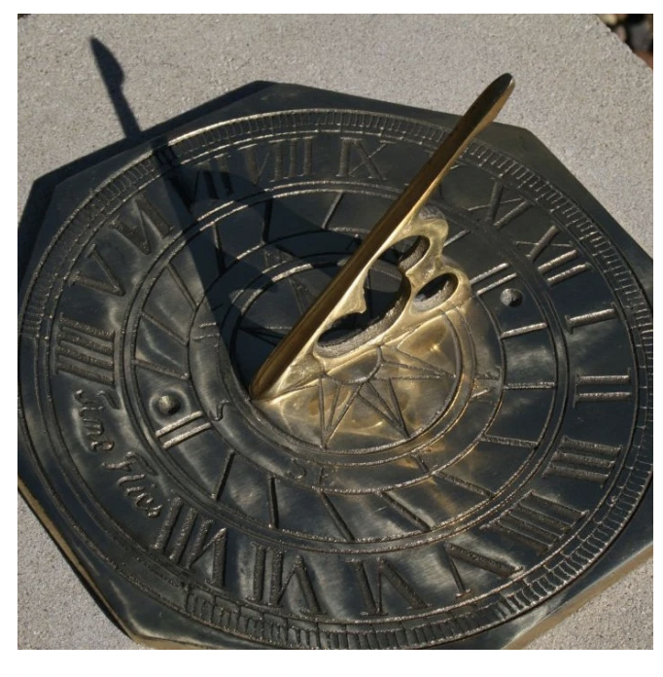
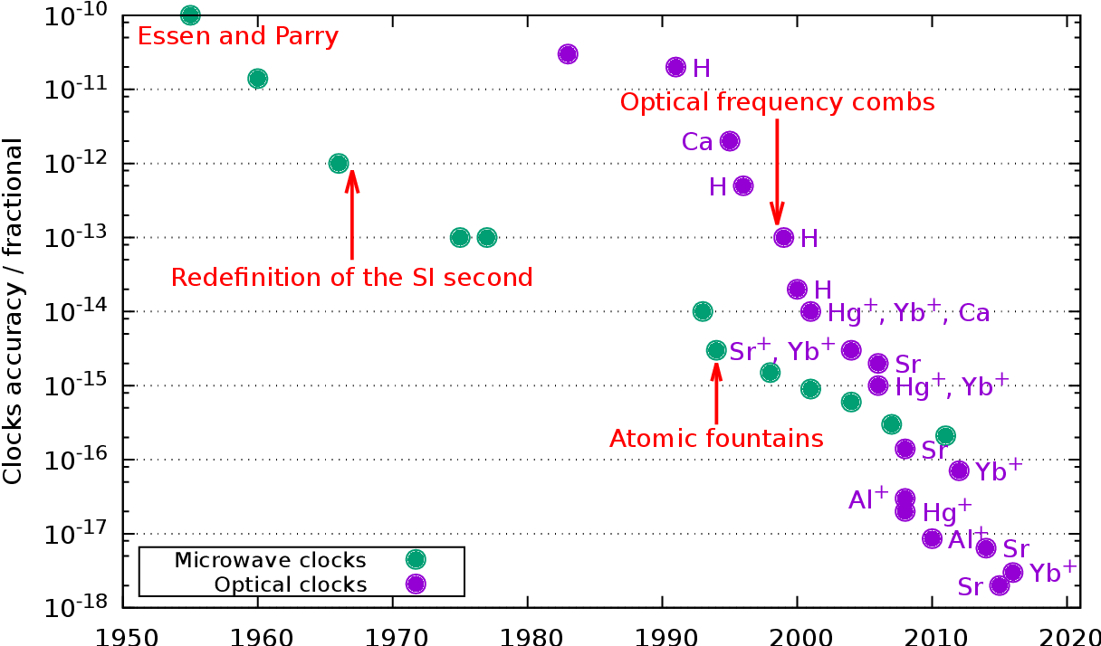
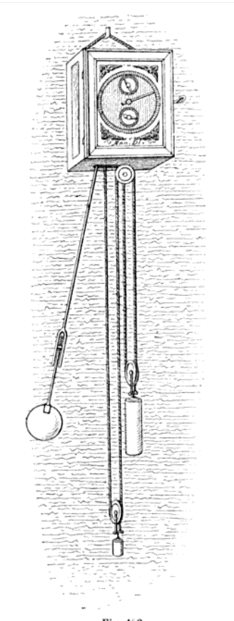
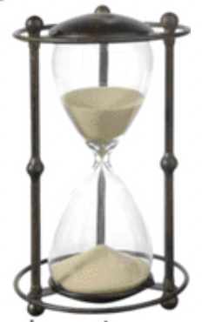
Atomic Clocks
S. Bilicki 2017
Huygens, 1656
Tremendous improvements in past decades
Notes:
@inproceedings{Bilicki2017StrontiumOL, title={Strontium optical lattice clocks : clock comparisons for timescales and fundamental physics applications}, author={Sławomir Bilicki}, year={2017}, url={https://api.semanticscholar.org/CorpusID:116467354} }

Slide 13
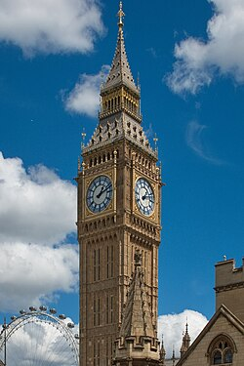
Measuring frequencies to 20 digits: what is it good for?
Clocks are good for society!
  GPS with SR, GR corrections
  (Look forward to BSM corrections to GPS!)
Clock frequencies (currently) not calculable
Relative comparison measurements
  Space variations
    Gravitational red shift
    Lorentz violation
  Time variations
    → Variation of fine structure constant
    → Ultra-light dark matter searches
  Isotopes (“King plot”)
  Antimatter
Notes:
If you can measure a physical quantity to 20 digits, it’s got to be good for something

Slide 14
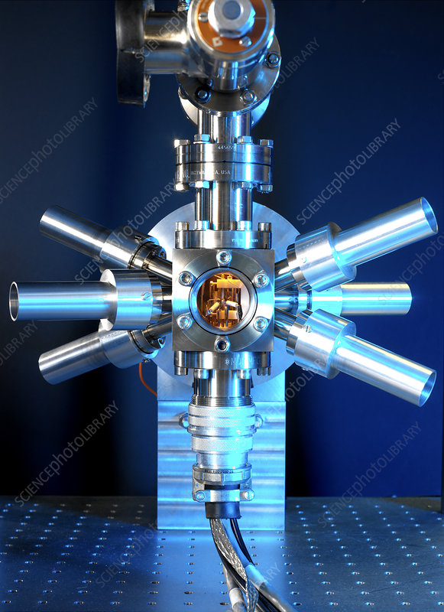
Sr Ion Optical Clocks
Longstanding effort at NRC Ottawa (led by P. Dubbe, former TRINAT postdoc)
Renewed effort at U Toronto (A. Vutha) for a cryogenic clock 4 K
  Aiming 10⁻¹⁸ precision
  Funded by a quantum grant
If HAICU goes well, we may need a clock like this at TRIUMF!
Strontium Ion Clock

Slide 15
Example: Atom Interferometer

Slide 16
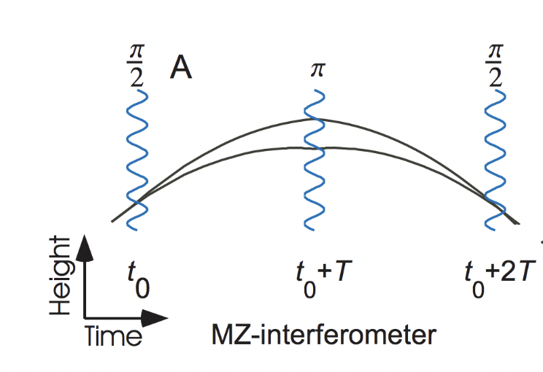
Atom Interferometers
Extremely sensitive to weak force
Good for society
  e.g. gravity survey
Fundamental physics
  Gravity
  Ultralight dark matter
  Dark Energy models
  Test of Quantum Mech.
  Gravitational waves?
Increasing interest in HEP community
H. Mueller
Mach-Zender Interferometer
Δφ = k_{eff} g T²
Analogous to neutrino oscillations

Slide 17
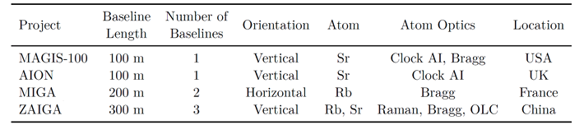
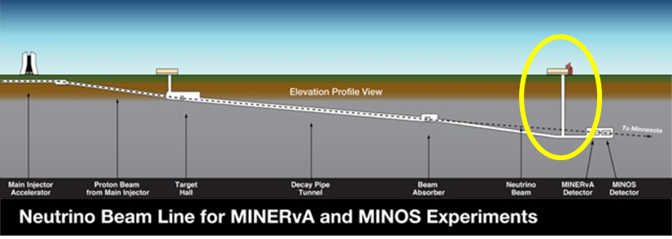
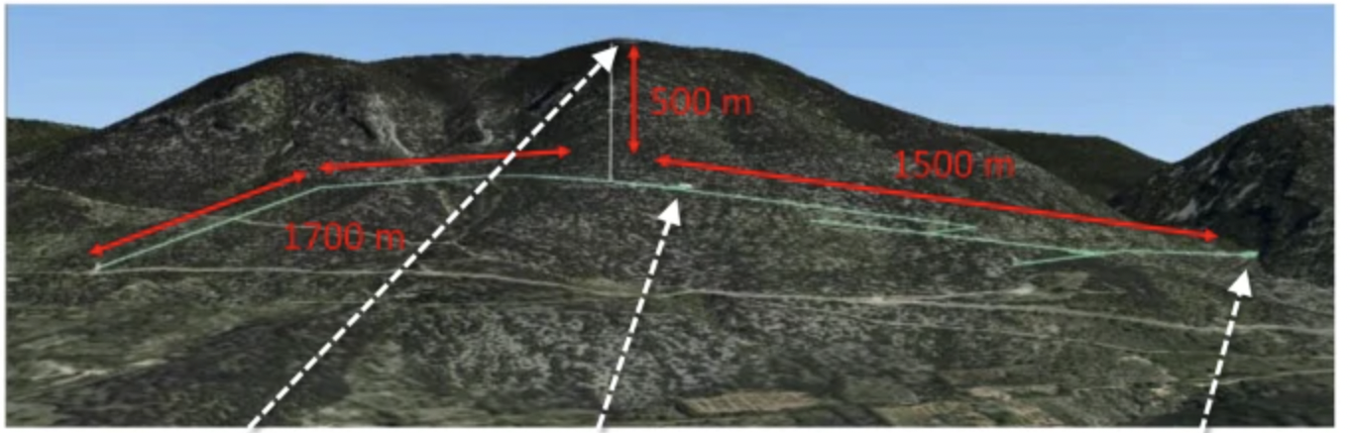
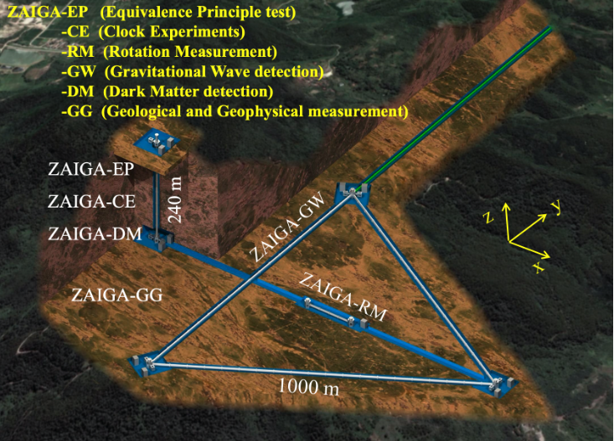
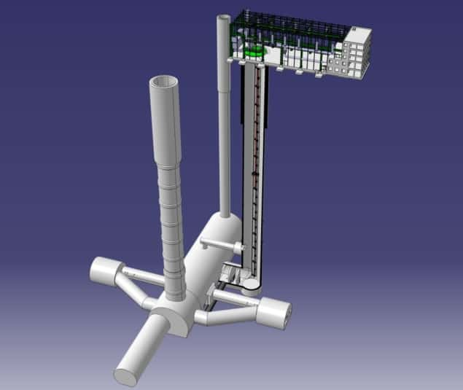
100 Meter-scale Atom Interferometers
Jason Hogan
MAGIS-100
MIGA
ZAIGA
AION-100
Notes:
AION ConceptualFeasibilityStudy, arXiv:2304.0061

Slide 18
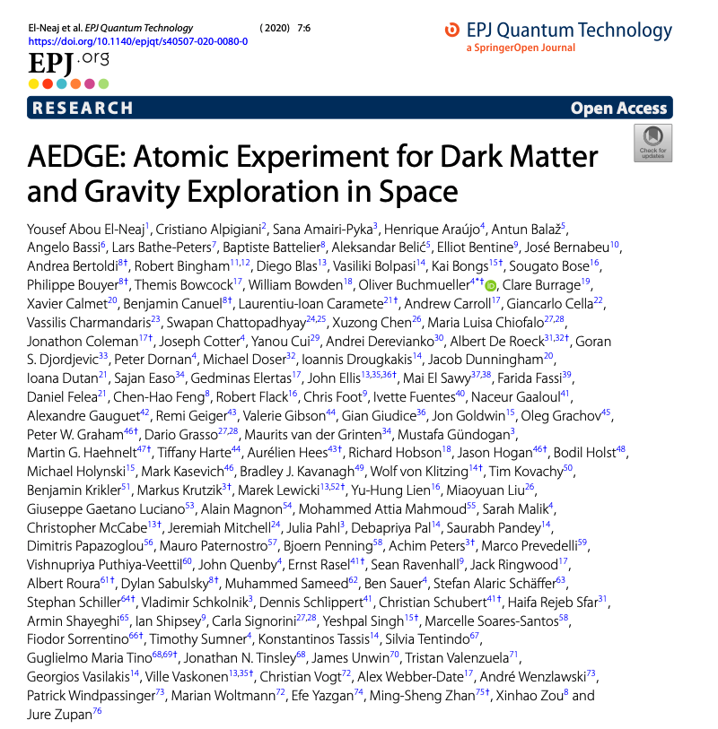
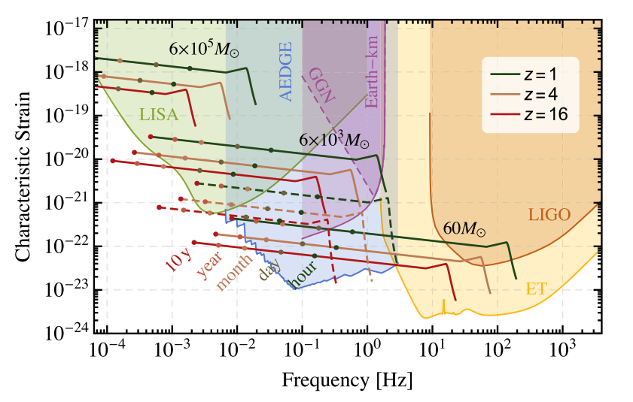
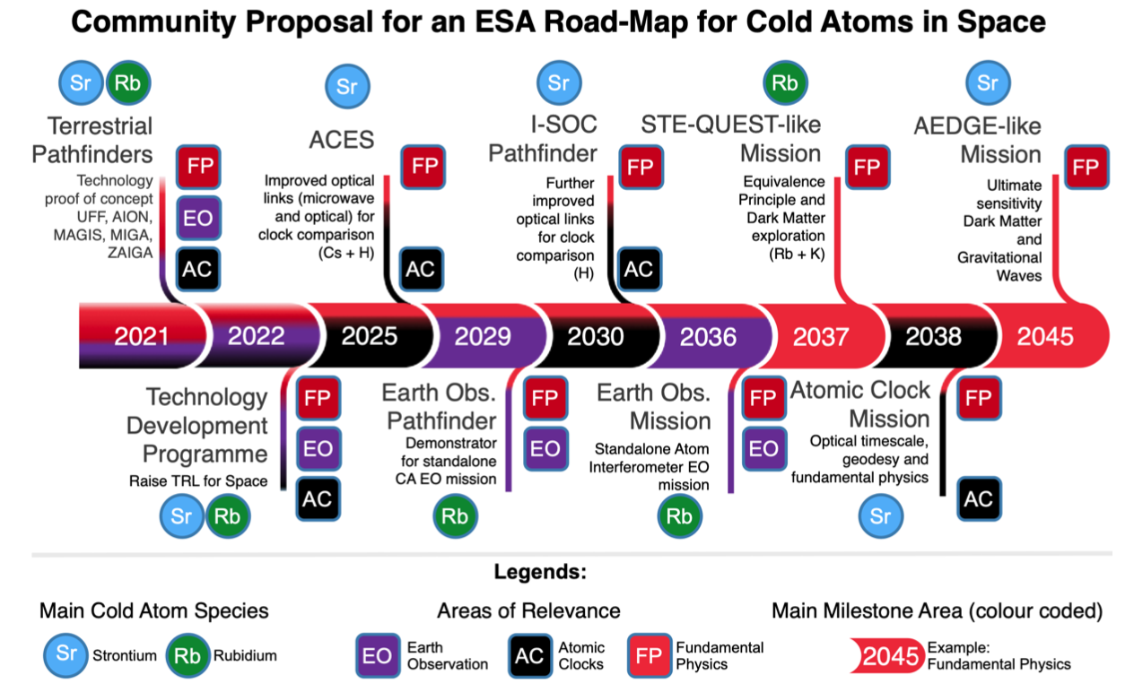
Gravitational Waves via Atom Interferometer?
Mid-frequency bands between LIGO and LISA sensitivity
via km scale (on earth) or in space interferometers
See Andrea’s talk for HAICU development for
Atom Interferometer

Slide 19
Question to Theorists!
Physics of Ultralight Dark Matter
  How well motivated is that?

Slide 20
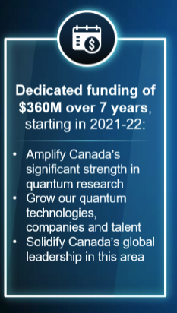
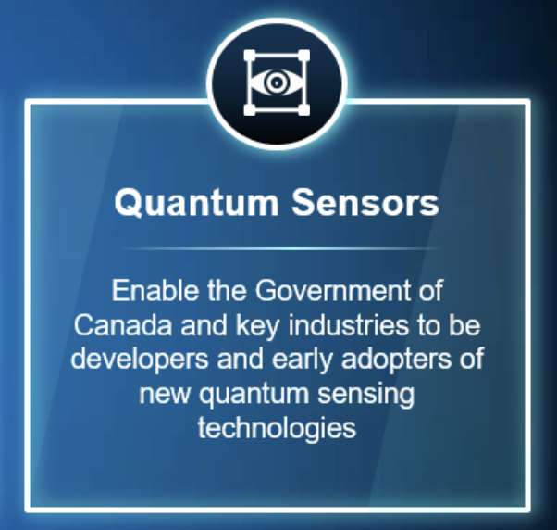
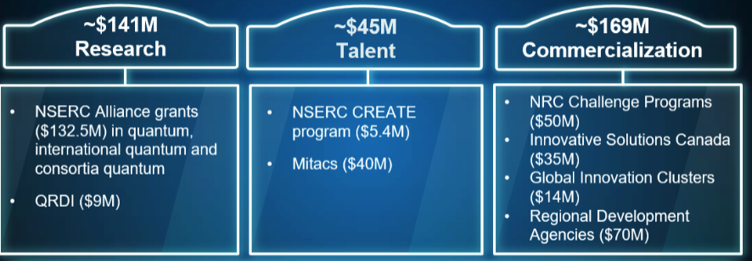
Canada’s National Quantum Strategies
One of
Missions
NQS priorities seem focused on application/commercialization
TRIUMF Quant. Strategy (TQS) options regarding FunPhys:
  Try to expand NQS to include FunPhys →this seems hard?
  Try to fill the current gap in Canadian quantum eco-system (as other countries are doing FunPhys with quantum!)
TQS should be helpful for future CFI (&NSERC?) applications!
  We want to be able to refer to TQS in our CFI applications
  NQS funding (so far) not sufficient for a major project
  NB: >$120M existing or proposed funds on Quantum&Precision at TRIUMF vs $365M for NQS (typically, up to 300k/yr for academics)

Slide 21
For discussion
“Quantum”
“Use-inspired”
“Fundamental”
“Non-Quantum”

Slide 22
For Discussion
Canada’s National Quantum Strategy
TRIUMF
Quantum Strategy
Quantum
Materials
Commercialization
Fundamental
physics
Quantum
probes
Various funding schemes
NSERC, CFI, NRC etc

Slide 23
Concluding Remarks
Quantum sensing have been around for long time
Recent growing interest in society and in Fundamental Physics
Promising for specific applications
  Atom interferometers
  Clocks, Antimatter
Many topics I did not cover (covered by other people)
  E.g. Superconducting devices, Condensed Matter, Entanglement
Connections with accelerator technologies
  Superconducting RF cavities (TRIUMF, Fermilab etc)
  Magnets, cryogenics, vacuum
Opportunities for Fundamental Physics
  Technical infrastructure, expertise
  Organization of large collaborations
  We are not afraid of technical challenges → will eventually benefit society

Slide 24
Back up

Slide 25
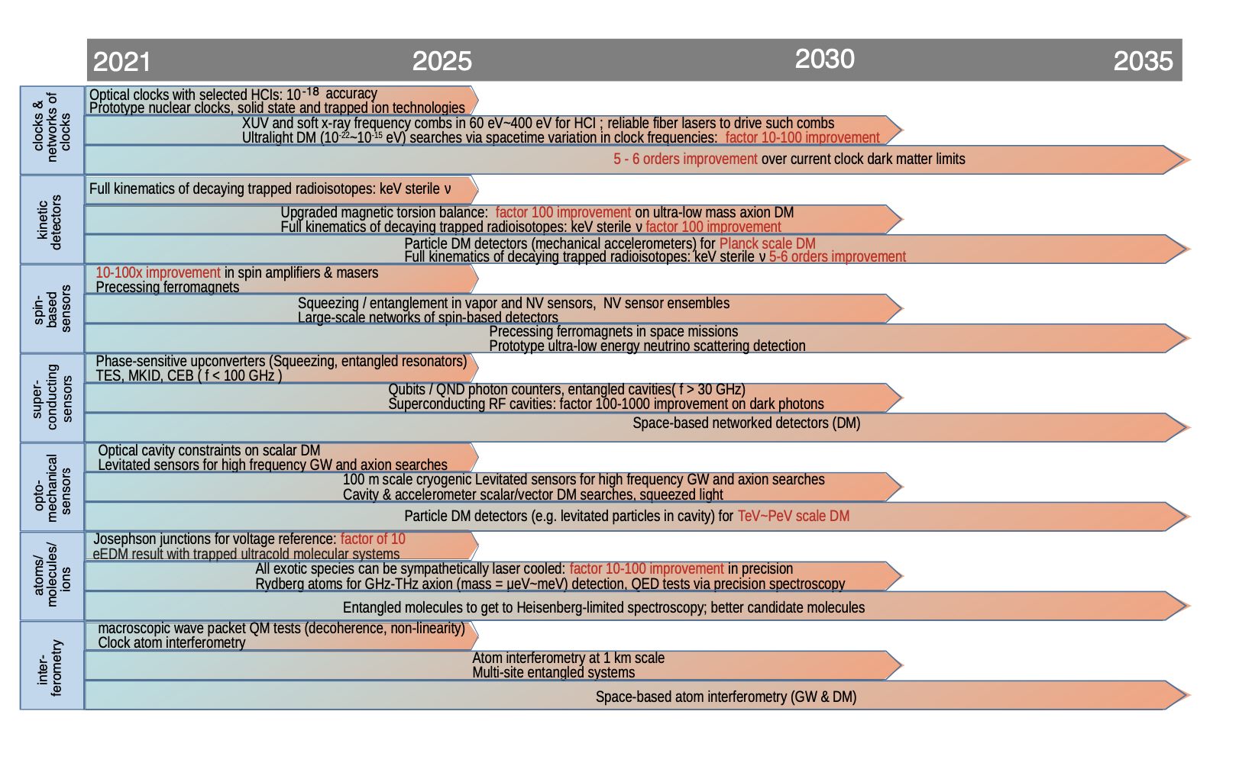
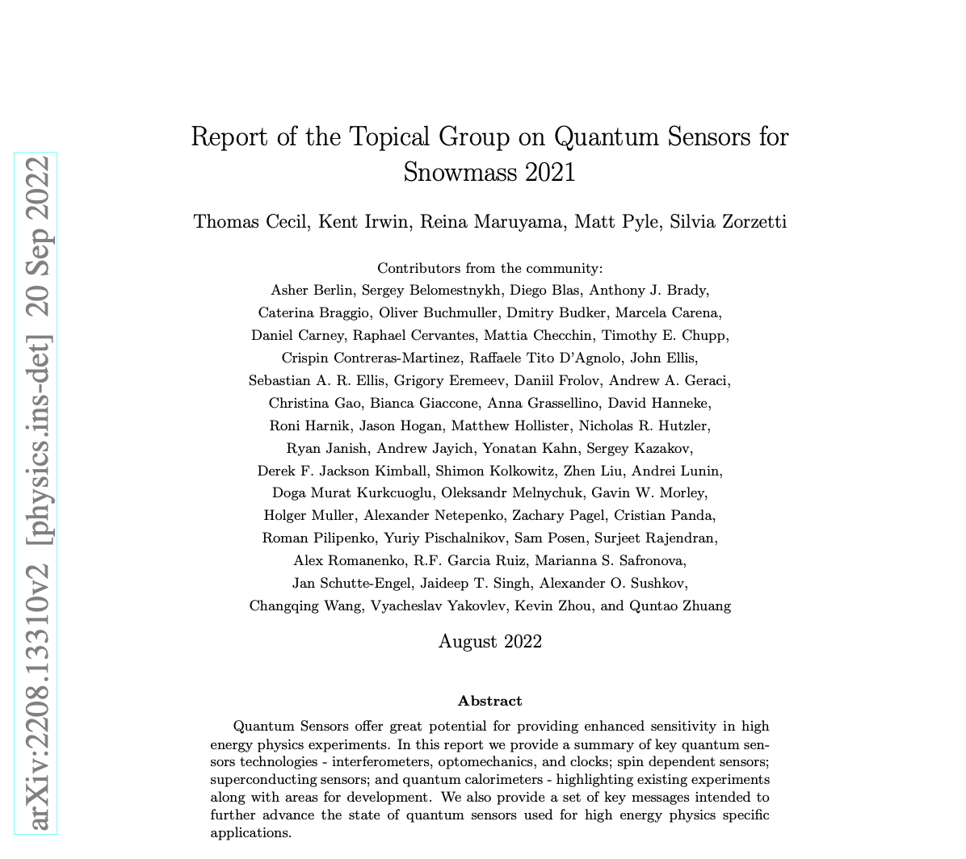
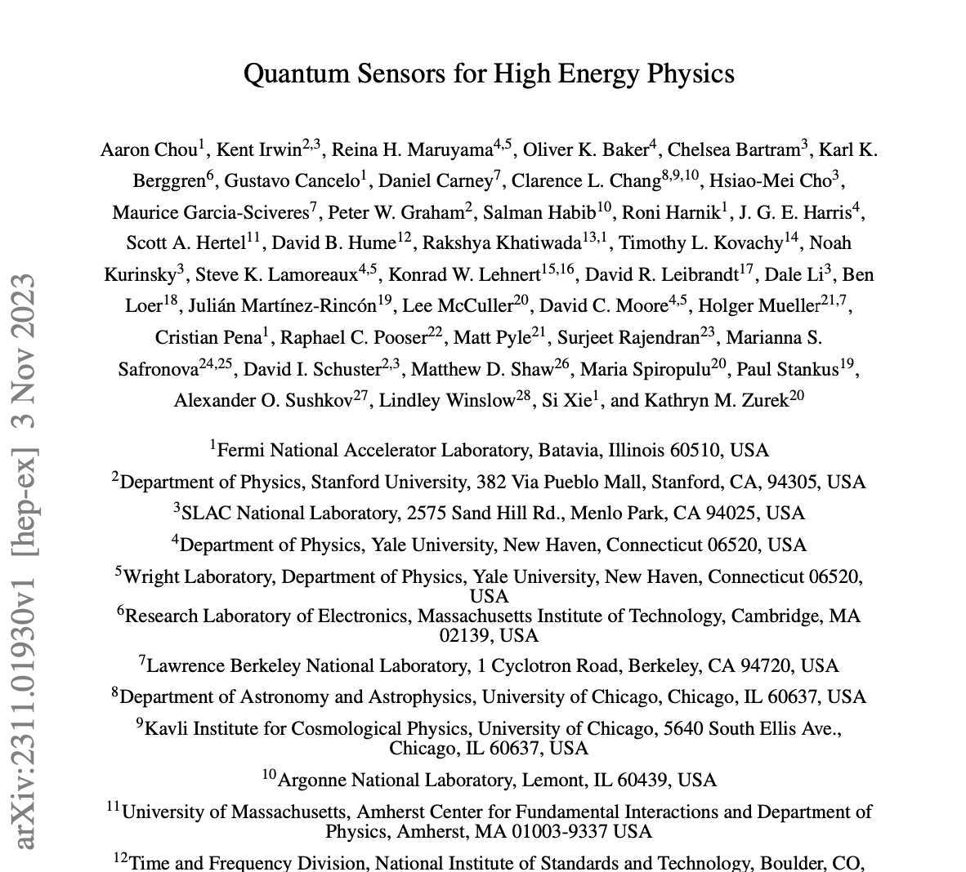
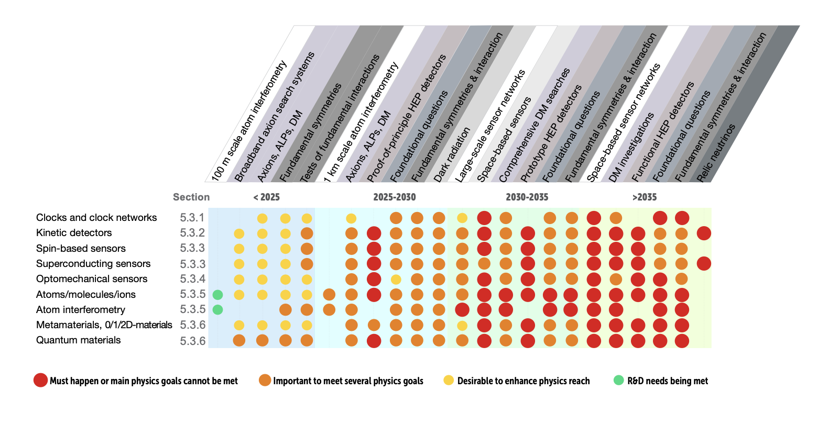
Excellent Road Maps, White Papers on Quantum Sensors for HEP
Didier Contardo

Slide 26
Example: Atomic Clocks

Slide 27
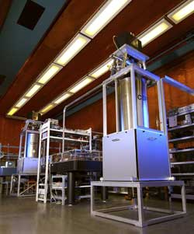
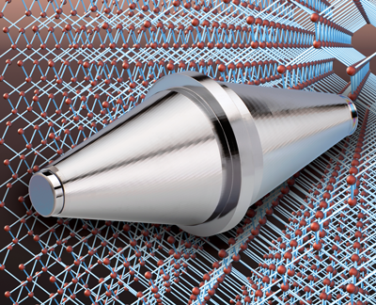
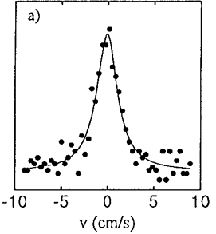
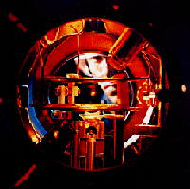
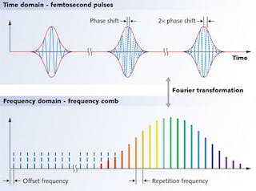
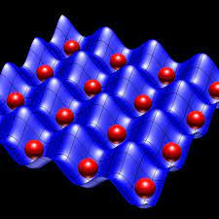
What made this possible?
Lasers (1960), Cavities
Laser cooling (1985)
Atomic fountains (1989)
Technical developments over > 60 years!
Atom/ion trapping (1959)
Frequency comb (~2000)
Optical Lattice (~2000)

Slide 28
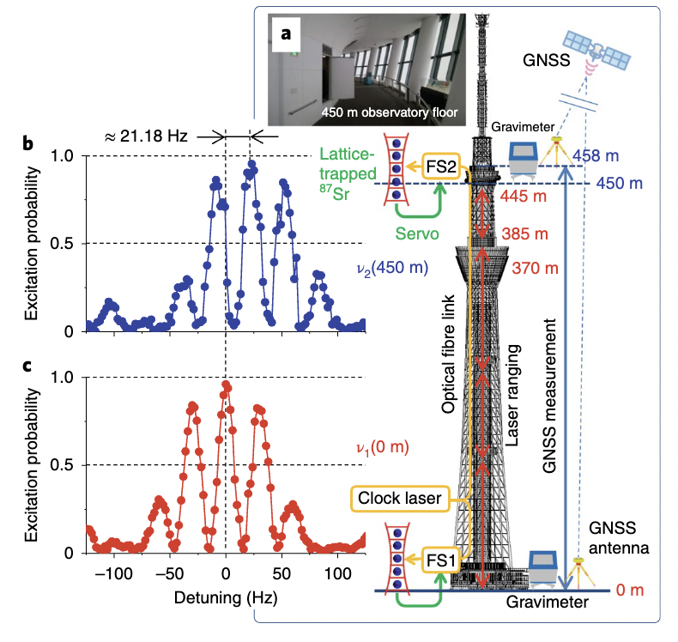


Gravitational red shift
Katori group (RIKEN/Tokyo), Nature Photonics, 14, 411 (2020)
Gravitational redshift
Tokyo Skytree, 450 m high
α: deviation from GR
2 portable clocks
stable to 10⁻¹⁸
Δν ~ 21 Hz over 450 m
α tested to 9 x 10⁻⁵

Slide 29



Gravitational red shift across a mm atomic sample
Jun Ye group (NIST/Colorado), Nature 602, 420 (2022)
Sr atoms
in optical lattice
Red shifts across
the mm sample
Relative frequency precision 7.6 x 10⁻²¹
Improving by a factor 100 from 2020 record!

Slide 30
Example: Atom Interferometer

Slide 31



Large Scale Interferometers
Wuhan, China 10 m
Stanford 10 m
Hanover 10 m

Slide 32



Slide 33
References
Reviews
  Quantum sensing, C.L. Degen et al. Rev. Mod. Phys. 89, 035002 (2017)
  Search for New Physics with Atoms and Molecules, M.S. Safronova et al. Rev. Mod. Phys. 90, 025008 (2018)
  Quantum sensing for particle physics, S.D. Bass, M. Doser, 2305.11518 (2023)
  Quantum measurements in fundamental physics: a user’s manual, J. Beckey, D. Carney, G. Marocco, 2311.07270 (2023)
  Quantum technologies for fundamental (HE) physics, D. Blas, 2311.10187 (2023)

Slide 34

Statistical Sensitivity of Atomic Spectroscopy
$$Δf \sim \frac{1}{W_{line}∙\sqrt{ ε_{det}∙N_{atom} {∙P}_{trans}}}$$
Factors
Example of technologies
# trapped atoms → Trapping techniques
Antihydrogen 1s-2s resonance
[Nature 2018]
Transition probability → laser, microwaves
Spectral linewidth → Laser cooling, coherent techniques
(Note 1/linear scaling!)
Detection efficiency → Photons (or annihilations)

Slide 35



Demonstration of Laser Cooling
Laser cooling (anti)hydrogen is hard
  121 nm: vacuum ultraviolet
  Challenging laser built at UBC, Canada
  Cooling takes hours (rather than msec)
Laser cooling a likely game changer in anti-H and H studies

Slide 36



Atom Interferometer Physics – Ultralight DM
Jon Coleman
Notes:
https://indico.fnal.gov/event/19947/contributions/54724/attachments/34153/41784/DMUK_-_AION_-_Dark_Matter_searches_with_Atom_Interferometry.pdf

Slide 37

Ultra stable laser: 4 x 10⁻¹⁷ (for 1 – 10s second ave)
Laser stability limited by thermal motions of
Atoms in mirror coating (thickness only few 10 um
PRL118,263202(2017)

Slide 38







BASE: Axion-Photon Coupling
Axion detection via LC circuits
[Sikivie et al. Phys. Rev. Lett. 112, 131301 (2014) ]
  Axion in a strong B_{ext} field can source a small magnetic field B_{a}, which can be detected by BASE’s sensitive detector
Phys. Rev. Lett. 126, 041301 (2021)
B_{ext}
$$B_{a}$$
BASE
$$V_{\text{rms}}=\sqrt{V_{n}^{2}+V_{a}^{2}}$$
Expected signal
Trapped pbar used to characterize the detector

Slide 39

Improvement via entanglement
James Thompson
Entanglement enhanced phase measurement
Up to 18 dB (factor ~70) over Standard Quantum Limit
Practical implementation challenging ~ a few dB
James Thompson
Notes:
https://www.youtube.com/watch?v=GF_Q7uHUQJY

Slide 40


Seiji Kawamura; et al. (22 February 2021). "Current status of space gravitational wave antenna DECIGO and B-DECIGO" (PDF).
Progress of Theoretical and Experimental Physics. 2021 (5): 05A105.
Competition at mid-band GW?
Notes:
https://academic.oup.com/ptep/article-pdf/2021/5/05A105/38109685/ptab019.pdf

Slide 41

Ultra-light Dark Matter Search with Atomic Clocks: Example
Kobayashi et al. Phys. Rev. Lett. 129, 241301 (2022)

Slide 42


ALPHA-g superconducting magnetic trap
Designed by Chukman So (TRIUMF)
20 superconducting coils
Number and position of elements carefully tailored to achieve 10 ppm B control
Factors that influenced the design:
  Persistent field
  Wire placement error
  Quasi-trapped antiatoms
Coil winding at BNL

Slide 43



Technical detail example: Wire placement errors
Mirror coil winding
  Each layer is macro-photographed and precisely analysed
  Turns located to within ± 0.025 mm (1/1000”)
  Each coil trimmed by adaptive turn removal on outermost layer
Macro photograph
(24 M pixel)
Fitting ruler markings
Fitting wires

Slide 44
Precision measurements with antihydrogen
Aiming at ambitious goals!
CPT, WEP
Violation?
かたつぶり
そろそろ登れ
富士の山
小林一茶
O snail
Climb Mount Fuji
But slowly, slowly!
— Issa Kobayashi
R. Tomozawa

Slide 45
Example: Antimatter technologies

Slide 46

Antiproton Facility at CERN
Notes:
Fantastic facility at CERN

Slide 47


Antimatter spin-off: BASE’s search for milli-charged particles
BASE Penning trap: lowest noise trap
[Phys. Rev. Lett. 122, 043201]
Could search for anomalous heating from very low energy collisions, e.g. from milli-charged particles
[Graham, Ramani, Budker, Ulmer etc. 2022]
PRX Quantum 3, 010330 (2022)
Also limits on Axion-like particles from BASE, PRL 126, 041301 (2021)

Slide 48





20 Years of development of cold antihydrogen
Production of cold antihydrogen, Oct 3, 2002
Goals: precision test of CPT and Equiv. Principle
ATHENA finished in 2004
Developed new experiment to trap
anti-H for precision measurements in 2005
ALE —Antihydrogen Laser Experiment
ALPHA: Antihydrogen Laser Physics Apparatus
Trapped antihydrogen, Nov. 17, 2010
ATHENA at CERN AD

Slide 49
CPT tests via Antihydrogen Spectroscopy with ALPHA
1s-2s: 4x10⁻¹⁵
PRL 107, 203001 (2011)
1s-2s: 2x10⁻¹²
Nature 541, 506 (2017)
Nature 557, 71 (2018)
1s-2p:1.6x10⁻⁸; Lamb
Nature 561, 211 (2018)
Nature 578, 375 (2020)
HFS: 9x10⁻⁶(Prelim.)
Nature 483, 439 (2012)
Nature 548, 66 (2017)
Charge neutrality
Nature 539, 373 (2016)
Laser cooling (2021)
Gravity (2023)
Anti-H precision approaching that in H
Carleton 1994

Slide 50


ALPHA developments over past 20 years
H anti-H clock comparison
Hydrogen: 4 x 10⁻¹⁵
Antihydrogen: 2 x 10⁻¹²
Within 2 order of magnitude!
Improvement in anti-H trapping

Slide 51








Gravitation studies with antihydrogen
Nature 621, 716 (2023)
Equiv. Principle in antimatter sector
tested directly to 20% level
First step for precision measurements
Newton’s tree at TRIUMF
ALPHA-g at CERN

Slide 52

Future: (anti)hydrogen fountain!
Objective: to make precision hydrogen–antihydrogen comparison
in the same apparatus
Need to improve both anti-H and H techniques!
Notes:
Rules out the methods not applicable to antimatter
(no one has made even a H fountain)
Approaching H level of precision

Slide 53

Quantum Sensing Effort at TRIUMF
HAICU(俳句): Hydrogen-Antihydrogen Infrastructure at Canadian Universities
  R&D platform for development for quantum sensing techniques for anti-H
  Use H (and other cold atoms) as proxy
    (Anti)atomic fountain
    (Anti)Matter-wave interferometer
    Ramsey hyperfine spectroscopy
    Optical trapping
    Antimatter molecules
  Hydrogen difficult to handle
    1s-2p transition at 121 nm
    Difficult to trap & detect
    No fountain made with H
(Anti)Hydrogen Interferometer Simulation
  Techniques (e.g. laser, magnets) needed for anti-H will be useful to improve H measurements

