Slide 1
Quantum control of radioactive molecules to probe physics beyond the Standard Model
(What is RadMol up to?)
Kia Boon Ng (new postdoc at RadMol)
Quantum Science Workshop, TRIUMF
11 March 2024
Notes:
Thank you for having me here! If you are reading this, click to advance on the animation whenever you see an asterisk.
This title is quite a mouthful, but it can be summarized in just five words.
*What is RadMol up to?

Slide 2
Why RadMol?
The Standard Model (of particle physics) is the best (microscopic) model we have.
But the Standard Model does not explain many phenomena
  E.g. matter-antimatter imbalance.
There is physics beyond the Standard Model.
Many suggestions out there on how to extend the Standard Model.
Not obvious which one is more correct.
Test predictions of the new physics models.
Radioactive molecules provide enhanced sensitivity to new physics.
Can manifest as electric dipole moments (EDMs)
e.g., Schiff moment
Notes:
So here’s a one slide summary of why you should care about RadMol
As many of us in this room know…
*But the SM is incomplete
*So we believe that…
*It turns out that there are many suggestions…
*However, it is not obvious to us a priori…
*Fortunately, we can … and rule out those that disagree with measurements
*It turns out that….
*In particular, those that manifests as EDMs
And that’s why you should care about RadMol
*The EDM that RadMol is interested in is known as the Schiff moment.

Slide 3
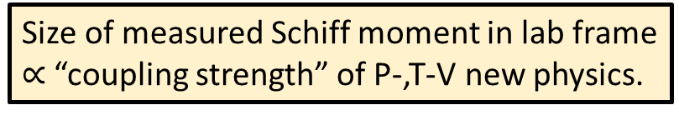
Radioactive molecules for Schiff moment
Size of measured Schiff moment in lab frame
$∝$ “coupling strength” of P-,T-V new physics.
About the Schiff moment
  Vector quantity
  Combined effect of the electron cloud and the electric moments of the nucleus with finite extent in an atom.
Effect of the Schiff moment
  Establish a volume of (approximately) uniform E-field inside nucleus.
  Interaction of electrons with field manifests as atomic EDM.
____ to have:
  Need: nonzero nuclear spin
  Nice: octupole-deformed nuclei
  Nice: molecular system
Schiff moment requires a direction: spin provides it.
Intrinsic Schiff moment enhanced by octupole deformation.
Typically occur in radioactive atoms.
RadMol
Molecules align spins to lab frame much more easily than atoms.
Notes:
The Schiff moment
*is a vector quantity
*that comes about from the interaction of the nucleus and surrounding electron cloud.
*Its effect is to establish a volume of uniform E-field inside the nucleus
*with which the electrons interact to give rise to an atomic EDM
*To measure the Schiff moment
*We need a nonzero nuclear spin, because the Schiff moment points along the spin
*It will be nice to have an octupole-deformed nucleus because the Schiff moment is enhanced in systems like this
All the experiments till date have only managed to place upper bounds on Schiff moments using systems without octupole deformation.
Working with atoms that have octupole-deformed nuclei gives us a better chance to measure a nonzero Schiff moment.
It turns out that atoms with this property are radioactive,
*so this explains the Rad part of RadMol.
*Lastly, it will be nice to have a molecular system instead of an atomic one.
You see, we perform the measurement in the lab frame, which may not be aligned with the nuclear frame, where the Schiff moment is well defined.
Semiclassically, you can think of the atom as being a spherical system that does not have a preferred direction, so it is harder to orient with the lab frame than molecules, which are aspherical.
Much like how the nonzero nuclear spin gives the Schiff moment a direction within the nucleus,
Molecules make it easier to align nuclear axis with the lab frame
So working with molecules makes our lives easier.
*And this explains the Mol part of RadMol.
The connection of the Schiff moment to new physics can get quite technical.
It turns out that the Schiff moment exists in systems with octupole deformed nuclei independently of new physics.
BUT, to be able to measure it in the lab frame, P-,T-V interactions are required.
Since the SM predicts that these interactions are largely absent in atoms,
*the size of the measured Schiff moment is proportional to the coupling strength of P-,T-V new physics

Slide 4

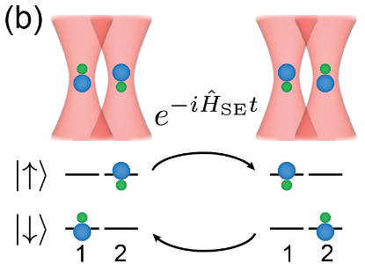
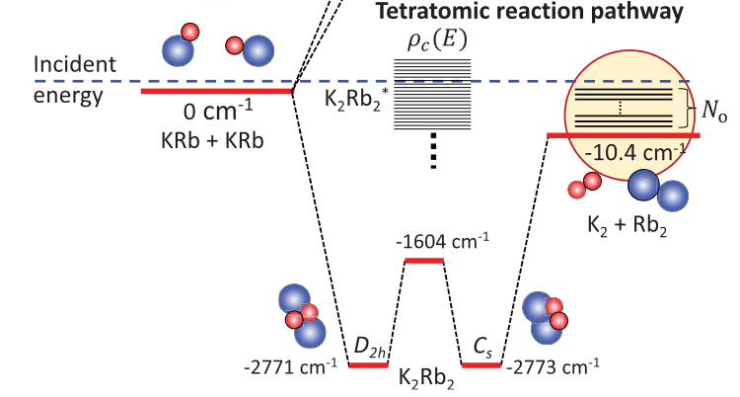
(Quantumly controlled) Molecules:
Great for many things!
Non-exhaustive list!!!
Precision measurements of physics
beyond the Standard Model
Probing intermediate complexes
in chemical reactions
Quantum simulation and
quantum computation
Cornell & Ye group, JILA
Ni group, Harvard
Cheuk group, Princeton
Laser cooling
Quantum state control
+
+
Entanglement
Trapping
Notes:
We are certainly not the first or only ones thinking of using molecules to do great things.
So let me take a step back and discuss the greater landscape of research with molecules.
*The current best bound on the electron’s electric dipole moment was measured with trapped molecular ions.
The JILA group took advantage of quantum control of their molecules to measure this very small physical quantity that sheds light on new physics.
In fact, our RadMol initiative is inspired by this class of experiments.
So far, all these experiments have been done with stable isotopes, for obvious reasons, and here at RadMol, we intend to spice it up with radioactive isotopes.
*That’s not all, people have been probing chemical reactions at the quantum level.
Quantum control enables them to isolate certain reaction pathways of interest, allowing them to probe intermediate complexes in chemical reactions like never before.
*And, of course, molecules have also joined in the latest craze in quantum simulation and computation.
Molecules are great for these because of their large intrinsic electric dipole moments, as compared to atoms, allowing, for instance, for stronger/faster interactions between the qubits.
*With all these exciting experiments going on, many techniques have already been developed on molecules.
We at RadMol are just joining this huge community, while bringing our expertise in radioactive isotopes.

Slide 5
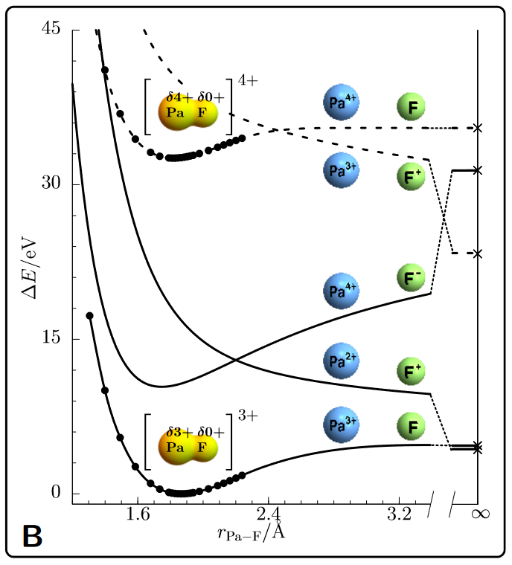
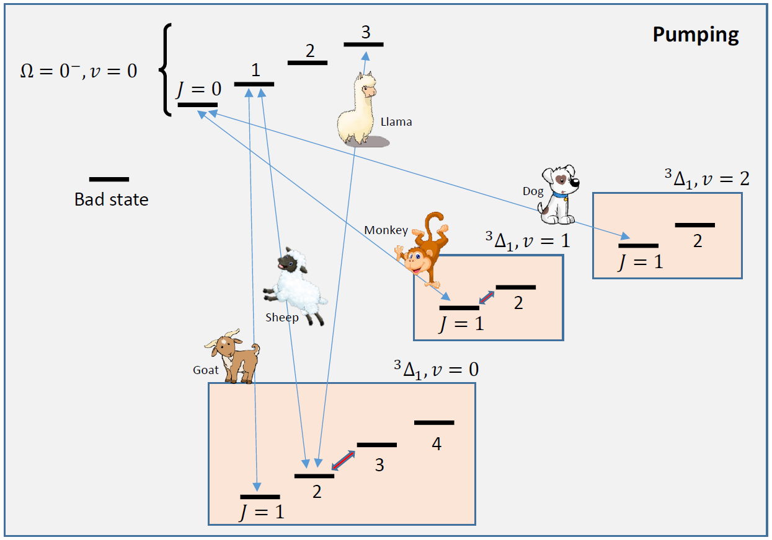
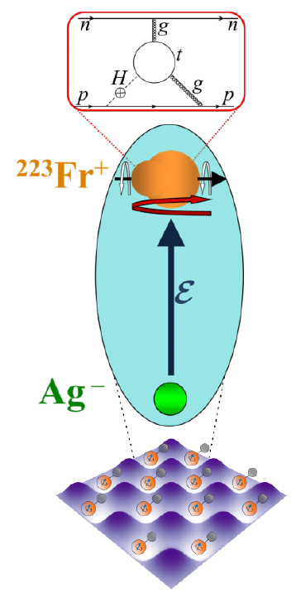
What RadMol?
Collaborative effort!!!
Ultracold molecular francium-silver
Towards highly charged molecules
Spectroscopy of ionic molecules
Cool atomic Fr and Ag (separately).
Associating ultracold atoms to form molecule.
Molecules trapped optically.
Measure science!
(Above) JILA’s optical pumping scheme.
Spectroscopy to learn about internal structure for quantum control.
Zülch et al., arXiv:2203.10333
Notes:
There are three projects running concurrently at RadMol.
I’d like to emphasize that RadMol is a collaborative effort with PIs spread out across many institutions across several countries.
But here, I’ll be focusing on the efforts at TRIUMF.
We have the neutral molecular francium-silver experiment.
This experiment involves making ultracold molecules of francium-silver, each molecule is then individually trapped and probed for new physics with lasers
*Then we have a project to create highly charged molecules.
It turns out that certain molecules have crazy high sensitivities to new physics, but they need to be highly charged.
It also turns out that having highly charged molecules is highly nontrivial.
For example, if the charge state is too high, the molecule may decide to dissociate into atoms instead of staying together as a molecule.
So we need to demonstrate that we can create and control highly charged molecules.
*Last but not least, there is the project on the spectroscopy of ionic molecules.
Common to all three projects is the richness of the internal quantum molecular structure that allows us to turn them into very sensitive probes of new physics.
To understand how this works, let us briefly look at the energy level structure of a typical molecule that we use.

Slide 6
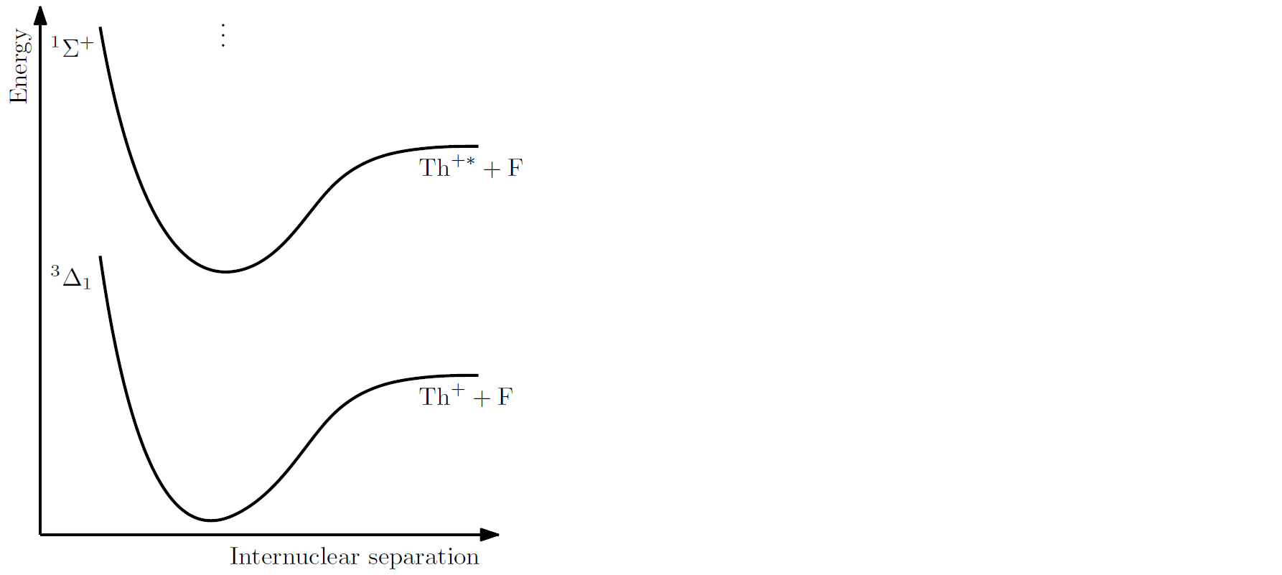
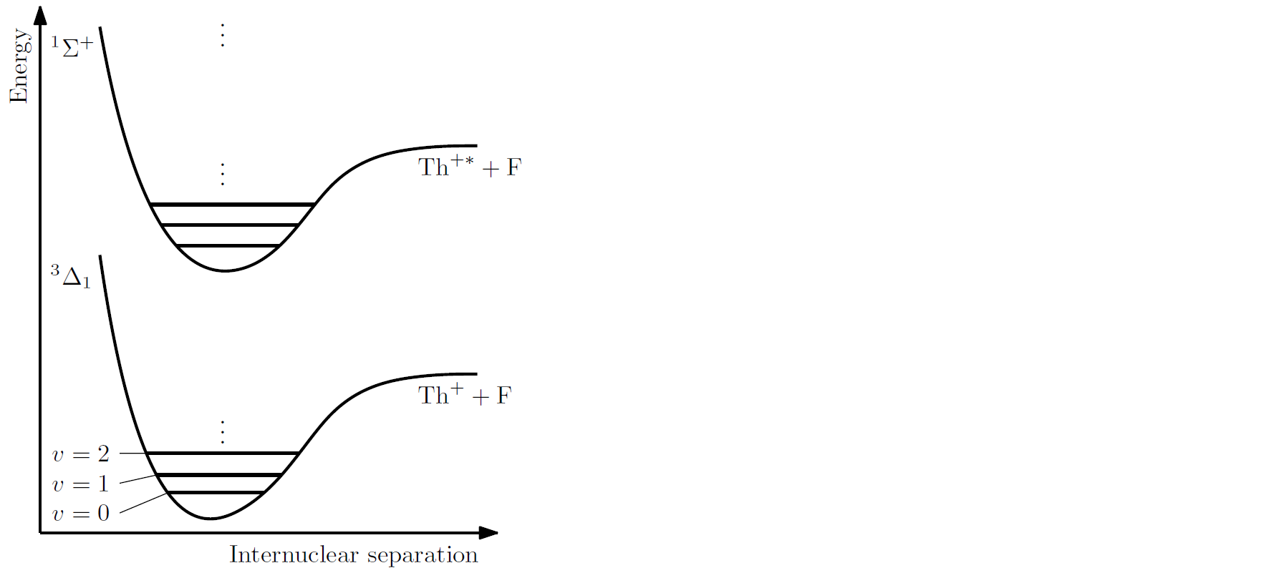
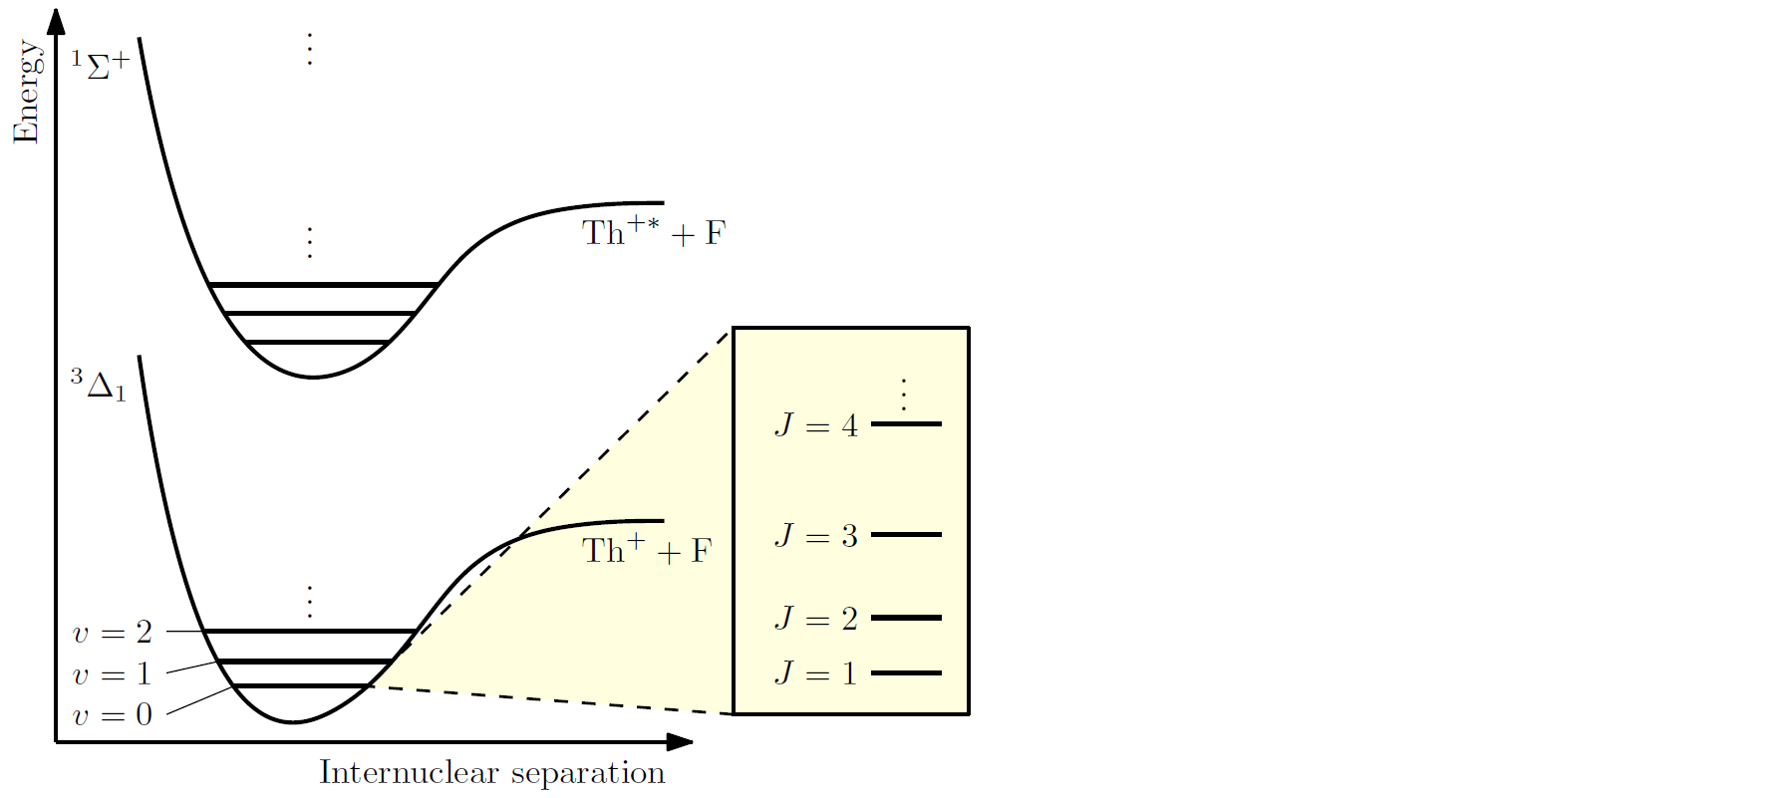
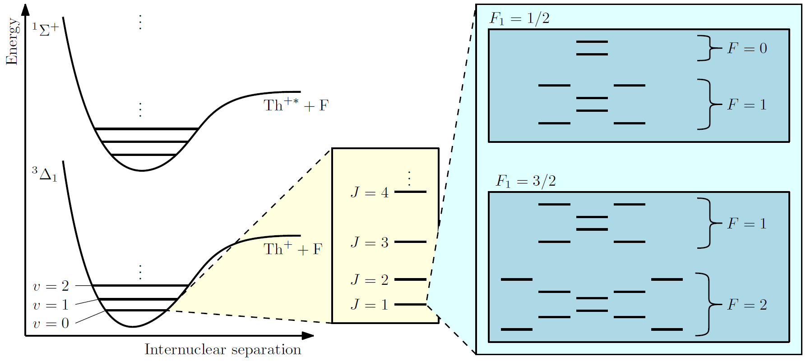

How RadMol?
New physics ➔ very tiny shifts of quantum states in molecule.
Shift from new physics!
Notes:
Molecules, much like atoms, have electronic structures.
Here in this diagram, they are labelled with symbols like the 3Δ1 and 1Σ+
*Unlike atoms, however, molecules can vibrate, so the electronic levels have vibrational manifolds nested into them.
*Molecules can also rotate, so each vibrational manifold has its own rotational substructure
*And if you zoom in further, you can see the hyperfine, parity, Stark, and Zeeman levels.
*It turns out that new physics can shift the energy levels ever so slightly,
so by measuring these shifts very precisely, we can make inferences on the nature of new physics.
To do so, however, requires quantum control of individual quantum states.

Slide 7
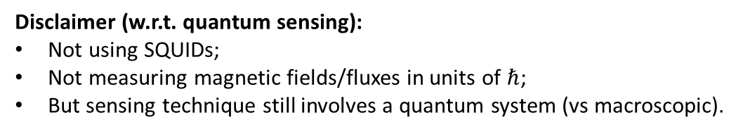
How RadMol?
Measuring shifts from new physics requires:
  Quantum control of individual quantum states, e.g.
    Preparing into a single quantum state;
    Creating a superposition of stationary states;
    Reading out individual quantum states.
  Extensive characterization and control of ambient conditions, e.g.
    Use the quantum states to measure ambient magnetic field;
    Feedback to magnetic field cancellation;
    Measure new physics / go back to step 1.
Very same techniques used in quantum computers (minus two-qubit entangling gates, etc.)
Disclaimer (w.r.t. quantum sensing):
Not using SQUIDs;
Not measuring magnetic fields/fluxes in units of $ℏ$;
But sensing technique still involves a quantum system (vs macroscopic).
We don’t need to, yet
Notes:
Let me give you a taste of what this quantum control entails
*We want to initialize our system into a single quantum state before we can do any measurement
*Then we prepare a superposition of the stationary states to perform Ramsey spectroscopy
*And finally we want to be able to read out individual quantum states to understand how the system has evolved and extract out the new physics
*These steps borrow the very same techniques used in quantum computers.
In fact, if you sprinkle in two-qubit entangling gates and a few others, you can end up with a quantum computer
*To perform these quantum operations with high fidelity, we must understand our system and be able to control the environment very well.
We need to sense the environment through the eyes of our quantum system.
Here’s an example of how we control the environment.
*We use the quantum states to measure the ambient magnetic field
*And feedback the measurement to our field cancellation apparatus so that our setup is free from unwanted stray fields
*And perform our new physics measurement
*Here’s a quick disclaimer regarding quantum sensing in our experiments
We are not using SQUIDs or measuring fields in quantized units
We don’t need to get there yet
*But our sensing techniques are still fundamentally quantum-enabled.
Depending on how you interpret the phrase “quantum sensing”, we are not sensors that sense quantum, but we are quantum systems that sense.

Slide 8
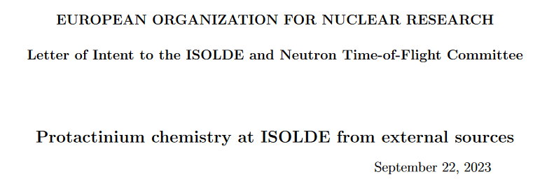
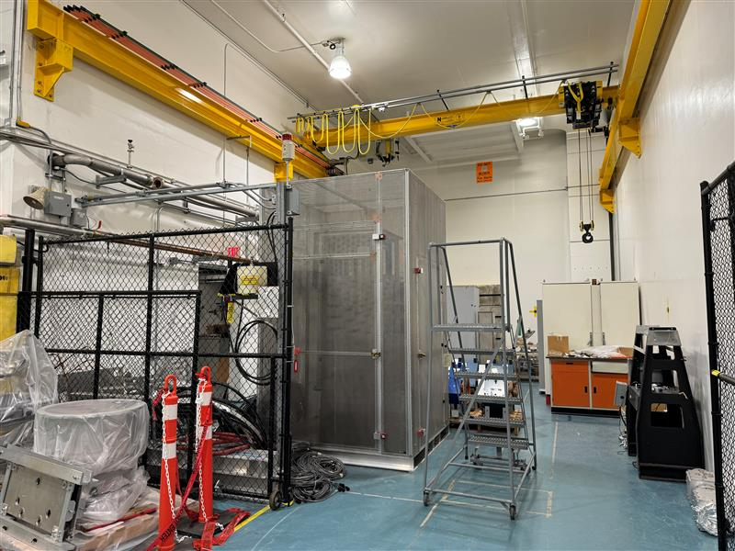
Where RadMol?
RadMol
  A fairly new initiative.
  New infrastructure on its way.
  Leeching off existing infrastructure
    UBC (francium-silver);
    Francium trapping facility (francium-silver);
    TITAN (highly charged molecules).
Infrastructure/resources required
  Control and DAQ systems;
  Ion traps;
  Cryogenics;
  Laser systems;
  Offline ion sources;
  Ion detectors...
RadMol lab (or lack thereof)
RadMol
Temporary storage space
at TRIUMF
Notes:
Unfortunately, this is the current state of the RadMol lab.
It is not even empty. It is storage space, and it doesn’t even have its own signage.
*Let me fix that.
*To be fair, RadMol is a fairly new initiative
*with new infrastructure on its way
*Currently, we are leeching off existing infrastructure for some of our pioneering endeavors.
*We don't have all the time in the world to set things up though, there are other giants who are catching up with us really quickly.
You can see this competition as an endorsement of what we are trying to do
But at the same time this means that our efforts will not be as impactful if we don’t move quickly
*Since we are building the molecule part of our lab pretty much from scratch, we need several new resources
For example, we need control and data acquisition systems, ion traps, cryogenics, laser system, and offline ion sources
Let me briefly touch on the latter four in the context of quantum control of our molecules and synergy with the rest of TRIUMF.

Slide 9
RadMol ⬄ rest of TRIUMF
+ position-sensitive
ion detectors
+ offline source
(long lived species)
Quantum control of individual quantum states
  Need to reduce entropy of system through cryogenics
+ lasers
+ more lasers
Cryogenic buffer gas cooling.
Rotational cooling with optical pumping.
Entropy reduction and quantum state manipulation with lasers and microwaves.
Test with stable isotopologues, e.g. ²³²ThF⁺.
Quantum projection noise limited measurement with two-state detection through anisotropic dissociation photofragments [JILA, Zhou et al., PRL (2020)].
Vibrational/Electronic levels
Rotational levels
Hyperfine levels
Temperature
~1000 K
~1 K
~1 mK
Notes:
We want to perform quantum control over individual quantum states,
*But if you create your molecules at a temperature of about 1000 K, typical of an ion beam
You will be populating multiple vibrational and electronic states.
Naturally all the substructures will also be populated, and there is no way to perform quantum control over individual quantum states.
*Now if you cool the system down to about 1 K with cryogenics,
You only populate the ground vibrational and electronic state.
*You can perform further cooling of the internal degrees of freedom with optical pumping
So that only the ground rotational state is populated/
*and you can employ more lasers to move the remaining population around to populate only the states you care about.
This requires a lot of fine tuning and long term studies,
*so we want to work with offline ion sources for most of the troubleshooting, and switch over to the precious rare isotopes for the final fine tuning and measurement.
*I also shouldn’t forget to mention that we also need position-sensitive ion detectors for our measurement and diagnostics to take full advantage of our molecular system.
We are not going to reinvent the wheel.
These techniques have already been demonstrated in the greater molecule community
We will be borrowing them, with some tweaks for our radioactive molecules.
*I hear, or as my boss tells me, that these are technologies that many others at TRIUMF have expertise in are also interested in obtaining.
So we believe that there will be quite a bit of sharing and exchange of technology between RadMol and the rest of TRIUMF.

Slide 10
Acknowledgements
Accelerator @ TRIUMF
  Jon Aoki
  Carla Babcock
  Ferran Boix Pamies
  Alexander Gottberg
  Peter Kunz
  Jens Lassen
  Ruohong Li
  Dave Neilson
  Navid Noori
  Aaron Schmidt
Life Sciences @ TRIUMF
  Joe Huser
  Valery Radchenko
  Hua Yang
Theory
  Robert Berger
  Lan Cheng
  Victor Flambaum
  Marianna Safronova
Wisdom
  Friedhelm Ames
  John Behr
  Greg Hackman
  Eric Cornell
  And many others…
Notes:
The synergy is already happening. These are some of the many people are already involved in RadMol’s operations.

Slide 11

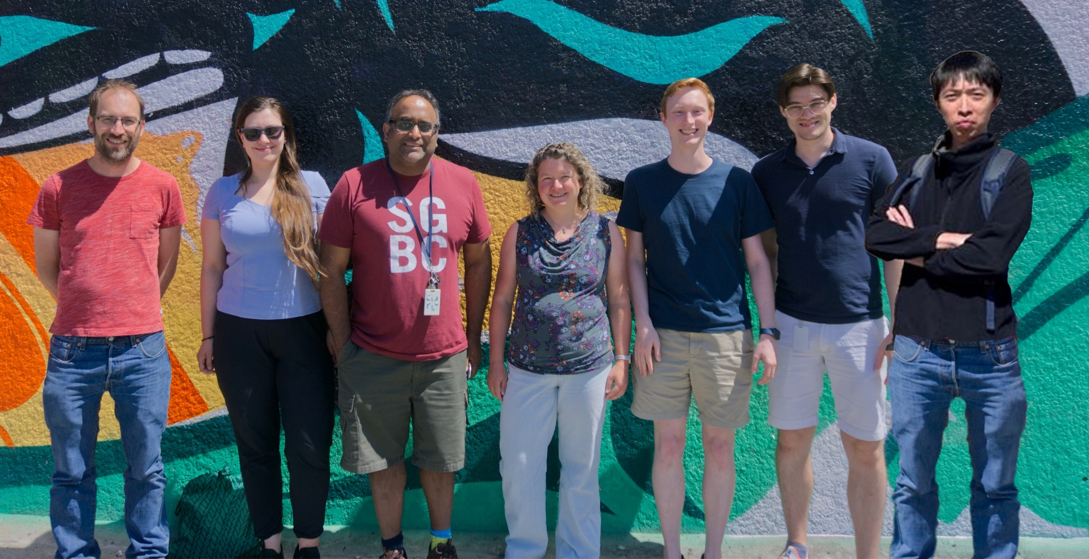




Who RadMol?
Local team:
PI: Stephan Malbrunot
Research scientist: Christopher Charles
Experimental officer: Andrea Teigelhoefer
Graduate students: Louis Croquette, Rane Simpson
Postdoc: Kia Boon Ng
[Space for more!]
Notes:
With that, let me end here with the names of people you can bug with more questions.
Thank you!

Slide 12
Molecules for EDMs
Adapted from Paul Hess’s thesis
(Right) bound on electron’s EDM vs publication date
Why atoms (instead of bare)?
  Sensitivity enhancement for certain types of EDM (e.g., eEDM, Schiff moment)
Why molecules (instead of just atoms)?
  Molecules have rich(er) internal structure.
  Exploit to enhance measurement sensitivity.

Slide 13






Distilling new physics from SM effects
$$E_{new physics}$$
$$E_{new physics}$$
$${−E}_{Zeeman}$$
$$E_{Zeeman}$$
$$E_{new physics}$$
$$E_{new physics}$$
Flip magnetic field direction
New physics introduces energy shifts in addition to those predicted by SM.
Perform experiment in a way that allows variation of SM contribution but keeping new physics constant.
E.g., flipping sign of magnetic field.

Slide 14








Choosing a system to measure an EDM with
New physics effects $∝$ projection of spin (onto inter-nuclear axis)
  Electron spin for electron’s EDM
  Nuclear spin for nuclear EDM, e.g., Schiff moment
Ω doubling in (certain) diatomic molecules
Flipped magnetic field
E_{NewPhysics}
$$ΔE=\left|−E_{StandardModel}+2E_{NewPhysics}\right|$$
$$ΔE∼d_{mf} ℰ∼100 MHz$$
$$ΔE=E_{StandardModel}+2E_{NewPhysics}$$
E_{New_Physics}
$$|↑ ⟩$$
$$|↗ ⟩$$
E_{StandardModel}
e.g., E_{Zeeman}
States of interest
$$|↘ ⟩$$
E_{StandardModel}
e.g., E_{Zeeman}
$$|↓ ⟩$$
E_{NewPhysics}

Slide 15
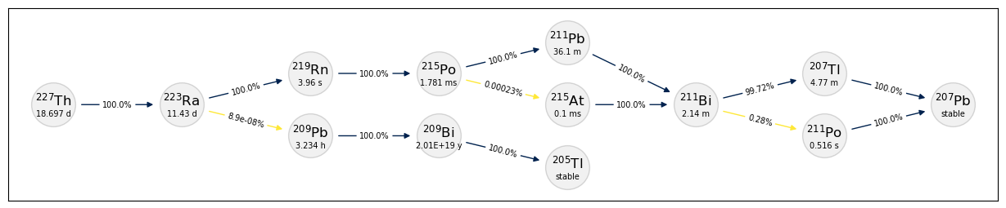
Decay pathway for Th-227

Slide 16
Rotational cooling
Use lasers and microwaves to move population around
  Entropy of system carried away by emitted photons
  Transitions chosen to exploit selection rules for net cooling.
Excited states can decay into unwanted states
  Use repump lasers to bring back lost population.
Typical number of lasers + microwaves ~ 10

Slide 17
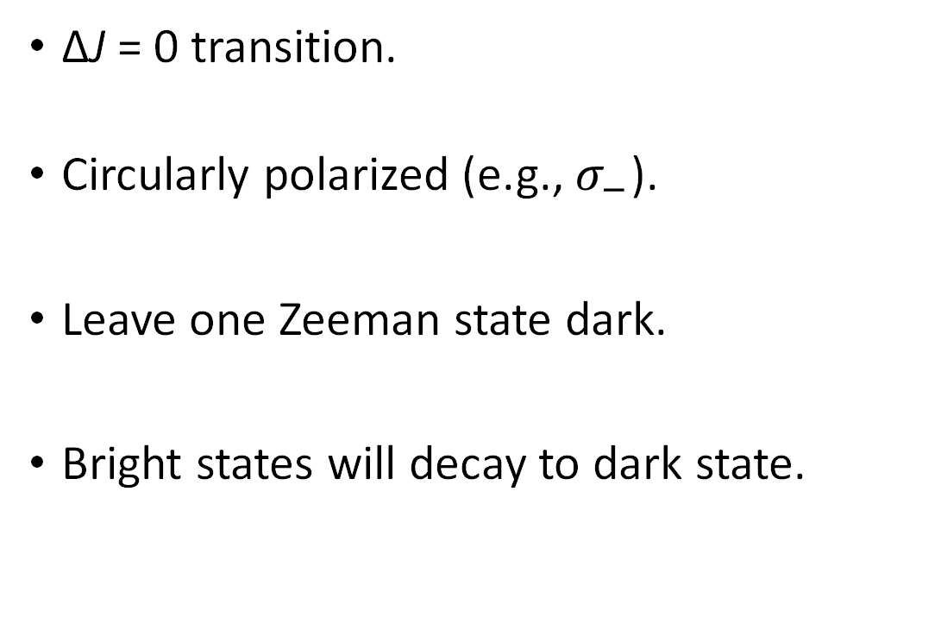
Moving to stretched Zeeman
Ω=0⁻ [14.59]
(v=0, J=1)
ΔJ = 0 transition.
Circularly polarized (e.g., $σ_{−}$).
Leave one Zeeman state dark.
Bright states will decay to dark state.

Slide 18
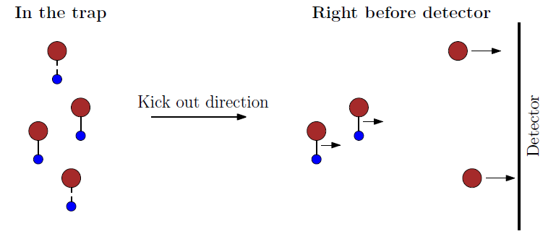
Anisotropic photofragment: semiclassical
Simplified picture:
  Ω doublets correspond to molecule in different orientations.
  Heavy metal ions (red) ejected along direction determined by state before dissociation.
Examples of detectors
  Gated MCP with phosphor screen.
  Delay line detectors.

