Slide 1
Single-photon detectors for quantum applications
Harry Lewis, PHORWARD group
TRIUMF Quantum workshop, March 2024

Slide 2
Quantum applications of single-photon detectors (SPDs)
Information can be encoded in the polarization state of a photon
Quantum key distribution requires reliable transmission and detection of single photons over long distance
Linear optical quantum computing requires accurate resolution of high photon numbers across a broad spectral range
Converting these technologies from proof-of-concept to practical use will require extremely high-performance detectors

Slide 3
Performance parameters for quantum SPDs
High photon detection efficiency
Low dark counts
High maximum count rates
Photon number resolution – requires multi-pixel devices or ultra-fast operation, critical for optical quantum computers and for closing security loopholes in QKD

Slide 4
Different SPD devices
Superconducting nanowire SPDs – massive advantage in detection efficiency (>90%) and dark count (0.01cps), but require sub-1K temperatures
Silicon SPADs and SiPMs – mature technology but limited to NIR wavelengths. PDE up to ~60%
Room for development in semiconductor SPDs – SWIR detection
1550nm detection lends compatibility with existing fibre networks and optimised components, as well as transmission in daylight for satellite links
InGaAs/InP SPADs and SPAD arrays – detection in telecoms band (1550nm), higher DCR than silicon, lower PDE <30%
Research into new materials to combine with InGaAs or other narrow band-gap absorbers
Up-conversion APDs – silicon SPAD coupled with waveguide and pump laser to detect lower-energy photons

Slide 5
Capabilities at TRIUMF
The PHORWARD group has facilities for detailed characterization of single-photon detectors
Currently targeted at studies of VUV-SiPMs for particle physics experiments, capacity to measure a range of semiconductor SPDs and developing infrastructure for IR characterization
Capabilities to measure device parameters including PDE, reflectivity, timing response, dark count rates, and secondary photon emission at a wide range of wavelengths and temperatures
Infrastructure for optical characterization of quantum sensors
What do we not do – grow and fabricate devices

Slide 6
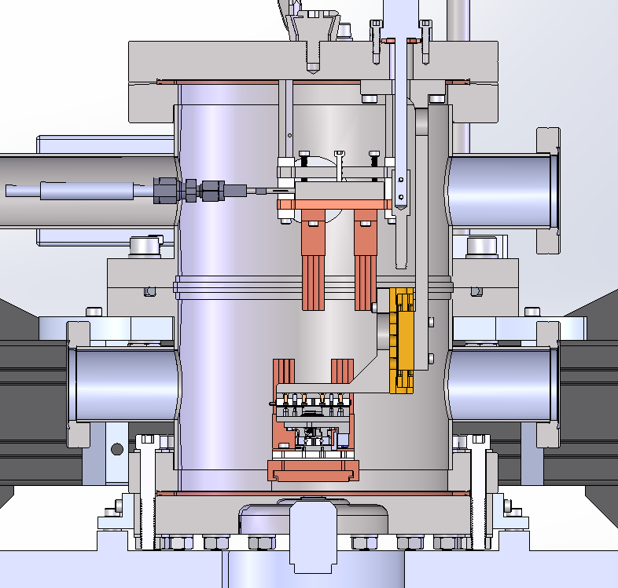
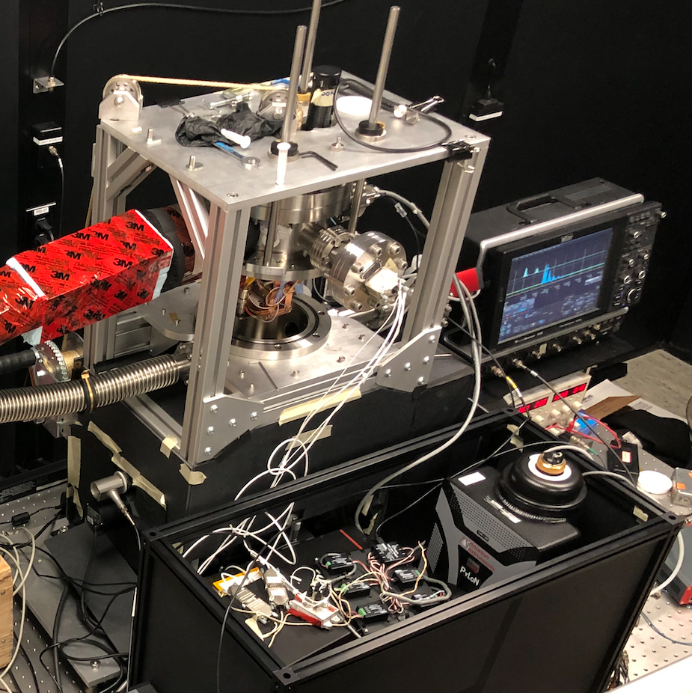
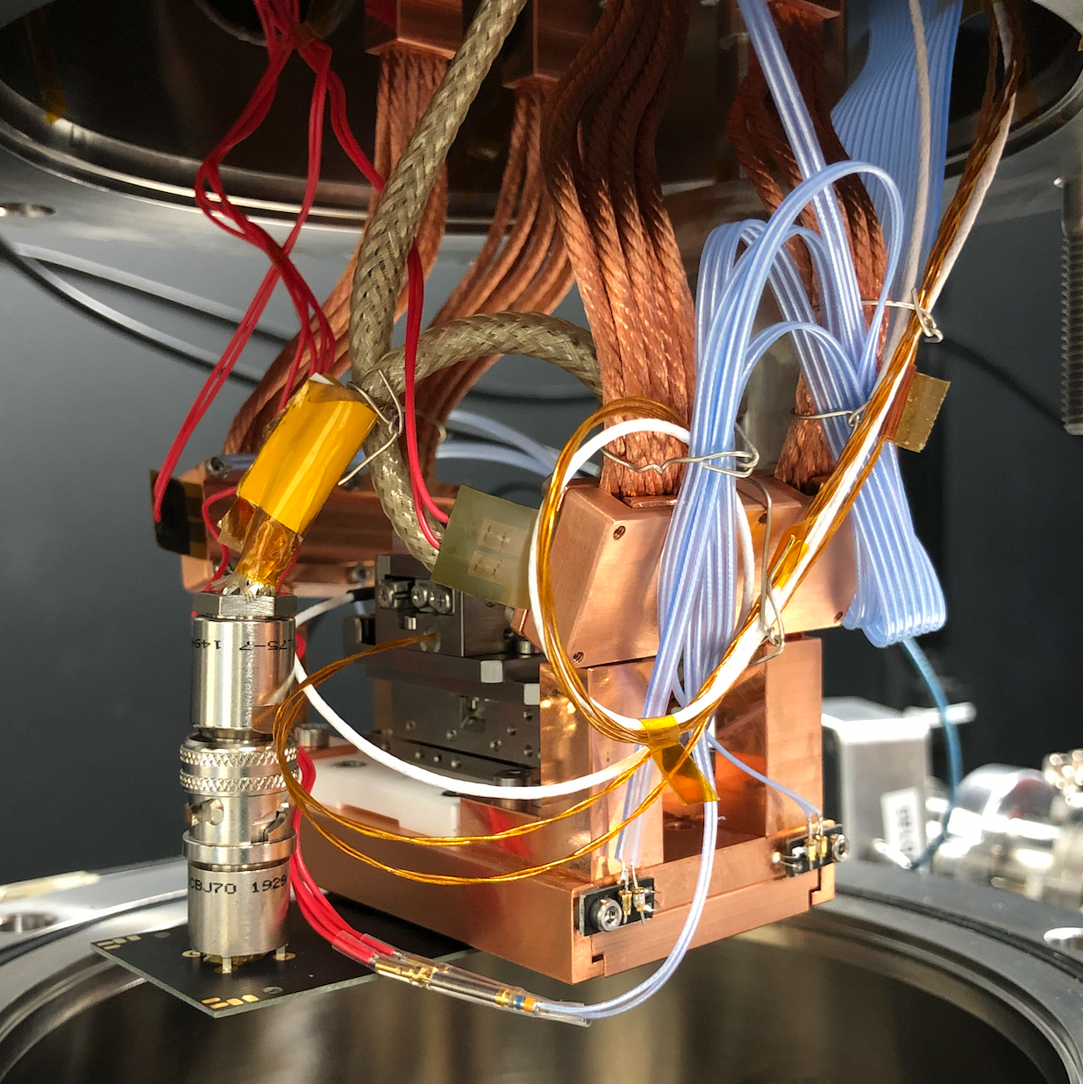
MIEL
Microscope for the Injection and Emission of Light
Cooled X-Y Stage
SPAD
DAQ
Vacuum Window
SiPM Surface
$$T(°K)$$
Upper Cold Stage
Vacuum Chamber
Objective
273$°K$
Copper Braided
Cold Fingers
Sync
Dichroic Mirror
X-Y Stage Motors
Laser
LASER
(405 nm)
LXe
165$°K$
SiPM Position
Microscope Objective
Emission Filter
Emitted Light
LAr
8$6°K$
LN₂
$$77°K$$
IX-83 Microscope
Diffraction Grating
B)
A)
Spectroscopy
Imaging
Spectrometer and Cryogenically Cooled Camera
The MIEL Experiment
Cryogenically Cooled X-Y Stage with SiPM Mounted

Slide 7
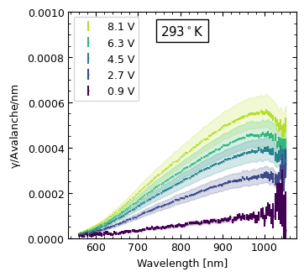
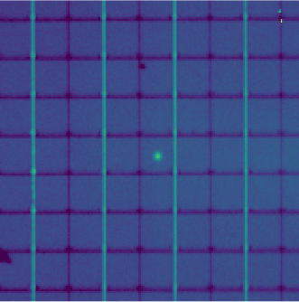
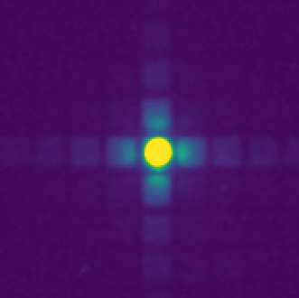
MIEL
Cooled X-Y Stage
Two basic modes
SPAD
Vacuum Window
SiPM Surface
A)
Vacuum Chamber
Objective
FBK Reflected Light and Laser Spot
Dichroic Mirror
Laser
(405 nm)
Emission Filter
B)
Emitted Light
IX-83 Microscope
Diffraction
Grating
B)
A)
Spectroscopy
Imaging
2D Emission Map
Spectrometer and Cryogenically Cooled Camera

Slide 8
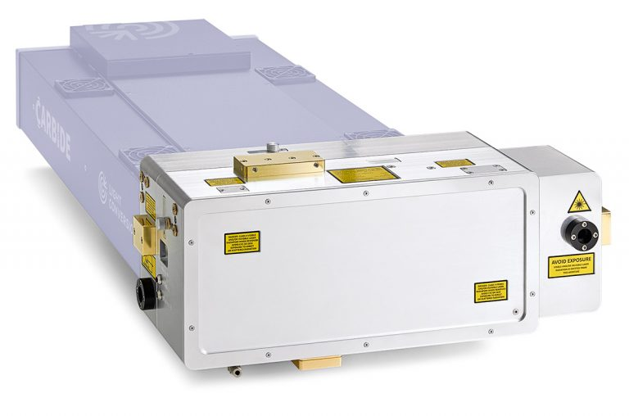
Future upgrades
OPA Light Source (this year):
Fast timing (fs scale)
Broad spectrum (310-2000nm)
Inspect device response to a specific wavelength
1200nm+ for two-photon absorption (generating charge carries at the focus, and focus can be anywhere in the bulk)
Characterize impact of IR light on performance of different quantum sensors, identify surface vs bulk effects
Upgrade microscope for SWIR imaging

Slide 9
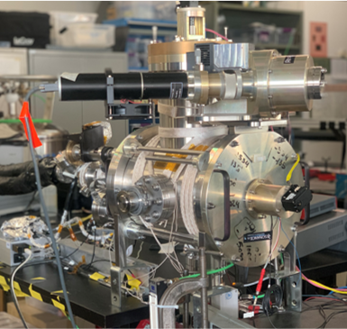
VERA Vacuum Efficiency, Reflectivity, and Absorption
Deuterium light source with emission from VUV to NIR (140-830nm), wavelength controlled with vacuum monochromator
LN2 cooling
Control of various parameters: Temperature, light source, optical angle of incidence
PMT inside chamber can be positioned to measure device reflectivity
Digitizer used for waveform-level measurements
Lamp
Cooling lines
Equipment flanges

Slide 10
Thank you Merci
www.triumf.ca
Follow us @TRIUMFLab

