Slide 1
Particle Physics Faculty Meeting
Agenda
News/Update
Research groups Updates

Slide 2
TRIUMF is located on the traditional, ancestral, and unceded territory of thexʷməθkʷəy̓əm (Musqueam) people, who for millennia have passed on their culture, history, and traditions from one generation to the next on this site.
TRIUMF’s home has always been a seat of learning.

Slide 3
Training Records
Next CNSC inspection, April 15-19
Focus on management system and training
Joint Tiger Team & LCH Taskforce Meeting to coordinate this
Need to make sure
All training plans are up to date
Check with your groups, that there are no
Expired training
All training records are completed
If training is no longer needed, please unenroll

Slide 4
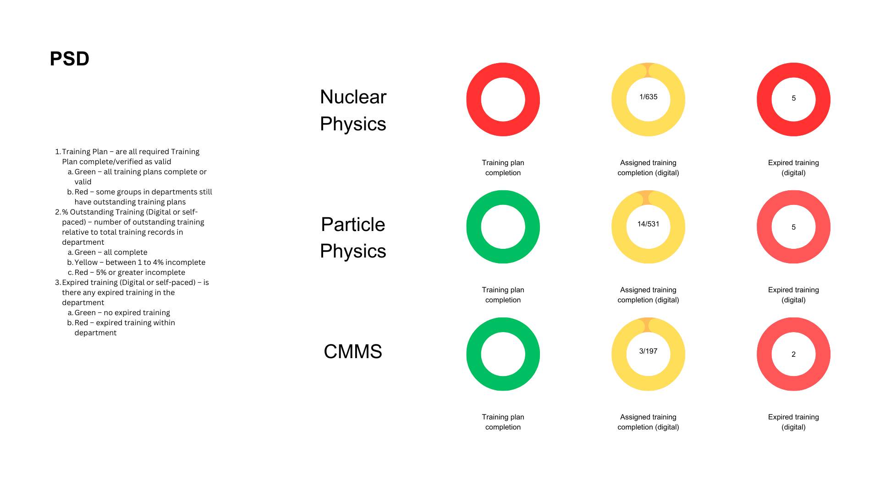
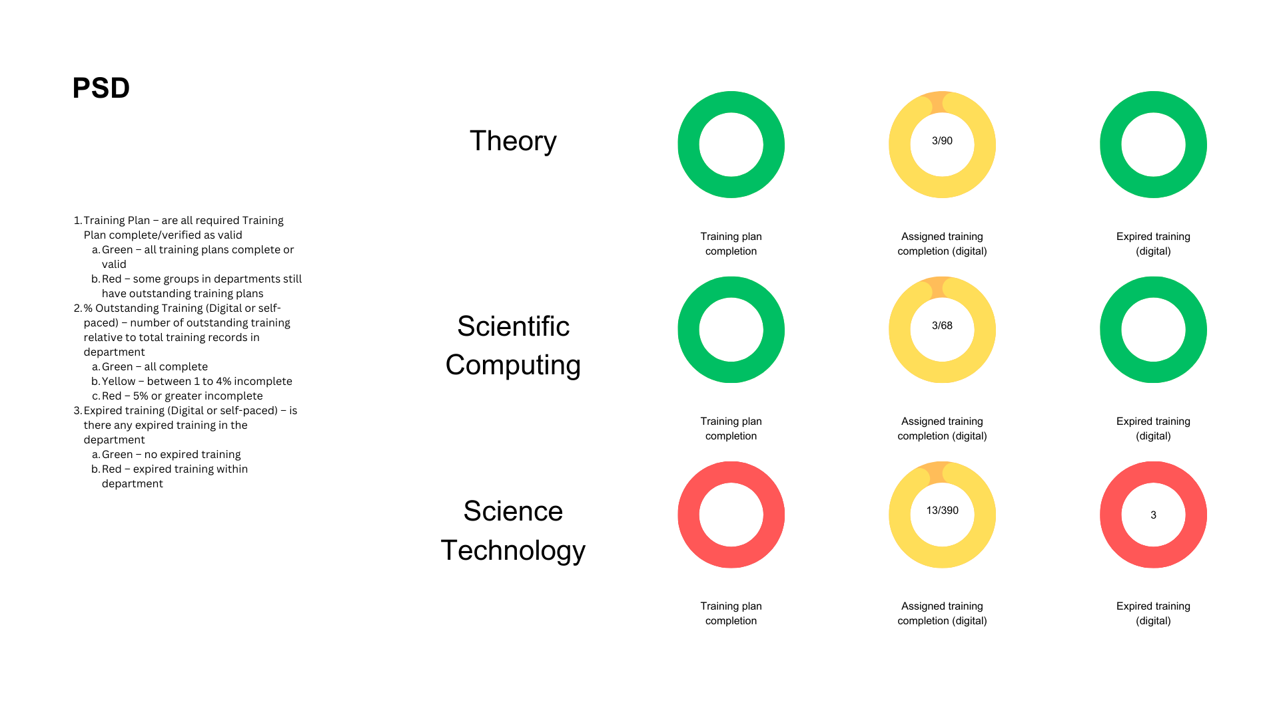
Training Records

Slide 5
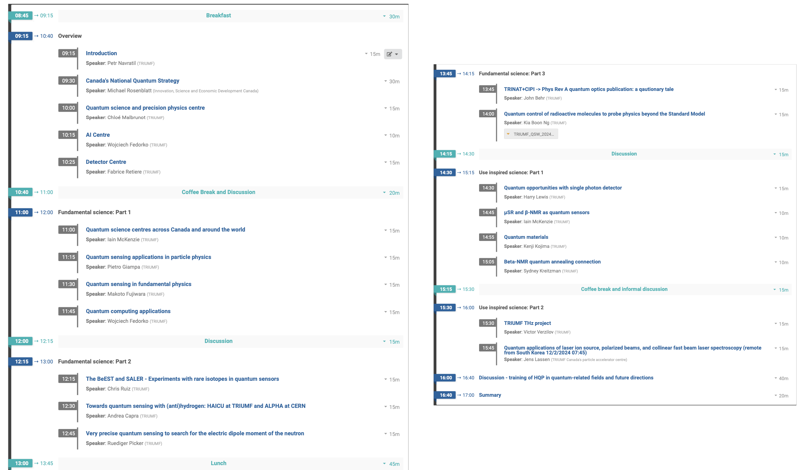
Quantum Strategy Workshop
Monday March 11th - Robert H. Lee Family Boardroom, UBC

Slide 6
UCN Search
Have a long list of initial interviews
Search committee
Chen-Yu Liu (chair), University of Illinois Urbana-Champaign
Brad Plaster, University of Kentucky
Jeff Martin, University of Winnipeg
Isabel Trigger, TRIUMF
Ruediger Picker, TRIUMF

Slide 7
Various
Next PP-EEC Thursday, May 2nd
The deadline for submission of all Proposals, Progress Reports, and Letters of Intent is Wednesday, April 17th, at 23:59 PT
New committee
Deborah Harris (York/FNAL) chair
Concettina Sfienti (Mainz)
Elise Novitski (UWashington)
Yan Friedrich (TU Munich)
Makoto Fujiwara (TRIUMF)
David McKeen (TRIUMF)
From SMM: PSD Director search – committee submitted report

Slide 8
Year End Performance Review
Divisional LT Communication
Valeriya Levchenkova
Organizational Development

Slide 9
Agenda
Role expectations
Process and changes
Support and resources

Slide 10
Year End Performance Reviews: role expectations
Become familiar with resources provided and complete training
Ensure the purpose, expected outcomes and role expectations are clear
Ensure the message is cascaded
Report on completion status
Notes:
Key messages from division directors to the department and group heads:
Value:
It is a forward-looking process aimed to coming to conclusions about what has to be done differently and better based on the past performance successes and challenges and what development has to happen so that the employee can do better.
Roles & responsibilities:
Get closely familiar with all guidelines provided, complete the online modules and encourage your employees do the same.
Reinforce the understanding of the purpose and the expected outcomes of the review.
Seek support from your direct leaders and SMEs if questions arise.
Set the example of commitment to making the process meaningful and useful.
Your active role in guiding employees in understanding the reasons for successes and challenges, in identifying what should be done differently moving forward and agreeing in support needed is a key to making this process meaningful and valuable both for you and your direct reports.
Communicate with your direct reports in a timely manner aka as soon as you receive any updates about the process. Ensure the message is cascaded. Have a team kick off to make sure everyone understands clearly what is expected of them.
Your leadership, wisdom and active support are vital to gradually shaping our high performing culture.
Acknowledge any links to remuneration and resistance around three performance ratings
Valeria will walk us through the process, the changes and answer the questions related to them

Slide 11
Year End Performance Reviews: process
March 04th – April 19th
Step 1
Employee completes
Self Evaluation
Goals and Objectives*
Development goals*
Feedback
Overall Self Rating
Step 2
Manager completes Employee Evaluation
Goals and Objectives
Development goals
Feedback
Overall Manager Rating
Step: 3
Manager schedules Year End Performance Review Meeting
Step 4
Employee Acknowledges Year End Performance Review completion
Step 5
Manager Acknowledges Year End Performance Review completion
Overall Performance rating
Next year performance objectives and development goals considerations
With or without Comments
With or without Comments
Annual Activity (BAEs only)
Annual Activity (BAEs only)
Submit
for Manager’s Evaluation
Complete by March, 22d
Save for later
to discuss during the meeting and make final edits
Manager
Make final changes and Submit for Employee Acknowledgment
Submit
for Manager’s Acknowledgment
Complete
by April 19th
* Employees can Add a Performance Objectives or Development Goals, if they have not been previously recorded and approved.
Notes:
The highest time investment should happen at step 3: the meeting, one hour.
Step 1,2, 3 and 4 are very straightforward and should require minimum time as if there was an ongoing conversation, it becomes a mere recording of what has been discussed and agreed.
The most important step is of course the meeting.
Critical leadership skills that you might want to brush on is: giving performance feedback and having a difficult conversation in case performance needs improvement. Please, take the online module and look up relevant courses on LinkedIn when preparing for the performance review meeting. I am sure you give feedback on a regular basis, during the end year you would summarize it and record to agree on what type of development has to happen and how you will support.
Acknowledge that the meeting took place.
It is a two-sided reciprocally accountable process where you move away from the quest for faults and instead focus on joint discussion on how the best use can be made of the individual skills.

Slide 12
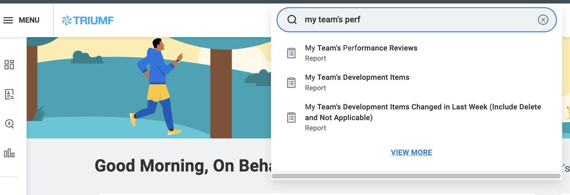
Year End Performance Reviews: report
My Team's Performance Reviews report | You can view performance reviews for the entire team in a single report and view the completion statuses. You can drill down on details for individual employee.

Slide 13
Community-sourced feedback: transparency settings
Get Feedback on Worker (feedback transparency is set by the feedback provider):
Do not share with Employee: feedback is ONLY visible to HR, direct and level-up managers
Share with others: Feedback is ONLY visible to HR, employee, direct and level-up managers
Get Feedback on Self:
Feedback is ONLY visible to HR, the employee requesting feedback, direct and level-up managers
Give Feedback:
Feedback is visible on the Employee’s Workday Profile to anyone in the lab
Notes:
Critical success factors to providing valuable feedback.

Slide 14
Support and Resources
“Year End Review” online module required for people managers (optional for employees)
Year End Review instructions n Workday with job aids links embedded
SMEs communication support:
Process: Valeriya Levchenkova, Manager, Organizational Development
Training resources: Gerardo Aguila, Manager, Training & Development

Slide 15
Key messages
1. Deadlines
2.Value (WIIFM): you will be able to share your assessment of the progress on performance objectives and development goals since our last formal check-in. We will discuss results, successes, challenges and will consider next year performance objectives and development goals.
3.Changes: Employee self-assessment and estimated performance rating
4.Expectations:
Prepare for the Year End Performance Review Self-Assessment by referring to the list of updated and approved throughout the year performance objectives, development goals, Check-Ins records
Use Community-sourced feedback to gather additional feedback
Identify successes, challenges and the reasons for them
Consider what should be done differently and better next performance year
5. Support and resources that are available to you

Slide 16
AOB

Slide 17
Round Table
ATLAS
T2K/HyperK
TUCAN
ALPHA
SuperCDMS
DarkLight
n-EXO / PHORWARD
PIONEER
NA62
P-One
SNO+
HALO
g-2
Belle
Theory

Slide 18
Next Meeting
April 11th

